Slide 1
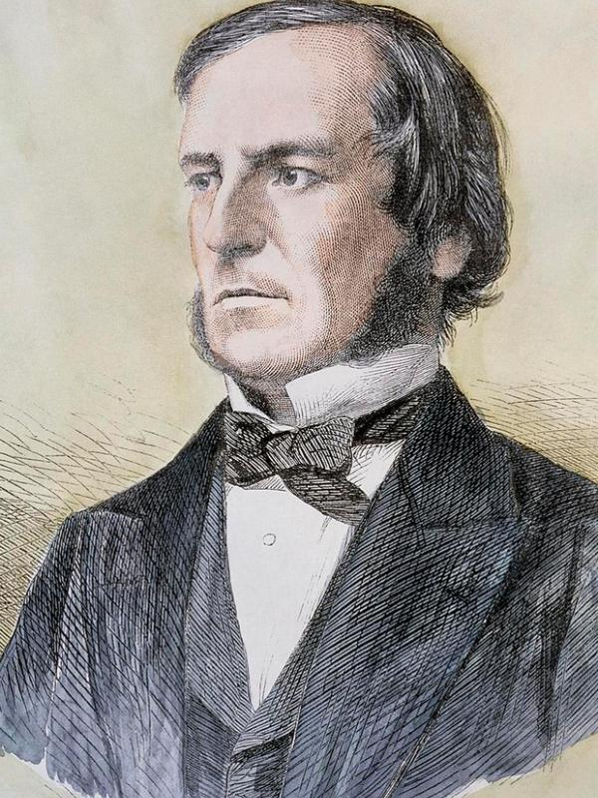
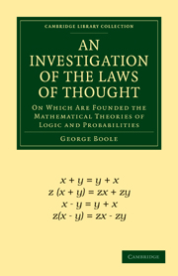
George Boole 1815-1864
Created what we now call boolean logic.
Died after getting soaked in the rain, and then getting wrapped in wet blankets.

