Slide 1
Algorithms: Introduction to Sorting
CMPT 120, Fall 2024
Random numbers
Shuffling a list with the Fisher-Yates algorithm
Sorting with selection sort
Sorting with mergesort

Slide 2
Random Numbers
Python’s random module is the easiest way to get random numbers in Python.
You get a different number in the range [0, 1) every time you call random.random()
import random
print(random.random())
print(random.random())
print(random.random())
print(random.random())
print(random.random())
0.530707419934566
0.4177937479114643
0.9573776144861584
0.09896609959358549
0.8980556261754689

Slide 3
Random Numbers
Python’s random module is the easiest way to get random numbers in Python.
random.randint(lo, hi)
returns a random integer in the range [lo, hi].
import random
print(random.randint(1, 10))
print(random.randint(1, 10))
print(random.randint(1, 10))
print(random.randint(1, 10))
print(random.randint(1, 10))
4
1
5
10
5

Slide 4
Random Numbers
Python’s random module is the easiest way to get random numbers in Python.
These are called pseudorandom numbers because they are generated from an algorithm, and if you knew the algorithm and its input you’d be able to predict the next number.
import random
print(random.randint(1, 10))
print(random.randint(1, 10))
print(random.randint(1, 10))
print(random.randint(1, 10))
print(random.randint(1, 10))
4
1
5
10
5

Slide 5
Random Numbers
Python’s random module is the easiest way to get random numbers in Python.
When debugging a program with random numbers, it can be useful to set a seed. This causes the same sequence of random numbers to be generated each time the program runs.
import random
random.seed(123) print(random.randint(1, 10))
print(random.randint(1, 10))
print(random.randint(1, 10))
print(random.randint(1, 10))
print(random.randint(1, 10))
1
5
2
7
5
Thanks to setting the seed to be 123, every time you re-run the program you get the same numbers.

Slide 6

Random Numbers
Python’s random module is the easiest way to get random numbers in Python.
You can use random.randint to choose a random value from a list …
import random
names = ['Al', 'Bob', 'Cap',
'Di', 'Ed']
for i in range(5):
n = len(names)
a = random.randint(0, n - 1)
winner = names[a]
print(winner)
Cap
Di
Ed
Di
Cap
Notice that the same name to be chosen more than once.

Slide 7
Random Numbers
Python’s random module is the easiest way to get random numbers in Python.
import random
names = ['Al', 'Bob', 'Cap',
'Di', 'Ed']
for i in range(5):
winner = random.choice(names)
print(winner)
Or more simply use Python’s random.choice …
Cap
Di
Ed
Di
Cap
Notice that the same name to be chosen more than once.

Slide 8

Random Numbers
Suppose you want to randomly shuffle the order of the items on s list. The Fisher-Yates algorithm is the standard way to do this …

Slide 9
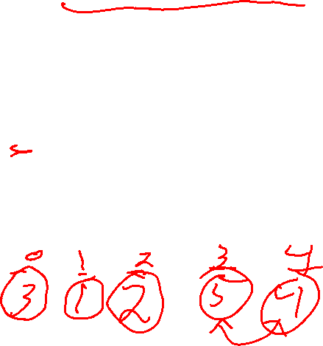
Random Numbers
Suppose you want to randomly shuffle the order of the items on s list. The Fisher-Yates algorithm is the standard way to do this …
Fisher-Yates Algorithm
To randomly shuffle the order of the items on a list of length n:
For i=0 to n-2 do:
r = random.randint(i, n-1)
swap the item at index i with the item at index r
This is a simple but subtle algorithm. It can be proved that it guarantees that all possible orderings are equally like.
0
n-1
Swap each value from 0 to n-1 with a random value after it.

Slide 10

Random Numbers
def fisher_yates_shuffle(L):
n = len(L)
for i in range(n - 1):
r = random.randint(i, n - 1)
L[i], L[r] = L[r], L[i]
return lst
lst = [1, 2, 3, 4, 5]
print(fisher_yates_shuffle(lst))
print(fisher_yates_shuffle(lst))
Python has this neat way to swap the value of two variables:
x, y = y, x
exchanges the values of x and y
[3, 2, 1, 5, 4]
[1, 5, 3, 4, 2]

Slide 11

Random Numbers
import random
lst = [1, 2, 3, 4, 5]
random.shuffle(lst)
print(lst)
random.shuffle(lst)
print(lst)
In practice, you can use random.shuffle …
[4, 1, 3, 5, 4]
[2, 3, 5, 1, 4]

Slide 12
Random Numbers
How can you get the 3 random items from a list, with no duplicates? And print the chosen items in sorted order.
import random
names = ['Al', 'Bob', 'Cap',
'Di', 'Ed’] ???
Al
Cap Ed

Slide 13

Random Numbers
How can you get the 3 random items from a list, with no duplicates? And print the chosen items in sorted order.
import random
names = ['Al', 'Bob', 'Cap',
'Di', 'Ed'] random.shuffle(names)
winners = names[:3]
winners.sort() print('\n'.join(winners))
Al
Cap Ed

Slide 14
Sorting
Shuffling the values of a list is a useful operation. But even more useful and common in practice is sorting …

Slide 15
Sorting
Sorting is the process of arranging the values on a list into order from biggest to smallest (e.g. for numbers), or in alphabetical order (e.g. for strings).
Shuffling the values of a list is a useful operation. But even more useful and common in practice is sorting …

Slide 16

Sorting
Sorting is the process of arranging the values on a list into order from biggest to smallest (e.g. for numbers), or in alphabetical order (e.g. for strings).
[8, 3, 1, 7, 3]
[1, 3, 3, 7, 8]
Sorting is useful and important because humans often want to see data in sorted order. Plus we can use binary search on sorted data.
['mouse', 'cat', 'show', 'bird’]
['bird', 'cat', 'mouse', 'show']

Slide 17

Sorting
Python’s built-in sort method is very efficient.
lst = [9, 3, 1, 4, 3]
lst.sort()
print(lst) # [1, 3, 3, 4, 9]
words = ['shell', 'nose', 'apple', 'tree', 'shoe']
words.sort()
print(words) # ['apple', 'nose', 'shell', 'shoe', 'tree']
lst.sort() modifies lst, i.e. it does not make a copy …

Slide 18
Sorting
Use Python’s built-in sorted(lst) method to make a sorted copy of lst without modifying lst.
lst = [9, 3, 1, 4, 3]
print(sorted(lst)) # [1, 3, 3, 4, 9]
print(lst) # [9, 3, 1, 4, 3]
words = ['co', 'de', 'ba', 'an']
print(sorted(words)) # ['an', 'ba', 'co', 'de']
print(words) # ['co', 'de', 'ba', 'an']

Slide 19
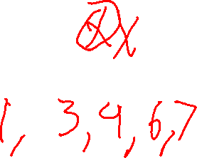
Sorting
Selection sort uses two lists: the original unsorted list, and the initially empty sorted list.
Selection sort is a simple sorting algorithm that you may already use when you need to sort things by hand.
Unsorted: 6, 7, 4, 1, 3
The idea is to remove the smallest value from Unsorted and append it to the end of Sorted. Do this until Unsorted is empty.
Sorted:

Slide 20
Sorting
Selection sort uses two lists: the original unsorted list, and the initially empty sorted list.
Selection sort is a simple sorting algorithm that you may already use when you need to sort things by hand.
Unsorted: 6, 7, 4, 1, 3
The idea is to remove the smallest value from Unsorted and append it to the end of Sorted. Do this until Unsorted is empty.
Sorted: 1

Slide 21
Sorting
Selection sort uses two lists: the original unsorted list, and the initially empty sorted list.
Selection sort is a simple sorting algorithm that you may already use when you need to sort things by hand.
Unsorted: 6, 7, 4, 3
The idea is to remove the smallest value from Unsorted and append it to the end of Sorted. Do this until Unsorted is empty.
Sorted: 1

Slide 22
Sorting
Selection sort uses two lists: the original unsorted list, and the initially empty sorted list.
Selection sort is a simple sorting algorithm that you may already use when you need to sort things by hand.
min
Unsorted: 6, 7, 4, 3
The idea is to remove the smallest value from Unsorted and append it to the end of Sorted. Do this until Unsorted is empty.
Sorted: 1, 3

Slide 23
Sorting
Selection sort uses two lists: the original unsorted list, and the initially empty sorted list.
Selection sort is a simple sorting algorithm that you may already use when you need to sort things by hand.
Unsorted: 6, 7, 4
The idea is to remove the smallest value from Unsorted and append it to the end of Sorted. Do this until Unsorted is empty.
Sorted: 1, 3

Slide 24
Sorting
Selection sort uses two lists: the original unsorted list, and the initially empty sorted list.
Selection sort is a simple sorting algorithm that you may already use when you need to sort things by hand.
min
Unsorted: 6, 7, 4
The idea is to remove the smallest value from Unsorted and append it to the end of Sorted. Do this until Unsorted is empty.
Sorted: 1, 3, 4

Slide 25
Sorting
Selection sort uses two lists: the original unsorted list, and the initially empty sorted list.
Selection sort is a simple sorting algorithm that you may already use when you need to sort things by hand.
Unsorted: 6, 7
The idea is to remove the smallest value from Unsorted and append it to the end of Sorted. Do this until Unsorted is empty.
Sorted: 1, 3, 4

Slide 26
Sorting
Selection sort uses two lists: the original unsorted list, and the initially empty sorted list.
Selection sort is a simple sorting algorithm that you may already use when you need to sort things by hand.
min
Unsorted: 6, 7
The idea is to remove the smallest value from Unsorted and append it to the end of Sorted. Do this until Unsorted is empty.
Sorted: 1, 3, 4, 6

Slide 27
Sorting
Selection sort uses two lists: the original unsorted list, and the initially empty sorted list.
Selection sort is a simple sorting algorithm that you may already use when you need to sort things by hand.
Unsorted: 7
The idea is to remove the smallest value from Unsorted and append it to the end of Sorted. Do this until Unsorted is empty.
Sorted: 1, 3, 4, 6

Slide 28
Sorting
Selection sort uses two lists: the original unsorted list, and the initially empty sorted list.
Selection sort is a simple sorting algorithm that you may already use when you need to sort things by hand.
min
Unsorted: 7
The idea is to remove the smallest value from Unsorted and append it to the end of Sorted. Do this until Unsorted is empty.
Sorted: 1, 3, 4, 6, 7

Slide 29
Sorting
Selection sort uses two lists: the original unsorted list, and the initially empty sorted list.
Selection sort is a simple sorting algorithm that you may already use when you need to sort things by hand.
Unsorted:
The idea is to remove the smallest value from Unsorted and append it to the end of Sorted. Do this until Unsorted is empty.
Sorted: 1, 3, 4, 6, 7

Slide 30

Sorting
def selection_sort1(unsorted):
sorted = []
while len(lst) > 0:
smallest = min(unsorted)
unsorted.remove(smallest)
sorted.append(smallest)
return sorted
L = [2, 1, 5, 3]
S = selection_sort1(L)
print(L) # []
print(S) # [1, 2, 3, 5]
This Python version of selection sort returns a copy of the unsorted list, and also makes the unsorted list empty.
How can we write a version of selection sort that doesn’t modify its input list?

Slide 31
Sorting
How can we write a version of selection sort that doesn’t modify its input list?
L = [2, 1, 5, 3]
S = selection_sort1(L)
print(L) # []
print(S) # [1, 2, 3, 5]
def selection_sort2(lst):
???

Slide 32

Sorting
lst[:] returns a copy of lst
L = [2, 1, 5, 3]
S = selection_sort2(L)
print(L) # [2, 1, 5, 3]
print(S) # [1, 2, 3, 5]
def selection_sort2(lst):
return selection_sort1(lst[:])
For you to try: write a version of selection sort that sorts the list in-place, i.e. without making a copy.
Selection sort is fine for small amounts of data, e.g. maybe lists of up length of about 1000. But it is not very efficient in general, and for large lists it can be painfully slow.

Slide 33
Merging
A
1
4
5
Suppose we happen to have two already-sorted lists. We can efficiently combine them into a single sorted list using the merge algorithm.
B
2
3
5
8
9

Slide 34
Merging
A
1
4
5
Suppose we happen to have two already-sorted lists. We can efficiently combine them into a single sorted list using the merge algorithm.
B
2
3
5
8
9
Algorithm: Continually copy the smallest remaining item from A and B into result.
result

Slide 35
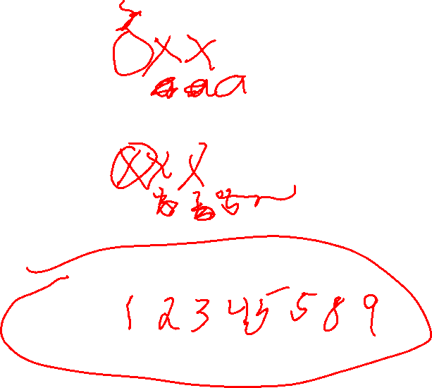
Merging
a
a and b keep the index values of the smallest remaining values in A and B
A
1
4
5
Suppose we happen to have two already-sorted lists. We can efficiently combine them into a single sorted list using the merge algorithm.
b
B
2
3
5
8
9
Algorithm: Continually copy the smallest remaining item from A and B into result.
result

Slide 36
Merging
a
A
1
4
5
Suppose we happen to have two already-sorted lists. We can efficiently combine them into a single sorted list using the merge algorithm.
b
B
2
3
5
8
9
Algorithm: Continually copy the smallest remaining item from A and B into result.
result

Slide 37
Merging
a
A
1
4
5
Suppose we happen to have two already-sorted lists. We can efficiently combine them into a single sorted list using the merge algorithm.
b
B
2
3
5
8
9
Algorithm: Continually copy the smallest remaining item from A and B into result.
result
1

Slide 38
Merging
a
A
1
4
5
Suppose we happen to have two already-sorted lists. We can efficiently combine them into a single sorted list using the merge algorithm.
b
B
2
3
5
8
9
Algorithm: Continually copy the smallest remaining item from A and B into result.
result
1

Slide 39
Merging
a
A
1
4
5
Suppose we happen to have two already-sorted lists. We can efficiently combine them into a single sorted list using the merge algorithm.
b
B
2
3
5
8
9
Algorithm: Continually copy the smallest remaining item from A and B into result.
result
1

Slide 40
Merging
a
A
1
4
5
Suppose we happen to have two already-sorted lists. We can efficiently combine them into a single sorted list using the merge algorithm.
b
B
2
3
5
8
9
Algorithm: Continually copy the smallest remaining item from A and B into result.
result
1
2

Slide 41

Merging
Merge continues in the same way until all the items are appended to result …
a
A
1
4
5
Suppose we happen to have two already-sorted lists. We can efficiently combine them into a single sorted list using the merge algorithm.
b
B
2
3
5
8
9
Algorithm: Continually copy the smallest remaining item from A and B into result.
result
1
2

Slide 42
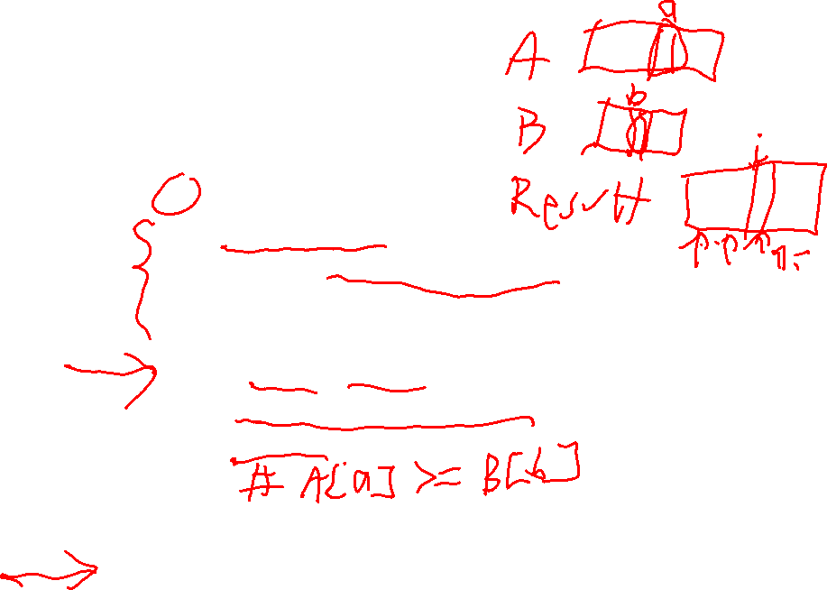
def merge(A, B):
a = 0
b = 0
n = len(A) + len(B)
result = []
for i in range(n):
if a >= len(A):
return result + B[b:]
elif b >= len(B):
return result + A[a:]
elif A[a] < B[b]:
result.append(A[a])
a += 1
else:
result.append(B[b])
b += 1
return result
Merging

Slide 43
def merge(A, B):
a = 0
b = 0
n = len(A) + len(B)
result = []
for i in range(n):
if a >= len(A):
return result + B[b:]
elif b >= len(B):
return result + A[a:]
elif A[a] < B[b]:
result.append(A[a])
a += 1
else:
result.append(B[b])
b += 1
return result
Merging
This if-statement handles the case when all the elements in list A have been added to result. In that case, all the remaining elements in B are added at once.

Slide 44

def merge(A, B):
a = 0
b = 0
n = len(A) + len(B)
result = []
for i in range(n):
if a >= len(A):
return result + B[b:]
elif b >= len(B):
return result + A[a:]
elif A[a] < B[b]:
result.append(A[a])
a += 1
else:
result.append(B[b])
b += 1
return result
Merging
This if-statement handles the case when all items in list A have been added to result. In that case, all the remaining elements in B are added at once.
This if-statement does the same thing when when all the items in B have been added to result.

Slide 45
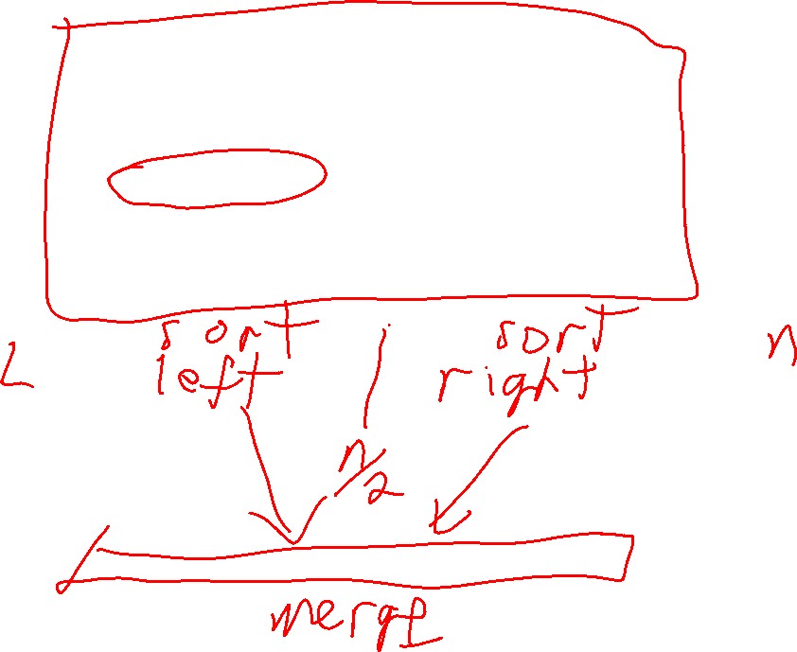
Mergesort
Mergesort on a list of values
divide the list into two halves
sort each half recursively using mergesort
merge the two sorted halves into a single sorted list
Mergesort is a sorting algorithm that is much faster than selection sort on long lists.

Slide 46
Mergesort
Mergesort on a list of values
divide the list into two halves
sort each half recursively using mergesort
merge the two sorted halves into a single sorted list
Mergesort is a sorting algorithm that is much faster than selection sort on long lists.
Divide the list into two equal halves.

Slide 47
Mergesort
Mergesort on a list of values
divide the list into two halves
sort each half recursively using mergesort
merge the two sorted halves into a single sorted list
Mergesort is a sorting algorithm that is much faster than selection sort on long lists.
Divide the list into two equal halves.
Sort both halves separately using mergesort.
sorted
sorted

Slide 48
Mergesort
Mergesort on a list of values
divide the list into two halves
sort each half recursively using mergesort
merge the two sorted halves into a single sorted list
Mergesort is a sorting algorithm that is much faster than selection sort on long lists.
Divide the list into two equal halves.
Sort both halves separately using mergesort.
sorted
sorted
merge
Merge both halves into a single sorted list.
sorted

Slide 49
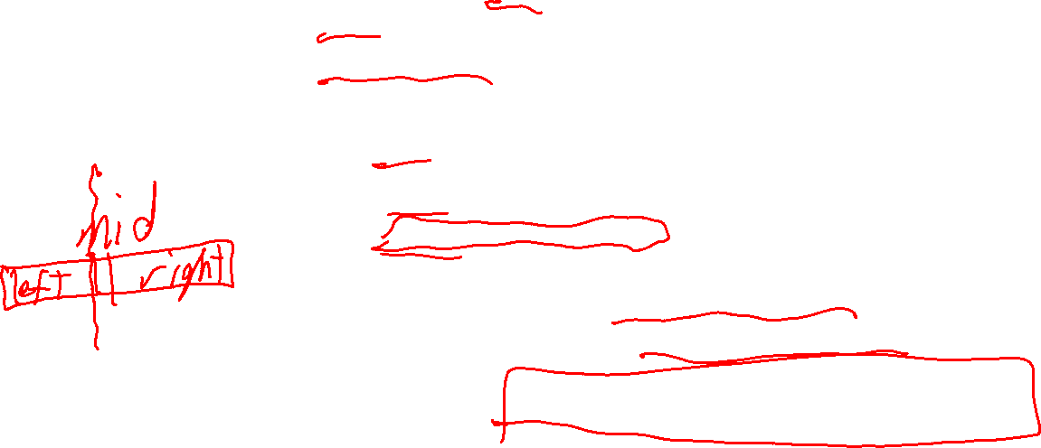
Mergsort
def mergesort(lst):
n = len(lst)
if n < 2:
return lst[:] # already sorted, return a copy
else:
mid = n // 2 # // is integer division
left = lst[:mid]
right = lst[mid:]
left_sorted = mergesort(left)
right_sorted = mergesort(right)
return merge(left_sorted, right_sorted)

Slide 50

Mergesort
def mergesort(lst):
n = len(lst)
if n < 2:
return lst[:] # already sorted, return a copy
else:
mid = n // 2 # // is integer division
left = lst[:mid]
right = lst[mid:]
left_sorted = mergesort(left)
right_sorted = mergesort(right)
return merge(left_sorted, right_sorted)
Mergesort is fast! The code below runs in less than 0.1 seconds. Selection sort takes over 10 seconds.
lst = list(range(50000))
random.shuffle(lst)
result = mergesort(lst)

Slide 51
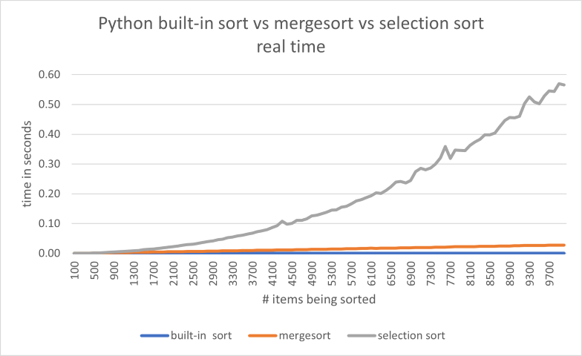
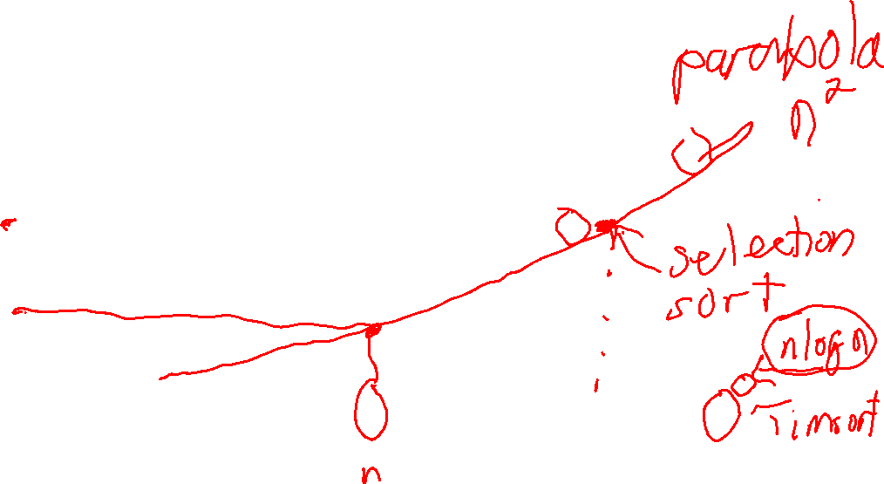
Comparison

Slide 52
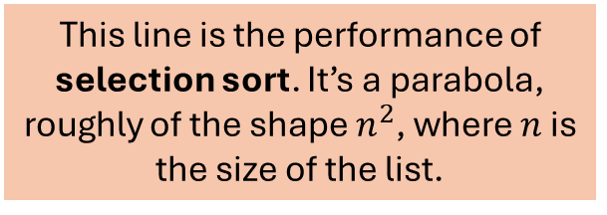
Comparison
This line is the performance of selection sort. It’s a parabola, roughly of the shape $n^{2}$, where $n$ is the size of the list.

Slide 53
Comparison
It’s “bumpy” because the computer might be doing other things.

Slide 54
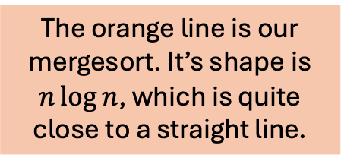
Comparison
The orange line is our mergesort. It’s shape is $n\log{n}$, which is quite close to a straight line.

Slide 55
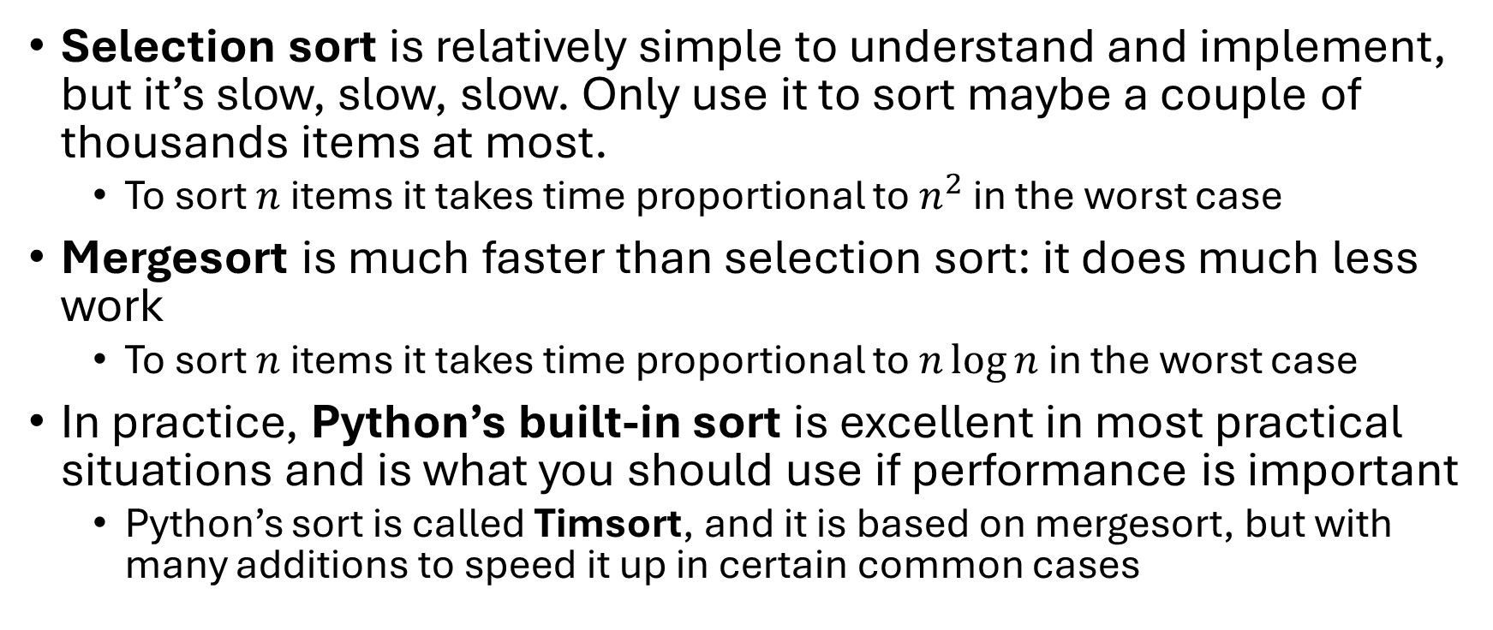
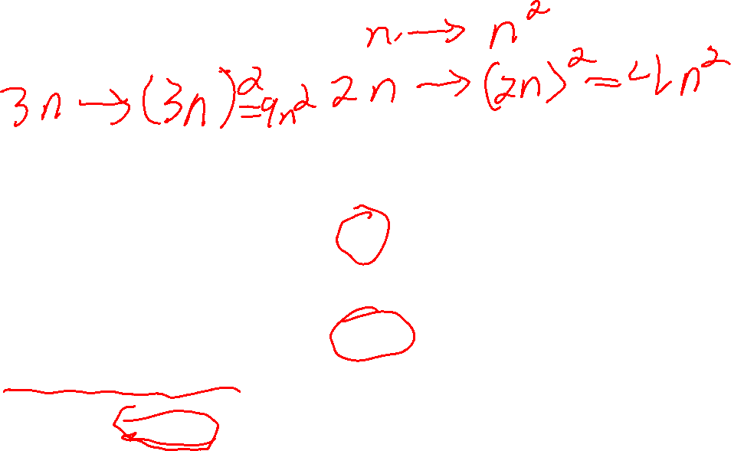
Summary
Selection sort is relatively simple to understand and implement, but it’s slow, slow, slow. Only use it to sort maybe a couple of thousands items at most.
To sort $n$ items it takes time proportional to $n^{2}$ in the worst case
Mergesort is much faster than selection sort: it does much less work
To sort $n$ items it takes time proportional to $n\log{n}$in the worst case
In practice, Python’s built-in sort is excellent in most practical situations and is what you should use if performance is important
Python’s sort is called Timsort, and it is based on mergesort, but with many additions to speed it up in certain common cases

