Slide 1
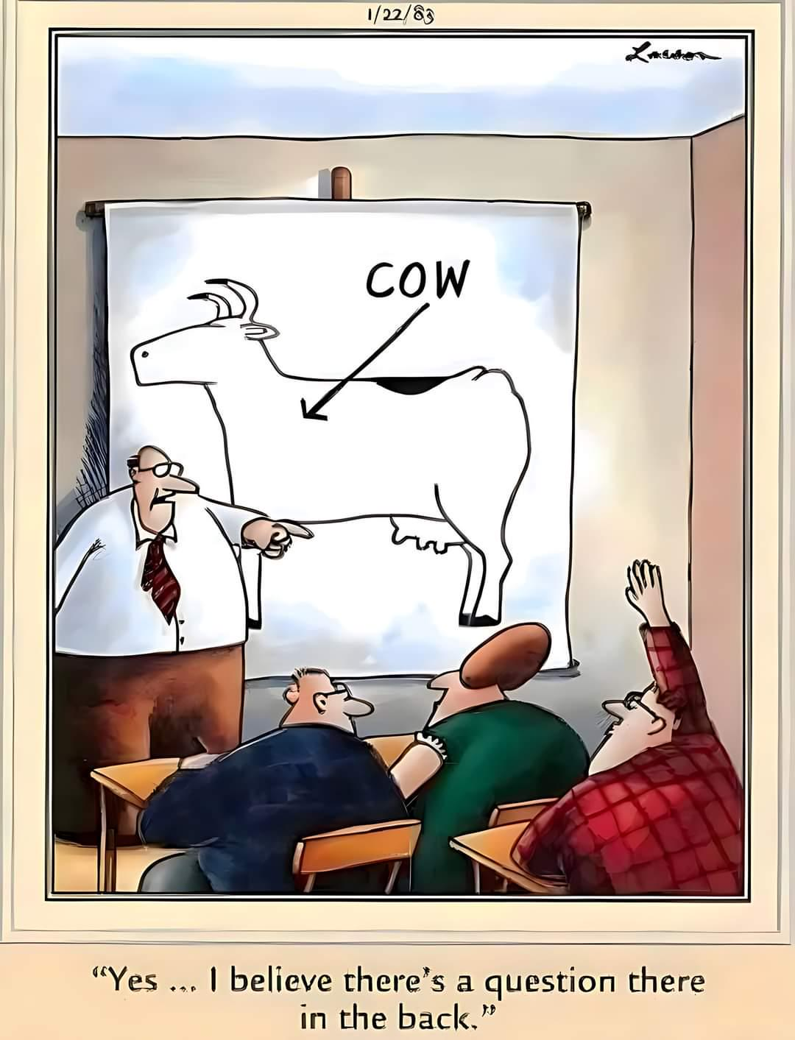
Chapter 2 Variables and Statements
CMPT 120-D1 Spring 2022

Slide 2
What is a computer?

Slide 3
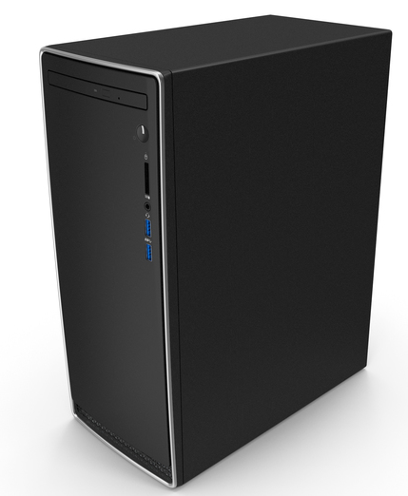
Computer

Slide 4
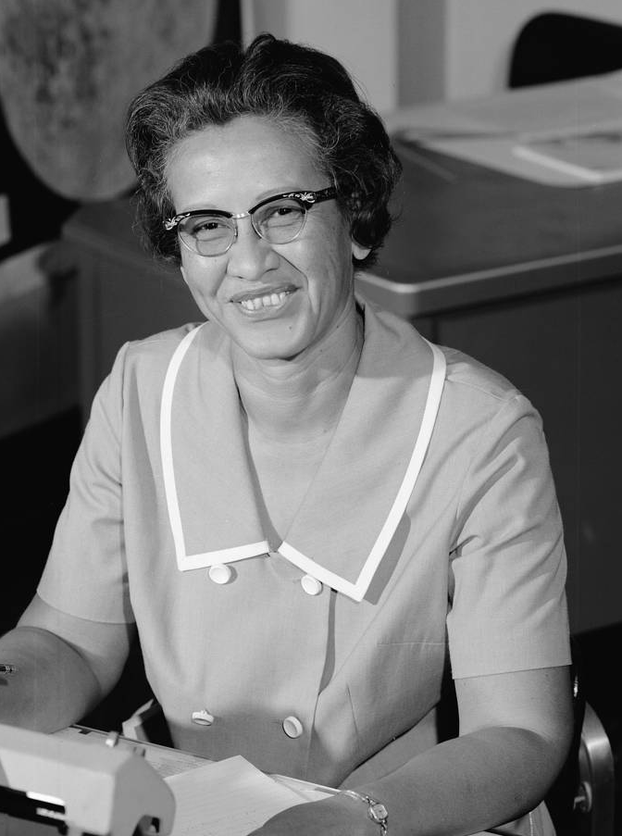
Computer
Katherine Johnson (human) computer for NASA, orbital mechanics
The movie Hidden Figures was about her

Slide 5
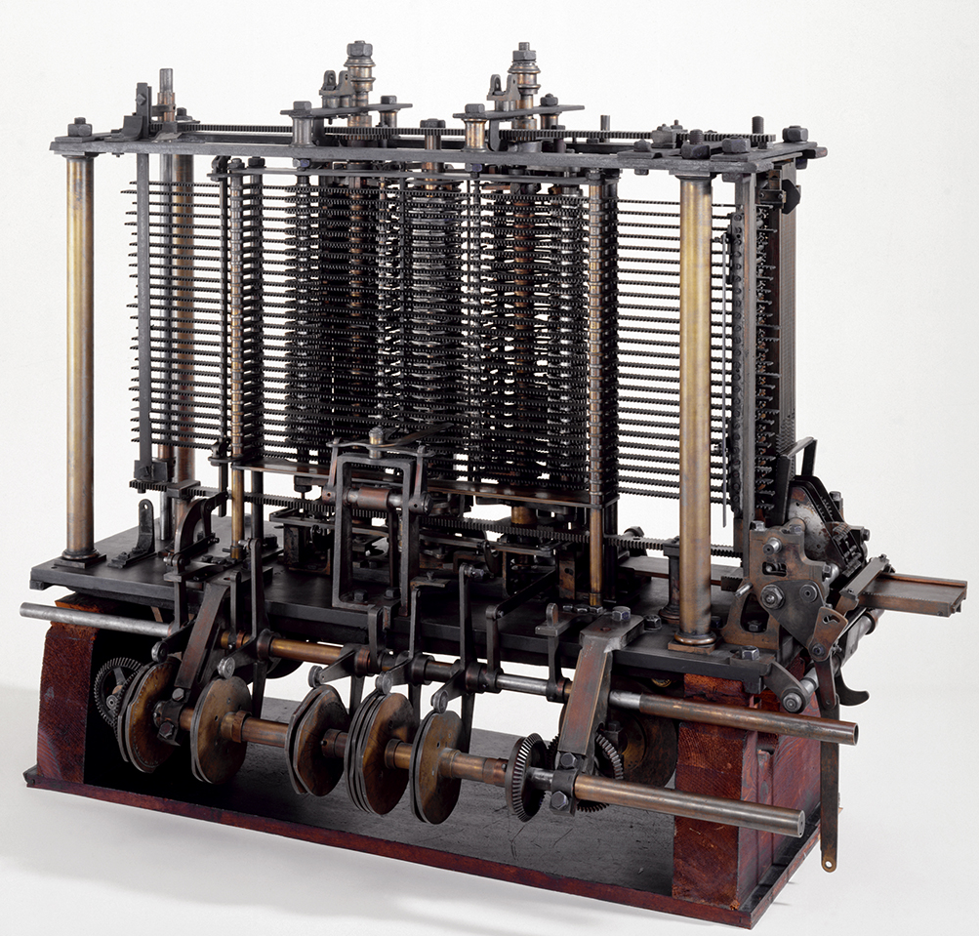
Computer
Analytical Engine, 1837 Created by Charles Babbage Hand-cranked, never completed

Slide 6

Computer
ENIAC, 1948 First general-purpose electronic computer Used decimal instead of binary

Slide 7
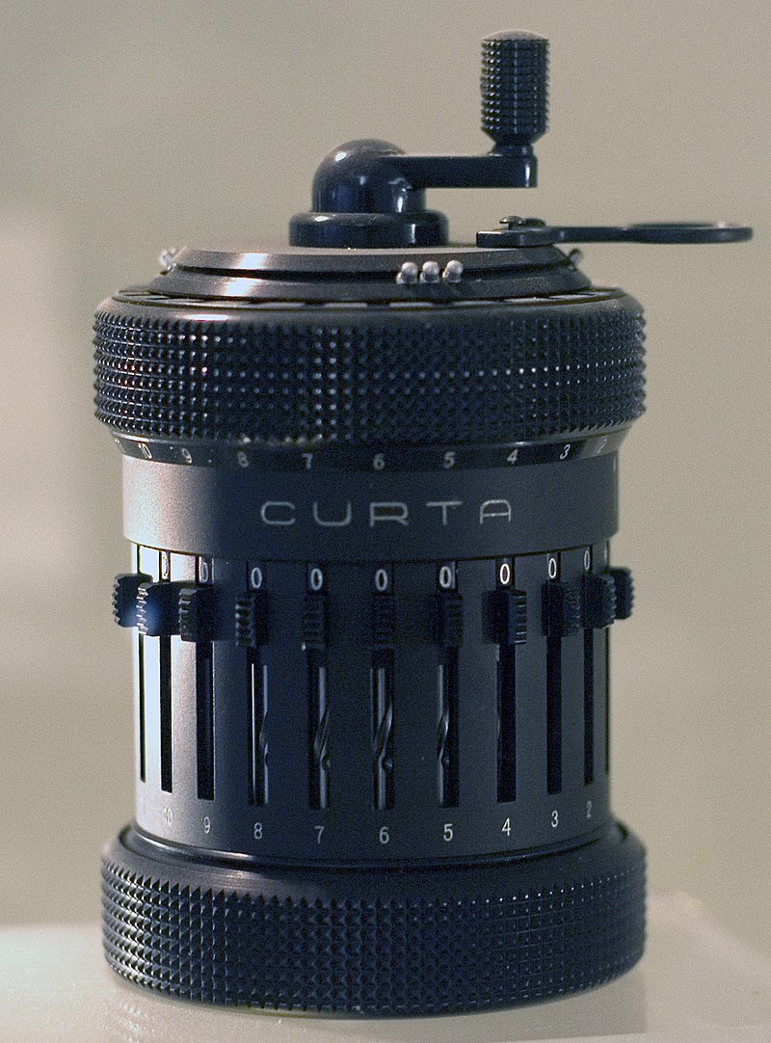
Computer
Curta Calculator, 1948 Hand-held mechanical calculator

Slide 8
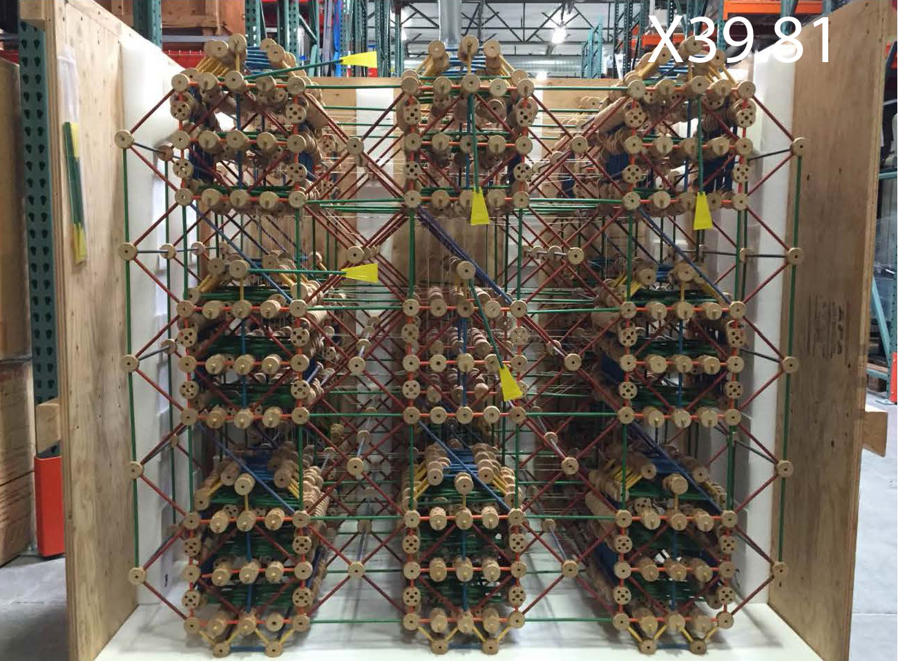
Computer
Tinker Toy Computer, 1978 Hand-cranked, plays Tic Tac Toe

Slide 9
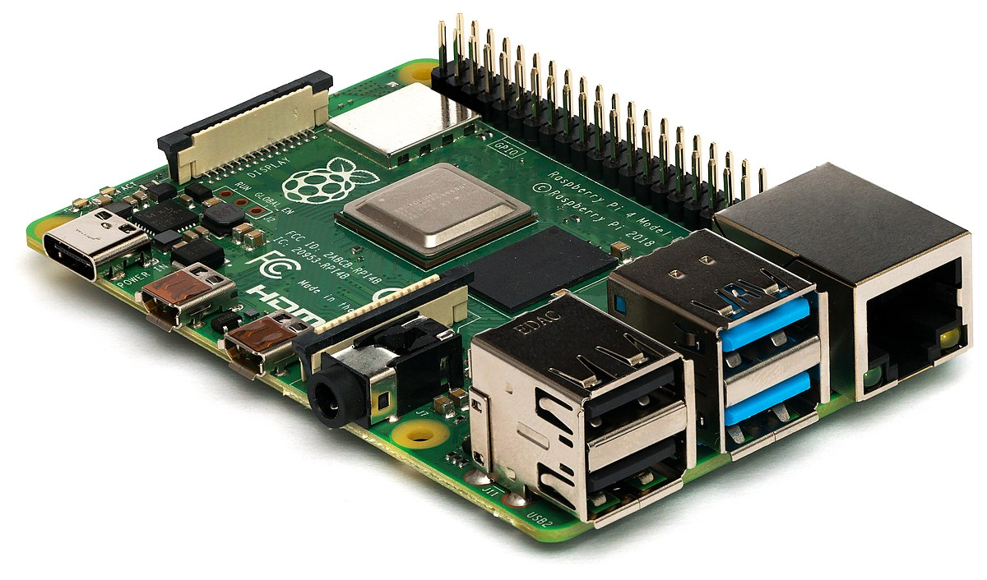

Computer
Raspberry Pi Very small, for embedded systems

Slide 10

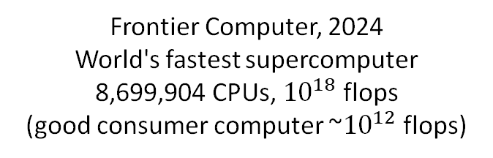

Computer
Frontier Computer, 2024 World's fastest supercomputer 8,699,904 CPUs, ${10}^{18}$ flops
(good consumer computer ~${10}^{12}$ flops)
flops = floating point operations per second

Slide 11
We will usually think of a computer in
an abstract way …
CPU Central Processing Unit
I/O Input and Output
Main Memory RAM Random Access Memory
Single CPU Computer

Slide 12
CPU is the “brain” of the computer. Does basic arithmetic, logic, reads/writes memory, ….
CPUs in a phone or laptop are very fast, e.g. they perform billions of low-level instructions per second.
CPU Central Processing Unit
I/O Input and Output
Main Memory RAM Random Access Memory
Single CPU Computer

Slide 13
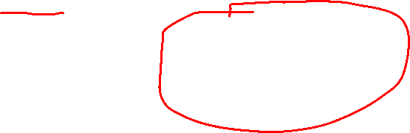
CPU is the “brain” of the computer. Does basic arithmetic, logic, reads/writes memory, ….
CPUs in a phone or laptop are very fast, e.g. they perform billions of low-level instructions per second.
CPU Central Processing Unit
I/O Input and Output
Main Memory RAM Random Access Memory
Main memory is “short term memory” where data and instructions are stored.
Single CPU Computer
RAM is usually erased when you turn the computer off.
Laptops and phones usually have large amounts of fast main memory.

Slide 14






CPU is the “brain” of the computer. Does basic arithmetic, logic, reads/writes memory, ….
CPUs in a phone or laptop are very fast, e.g. they perform billions of low-level instructions per second.
CPU Central Processing Unit
I/O refers to input and output devices you could attach a computer to …
I/O Input and Output
Internet
VR goggles
Main Memory RAM Random Access Memory
Not all computers have screens or keyboards or mice! E.g. computer that controls stop lights at an intersection.
Main memory is “short term memory” where data and instructions are stored.
Single CPU Computer
RAM is usually erased when you turn the computer off.
Laptops and phones usually have large amounts of fast main memory.

Slide 15
At the lowest level, we imagine main memory (RAM) consists of many 0/1 bits.
0100111010110000111010100110100110
1111101000100010110011011100100100
0010001110111100000110100011101011
1110101010111100100001111110000000
0100001001011110111111010011100000
…
Main Memory (RAM)

Slide 16
At the lowest level, we imagine main memory (RAM) consists of many 0/1 bits.
16 megabytes of RAM has 8 * 16 * 1000000 bits = 128,000,000 bits
0100111010110000111010100110100110
1 byte = 8 bits
1111101000100010110011011100100100
0010001110111100000110100011101011
1 bit = 0 or 1
1110101010111100100001111110000000
0100001001011110111111010011100000
…
Main Memory (RAM)

Slide 17
At the lowest level, we imagine main memory (RAM) consists of many 0/1 bits.
16 megabytes of RAM has 8 * 16 * 1000000 bits = 128,000,000 bits
0100111010110000111010100110100110
1 byte = 8 bits
Most computers operate on fixed-size chunks of bits, e.g. a 64-bit computer operates on 64-bits at a time.
1111101000100010110011011100100100
0010001110111100000110100011101011
1 bit = 0 or 1
1110101010111100100001111110000000
0100001001011110111111010011100000
…
Main Memory (RAM)

Slide 18

At the lowest level, we imagine main memory (RAM) consists of many 0/1 bits.
16 megabytes of RAM has 8 * 16 * 1000000 bits = 128,000,000 bits
0100111010110000111010100110100110
1 byte = 8 bits
Most computers operate on fixed-size chunks of bits, e.g. a 64-bit computer operates on 64-bits at a time.
1111101000100010110011011100100100
0010001110111100000110100011101011
1 bit = 0 or 1
1110101010111100100001111110000000
0100001001011110111111010011100000
…
Reading all these 0s and 1s is tough for people!
So we’ll use regular base-10 numbers and characters instead of bits. But remember, everything is ultimately bits!
206 = 1100 1110
'a' = 97 = 1100 1110
Main Memory (RAM)

Slide 19
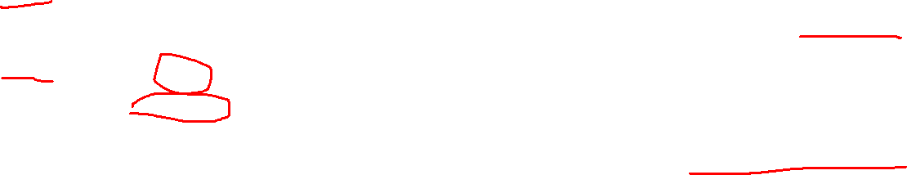
Address | Value
… | …
47339 | 0
47340 | 556345
47341 | -454
47342 | 3279267
47343 | 454277
… | …
RAM is addressable, meaning that each chunk of 64 bits has a numeric address. Given an address, we can quickly read/write those bits.
This is also why some languages have max values for their numbers: the numbers must fit in 64 bits.
Python implements ints differently, and so Python ints have no pre-defined max value.
Main Memory (RAM)

Slide 20
In assembly language programming, the programmer must keep track of addresses and values. This is error-prone and tedious!
Given address 47341, the computer can read/write the value there extremely quickly.
Address | Value
… | …
47339 | 0
47340 | 556345
47341 | -454
47342 | 3279267
47343 | 454277
… | …
The value -454 is stored at address 47341.
High-level programming languages like Python keep track of memory values using human-readable names …
Main Memory (RAM)

Slide 21
In assembly language programming, the programmer must keep track of addresses and values. This is error-prone and tedious!
Given address 47341, the computer can read/write the value there extremely quickly.
Address | Value
… | …
47339 | 0
47340 | 556345
score | -454
47342 | 3279267
47343 | 454277
… | …
The value -454 is stored at address 47341.
47341
-454 is stored at address 47341, but the programmer thinks of it as the value of the variable named score.
High-level programming languages like Python keep track of memory values using human-readable names …
Main Memory (RAM)

Slide 22
When talking about the memory a program uses, we usually only care about the variables and values in the program, and ignore the rest of memory.
score: -454
If such details matter, you probably shouldn’t use a language other than Python (like C or C++).
In Python we rarely care about the exact address or bits of value.
Main Memory (RAM)

Slide 23
Usually we will just write the name and value for a variable, like in math.
score: -454

Slide 24
Usually we will just write the name and value for a variable, like in math.
score: -454
Sometimes it’s useful to think of a variable as a named bucket that contains a value …
-454
score

Slide 25
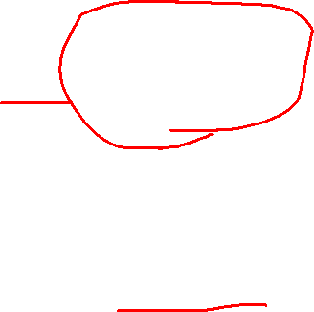
Usually we will just write the name and value for a variable, like in math.
score: -454
score
-454
Sometimes it’s useful to think of a variable as a named bucket that contains a value …
… or as labelling a box.
-454
score
-454
score

Slide 26
Usually we will just write the name and value for a variable, like in math.
score: -454
score
-454
Sometimes it’s useful to think of a variable as a named bucket that contains a value …
… or as labelling a box.
-454
… or as pointing, or referring, to its value.
score
-454
score
score
-454

Slide 27
Python’s Assignment Statement
X = Y

Slide 28
Python’s Assignment Statement
= is called the assignment operator
X = Y

Slide 29
Python’s Assignment Statement
= is called the assignment operator
X = Y

Slide 30
Python’s Assignment Statement
= is called the assignment operator
X = Y
X is on the left-hand side of the =, so it’s called the LHS, or L-value
For us, L-values are usually variables.

Slide 31
Python’s Assignment Statement
= is called the assignment operator
X = Y
Y is on the right-hand side of the =, so it’s called the RHS, or R-value
X is on the left-hand side of the =, so it’s called the LHS, or L-value
An R-value can be any expression that evaluates to some value.
For us, L-values are usually variables.

Slide 32
Python’s Assignment Statement
= is called the assignment operator
X = Y
Y is on the right-hand side of the =, so it’s called the RHS, or R-value
X is on the left-hand side of the =, so it’s called the LHS, or L-value
An R-value can be any expression that evaluates to some value.
For us, L-values are usually variables.

Slide 33
Python’s Assignment Statement
= is called the assignment operator
X = Y
Y is on the right-hand side of the =, so it’s called the RHS, or R-value
X is on the left-hand side of the =, so it’s called the LHS, or L-value
As assignment statement works like this:
Evaluate Y to gets it value.
Put a copy of Y’s value into variable X (over-writing the value already in X).
An R-value can be any expression that evaluates to some value.
For us, L-values are usually variables.

Slide 34
Python’s Assignment Statement
X = Y
Evaluate Y to gets it value.
Put a copy of Y’s value into variable X (over-writing the value already in X).
a = 2 b = 4 + a c = (b – 1) ** a

Slide 35
Python’s Assignment Statement
X = Y
Evaluate Y to gets it value.
Put a copy of Y’s value into variable X (over-writing the value already in X).
This statement defines the variable a, and then assigns it the initial value 2.
a = 2 b = 4 + a c = (b – 1) ** a
a
2

Slide 36
Python’s Assignment Statement
X = Y
Evaluate Y to gets it value.
Put a copy of Y’s value into variable X (over-writing the value already in X).
This statement defines the variable b …
a = 2 b = 4 + a c = (b – 1) ** a
a
2
b
?

Slide 37
Python’s Assignment Statement
X = Y
Evaluate Y to gets it value.
Put a copy of Y’s value into variable X (over-writing the value already in X).
Then it evaluates 4 + a …
a = 2 b = 4 + a c = (b – 1) ** a
a
2
To evaluate 4 + a:
Replace a with its value 2 4 + 2
Evaluate 4 + 2 6
Put a copy of 6 into b
b
6

Slide 38
Python’s Assignment Statement
X = Y
Evaluate Y to gets it value.
Put a copy of Y’s value into variable X (over-writing the value already in X).
This defines variable c …
a = 2 b = 4 + a c = (b – 1) ** a
a
2
b
6
c
?

Slide 39
Python’s Assignment Statement
X = Y
Evaluate Y to gets it value.
Put a copy of Y’s value into variable X (over-writing the value already in X).
Then evaluate (b - 1) ** a …
a = 2 b = 4 + a c = (b – 1) ** a
a
2
To evaluate (b – 1) ** a:
Replace a with its value 2 (b – 1) ** 2
Replace b with its value 6 (6 – 1) ** 2
Evaluate 6 – 1 5 ** 2
Evaluate 5 ** 2 25
Put 25 into c
b
6
c
25

Slide 40
Python’s Assignment Statement
X = Y
Important: the first time you assign a value to a variable, you also define that variable into existence.
Evaluate Y to gets it value.
Put a copy of Y’s value into variable X (over-writing the value already in X).
a = 2 b = 4 + a c = (b – 1) ** a
Each of these statements does two things:
They define the variable on the left.
They assign it an initial value.

Slide 41
Python’s Assignment Statement
X = Y
Important: the first time you assign a value to a variable, you also define that variable into existence.
Evaluate Y to gets it value.
Put a copy of Y’s value into variable X (over-writing the value already in X).
a = 2
a = 2 + a b = 4 + a c = (b – 1) ** a
This defines a and gives it an initial value of 2.
Since a is already defined, this only gives a a new value (of 4).

Slide 42
Python’s Assignment Statement
X = Y
Evaluate Y to gets it value.
Put a copy of Y’s value into variable X (over-writing the value already in X).
These two code fragments do the same thing.
a = 2
b = 'cat'
c = 3.14
a, b, c = 2, 'cat’, 3.14

Slide 43
Python’s Assignment Statement
X = Y
Evaluate Y to gets it value.
Put a copy of Y’s value into variable X (over-writing the value already in X).
These two code fragments do the same thing.
a = 2
b = 'cat'
c = 3.14
a, b, c = 2, 'cat’, 3.14
This is an example of multiple assignment (or tuple assignment).

Slide 44
Python’s Assignment Statement
X = Y
Evaluate Y to gets it value.
Put a copy of Y’s value into variable X (over-writing the value already in X).
a = 2
b = 'cat’
a, b = b, a
print(a) # cat
print(b) # 2
This is a neat Python trick for swapping the values of two variables.

Slide 45
Python’s Assignment Statement
X = Y
Evaluate Y to gets it value.
Put a copy of Y’s value into variable X (over-writing the value already in X).
a = 2
b = 'cat’
a, b = b, a
print(a) # cat
print(b) # 2
This is a neat Python trick for swapping the values of two variables.
temp = a
a = b
b = temp
Without multiple assignment, you’d need to write code like this.

Slide 46
Function Arguments
This is a function call.
p = 3 x = math.pow(1+1, p)

Slide 47
Function Arguments
p = 3 x = math.pow(1+1, p)
math.pow is the name of the function.

Slide 48
Function Arguments
p = 3 x = math.pow(1+1, p)
This is the list of inputs. math.pow takes two inputs …

Slide 49
Function Arguments
Function call lists always start with a ( and end with a )
( and ) are called parentheses, or round brackets.
p = 3 x = math.pow(1+1, p)
This is the list of inputs. math.pow takes two inputs …

Slide 50
Function Arguments
p = 3 x = math.pow(1+1, p)
This is the first input …
… this is the second input.

Slide 51
Function Arguments
p = 3 x = math.pow(1+1, p)
This is the first input …
… this is the second input.
Instead of calling these inputs, we often call them function arguments.

Slide 52
Function Arguments
p = 3 x = math.pow(1+1, p)
This is the first argument …
… this is the second argument.

Slide 53
Function Arguments
p = 3 x = math.pow(1+1, p)
This is the first argument …
… this is the second argument.
math.pow always takes exactly 2 arguments: math.pow(x, y)
math.pow is a 2-argument function

Slide 54
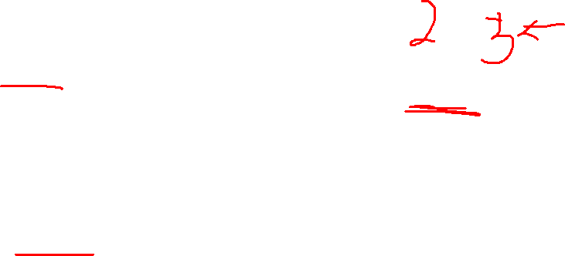
Function Arguments
p = 3 x = math.pow(1+1, p)
When a function is called, the arguments are first evaluated …
x = math.pow(2, 3)

Slide 55
Function Arguments
p = 3 x = math.pow(2, 3)
Then the resulting values are passed to the function, and the function returns a value

Slide 56
Function Arguments
p = 3 x = 8
The final result is that x gets the value 8.

Slide 57
Source Code Comments
A source code comment is a note that a programmer writes in their program that is just for them or other humans.
Python ignores source code comments … it just skips over them.
# set the length of the sides
side1 = 3
side2 = 4
# calculate the hypotenuse using the Pythagorean theorem
hypotenuse = math.sqrt(side1 ** 2 + side2 ** 2)
# print the results
print(hypotenuse)

Slide 58
Source Code Comments
A source code comment is a note that a programmer writes in their program that is just for them or other humans.
Python ignores source code comments … it just skips over them.
# set the length of the sides
side1 = 3
side2 = 4
# calculate the hypotenuse using the Pythagorean theorem
hypotenuse = math.sqrt(side1 ** 2 + side2 ** 2)
# print the results
print(hypotenuse)
Python source code comments always start with the # character.

Slide 59
Source Code Comments
A source code comment is a note that a programmer writes in their program that is just for them or other humans.
Python ignores source code comments … it just skips over them.
# set the length of the sides
side1 = 3
side2 = 4
# calculate the hypotenuse using the Pythagorean theorem
hypotenuse = math.sqrt(side1 ** 2 + side2 ** 2)
# print the results
print(hypotenuse)
Python source code comments always start with the # character.
Good comments make your code more readable.

Slide 60
Source Code Comments
A source code comment is a note that a programmer writes in their program that is just for them or other humans.
Python ignores source code comments … it just skips over them.
# set the length of the sides
side1 = 3
side2 = 4
# calculate the hypotenuse using the Pythagorean theorem
hypotenuse = math.sqrt(side1 ** 2 + side2 ** 2)
# print the results
print(hypotenuse)
Variable names should generally be self-descriptive.

Slide 61
1
2
# set the length of the sides
side1 = 3
side2 = 4
# calculate the hypotenuse of the triangle using # the Pythagorean theorem
hypotenuse = math.sqrt(side1 ** 2 + side2 ** 2)
# print the results
print(hypotenuse)
# set the length of the sides
a = 3
b = 4
# calculate the hypotenuse of the triangle using # the Pythagorean theorem
h = math.sqrt(a ** 2 + b ** 2)
# print the results
print(h)
Which version do you find to be the most readable?
3
4
side1 = 3
side2 = 4
hypotenuse = math.sqrt(side1 ** 2 + side2 ** 2)
print(hypotenuse)
a = 3
b = 4
h = math.sqrt(a ** 2 + b ** 2)
print(h)

Slide 62
Source Code Comments
#
# This program calculates the hypotenuse of a right triangle
# given the lengths of the two sides (side1 and side2).
#
# |\
# | \
# | \ Pythagorean theorem
# a | \ hypotenuse = sqrt(a ** 2 + b ** 2)
# | \
# | \
# +------+
# b
#
import math
a = 3
b = 4
hypotenuse = math.sqrt(a ** 2 + b ** 2)
print(hypotenuse)
There are many ways to document and format a program.

Slide 63
Source Code Comments
A good way to write some programs is to write down each step, write them as comments first, and then fill in the code …
set the length of the sides
calculate the hypotenuse of the triangle using the Pythagorean theorem
print the results
This is pseudocode: a program written in an English-like form that’s easy for humans to read.

Slide 64
Source Code Comments
A good way to write some programs is to write down each step, write them as comments first, and then fill in the code …
# set the length of the sides
# calculate the hypotenuse of the triangle
# using the Pythagorean theorem
# print the results
This is pseudocode: a program written in an English-like form that’s easy for humans to read.

Slide 65
Source Code Comments
A good way to write some programs is to write down each step in comments first, and then fill in the code …
# set the length of the sides
side1 = 3
side2 = 4
# calculate the hypotenuse of the triangle using # the Pythagorean theorem
# print the results

Slide 66
Source Code Comments
A good way to write some programs is to write down each step in comments first, and then fill in the code …
# set the length of the sides
side1 = 3
side2 = 4
# calculate the hypotenuse of the triangle using # the Pythagorean theorem
hypotenuse = math.sqrt(side1 ** 2 + side2 ** 2)
# print the results

Slide 67
Source Code Comments
A good way to write some programs is to write down each step in comments first, and then fill in the code …
# set the length of the sides
side1 = 3
side2 = 4
# calculate the hypotenuse of the triangle using # the Pythagorean theorem
hypotenuse = math.sqrt(side1 ** 2 + side2 ** 2)
# print the results
print(hypotenuse)

Slide 68
Source Code Comments
Many programs have this general form …
# get input
…
# process the input
…
# print the results
…

