Slide 1
Chapter 3 Functions (and simple loops)
Notes
Assignment 2 due next week
Don’t start too late!
Take advantage of TA office hours this week
Start turtle graphics --- it’s fun and the assignment is about it
CMPT 120-D2 Spring 2026

Slide 2
Functions
A function is a “black box” that takes some input and returns some output.
Input
Function
Output

Slide 3
Functions
A function is a “black box” that takes some input and returns some output.
Input
4
Function
math.sqrt
Output
2

Slide 4
Functions
A function is a “black box” that takes some input and returns some output.
Input
4
Function
math.sqrt
x = math.sqrt(4)
Output
2

Slide 5
Defining New Functions
This defines a new function named print_a_joke() that takes no input.
def print_a_joke () :
print("Knock knock!")
print("Who's there?")
print("A broken pencil.")
print("A broken pencil who?")
print("Never mind, it's pointless.")

Slide 6
Defining New Functions
This is the function header.
This defines a new function named print_a_joke() that takes no input.
def print_a_joke () :
print("Knock knock!")
print("Who's there?")
print("A broken pencil.")
print("A broken pencil who?")
print("Never mind, it's pointless.")

Slide 7
Defining New Functions
This is the function header.
This is the function body.
This defines a new function named print_a_joke() that takes no input.
def print_a_joke () :
print("Knock knock!")
print("Who's there?")
print("A broken pencil.")
print("A broken pencil who?")
print("Never mind, it's pointless.")

Slide 8
Defining New Functions
This defines a new function named print_a_joke() that takes no input.
def print_a_joke () :
print("Knock knock!")
print("Who's there?")
print("A broken pencil.")
print("A broken pencil who?")
print("Never mind, it's pointless.")
A function definition starts with the keyword def.

Slide 9
Defining New Functions
After def comes the function name.
This defines a new function named print_a_joke() that takes no input.
def print_a_joke () :
print("Knock knock!")
print("Who's there?")
print("A broken pencil.")
print("A broken pencil who?")
print("Never mind, it's pointless.")
A function definition starts with the keyword def.

Slide 10

Defining New Functions
After def comes the function name.
After the name comes the parameter list.
( is an open parenthesis ) is a closed parenthesis
This defines a new function named print_a_joke() that takes no input.
def print_a_joke () :
print("Knock knock!")
print("Who's there?")
print("A broken pencil.")
print("A broken pencil who?")
print("Never mind, it's pointless.")
A function definition starts with the keyword def.

Slide 11
Defining New Functions
After def comes the function name.
After the name comes the parameter list.
( is an open parenthesis ) is a closed parenthesis
This defines a new function named print_a_joke() that takes no input.
After the parameter list comes a : (colon).
def print_a_joke () :
print("Knock knock!")
print("Who's there?")
print("A broken pencil.")
print("A broken pencil who?")
print("Never mind, it's pointless.")
A function definition starts with the keyword def.

Slide 12
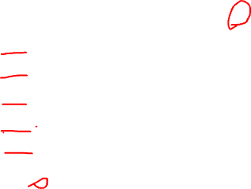
Defining New Functions
The body of a function definition consists of 1 or more statements.
This particular function body has 5 print statements.
This defines a new function named print_a_joke() that takes no input.
def print_a_joke () :
print("Knock knock!")
print("Who's there?")
print("A broken pencil.")
print("A broken pencil who?")
print("Never mind, it's pointless.")
Important! The statements in the body of a function must be consistently indented.

Slide 13
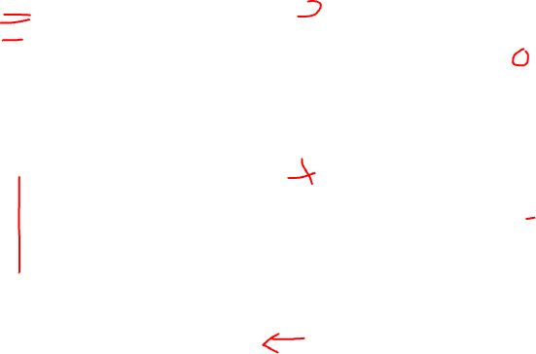
def print_a_joke():
print("Knock knock!")
print("Who's there?")
print("A broken pencil.")
print("A broken pencil who?")
print("Never mind, it's pointless.")
def print_a_joke():
print("Knock knock!")
print("Who's there?")
print("A broken pencil.")
print("A broken pencil who?")
print("Never mind, it's pointless.")
def print_a_joke():
print("Knock knock!")
print("Who's there?")
print("A broken pencil.")
print("A broken pencil who?")
print("Never mind, it's pointless.")
def print_a_joke():
print("Knock knock!")
print("Who's there?")
print("A broken pencil.")
print("A broken pencil who?")
print("Never mind, it's pointless.")
def print_a_joke():
print("Knock knock!")
print("Who's there?")
print("A broken pencil.")
print("A broken pencil who?")
print("Never mind, it's pointless.")
Which functions are
correctly indented?

Slide 14
def print_a_joke():
print("Knock knock!")
print("Who's there?")
print("A broken pencil.")
print("A broken pencil who?")
print("Never mind, it's pointless.")
Works!
def print_a_joke():
print("Knock knock!")
print("Who's there?")
print("A broken pencil.")
print("A broken pencil who?")
print("Never mind, it's pointless.")
Syntax error!
def print_a_joke():
print("Knock knock!")
print("Who's there?")
print("A broken pencil.")
print("A broken pencil who?")
print("Never mind, it's pointless.")
Syntax error!
def print_a_joke():
print("Knock knock!")
print("Who's there?")
print("A broken pencil.")
print("A broken pencil who?")
print("Never mind, it's pointless.")
Syntax error!
def print_a_joke():
print("Knock knock!")
print("Who's there?")
print("A broken pencil.")
print("A broken pencil who?")
print("Never mind, it's pointless.")
Which functions are
correctly indented?
Works!

Slide 15
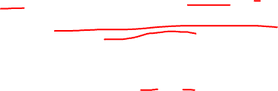
Read this function. What are its parts? What does it do?
def underline(word):
n = len(word) + 2
print(word)
print('-' * n)

Slide 16
Read this function. What are its parts? What does it do?
underline('Hello')
def underline(word):
n = len(word) + 2
print(' ' + word)
print('-' * n)
Hello
-------

Slide 17
underline('Hello')
Variable n is defined inside the underline function.
def underline(word):
n = len(word) + 2
print(' ' + word)
print('-' * n)
Hello
-------

Slide 18
underline('Hello')
Variable n is defined inside the underline function.
def underline(word):
n = len(word) + 2
print(' ' + word)
print('-' * n)
Hello
-------
A variable defined inside a function is called a local variable.

Slide 19
underline('Hello')
Variable n is defined inside the underline function.
def underline(word):
n = len(word) + 2
print(' ' + word)
print('-' * n)
Hello
-------
A variable defined inside a function is called a local variable.
Local variables only exist inside the function they’re defined.

Slide 20
underline('Hello')
Variable n is defined inside the underline function.
def underline(word):
n = len(word) + 2
print(' ' + word)
print('-' * n)
Hello
-------
A variable defined inside a function is called a local variable.
We say that the scope of a local variable is the function it’s defined in.
Local variables only exist inside the function they’re defined.

Slide 21
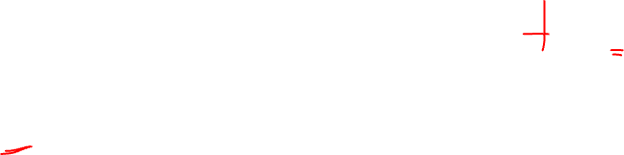
underline('Hello') print(n)
Variable n is defined inside the underline function.
def underline(word):
n = len(word) + 2
print(' ' + word)
print('-' * n)
NameError: n is not defined
A variable defined inside a function is called a local variable.
We say that the scope of a local variable is the function it’s defined in.
Local variables only exist inside the function they’re defined.

Slide 22
Parameters of a function are treated like local variables.
underline('Hello')
Hello
-------
def underline(word):
n = len(word) + 2
print(' ' + word)
print('-' * n)

Slide 23
Parameters of a function are treated like local variables.
When underline is called, word is replaced by 'Hello' …
underline('Hello')
Hello
-----
def underline(word):
n = len(word) + 2
print(' ' + word)
print('-' * n)
n = len('Hello') + 2
print(' ' + 'Hello')
print('-' * n)

Slide 24
More Examples
To understand functions it helps to look at more examples … (see notes)

Slide 25
Repeat Code with for-loop
In Python, a for-loop is a common way to repeat code …

Slide 26
Repeating
with for-loops
Suppose you want to print the numbers 0 to 3.
0
1
2
3

Slide 27
Repeating
with for-loops
This works, but if you want to print out 1000 numbers it will get tedious!
Suppose you want to print the numbers 0 to 3.
print(0)
print(1)
print(2)
print(3)
0
1
2
3

Slide 28

Repeating
with for-loops
This prints 0 to 3 using a for-loop.
Suppose you want to print the numbers 0 to 3.
Prints the same thing
for i in range(4):
print(i)
print(0)
print(1)
print(2)
print(3)
0
1
2
3

Slide 29
Repeating
with for-loops
This prints 0 to 3 using a for-loop.
Suppose you want to print the numbers 0 to 3.
for i in range(4):
print(i)
print(0)
print(1)
print(2)
print(3)
0
1
2
3

Slide 30
Repeating
with for-loops
This is the for-loop header.
Suppose you want to print the numbers 0 to 3.
for i in range(4):
print(i)
0
1
2
3
This is the for-loop body.

Slide 31
Repeating
with for-loops
Suppose you want to print the numbers 0 to 3.
for i in range(4):
print(i)
0
1
2
3
A for-loop always starts with the keyword for

Slide 32
Repeating
with for-loops
This is the loop variable. It can be any variable name you like. i is the traditional variable, short for “index”.
Suppose you want to print the numbers 0 to 3.
for i in range(4):
print(i)
0
1
2
3
A for-loop always starts with the keyword for

Slide 33
Repeating
with for-loops
This is the loop variable. It can be any variable name you like. i is the traditional variable, short for “index”
The keyword in always comes after the loop variable.
Suppose you want to print the numbers 0 to 3.
for i in range(4):
print(i)
0
1
2
3
A for-loop always starts with the keyword for

Slide 34
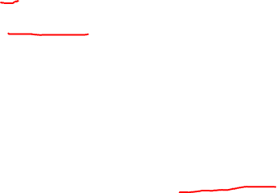
Repeating
with for-loops
This is the loop variable. It can be any variable name you like. i is the traditional variable, short for “index”
The keyword in always comes after the loop variable.
Suppose you want to print the numbers 0 to 3.
for i in range(4):
print(i)
0
1
2
3
A for-loop always starts with the keyword for
This expression makes the loop repeat 4 times. Each time through the loop i gets the value 0, then 1, then 2, …
In a for-loop, range(n) generates the numbers 0, 1, 2, …, n-1.
It starts at 0, ends at n-1.

Slide 35
Repeating
with for-loops
This is the loop variable. It can be any variable name you like. i is the traditional variable, short for “index”
The keyword in always comes after the loop variable.
A colon : marks the end of the for-loop header.
Suppose you want to print the numbers 0 to 3.
for i in range(4):
print(i)
0
1
2
3
A for-loop always starts with the keyword for
This expression makes the loop repeat 4 times. Each time through the loop i gets the value 0, then 1, then 2, …
In a for-loop, range(n) generates the numbers 0, 1, 2, …, n-1.
It starts at 0, ends at n-1.

Slide 36
Repeating
with for-loops
Suppose you want to print the numbers 0 to 3.
for i in range(4):
print(i)
0
1
2
3
The statements in the body of a for-loop must be consistently indented at least 1 space.
This particular body has only one statement. In general, a for-loop body can have as many statements as you like.

Slide 37
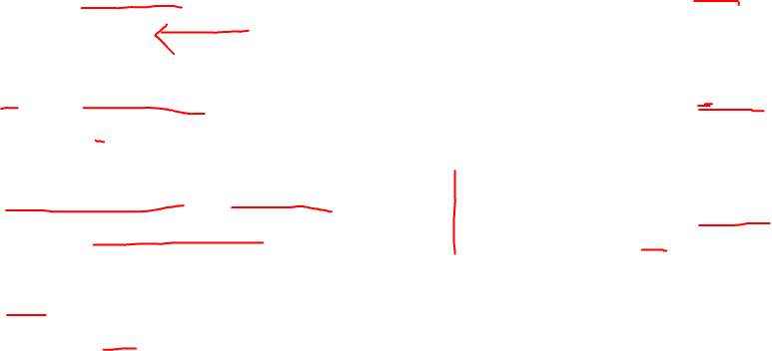
Loops in green boxes all print the same thing.
for i in range(4):
print(i)
for i in range(3+1):
print(i)
for k in range(4):
print(k)
for i in range(0, 4):
print(i)
for index_value in range(4):
print(index_value)
for i in range(5, 9):
print(i-5)
i = 5, 6, 7, 8
for int in range(4):
print(int)
Error!

Slide 38
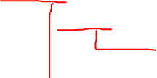
Repeating
with for-loops
What does this print?
for i in range(3):
for j in range(2):
print('*', end='') print()

Slide 39
Repeating
with for-loops
What does this print?
This causes the print statement to not put a newline at the end.
for i in range(3):
for j in range(2):
print('*', end='') print()
Prints just a newline.

Slide 40
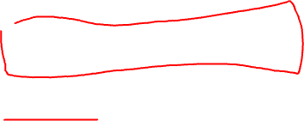
Repeating
with for-loops
for i in range(3):
for j in range(2):
print('*', end='') print()
**
**
**

Slide 41
Repeating
with for-loops
for j in range(2):
print('*', end='')
print()
The outer loop repeats the inner loop three times.
for i in range(3):
for j in range(2):
print('*', end='') print()
**
**
**
for j in range(2):
print('*', end='')
print()
for j in range(2):
print('*', end='')
print()

Slide 42

Repeating
with for-loops
for j in range(2):
print('*', end='')
print()
The outer loop repeats the inner loop three times.
for i in range(3):
for j in range(2):
print('*', end='') print()
**
**
**
for j in range(2):
print('*', end='')
print()
for j in range(2):
print('*', end='')
print()
This is the body of the outer for-loop. Note the consistent of for and print indentation.

Slide 43
Repeating
with for-loops
for j in range(2):
print('*', end='')
print()
The outer loop repeats the inner loop three times.
for i in range(3):
for j in range(2):
print('*', end='') print()
**
**
**
for j in range(2):
print('*', end='')
print()
for j in range(2):
print('*', end='')
print()
This is the body of the outer for-loop. Note the consistent of for and print indentation.
This is the body of the inner for-loop.

Slide 44
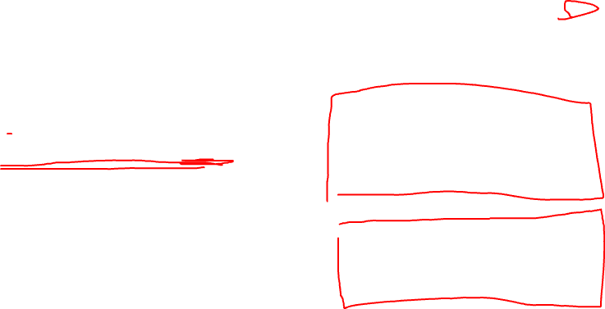
Repeating
with for-loops
We’ve replaced the 2 with i, the index variable of the outer loop.
for j in range(0):
print('*', end='')
print()
for i in range(3):
for j in range(i):
print('*', end='') print()
for j in range(1):
print('*', end='')
print()
for j in range(2):
print('*', end='')
print()
Each inner loop has a different range value.

Slide 45

Repeating
with for-loops
We’ve replaced the 2 with i, the index variable of the outer loop.
for j in range(0):
print('*', end='')
print()
for i in range(3):
for j in range(i):
print('*', end='') print()
*
**
for j in range(1):
print('*', end='')
print()
for j in range(2):
print('*', end='')
print()
Each inner loop has a different range value.

Slide 46
Example: Multiplication Table
As practice with for-loops, lets build a program that prints a multiplication table like this …
1 2 3 4 5 6 7 8 9 10
----------------------------------------
1 | 1 2 3 4 5 6 7 8 9 10
2 | 2 4 6 8 10 12 14 16 18 20
3 | 3 6 9 12 15 18 21 24 27 30
4 | 4 8 12 16 20 24 28 32 36 40
5 | 5 10 15 20 25 30 35 40 45 50
6 | 6 12 18 24 30 36 42 48 54 60
7 | 7 14 21 28 35 42 49 56 63 70
8 | 8 16 24 32 40 48 56 64 72 80
9 | 9 18 27 36 45 54 63 72 81 90
10 | 10 20 30 40 50 60 70 80 90 100

