Slide 1

Chapter 5 Booleans, if-statements, and recursion
CMPT 120-D2 Spring 2026

Slide 2
Chapter 5 Booleans, if-statements, and recursion
CMPT 120-D2 Spring 2026

Slide 3
The Remainder Operator
7 % 1 == ??
Python uses == to mean “equals”.

Slide 4
The Remainder Operator
7 % 1 == ??
N % A is how much is “left over” when A is divided into N.

Slide 5
The Remainder Operator
7 % 1 == ??
1 goes into 7 seven times, with 0 left over
N % A is how much is “left over” when A is divided into N.

Slide 6
The Remainder Operator
7 % 1 == 0
1 goes into 7 seven times, with 0 left over
N % A is how much is “left over” when A is divided into N.

Slide 7
The Remainder Operator
7 % 1 == 0
1 goes into 7 seven times, with 0 left over
7 % 2 == ??
N % A is how much is “left over” when A is divided into N.

Slide 8
The Remainder Operator
7 % 1 == 0
1 goes into 7 seven times, with 0 left over
7 % 2 == 1
2 goes into 7 three times, with 1 left over
N % A is how much is “left over” when A is divided into N.

Slide 9
The Remainder Operator
7 % 1 == 0
1 goes into 7 seven times, with 0 left over
7 % 2 == 1
2 goes into 7 three times, with 1 left over
7 % 3 == ??
N % A is how much is “left over” when A is divided into N.

Slide 10
The Remainder Operator
7 % 1 == 0
1 goes into 7 seven times, with 0 left over
7 % 2 == 1
2 goes into 7 three times, with 1 left over
7 % 3 == 1
3 goes into 7 two times, with 1 left over
N % A is how much is “left over” when A is divided into N.

Slide 11
The Remainder Operator
7 % 1 == 0
1 goes into 7 seven times, with 0 left over
7 % 2 == 1
2 goes into 7 three times, with 1 left over
7 % 3 == 1
3 goes into 7 two times, with 1 left over
N % A is how much is “left over” when A is divided into N.
7 % 4 == ??
7 % 5 == ??
7 % 6 == ??
7 % 7 == ??

Slide 12
The Remainder Operator
7 % 1 == 0
1 goes into 7 seven times, with 0 left over
7 % 2 == 1
2 goes into 7 three times, with 1 left over
7 % 3 == 1
3 goes into 7 two times, with 1 left over
N % A is how much is “left over” when A is divided into N.
7 % 4 == 3
7 % 5 == ??
7 % 6 == ??
7 % 7 == ??

Slide 13
The Remainder Operator
7 % 1 == 0
1 goes into 7 seven times, with 0 left over
7 % 2 == 1
2 goes into 7 three times, with 1 left over
7 % 3 == 1
3 goes into 7 two times, with 1 left over
N % A is how much is “left over” when A is divided into N.
7 % 4 == 3
7 % 5 == 2
7 % 6 == ??
7 % 7 == ??

Slide 14
The Remainder Operator
7 % 1 == 0
1 goes into 7 seven times, with 0 left over
7 % 2 == 1
2 goes into 7 three times, with 1 left over
7 % 3 == 1
3 goes into 7 two times, with 1 left over
N % A is how much is “left over” when A is divided into N.
7 % 4 == 3
7 % 5 == 2
7 % 6 == 1
7 % 7 == ??

Slide 15
The Remainder Operator
7 % 1 == 0
1 goes into 7 seven times, with 0 left over
7 % 2 == 1
2 goes into 7 three times, with 1 left over
7 % 3 == 1
3 goes into 7 two times, with 1 left over
N % A is how much is “left over” when A is divided into N.
7 % 4 == 3
7 % 5 == 2
7 % 6 == 1
7 % 7 == 0

Slide 16
The Remainder Operator
7 % 1 == 0
7 % 8 == ??
7 % 2 == 1
7 % 9 == ??
7 % 3 == 1
7 % 10 == ??
N % A is how much is “left over” when A is divided into N.
7 % 4 == 3
7 % 5 == 2
7 % 6 == 1
7 % 7 == 0

Slide 17
The Remainder Operator
7 % 1 == 0
7 % 8 == 7
7 % 2 == 1
7 % 9 == ??
7 % 3 == 1
7 % 10 == ??
N % A is how much is “left over” when A is divided into N.
7 % 4 == 3
7 % 5 == 2
7 % 6 == 1
7 % 7 == 0

Slide 18
The Remainder Operator
7 % 1 == 0
7 % 8 == 7
7 % 2 == 1
7 % 9 == 7
7 % 3 == 1
7 % 10 == ??
N % A is how much is “left over” when A is divided into N.
7 % 4 == 3
7 % 5 == 2
7 % 6 == 1
7 % 7 == 0

Slide 19
The Remainder Operator
7 % 1 == 0
7 % 8 == 7
7 % 2 == 1
7 % 9 == 7
7 % 3 == 1
7 % 10 == 7
N % A is how much is “left over” when A is divided into N.
7 % 4 == 3
7 % 5 == 2
7 % 6 == 1
7 % 7 == 0

Slide 20
The Remainder Operator
N % A is how much is “left over” when A is divided into N.
7 % 0 == ???

Slide 21
The Remainder Operator
N % A is how much is “left over” when A is divided into N.
7 % 0 == ZeroDivisionError

Slide 22
The Remainder Operator
N % A is how much is “left over” when A is divided into N.
In a crowd of 249 people:
How many groups of exactly 14 people can be made?
How many people are left-over?

Slide 23
The Remainder Operator
N % A is how much is “left over” when A is divided into N.
In a crowd of 249 people:
How many groups of exactly 14 people can be made?
>>> 249 // 14 17
How many people are left-over?

Slide 24
The Remainder Operator
N % A is how much is “left over” when A is divided into N.
In a crowd of 249 people:
How many groups of exactly 14 people can be made?
>>> 249 // 14 17
How many people are left-over?
>>> 249 % 14 11
14 * 17 + 11 = 249

Slide 25
The Remainder Operator
N % A is how much is “left over” when A is divided into N.
N % 2 == 0 means N is even, i.e. 0 left-over when dividing by 2
N % 2 == 1 means N is odd, i.e. 1 left-over when dividing by 2
N % 10 is the right-most digit of N e.g. 346 % 10 == 6

Slide 26
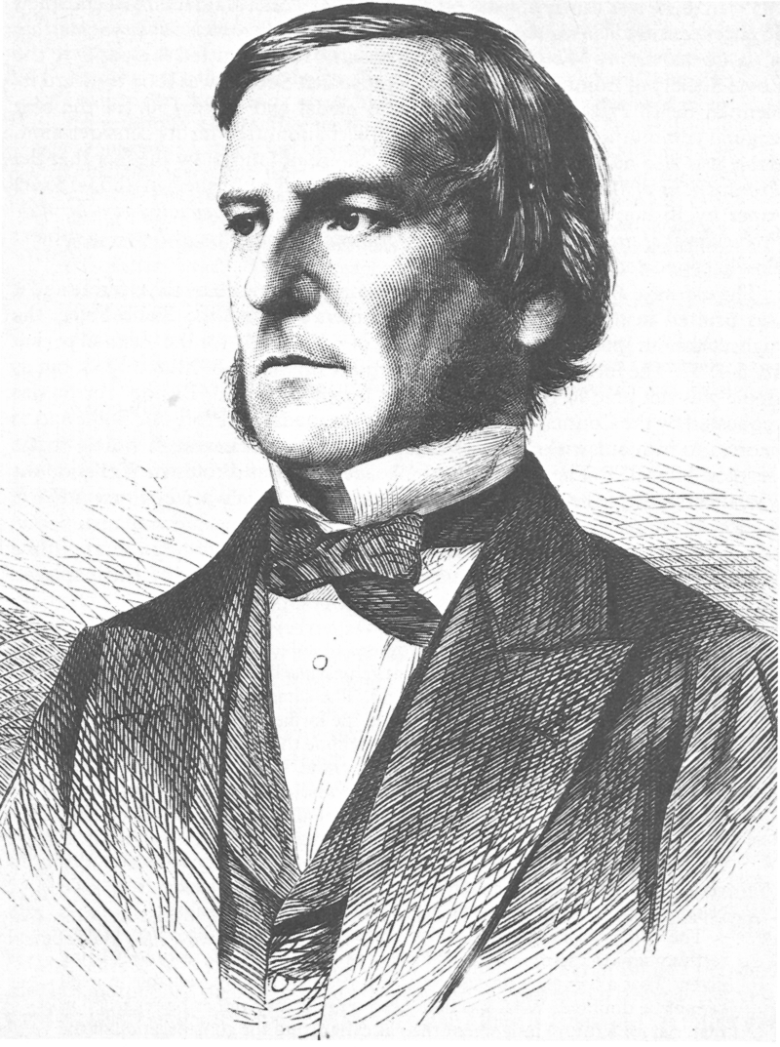
George Boole 1815 - 1864
British mathematician and philosopher
Formalized propositional logic into the form we use today

Slide 27
Boolean Expressions
A Boolean expression is any expression that evaluates to either True or False
>>> True True >>> False
False

Slide 28
Boolean Expressions
A Boolean expression is any expression that evaluates to either True or False
>>> True True >>> False
False
>>> is the Python interpreter prompt: after the >>> is what the user typed, and the next line is Python’s response.

Slide 29
Boolean Expressions
A Boolean expression is any expression that evaluates to either True or False
>>> 2 == 2 True >>> 5 == 4
False
Important: Python uses == to mean “equals”

Slide 30
Boolean Expressions
A Boolean expression is any expression that evaluates to either True or False
>>> 2 == 2 True >>> 5 == 4
False

Slide 31
Boolean Expressions
A Boolean expression is any expression that evaluates to either True or False
>>> 1 + 3 == 4 * (2 – 1) True >>> 1 + 3 == 3 - 1
False

Slide 32
Boolean Expressions
A Boolean expression is any expression that evaluates to either True or False
>>> 'up' == 'up' True >>> 'cat ' == 'cat'
False

Slide 33
Boolean Expressions
A Boolean expression is any expression that evaluates to either True or False
>>> 'cat' + 's' == 'cats' True >>> 3 * 'a' == 'a' + 'aaa'
False

Slide 34
Boolean Expressions
A Boolean expression is any expression that evaluates to either True or False
a = 2
b = 3
>>> a == b False >>> 2*a == b + 1
True

Slide 35
Boolean Expressions
A single = means an assignment statement: A copy of the value of b is put into variable a.
a = b
a == b
Double == means equality: are a and b the same value?

Slide 36
Boolean Expressions
!= is the not equal operator, and it returns the opposite of ==
>>> 2 == 2 True >>> 5 == 4
False
>>> 2 != 2 False >>> 5 != 4
True

Slide 37
Boolean Expressions
!= is the not equal operator, and it returns the opposite of ==
>>> 'up' == 'up' True >>> 'Cat' == 'cat'
False
>>> 'up' != 'up’ False >>> 'Cat' != 'cat’
True

Slide 38
Boolean Expressions
>>> 2 * 8 < 20
True
>>> 5 - 1 < 4
False
s < t is True just when
s is smaller than t (when they are numbers)
s is alphabetically before t (when they are strings)
Otherwise, s < t is False.
>>> 'cow' < 'shoe'
True
>>> 'bird' < 'bat'
False >>> 'on' < 'on'
False

Slide 39
Boolean Expressions
>>> 2 * 8 > 20
False
>>> 5 - 1 > 4
False
s > t is True just when
s is bigger than t (when they are numbers)
s is alphabetically after t (when they are strings)
Otherwise, s > t is False.
>>> 'cow' > 'shoe'
False
>>> 'bird' > 'bat'
True >>> 'on' > 'on'
False

Slide 40
Boolean Expressions
>>> 2 * 8 <= 20
True
>>> 5 - 1 <= 4
True
s <= t is True just when
s is less than, or equal to, t (when they are numbers)
s is alphabetically before, or equal to, t (when they are strings)
Otherwise, s <= t is False.
>>> 'cow' <= 'shoe'
True
>>> 'bird' <= 'bat'
False >>> 'on' <= 'on’
True

Slide 41
Boolean Expressions
>>> 2 * 8 >= 20
False
>>> 5 - 1 >= 4
True
s >= t is True just when
s is greater than, or equal to, t (when they are numbers)
s is alphabetically after, or equal to, t (when they are strings)
Otherwise, s >= t is False.
>>> 'cow' >= 'shoe'
False
>>> 'bird' >= 'bat'
True >>> 'on' >= 'on'
True

Slide 42
Boolean Expressions
>>> 5 < 6 < 7
True
>>> 5 < 7 < 6 False
>>> 'a' < 'm' < 'x' < 'y'
True
>>> 'shoe' <= 'lace' <= '!'
False
In Python, chaining inequalities together works like in math.
In many other programming languages, this does not work as you would expect!

Slide 43
Logical Operators
If A and B are Boolean expressions, then we can combine them in the following ways to make new Boolean expressions:
A and B A or B
not A

Slide 44
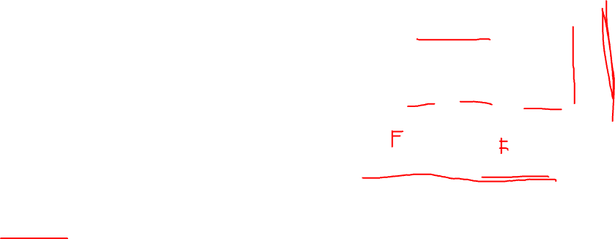
Logical Operators
This is a truth table for the and operator.
A | B | A and B
True | True | True
True | False | False
False | True | False
False | False | False
and
If A and B are Boolean expressions, then we can combine them in the following ways to make new Boolean expressions:
A and B A or B
not A
>>> False and (1 == 3)
False
>>> 1 < 3 and 'dog' > 'cat'
True

Slide 45
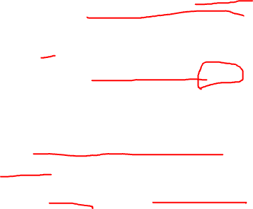
Logical Operators
This is a truth table for the or operator.
A | B | A or B
True | True | True
True | False | True
False | True | True
False | False | False
or
If A and B are Boolean expressions, then we can combine them in the following ways to make new Boolean expressions:
A and B A or B
not A
>>> False or (1 == 3)
False
>>> 1 < 3 or 'dog' > 'cat'
True

Slide 46
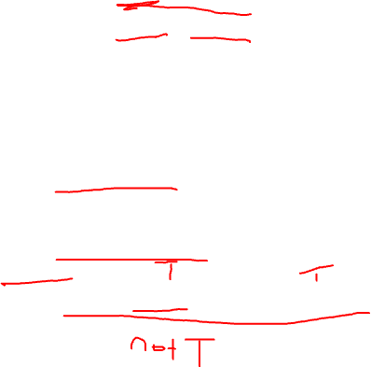
Logical Operators
This is a truth table for the not operator.
A | not A
True | False
False | True
not
If A and B are Boolean expressions, then we can combine them in the following ways to make new Boolean expressions:
A and B A or B
not A
>>> not False
True
>>> not (3 < 4)
False
>>> not (1 < 2 and 3 <= 4)
False

Slide 47
Logical Operators
A | B | A and B
True | True | True
True | False | False
False | True | False
False | False | False
Know your truth tables!
You need to either memorize them or be able to re-create them
and
If A and B are Boolean expressions, then we can combine them in the following ways to make new Boolean expressions:
A and B A or B
not A
A | B | A or B
True | True | True
True | False | True
False | True | True
False | False | False
or
A | not A
True | False
False | True
not

Slide 48
If-statements (conditionals)
An if-statement runs a block of code just when some Boolean expression is true.
x = 2
if x > 0:
print("x is positive")

Slide 49
If-statements (conditionals)
This is a simple if-statement consisting of a header and a body.
An if-statement runs a block of code just when some Boolean expression is true.
x = 2
if x > 0:
print("x is positive")

Slide 50
If-statements (conditionals)
The header:
Starts with if
Is followed by a Boolean expression
Ends with :
An if-statement runs a block of code just when some Boolean expression is true.
x = 2
if x > 0:
print("x is positive")

Slide 51
If-statements (conditionals)
The header:
Starts with if
Is followed by a Boolean expression
Ends with :
An if-statement runs a block of code just when some Boolean expression is true.
x = 2
if x > 0:
print("x is positive")

Slide 52
If-statements (conditionals)
The header:
Starts with if
Is followed by a Boolean expression
Ends with :
An if-statement runs a block of code just when some Boolean expression is true.
x = 2
if x > 0:
print("x is positive")

Slide 53
If-statements (conditionals)
The header:
Starts with if
Is followed by a Boolean expression
Ends with :
An if-statement runs a block of code just when some Boolean expression is true.
x = 2
if x > 0:
print("x is positive")

Slide 54
If-statements (conditionals)
An if-statement runs a block of code just when some Boolean expression is true.
x = 2
if x > 0:
print("x is positive")
The body of an if-statement must be consistently indented under the header.

Slide 55

If-statements (conditionals)
x = 8
if x % 2 == 0:
print("x is even")
else:
print("x is odd")
An if-else statement runs a block of code just when some Boolean expression is true, and a different block of code when the expression is false.

Slide 56
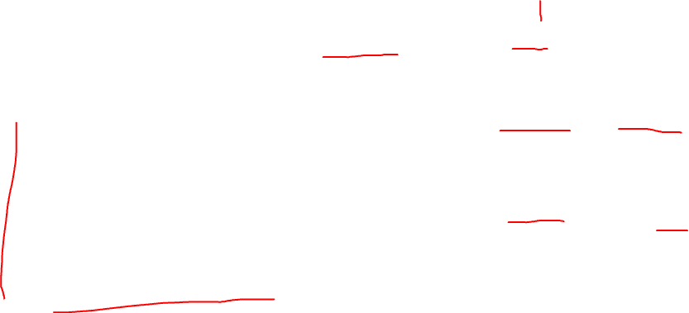
If-statements (conditionals)
x = 8
This if a flow chart. It visually shows the flow of an if-statement.
x % 2 == 0
True
x = 8
if x % 2 == 0:
print("x is even")
else:
print("x is odd")
False
print("x is odd")
print("x is even")
Notice that there are two different execution paths to get from the top to the bottom.

Slide 57
If-statements (conditionals)
The if-statement part is like the previous if-statement.
x = 8
if x % 2 == 0:
print("x is even")
else:
print("x is odd")
An if-else statement runs a block a block of code just when some Boolean expression is true, and a different block of code when the expression is false.

Slide 58

If-statements (conditionals)
x = 8
if x % 2 == 0:
print("x is even")
else:
print("x is odd")
An if-else statement runs a block a block of code just when some Boolean expression is true, and a different block of code when the expression is false.
The else-part has a different structure …

Slide 59
If-statements (conditionals)
x = 8
if x % 2 == 0:
print("x is even")
else:
print("x is odd")
An if-else statement runs a block a block of code just when some Boolean expression is true, and a different block of code when the expression is false.
It starts with else and ends with : and must be consistently indented with the if above it.

Slide 60

If-statements (conditionals)
x = 8
if x % 2 == 0:
print("x is even")
else:
print("x is odd")
An if-else statement runs a block a block of code just when some Boolean expression is true, and a different block of code when the expression is false.
The body of the else part must be consistently indented under the else: and should be the same indentation level as for the if body.

Slide 61
If-statements (conditionals)
x = 8
if x % 2 == 0:
print("x is even")
else:
print("x is odd")
An if-else statement runs a block a block of code just when some Boolean expression is true, and a different block of code when the expression is false.
If the condition x % 2 == 0 is True, then just this code is run (and the else code is skipped)

Slide 62
If-statements (conditionals)
x = 8
if x % 2 == 0:
print("x is even")
else:
print("x is odd")
An if-else statement runs a block a block of code just when some Boolean expression is true, and a different block of code when the expression is false.
If the condition x % 2 == 0 is False, then just this code is run (and the if code is skipped)

Slide 63
If-statements (conditionals)
Exactly one of the bodies is run. They never both run.
x = 8
if x % 2 == 0:
print("x is even")
else:
print("x is odd")
An if-else statement runs a block a block of code just when some Boolean expression is true, and a different block of code when the expression is false.

Slide 64
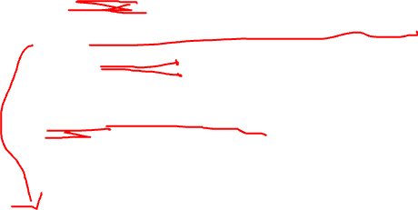
If-statements (conditionals)
x = 4
y = 5
if x < y:
print('x is less than y')
elif x > y:
print('x is greater than y')
else:
print('x and y are equal')
An if-elif-else statement is the most general kind of if-statement and can check multiple conditionals.

Slide 65
If-statements (conditionals)
x = 4
y = 5
if x < y:
print('x is less than y')
elif x > y:
print('x is greater than y')
else:
print('x and y are equal')
An if-elif-else statement is the most general kind of if-statement and can check multiple conditionals.

Slide 66
If-statements (conditionals)
x = 4
y = 5
if x < y:
print('x is less than y')
elif x > y:
print('x is greater than y')
else:
print('x and y are equal')
An if-elif-else statement is the most general kind of if-statement and can check multiple conditionals.
Notice it is spelled elif Not else if, not elseif, …

Slide 67
If-statements (conditionals)
x = 4
y = 5
if x < y:
print('x is less than y')
elif x > y:
print('x is greater than y')
else:
print('x and y are equal')
An if-elif-else statement is the most general kind of if-statement and can check multiple conditionals.
The conditions are always checked in the order they occur.

Slide 68
If-statements (conditionals)
x = 4
y = 5
if x < y:
print('x is less than y')
elif x > y:
print('x is greater than y')
else:
print('x and y are equal')
An if-elif-else statement is the most general kind of if-statement and can check multiple conditionals.
The else part is optional.

Slide 69

If-statements (conditionals)
x = 4
y = 5
if x < y:
print('x is less than y')
elif x > y:
print('x is greater than y')
An if-elif-else statement is the most general kind of if-statement and can check multiple conditionals.
The else part is optional.

Slide 70
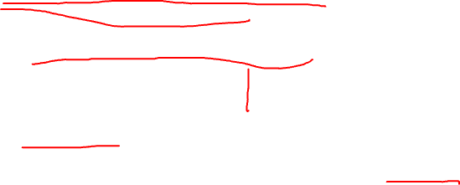
If-statements (conditionals)
Another example of an if-elif-else statement, showing more elaborate conditionals.
x = 1
y = 2
if x % 2 == 0 and y % 2 == 0:
print('x and y are both even')
elif x % 2 == 1 and y % 2 == 1:
print('x is odd') print('y is odd')
else:
print('x and y are different parity')
An if-elif-else statement is the most general kind of if-statement and can check multiple conditionals.

Slide 71
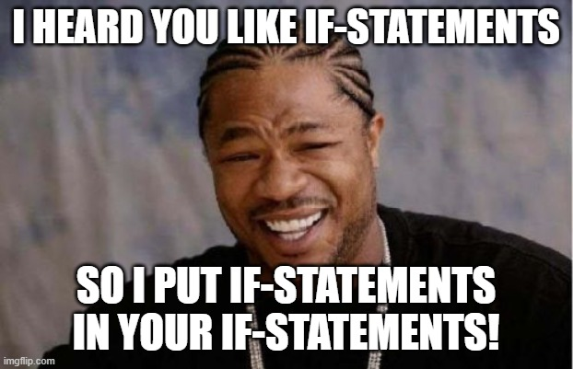
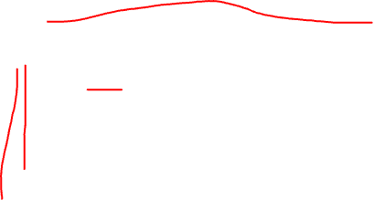
If-statements (conditionals)
x = 4
y = 5
if x == y:
print('x and y are equal')
else:
if x < y:
print('x is less than y')
else:
print('x is greater than y')
You can put if-statements inside if-statements. These are called nested conditionals.

Slide 72
If-statements (conditionals)
x = 4
y = 5
if x == y:
print('x and y are equal')
else:
if x < y:
print('x is less than y')
else:
print('x is greater than y')
x = 4
y = 5
if x == y:
print('x and y are equal')
elif x < y:
print('x is less than y')
else:
print('x is greater than y')
Same
In general, try to avoid nested conditionals.
Non-nested “flat” conditionals are often easier to read.

Slide 73
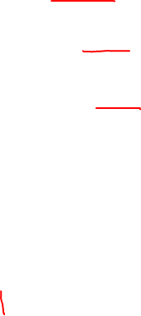
If-statements (conditionals)
if condition1:
The conditions are checked in the order they occur, from top to bottom.
Code block 1
elif condition2:
Code block 2
For the first condition that is true, the corresponding code block is executed.
elif condition3:
An if-elif-else statement is the most general kind of if-statement and can check multiple conditionals.
Code block 3
. .
.
After the code block finishes, the computer jumps out and runs the code that comes after the if-elif-else statement.
elif conditionN:
Code block N
else:
So, when there is an else, exactly one of the code blocks is executed.
The elif and else parts of an if-statement are optional. Whether you need them depends upon your program.
Code Block N+1

Slide 74
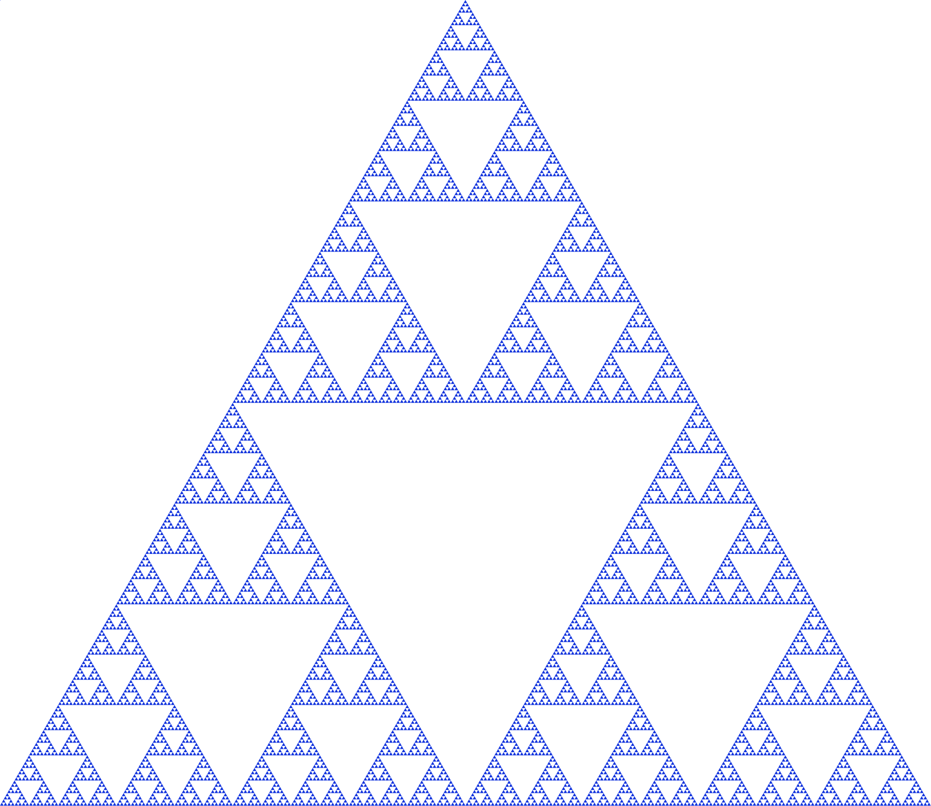
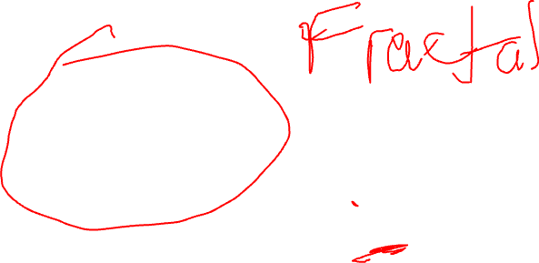
How would you describe this picture to someone over the phone?

Slide 75
What happens when you call mystery() ?
See mystery1.py
def mystery():
mystery()

Slide 76
What happens when you call mystery() ?
See mystery2.py
def mystery():
mystery() print('done')

Slide 77
What happens when you call mystery() ?
See mystery3.py
def mystery():
print('calling ...') mystery()

Slide 78
What happens when you call mystery() ?
See mystery4.py
n is a global variable, i.e. it is defined outside of a function.
n = 0
def mystery():
global n
print('calling ...')
n += 1
print(f'n = {n}') mystery()
Necessary to modify global variable n.

Slide 79
What happens when you call mystery(1) ?
See mystery5.py
def mystery(n):
print('calling ...')
mystery(n)

Slide 80
What happens when you call mystery(1) ?
See mystery6.py
def mystery(n):
print('calling ...')
mystery(n + 1)

Slide 81
What happens when you call mystery(1) ?
See mystery7.py
def mystery(n):
if n > 5:
return
else:
print('calling ...')
mystery(n + 1)

Slide 82
What happens when you call mystery(5) ?
See mystery8.py
def mystery(n):
if n < 1:
return
else:
print('calling ...')
mystery(n - 1)

Slide 83
What happens when you call count_down(5) ?
See mystery9.py
def count_down(n):
if n < 1:
return
else:
print(n)
count_down(n - 1)

Slide 84
How can you make count_up(n) print 1, 2, 3, …, n ?
See mystery10.py
def count_up(n):
def count_down(n):
if n < 1:
return
else:
print(n)
count_down(n - 1)

Slide 85
Recursive Functions
When a function is called in Python, it is put on the call stack. The first function called is at the bottom, the most recent function called is at the top.
We start out with an empty stack, since no functions have been called yet …
Call Stack (bottom)

Slide 86
Recursive Functions
def countdown(2):
if 2 <= 0:
print('Blastoff!')
else:
print(2)
countdown(2-1)
2 <= 0 is False, so we skip to the else part.
First countdown(2) is called. It’s at the bottom of the call stack. n=2 throughout the function.
Call Stack (bottom)

Slide 87
Recursive Functions
def countdown(2):
if 2 <= 0:
print('Blastoff!')
else:
print(2)
countdown(2-1)
2 <= 0 is False, so we skip to the else part.
First countdown(2) is called. It’s at the bottom of the call stack. n=2 throughout the function.
A 2 is printed right here.
Call Stack (bottom)

Slide 88
Recursive Functions
def countdown(2):
if 2 <= 0:
print('Blastoff!')
else:
print(2)
countdown(2-1)
2 <= 0 is False, so we skip to the else part.
First countdown(2) is called. It’s at the bottom of the call stack. n=2 throughout the function.
A 2 is printed right here.
Now countdown(1) is called.
Call Stack (bottom)

Slide 89
Recursive Functions
countdown(1) is called next. It is put on top of the call to countdown(2). countdown(2) has not finished yet, and it sits at the bottom of the stack waiting for countdown(1) to finish.
def countdown(1):
if 1 <= 0:
print('Blastoff!')
else:
print(1)
countdown(1-1)
def countdown(2):
if 2 <= 0:
print('Blastoff!')
else:
print(2)
countdown(2-1)
Call Stack (bottom)

Slide 90
Recursive Functions
def countdown(1):
if 1 <= 0:
print('Blastoff!')
else:
print(1)
countdown(1-1)
1 <= 0 is False, so we skip to the else part.
countdown(1) is called next. It is put on top of the call to countdown(2). countdown(2) has not finished yet, and it sits at the bottom of the stack waiting for countdown(1) to finish.
A 1 is printed right here.
Now countdown(0) is called.
def countdown(2):
if 2 <= 0:
print('Blastoff!')
else:
print(2)
countdown(2-1)
Call Stack (bottom)

Slide 91
Recursive Functions
def countdown(0):
if 0 <= 0:
print('Blastoff!')
else:
print(0)
countdown(0-1)
countdown(0) is called next. It is put on top of the call to countdown(1). countdown(1) and countdown(2) sit on the stack waiting for countdown(0) to finish.
def countdown(1):
if 1 <= 0:
print('Blastoff!')
else:
print(1)
countdown(1-1)
def countdown(2):
if 2 <= 0:
print('Blastoff!')
else:
print(2)
countdown(2-1)
Call Stack (bottom)

Slide 92
Recursive Functions
def countdown(0):
if 0 <= 0:
print('Blastoff!')
else:
print(0)
countdown(0-1)
0 <= 0 is True, so Blastoff! is printed.
The else part is skipped and does not run. So no more recursive calls.
countdown(0) is called next. It is put on top of the call to countdown(1). countdown(1) and countdown(2) sit on the stack waiting for countdown(0) to finish.
def countdown(1):
if 1 <= 0:
print('Blastoff!')
else:
print(1)
countdown(1-1)
def countdown(2):
if 2 <= 0:
print('Blastoff!')
else:
print(2)
countdown(2-1)
Call Stack (bottom)

Slide 93
Recursive Functions
def countdown(0):
if 0 <= 0:
print('Blastoff!')
else:
print(0)
countdown(0-1)
0 <= 0 is True, so Blastoff! is printed.
The else part is skipped and does not run. So no more recursive calls.
def countdown(1):
if 1 <= 0:
print('Blastoff!')
else:
print(1)
countdown(1-1)
The stack has now gotten as big as it is going to get for calling countdown(2). If we do too many function calls we can run out of stack memory, known as stack overflow.
def countdown(2):
if 2 <= 0:
print('Blastoff!')
else:
print(2)
countdown(2-1)
Call Stack (bottom)

Slide 94
Recursive Functions
def countdown(0):
if 0 <= 0:
print('Blastoff!')
else:
print(0)
countdown(0-1)
When a function ends, it is removed from the stack. This is called popping the stack.
def countdown(1):
if 1 <= 0:
print('Blastoff!')
else:
print(1)
countdown(1-1)
def countdown(2):
if 2 <= 0:
print('Blastoff!')
else:
print(2)
countdown(2-1)
Call Stack (bottom)

Slide 95
Recursive Functions
def countdown(1):
if 1 <= 0:
print('Blastoff!')
else:
print(1)
countdown(1-1)
Now we are back to countdown(1), at this point. So this function call is done and is popped off the stack.
def countdown(2):
if 2 <= 0:
print('Blastoff!')
else:
print(2)
countdown(2-1)
Call Stack (bottom)

Slide 96
Recursive Functions
def countdown(2):
if 2 <= 0:
print('Blastoff!')
else:
print(2)
countdown(2-1)
Now we are back to countdown(0), at this point. So this function call is done and is popped off the stack.
Call Stack (bottom)

Slide 97
Recursive Functions
def countdown(2):
if 2 <= 0:
print('Blastoff!')
else:
print(2)
countdown(2-1)
Now we are back to countdown(0), at this point. So this function call is done and is popped off the stack.
Call Stack (bottom)

Slide 98
Recursive Functions
Now the call stack is empty, meaning all the functions have finished. We’re done!
Call Stack (bottom)

Slide 99
Problem 1
Write a program that asks the user for the wind speed, and prints its category (or that it's not a hurricane) and if it's major.
The Saffir-Simpson hurricane scale ranks the severity of hurricanes based on their wind speed. The scale ranges from 1 to 5 (most severe):
Category 1 hurricane: wind speed 119 to less than 154 km/h
Category 2 hurricane: wind speed 154 to less than 178 km/h
Category 3 hurricane: wind speed 178 to less than 209 km/h
Category 4 hurricane: wind speed 209 to less than 252 km/h
Category 5 hurricane: wind speed 252 km/h or more
A wind speed of less than 119 km/h is not considered to be a hurricane. Category 3 and higher are “major” hurricanes.
Wind speed in km/h? 201.5
A hurricane with wind speed 201.5 km/h is a Category 3 hurricane.
It is a major hurricane.
Wind speed in km/h? 75
A wind speed of 75 km/h is not a hurricane.
Wind speed in km/h? 145
A hurricane with wind speed 145 km/h is a Category 1 hurricane.
It is not a major hurricane.

Slide 100
Problem 2
Write a program that prints all the numbers from 1 to 100 that are multiples of both 3 and 5, but not multiples of 2.

Slide 101
Problem 3
Write a program that prints all the numbers from 100 to 999 that are evenly divisible by the sum of its digits.
For example, 540 is printed because the sum of its digits is 5 + 4 + 0 = 9, and 540 is a multiple of 9.
Hint: There are 180 numbers in total: 100, 102, 108, …, 990, 999.

