Slide 1
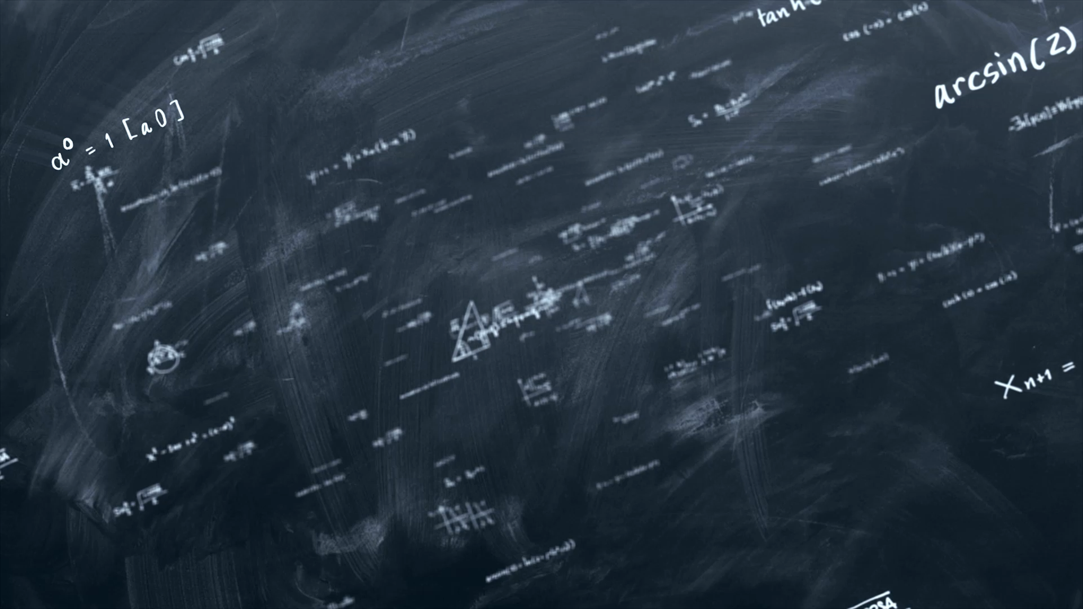
Chapter 6: Functions with return values
CMTP 120, Spring 2026

Slide 2
Functions that Return Values
In math, we define functions like this …
f(x) = 2x + 1

Slide 3
Functions that Return Values
In math, we define functions like this …
f(x) = 2x + 1
When we pass a number to f(x), we can evaluate it to get a new number.
f(1) = 2*1 + 1 = 3
f(2) = 2*2 + 1 = 5
We’ll say that f(x) returns a value.
f(3) = 2*3 + 1 = 7

Slide 4
Functions that Return Values
In Python we would define the function like this …
f(x) = 2x + 1
def f(x): return 2 * x + 1
return causes the function to stop, and we say f(x) returns the value of the expression

Slide 5
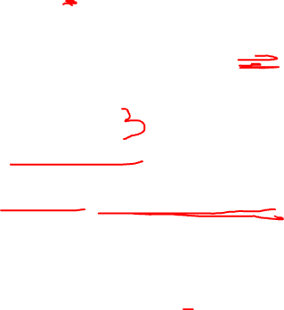
Functions that Return Values
return causes the function to stop, and f(x) is said to return the value of the expression
In Python we would define the function like this …
def f(x): return 2 * x + 1
a = f(1)
b = 2 + f(2 + 1) print(a) # ? print(b) # ?
f(x) = 2x + 1
What gets printed?

Slide 6
Functions that Return Values
return causes the function to stop, and f(x) is said to return the value of the expression
In Python we would define the function like this …
def f(x): return 2 * x + 1
a = f(1)
b = 2 + f(2 + 1) print(a) # 3 print(b) # 9
f(x) = 2x + 1
What gets printed?

Slide 7
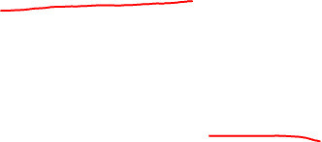
Functions that Return Values
import math
def circle_area(radius):
area = math.pi * radius**2
return area

Slide 8
Functions that Return Values
import math
def circle_area(radius):
area = math.pi * radius**2
return area
A function meant to return a value should end with a call to a return statement.

Slide 9

Functions that Return Values
import math
def circle_area(radius):
area = math.pi * radius**2
return area
print('done!')
Any statements after return are not executed.
This is dead code: it can never run.
Always delete dead code!

Slide 10
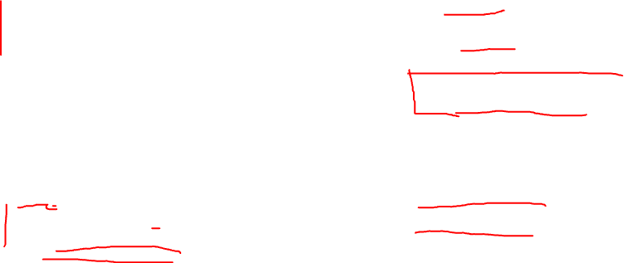
Functions that Return Values
Some more examples of functions with dead code.
def dead_code_ex1():
return 1
return 2 # dead code
return 3 # dead code
def dead_code_ex3():
if x <= 0:
print('up')
elif x >= 0:
print('down')
else:
print('around') # dead code
def dead_code_ex2():
n = 0
for i in range(n):
print('Hello!') # dead code
def dead_code_ex4():
dead_code_ex4()
print('done!') # dead code

Slide 11
Functions that Don’t Return Values
This is an example of a function that does not return a value. It ends without explicitly calling return.
def greet(name):
print(f'Hello {name}!')
greet('Elon') # Hello Elon!

Slide 12
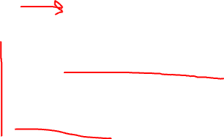
Functions that Don’t Return Values
def greet(name):
print(f'Hello {name}!')
What happens when you run this code?
x = greet('Elon')
print(x)

Slide 13
Functions that Don’t Return Values
def greet(name):
print(f'Hello {name}!')
x = greet('Elon') # Hello Elon!
print(x)

Slide 14
Functions that Don’t Return Values
def greet(name):
print(f'Hello {name}!')
x = greet('Elon') # Hello Elon!
print(x) # None

Slide 15
Functions that Don’t Return Values
def greet(name):
print(f'Hello {name}!')
A function that does not explicitly return a value returns the special value None, which indicates no value was intentionally returned.
x = greet('Elon') # Hello Elon!
print(x) # None

Slide 16

Functions that Don’t Return Values
def greet(name):
print(f'Hello {name}!')
x = greet('Elon') # Hello Elon!
print(x) # None
None appearing in your programs is a warning sign. It’s almost always a sign of a mistake in your program.

Slide 17
Functions that Don’t Return Values
def greet(name):
print(f'Hello {name}!')
While this statement does run, it does not make sense to assign a non-returning function to a variable.
x = greet('Elon') # Hello Elon!
print(x) # None
None appearing in your programs is a warning sign. It’s almost always a sign of a mistake in your program.

Slide 18
Functions with conditionals
Let’s a function called my_abs(x) that returns the absolute value of x. Don’t use the built-in abs function.
my_abs(-4) returns 4 my_abs(5) returns 5
my_abs(0) returns 0

Slide 19
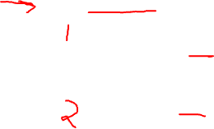
Functions with conditionals
def my_abs(x):
if x < 0: return –x else: return x
This function has two returns, and two execution paths. Exactly one of the returns is guaranteed to be called, no matter the value of x.

Slide 20
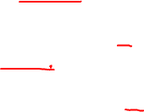
Functions with conditionals
def bad_abs(x):
if x < 0: return –x if x > 0: return x
What’s the bug in this function?

Slide 21
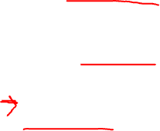
Functions with conditionals
def bad_abs(x):
if x < 0: return –x if x > 0: return x
# oops: x == 0 here!
What’s the bug in this function?
The problem is that if x is 0, then neither return statement is run. If x is 0, the program “falls off” the end of the function without a return.

Slide 22
Functions with conditionals
def bad_abs(x):
if x < 0: return –x if x > 0: return x
# oops: x == 0 here!
What’s the bug in this function?
There are three execution paths through this function:
one ending with return –x
one ending with return x
one ending with nothing
The problem is that if x is 0, then neither return statement is run. If x is 0, the program “falls off” the end of the function without a return.

Slide 23
Functions with conditionals
def bad_abs(x):
if x < 0: return –x if x > 0: return x
# oops: x == 0 gets here!
What’s the bug in this function?
There are three execution paths through this function:
one ending with return –x
one ending with return x
one ending with nothing
The problem is that if x is 0, then neither return statement is run. If x is 0, the program “falls off” the end of the function without a return.
When x is 0 the function ends without a return, so None is returned. This is a bad mistake!

Slide 24
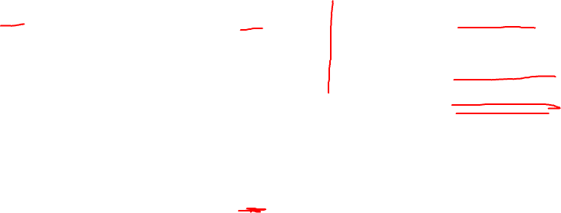
Functions with conditionals
Different ways to write the abs function.
def bad_abs(x):
if x < 0: return –x if x > 0: return x
def fixed1_abs(x):
if x <= 0: return –x if x > 0: return x
def fixed3_abs(x):
if x < 0: return –x if x > 0: return x if x == 0: return 0
def fixed2_abs(x):
if x < 0: return –x if x >= 0: return x

Slide 25
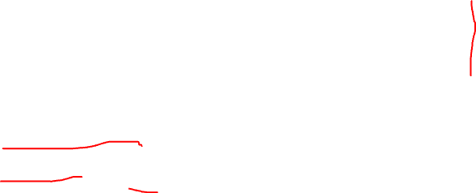
Boolean functions
Boolean Function A function that returns only either True or False. It can have any number of inputs.
def is_positive(x):
if x > 0:
return True
else:
return False
A shorter way to write this function …

Slide 26
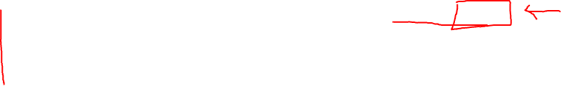
Boolean functions
Boolean Function A function that returns only either True or False. It can have any number of inputs.
def is_positive(x):
if x > 0:
return True
else:
return False
def is_positive(x):
return x > 0
A shorter way to write this function …

Slide 27
Boolean functions
Boolean Function A function that returns only either True or False. It can have any number of inputs.
def is_positive(x):
if x > 0:
return True
else:
return False
def is_positive(x):
return x > 0
A shorter way to write this function …
This is a boolean expression: it evaluates to either True or False.
Most programmers prefer this style when they get used to it.

Slide 28
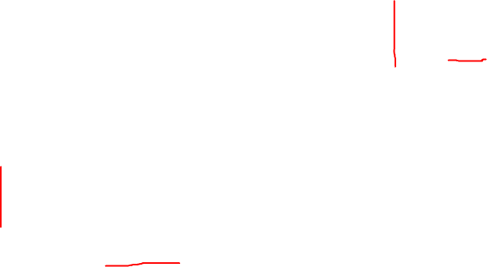
Boolean functions
Challenge Write a boolean function called is_prime(n) that returns True if the int n is a prime, and False otherwise.
def is_prime(n):
pass
pass is an actual Python statement that does nothing.
A prime number is an integer greater than one that is evenly divisible by only 1 and itself.
Some primes: 2, 3, 5, 7, 11, …, 101, …
Some not primes: -5, 0, 1, 4, 6, 9, 10, 14, 15, …

Slide 29
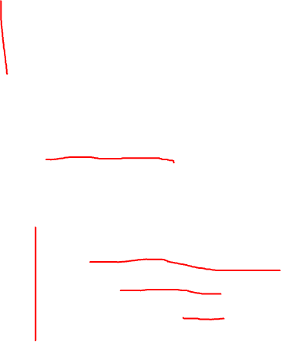
Boolean functions
See lecture notes for an implementation of is_prime.
def is_prime(n):
pass
Challenge Write a boolean function called is_prime(n) that returns True if the int n is a prime, and False otherwise.
We can use is_prime to count how many primes are <= some number n.
def num_primes(n):
"""Returns the number of primes less than, or equal to, n.
"""
count = 0
for i in range(2, n + 1):
if is_prime(i):
count += 1
return count
A prime number is an integer greater than one that is evenly divisible by only 1 and itself.
primes: 2, 3, 5, 7, 11, …, 101, … not primes: -5, 0, 1, 4, 6, 9, 10, 14, 15, …

Slide 30
Recursive Functions
What is the sum of the numbers from 1 to n?
1+ 2 + 3 + … + (n-1) + n

Slide 31
Recursive Functions
What is the sum of the numbers from 1 to n?
S(n) = 1 + 2 + 3 + … + (n-1) + n

Slide 32
Recursive Functions
What is the sum of the numbers from 1 to n?
S(n) = 1 + 2 + 3 + … + (n-1) + n
S(n) = n + (n-2) + (n-3) + … + 2 + 1

Slide 33
Recursive Functions
What is the sum of the numbers from 1 to n?
S(n) = 1 + 2 + 3 + … + (n-1) + n
S(n) = n + (n-2) + (n-3) + … + 2 + 1

Slide 34
Recursive Functions
What is the sum of the numbers from 1 to n?
S(n) = 1 + 2 + 3 + … + (n-1) + n
+
S(n) = n + (n-2) + (n-3) + … + 2 + 1
2*S(n) = (n+1) + (n+1) + (n+1) + ... + (n+1) + (n+1)

Slide 35
Recursive Functions
What is the sum of the numbers from 1 to n?
S(n) = 1 + 2 + 3 + … + (n-1) + n
+
S(n) = n + (n-2) + (n-3) + … + 2 + 1
2*S(n) = (n+1) + (n+1) + (n+1) + ... + (n+1) + (n+1)
The term (n+1) occurs n times, so it all sums to n(n+1)

Slide 36
Recursive Functions
What is the sum of the numbers from 1 to n?
S(n) = 1 + 2 + 3 + … + (n-1) + n
+
S(n) = n + (n-2) + (n-3) + … + 2 + 1
2*S(n) = (n+1) + (n+1) + (n+1) + ... + (n+1) + (n+1)
2*S(n) = n*(n+1)
The term (n+1) occurs n times, so it all sums to n(n+1)

Slide 37
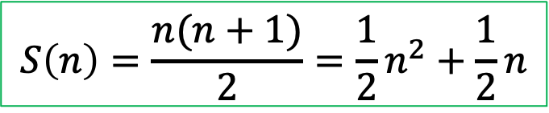
Recursive Functions
What is the sum of the numbers from 1 to n?
S(n) = 1 + 2 + 3 + … + (n-1) + n
+
S(n) = n + (n-2) + (n-3) + … + 2 + 1
2*S(n) = (n+1) + (n+1) + (n+1) + ... + (n+1) + (n+1)
2*S(n) = n*(n+1)
The term (n+1) occurs n times, so it all sums to n(n+1)
S(n) = n*(n+1) / 2
$$S\left(n\right)=\frac{n(n+1)}{2}=\frac{1}{2}n^{2}+\frac{1}{2}n$$

Slide 38
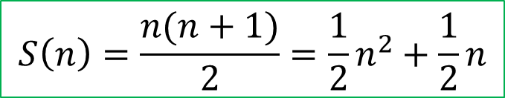
Recursive Functions
What is the sum of the numbers from 1 to n?
1+ 2 + 3 + … + (n-1) + n
def S(n):
return n * (n + 1) // 2
$$S\left(n\right)=\frac{n(n+1)}{2}=\frac{1}{2}n^{2}+\frac{1}{2}n$$
This is fast and simple: the best way to implement S(n).
Only three operations are needed, no matter the size of n.

Slide 39
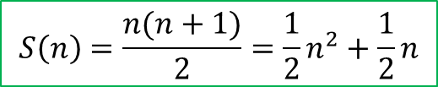

Recursive Functions
What is the sum of the numbers from 1 to n?
1+ 2 + 3 + … + (n-1) + n
$$S\left(n\right)=\frac{n(n+1)}{2}=\frac{1}{2}n^{2}+\frac{1}{2}n$$
def S(n):
return n * (n + 1) // 2
def S(n):
total = 0 for i in range(n + 1): total += i return total
Another way of calculating the sum is to use a loop …

Slide 40
Recursive Functions
What is the sum of the numbers from 1 to n?
1+ 2 + 3 + … + (n-1) + n
$$S\left(n\right)=\frac{n(n+1)}{2}=\frac{1}{2}n^{2}+\frac{1}{2}n$$
def S(n):
return n * (n + 1) // 2
def S(n):
total = 0 for i in range(n + 1): total += i return total
+= is called n times … so the amount of work this function does is proportional to n
Another way of calculating the sum is to use a loop …
So this is much more work than the 3 operations done by the other function.

Slide 41
Recursive Functions
What is the sum of the numbers from 1 to n?
1+ 2 + 3 + … + (n-1) + n
$$S\left(n\right)=\frac{n(n+1)}{2}=\frac{1}{2}n^{2}+\frac{1}{2}n$$
def S(n):
return n * (n + 1) // 2
Another way of calculating the sum is to use a recurrence relation …
$$S\left(n\right)=1+2+3+…+\left(n−1\right)+n$$

Slide 42
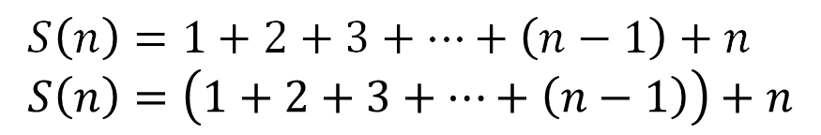
Recursive Functions
What is the sum of the numbers from 1 to n?
1+ 2 + 3 + … + (n-1) + n
$$S\left(n\right)=\frac{n(n+1)}{2}=\frac{1}{2}n^{2}+\frac{1}{2}n$$
def S(n):
return n * (n + 1) // 2
Another way of calculating the sum is to use a recurrence relation …
$$S\left(n\right)=1+2+3+…+\left(n−1\right)+n \\ S\left(n\right)=\left(1+2+3+…+\left(n−1\right)\right)+n$$

Slide 43
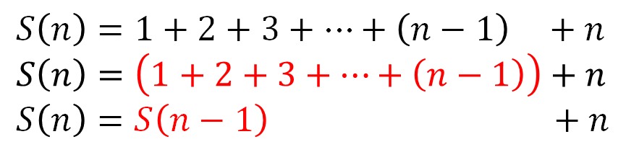
Recursive Functions
What is the sum of the numbers from 1 to n?
1+ 2 + 3 + … + (n-1) + n
$$S\left(n\right)=\frac{n(n+1)}{2}=\frac{1}{2}n^{2}+\frac{1}{2}n$$
def S(n):
return n * (n + 1) // 2
Another way of calculating the sum is to use a recurrence relation …
$$S\left(n\right)=1+2+3+…+\left(n−1\right) +n \\ S\left(n\right)=\left(1+2+3+…+\left(n−1\right)\right)+n \\ S\left(n\right)=S\left(n−1\right) +n$$

Slide 44
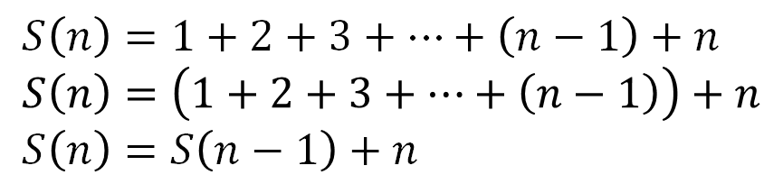
Recursive Functions
What is the sum of the numbers from 1 to n?
1+ 2 + 3 + … + (n-1) + n
$$S\left(n\right)=\frac{n(n+1)}{2}=\frac{1}{2}n^{2}+\frac{1}{2}n$$
def S(n):
return n * (n + 1) // 2
Another way of calculating the sum is to use a recurrence relation …
$$S\left(n\right)=1+2+3+…+\left(n−1\right)+n \\ S\left(n\right)=\left(1+2+3+…+\left(n−1\right)\right)+n \\ S\left(n\right)=S\left(n−1\right)+n$$
S(1) = S(0) + 1 S(0) = S(-1) + 0 S(-1) = S(-2) + -1 …
Problem! This keeps going forever …

Slide 45
Recursive Functions
What is the sum of the numbers from 1 to n?
1+ 2 + 3 + … + (n-1) + n
$$S\left(n\right)=\frac{n(n+1)}{2}=\frac{1}{2}n^{2}+\frac{1}{2}n$$
def S(n):
return n * (n + 1) // 2
Another way of calculating the sum is to use a recurrence relation …
$$S\left(n\right)=1+2+3+…+\left(n−1\right)+n \\ S\left(n\right)=\left(1+2+3+…+\left(n−1\right)\right)+n \\ S\left(n\right)=S\left(n−1\right)+n$$
S(1) = S(0) + 1 S(0) = S(-1) + 0 S(-1) = S(-2) + -1 …
We stop the recursion with by setting S(0) = 0
Problem! This keeps going forever …

Slide 46
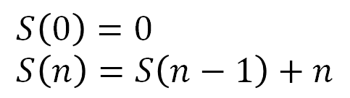

Recursive Functions
What is the sum of the numbers from 1 to n?
1+ 2 + 3 + … + (n-1) + n
$$S\left(n\right)=\frac{n(n+1)}{2}=\frac{1}{2}n^{2}+\frac{1}{2}n$$
def S(n):
return n * (n + 1) // 2
Base case: no recursion
Remember All useful recursive functions need at least one base case and at least one recursive case.
Another way of calculating the sum is to use a recurrence relation …
$$S\left(0\right)=0 \\ S\left(n\right)=S\left(n−1\right)+n$$
Recursive case: S calls itself

Slide 47
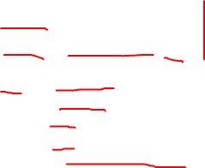
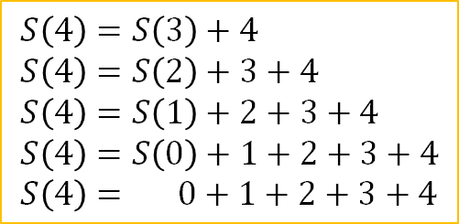
Recursive Functions
What is the sum of the numbers from 1 to n?
1+ 2 + 3 + … + (n-1) + n
$$S\left(n\right)=\frac{n(n+1)}{2}=\frac{1}{2}n^{2}+\frac{1}{2}n$$
def S(n):
return n * (n + 1) // 2
Another way of calculating the sum is to use a recurrence relation …
$$S\left(0\right)=0 \\ S\left(n\right)=S\left(n−1\right)+n$$
$$S\left(4\right)=S\left(3\right)+4 \\ S\left(4\right)=S\left(2\right)+3+4 \\ S\left(4\right)=S\left(1\right)+2+3+4 \\ S\left(4\right)=S\left(0\right)+1+2+3+4 \\ S\left(4\right)= 0+1+2+3+4$$

Slide 48
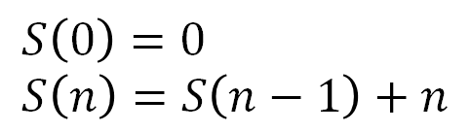

Recursive Functions
What is the sum of the numbers from 1 to n?
1+ 2 + 3 + … + (n-1) + n
$$S\left(n\right)=\frac{n(n+1)}{2}=\frac{1}{2}n^{2}+\frac{1}{2}n$$
def S(n):
return n * (n + 1) // 2
def S(n):
if n == 0: return 0 else: return S(n-1) + n
Another way of calculating the sum is to use a recurrence relation …
$$S\left(0\right)=0 \\ S\left(n\right)=S\left(n−1\right)+n$$
$$S\left(4\right)=S\left(3\right)+4 \\ S\left(4\right)=S\left(2\right)+3+4 \\ S\left(4\right)=S\left(1\right)+2+3+4 \\ S\left(4\right)=S\left(0\right)+1+2+3+4 \\ S\left(4\right)= 0+1+2+3+4$$

Slide 49
Recursive Functions
Stack trace of calling S(4)
Remember: Every time a function is called a copy of it is pushed on top of the call stack.
Before calling S(4) the call stack is empty.
Bottom of the Call Stack

Slide 50

Recursive Functions
Stack trace of calling S(4)
Remember: Every time a function is called a copy of it is pushed on top of the call stack.
S(4) called, so it’s pushed on top of the stack.
def S(4):
if 4 == 0: return 0 else: return S(4-1) + 4
Bottom of the Call Stack

Slide 51
Recursive Functions
Stack trace of calling S(4)
Remember: Every time a function is called a copy of it is pushed on top of the call stack.
S(3) is called here, so the call to S(3) is pushed on top of the stack
def S(4):
if 4 == 0: return 0 else: return S(4-1) + 4
Bottom of the Call Stack

Slide 52

Recursive Functions
Stack trace of calling S(4)
Remember: Every time a function is called a copy of it is pushed on top of the call stack.
Now the call to S(3) is on the top of the stack.
def S(3):
if 3 == 0: return 0 else: return S(3-1) + n
def S(4):
if 4 == 0: return 0 else: return S(4-1) + 4
The call to S(4) has not finished yet … it sits waiting for S(3) to finish.
Bottom of the Call Stack

Slide 53
Recursive Functions
Stack trace of calling S(4)
Remember: Every time a function is called a copy of it is pushed on top of the call stack.
Next S(2) is called here, and the call to S(2) is pushed on top of the stack.
def S(3):
if 3 == 0: return 0 else: return S(3-1) + 3
def S(4):
if 4 == 0: return 0 else: return S(4-1) + 4
Bottom of the Call Stack

Slide 54
Recursive Functions
Stack trace of calling S(4)
Remember: Every time a function is called a copy of it is pushed on top of the call stack.
def S(2):
if 2 == 0: return 0 else: return S(2-1) + 2
def S(3):
if 3 == 0: return 0 else: return S(3-1) + 3
The calls to S(3) and S(4) are not finished … they are waiting for results! To they sit here on the stack.
def S(4):
if 4 == 0: return 0 else: return S(4-1) + 4
Bottom of the Call Stack

Slide 55
Recursive Functions
Stack trace of calling S(4)
Now S(1) is called here, and so the call to S(1) is push on top of the stack.
Remember: Every time a function is called a copy of it is pushed on top of the call stack.
def S(2):
if 2 == 0: return 0 else: return S(2-1) + 2
def S(3):
if 3 == 0: return 0 else: return S(3-1) + 3
def S(4):
if 4 == 0: return 0 else: return S(4-1) + 4
Bottom of the Call Stack

Slide 56
Recursive Functions
Now S(0) is called here, and so the call to S(0) is push on top of the stack.
def S(1):
if 1 == 0: return 0 else: return S(1-1) + 1
Stack trace of calling S(4)
Remember: Every time a function is called a copy of it is pushed on top of the call stack.
def S(2):
if 2 == 0: return 0 else: return S(2-1) + 2
def S(3):
if 3 == 0: return 0 else: return S(3-1) + 3
def S(4):
if 4 == 0: return 0 else: return S(4-1) + 4
Bottom of the Call Stack

Slide 57

Recursive Functions
When S(0) is called, the non-recursive base case is called.
def S(0):
if 0 == 0: return 0 else: return S(0-1) + 0
def S(1):
if 1 == 0: return 0 else: return S(1-1) + 1
Stack trace of calling S(4)
Remember: Every time a function is called a copy of it is pushed on top of the call stack.
def S(2):
if 2 == 0: return 0 else: return S(2-1) + 2
def S(3):
if 3 == 0: return 0 else: return S(3-1) + 3
def S(4):
if 4 == 0: return 0 else: return S(4-1) + 4
Bottom of the Call Stack

Slide 58
Recursive Functions
def S(0):
if 0 == 0: return 0 else: return S(0-1) + 0
def S(1):
if 1 == 0: return 0 else: return S(1-1) + 1
Stack trace of calling S(4)
Notice that at the point just before S(0) returns 0, 5 calls to S(n) are on the stack. This takes up a lot of memory and is a major reason why recursion is unpopular in practice.
Remember: Every time a function is called a copy of it is pushed on top of the call stack.
def S(2):
if 2 == 0: return 0 else: return S(2-1) + 2
def S(3):
if 3 == 0: return 0 else: return S(3-1) + 3
def S(4):
if 4 == 0: return 0 else: return S(4-1) + 4
Bottom of the Call Stack

Slide 59
Recursive Functions
def S(0):
if 0 == 0: return 0 else: return S(0-1) + 0
Now the S(0) returns 0, and it is popped off the top of the stack, leaving 0 as the return value.
def S(1):
if 1 == 0: return 0 else: return S(1-1) + 1
Stack trace of calling S(4)
Remember: Every time a function is called a copy of it is pushed on top of the call stack.
def S(2):
if 2 == 0: return 0 else: return S(2-1) + 2
def S(3):
if 3 == 0: return 0 else: return S(3-1) + 3
def S(4):
if 4 == 0: return 0 else: return S(4-1) + 4
Bottom of the Call Stack

Slide 60
Recursive Functions
0
The result of the call to S(0) here is now known: it’s 0. So we replace it with 0.
def S(1):
if 1 == 0: return 0 else: return S(1-1) + 1
Stack trace of calling S(4)
Remember: Every time a function is called a copy of it is pushed on top of the call stack.
def S(2):
if 2 == 0: return 0 else: return S(2-1) + 2
def S(3):
if 3 == 0: return 0 else: return S(3-1) + 3
def S(4):
if 4 == 0: return 0 else: return S(4-1) + 4
Bottom of the Call Stack

Slide 61
Recursive Functions
def S(1):
if 1 == 0: return 0 else: return 0 + 1
Stack trace of calling S(4)
This evaluates to 1.
Remember: Every time a function is called a copy of it is pushed on top of the call stack.
def S(2):
if 2 == 0: return 0 else: return S(2-1) + 2
def S(3):
if 3 == 0: return 0 else: return S(3-1) + 3
def S(4):
if 4 == 0: return 0 else: return S(4-1) + 4
Bottom of the Call Stack

Slide 62
Recursive Functions
def S(1):
if 1 == 0: return 0 else: return 1
Stack trace of calling S(4)
This evaluates to 1.
Remember: Every time a function is called a copy of it is pushed on top of the call stack.
def S(2):
if 2 == 0: return 0 else: return S(2-1) + 2
def S(3):
if 3 == 0: return 0 else: return S(3-1) + 3
def S(4):
if 4 == 0: return 0 else: return S(4-1) + 4
Bottom of the Call Stack

Slide 63
Recursive Functions
def S(1):
if 1 == 0: return 0 else: return 1
The call to S(1) is done, and so it is popped from the stack and 1 is left in its place.
Stack trace of calling S(4)
Remember: Every time a function is called a copy of it is pushed on top of the call stack.
def S(2):
if 2 == 0: return 0 else: return S(2-1) + 2
def S(3):
if 3 == 0: return 0 else: return S(3-1) + 3
def S(4):
if 4 == 0: return 0 else: return S(4-1) + 4
Bottom of the Call Stack

Slide 64
Recursive Functions
Stack trace of calling S(4)
1
Remember: Every time a function is called a copy of it is pushed on top of the call stack.
def S(2):
if 2 == 0: return 0 else: return S(2-1) + 2
The call to S(1) inside of S(2) is now replaced by 1.
def S(3):
if 3 == 0: return 0 else: return S(3-1) + 3
def S(4):
if 4 == 0: return 0 else: return S(4-1) + 4
Bottom of the Call Stack

Slide 65
Recursive Functions
Stack trace of calling S(4)
Remember: Every time a function is called a copy of it is pushed on top of the call stack.
def S(2):
if 2 == 0: return 0 else: return 1 + 2
The call to S(1) inside of S(2) is now replaced by 1.
def S(3):
if 3 == 0: return 0 else: return S(3-1) + 3
def S(4):
if 4 == 0: return 0 else: return S(4-1) + 4
Bottom of the Call Stack

Slide 66
Recursive Functions
Stack trace of calling S(4)
Remember: Every time a function is called a copy of it is pushed on top of the call stack.
def S(2):
if 2 == 0: return 0 else: return 3
The expression evaluates to 3.
def S(3):
if 3 == 0: return 0 else: return S(3-1) + 3
def S(4):
if 4 == 0: return 0 else: return S(4-1) + 4
Bottom of the Call Stack

Slide 67
Recursive Functions
Stack trace of calling S(4)
Remember: Every time a function is called a copy of it is pushed on top of the call stack.
def S(2):
if 2 == 0: return 0 else: return 3
Now the call to S(2) is done. It is popped off the top of the stack and replaced by its return value 3.
def S(3):
if 3 == 0: return 0 else: return S(3-1) + 3
def S(4):
if 4 == 0: return 0 else: return S(4-1) + 4
Bottom of the Call Stack

Slide 68
Recursive Functions
Stack trace of calling S(4)
Remember: Every time a function is called a copy of it is pushed on top of the call stack.
3
def S(3):
if 3 == 0: return 0 else: return S(3-1) + 3
S(2) gets replace by its value 3.
def S(4):
if 4 == 0: return 0 else: return S(4-1) + 4
Bottom of the Call Stack

Slide 69
Recursive Functions
Stack trace of calling S(4)
Remember: Every time a function is called a copy of it is pushed on top of the call stack.
def S(3):
if 3 == 0: return 0 else: return 3 + 3
S(2) gets replace by its value 3.
def S(4):
if 4 == 0: return 0 else: return S(4-1) + 4
Bottom of the Call Stack

Slide 70
Recursive Functions
Stack trace of calling S(4)
Remember: Every time a function is called a copy of it is pushed on top of the call stack.
def S(3):
if 3 == 0: return 0 else: return 6
The expression evaluates to 6.
def S(4):
if 4 == 0: return 0 else: return S(4-1) + 4
Bottom of the Call Stack

Slide 71
Recursive Functions
Stack trace of calling S(4)
Remember: Every time a function is called a copy of it is pushed on top of the call stack.
def S(3):
if 3 == 0: return 0 else: return 6
Now the call to S(3) is done. It is popped off the top of the stack and replaced by its return value 6.
def S(4):
if 4 == 0: return 0 else: return S(4-1) + 4
Bottom of the Call Stack

Slide 72
Recursive Functions
Stack trace of calling S(4)
Remember: Every time a function is called a copy of it is pushed on top of the call stack.
def S(3):
if 3 == 0: return 0 else: return 6
Now the call to S(3) is done. It is popped off the top of the stack and replaced by its return value 6.
def S(4):
if 4 == 0: return 0 else: return S(4-1) + 4
Bottom of the Call Stack

Slide 73
Recursive Functions
Stack trace of calling S(4)
Remember: Every time a function is called a copy of it is pushed on top of the call stack.
6
S(3) gets replaced by its value 6.
def S(4):
if 4 == 0: return 0 else: return S(4-1) + 4
Bottom of the Call Stack

Slide 74
Recursive Functions
Stack trace of calling S(4)
Remember: Every time a function is called a copy of it is pushed on top of the call stack.
S(3) gets replaced by its value 6.
def S(4):
if 4 == 0: return 0 else: return 6 + 4
Bottom of the Call Stack

Slide 75
Recursive Functions
Stack trace of calling S(4)
Remember: Every time a function is called a copy of it is pushed on top of the call stack.
The expression evaluates to 10
def S(4):
if 4 == 0: return 0 else: return 10
Bottom of the Call Stack

Slide 76
Recursive Functions
Stack trace of calling S(4)
Remember: Every time a function is called a copy of it is pushed on top of the call stack.
Now the call to S(4) is done, so it is popped from the stack and 10 is left in its place.
def S(4):
if 4 == 0: return 0 else: return 10
Bottom of the Call Stack

Slide 77
Recursive Functions
Stack trace of calling S(4)
Remember: Every time a function is called a copy of it is pushed on top of the call stack.
No more function calls on the stack, so this is the final answer.
10
Bottom of the Call Stack

Slide 78
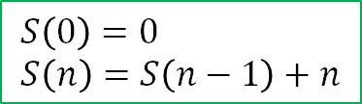

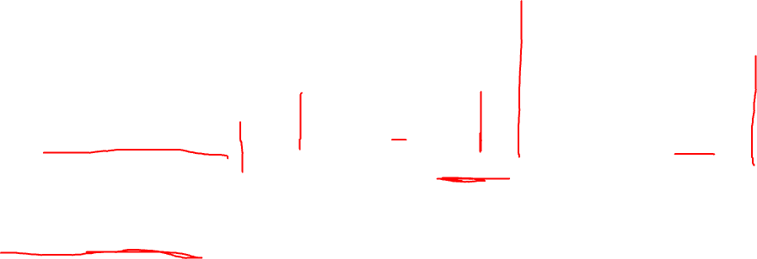
Recursive Functions
What is the sum of the numbers from 1 to n?
1+ 2 + 3 + … + (n-1) + n
$$S\left(0\right)=0 \\ S\left(n\right)=S\left(n−1\right)+n$$
$$S\left(n\right)=\frac{n(n+1)}{2}=\frac{1}{2}n^{2}+\frac{1}{2}n$$
def S(n):
total = 0 for i in range(n + 1): total += i return total
def S(n):
if n == 0: return 0 else: return S(n-1) + n
def S(n):
return n * (n + 1) // 2
Formula
Fast
Doesn’t use much memory
Loop
Slow
Doesn’t use much memory
Recursion
Slow
Uses a lot of memory

Slide 79
What’s the pattern?
0, 1, 1, 2, 3, 5, 8, 13, 21, 34, ???, …

Slide 80
Fibonacci Numbers
This sequence of numbers shows up surprisingly often in nature and various applications.
What’s the pattern?
0, 1, 1, 2, 3, 5, 8, 13, 21, 34, 55, …
=21+34

Slide 81
Fibonacci Numbers
What’s the pattern?
0, 1, 1, 2, 3, 5, 8, 13, 21, 34, 55, …
Each of these numbers is the sum of the two immediately before it.

Slide 82
Fibonacci Numbers
What’s the pattern?
0, 1, 1, 2, 3, 5, 8, 13, 21, 34, 55, …
The first two numbers are special: they are set to be 0 and 1.
Each of these numbers is the sum of the two immediately before it.

Slide 83





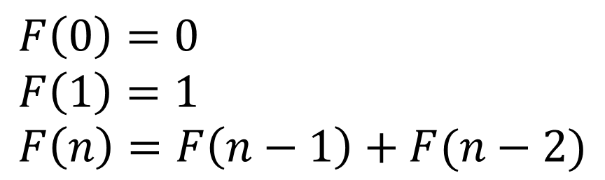



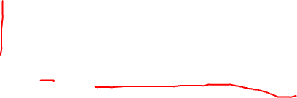



Fibonacci Numbers
What’s the pattern?
$$F(0)$$
$$F(1)$$
$$F(2)$$
$$F(3)$$
$$F(4)$$
$$F(5)$$
$$F(6)$$
$$F(7)$$
$$F(8)$$
$$F(9)$$
$$F(10)$$
0, 1, 1, 2, 3, 5, 8, 13, 21, 34, 55, …
This recurrence relation precisely defines the values of each number in the sequence.
$$F\left(0\right)=0 \\ F\left(1\right)=1 \\ F\left(n\right)=F\left(n−1\right)+F(n−2)$$

Slide 84





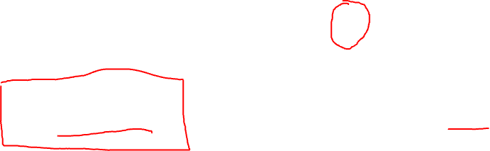
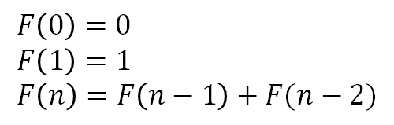







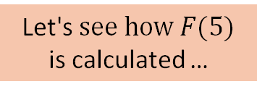
Fibonacci Numbers
$$F(0)$$
$$F(1)$$
$$F(2)$$
$$F(3)$$
$$F(4)$$
$$F(5)$$
$$F(6)$$
$$F(7)$$
$$F(8)$$
$$F(9)$$
$$F(10)$$
0, 1, 1, 2, 3, 5, 8, 13, 21, 34, 55, …
$$F\left(0\right)=0 \\ F\left(1\right)=1 \\ F\left(n\right)=F\left(n−1\right)+F(n−2)$$
Let's$see how F(5)$ is calculated …
$$F(5)$$

Slide 85


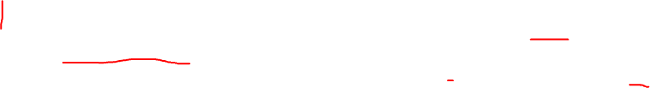
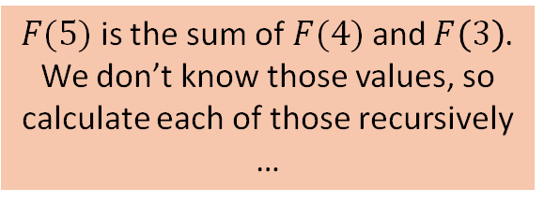
Fibonacci Numbers
$$F(0)$$
$$F(1)$$
$$F(2)$$
$$F(3)$$
$$F(4)$$
$$F(5)$$
$$F(6)$$
$$F(7)$$
$$F(8)$$
$$F(9)$$
$$F(10)$$
0, 1, 1, 2, 3, 5, 8, 13, 21, 34, 55, …
$$F\left(0\right)=0 \\ F\left(1\right)=1 \\ F\left(n\right)=F\left(n−1\right)+F(n−2)$$
$$F(5)$$
$$F(4)$$
$$F(3)$$
$F(5)$ is the sum of $F(4)$ and $F\left(3\right)$. We don’t know those values, so calculate each of those recursively …

Slide 86


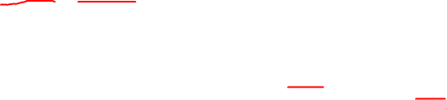
Fibonacci Numbers
$$F(0)$$
$$F(1)$$
$$F(2)$$
$$F(3)$$
$$F(4)$$
$$F(5)$$
$$F(6)$$
$$F(7)$$
$$F(8)$$
$$F(9)$$
$$F(10)$$
0, 1, 1, 2, 3, 5, 8, 13, 21, 34, 55, …
$$F\left(0\right)=0 \\ F\left(1\right)=1 \\ F\left(n\right)=F\left(n−1\right)+F(n−2)$$
$$F(5)$$
$$F(4)$$
$$F(3)$$
$$F(3)$$
$$F(2)$$

Slide 87
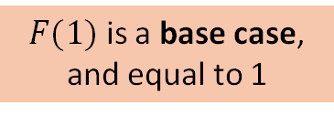


Fibonacci Numbers
$$F(0)$$
$$F(1)$$
$$F(2)$$
$$F(3)$$
$$F(4)$$
$$F(5)$$
$$F(6)$$
$$F(7)$$
$$F(8)$$
$$F(9)$$
$$F(10)$$
0, 1, 1, 2, 3, 5, 8, 13, 21, 34, 55, …
$$F\left(0\right)=0 \\ F\left(1\right)=1 \\ F\left(n\right)=F\left(n−1\right)+F(n−2)$$
$$F(5)$$
$$F(4)$$
$$F(3)$$
$$F(3)$$
$$F(2)$$
$$F(1)$$
$$F(2)$$
$F(1)$ is a base case, and equal to 1

Slide 88
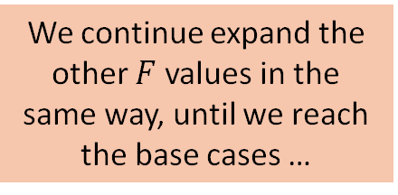

Fibonacci Numbers
$$F(0)$$
$$F(1)$$
$$F(2)$$
$$F(3)$$
$$F(4)$$
$$F(5)$$
$$F(6)$$
$$F(7)$$
$$F(8)$$
$$F(9)$$
$$F(10)$$
0, 1, 1, 2, 3, 5, 8, 13, 21, 34, 55, …
$$F\left(0\right)=0 \\ F\left(1\right)=1 \\ F\left(n\right)=F\left(n−1\right)+F(n−2)$$
$$F(5)$$
$$F(4)$$
$$F(3)$$
$$F(3)$$
$$F(2)$$
$$F(1)$$
We continue expand the other $F$ values in the same way, until we reach the base cases …
$$F(2)$$
$$1$$

Slide 89



Fibonacci Numbers
$$F(0)$$
$$F(1)$$
$$F(2)$$
$$F(3)$$
$$F(4)$$
$$F(5)$$
$$F(6)$$
$$F(7)$$
$$F(8)$$
$$F(9)$$
$$F(10)$$
0, 1, 1, 2, 3, 5, 8, 13, 21, 34, 55, …
$$F\left(0\right)=0 \\ F\left(1\right)=1 \\ F\left(n\right)=F\left(n−1\right)+F(n−2)$$
$$F(5)$$
$$F(4)$$
$$F(3)$$
$$F(3)$$
$$F(2)$$
$$F(1)$$
$$F(2)$$
$$1$$
$$F(2)$$
$$F(1)$$

Slide 90


Fibonacci Numbers
$$F(0)$$
$$F(1)$$
$$F(2)$$
$$F(3)$$
$$F(4)$$
$$F(5)$$
$$F(6)$$
$$F(7)$$
$$F(8)$$
$$F(9)$$
$$F(10)$$
0, 1, 1, 2, 3, 5, 8, 13, 21, 34, 55, …
$$F\left(0\right)=0 \\ F\left(1\right)=1 \\ F\left(n\right)=F\left(n−1\right)+F(n−2)$$
$$F(5)$$
$$F(4)$$
$$F(3)$$
$$F(3)$$
$$F(2)$$
$$F(1)$$
$$F(2)$$
$$1$$
$$F(2)$$
$$F(1)$$
$$F(1)$$
$$F(0)$$

Slide 91

Fibonacci Numbers
$$F(0)$$
$$F(1)$$
$$F(2)$$
$$F(3)$$
$$F(4)$$
$$F(5)$$
$$F(6)$$
$$F(7)$$
$$F(8)$$
$$F(9)$$
$$F(10)$$
0, 1, 1, 2, 3, 5, 8, 13, 21, 34, 55, …
$$F\left(0\right)=0 \\ F\left(1\right)=1 \\ F\left(n\right)=F\left(n−1\right)+F(n−2)$$
$$F(5)$$
$$F(4)$$
$$F(3)$$
$$F(3)$$
$$F(2)$$
$$F(1)$$
$$F(2)$$
$$F(1)$$
$$F(0)$$
$$1$$
$$F(2)$$
$$F(1)$$
$$F(1)$$
$$F(0)$$

Slide 92


Fibonacci Numbers
$$F(0)$$
$$F(1)$$
$$F(2)$$
$$F(3)$$
$$F(4)$$
$$F(5)$$
$$F(6)$$
$$F(7)$$
$$F(8)$$
$$F(9)$$
$$F(10)$$
0, 1, 1, 2, 3, 5, 8, 13, 21, 34, 55, …
$$F\left(0\right)=0 \\ F\left(1\right)=1 \\ F\left(n\right)=F\left(n−1\right)+F(n−2)$$
$$F(5)$$
$$F(4)$$
$$F(3)$$
$$F(3)$$
$$F(2)$$
$$F(1)$$
$$F(2)$$
$$F(1)$$
$$F(0)$$
$$1$$
$$F(2)$$
$$F(1)$$
$$F(1)$$
$$F(0)$$
$$F(1)$$
$$F(0)$$

Slide 93




Fibonacci Numbers
$$F(0)$$
$$F(1)$$
$$F(2)$$
$$F(3)$$
$$F(4)$$
$$F(5)$$
$$F(6)$$
$$F(7)$$
$$F(8)$$
$$F(9)$$
$$F(10)$$
0, 1, 1, 2, 3, 5, 8, 13, 21, 34, 55, …
$$F\left(0\right)=0 \\ F\left(1\right)=1 \\ F\left(n\right)=F\left(n−1\right)+F(n−2)$$
$$F(5)$$
$$F(4)$$
$$F(3)$$
Now all the F values have been expanded, and we can add up the values from the bottom of the tree moving upward …
$$F(2)$$
$$F(1)$$
$$F(3)$$
$$F(2)$$
$$F(1)$$
$$F(0)$$
$$1$$
$$F(2)$$
$$F(1)$$
$$F(1)$$
$$F(0)$$
$$1$$
$$0$$
$$F(1)$$
$$F(0)$$
$$1$$
$$1$$
$$0$$
$$1$$
$$0$$

Slide 94
Fibonacci Numbers
$$F(0)$$
$$F(1)$$
$$F(2)$$
$$F(3)$$
$$F(4)$$
$$F(5)$$
$$F(6)$$
$$F(7)$$
$$F(8)$$
$$F(9)$$
$$F(10)$$
0, 1, 1, 2, 3, 5, 8, 13, 21, 34, 55, …
$$F\left(0\right)=0 \\ F\left(1\right)=1 \\ F\left(n\right)=F\left(n−1\right)+F(n−2)$$
$$F(5)$$
$$F(4)$$
$$F(3)$$
Now all the F values have been expanded, and we can add up the values from the bottom of the tree moving upward …
$$F(2)$$
$$F(1)$$
$$F(3)$$
$$F(2)$$
$$F(1)$$
$$F(0)$$
$$1$$
$$F(2)$$
$$F(1)$$
$$F(1)$$
$$F(0)$$
$$1$$
$$0$$
$$1$$
$$0$$
$$1$$
$$1$$
$$0$$
$$1$$
$$0$$

Slide 95
Fibonacci Numbers
$$F(0)$$
$$F(1)$$
$$F(2)$$
$$F(3)$$
$$F(4)$$
$$F(5)$$
$$F(6)$$
$$F(7)$$
$$F(8)$$
$$F(9)$$
$$F(10)$$
0, 1, 1, 2, 3, 5, 8, 13, 21, 34, 55, …
$$F\left(0\right)=0 \\ F\left(1\right)=1 \\ F\left(n\right)=F\left(n−1\right)+F(n−2)$$
$$F(5)$$
$$F(4)$$
$$F(3)$$
Now all the F values have been expanded, and we can add up the values from the bottom of the tree moving upward …
$$F(2)$$
$$F(1)$$
$$F(3)$$
$$F(2)$$
$$F(1)$$
$$F(0)$$
$$1$$
$$1$$
$$F(1)$$
$$F(1)$$
$$F(0)$$
$$1$$
$$0$$
$$1$$
$$0$$
$$1$$
$$1$$
$$0$$
$$1$$
$$0$$

Slide 96
Fibonacci Numbers
$$F(0)$$
$$F(1)$$
$$F(2)$$
$$F(3)$$
$$F(4)$$
$$F(5)$$
$$F(6)$$
$$F(7)$$
$$F(8)$$
$$F(9)$$
$$F(10)$$
0, 1, 1, 2, 3, 5, 8, 13, 21, 34, 55, …
$$F\left(0\right)=0 \\ F\left(1\right)=1 \\ F\left(n\right)=F\left(n−1\right)+F(n−2)$$
$$F(5)$$
$$F(4)$$
$$F(3)$$
Now all the F values have been expanded, and we can add up the values from the bottom of the tree moving upward …
$$F(2)$$
$$F(1)$$
$$F(3)$$
$$F(2)$$
$$F(1)$$
$$F(0)$$
$$1$$
$$1$$
$$1$$
$$F(1)$$
$$F(0)$$
$$1$$
$$0$$
$$1$$
$$0$$
$$1$$
$$1$$
$$0$$
$$1$$
$$0$$

Slide 97

Fibonacci Numbers
$$F(0)$$
$$F(1)$$
$$F(2)$$
$$F(3)$$
$$F(4)$$
$$F(5)$$
$$F(6)$$
$$F(7)$$
$$F(8)$$
$$F(9)$$
$$F(10)$$
0, 1, 1, 2, 3, 5, 8, 13, 21, 34, 55, …
$$F\left(0\right)=0 \\ F\left(1\right)=1 \\ F\left(n\right)=F\left(n−1\right)+F(n−2)$$
$$F(5)$$
$$F(4)$$
$$F(3)$$
Now all the F values have been expanded, and we can add up the values from the bottom of the tree moving upward …
$$F(2)$$
$$F(1)$$
$$2$$
$$F(2)$$
$$F(1)$$
$$F(0)$$
$$1$$
$$1$$
$$1$$
$$F(1)$$
$$F(0)$$
$$1$$
$$0$$
$$1$$
$$0$$
$$1$$
$$1$$
$$0$$
$$1$$
$$0$$

Slide 98


Fibonacci Numbers
$$F(0)$$
$$F(1)$$
$$F(2)$$
$$F(3)$$
$$F(4)$$
$$F(5)$$
$$F(6)$$
$$F(7)$$
$$F(8)$$
$$F(9)$$
$$F(10)$$
0, 1, 1, 2, 3, 5, 8, 13, 21, 34, 55, …
$$F\left(0\right)=0 \\ F\left(1\right)=1 \\ F\left(n\right)=F\left(n−1\right)+F(n−2)$$
$$F(5)$$
$$F(4)$$
$$F(3)$$
Now all the F values have been expanded, and we can add up the values from the bottom of the tree moving upward …
$$F(2)$$
$$F(1)$$
$$2$$
$$F(2)$$
$$F(1)$$
$$F(0)$$
$$1$$
$$1$$
$$1$$
$$1$$
$$0$$
$$1$$
$$0$$
$$1$$
$$0$$
$$1$$
$$1$$
$$0$$
$$1$$
$$0$$

Slide 99

Fibonacci Numbers
$$F(0)$$
$$F(1)$$
$$F(2)$$
$$F(3)$$
$$F(4)$$
$$F(5)$$
$$F(6)$$
$$F(7)$$
$$F(8)$$
$$F(9)$$
$$F(10)$$
0, 1, 1, 2, 3, 5, 8, 13, 21, 34, 55, …
$$F\left(0\right)=0 \\ F\left(1\right)=1 \\ F\left(n\right)=F\left(n−1\right)+F(n−2)$$
$$F(5)$$
$$F(4)$$
$$F(3)$$
Now all the F values have been expanded, and we can add up the values from the bottom of the tree moving upward …
$$F(2)$$
$$F(1)$$
$$2$$
$$1$$
$$F(1)$$
$$F(0)$$
$$1$$
$$1$$
$$1$$
$$1$$
$$0$$
$$1$$
$$0$$
$$1$$
$$0$$
$$1$$
$$1$$
$$0$$
$$1$$
$$0$$

Slide 100

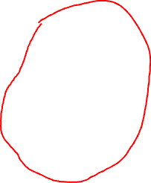
Fibonacci Numbers
$$F(0)$$
$$F(1)$$
$$F(2)$$
$$F(3)$$
$$F(4)$$
$$F(5)$$
$$F(6)$$
$$F(7)$$
$$F(8)$$
$$F(9)$$
$$F(10)$$
0, 1, 1, 2, 3, 5, 8, 13, 21, 34, 55, …
$$F\left(0\right)=0 \\ F\left(1\right)=1 \\ F\left(n\right)=F\left(n−1\right)+F(n−2)$$
$$F(5)$$
$$3$$
$$F(3)$$
Now all the F values have been expanded, and we can add up the values from the bottom of the tree moving upward …
$$F(2)$$
$$F(1)$$
$$2$$
$$1$$
$$F(1)$$
$$F(0)$$
$$1$$
$$1$$
$$1$$
$$1$$
$$0$$
$$1$$
$$0$$
$$1$$
$$0$$
$$1$$
$$1$$
$$0$$
$$1$$
$$0$$

Slide 101
Fibonacci Numbers
$$F(0)$$
$$F(1)$$
$$F(2)$$
$$F(3)$$
$$F(4)$$
$$F(5)$$
$$F(6)$$
$$F(7)$$
$$F(8)$$
$$F(9)$$
$$F(10)$$
0, 1, 1, 2, 3, 5, 8, 13, 21, 34, 55, …
Let’s do the right tree all at once to save time drawing …
$$F\left(0\right)=0 \\ F\left(1\right)=1 \\ F\left(n\right)=F\left(n−1\right)+F(n−2)$$
$$F(5)$$
$$3$$
$$F(3)$$
Now all the F values have been expanded, and we can add up the values from the bottom of the tree moving upward …
$$F(2)$$
$$F(1)$$
$$2$$
$$1$$
$$F(1)$$
$$F(0)$$
$$1$$
$$1$$
$$1$$
$$1$$
$$0$$
$$1$$
$$0$$
$$1$$
$$0$$
$$1$$
$$1$$
$$0$$
$$1$$
$$0$$

Slide 102

Fibonacci Numbers
$$F(0)$$
$$F(1)$$
$$F(2)$$
$$F(3)$$
$$F(4)$$
$$F(5)$$
$$F(6)$$
$$F(7)$$
$$F(8)$$
$$F(9)$$
$$F(10)$$
0, 1, 1, 2, 3, 5, 8, 13, 21, 34, 55, …
Let’s do the right tree all at once to save time drawing …
$$F\left(0\right)=0 \\ F\left(1\right)=1 \\ F\left(n\right)=F\left(n−1\right)+F(n−2)$$
$$F(5)$$
$$3$$
$$2$$
Now all the F values have been expanded, and we can add up the values from the bottom of the tree moving upward …
$$1$$
$$1$$
$$2$$
$$1$$
$$1$$
$$0$$
$$1$$
$$1$$
$$1$$
$$1$$
$$0$$
$$1$$
$$0$$
$$1$$
$$0$$
$$1$$
$$1$$
$$0$$
$$1$$
$$0$$

Slide 103

Fibonacci Numbers
$$F(0)$$
$$F(1)$$
$$F(2)$$
$$F(3)$$
$$F(4)$$
$$F(5)$$
$$F(6)$$
$$F(7)$$
$$F(8)$$
$$F(9)$$
$$F(10)$$
0, 1, 1, 2, 3, 5, 8, 13, 21, 34, 55, …
$$F\left(0\right)=0 \\ F\left(1\right)=1 \\ F\left(n\right)=F\left(n−1\right)+F(n−2)$$
$$5$$
Finally the answer!
$$3$$
$$2$$
Now all the F values have been expanded, and we can add up the values from the bottom of the tree moving upward …
$$1$$
$$1$$
$$2$$
$$1$$
$$1$$
$$0$$
$$1$$
$$1$$
$$1$$
$$1$$
$$0$$
$$1$$
$$0$$
$$1$$
$$0$$
$$1$$
$$1$$
$$0$$
$$1$$
$$0$$

Slide 104
Fibonacci Numbers
$$F(0)$$
$$F(1)$$
$$F(2)$$
$$F(3)$$
$$F(4)$$
$$F(5)$$
$$F(6)$$
$$F(7)$$
$$F(8)$$
$$F(9)$$
$$F(10)$$
0, 1, 1, 2, 3, 5, 8, 13, 21, 34, 55, …
$$F\left(0\right)=0 \\ F\left(1\right)=1 \\ F\left(n\right)=F\left(n−1\right)+F(n−2)$$
$$5$$
$$3$$
$$2$$
As you can see, a lot of the calculations are repeated …
$$1$$
$$1$$
$$2$$
$$1$$
$$1$$
$$0$$
$$1$$
$$1$$
$$1$$
$$1$$
$$0$$
$$1$$
$$0$$
$$1$$
$$0$$
$$1$$
$$1$$
$$0$$
$$1$$
$$0$$
Same!

Slide 105





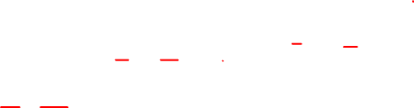




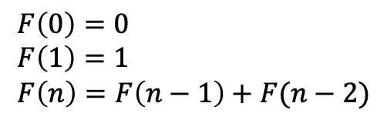





















Fibonacci Numbers
$$F(0)$$
$$F(1)$$
$$F(2)$$
$$F(3)$$
$$F(4)$$
$$F(5)$$
$$F(6)$$
$$F(7)$$
$$F(8)$$
$$F(9)$$
$$F(10)$$
0, 1, 1, 2, 3, 5, 8, 13, 21, 34, 55, …
$$F\left(0\right)=0 \\ F\left(1\right)=1 \\ F\left(n\right)=F\left(n−1\right)+F(n−2)$$
$$5$$
$$3$$
$$2$$
As you can see, a lot of the calculations are repeated …
$$1$$
$$1$$
$$2$$
$$1$$
$$1$$
$$0$$
$$1$$
$$1$$
$$1$$
$$1$$
$$0$$
$$1$$
$$0$$
$$1$$
$$0$$
$$1$$
$$1$$
$$0$$
$$1$$
$$0$$
Same!

Slide 106
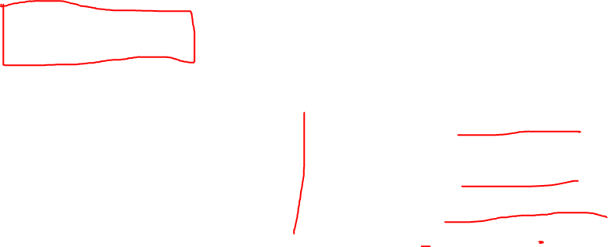
Fibonacci Numbers
$$F(0)$$
$$F(1)$$
$$F(2)$$
$$F(3)$$
$$F(4)$$
$$F(5)$$
$$F(6)$$
$$F(7)$$
$$F(8)$$
$$F(9)$$
$$F(10)$$
0, 1, 1, 2, 3, 5, 8, 13, 21, 34, 55, …
$$F\left(0\right)=0 \\ F\left(1\right)=1 \\ F\left(n\right)=F\left(n−1\right)+F(n−2)$$
def F(n):
"""Returns the nth Fibonacci number.
"""
if n == 0: # base case 1
return 0
elif n == 1: # base case 2
return 1
else: # recursive case
return F(n - 1) + F(n - 2)
Converting this recurrence relation to Python is relatively easy …

Slide 107
Fibonacci Numbers
$$F(0)$$
$$F(1)$$
$$F(2)$$
$$F(3)$$
$$F(4)$$
$$F(5)$$
$$F(6)$$
$$F(7)$$
$$F(8)$$
$$F(9)$$
$$F(10)$$
0, 1, 1, 2, 3, 5, 8, 13, 21, 34, 55, …
$$F\left(0\right)=0 \\ F\left(1\right)=1 \\ F\left(n\right)=F\left(n−1\right)+F(n−2)$$
def F(n):
"""Returns the nth Fibonacci number.
"""
if n == 0: # base case 1
return 0
elif n == 1: # base case 2
return 1
else: # recursive case
return F(n - 1) + F(n - 2)
Converting this recurrence relation to Python is relatively easy …
But it runs slowly … F(40) takes over 20 seconds on my computer!

Slide 108
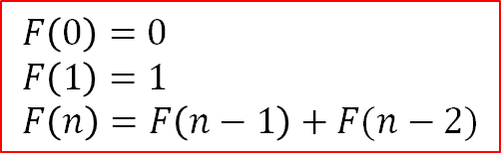

$$F(0)$$
$$F(1)$$
$$F(2)$$
$$F(3)$$
$$F(4)$$
$$F(5)$$
$$F(6)$$
$$F(7)$$
$$F(8)$$
$$F(9)$$
$$F(10)$$
0, 1, 1, 2, 3, 5, 8, 13, 21, 34, 55, …
$$F\left(0\right)=0 \\ F\left(1\right)=1 \\ F\left(n\right)=F\left(n−1\right)+F(n−2)$$
def F(n):
"""Returns the nth Fibonacci number.
"""
if n == 0: # base case 1
return 0
elif n == 1: # base case 2
return 1
else: # recursive case
return F(n - 1) + F(n - 2)
def F_loop(n): """Returns the nth Fibonacci number.
"""
a = 0
b = 1
for i in range(n):
a_old = a
b_old = b
a = b_old
b = a_old + b_old
return a
F(40) takes over 20 seconds to calculate on my computer!
This for-loop version directly sums the previous two numbers.
F_loop(40) on my computer takes 0.00005 seconds to calculate.

Slide 109
Recursion
Recursion is a powerful design tool
In theoretical computer science it can be used as the basis for all computation
It can give you relatively simple-looking ways of doing some calculations
But function calls are not free: every function call takes time and memory
Recursion is often impractical because it does lots of function calls and the cost adds up
Rule of thumb: in practice, prefer loops to recursion

