Slide 1
Chapter 8:
Strings, Slices & Files
CMPT 120 · Spring 2026
Text is everywhere — let's learn how to work with it!

Slide 2
Strings Are Everywhere
🌐 Web Pages
📄 Text Files
⌨️ User Input
Every webpage is a big string of HTML.
Tip: press Ctrl+U in Chrome to see it!
Your .py, .txt, and .csv files are just
strings stored on disk.
Everything a user types in
arrives as a string in Python.
A string is a sequence of characters — letters, digits, spaces, symbols, and more. Order matters. See Unicde.org for lists of all characters --- nearly 160,000 characters currently!

Slide 3

What Is a String?
A string is a sequence of 0 or more characters, in a specific order.
How to write a string literal in Python:
'Hello, world!' # single quotes — most common

Slide 4
What Is a String?
A string is a sequence of 0 or more characters, in a specific order.
How to write a string literal in Python:
'Hello, world!' # single quotes — most common
"Hello, world!" # double quotes — also fine

Slide 5
What Is a String?
A string is a sequence of 0 or more characters, in a specific order.
How to write a string literal in Python:
'Hello, world!' # single quotes — most common
"Hello, world!" # double quotes — also fine
"""Hello, # triple double quotes
world!""" # can span multiple lines!
Use triple quotes when your string spans multiple lines or contains both ' and ".

Slide 6
What Is a String?
A string is a sequence of 0 or more characters, in a specific order.
How to write a string literal in Python:
'Hello, world!' # single quotes — most common
"Hello, world!" # double quotes — also fine
"""Hello, # triple double quotes
world!""" # can span multiple lines!
'''Hello, world!''' # triple single quotes — same idea
Use triple quotes when your string spans multiple lines or contains both ' and ".

Slide 7
💻 Try It! — chapter8_lecture.ipynb
▶ Run: the intro = """...""" cell
intro = """
Triple-quote strings can contain
"-quotes and '-quotes, and can
also span multiple lines.
"""
print(intro)
What to notice:
The string contains both single and double quotes — no escaping needed!
Also notice the blank line at the end: the \n before the closing """ is part of the string.
Triple-quote strings are perfect for docstrings and long text.

Slide 8
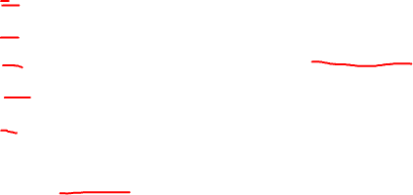
Escape Characters
Some characters need a special way to be written inside a string literal:
Escape
Meaning
Example
\n
Newline
'Line 1\nLine 2'
\t
Tab (indent)
'Name:\tAlice'
\\
Backslash ( \ )
'C:\\Users\\Alice'
\'
Single quote ( ' )
'it\'s fun'
\"
Double quote ( " )
"she said \"hi\""
Even though \n is written as two characters, it represents just one character in the string.

Slide 9
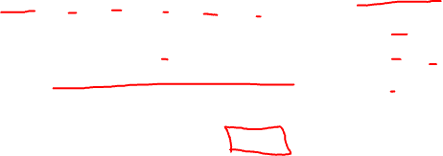
String Indexing
Use s[i] to get the character at position i. Positions (indices) start at 0:
index:
0
1
2
3
4
5
fruit = 'banana'
fruit[0] → 'b' ← first!
char:
b
a
n
a
n
a
fruit[1] → 'a'
fruit[5] → 'a' ← last!
⚠️ Indexing starts at 0, not 1! fruit[0] is the first character.
For a string of length n, valid indices are: 0, 1, 2, …, n−1

Slide 10
💻 Try It! — chapter8_lecture.ipynb
▶ Run: the fruit indexing cells (look for print(fruit[0]), print(fruit[1]), …)
fruit = 'banana'
print(fruit[0]) # b
print(fruit[1]) # a
print(fruit[2]) # n
print(fruit[3]) # a
print(fruit[4]) # n
print(fruit[5]) # a
What to notice:
fruit[0] is 'b', the first character — not fruit[1]!
The last character of a 6-letter string is at index 5 (= length − 1).
Try changing 'banana' to your own name and see what each index gives you.

Slide 11
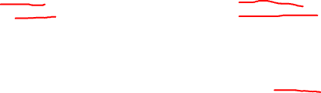
Watch Out: IndexError!
❌ This crashes:
✅ Use len() to be safe:
fruit = 'banana' # length 6
print(fruit[6]) # IndexError!
print(fruit[-7]) # IndexError!
fruit = 'banana'
n = len(fruit) # n = 6
print(fruit[n-1]) # fruit[5] = 'a'
# the last character
string index out of range
len(s) returns the number of characters in string s.
Rule: for a string of length n, valid positive indices are 0 to n−1
Trying to use index n (or anything outside range) causes IndexError.

Slide 12
Negative Indexing
Python lets you count from the end of a string using negative indices:
positive:
0
1
2
3
4
0
1
2
3
4
5
char:
b
a
n
a
n
a
negative:
-6
-5
-4
-3
-2
-1
fruit[-1] is always the last character, fruit[-2] is second-to-last … and so on!
fruit = 'banana'
print(fruit[-1]) # a ← last character
print(fruit[-2]) # n ← second to last
print(fruit[-6]) # b ← same as fruit[0]

Slide 13
💻 Try It! — chapter8_lecture.ipynb
▶ Run: the print(fruit[-1]) cells
fruit = 'banana'
print(fruit[-1]) # a (last)
print(fruit[-2]) # n (second to last)
print(fruit[-3]) # a
What to notice:
fruit[-1] is the last character — always! No need to know the length.
fruit[-6] is the same as fruit[0] for a 6-character string.
Negative indices are great shortcuts when you need the end of a string.

Slide 14


String Slices
A slice is a substring — a piece cut out of a string:
s[m:n] gives characters at positions m, m+1, …, n−1
index:
0
2
4
5
0
1
2
3
4
5
char:
b
a
n
a
n
a
fruit[2:5] → 'nan' (indices 2, 3, 4 — NOT 5! The end index is exclusive.)

Slide 15

Slice Shortcuts
Python has handy shorthand for common slice patterns:
s = 'banana'
s[m:]
From index m to the end of the string
fruit[2:] → 'nana'
s[:n]
From the start up to (not including) n
fruit[:3] → 'ban'
s[:]
The whole string (a copy)
fruit[:] → 'banana'
s[m:n:k]
Every k-th character from m to n
fruit[::2] → 'bnn'

Slide 16
💻 Try It! — chapter8_lecture.ipynb
▶ Run: the print(fruit[2:5]) slicing cells
fruit = 'banana'
print(fruit[2:5]) # nan (indices 2, 3, 4)
print(fruit[2:]) # nana (index 2 to end)
print(fruit[:3]) # ban (start up to index 2)
print(fruit[:]) # banana (whole string)
What to notice:
fruit[2:5] gives indices 2, 3, 4 — not 5! The end is always exclusive.
Try different numbers and predict the result before running.
Notice: fruit[:] makes a copy — same characters, same order.

Slide 17

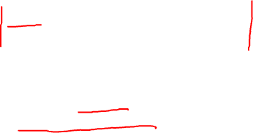
Strings Are Immutable
Immutable means you cannot change the characters of an existing string.
❌ You CANNOT do this:
✅ But you CAN build a new string:
fruit = 'banana'
fruit[0] = 'B' # TypeError!
# 'str' object does not
# support item assignment
fruit = 'banana'
# Use slicing + concatenation:
fruit = 'B' + fruit[1:]
print(fruit) # Banana
Why immutability?
fruit
fruit2
✦ Fast assignment: fruit2 = fruit doesn't copy characters — they share memory.
✦ Strings can be used as dictionary keys (more on dicts later!).
'banana'

Slide 18
💻 Try It! — chapter8_lecture.ipynb
▶ Run: the fruit[0] = 'B' and 'B' + fruit[1:] cells
fruit = 'banana'
fruit[0] = 'B' # TypeError! Can't do this.
# Workaround: build a new string
phrase = 'cat is my favourite word'
phrase = 'b' + phrase[1:]
print(phrase) # bat is my favourite word
What to notice:
The TypeError tells you: strings are read-only. You can't change individual characters.
The workaround uses slicing and + to create a brand-new string.
This is common Python — you'll write this pattern a lot!

Slide 19

Comparing Strings
You can compare strings with the same operators used for numbers:
Operator
Meaning
Example
Result
==
Equal to
'apple' == 'apple'
True
!=
Not equal to
'apple' != 'orange'
True
<
Less than (alphabet)
'apple' < 'banana'
True
>
Greater than
'banana' > 'apple'
True
<=
Less/equal
'apple' <= 'apple'
True
Strings are compared character-by-character, alphabetically (using Unicode values).
This means 'Z' < 'a' because uppercase letters come before lowercase in Unicode!

Slide 20
Writing to
Text Files
Saving data to files lets your programs remember things between runs.
A string skill with real-world impact

Slide 21
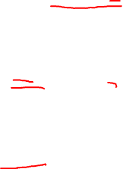
Writing to a File: Three Steps
Open for writing
Creates the file if it doesn't exist.
ERASES the file if it already does. Be careful!
1
f = open('todo.txt', 'w')
Write strings to it
Each .write() call appends to the file.
Don't forget \n for newlines!
2
f.write('Hello, file!\n')
Close it
Flushes the buffer and saves. Always close!
Content may not appear until you do.
3
f.close()
.write() writes to a memory region called a buffer, and the entire buffer is written to disk when it is filled, i.e. immediately after you call .write() the string might not be on disk

Slide 22
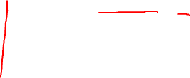
💻 Try It! — chapter8_lecture.ipynb
▶ Run: the todo_file = open('todo_list.txt', 'w') cell
todo_file = open('todo_list.txt', 'w') # 'w' for writing
todo_file.write('How to succeed:\n')
todo_file.write('1. learn to write poems\n')
todo_file.write('2. get a job at a poetry company\n')
todo_file.write('3. profit!\n')
todo_file.close() # always close!
What to notice:
After running this, look in your folder for todo_list.txt — open it in a text editor!
Run the cell again: notice the old contents are gone (overwritten by 'w').
Try adding your own lines, or change the filename to create a different file.

Slide 23
That's Chapter 8!
1
Strings are sequences of characters — they're everywhere in programming.
2
Use s[i] to read a character; s[m:n] to take a slice.
3
Negative indices count from the end: s[-1] is the last character.
4
Strings are immutable — build new ones with slices and +.
5
Compare strings with ==, !=, <, > (alphabetical order).
6
Write files: open('file.txt', 'w') → .write() → .close()
7
We’re skipping regular expressions.

