Slide 1
Interacting with Python
CMPT 120
Fall 2026
SFU Burnaby

Slide 2
Advice for Organizing Your Folders
On your computer desktop, create a folder named CMPT 120
Put all your work for this course in that folder
Add new folders within it to keep it organized
As we will see, all Python files end with .py
Make sure that your Python program files end with .py

Slide 3
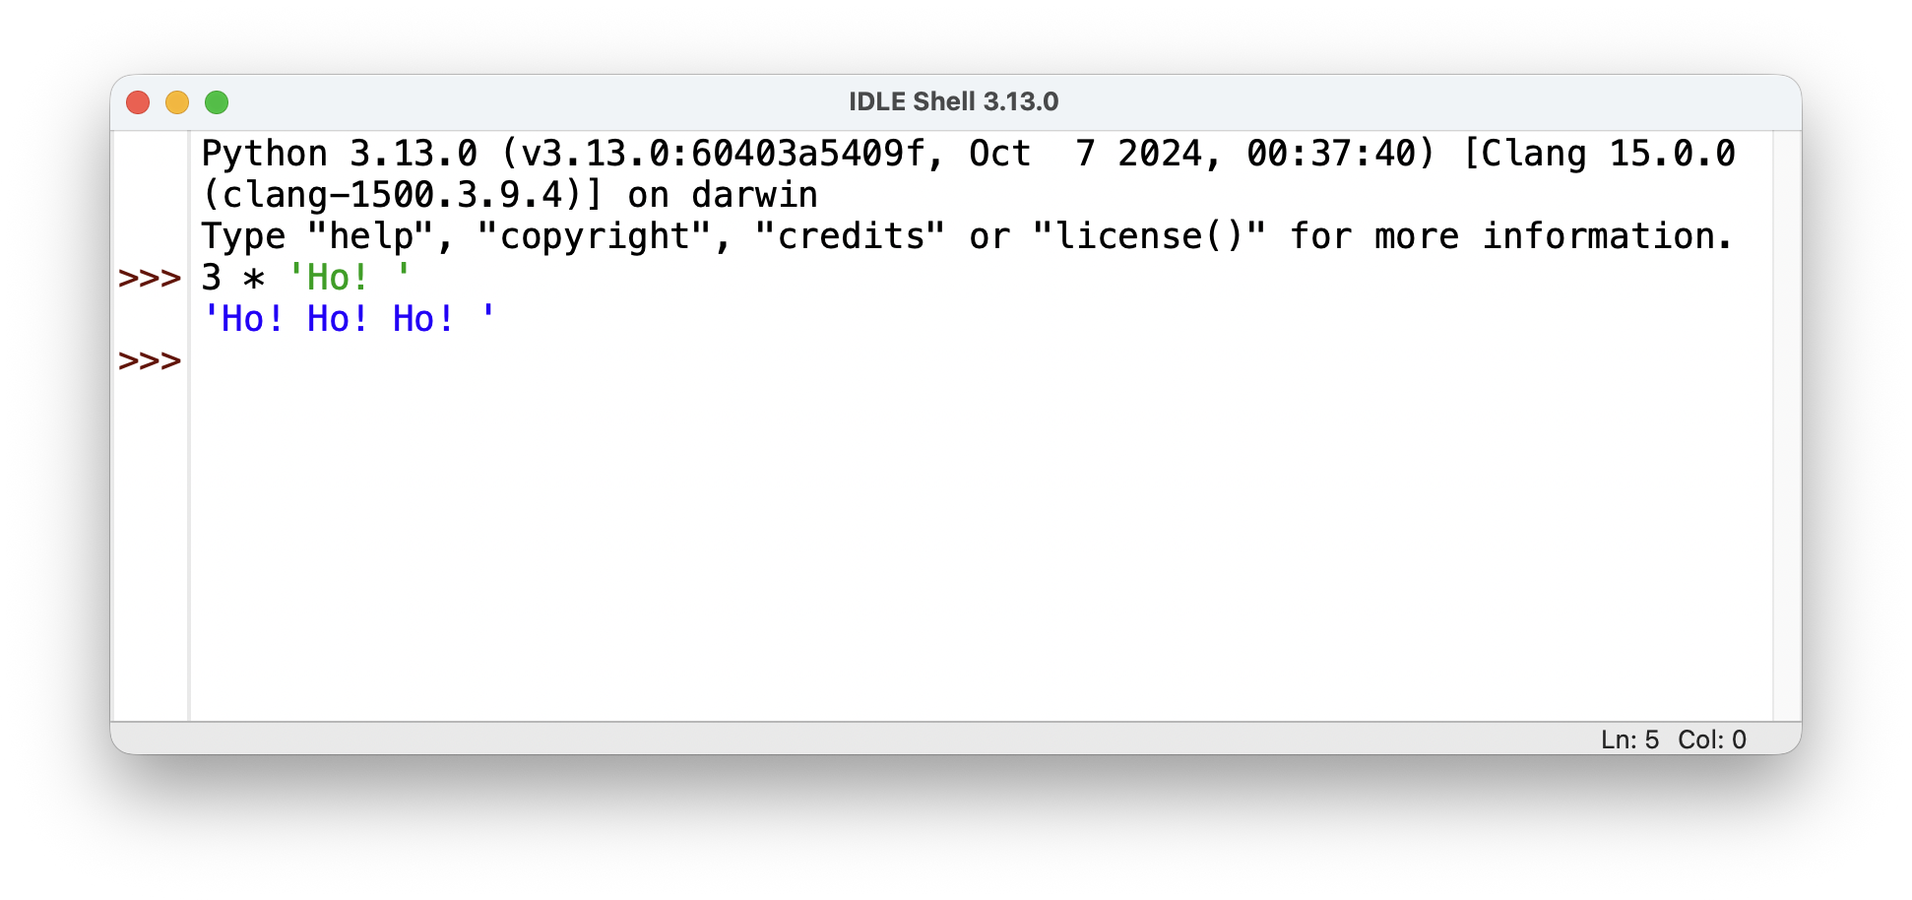
3 Common Ways of Interacting with Python
The interactive interpreter
Evaluates one statement at a time
Great for testing and doing small calculations
The interpreter is the one in IDLE (the editor that comes with Python).

Slide 4
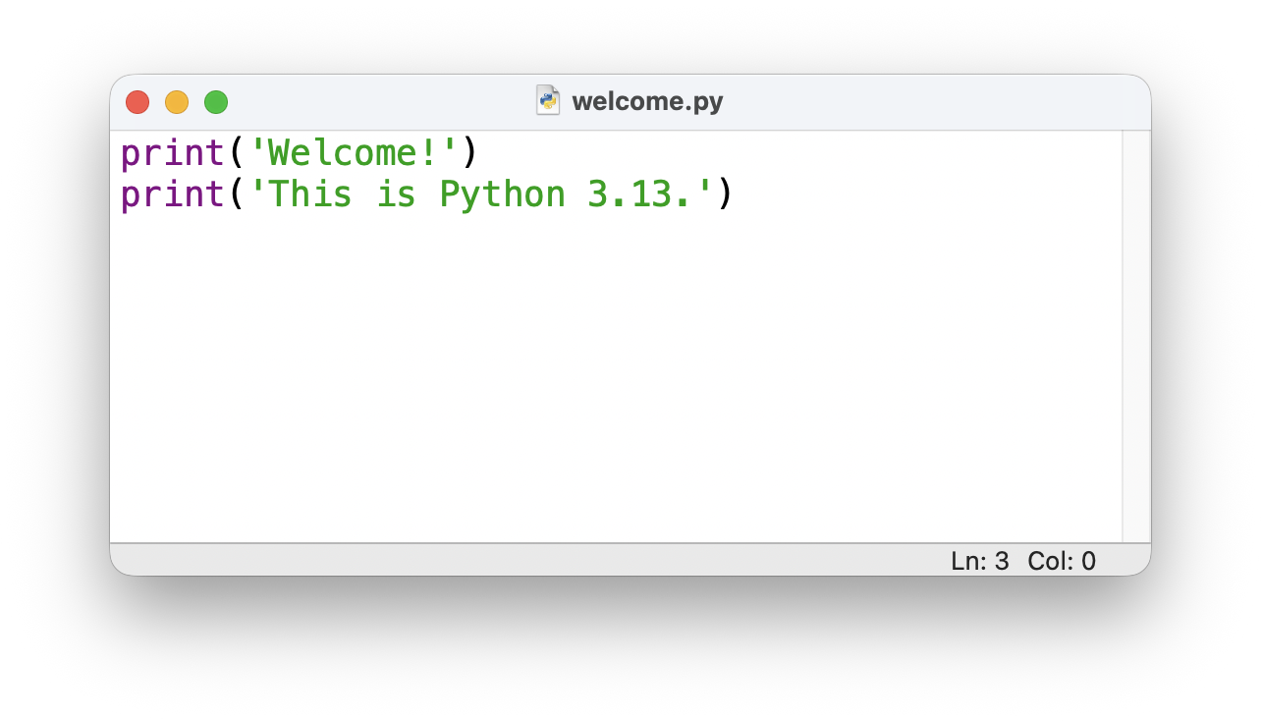
3 Common Ways of Interacting with Python
The interactive interpreter
Evaluates one statement at a time typed in by the user
Great for testing and doing small calculations
Running programs
Runs a text file of Python statements
For longer, more complex programs
When welcome.py runs, this is printed on the screen …
This is the contents of a text file named welcome.py. You can run it in IDLE, and it will print to lines of text …
Welcome! This is Python 3.13!

Slide 5
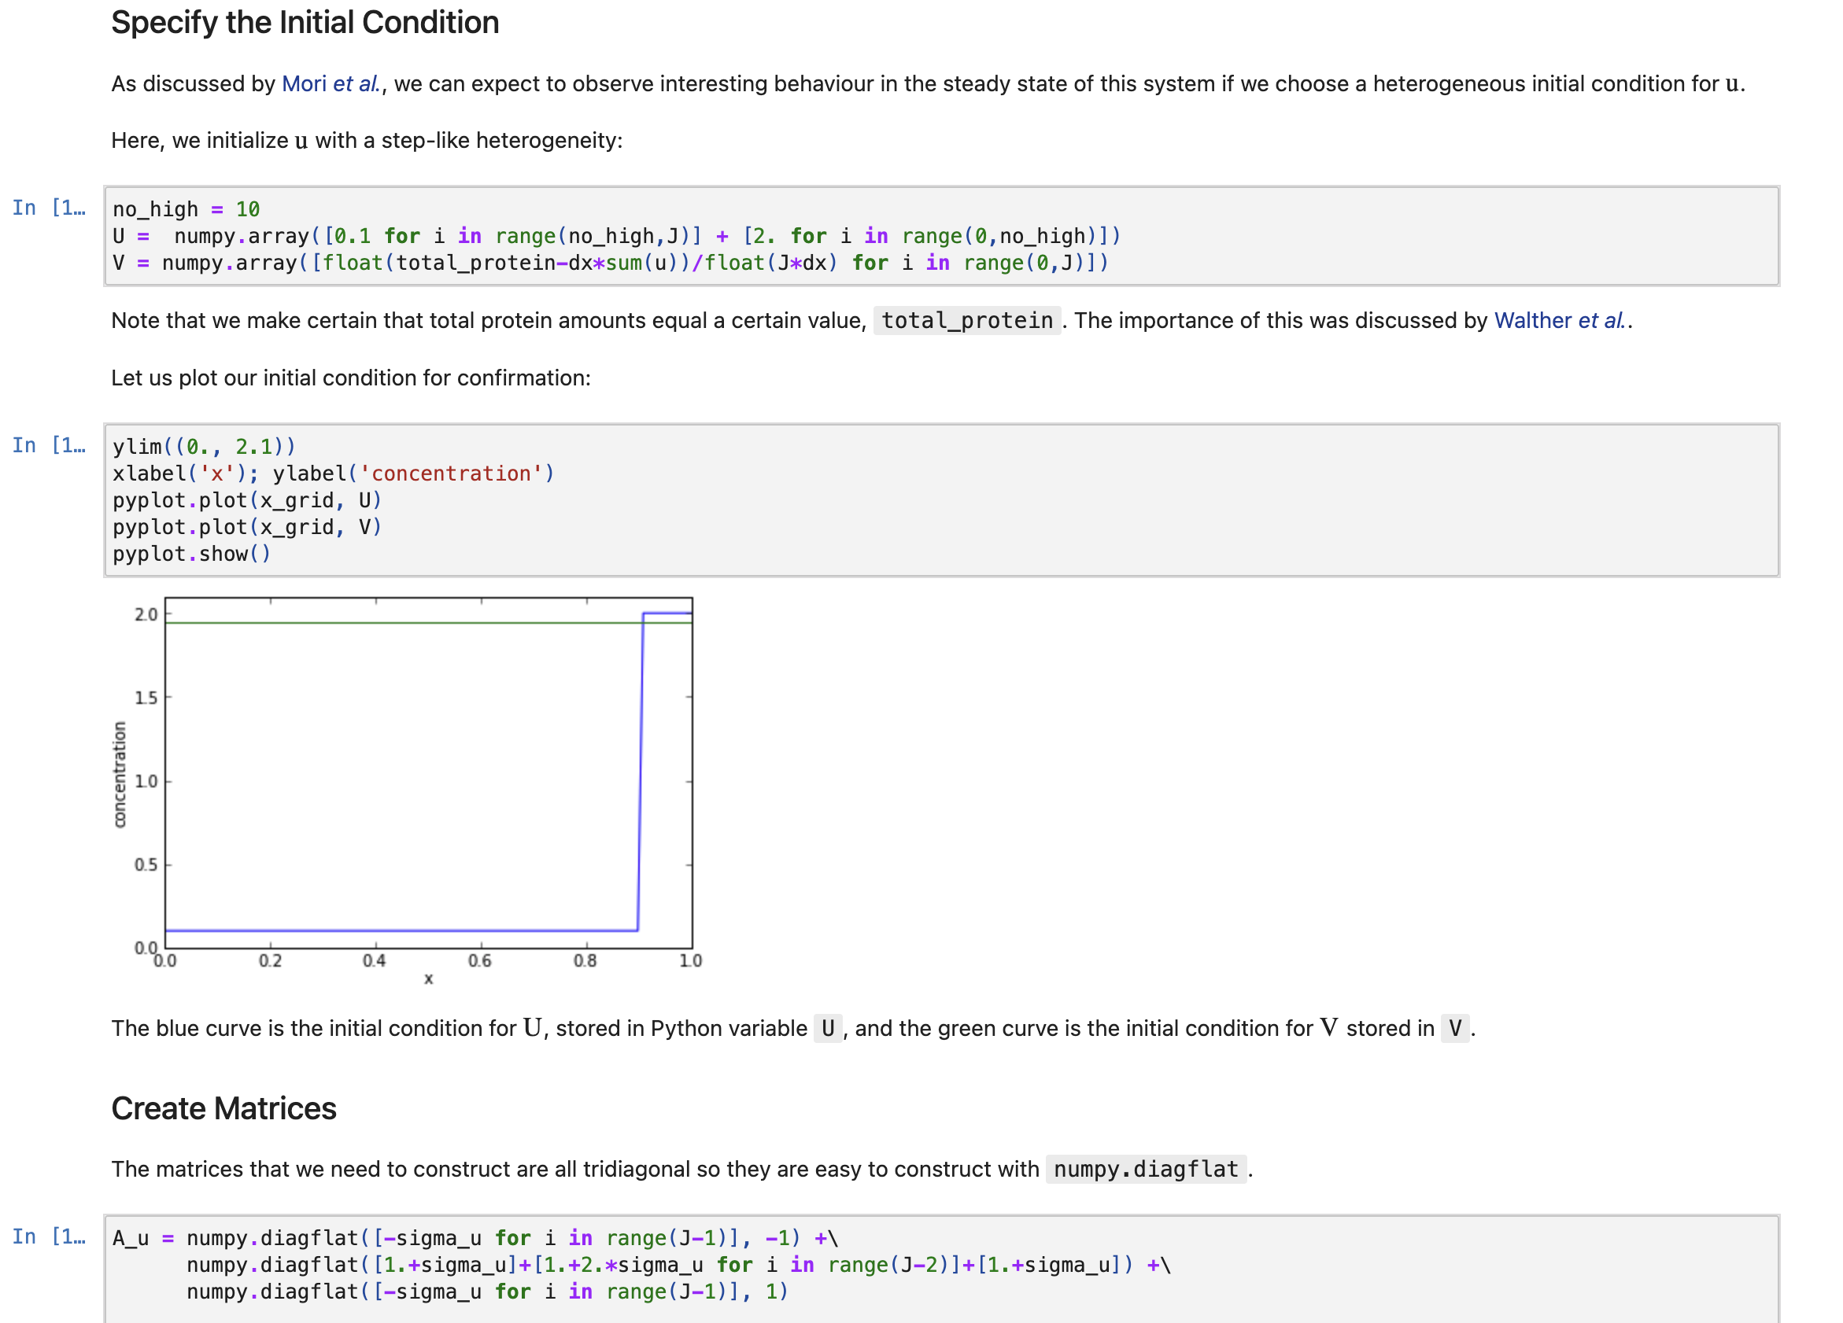
3 Common Ways of Interacting with Python
The interactive interpreter
Evaluates one statement at a time
Great for testing and doing small calculations
Running programs
Runs a “script”, i.e. a text file of Python statements
For longer, more complex programs
Notebooks
Mix text, images and code
Very popular in data science

Slide 6
3 Common Ways of Interacting with Python
The interactive interpreter
Evaluates one statement at a time
Great for testing and doing small calculations
Running programs
Runs a “script”, i.e. a text file of Python statements
For longer, more complex programs
Notebooks
Mix text, images and code
Very popular in data science
This course will use just the interpreter and running programs.
We will NOT be creating any notebooks (although many of the course notes are in notebook form).

Slide 7
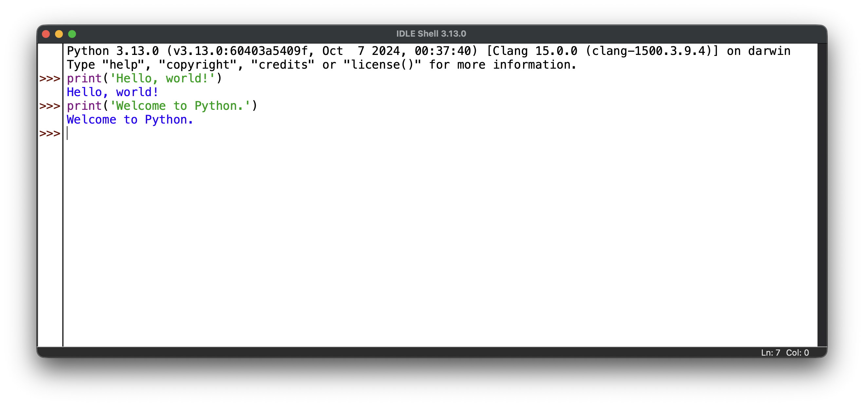
The IDLE Editor
IDLE is the free interpreter and editor that comes with Python
Search for and run “IDLE” on your computer
If you don’t have it you can install Python from www.python.org
This is the interpreter window. Note the Python prompt: >>>

Slide 8
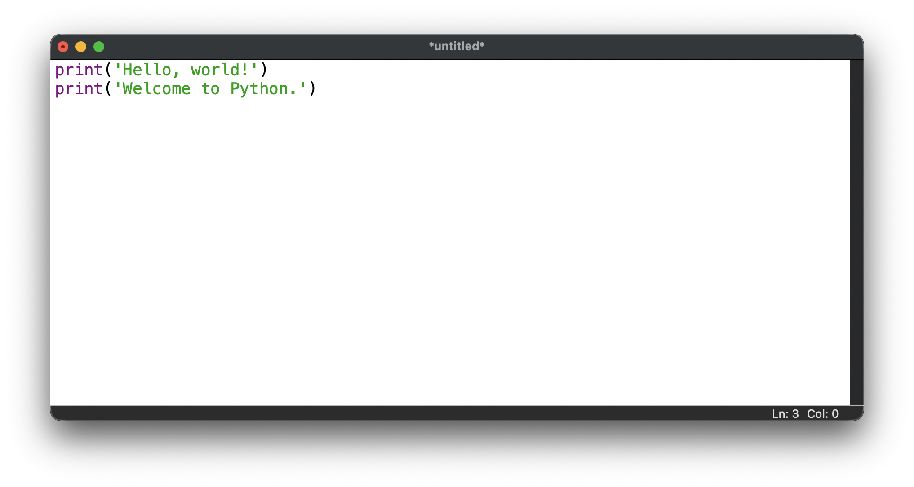
The IDLE Editor
IDLE is the free interpreter and editor that comes with Python
Search for and run “IDLE” on your computer
If you don’t have it you can install Python from www.python.org
This is the program window. Note the name of the file at the top (currently *untitled*).
To run the program, choose Run Module in the Run menu, or press F5.

Slide 9
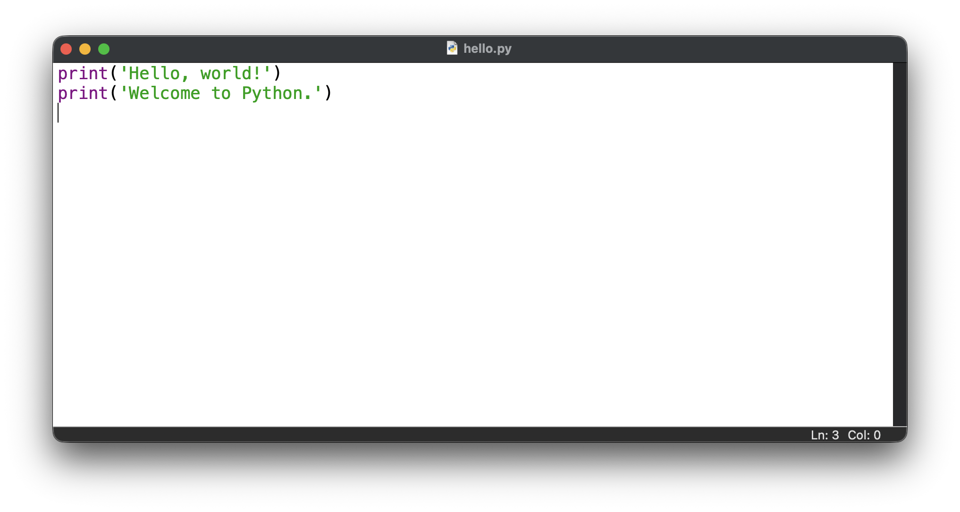
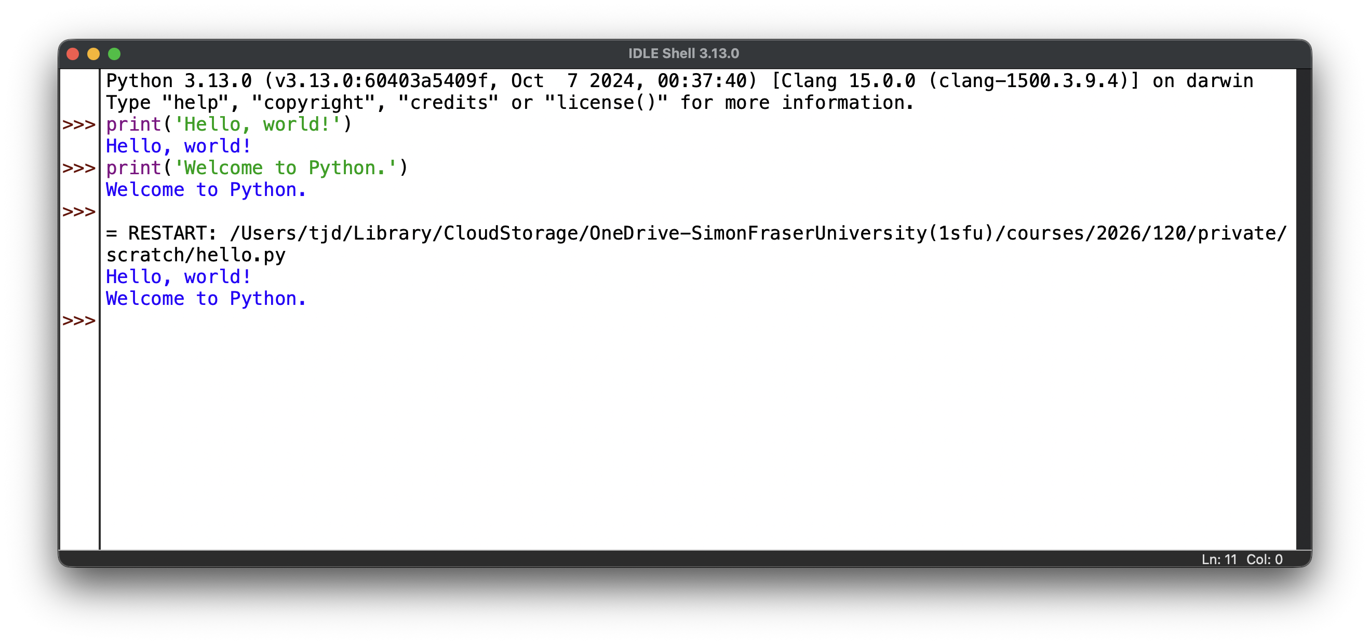
When you run the program in IDLE you will be asked to save it in a file first. I’ve called the file hello.py
The results of the program appear in the interpreter window.

Slide 10
When you run the program in IDLE you will be asked to save it in a file first. I’ve called the file hello.py
The results of the program appear in the interpreter window.
Careful! If you are new to programming it can be easy to confuse these windows.

