Slide 1
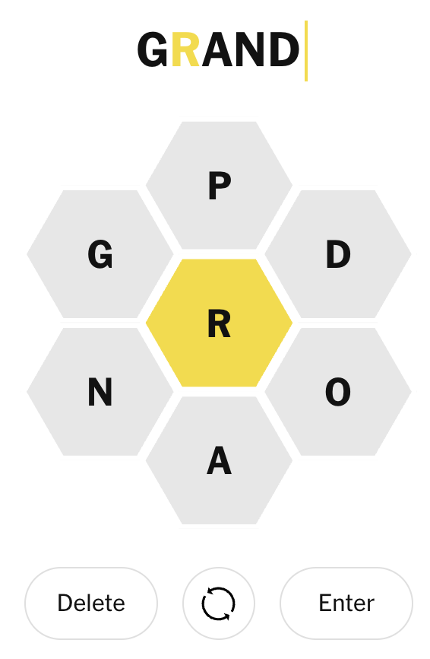
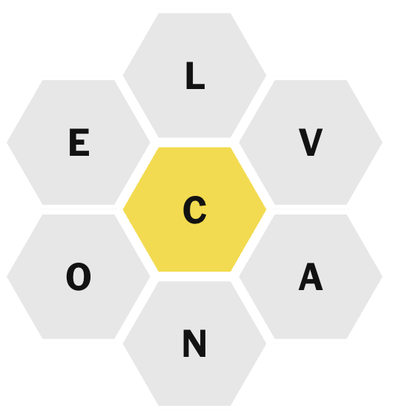
Spelling Bee: How Many Words
Can you Find?
Word Rules
Must be 4 or more letters
Must include the yellow letter in the middle, e.g. R
Letters can be repeated, e.g. POOR is a word
Letter do not need to be in sequence, e.g. DROP is a word
Scoring Rules
Words that don't contain the middle letter, or contain any letters not in the puzzle, score 0
  e.g. GOOD scores 0, ROPE scores 0
Words with 3 or fewer letters score 0
  e.g. RAP scores 0 points
Words with exactly 4 letters score 1 point
  e.g. POOR scores 1 point
Words with 5 or more letters score 1 point per letter
  e.g. DROOP scores 5 points
Words that uses all seven letters are pangrams and get an additional 7 bonus points
  e.g. PROPAGANDA gets 10 for the letters, and 7 for being a pangram, for a score of 10 + 7 = 17
test your code with this

