Slide 1
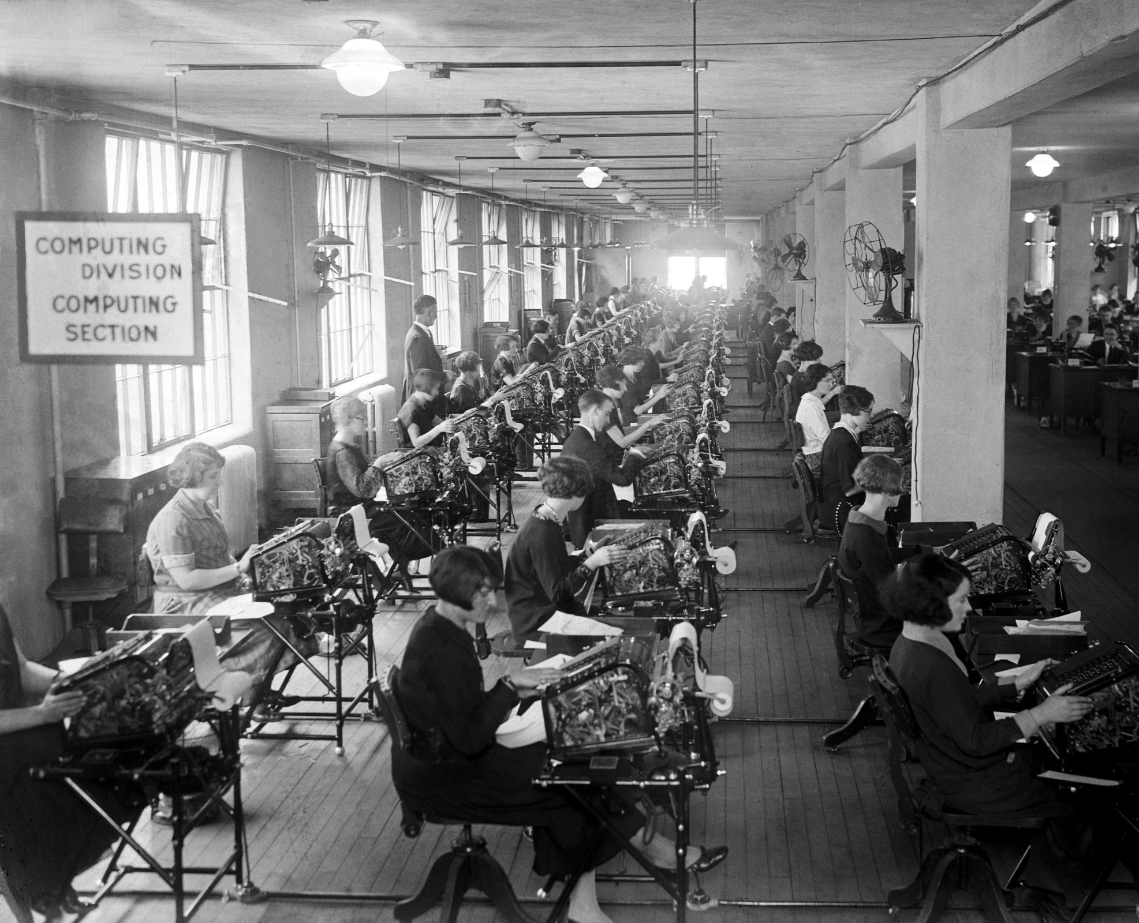
CMPT 120
Human computers
US Veterans Bureau
1924
Notes:
Some things to notice:
The calculators are huge, and most likely not electronic.
There are electric lights.
There are fans … even today computers use fans to cool down.
The operators are mostly women.
Points to ponder:
How many machines do they need?
How fast does each machine go? What exactly does it compute?
How do the operators know what to do? Where do they put their results?
The idea of making calculating machines electronic was still science fiction. It wasn’t until the 1940s when automatic electronic computers became a reality.

Slide 2
Human Computers
Computer used to mean “a person who does computations”.
Human computers were needed in finance, and in calculation of things like artillery tables.
Human computers
US Veterans Bureau
1924
Notes:
Some things to notice:
The calculators are huge, and most likely not electronic.
There are electric lights.
There are fans … even today computers use fans to cool down.
The operators are mostly women.
Points to ponder:
How many machines do they need?
How fast does each machine go? What exactly does it compute?
How do the operators know what to do? Where do they put their results?
The idea of making calculating machines electronic was still science fiction. It wasn’t until the 1940s when automatic electronic computers became a reality.

Slide 3
How Fast can You Add Numbers?
-29.41 -17.77

Slide 4
How Fast can You Add Numbers?
-29.41 -17.77 14.50

Slide 5
How Fast can You Add Numbers?
-29.41 -17.77 14.50 21.67 -26.20 42.03 -36.26 -37.15 -1.71 -44.74
47.49 -41.78 43.49 -17.45 -31.53 -45.13 -46.20 45.56 1.90 35.39
-34.27 -43.01 -23.81 43.26 47.06 -8.04 -15.09 -26.69 48.40 -16.27
8.21 12.14 33.82 45.84 6.14 47.82 18.74 -43.77 6.86 -43.48
-41.61 -39.93 47.83 2.44 -14.62 45.81 11.76 32.67 -44.14 -21.53
6.65 2.90 -36.07 3.02 -42.65 19.27 8.93 21.96 44.30 8.65
15.80 -25.86 -14.01 -27.05 -38.98 -25.45 43.20 14.68 44.99 -29.57
2.72 32.17 0.33 41.66 37.18 -32.27 -5.86 -28.08 -45.73 1.70
-36.63 12.24 44.89 -19.64 -19.67 10.11 -18.18 -30.36 17.58 -22.84
28.31 -43.76 29.56 22.45 16.78 -5.15 40.38 26.56 31.55 -21.28

Slide 6
How Fast can You Add Numbers?
-29.41 -17.77 14.50 21.67 -26.20 42.03 -36.26 -37.15 -1.71 -44.74
47.49 -41.78 43.49 -17.45 -31.53 -45.13 -46.20 45.56 1.90 35.39
-34.27 -43.01 -23.81 43.26 47.06 -8.04 -15.09 -26.69 48.40 -16.27
8.21 12.14 33.82 45.84 6.14 47.82 18.74 -43.77 6.86 -43.48
-41.61 -39.93 47.83 2.44 -14.62 45.81 11.76 32.67 -44.14 -21.53
6.65 2.90 -36.07 3.02 -42.65 19.27 8.93 21.96 44.30 8.65
15.80 -25.86 -14.01 -27.05 -38.98 -25.45 43.20 14.68 44.99 -29.57
2.72 32.17 0.33 41.66 37.18 -32.27 -5.86 -28.08 -45.73 1.70
-36.63 12.24 44.89 -19.64 -19.67 10.11 -18.18 -30.36 17.58 -22.84
28.31 -43.76 29.56 22.45 16.78 -5.15 40.38 26.56 31.55 -21.28
If you were a human computer working for a bank, these might be the transactions on a bank account over the week. Adding these up tells you the balance of the account.

Slide 7
How Fast can You Add Numbers?
-29.41 -17.77 14.50 21.67 -26.20 42.03 -36.26 -37.15 -1.71 -44.74
47.49 -41.78 43.49 -17.45 -31.53 -45.13 -46.20 45.56 1.90 35.39
-34.27 -43.01 -23.81 43.26 47.06 -8.04 -15.09 -26.69 48.40 -16.27
8.21 12.14 33.82 45.84 6.14 47.82 18.74 -43.77 6.86 -43.48
-41.61 -39.93 47.83 2.44 -14.62 45.81 11.76 32.67 -44.14 -21.53
6.65 2.90 -36.07 3.02 -42.65 19.27 8.93 21.96 44.30 8.65
15.80 -25.86 -14.01 -27.05 -38.98 -25.45 43.20 14.68 44.99 -29.57
2.72 32.17 0.33 41.66 37.18 -32.27 -5.86 -28.08 -45.73 1.70
-36.63 12.24 44.89 -19.64 -19.67 10.11 -18.18 -30.36 17.58 -22.84
28.31 -43.76 29.56 22.45 16.78 -5.15 40.38 26.56 31.55 -21.28
If you were a human computer working for a bank, these might be the transactions on a bank account over the week. Adding these up tells you the balance of the account.
24.03

Slide 8
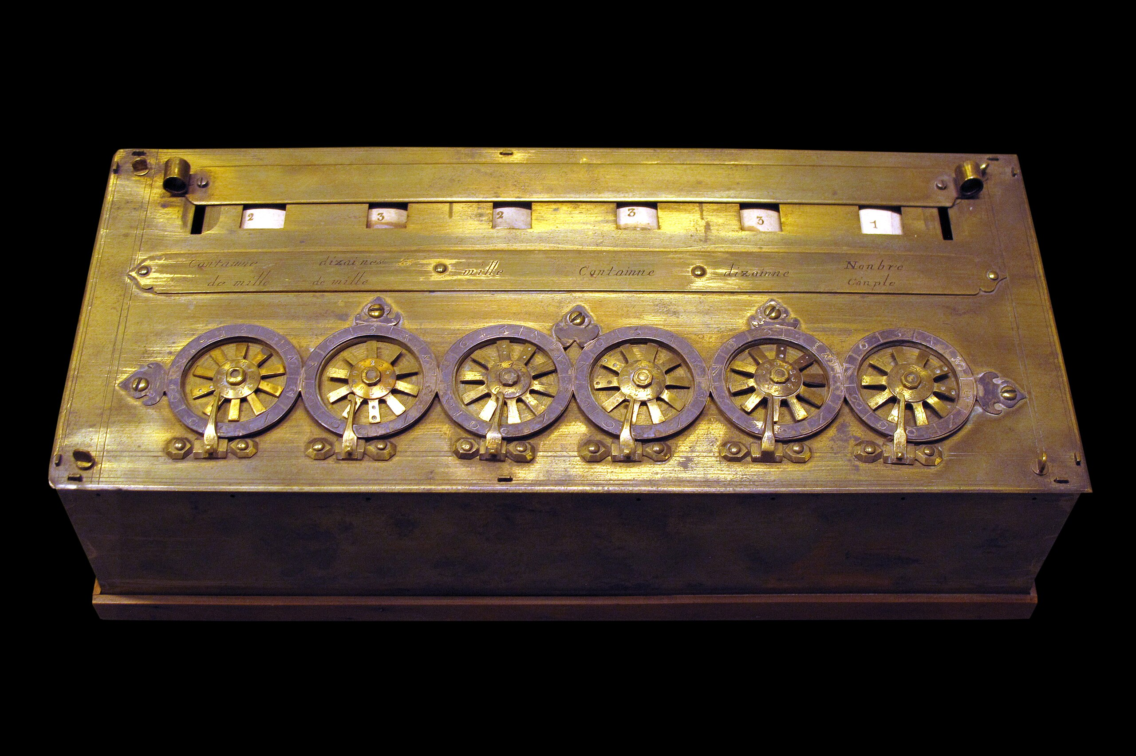
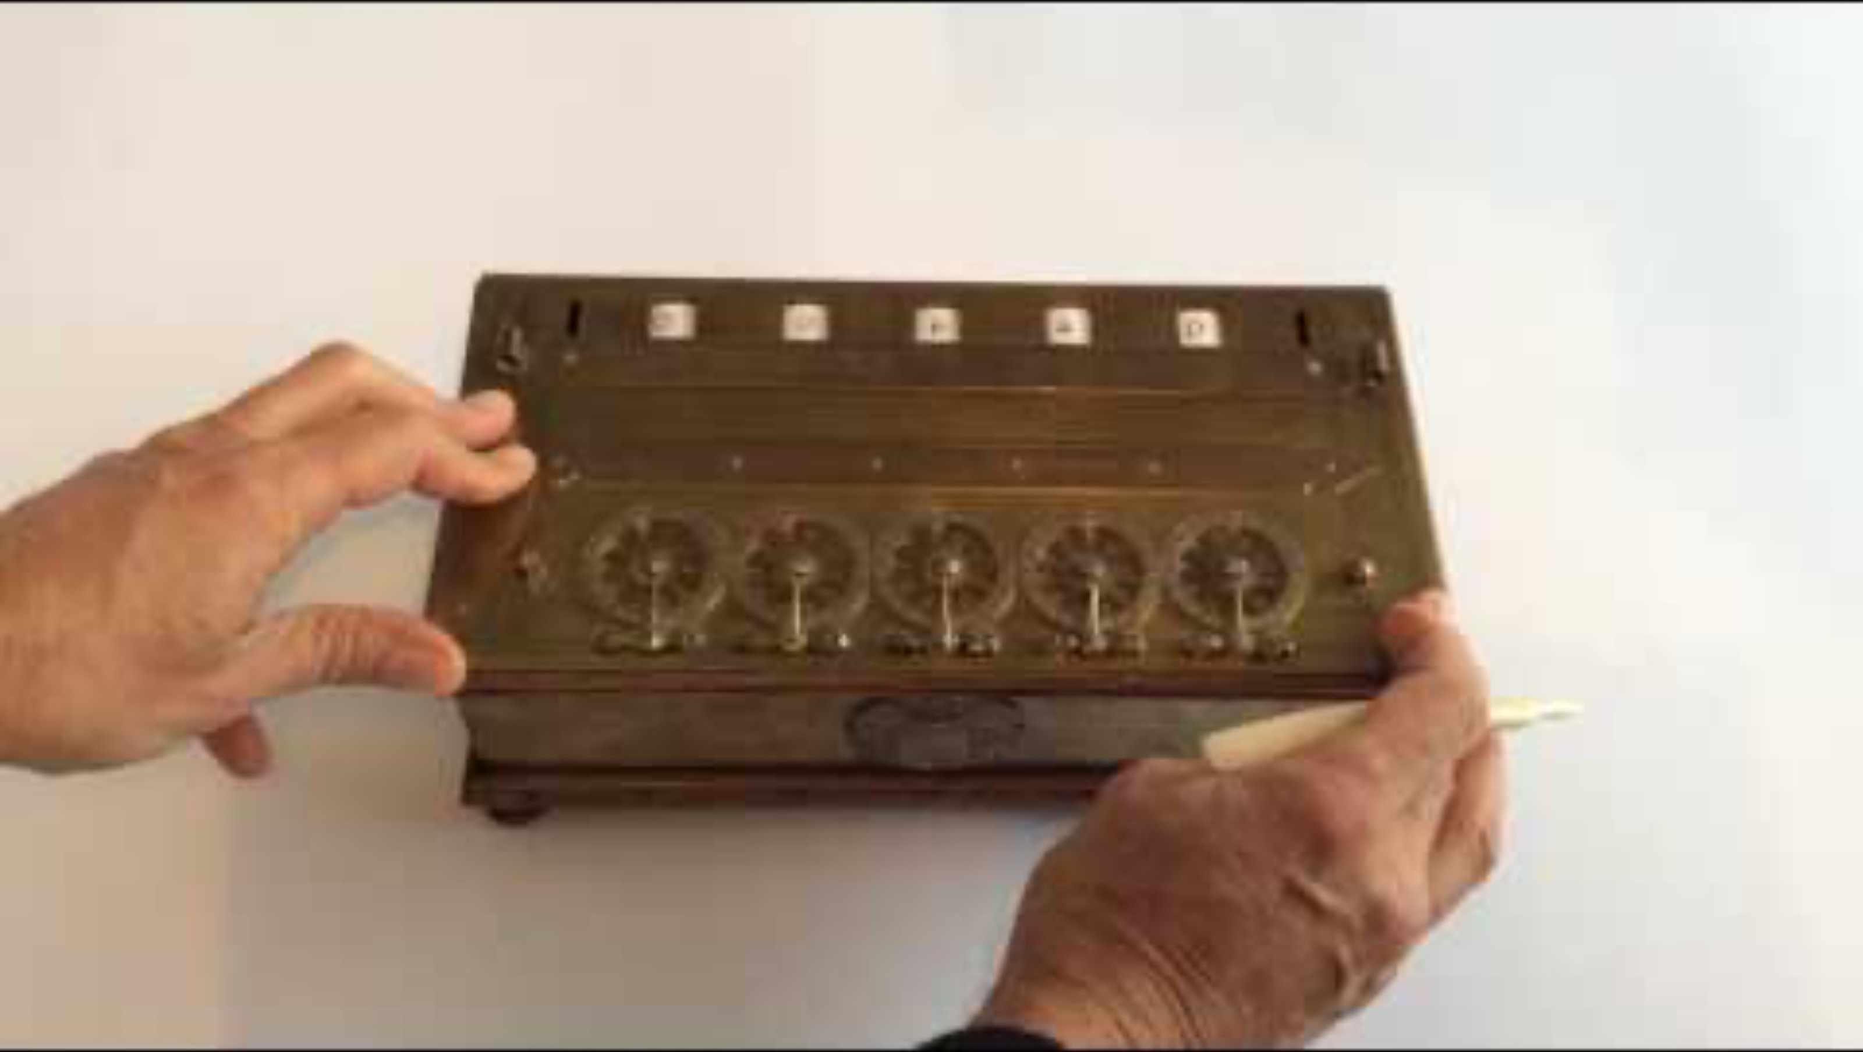
The Pascaline
Created by Blaise Pascal in the
1640s.
It could do addition and subtraction
by turning the wheels. Demo (in French)

Slide 9
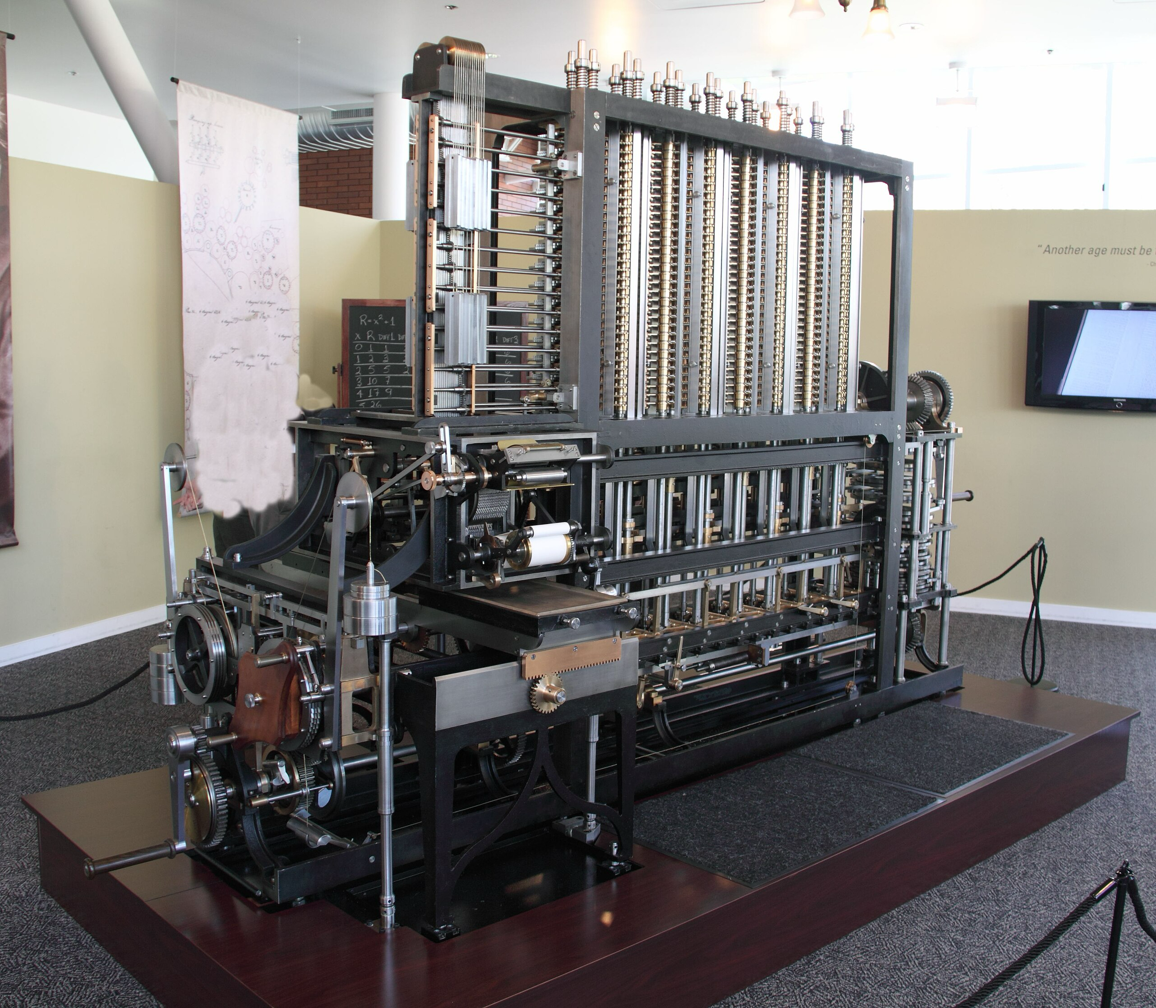
Charle’s Babbage’s Difference Engine
Designed by Charles Babbage in the 1820s, it was made to create tables of numbers using the method of “finite differences”.

Slide 10
Charle’s Babbage’s Difference Engine
Designed by Charles Babbage in the 1820s, it was made to create tables of numbers using the method of “finite differences”.
The British government gave funding, but by the 1840s had abandoned it. The full machine Babbage wanted to make was estimated to weigh 4 tons and 25,000 mechanical parts.

Slide 11
Charle’s Babbage’s Difference Engine
Designed by Charles Babbage in the 1820s, it was made to create tables of numbers using the method of “finite differences”.
The British government gave funding, but by the 1840s had abandoned it. The full machine Babbage wanted to make was estimated to weigh 4 tons and 25,000 mechanical parts.
While it was not a general-purpose computer, Babbage did later design a more sophisticated machine called the Analytical Engine which was a general-purpose computer in theory, although it was not implemented until the 1990s by the London Science Museum.

Slide 12
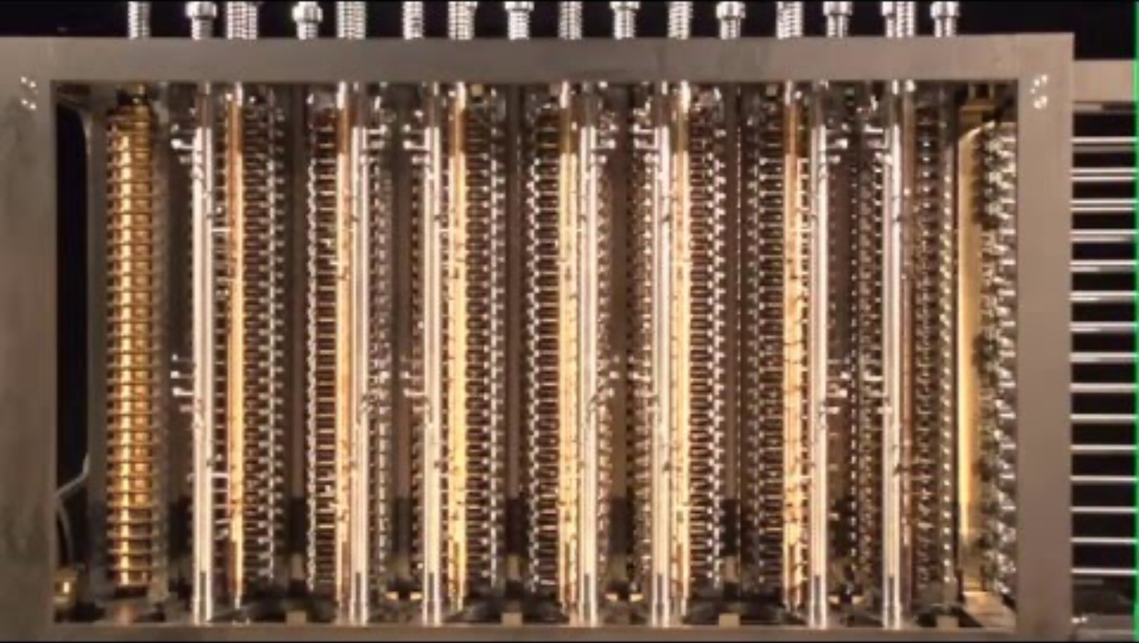
Charle’s Babbage’s Difference Engine

Slide 13
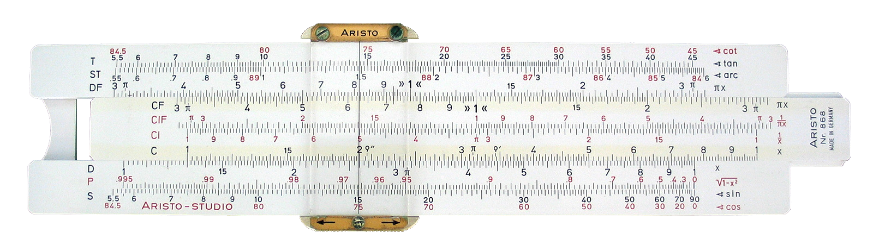

Slide Rule: Calculates Logarithms
Before hand-held calculators become common in the 1970s, many engineers and scientists
used slide rules to do multiplication and division. You need to know logarithms to use them.

Slide 14

In the 1930s, the idea of an electronic calculator was in the air!
ENIAC, 1945 1st automatic electronic computer
Glenn Beck Betty Snyder
Notes:
Things to notice:
It’s huge --- it takes up a whole room. But a smaller room and less hardware than the previous picture.
Programmed by plugging wires into different sockets.
You can see some of the vacuum tubes on the top left.
The plug boards on the right are on wheels.

Slide 15
In the 1930s, the idea of an electronic calculator was in the air!
Extremely challenging
to create, and many “partial”
computers were created before arriving at the designs we use today.
ENIAC, 1945 1st automatic electronic computer
Glenn Beck Betty Snyder
Notes:
Things to notice:
It’s huge --- it takes up a whole room. But a smaller room and less hardware than the previous picture.
Programmed by plugging wires into different sockets.
You can see some of the vacuum tubes on the top left.
The plug boards on the right are on wheels.

Slide 16
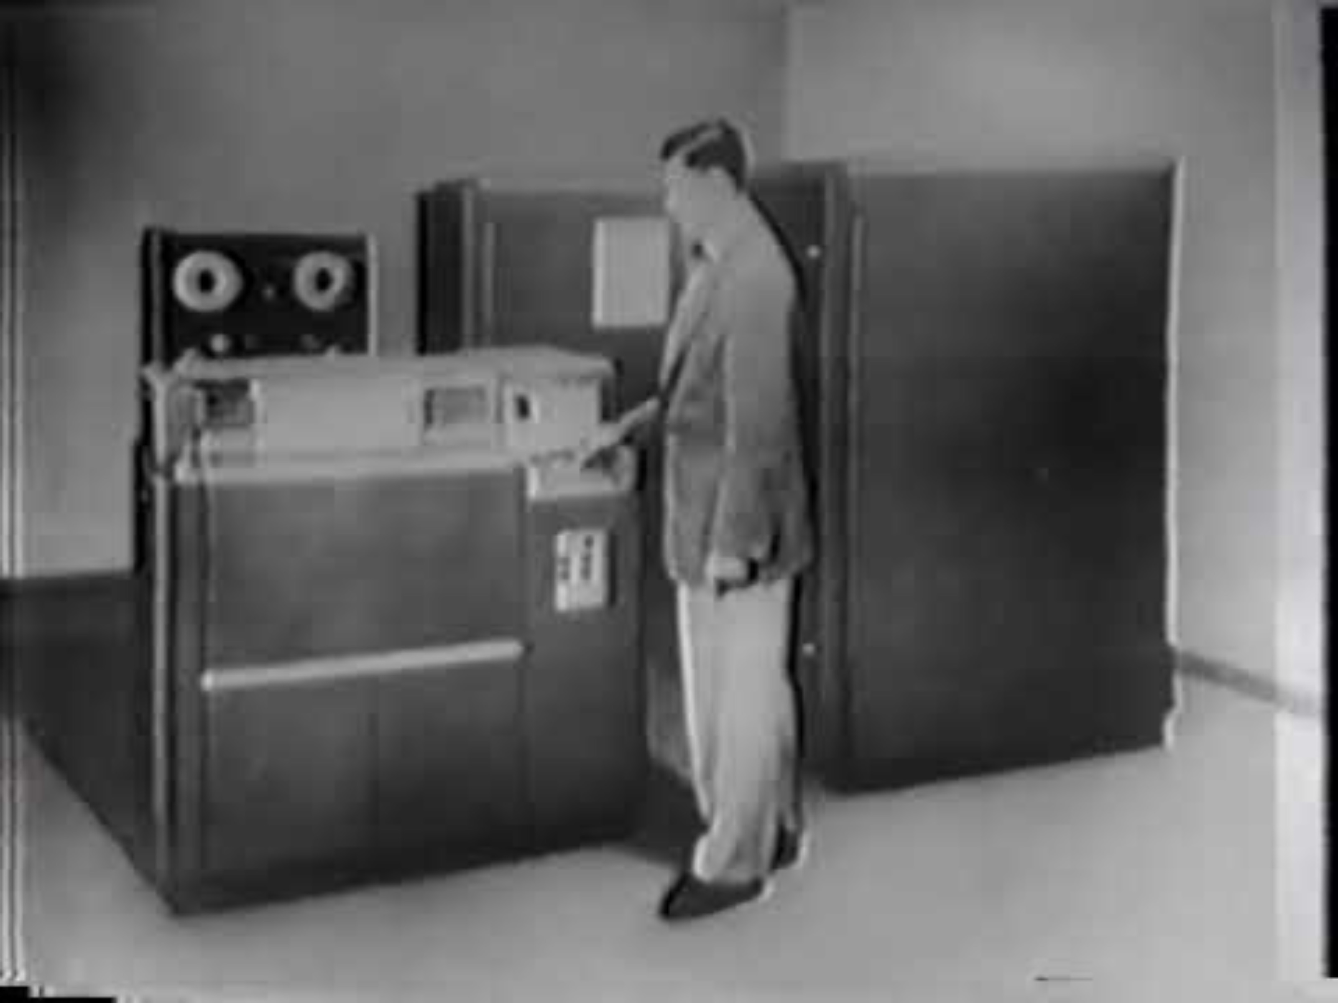
Univac TV Commercial (1954)

Slide 17
What is Computer Science?

Slide 18
What is Computer Science?
the systematic study of computation

Slide 19
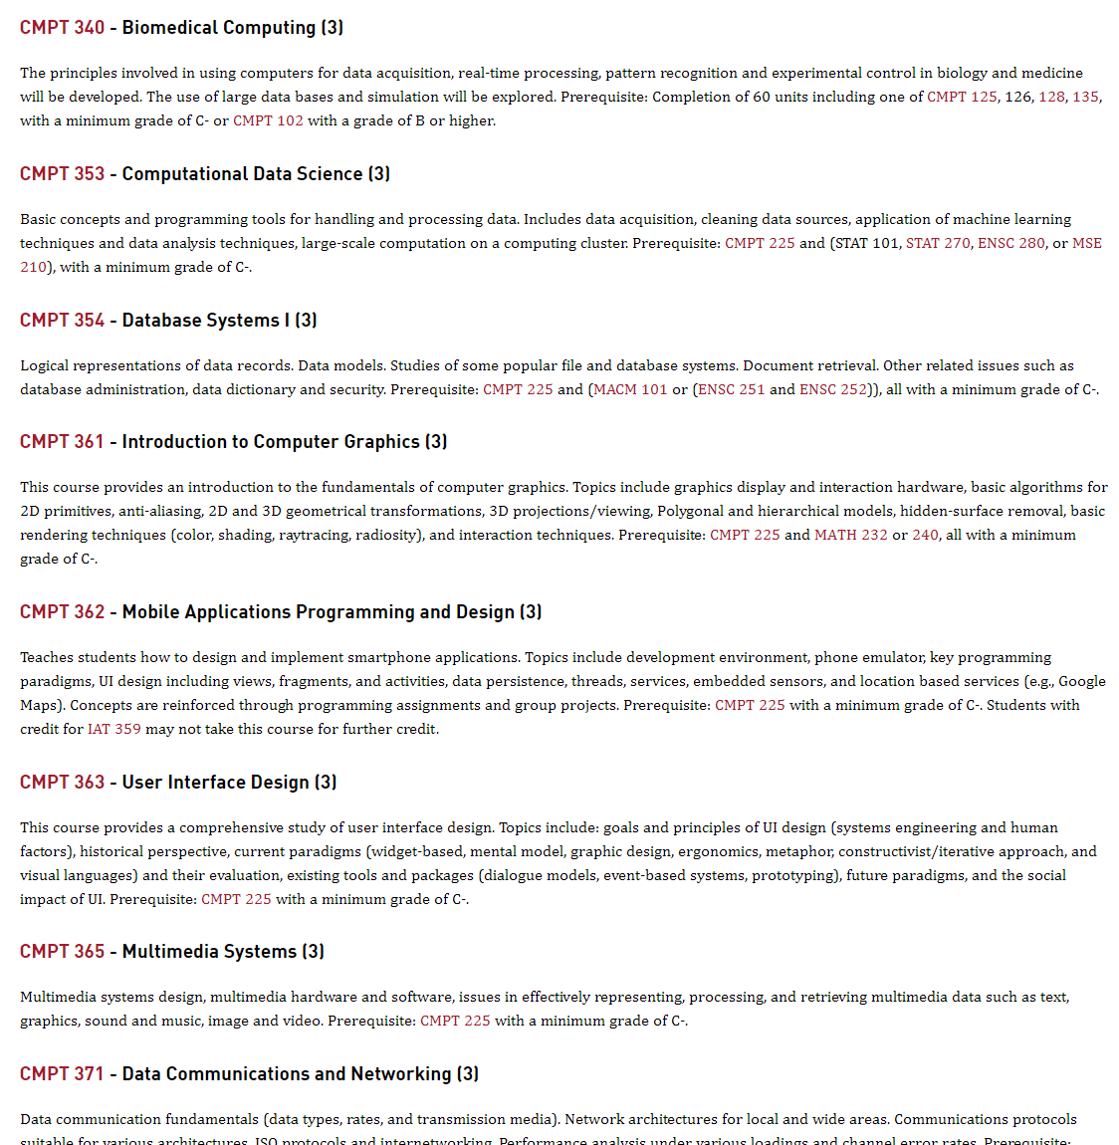
What is Computer Science?
the systematic study of computation
Programming, software engineering, databases, operating systems, computer graphics, multimedia systems, data science, machine learning, programming languages, computability and complexity theory, cryptography, networking, human-computer interaction, robotics, …

Slide 20

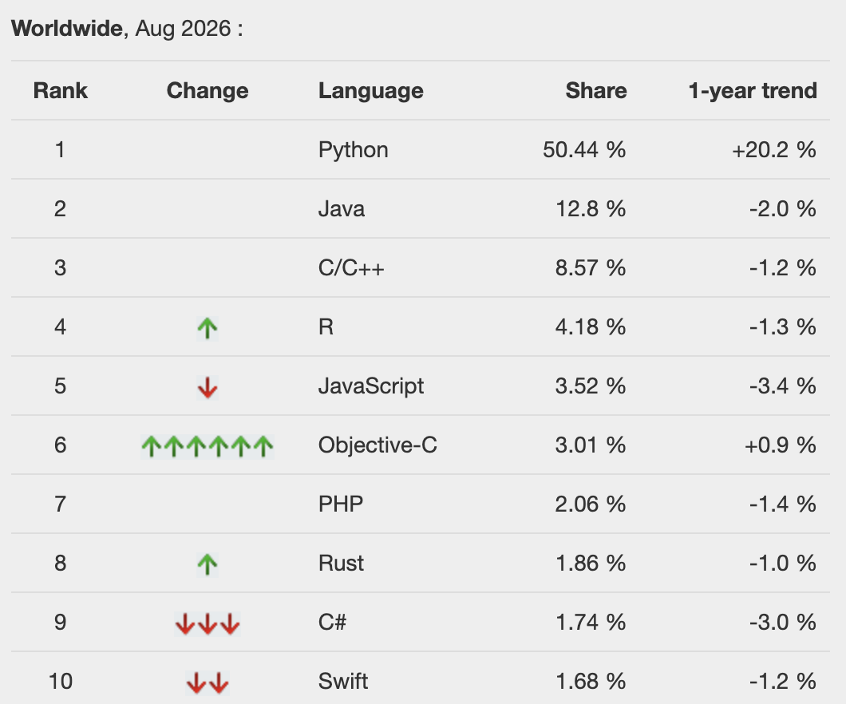
Is Python Popular?
Yes!
PYPL Popularity of Programming Language
(based on how often language tutorials are searched for) https://pypl.github.io/PYPL.html

Slide 21
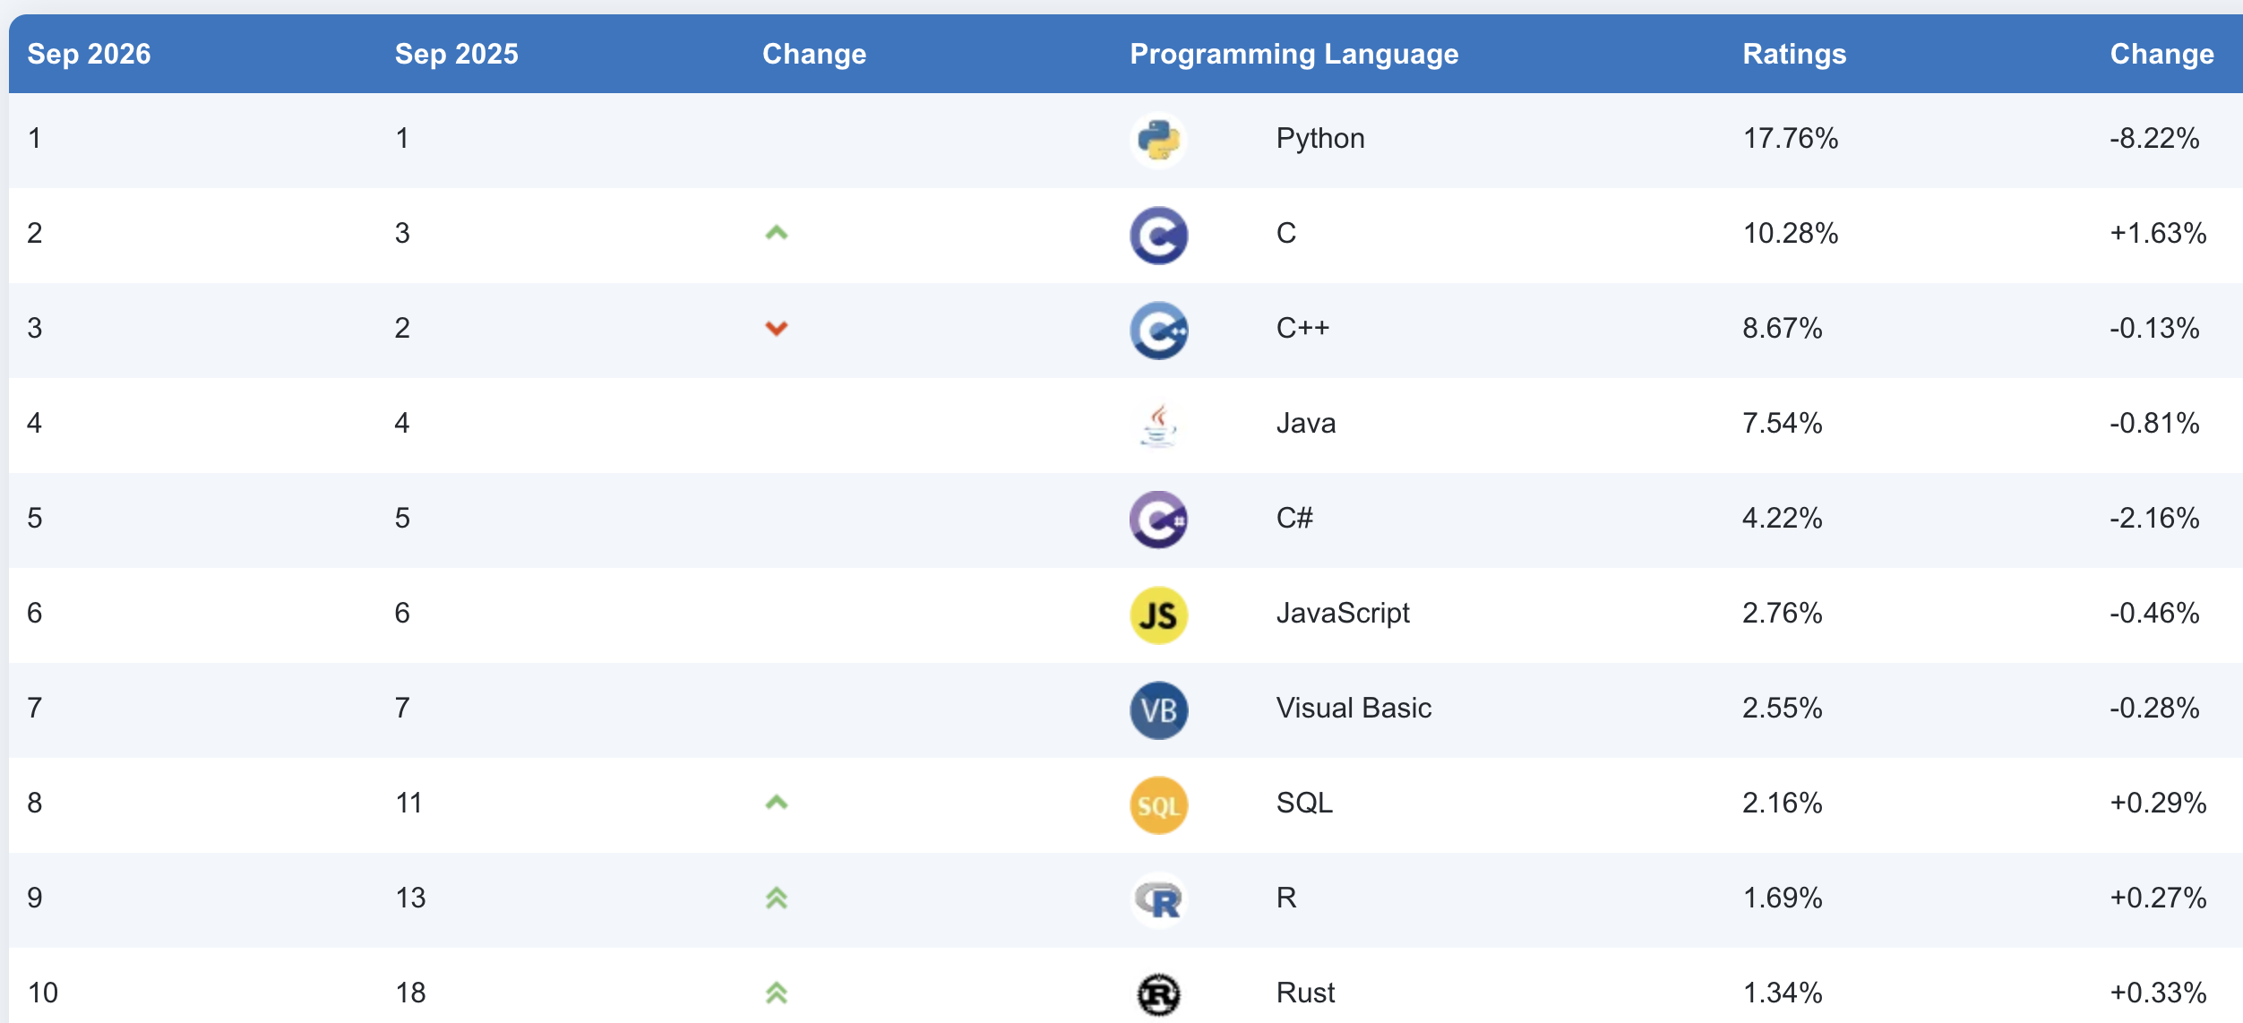
Is Python Popular?
Yes!
TIOBE Index
https://www.tiobe.com/tiobe-index/

Slide 22

Some popular Python libraries for data science and machine learning
Is Python popular in data science and machine learning (ML)?
Yes!

Slide 23
Python is also popular in …
Scripting
scripts are programs that “glue” together other programs, even ones written in other languages
Education
popular 1st programming language

Slide 24
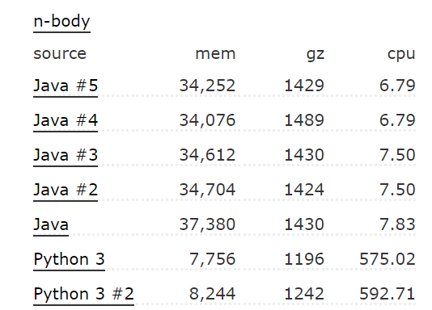
Are Python programs known for running efficiently?
No!
Java is another popular 1st programming language
n-body is a test program that calculates planetary orbits
From the Computer Languages Benchmark Game https://benchmarksgame-team.pages.debian.net/benchmarksgame/fastest/python3-java.html

Slide 25
If it’s so slow, why is it so popular?
It’s relatively easy to learn.
Python programs are often quite readable.
It’s programmer friendly … lots of useful built-in functions do most common programming tasks. Plus thousands more on the web.
Python generally aims to optimize programmer time (instead of run-time).

