Slide 1
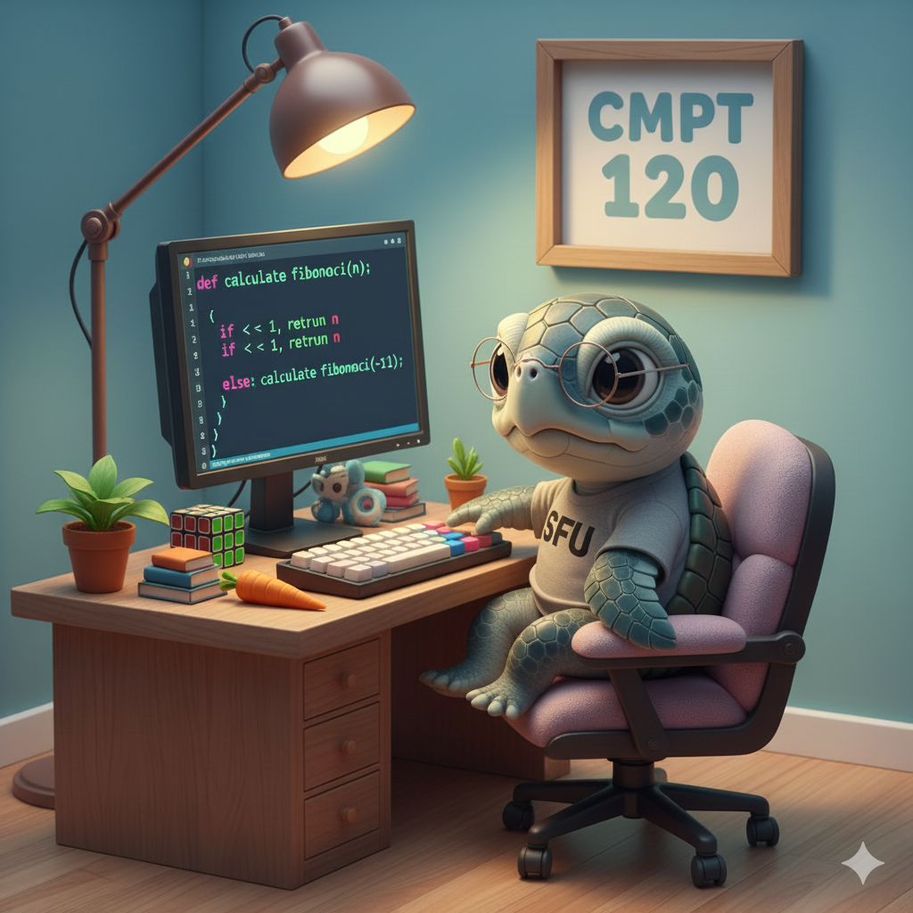
CMPT 120-D200
Spring 2026
SFU Burnaby
Instructor: Toby Donaldson

Slide 2
CMPT 120
An introduction to computer science and Python programming
Assumes you have not taken a prior programming course

Slide 3
CMPT 120
Check out Canvas
  Dates and grades of assignments, quizzes, and exams
  Office hours for teaching assistants (TAs)
  Announcements, tech support, etc.
Course notes are on a different website
  Find it through the Canvas home page
  Weekly lecture notes and homework activities (with solutions)

Slide 4
What’ll you’ll need for this course
All the notes are online
  Textbook is online
  Lectures and practice questions are based on the textbook

Slide 5
What’ll you’ll need for this course
All the notes are online
  Textbook is online
  Lectures and practice questions are based on the textbook
You should install Python on your own computer
  Go to python.org and download it

Slide 6
What’ll you’ll need for this course
All the notes are online
  Textbook is online
  Lectures and practice questions are based on the textbook
You should install Python on your own computer
  Go to python.org and download it
You need a programming text editor (IDE) to write and run programs
  IDLE, which comes with Python, is fine for this course
  VS Code is very popular (and the one I use)
  You can find other Python editors online, including web pages that run Python

Slide 7
What’ll you’ll need for this course
The lecture notes, homework questions, and assignments are mostly written in (Jupyter) notebooks
  You can view them directly on the web
  No need to interact with the notebooks, but here are some options if you want to:
    Google Colab (probably the easiest overall, but you need a Google account)
    Jupyter web viewer by typing a URL: https://nbviewer.org/
    VS Code, which takes a bit of setup; search the web for help

Slide 8
Background Survey
…

