Slide 1
Chapter 4
Turtle Graphics
Notes
Assignment 2 due this week
CMPT 120-D2 Spring 2026

Slide 2
Turtle Graphics
Turtle graphics is a way of making drawings
You imagine a turtle on the screen at some (x, y) position and facing some direction
It has a pen, so when it moves it draws a line
You draw shapes by giving the turtle commands like forward(10), left(90), forward(25), …
Python has a rich turtle graphics library that you can use by writing import turtle at the top of your program …

Slide 3
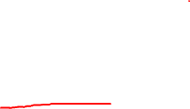
Turtle Graphics
import turtle
turtle.forward(100)
turtle.left(90)
turtle.forward(100)
turtle.left(90)
turtle.forward(100)
turtle.left(90)
turtle.forward(100)
turtle.left(90)
turtle.done()

Slide 4
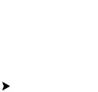
Turtle Graphics
import turtle
turtle.forward(100)
turtle.left(90)
turtle.forward(100)
turtle.left(90)
turtle.forward(100)
turtle.left(90)
turtle.forward(100)
turtle.left(90)
turtle.done()

Slide 5
Turtle Graphics
Gives access to turtle graphics.
import turtle
turtle.forward(100)
turtle.left(90)
turtle.forward(100)
turtle.left(90)
turtle.forward(100)
turtle.left(90)
turtle.forward(100)
turtle.left(90)
turtle.done()

Slide 6
Turtle Graphics
Gives access to turtle graphics.
import turtle
turtle.forward(100)
turtle.left(90)
turtle.forward(100)
turtle.left(90)
turtle.forward(100)
turtle.left(90)
turtle.forward(100)
turtle.left(90)
turtle.done()
Draws a square.

Slide 7
Turtle Graphics
Gives access to turtle graphics.
import turtle
turtle.forward(100)
turtle.left(90)
turtle.forward(100)
turtle.left(90)
turtle.forward(100)
turtle.left(90)
turtle.forward(100)
turtle.left(90)
turtle.done()
Draws a square.
Stops screen from closing immediately.

Slide 8
Turtle Graphics
Gives access to turtle graphics.
import turtle
turtle.forward(100)
turtle.left(90)
turtle.forward(100)
turtle.left(90)
turtle.forward(100)
turtle.left(90)
turtle.forward(100)
turtle.left(90)
turtle.done()
Draws a square.
Stops screen from closing immediately.

Slide 9
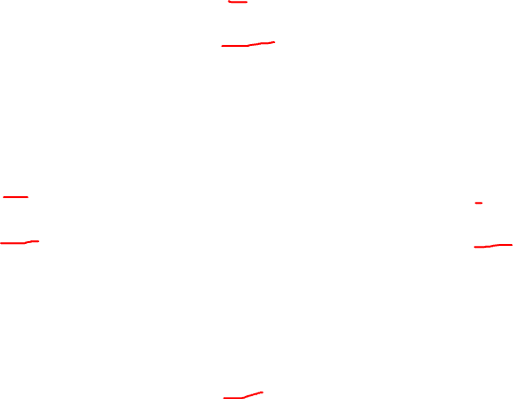
Turtle Graphics
90 makes turtle face north
The default turtle screen coordinates are as in math …
180 makes turtle face west
0 makes turtle face east
Turtle starts at the origin, at (0, 0) in the center of the screen.
It always starts facing to the right (east).
270 makes turtle face south

Slide 10
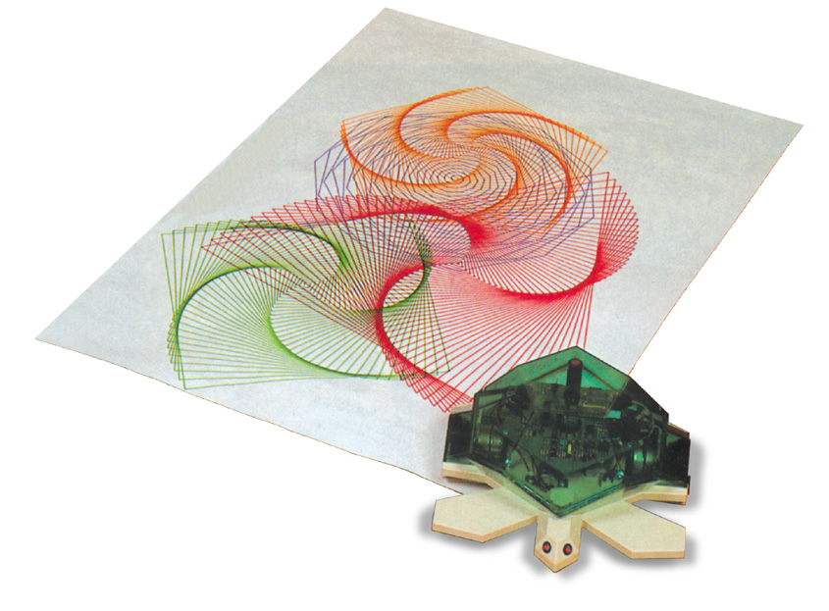
Turtle Graphics
The Python turtle graphics page (search “Python turtle graphics”) shows the many commands for turtle graphics
Famously, turtle graphics was added to the kids programming language Logo in the 1960s by computer scientist Seymour Papert
He used it with robots that drew on paper
Despite begin easy enough for elementary school
kids, it is one of many tools graphics programmers
use

