Slide 1

Chapter 5 Booleans, if-statements, and recursion
CMPT 120-D2 Spring 2026

Slide 2
The Remainder Operator
7 % 1 == ??
1 goes into 7 seven times, with 0 left over
N % A is how much is “left over” when A is divided into N.

Slide 3
The Remainder Operator
7 % 1 == 0
1 goes into 7 seven times, with 0 left over
N % A is how much is “left over” when A is divided into N.

Slide 4
The Remainder Operator
7 % 1 == 0
1 goes into 7 seven times, with 0 left over
7 % 2 == ??
2 goes into 7 three times, with 1 left over
N % A is how much is “left over” when A is divided into N.

Slide 5
The Remainder Operator
7 % 1 == 0
1 goes into 7 seven times, with 0 left over
7 % 2 == 1
2 goes into 7 three times, with 1 left over
N % A is how much is “left over” when A is divided into N.

Slide 6
The Remainder Operator
7 % 1 == 0
1 goes into 7 seven times, with 0 left over
7 % 2 == 1
2 goes into 7 three times, with 1 left over
7 % 3 == ??
3 goes into 7 two times, with 1 left over
N % A is how much is “left over” when A is divided into N.

Slide 7
The Remainder Operator
7 % 1 == 0
1 goes into 7 seven times, with 0 left over
7 % 2 == 1
2 goes into 7 three times, with 1 left over
7 % 3 == 1
3 goes into 7 two times, with 1 left over
N % A is how much is “left over” when A is divided into N.

Slide 8
The Remainder Operator
7 % 1 == 0
1 goes into 7 seven times, with 0 left over
7 % 2 == 1
2 goes into 7 three times, with 1 left over
7 % 3 == 1
3 goes into 7 two times, with 1 left over
N % A is how much is “left over” when A is divided into N.
7 % 4 == ??
7 % 5 == ??
7 % 6 == ??
7 % 7 == ??

Slide 9
The Remainder Operator
7 % 1 == 0
1 goes into 7 seven times, with 0 left over
7 % 2 == 1
2 goes into 7 three times, with 1 left over
7 % 3 == 1
3 goes into 7 two times, with 1 left over
N % A is how much is “left over” when A is divided into N.
7 % 4 == 3
7 % 5 == ??
7 % 6 == ??
7 % 7 == ??

Slide 10
The Remainder Operator
7 % 1 == 0
1 goes into 7 seven times, with 0 left over
7 % 2 == 1
2 goes into 7 three times, with 1 left over
7 % 3 == 1
3 goes into 7 two times, with 1 left over
N % A is how much is “left over” when A is divided into N.
7 % 4 == 3
7 % 5 == 2
7 % 6 == ??
7 % 7 == ??

Slide 11
The Remainder Operator
7 % 1 == 0
1 goes into 7 seven times, with 0 left over
7 % 2 == 1
2 goes into 7 three times, with 1 left over
7 % 3 == 1
3 goes into 7 two times, with 1 left over
N % A is how much is “left over” when A is divided into N.
7 % 4 == 3
7 % 5 == 2
7 % 6 == 1
7 % 7 == ??

Slide 12
The Remainder Operator
7 % 1 == 0
1 goes into 7 seven times, with 0 left over
7 % 2 == 1
2 goes into 7 three times, with 1 left over
7 % 3 == 1
3 goes into 7 two times, with 1 left over
N % A is how much is “left over” when A is divided into N.
7 % 4 == 3
7 % 5 == 2
7 % 6 == 1
7 % 7 == 0

Slide 13
The Remainder Operator
7 % 1 == 0
7 % 8 == ??
7 % 2 == 1
7 % 9 == ??
7 % 3 == 1
7 % 10 == ??
N % A is how much is “left over” when A is divided into N.
7 % 4 == 3
7 % 5 == 2
7 % 6 == 1
7 % 7 == 0

Slide 14
The Remainder Operator
7 % 1 == 0
7 % 8 == 7
7 % 2 == 1
7 % 9 == ??
7 % 3 == 1
7 % 10 == ??
N % A is how much is “left over” when A is divided into N.
7 % 4 == 3
7 % 5 == 2
7 % 6 == 1
7 % 7 == 0

Slide 15
The Remainder Operator
7 % 1 == 0
7 % 8 == 7
7 % 2 == 1
7 % 9 == 7
7 % 3 == 1
7 % 10 == ??
N % A is how much is “left over” when A is divided into N.
7 % 4 == 3
7 % 5 == 2
7 % 6 == 1
7 % 7 == 0

Slide 16
The Remainder Operator
7 % 1 == 0
7 % 8 == 7
7 % 2 == 1
7 % 9 == 7
7 % 3 == 1
7 % 10 == 7
N % A is how much is “left over” when A is divided into N.
7 % 4 == 3
7 % 5 == 2
7 % 6 == 1
7 % 7 == 0

Slide 17
The Remainder Operator
N % A is how much is “left over” when A is divided into N.
7 % 0 == ???

Slide 18
The Remainder Operator
N % A is how much is “left over” when A is divided into N.
7 % 0 == ZeroDivisionError

Slide 19
The Remainder Operator
N % A is how much is “left over” when A is divided into N.
In a crowd of 249 people:
How many groups of exactly 14 people can be made?
How many people are left-over?

Slide 20
The Remainder Operator
N % A is how much is “left over” when A is divided into N.
In a crowd of 249 people:
How many groups of exactly 14 people can be made?
>>> 249 // 14 17
How many people are left-over?

Slide 21
The Remainder Operator
N % A is how much is “left over” when A is divided into N.
In a crowd of 249 people:
How many groups of exactly 14 people can be made?
>>> 249 // 14 17
How many people are left-over?
>>> 249 % 14 11
14 * 17 + 11 = 249

Slide 22
The Remainder Operator
N % A is how much is “left over” when A is divided into N.
N % 2 == 0 means N is even, i.e. 0 left-over when dividing by 2
N % 2 == 1 means N is odd, i.e. 1 left-over when dividing by 2
N % 10 the right-most digit of N e.g. 346 % 10 == 6

Slide 23
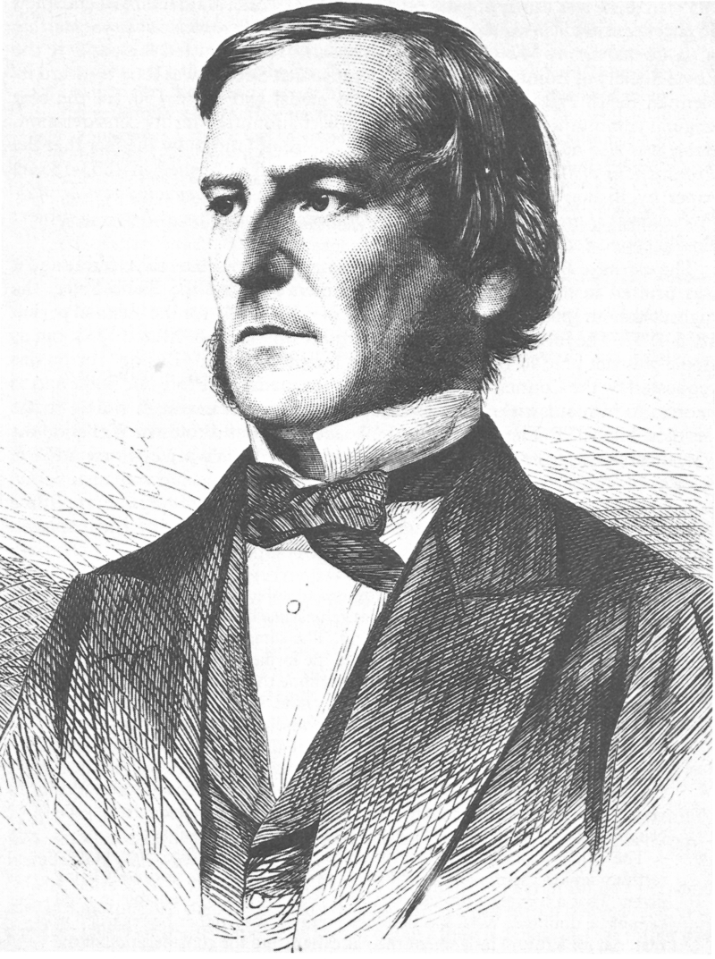
George Boole 1815 - 1864
British mathematician and philosopher
Formalized propositional logic into the form we use today

Slide 24
Boolean Expressions
A Boolean expression is any expression that evaluates to either True or False
>>> True True >>> False
False

Slide 25
Boolean Expressions
A Boolean expression is any expression that evaluates to either True or False
>>> 2 == 2 True >>> 5 == 4
False

Slide 26
Boolean Expressions
A Boolean expression is any expression that evaluates to either True or False
>>> 1 + 3 == 4 * (2 – 1) True >>> 1 + 3 == 3 - 1
False

Slide 27
Boolean Expressions
A Boolean expression is any expression that evaluates to either True or False
>>> 'up' == 'up' True >>> 'cat ' == 'cat'
False

Slide 28
Boolean Expressions
A Boolean expression is any expression that evaluates to either True or False
>>> 'cat' + 's' == 'cats' True >>> 3 * 'a' == 'a' + 'aaa'
False

Slide 29
Boolean Expressions
A Boolean expression is any expression that evaluates to either True or False
a = 2
b = 3
>>> a == b False >>> 2*a == b + 1
True

Slide 30
Boolean Expressions
A single = means an assignment statement: A copy of the value of b is put into variable a.
a = b
a == b
Double == means equality: are a and b the same value?

Slide 31
Boolean Expressions
!= is the not equal operator, and it returns the opposite of ==
>>> 2 == 2 True >>> 5 == 4
False
>>> 2 != 2 False >>> 5 != 4
True

Slide 32
Boolean Expressions
!= is the not equal operator, and it returns the opposite of ==
>>> 'up' == 'up' True >>> 'Cat' == 'cat'
False
>>> 'up' != 'up’ False >>> 'Cat' != 'cat’
True

Slide 33
Boolean Expressions
>>> 2 * 8 < 20
True
>>> 5 - 1 < 4
False
s < t is True just when
s is smaller than t (when they are numbers)
s is alphabetically before t (when they are strings)
Otherwise, s < t is False.
>>> 'cow' < 'shoe'
True
>>> 'bird' < 'bat'
False >>> 'on' < 'on'
False

Slide 34
Boolean Expressions
>>> 2 * 8 > 20
False
>>> 5 - 1 < 4
False
s > t is True just when
s is bigger than t (when they are numbers)
s is alphabetically after t (when they are strings)
Otherwise, s > t is False.
>>> 'cow' > 'shoe’
False
>>> 'bird' > 'bat’
True >>> 'on' > 'on'
False

Slide 35
Boolean Expressions
>>> 2 * 8 <= 20
True
>>> 5 - 1 <= 4
True
s <= t is True just when
s is less than, or equal to, t (when they are numbers)
s is alphabetically before, or equal to, t (when they are strings)
Otherwise, s <= t is False.
>>> 'cow' <= 'shoe'
True
>>> 'bird' <= 'bat'
False >>> 'on' <= 'on’
True

Slide 36
Boolean Expressions
>>> 2 * 8 >= 20
False
>>> 5 - 1 >= 4
True
s >= t is True just when
s is greater than, or equal to, t (when they are numbers)
s is alphabetically after, or equal to, t (when they are strings)
Otherwise, s >= t is False.
>>> 'cow' >= 'shoe’
False
>>> 'bird' >= 'bat’
True >>> 'on' >= 'on’
True

Slide 37
Boolean Expressions
>>> 5 < 6 < 7
True
>>> 5 < 7 < 6 False
>>> 'a' < 'm' < 'x' < 'y'
True
>>> 'shoe' <= 'lace' <= '!'
False
In Python, chaining inequalities together works like in math.
In many other programming languages, this does not work as you would expect!

Slide 38
Logical Operators
If A and B are Boolean expressions, then we can combine them in the following ways to make new Boolean expressions:
A and B A or B
not A

Slide 39
Logical Operators
This is a truth table for the and operator.
A | B | A and B
True | True | True
True | False | False
False | True | False
False | False | False
If A and B are Boolean expressions, then we can combine them in the following ways to make new Boolean expressions:
A and B A or B
not A
>>> False and (1 == 3)
False
>>> 1 < 3 and 'dog' > 'cat'
True

Slide 40
Logical Operators
This is a truth table for the or operator.
A | B | A or B
True | True | True
True | False | True
False | True | True
False | False | False
If A and B are Boolean expressions, then we can combine them in the following ways to make new Boolean expressions:
A and B A or B
not A
>>> False or (1 == 3)
False
>>> 1 < 3 or 'dog' > 'cat'
True

Slide 41
Logical Operators
This is a truth table for the not operator.
A | not A
True | False
False | True
If A and B are Boolean expressions, then we can combine them in the following ways to make new Boolean expressions:
A and B A or B
not A
>>> not False
True
>>> not (3 < 4)
False
>>> not (1 < 2 and 3 <= 4)
False

Slide 42
If-statements (conditionals)
An if-statement runs a block of code just when some Boolean expression is true.
x = 2
if x > 0:
print("x is positive")

Slide 43
If-statements (conditionals)
This is a simple if-statement consisting of a header and a body.
An if-statement runs a block of code just when some Boolean expression is true.
x = 2
if x > 0:
print("x is positive")

Slide 44
If-statements (conditionals)
The header:
Starts with if
Is followed by a Boolean expression
Ends with :
An if-statement runs a block of code just when some Boolean expression is true.
x = 2
if x > 0:
print("x is positive")

Slide 45
If-statements (conditionals)
The header:
Starts with if
Is followed by a Boolean expression
Ends with :
An if-statement runs a block of code just when some Boolean expression is true.
x = 2
if x > 0:
print("x is positive")

Slide 46
If-statements (conditionals)
The header:
Starts with if
Is followed by a Boolean expression
Ends with :
An if-statement runs a block of code just when some Boolean expression is true.
x = 2
if x > 0:
print("x is positive")

Slide 47
If-statements (conditionals)
The header:
Starts with if
Is followed by a Boolean expression
Ends with :
An if-statement runs a block of code just when some Boolean expression is true.
x = 2
if x > 0:
print("x is positive")

Slide 48
If-statements (conditionals)
An if-statement runs a block of code just when some Boolean expression is true.
x = 2
if x > 0:
print("x is positive")
The body of an if-statement must be consistently indented under the header.

Slide 49
If-statements (conditionals)
x = 8
if x % 2 == 0:
print("x is even")
else:
print("x is odd")
An if-else statement runs a block of code just when some Boolean expression is true, and a different block of code when the expression is false.

Slide 50
If-statements (conditionals)
x = 8
This if a flow chart. It visually shows the flow of an if-statement.
x % 2 == 0
True
x = 8
if x % 2 == 0:
print("x is even")
else:
print("x is odd")
False
print("x is odd")
print("x is even")
Notice that there are two different execution paths to get from the top to the bottom.

Slide 51
If-statements (conditionals)
The if-statement part is like the previous if-statement.
x = 8
if x % 2 == 0:
print("x is even")
else:
print("x is odd")
An if-else statement runs a block a block of code just when some Boolean expression is true, and a different block of code when the expression is false.

Slide 52
If-statements (conditionals)
x = 8
if x % 2 == 0:
print("x is even")
else:
print("x is odd")
An if-else statement runs a block a block of code just when some Boolean expression is true, and a different block of code when the expression is false.
The else-part has a different structure …

Slide 53
If-statements (conditionals)
x = 8
if x % 2 == 0:
print("x is even")
else:
print("x is odd")
An if-else statement runs a block a block of code just when some Boolean expression is true, and a different block of code when the expression is false.
It starts with else and ends with : and must be consistently indented with the if above it.

Slide 54
If-statements (conditionals)
x = 8
if x % 2 == 0:
print("x is even")
else:
print("x is odd")
An if-else statement runs a block a block of code just when some Boolean expression is true, and a different block of code when the expression is false.
The body of the else part must be consistently indented under the else: and should be the same indentation level as for the if body.

Slide 55
If-statements (conditionals)
x = 8
if x % 2 == 0:
print("x is even")
else:
print("x is odd")
An if-else statement runs a block a block of code just when some Boolean expression is true, and a different block of code when the expression is false.
If the condition x % 2 == 0 is True, then just this code is run (and the else code is skipped)

Slide 56
If-statements (conditionals)
x = 8
if x % 2 == 0:
print("x is even")
else:
print("x is odd")
An if-else statement runs a block a block of code just when some Boolean expression is true, and a different block of code when the expression is false.
If the condition x % 2 == 0 is False, then just this code is run (and the if code is skipped)

Slide 57
If-statements (conditionals)
Exactly one of the bodies is run. They never both run.
x = 8
if x % 2 == 0:
print("x is even")
else:
print("x is odd")
An if-else statement runs a block a block of code just when some Boolean expression is true, and a different block of code when the expression is false.

Slide 58
If-statements (conditionals)
x = 4
y = 5
if x < y:
print('x is less than y')
elif x > y:
print('x is greater than y')
else:
print('x and y are equal')
An if-elif-else statement is the most general kind of if-statement and can check multiple conditionals.

Slide 59
If-statements (conditionals)
x = 4
y = 5
if x < y:
print('x is less than y')
elif x > y:
print('x is greater than y')
else:
print('x and y are equal')
An if-elif-else statement is the most general kind of if-statement and can check multiple conditionals.

Slide 60
If-statements (conditionals)
x = 4
y = 5
if x < y:
print('x is less than y')
elif x > y:
print('x is greater than y')
else:
print('x and y are equal')
An if-elif-else statement is the most general kind of if-statement and can check multiple conditionals.
Notice it is spelled elif Not else if, not elseif, …

Slide 61
If-statements (conditionals)
x = 4
y = 5
if x < y:
print('x is less than y')
elif x > y:
print('x is greater than y')
else:
print('x and y are equal')
An if-elif-else statement is the most general kind of if-statement and can check multiple conditionals.
The conditions are always checked in the order they occur.

Slide 62
If-statements (conditionals)
x = 4
y = 5
if x < y:
print('x is less than y')
elif x > y:
print('x is greater than y')
else:
print('x and y are equal')
An if-elif-else statement is the most general kind of if-statement and can check multiple conditionals.
The else part is optional.

Slide 63
If-statements (conditionals)
x = 4
y = 5
if x < y:
print('x is less than y')
elif x > y:
print('x is greater than y')
An if-elif-else statement is the most general kind of if-statement and can check multiple conditionals.
The else part is optional.

Slide 64
If-statements (conditionals)
Another example of an if-elif-else statement, showing more elaborate conditionals.
x = 1
y = 2
if x % 2 == 0 and y % 2 == 0:
print('x and y are both even')
elif x % 2 == 1 and y % 2 == 1:
print('x is odd') print('y is odd')
else:
print('x and y are different parity')
An if-elif-else statement is the most general kind of if-statement and can check multiple conditionals.

Slide 65
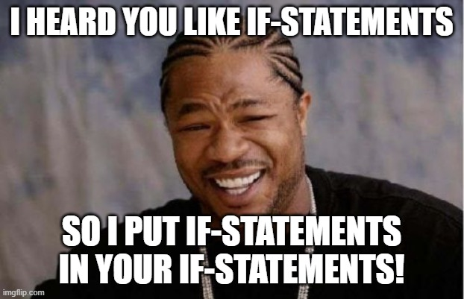
If-statements (conditionals)
x = 4
y = 5
if x == y:
print('x and y are equal')
else:
if x < y:
print('x is less than y')
else:
print('x is greater than y')
You can put if-statements inside if-statements. These are called nested conditionals.

Slide 66
If-statements (conditionals)
x = 4
y = 5
if x == y:
print('x and y are equal')
else:
if x < y:
print('x is less than y')
else:
print('x is greater than y')
x = 4
y = 5
if x == y:
print('x and y are equal')
elif x < y:
print('x is less than y')
else:
print('x is greater than y')
Same
In general, try to avoid nested conditionals.
Non-nested “flat” conditionals are often easier to read.

Slide 67
If-statements (conditionals)
if condition1:
The conditions are checked in the order they occur, from top to bottom.
Code block 1
elif condition2:
Code block 2
For the first condition that is true, the corresponding code block is executed.
elif condition3:
An if-elif-else statement is the most general kind of if-statement and can check multiple conditionals.
Code block 3
. .
.
After the code block finishes, the computer jumps out and runs the code that comes after the if-elif-else statement.
elif conditionN:
Code block N
else:
So, when there is an else, exactly one of the code blocks is executed.
The elif and else parts of an if-statement are optional. Whether you need them depends upon your program.
Code Block N+1

Slide 68

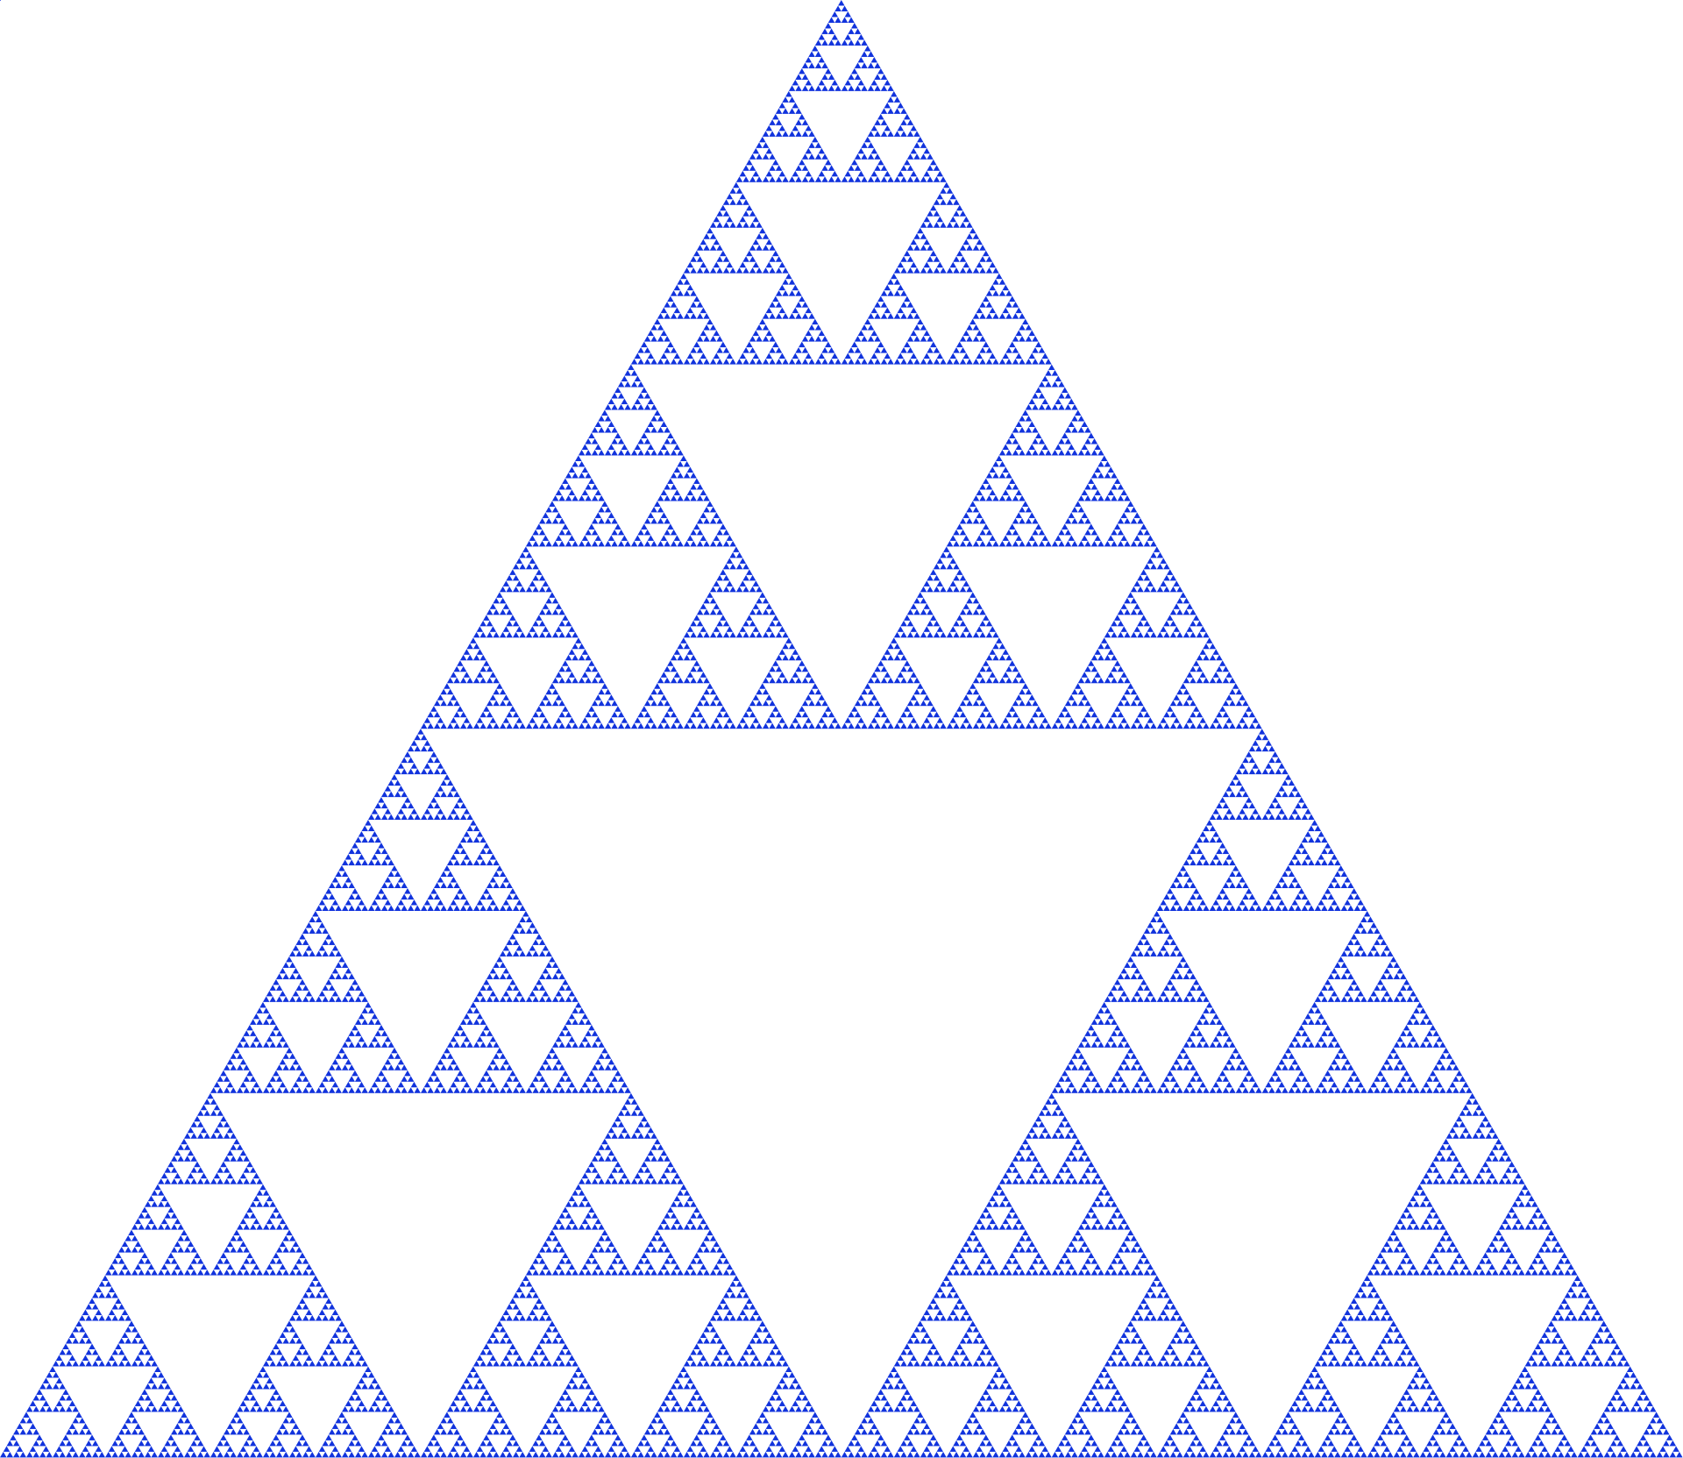
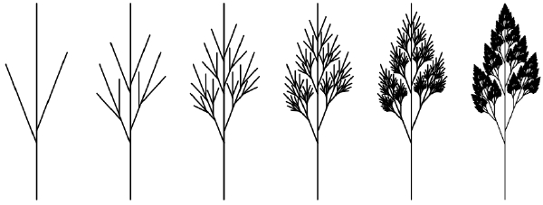
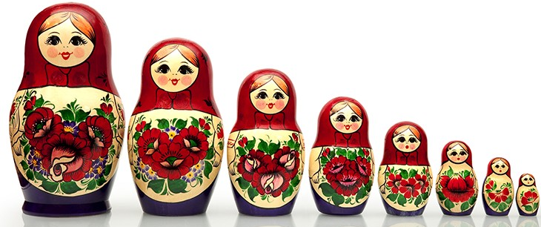
Recursive Functions
In general, recursion is the idea of making a thing out of smaller copies of that thing. We often see this is nature and math.

Slide 69
Recursive Functions
Recursive functions are not very common in practice.
But they appear all the time in the theory of computer science!
Recursion is at the core of computation.

Slide 70
Recursive Functions
A function is recursive if it calls itself.
forever()
def forever():
forever()

Slide 71
Recursive Functions
A function is recursive if it calls itself.
forever()
def forever():
forever()
In theory, this causes an infinite loop when called: forever() keeps getting called and it never stops …

Slide 72
Recursive Functions
A function is recursive if it calls itself.
forever()
def forever():
forever()
In theory, this causes an infinite loop when called: runs forever and never stops …
… but in practice each function call uses a little memory, so eventually all memory is used and it crashes.

Slide 73
Recursive Functions
def countdown(n):
if n <= 0:
print('Blastoff!')
else:
print(n)
countdown(n-1)
This recursive function prints this:
>>> countdown(3)
3
2
1
Blastoff!

Slide 74
Recursive Functions
def countdown(n):
if n <= 0:
print('Blastoff!')
else:
print(n)
countdown(n-1)
This recursive function prints this:
>>> countdown(3)
3
2
1
Blastoff!
You can tell that this is recursive because it calls itself.

Slide 75
Recursive Functions
def countdown(n):
if n <= 0:
print('Blastoff!')
else:
print(n)
countdown(n-1)
This recursive function prints this:
>>> countdown(3)
3
2
1
Blastoff!
You can tell that this is recursive because it calls itself.
Importantly, it is called with n-1. This ensures it will eventually stop.

Slide 76
Recursive Functions
def countdown(n):
if n <= 0:
print('Blastoff!')
else:
print(n)
countdown(n-1)
Useful recursive functions are usually structured as if-statements.
This recursive function prints this:
>>> countdown(3)
3
2
1
Blastoff!

Slide 77
Recursive Functions
def countdown(n):
if n <= 0:
print('Blastoff!')
else:
print(n)
countdown(n-1)
This part is non-recursive. It is called a base case.
This recursive function prints this:
>>> countdown(3)
3
2
1
Blastoff!

Slide 78
Recursive Functions
def countdown(n):
if n <= 0:
print('Blastoff!')
else:
print(n)
countdown(n-1)
This part is non-recursive. It is called a base case.
This recursive function prints this:
>>> countdown(3)
3
2
1
Blastoff!
This part is recursive. It is called a recursive case.
Every useful recursive function has at 1 or more base cases, and 1 or more recursive cases.

Slide 79
Recursive Functions
When a function is called in Python, it is put on the call stack. The first function called is at the bottom, the most recent function called is at the top.
We start out with an empty stack, since no functions have been called yet …
Call Stack (bottom)

Slide 80
Recursive Functions
def countdown(2):
if 2 <= 0:
print('Blastoff!')
else:
print(2)
countdown(2-1)
2 <= 0 is False, so we skip to the else part.
First countdown(2) is called. It’s at the bottom of the call stack. n=2 throughout the function.
Call Stack (bottom)

Slide 81
Recursive Functions
def countdown(2):
if 2 <= 0:
print('Blastoff!')
else:
print(2)
countdown(2-1)
2 <= 0 is False, so we skip to the else part.
First countdown(2) is called. It’s at the bottom of the call stack. n=2 throughout the function.
A 2 is printed right here.
Call Stack (bottom)

Slide 82
Recursive Functions
def countdown(2):
if 2 <= 0:
print('Blastoff!')
else:
print(2)
countdown(2-1)
2 <= 0 is False, so we skip to the else part.
First countdown(2) is called. It’s at the bottom of the call stack. n=2 throughout the function.
A 2 is printed right here.
Now countdown(1) is called.
Call Stack (bottom)

Slide 83
Recursive Functions
countdown(1) is called next. It is put on top of the call to countdown(2). countdown(2) has not finished yet, and it sits at the bottom of the stack waiting for countdown(1) to finish.
def countdown(1):
if 1 <= 0:
print('Blastoff!')
else:
print(1)
countdown(1-1)
def countdown(2):
if 2 <= 0:
print('Blastoff!')
else:
print(2)
countdown(2-1)
Call Stack (bottom)

Slide 84
Recursive Functions
def countdown(1):
if 1 <= 0:
print('Blastoff!')
else:
print(1)
countdown(1-1)
1 <= 0 is False, so we skip to the else part.
countdown(1) is called next. It is put on top of the call to countdown(2). countdown(2) has not finished yet, and it sits at the bottom of the stack waiting for countdown(1) to finish.
A 1 is printed right here.
Now countdown(0) is called.
def countdown(2):
if 2 <= 0:
print('Blastoff!')
else:
print(2)
countdown(2-1)
Call Stack (bottom)

Slide 85
Recursive Functions
def countdown(0):
if 0 <= 0:
print('Blastoff!')
else:
print(0)
countdown(0-1)
countdown(0) is called next. It is put on top of the call to countdown(1). countdown(1) and countdown(2) sit on the stack waiting for countdown(0) to finish.
def countdown(1):
if 1 <= 0:
print('Blastoff!')
else:
print(1)
countdown(1-1)
def countdown(2):
if 2 <= 0:
print('Blastoff!')
else:
print(2)
countdown(2-1)
Call Stack (bottom)

Slide 86
Recursive Functions
def countdown(0):
if 0 <= 0:
print('Blastoff!')
else:
print(0)
countdown(0-1)
0 <= 0 is True, so Blastoff! is printed.
The else part is skipped and does not run. So no more recursive calls.
countdown(0) is called next. It is put on top of the call to countdown(1). countdown(1) and countdown(2) sit on the stack waiting for countdown(0) to finish.
def countdown(1):
if 1 <= 0:
print('Blastoff!')
else:
print(1)
countdown(1-1)
def countdown(2):
if 2 <= 0:
print('Blastoff!')
else:
print(2)
countdown(2-1)
Call Stack (bottom)

Slide 87
Recursive Functions
def countdown(0):
if 0 <= 0:
print('Blastoff!')
else:
print(0)
countdown(0-1)
0 <= 0 is True, so Blastoff! is printed.
The else part is skipped and does not run. So no more recursive calls.
def countdown(1):
if 1 <= 0:
print('Blastoff!')
else:
print(1)
countdown(1-1)
The stack has now gotten as big as it is going to get for calling countdown(2). If we do too many function calls we can run out of stack memory, known as stack overflow.
def countdown(2):
if 2 <= 0:
print('Blastoff!')
else:
print(2)
countdown(2-1)
Call Stack (bottom)

Slide 88
Recursive Functions
def countdown(0):
if 0 <= 0:
print('Blastoff!')
else:
print(0)
countdown(0-1)
When a function ends, it is removed from the stack. This is called popping the stack.
def countdown(1):
if 1 <= 0:
print('Blastoff!')
else:
print(1)
countdown(1-1)
def countdown(2):
if 2 <= 0:
print('Blastoff!')
else:
print(2)
countdown(2-1)
Call Stack (bottom)

Slide 89
Recursive Functions
def countdown(1):
if 1 <= 0:
print('Blastoff!')
else:
print(1)
countdown(1-1)
Now we are back to countdown(1), at this point. So this function call is done and is popped off the stack.
def countdown(2):
if 2 <= 0:
print('Blastoff!')
else:
print(2)
countdown(2-1)
Call Stack (bottom)

Slide 90
Recursive Functions
def countdown(2):
if 2 <= 0:
print('Blastoff!')
else:
print(2)
countdown(2-1)
Now we are back to countdown(0), at this point. So this function call is done and is popped off the stack.
Call Stack (bottom)

Slide 91
Recursive Functions
def countdown(2):
if 2 <= 0:
print('Blastoff!')
else:
print(2)
countdown(2-1)
Now we are back to countdown(0), at this point. So this function call is done and is popped off the stack.
Call Stack (bottom)

Slide 92
Recursive Functions
Now the call stack is empty, meaning all the functions have finished. We’re done!
Call Stack (bottom)

Slide 93
Problem 1
Write a program that asks the user for the wind speed, and prints its category (or that it's not a hurricane) and if it's major.
The Saffir-Simpson hurricane scale ranks the severity of hurricanes based on their wind speed. The scale ranges from 1 to 5 (most severe):
Category 1 hurricane: wind speed 119 to less than 154 km/h
Category 2 hurricane: wind speed 154 to less than 178 km/h
Category 3 hurricane: wind speed 178 to less than 209 km/h
Category 4 hurricane: wind speed 209 to less than 252 km/h
Category 5 hurricane: wind speed 252 km/h or more
A wind speed of less than 119 km/h is not considered to be a hurricane. Category 3 and higher are “major” hurricanes.
Wind speed in km/h? 201.5
A hurricane with wind speed 201.5 km/h is a Category 3 hurricane.
It is a major hurricane.
Wind speed in km/h? 75
A wind speed of 75 km/h is not a hurricane.
Wind speed in km/h? 145
A hurricane with wind speed 145 km/h is a Category 1 hurricane.
It is not a major hurricane.

Slide 94
Problem 2
Write a program that prints all the numbers from 1 to 100 that are multiples of both 3 and 5, but not multiples of 7.

Slide 95
Problem 3
Write a program that prints all the numbers from 100 to 999 that are evenly divisible by the sum of its digits.
For example, 540 is printed because the sum of its digits is 5 + 4 + 0 = 9, and 540 is a multiple of 9.
Hint: There are 180 numbers in total: 100, 102, 108, …, 990, 999.

