Slide 1
Natural Languages and Formal Languages
CMPT 120
From Chapter 1 of textbook
Spring 2026

Slide 2
Natural Languages
Languages spoken by people, e.g. English, German, Chinese, etc.
Have grammar and rules, but they are often implicit and informal
Linguists study these rules
But speakers of the language need not be aware of them
It can often be okay to break grammar rules if the meaning is still clear
“I am at the restaurant.”
“Me at restaurant.” (ungrammatical, but understandable)

Slide 3
Formal Languages
Programming languages like Python are formal languages
Unlike natural languages, formal languages require that you follow the rules strictly
Even if the meaning of a program is clear, it will be rejected if it is not also perfectly grammatical …

Slide 4
Formal Languages
Part of the challenge of learning
to program is getting used to the
strictness of using a formal language.
It can be frustrating at first!
print('Hi!') # ok
Print('Hi!') # error
print('Hi!") # error
print('Hi!') # error

Slide 5
Formal Languages
Part of the challenge of learning
to program is getting used to the
strictness of using a formal language.
It can be frustrating at first!
print('Hi!') # ok
Print('Hi!') # error: capitalized is incorrect (case matters)
print('Hi!") # error: mis-matched quotes
print('Hi!') # error: space at beginning

Slide 6
Hello World in Various Languages
Writing a program that prints “Hello, world!” is a classic programming exercise.
Let’s see how a few popular languages do it …

Slide 7
Natural Language
English: Hello, world!
Chinook: Wawa Klahowya Hayas Klaska!

Slide 8
Assembly Language
section .text ; declare the .text section
global _start ; has to be declared for the linker (ld)
_start: ; entry point for _start
mov edx, len ; "invoke" the len of the message
mov ecx, msg ; "invoke" the message itself
mov ebx, 1 ; set the file descriptor (fd) to stdout
mov eax, 4 ; system call for "write"
int 0x80 ; call the kernel
mov eax, 1 ; system call for "exit"
int 0x80 ; call the kernel
section .data ; here you declare the data
msg db "Hello world!" ; the actual message to use
len equ $ -msg ; get the size of the message
Assembly language is the lowest level of programming language most programmers will ever deal with. It is the native language of the computer.
Pros: fast, flexible Cons: long programs needed to do simple things; difficult and time-consuming to write and debug

Slide 9
C Language
#include <stdio.h>
int main()
{
printf("Hello, World!\n");
return 0;
}
C is an extremely influential language originally designed to write the Unix operating system. While not as low level and fast as assembly, it is still very low level and fast compared to most other programming languages.
Pros: fast, flexible, easier than assembly, portable across computers Cons: still quite low-level and not very “programmer friendly”; designed for programs like operating systems; memory management is manual (no garbage collection)

Slide 10
C++ Language
#include <iostream>
using namespace std;
int main()
{
cout << "Hello, World!" << endl;
return 0;
}
C++ is essentially C but with extra features, such as object-oriented programming (OOP) and generics.
Pros: fast, flexible, often easier than C, more support for writing big programs Cons: huge and complex; still relatively low-level, i.e. like C and assembly, memory is managed manually (no garbage collection)

Slide 11
Java Language
public class HelloWorld {
public static void main(String[] args) {
System.out.println("Hello, World!");
}
}
Java was designed as an alternative to C++, but a little more programmer friendly and with a stronger commitment to object-oriented programming (OOP).
Pros: OOP is built-in; has garbage collection: memory management is automatic; on the surface, looks like C/C++; catches more errors than C/C++ Cons: verbose --- many simple programs are quite long; OOP is not optional --- OOP is not the best choice for everything

Slide 12
Go Language
Go is based on C but goes in a different direction than C++. It is more programmer friendly, simpler, and has automatic memory management. It is very popular for writing “server” programs, e.g. web servers, or applications that might have many users at the same time.
Pros: grammar are rules are different and simpler than C/C++/Java; allows multiple programming styles; has garbage collection: memory management is automatic Cons: verbose --- many simple programs are quite long; not close enough to C/C++/Java for some programmers; some odd design decisions, e.g. error-handling is unusual compared to many modern languages
package main
import "fmt"
func main() {
fmt.Println("Hello, World!")
}

Slide 13
JavaScript Language
JavaScript is the native language of web browsers: if you want to run a program in a browser, it needs to be in JavaScript. On the surface it looks like Java, but the programming styles it supports and encourages are very different.
Pros: relatively easy to use; supports OOP and other coding styles; surface-level similarity to C/C++; is THE language for web browsers Cons: runs differently, and generally more slowly, than C/C++; can be difficult to write large programs due to quirks in the language and lack of support for data types (the TypeScript language is a popular alternative --- it has better support for writing big programs but is compatible with JavaScript)
console.log("Hello, World!");

Slide 14
Python Language
Python is the language we’re learning. It is extremely popular in applications such as data science, machine learning, and education.
Pros: relatively easy to use and learn; supports OOP and other coding styles Cons: can use orders of magnitude more time and memory than C/C++, so not practical for programs where performance is crucial; like JavaScript, can be difficult to write bigger programs
print("Hello, World!")

Slide 15
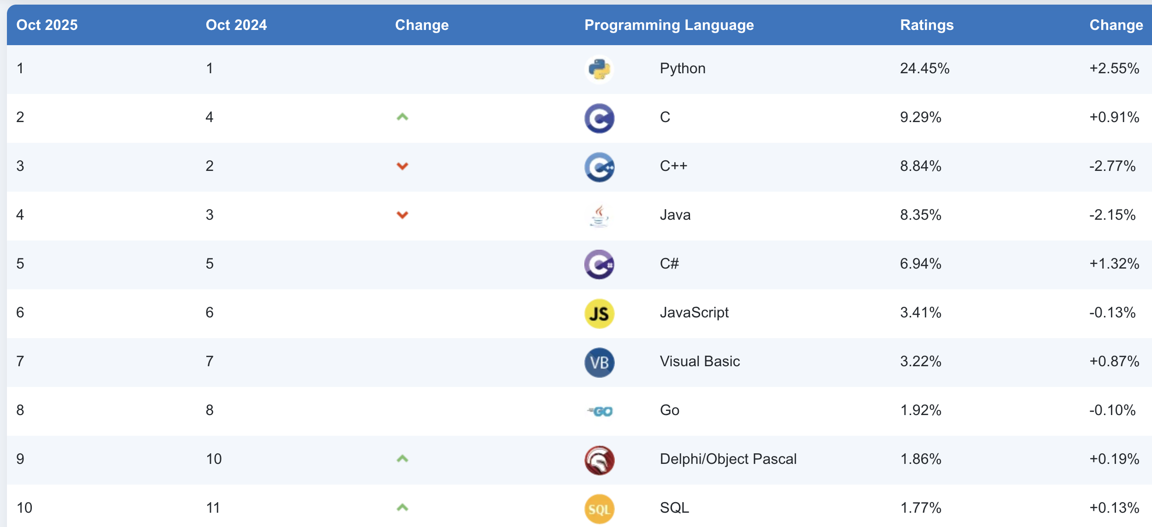
TIOBE Language Popularity Ratings

