Slide 1
Interacting with Python
CMPT 120
Spring 2026
SFU Burnaby

Slide 2
2 Main Ways of Interacting with Python
Interpreter
Programs

Slide 3
2 Main Ways of Interacting with Python
Interpreter
Programs
Evaluate one command at a time
Immediate feedback
Can evaluate individual expressions
Like a super calculator

Slide 4
2 Main Ways of Interacting with Python
Interpreter
Programs
Evaluate one command at a time
Immediate feedback
Can evaluate individual expressions
Like a super calculator
Write sequences of commands in text files (ending with .py)
The program in these files is called source code
Python runs them all in sequence
Use an editor like IDLE or VS Code etc. to edit the source code

Slide 5
2 Main Ways of Interacting with Python
In this course we will mainly write programs, but it is often useful to user the interpreter to help write the program.
Interpreter
Programs
Evaluate one command at a time
Immediate feedback
Can evaluate individual expressions
Like a super calculator
Write sequences of commands in text files (ending with .py)
The program in these files is called source code
Python runs them all in sequence
Use an editor like IDLE or VS Code etc. to edit the source code
Another popular format is a notebook, where Python code and text notes are interspersed.

Slide 6
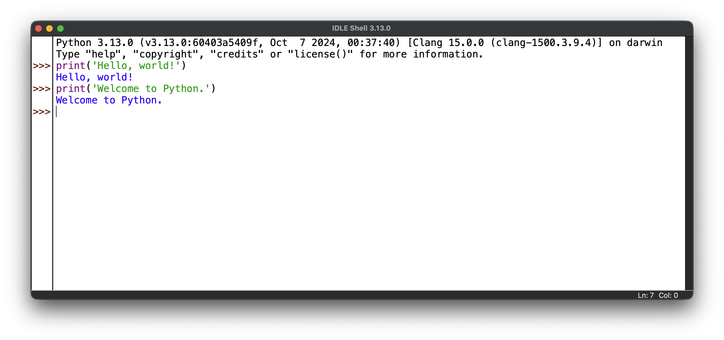
The IDLE Editor
IDLE is the free interpreter and editor that comes with Python
Search for and run “IDLE” on your computer
  If you don’t have it you can install Python from www.python.org
This is the interpreter window. Note the Python prompt: >>>

Slide 7
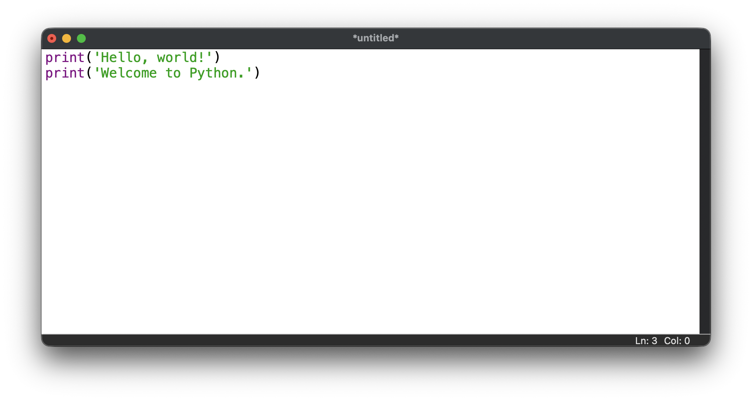
The IDLE Editor
IDLE is the free interpreter and editor that comes with Python
Search for and run “IDLE” on your computer
  If you don’t have it you can install Python from www.python.org
This is the program window. Note the name of the file at the top (currently *untitled*).
To run the program, choose Run Module in the Run menu, or press F5.

Slide 8
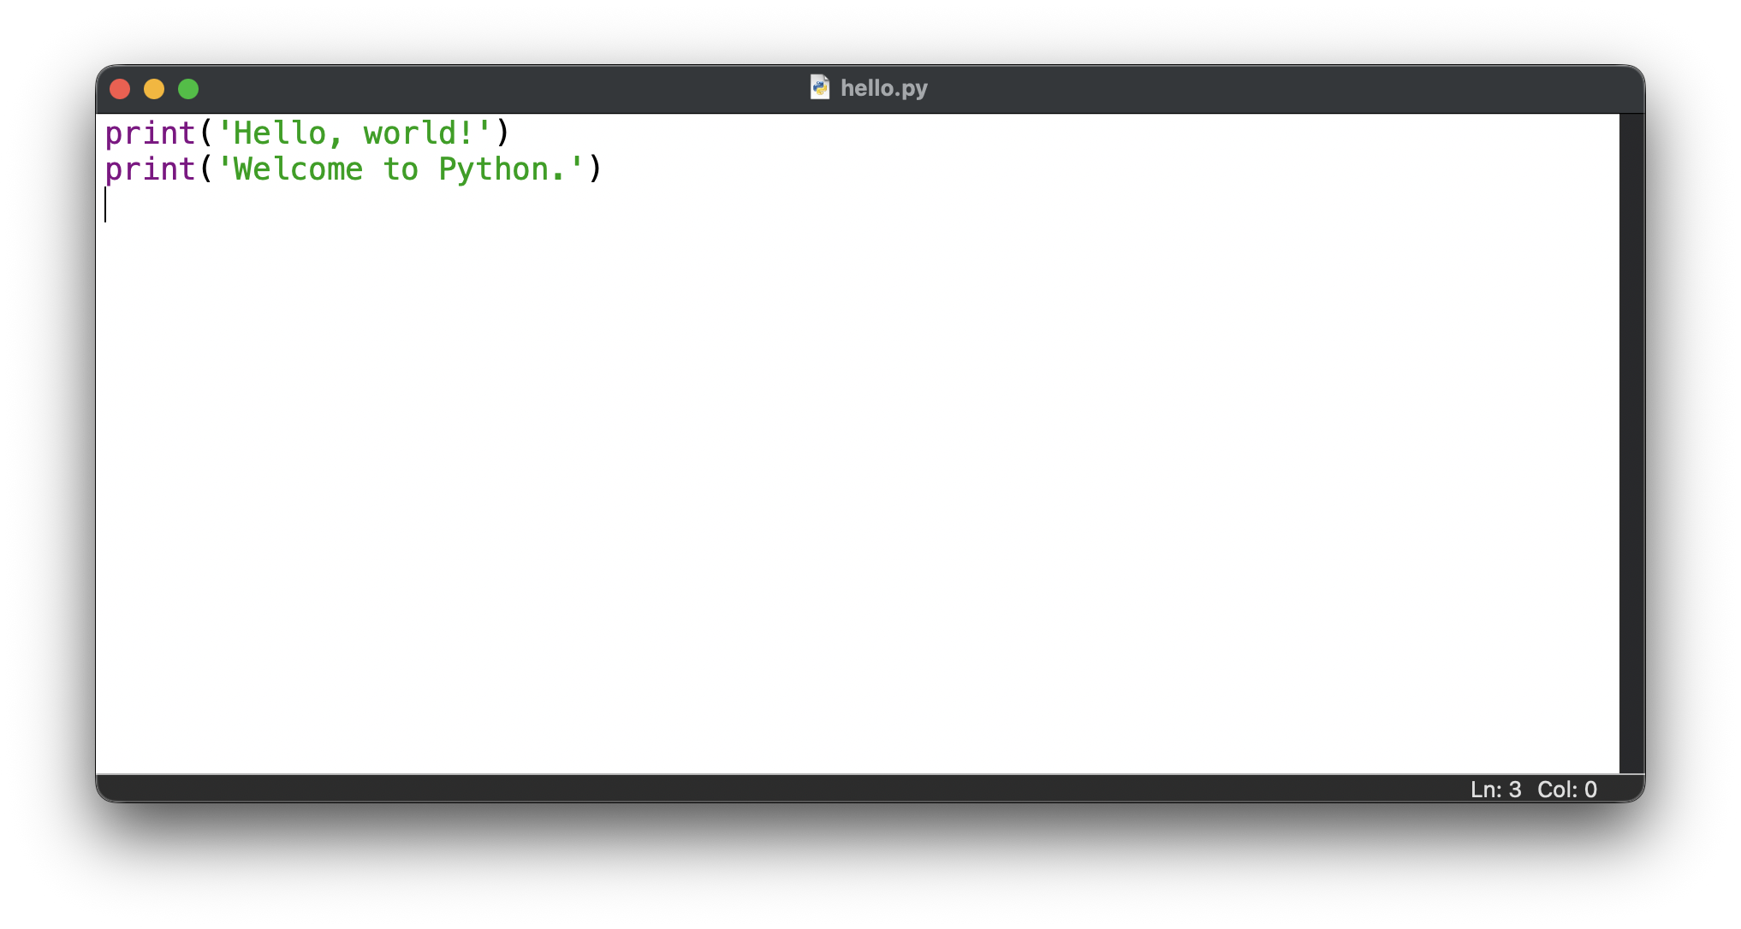
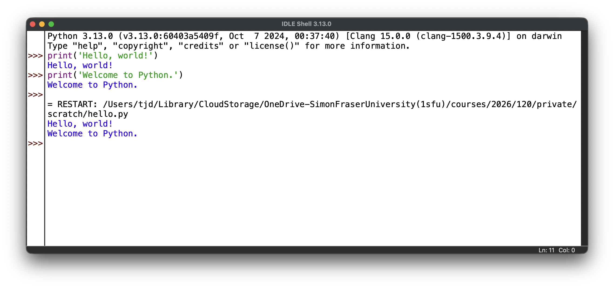
When you run the program in IDLE you will be asked to save it in a file first. I’ve called the file hello.py
The results of the program appear in the interpreter window.

Slide 9
When you run the program in IDLE you will be asked to save it in a file first. I’ve called the file hello.py
The results of the program appear in the interpreter window.
Careful!
If you are new to programming it can be easy to confuse these windows.

Slide 10
Advice for Saving Programs
All Python program files are text files and should end with .py
Save these files in a folder on your desktop called CMPT120
  Inside this folder you should make folders assignment1, assignment2, etc.

