Slide 1
Week 2
Topics
Finish basic C++ examples
How function calls work
Testing code
CMPT 125-D100
Spring 2026
SFU Burnaby

Slide 2
Compiling
Reminder: In this course you should compile programs from the command-line.
Use make to avoid typing.
source code file
Text
editor
hello_world.cpp
$ make hello_world
c++ -std=c++17 –Wall ...
$ ls
hello_world* hello_world.cpp
$./hello_world
Hello, world!
Compiler
error
C++
Compiler
./hello_world
executable file

Slide 3
Pass by Reference
x
y
int x = 2;
int y = 3;
swap(x, y);
2
3
void swap(int& a,
int& b)
{
int temp = a;
a = b;
b = temp;
}

Slide 4
Pass by Reference
x
y
int x = 2;
int y = 3;
swap(x, y);
2
3
a
b
void swap(int& a,
int& b)
{
int temp = a;
a = b;
b = temp;
}
temp
2
When swap(x, y) is called, a and b become new names for x and y (no copy is made).

Slide 5

Pass by Reference
x
y
int x = 2;
int y = 3;
swap(x, y);
3
2
a
b
void swap(int& a,
int& b)
{
int temp = a;
a = b;
b = temp;
}
temp
2
Changes to a and b are also changes to x and y.

Slide 6
Pass by Reference
x
y
int x = 2;
int y = 3;
swap(x, y);
3
2
a
b
void swap(int& a,
int& b)
{
int temp = a;
a = b;
b = temp;
}
temp
2
Changes to a and b are also changes to x and y.

Slide 7
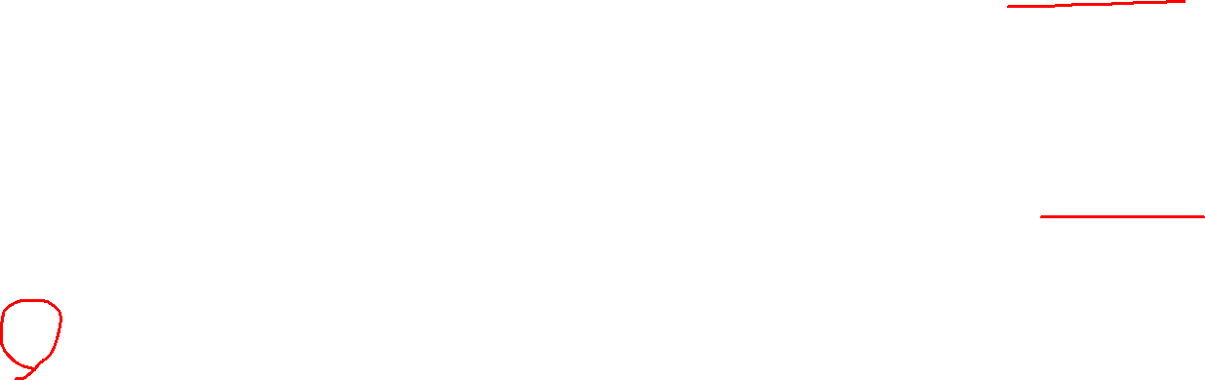
Pass by Reference
x
y
int x = 2;
int y = 3;
swap(x, y);
3
2
a
b
void swap(int& a,
int& b)
{
int temp = a;
a = b;
b = temp;
}
temp
2
When swap returns, its local variables and values are all de-allocated.

Slide 8
Pass by Reference
x
y
int x = 2;
int y = 3;
swap(x, y);
3
2
void swap(int& a,
int& b)
{
int temp = a;
a = b;
b = temp;
}
The values of x and y have been correctly swapped.

Slide 9
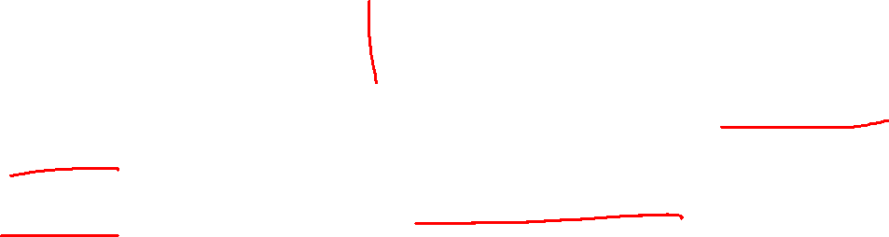
Pass by Value
x
y
int x = 2;
int y = 3;
bad(x, y);
2
3
void bad(int a,
int b)
{
int temp = a;
a = b;
b = temp;
}

Slide 10
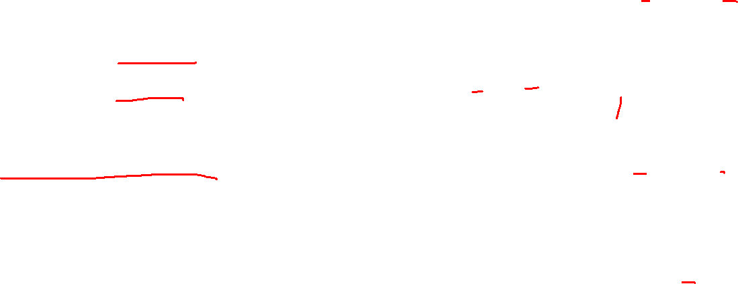
Pass by Value
x
y
int x = 2;
int y = 3;
bad(x, y);
2
3
void bad(int a,
int b)
{
int temp = a;
a = b;
b = temp;
}
a
b
When bad(x, y) is called,
x and y are copied into new local variables a and b.
2
3
temp
2

Slide 11
Pass by Value
x
y
int x = 2;
int y = 3;
bad(x, y);
2
3
void bad(int a,
int b)
{
int temp = a;
a = b;
b = temp;
}
a
b
Changes to a and b do not change x and y.
3
3
temp
2

Slide 12
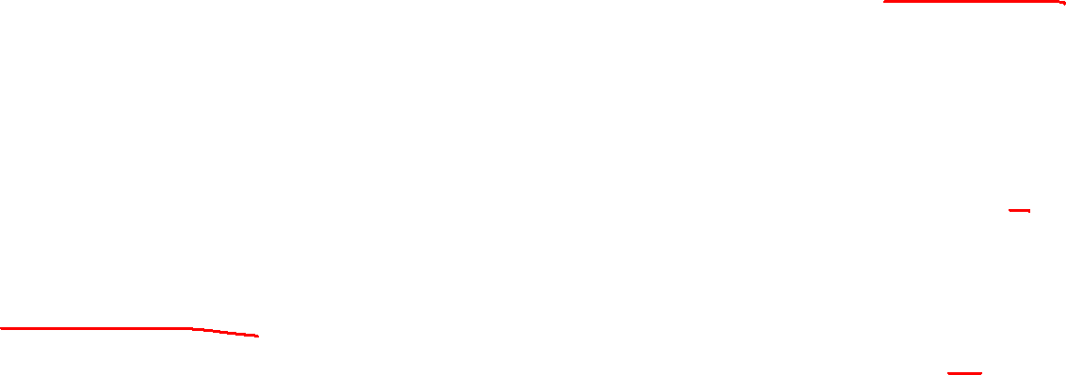
Pass by Value
x
y
int x = 2;
int y = 3;
bad(x, y);
2
3
void bad(int a,
int b)
{
int temp = a;
a = b;
b = temp;
}
a
b
Changes to a and b do not change x and y.
3
2
temp
2

Slide 13

Pass by Value
x
y
int x = 2;
int y = 3;
bad(x, y);
2
3
void bad(int a,
int b)
{
int temp = a;
a = b;
b = temp;
}
a
b
When bad returns, it’s local variables and values are automatically de-allocated.
3
2
temp
2

Slide 14
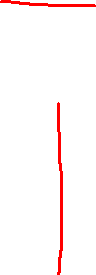
Pass by Value
x
y
int x = 2;
int y = 3;
bad(x, y);
2
3
void bad(int a,
int b)
{
int temp = a;
a = b;
b = temp;
}
x and y are not swapped:
bad(x, y) only swapped local copies (and then threw them away!)

Slide 15
Calling Functions
This defines the function f.
int f(int a)
{
return a + 1;
}

Slide 16
Calling Functions
Function header
This defines the function f.
int f(int a)
{
return a + 1;
}
Function body

Slide 17
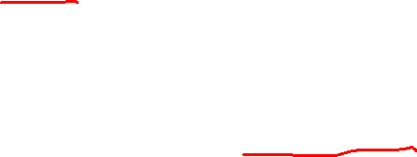
Calling Functions
Type of returned value.
This defines the function f.
Returned value
int f(int a)
{
return a + 1;
}

Slide 18
Calling Functions
Pass by value means the function is given a copy of the value of a.
A single parameter passed by value.
int f(int a)
{
return a + 1;
}

Slide 19
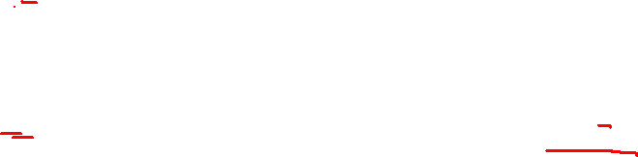
Calling Functions
n
When int n = 3 runs we imagine a memory location called n is created with value 3.
3
int f(int a)
{
return a + 1;
}
int n = 3;
cout << f(n); // 4

Slide 20
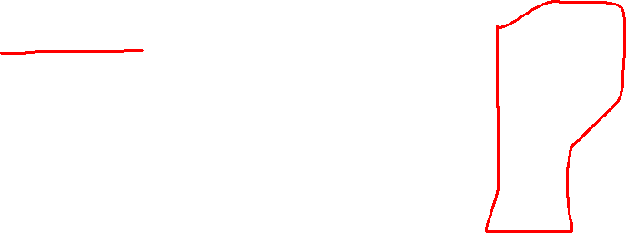
Calling Functions
n
When int n = 3 runs we imagine a memory location called n is created with value 3.
3
int f(int a)
{
return a + 1;
}
int n = 3;
cout << f(n); // 4
a
When f(n) is called, a is created with a copy of the value of n.
a is a local variable: it only exists when function f is running.
3
4
returns

Slide 21
Calling Functions
n
When int n = 3 runs we imagine a memory location called n is created with value 3.
3
int f(int a)
{
return a + 1;
}
int n = 3;
cout << f(n); // 4
a
Important: when function f ends, what happens to memory location a?
??
3
4
returns

Slide 22
Calling Functions
n
When int n = 3 runs we imagine a memory location called n is created with value 3.
3
int f(int a)
{
return a + 1;
}
int n = 3;
cout << f(n); // 4
Answer: it is automatically
de-allocated so that the memory can be re-used.
a
Important: when function f ends, what happens to memory location a?
??
3
4
returns

Slide 23

Calling Functions: The Call Stack
int n = 3;
cout << f(n);
int f(int a)
{
return a + 1;
}
top of the stack
Every running C++ program has a special memory region named the call stack.
It is the key trick for making function calls and returns.
bottom of the stack

Slide 24
Calling Functions: The Call Stack
int n = 3;
cout << f(n);
int f(int a)
{
return a + 1;
}
top of the stack
A stack allows for two main operations:
push (add) a value on the top
pop (remove) a value off the top
The key idea is that on a stack items can only be added/removed at the top.
bottom of the stack

Slide 25
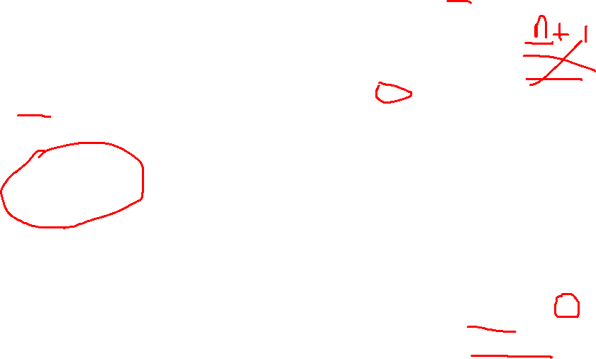
Calling Functions: The Call Stack
int n = 3;
cout << f(n);
int f(int a)
{
return a + 1;
}
This pointer tells C++ where to continue execution from after the function returns.
When a function is called, the function, it’s parameters and local variables, and pointer for where to return to get pushed onto the top of the stack.
top of the stack
f(3)
a = 3
Rule of thumb
Calling a function corresponds to pushing that function onto the call stack.
bottom of the stack

Slide 26
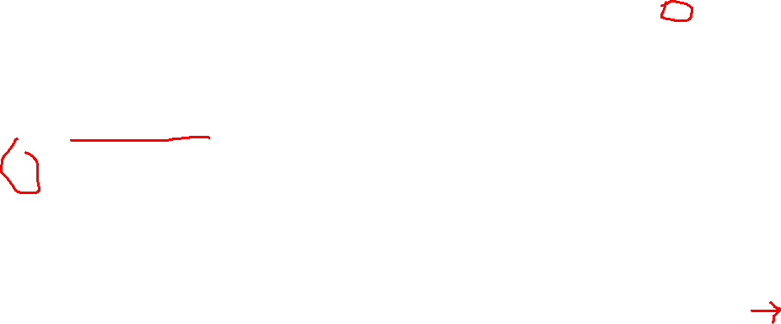
Calling Functions: The Call Stack
int n = 3;
cout << f(n);
int f(int a)
{
return a + 1;
}
When a function returns, the top of the stack is popped (removed) and the return value is put on top of the stack.
top of the stack
f(3)
a = 3
Rule of thumb
Returning from a function corresponds to popping that function off the call stack.
bottom of the stack

Slide 27
Calling Functions: The Call Stack
int n = 3;
cout << f(n);
int f(int a)
{
return a + 1;
}
When a function returns, the top of the stack is popped (removed) and the return value is put on top of the stack.
top of the stack
4
Rule of thumb
Returning from a function corresponds to popping that function off the call stack.
bottom of the stack

Slide 28
Things to Note About the Call Stack
In particular, recursive functions often make a lot of function calls and are a common source of stack overflows.
Function calls take up some memory
If you do too many function calls within function calls, you could run out of stack memory. This is called a stack overflow.

Slide 29
Things to Note About the Call Stack
In particular, recursive functions often make a lot of function calls and are a common source of stack overflows.
Function calls take up some memory
If you do too many function calls within function calls, you could run out of stack memory. This is called a stack overflow.
Using a trick called function inlining, the C++ compiler might, in some cases, replace function calls with their code so that the function all does not use the call stack

Slide 30
Things to Note About the Call Stack
In particular, recursive functions often make a lot of function calls and are a common source of stack overflows.
Function calls take up some memory
If you do too many function calls within function calls, you could run out of stack memory. This is called a stack overflow.
Using a trick called function inlining, the C++ compiler might, in some cases, replace function calls with their code so that the function all does not use the call stack
int n = 3;
cout << f(n);
int n = 3;
cout << n + 1;
Might be inlined to

Slide 31
Things to Note About the Call Stack
In particular, recursive functions often make a lot of function calls and are a common source of stack overflows.
Function calls take up some memory
If you do too many function calls within function calls, you could run out of stack memory. This is called a stack overflow.
Using a trick called function inlining, the C++ compiler might, in some cases, replace function calls with their code so that the function all does not use the call stack
In practice inlining usually speeds up programs, but can increase the executable file size.
int n = 3;
cout << f(n);
int n = 3;
cout << n + 1;
Might be inlined to

Slide 32

Calling Functions: The Call Stack
h(3);
Suppose we have the three functions f, g, and h, can then call h(3). Let’s trace the call stack.
int f(int a) {
return a + 1;
}
int g(int a) {
int n = a + 2;
return 3*n;
}
int h(int a) {
int x = f(a);
int y = g(a);
return x + y;
}
top of the stack
bottom of the stack

Slide 33
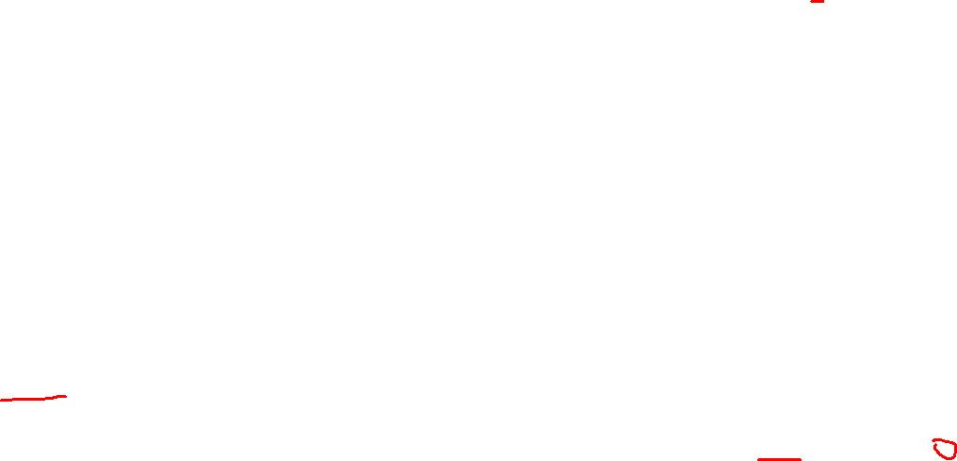
Calling Functions: The Call Stack
h(3);
int f(int a) {
return a + 1;
}
int g(int a) {
int n = a + 2;
return 3*n;
}
int h(int a) {
int x = f(a);
int y = g(a);
return x + y;
}
top of the stack
When h(3) is called this is pushed on top of the stack.
h(3), a=3, x=?, y=?
bottom of the stack

Slide 34
Calling Functions: The Call Stack
h(3);
int f(int a) {
return a + 1;
}
int g(int a) {
int n = a + 2;
return 3*n;
}
int h(int a) {
int x = f(a);
int y = g(a);
return x + y;
}
top of the stack
h(3), a=3, x=?, y=?
Next f(3) is called to get the value of x.
bottom of the stack

Slide 35
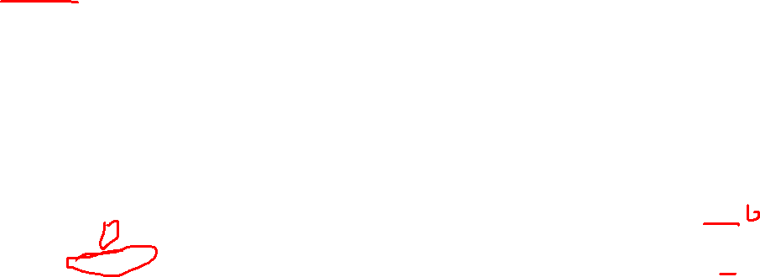
Calling Functions: The Call Stack
h(3);
int f(int a) {
return a + 1;
}
int g(int a) {
int n = a + 2;
return 3*n;
}
int h(int a) {
int x = f(a);
int y = g(a);
return x + y;
}
top of the stack
f(3), a=3
The call to f(3) is pushed on top of the stack (the call to h stays there).
h(3), a=3, x=?, y=?
bottom of the stack

Slide 36
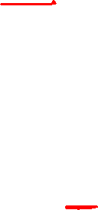
Calling Functions: The Call Stack
h(3);
int f(int a) {
return a + 1;
}
int g(int a) {
int n = a + 2;
return 3*n;
}
int h(int a) {
int x = f(a);
int y = g(a);
return x + y;
}
top of the stack
f(3), a=3
The body of f runs and returns the value 4. The return pointer tells us what to execute next.
h(3), a=3, x=?, y=?
bottom of the stack

Slide 37
Calling Functions: The Call Stack
h(3);
int f(int a) {
return a + 1;
}
int g(int a) {
int n = a + 2;
return 3*n;
}
int h(int a) {
int x = f(a);
int y = g(a);
return x + y;
}
top of the stack
4
The body of f runs and returns the value 4. The return pointer tells us what to execute next.
h(3), a=3, x=?, y=?
bottom of the stack

Slide 38
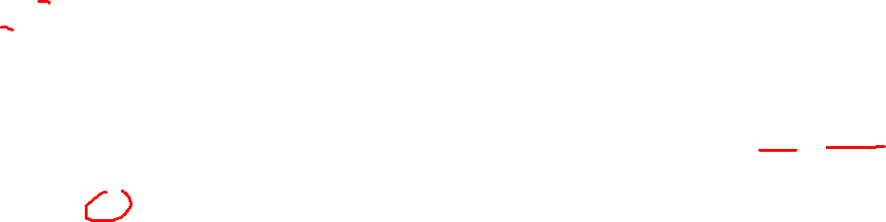
Calling Functions: The Call Stack
h(3);
int f(int a) {
return a + 1;
}
int g(int a) {
int n = a + 2;
return 3*n;
}
int h(int a) {
int x = f(a);
int y = g(a);
return x + y;
}
top of the stack
g(3), a=3, n=3+2
Next we call g(4), which pushes this on top of the call stack.
h(3), a=3, x=4, y=?
bottom of the stack

Slide 39

Calling Functions: The Call Stack
h(3);
int f(int a) {
return a + 1;
}
int g(int a) {
int n = a + 2;
return 3*n;
}
int h(int a) {
int x = f(a);
int y = g(a);
return x + y;
}
top of the stack
g(3), a=3, n=3+2
Notice that there are two a variables on the stack at the same time. There’s no confusion because they are in different function calls.
h(3), a=3, x=4, y=?
bottom of the stack

Slide 40
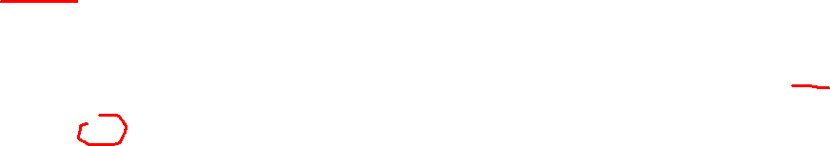
Calling Functions: The Call Stack
h(3);
int f(int a) {
return a + 1;
}
int g(int a) {
int n = a + 2;
return 3*n;
}
int h(int a) {
int x = f(a);
int y = g(a);
return x + y;
}
top of the stack
g(3), a=3, n=5
When the body of g runs it returns 15.
h(3), a=3, x=4, y=?
bottom of the stack

Slide 41
Calling Functions: The Call Stack
h(3);
int f(int a) {
return a + 1;
}
int g(int a) {
int n = a + 2;
return 3*n;
}
int h(int a) {
int x = f(a);
int y = g(a);
return x + y;
}
top of the stack
15
When the body of g runs it returns 15.
h(3), a=3, x=4, y=15
bottom of the stack

Slide 42
Calling Functions: The Call Stack
h(3);
int f(int a) {
return a + 1;
}
int g(int a) {
int n = a + 2;
return 3*n;
}
int h(int a) {
int x = f(a);
int y = g(a);
return x + y;
}
top of the stack
Now that the values of x and y are computed, h can return their sum, 19.
h(3), a=3, x=4, y=15
bottom of the stack

Slide 43

Calling Functions: The Call Stack
h(3);
int f(int a) {
return a + 1;
}
int g(int a) {
int n = a + 2;
return 3*n;
}
int h(int a) {
int x = f(a);
int y = g(a);
return x + y;
}
top of the stack
Now that the values of x and y are computed, h can return their sum, 19.
h(3), a=3, x=4, y=15
bottom of the stack

Slide 44
Calling Functions: The Call Stack
h(3);
After h returns, the program runs whatever code comes after it.
In this case, the return value is ignored.
19
int f(int a) {
return a + 1;
}
int g(int a) {
int n = a + 2;
return 3*n;
}
int h(int a) {
int x = f(a);
int y = g(a);
return x + y;
}
top of the stack
Now that the values of x and y are computed, h can return their sum, 19.
19
bottom of the stack

Slide 45
Unit Testing
Testing is the most common practical way to check if a program is correct
  Some computer scientists also try to prove programs are correct using mathematical proofs. But that has not caught on.
“Program testing can be used to show the presence of bugs, but never to show their absence!” ― Edsger W. Dijkstra
In practice, testing frameworks are available that can help
  But for this course we will not use those and stick to regular C++
To understand the key ideas of testing, let’s work through an example …

Slide 46
Testing the trim(s) Function
Specification: Write a function trim(s) that returns a copy of string s with leading/trailing spaces removed.
string trim(const string& s)
{
// ...
}

Slide 47
Testing the trim(s) Function
Specification: Write a function trim(s) that returns a copy of string s with leading/trailing spaces removed.
string trim(const string& s)
{
// ...
}

Slide 48
Testing the trim(s) Function
Specification: Write a function trim(s) that returns a copy of string s with leading/trailing spaces removed.
From the specification alone we can determine the function header.
string trim(const string& s)
{
// ...
}

Slide 49
Testing the trim(s) Function
Before we write any code, let’s write some test cases. Writing test cases first is called Test Driven Development (TDD).
Specification: Write a function trim(s) that returns a copy of string s with leading/trailing spaces removed.
string trim(const string& s)
{
// ...
}

Slide 50
Testing the trim(s) Function
Before we write any code, let’s write some test cases. Writing test cases first is called Test Driven Development (TDD).
Specification: Write a function trim(s) that returns a copy of string s with leading/trailing spaces removed.
Input | Expected Output | Description
" cat " | "cat" | leading and trailing spaces
" cat dog " | "cat dog" | spaces in the middle are not changed
" puppy" | "puppy" | leading spaces only
"puppy " | "puppy" | trailing spaces only
"puppy" | "puppy" | no leading/trailing spaces
" " | "" | just spaces
"" | "" | always test the empty string
Test Table
All the cases have reasons for being there, and it seems like a reasonable start. We can always add more test cases later.

Slide 51
Testing
Specification: Write a function trim(s) that returns a copy of string s with leading/trailing spaces removed.
One way to convert the test table to code is to use
if-statements. It’s flexible, but a lot of typing!
void test_ifs()
{
cout << "Testing trim with if-statements ...\n";
if (trim(" cat ") != "cat")
{
throw runtime_error("test failed");
}
if (trim(" cat dog ") != "cat dog")
{
throw runtime_error("test failed");
}
// ...
cout << "All if-statements tests passed!" << endl;
}
Input | Expected Output
" cat " | "cat"
" cat dog " | "cat dog"
" puppy" | "puppy"
"puppy " | "puppy"
"puppy" | "puppy"
" " | ""
"" | ""

Slide 52
Testing
Specification: Write a function trim(s) that returns a copy of string s with leading/trailing spaces removed.
Another way is to use the assert(expr) macro, which does nothing if expr is true, and crashes the program if expr is false.
#include <assert>
void test_asserts()
{
cout << "Testing trim with assert statements ...\n";
assert(trim(" cat ") == "cat");
assert(trim(" cat dog ") == "cat dog");
assert(trim(" puppy") == "puppy");
assert(trim("puppy ") == "puppy");
assert(trim("puppy") == "puppy");
assert(trim(" ") == "");
assert(trim("") == "");
cout << "All assert tests passed!\n";
}
Input | Expected Output
" cat " | "cat"
" cat dog " | "cat dog"
" puppy" | "puppy"
"puppy " | "puppy"
"puppy" | "puppy"
" " | ""
"" | ""
Much more compact and readable compared to the if-statements, but not as flexible.

Slide 53
Testing
Specification: Write a function trim(s) that returns a copy of string s with leading/trailing spaces removed.
Yet another way is to use table-based testing. You put the test cases into a “table”, e.g. a vector.
#include <vector>
struct Testcase
{
string input;
string expected_output;
};
vector<Testcase> all_tests = {
Testcase{" cat " , "cat" },
Testcase{" cat dog ", "cat dog"},
Testcase{" puppy" , "puppy" },
Testcase{"puppy " , "puppy" },
Testcase{"puppy" , "puppy" },
Testcase{" " , "" },
Testcase{"" , "" },
};
Input | Expected Output
" cat " | "cat"
" cat dog " | "cat dog"
" puppy" | "puppy"
"puppy " | "puppy"
"puppy" | "puppy"
" " | ""
"" | ""
The code is similar to the test table, which improves readability.

Slide 54
Testing
Specification: Write a function trim(s) that returns a copy of string s with leading/trailing spaces removed.
void test_table() {
// ...
Now we write a function that calls trim on all the test cases and checks that it returns the correct answer …

Slide 55
Testing
Specification: Write a function trim(s) that returns a copy of string s with leading/trailing spaces removed.
void test_table() {
const int n = all_tests.size();
int passed = 0;
for (int i = 0; i < n; i++) {
Testcase tc = all_tests[i];
cout << "Test " << (i + 1)
<< ": trim(\"" << tc.input << "\") ... ";
string actual = trim(tc.input);
if (actual == tc.expected_output) {
passed++;
cout << "passed\n";
} else {
cout << "failed:\n" << " expected \""
<< tc.expected_output << "\"\n"
<< " returned \"" << actual << "\"\n";
}
}
cout << "Done: " << passed << "/" << n
<< " tests passed.\n";}
The test code loops through all the test cases in all_tests.

Slide 56
Testing
Specification: Write a function trim(s) that returns a copy of string s with leading/trailing spaces removed.
void test_table() {
const int n = all_tests.size();
int passed = 0;
for (int i = 0; i < n; i++) {
Testcase tc = all_tests[i];
cout << "Test " << (i + 1)
<< ": trim(\"" << tc.input << "\") ... ";
string actual = trim(tc.input);
if (actual == tc.expected_output) {
passed++;
cout << "passed\n";
} else {
cout << "failed:\n" << " expected \""
<< tc.expected_output << "\"\n"
<< " returned \"" << actual << "\"\n";
}
}
cout << "Done: " << passed << "/" << n
<< " tests passed.\n";}
Print a helpful message.

Slide 57
Testing
Specification: Write a function trim(s) that returns a copy of string s with leading/trailing spaces removed.
void test_table() {
const int n = all_tests.size();
int passed = 0;
for (int i = 0; i < n; i++) {
Testcase tc = all_tests[i];
cout << "Test " << (i + 1)
<< ": trim(\"" << tc.input << "\") ... ";
string actual = trim(tc.input);
if (actual == tc.expected_output) {
passed++;
cout << "passed\n";
} else {
cout << "failed:\n" << " expected \""
<< tc.expected_output << "\"\n"
<< " returned \"" << actual << "\"\n";
}
}
cout << "Done: " << passed << "/" << n
<< " tests passed.\n";}
Call the trim function and save the result it returns.

Slide 58
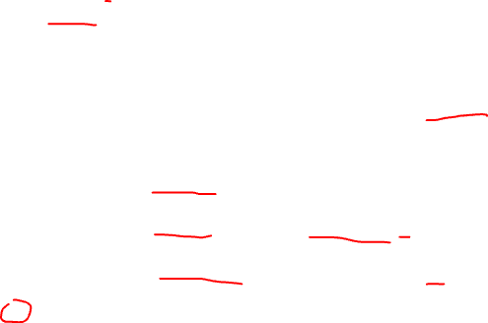
Testing
Specification: Write a function trim(s) that returns a copy of string s with leading/trailing spaces removed.
void test_table() {
const int n = all_tests.size();
int passed = 0;
for (int i = 0; i < n; i++) {
Testcase tc = all_tests[i];
cout << "Test " << (i + 1)
<< ": trim(\"" << tc.input << "\") ... ";
string actual = trim(tc.input);
if (actual == tc.expected_output) {
passed++;
cout << "passed\n";
} else {
cout << "failed:\n" << " expected \""
<< tc.expected_output << "\"\n"
<< " returned \"" << actual << "\"\n";
}
}
cout << "Done: " << passed << "/" << n
<< " tests passed.\n";}
If the returned value is the same as the expected value, then the test passed.

Slide 59
Testing
Specification: Write a function trim(s) that returns a copy of string s with leading/trailing spaces removed.
void test_table() {
const int n = all_tests.size();
int passed = 0;
for (int i = 0; i < n; i++) {
Testcase tc = all_tests[i];
cout << "Test " << (i + 1)
<< ": trim(\"" << tc.input << "\") ... ";
string actual = trim(tc.input);
if (actual == tc.expected_output) {
passed++;
cout << "passed\n";
} else {
cout << "failed:\n" << " expected \""
<< tc.expected_output << "\"\n"
<< " returned \"" << actual << "\"\n";
}
}
cout << "Done: " << passed << "/" << n
<< " tests passed.\n";}
If the returned value is different than the expected value, then the test failed.

Slide 60

Testing
Specification: Write a function trim(s) that returns a copy of string s with leading/trailing spaces removed.
void test_table() {
const int n = all_tests.size();
int passed = 0;
for (int i = 0; i < n; i++) {
Testcase tc = all_tests[i];
cout << "Test " << (i + 1)
<< ": trim(\"" << tc.input << "\") ... ";
string actual = trim(tc.input);
if (actual == tc.expected_output) {
passed++;
cout << "passed\n";
} else {
cout << "failed:\n" << " expected \""
<< tc.expected_output << "\"\n"
<< " returned \"" << actual << "\"\n";
}
}
cout << "Done: " << passed << "/" << n
<< " tests passed.\n";}
Print a final summary of the testing.

Slide 61
Testing
Specification: Write a function trim(s) that returns a copy of string s with leading/trailing spaces removed.
void test_table() {
const int n = all_tests.size();
int passed = 0;
for (int i = 0; i < n; i++) {
Testcase tc = all_tests[i];
cout << "Test " << (i + 1)
<< ": trim(\"" << tc.input << "\") ... ";
string actual = trim(tc.input);
if (actual == tc.expected_output) {
passed++;
cout << "passed\n";
} else {
cout << "failed:\n" << " expected \""
<< tc.expected_output << "\"\n"
<< " returned \"" << actual << "\"\n";
}
}
cout << "Done: " << passed << "/" << n
<< " tests passed.\n";}
A testing framework would provide most of this code, so all you’d need to do is write the table of tests.
Print a final summary of the testing.

Slide 62
Testing the trim(s) Function
We’ve written test cases, but still have not written the body of the trim function.
This is typical in test-driven development.
Specification: Write a function trim(s) that returns a copy of string s with leading/trailing spaces removed.
string trim(const string& s)
{
// ...
}

Slide 63
Testing the trim(s) Function
It helps to sketch a picture that shows what we want to do.
Specification: Write a function trim(s) that returns a copy of string s with leading/trailing spaces removed.
" Elon Musk "
"Elon Musk"
string trim(const string& s)
{
// ...
}
s
this is the string we want
leading
spaces
trailing
spaces

Slide 64
Testing the trim(s) Function
Specification: Write a function trim(s) that returns a copy of string s with leading/trailing spaces removed.
Strategy: find the first non-space character, and the last non-space character. Then extract and return the substring from first to last.
string trim(const string& s)
{
// ...
}
first
last
s
this is the string we want
leading
spaces
trailing
spaces

Slide 65
Testing the trim(s) Function
Specification: Write a function trim(s) that returns a copy of string s with leading/trailing spaces removed.
A good start is to write out pseudocode for the basic strategy your function follows to solve the problem.
string trim(const string& s)
{
// find the first non-space character of s
// find the last non-space character of s
// return the substring of s between those characters
}

Slide 66
Testing the trim(s) Function
Specification: Write a function trim(s) that returns a copy of string s with leading/trailing spaces removed.
Use a loop to scan through the characters and find the first non-space character.
string trim(const string& s)
{
// find the first non-space character of s
// find the last non-space character of s
// return the substring of s between those characters
}

Slide 67
Testing the trim(s) Function
Specification: Write a function trim(s) that returns a copy of string s with leading/trailing spaces removed.
Use a loop to scan through the characters and find the first non-space character.
string trim(const string& s)
{
// find the first non-space character of s
int first = 0;
while (first < n && s[first] == ' ') first++;
// find the last non-space character of s
// return the substring of s between those characters
}

Slide 68
Testing the trim(s) Function
Specification: Write a function trim(s) that returns a copy of string s with leading/trailing spaces removed.
Use a loop to scan through the characters and find the first non-space character.
string trim(const string& s)
{
// find the first non-space character of s
int first = 0;
while (first < n && s[first] == ' ') first++;
// find the last non-space character of s
// return the substring of s between those characters
}
Need to check that first is still in the string.

Slide 69
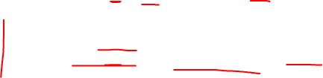
Testing the trim(s) Function
Specification: Write a function trim(s) that returns a copy of string s with leading/trailing spaces removed.
string trim(const string& s) {
int n = s.size();
// find the first non-space character
int first = 0;
while (first < n && s[first] == ' ') first++;
// find the last non-space character
int last = n - 1;
while (last >= 0 && s[last] == ' ') last--;
// return the substring between the first and last non-space characters
}
This starts at the right end of the string and scans through characters right-to-left.

Slide 70
Testing the trim(s) Function
Specification: Write a function trim(s) that returns a copy of string s with leading/trailing spaces removed.
string trim(const string& s) {
int n = s.size();
// find the first non-space character
int first = 0;
while (first < n && s[first] == ' ') first++;
// find the last non-space character
int last = n - 1;
while (last >= 0 && s[last] == ' ') last--;
// return the substring between the first and last non-space characters
return s.substr(first, last - first + 1);
}
Now with first and last calculated, we can use substr to extra the substring of s without leading/trailing spaces …

Slide 71
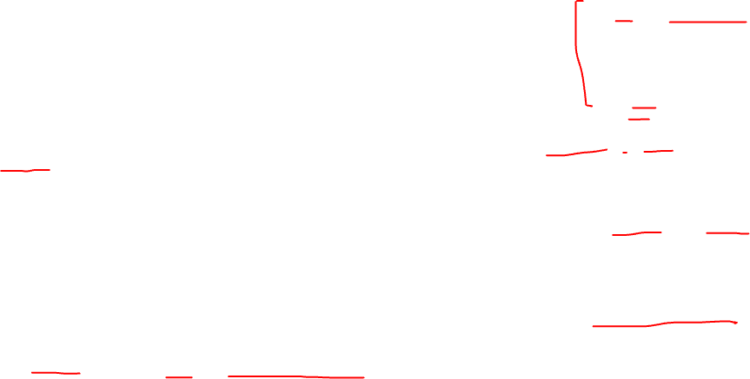
Testing the trim(s) Function
i
num+i-1
s
Specification: Write a function trim(s) that returns a copy of string s with leading/trailing spaces removed.
num chars
s.substr(i, num) returns num characters from s starting at location i
string trim(const string& s) {
int n = s.size();
// find the first non-space character
int first = 0;
while (first < n && s[first] == ' ') first++;
// find the last non-space character
int last = n - 1;
while (last >= 0 && s[last] == ' ') last--;
// return the substring between the first and last non-space characters
return s.substr(first, last - first + 1);
}
first
last
s
last-first+1 chars

Slide 72
Testing the trim(s) Function
Specification: Write a function trim(s) that returns a copy of string s with leading/trailing spaces removed.
string trim(const string& s) {
int n = s.size();
// find the first non-space character
int first = 0;
while (first < n && s[first] == ' ') first++;
// find the last non-space character
int last = n - 1;
while (last >= 0 && s[last] == ' ') last--;
// return the substring between the first and last non-space characters
return s.substr(first, last - first + 1);
}
Leaving the comments in helps document the function.

Slide 73
Testing the trim(s) Function
Specification: Write a function trim(s) that returns a copy of string s with leading/trailing spaces removed.
Is this function correct? It’s very hard to tell just by looking at the code! So lets run the tests …
string trim(const string& s) {
int n = s.size();
// find the first non-space character
int first = 0;
while (first < n && s[first] == ' ') first++;
// find the last non-space character
int last = n - 1;
while (last >= 0 && s[last] == ' ') last--;
// return the substring between the first and last non-space characters
return s.substr(first, last - first + 1);
}

