Slide 1
Big Powers and Finding the Max
CMPT 125

Slide 2
Algorithms
We’re taking a break from introducing C++ features
We’re going to study some basic algorithms
We will see how to implement them
And how to estimate their performance

Slide 3


Alice wants to send Bob some money.
Alice
Bob
$$

Slide 4

Alice wants to send Bob some money.
$$
Alice
Bob
If she just sends it to Bob then Eve will steal it.
Eve

Slide 5


Alice uses her lock and key to lock the money in a box …
Alice
Bob
$$
Eve

Slide 6
$$
Alice
Bob
Eve can’t open the box because she doesn’t have the key.
Eve

Slide 7
Alice
But how does Bob unlock the box? He needs Alice’s key.
Bob
$$
Eve can’t open the box because she doesn’t have the key.
Eve

Slide 8
If Alice sends Bob the key, then Eve could steal it.
Alice
Bob
$$
Eve

Slide 9


Alice
Bob
$$
What if Alice locked the key in a box?
key for second box
Now Eve can’t steal the key being sent.
Eve

Slide 10
But Bob can’t unlock the second box! How does he get the second key?
Alice
Bob
$$
key for second box
Eve

Slide 11
We need a new idea. How can Alice securely send her money to Bob?
Alice
Bob
$$
Lock
Key
Eve

Slide 12
Alice
Bob
Idea: Bob has a lock and a key.
$$
Lock
Key
Eve

Slide 13
Alice
Bob
Idea: Bob has a lock and a key.
$$
Lock
Key
He lets Alice use his lock.
He protects the key and keeps it secret.
Eve

Slide 14
Alice locks the money using Bob’s lock.
Alice
Bob
$$
Key
He protects the key and keeps it secret.
Eve

Slide 15
$$
She sends the locked box to Bob.
Alice
Bob
Key
He protects the key and keeps it secret.
Eve cannot get the money because she does not have the key.
Eve

Slide 16
Alice
Bob
Bob unlocks the box with his key and gets the money.
Key
$$
He protects the key and keeps it secret.
Eve

Slide 17
This is the basic idea of public key cryptography. It lets us securely share information on the web.
Alice
Bob
Key
$$
He protects the key and keeps it secret.
Eve

Slide 18
This is the basic idea of public key cryptography. It lets us securely share information on the web.
Alice
Bob
RSA is one of the first and most famous public key cryptography systems. And one step of it is of interest to use …
Key
$$
He protects the key and keeps it secret.
Eve

Slide 19
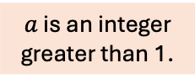
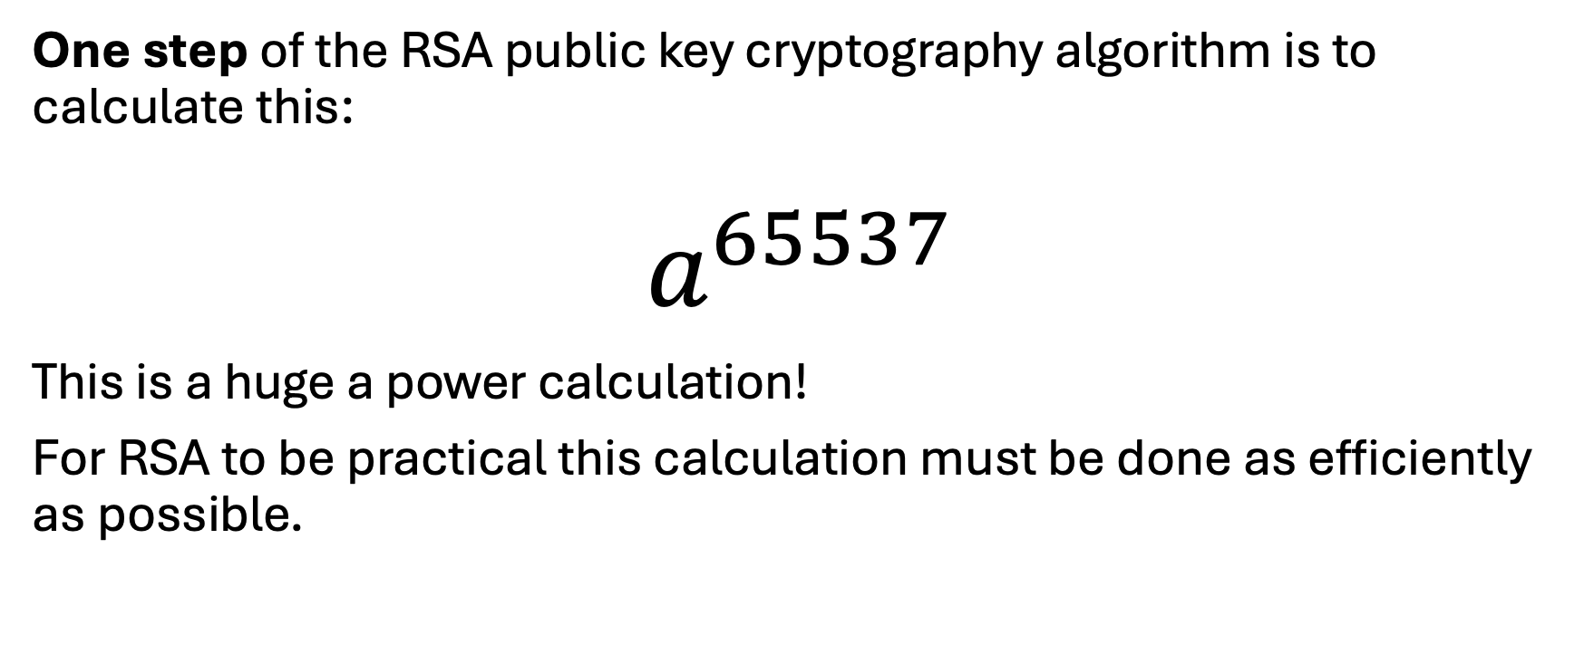
RSA Public Key Cryptography
One step of the RSA public key cryptography algorithm is to calculate this:
$$a^{65537}$$
This is a huge a power calculation!
For RSA to be practical this calculation must be done as efficiently as possible.
$a$ is an integer greater than 1.

Slide 20
Calculating Big Powers
The “obvious” method
With a loop
Using recursion
A faster method (using recursion)

Slide 21
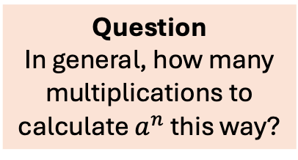

The Obvious Method
$$a^{5}=a⋅a⋅a⋅a⋅a$$
4 multiplications
Question In general, how many multiplications to calculate $a^{n}$ this way?

Slide 22
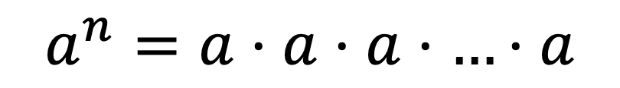

The Obvious Method
$$a^{5}=a⋅a⋅a⋅a⋅a$$
4 multiplications
$n−1$ multiplications
Question In general, how many multiplications to calculate $a^{n}$ this way?
$$a^{n}=a⋅a⋅a⋅…⋅a$$

Slide 23
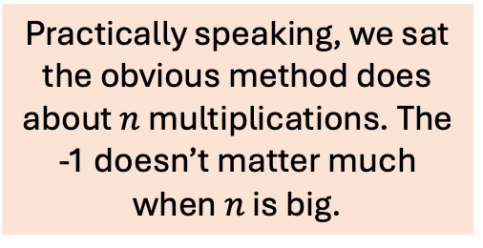
The Obvious Method
$$a^{5}=a⋅a⋅a⋅a⋅a$$
4 multiplications
Practically speaking, we sat the obvious method does about $n$ multiplications. The -1 doesn’t matter much when $n$ is big.
$n−1$ multiplications
Question In general, how many multiplications to calculate $a^{n}$ this way?
$$a^{n}=a⋅a⋅a⋅…⋅a$$

Slide 24
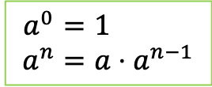
The Obvious Method
$$a^{5}=a⋅a⋅a⋅a⋅a$$
4 multiplications
Practically speaking, we sat the obvious method does about $n$ multiplications. The -1 doesn’t matter much when $n$ is big.
$n−1$ multiplications
Question In general, how many multiplications to calculate $a^{n}$ this way?
$$a^{n}=a⋅a⋅a⋅…⋅a$$
$${ a}^{0 }=1$$
$$a^{n}=a⋅a^{n−1}$$

Slide 25
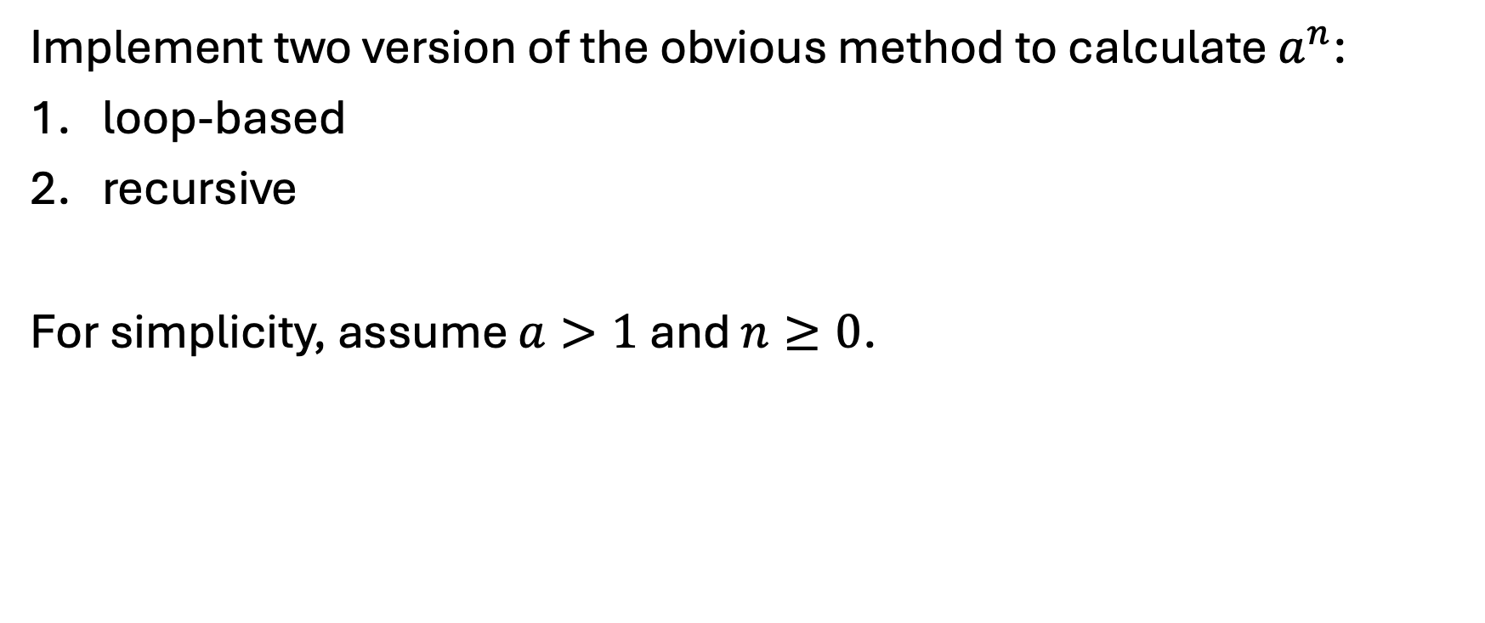
The Obvious Method
Implement two version of the obvious method to calculate $a^{n}$:
loop-based
recursive
For simplicity, assume $a>1$ and $n≥0$.

Slide 26

The Obvious Method
So to calculate $a^{65537}$ the obvious method does 65536 multiplications.
If one multiplication takes 0.0001 seconds, then this would take 65536 * 0.0001 = 6.6 seconds
Of course, modern computers are faster than this. But suppose this is special-purpose hardware that is cheap and slow.
Question
How can we make this faster without spending more money to buy a faster computer?

Slide 27
The Obvious Method
So to calculate $a^{65537}$ the obvious method does 65536 multiplications.
If one multiplication takes 0.0001 seconds, then this would take 65536 * 0.0001 = 6.6 seconds
Of course, modern computers are faster than this. But suppose this is special-purpose hardware that is cheap and slow.
Question
How can we make this faster without spending more money to buy a faster computer?

Slide 28

The Obvious Method
So to calculate $a^{65537}$ the obvious method does 65536 multiplications.
Question
Is there any way to do fewer multiplications?
Hint: Yes!

Slide 29
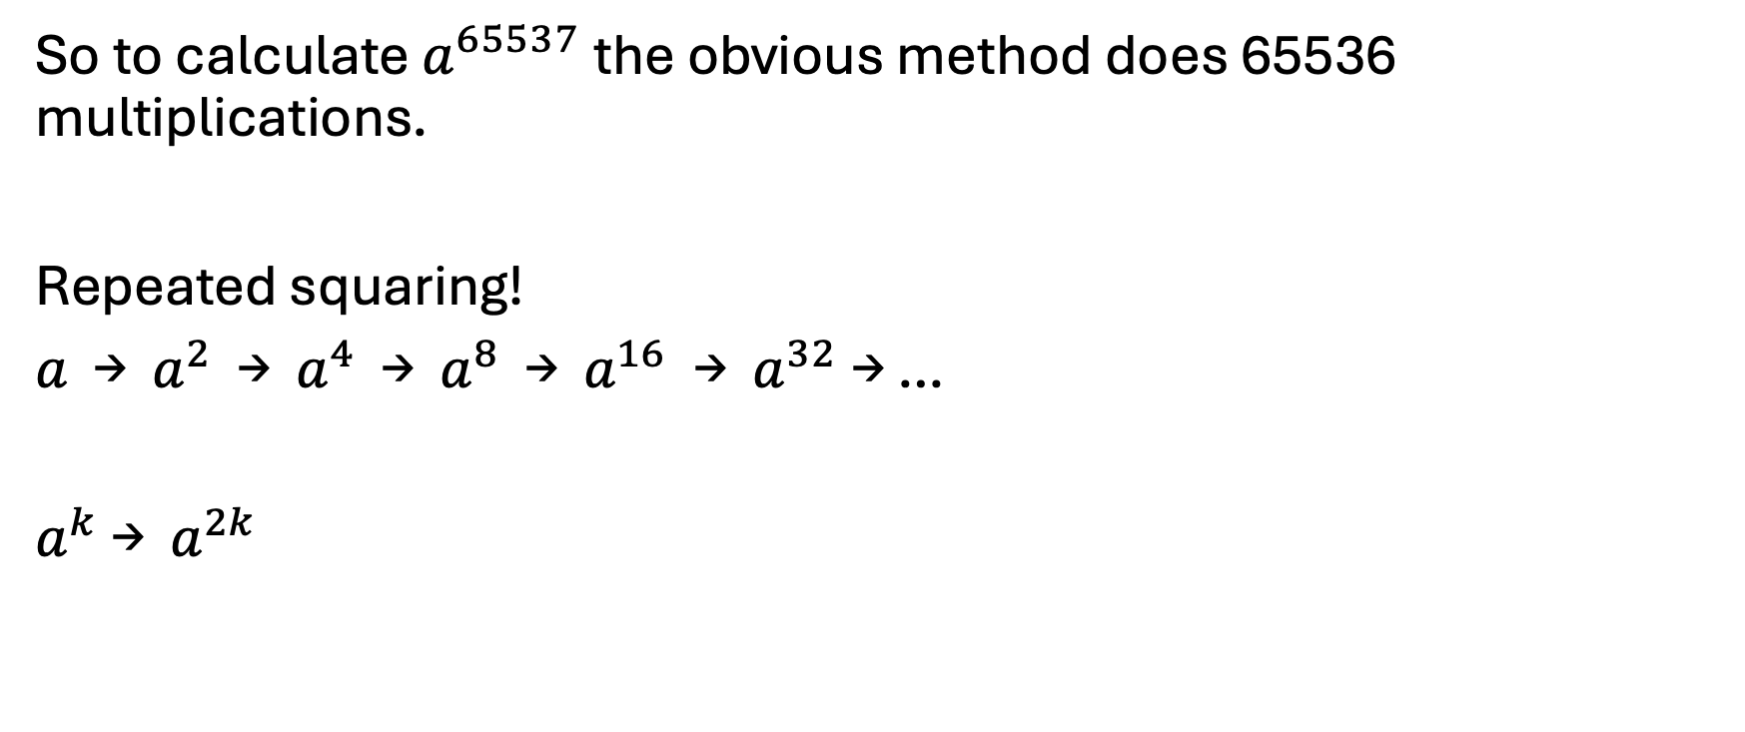

The Squaring Method
So to calculate $a^{65537}$ the obvious method does 65536 multiplications.
Repeated squaring!
$a$ → $a^{2}$ → $a^{4}$ → $a^{8}$ → $a^{16}$→ $a^{32}$→ …
$a^{k}$ → $a^{2k}$
Question
Is there any way to do fewer multiplications?
Hint: Yes!

Slide 30
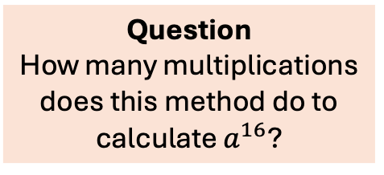

The Squaring Method
Repeated squaring quickly calculates any exponent that is a power of 2.
Repeated squaring!
$a$ → $a^{2}$ → $a^{4}$ → $a^{8}$ → $a^{16}$→ $a^{32}$→ …
$a^{k}$ → $a^{2k}$
Each arrow corresponds to one “squaring”, which takes one multiplication.
Question
How many multiplications does this method do to calculate $a^{16}$?

Slide 31
The Squaring Method
Repeated squaring quickly calculates any exponent that is a power of 2.
Repeated squaring!
$a$ → $a^{2}$ → $a^{4}$ → $a^{8}$ → $a^{16}$→ $a^{32}$→ …
$a^{k}$ → $a^{2k}$
Each arrow corresponds to one “squaring”, which takes one multiplication.
Question
How many multiplications does this method do to calculate $a^{16}$?
4 multiplications Compared to 15 for the obvious method.
The squaring method does 4 times less work in this case.

Slide 32
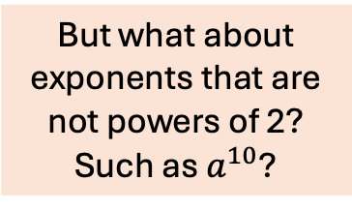
The Squaring Method
But what about exponents that are not powers of 2? Such as $a^{10}$?
Repeated squaring!
$a$ → $a^{2}$ → $a^{4}$ → $a^{8}$ → $a^{16}$→ $a^{32}$→ …
$a^{k}$ → $a^{2k}$

Slide 33
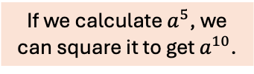

The Squaring Method
But what about exponents that are not powers of 2? Such as $a^{10}$?
Repeated squaring!
$a$ → $a^{2}$ → $a^{4}$ → $a^{8}$ → $a^{16}$→ $a^{32}$→ …
$a^{k}$ → $a^{2k}$
$$a^{10}=a^{5}⋅a^{5}$$
If we calculate $a^{5}$, we can square it to get $a^{10}$.

Slide 34

The Squaring Method
But what about exponents that are not powers of 2? Such as $a^{10}$?
Repeated squaring!
$a$ → $a^{2}$ → $a^{4}$ → $a^{8}$ → $a^{16}$→ $a^{32}$→ …
$a^{k}$ → $a^{2k}$
$$a^{10}=a^{5}⋅a^{5}$$
If we calculate $a^{5}$, we can square it to get $a^{10}$.
How can we get $a^{5}$?

Slide 35

The Squaring Method
But what about exponents that are not powers of 2? Such as $a^{10}$?
Repeated squaring!
$a$ → $a^{2}$ → $a^{4}$ → $a^{8}$ → $a^{16}$→ $a^{32}$→ …
$a^{k}$ → $a^{2k}$
$$a^{10}=a^{5}⋅a^{5}$$
If we calculate $a^{5}$, we can square it to get $a^{10}$.
How can we get $a^{5}$?
$$a^{5}={a⋅a^{4}=a⋅a}^{2}⋅a^{2}$$

Slide 36
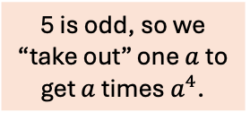
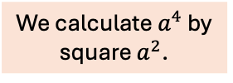
The Squaring Method
But what about exponents that are not powers of 2? Such as $a^{10}$?
Repeated squaring!
$a$ → $a^{2}$ → $a^{4}$ → $a^{8}$ → $a^{16}$→ $a^{32}$→ …
$a^{k}$ → $a^{2k}$
$$a^{10}=a^{5}⋅a^{5}$$
If we calculate $a^{5}$, we can square it to get $a^{10}$.
How can we get $a^{5}$?
$$a^{5}={a⋅a^{4}=a⋅a}^{2}⋅a^{2}$$
5 is odd, so we “take out” one $a$ to get $a$ times $a^{4}$.
We calculate $a^{4}$ by square $a^{2}$.

Slide 37

The Squaring Method
But what about exponents that are not powers of 2? Such as $a^{10}$?
Repeated squaring!
$a$ → $a^{2}$ → $a^{4}$ → $a^{8}$ → $a^{16}$→ $a^{32}$→ …
$a^{k}$ → $a^{2k}$
$$a^{10}=a^{5}⋅a^{5}$$
If we calculate $a^{5}$, we can square it to get $a^{10}$.
How can we get $a^{5}$?
$$a^{5}={a⋅a^{4}=a⋅a}^{2}⋅a^{2}$$
5 is odd, so we “take out” one $a$ to get $a$ times $a^{4}$.
We calculate $a^{4}$ by square $a^{2}$.
Final case
$$a^{2}=a^{1}⋅a^{1}$$

Slide 38
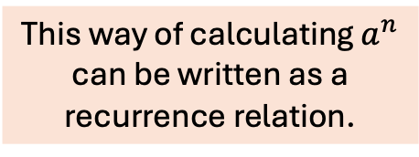
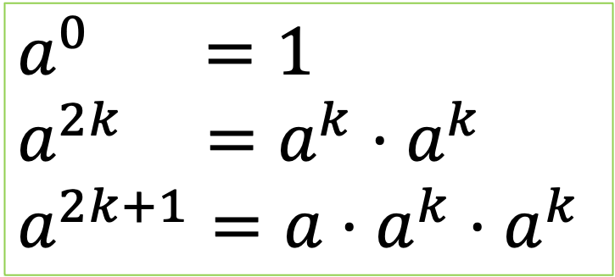
The Squaring Method
But what about exponents that are not powers of 2? Such as $a^{10}$?
$$a^{0} =1$$
$$a^{2k} =a^{k}⋅a^{k}$$
$$a^{2k+1}=a⋅a^{k}⋅a^{k}$$
$$a^{10}=a^{5}⋅a^{5}$$
If we calculate $a^{5}$, we can square it to get $a^{10}$.
How can we get $a^{5}$?
$$a^{5}={a⋅a^{4}=a⋅a}^{2}⋅a^{2}$$
This way of calculating $a^{n}$ can be written as a recurrence relation.
5 is odd, so we “take out” one $a$ to get $a$ times $a^{4}$.
We calculate $a^{4}$ by square $a^{2}$.
Final case
$$a^{2}=a^{1}⋅a^{1}$$

Slide 39
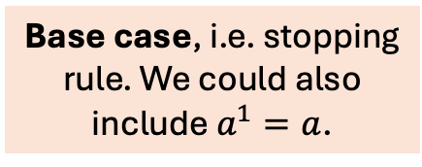
The Squaring Method
Base case, i.e. stopping rule. We could also include $a^{1}=a$.
$$a^{0} =1$$
$$a^{2k} =a^{k}⋅a^{k}$$
$$a^{2k+1}=a⋅a^{k}⋅a^{k}$$
Even exponent case A recursive case.
Odd exponent case A recursive case.

Slide 40
The Squaring Method
It’s useful to add a counter to the code to see how multiplication it is doing …

Slide 41
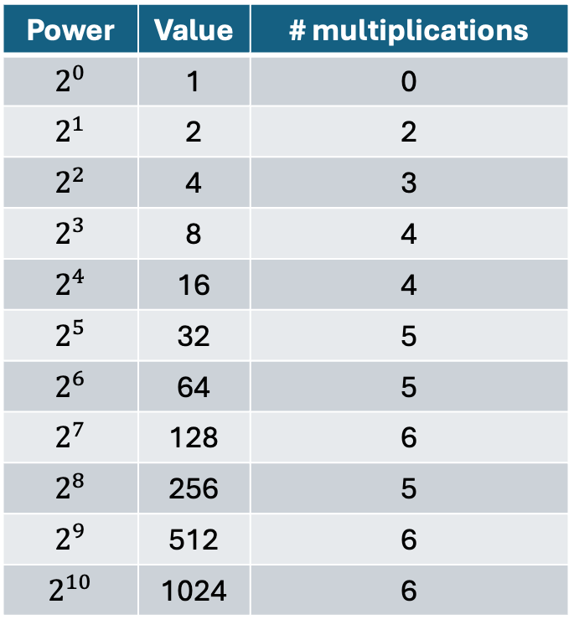

Squaring Method Performance
Power | Value | # multiplications
$$2^{0}$$ | 1 | 0
$$2^{1}$$ | 2 | 2
$$2^{2}$$ | 4 | 3
$$2^{3}$$ | 8 | 4
$$2^{4}$$ | 16 | 4
$$2^{5}$$ | 32 | 5
$$2^{6}$$ | 64 | 5
$$2^{7}$$ | 128 | 6
$$2^{8}$$ | 256 | 5
$$2^{9}$$ | 512 | 6
$$2^{10}$$ | 1024 | 6
It’s not obvious how many multiplications the squaring method does to calculate $a^{n}$, so lets look at some data …

Slide 42
Squaring Method Performance
Power | Value | # multiplications
$$2^{0}$$ | 1 | 0
$$2^{1}$$ | 2 | 2
$$2^{2}$$ | 4 | 3
$$2^{3}$$ | 8 | 4
$$2^{4}$$ | 16 | 4
$$2^{5}$$ | 32 | 5
$$2^{6}$$ | 64 | 5
$$2^{7}$$ | 128 | 6
$$2^{8}$$ | 256 | 5
$$2^{9}$$ | 512 | 6
$$2^{10}$$ | 1024 | 6
It’s not obvious how many multiplications the squaring method does to calculate $a^{n}$, so lets look at some data …
Can you see a pattern in the number of multiplications?

Slide 43
Squaring Method Performance
The pattern doesn’t seem obvious (to me!).
So lets try printing out other information …
… maybe we should print which recursive rule we call, i.e. either the even exponent or the odd exponent …

Slide 44
Squaring Method Performance
Try running the code on the previous slide before continuing …
There is a surprise that you can find in the code for fast powers …

Slide 45
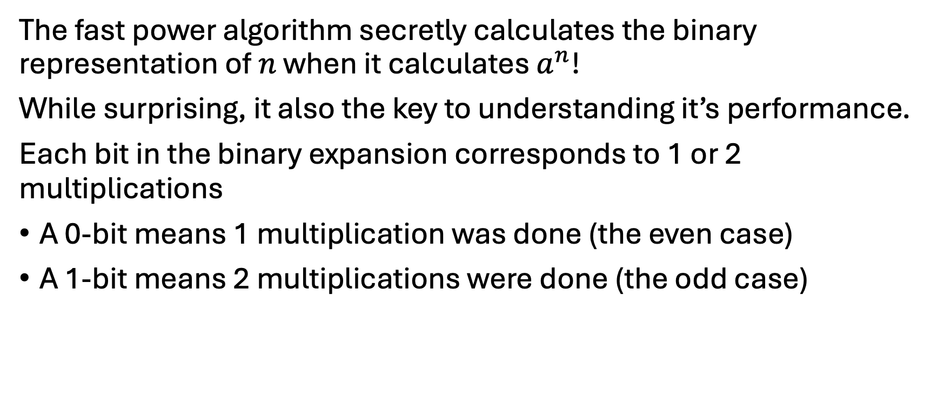
Squaring Method Performance
The fast power algorithm secretly calculates the binary representation of $n$ when it calculates $a^{n}$!
While surprising, it also the key to understanding it’s performance.
Each bit in the binary expansion corresponds to 1 or 2 multiplications
A 0-bit means 1 multiplication was done (the even case)
A 1-bit means 2 multiplications were done (the odd case)

Slide 46
Squaring Method Performance
The fast power algorithm secretly calculates the binary representation of $n$ when it calculates $a^{n}$!
While surprising, it also the key to understanding it’s performance.
Each bit in the binary expansion corresponds to 1 or 2 multiplications
A 0-bit means 1 multiplication was done (the even case)
A 1-bit means 2 multiplications were done (the odd case)
Question Assuming the worst case, how many multiplications are done?

Slide 47
Squaring Method Performance
The fast power algorithm secretly calculates the binary representation of $n$ when it calculates $a^{n}$!
While surprising, it also the key to understanding it’s performance.
Each bit in the binary expansion corresponds to 1 or 2 multiplications
A 0-bit means 1 multiplication was done (the even case)
A 1-bit means 2 multiplications were done (the odd case)
Question Assuming the worst case, how many multiplications are done?
At worst, 2 multiplications for each bit.

Slide 48
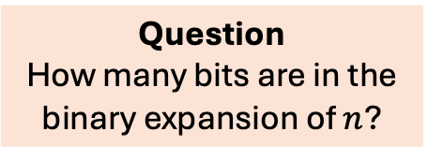
Squaring Method Performance
The fast power algorithm secretly calculates the binary representation of $n$ when it calculates $a^{n}$!
While surprising, it also the key to understanding it’s performance.
Each bit in the binary expansion corresponds to 1 or 2 multiplications
A 0-bit means 1 multiplication was done (the even case)
A 1-bit means 2 multiplications were done (the odd case)
Question Assuming the worst case, how many multiplications are done?
Question How many bits are in the binary expansion of $n$?
At worst, 2 multiplications for each bit.

Slide 49
Squaring Method Performance
The fast power algorithm secretly calculates the binary representation of $n$ when it calculates $a^{n}$!
While surprising, it also the key to understanding it’s performance.
Each bit in the binary expansion corresponds to 1 or 2 multiplications
A 0-bit means 1 multiplication was done (the even case)
A 1-bit means 2 multiplications were done (the odd case)
Question Assuming the worst case, how many multiplications are done?
Question How many bits are in the binary expansion of $n$?
At worst, 2 multiplications for each bit.

Slide 50
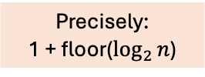
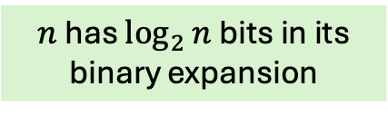
Squaring Method Performance
The fast power algorithm secretly calculates the binary representation of $n$ when it calculates $a^{n}$!
While surprising, it also the key to understanding it’s performance.
Each bit in the binary expansion corresponds to 1 or 2 multiplications
A 0-bit means 1 multiplication was done (the even case)
A 1-bit means 2 multiplications were done (the odd case)
Precisely: 1 + floor($\log_{2}{n}$)
Question Assuming the worst case, how many multiplications are done?
Question How many bits are in the binary expansion of $n$?
At worst, 2 multiplications for each bit.
$n$ has $\log_{2}{n}$ bits in its binary expansion

Slide 51


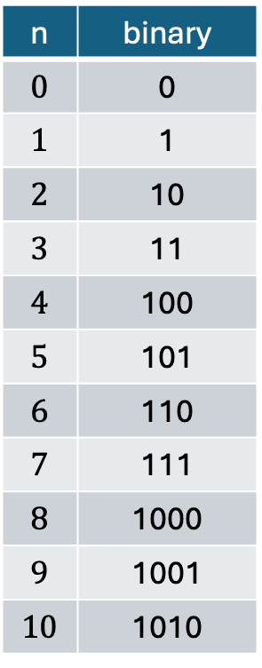
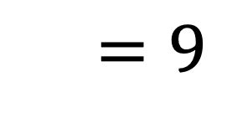
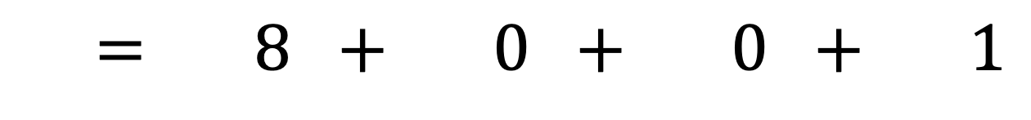

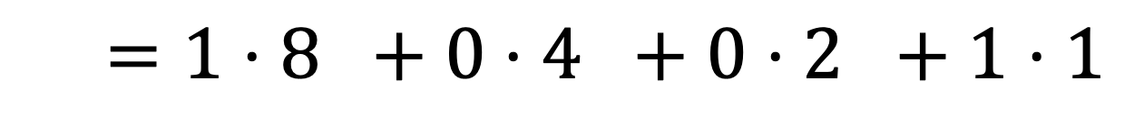

Squaring Method Performance
n | binary
$$0$$ | 0
$$1$$ | 1
$$2$$ | 10
$$3$$ | 11
$$4$$ | 100
$$5$$ | 101
$$6$$ | 110
$$7$$ | 111
$$8$$ | 1000
$$9$$ | 1001
$$10$$ | 1010
In binary (base 2), the place values of the bits are powers of 2.
9 =
1
0
0
1
$$2^{3}$$
$$2^{2}$$
$$2^{1}$$
$$2^{0}$$
$$9=1⋅2^{3}+0⋅2^{2}+0⋅2^{1}+1⋅2^{0}$$
$$=1⋅8 +0⋅4 +0⋅2 +1⋅1$$
$$= 8 + 0 + 0 + 1$$
$$=9$$

Slide 52
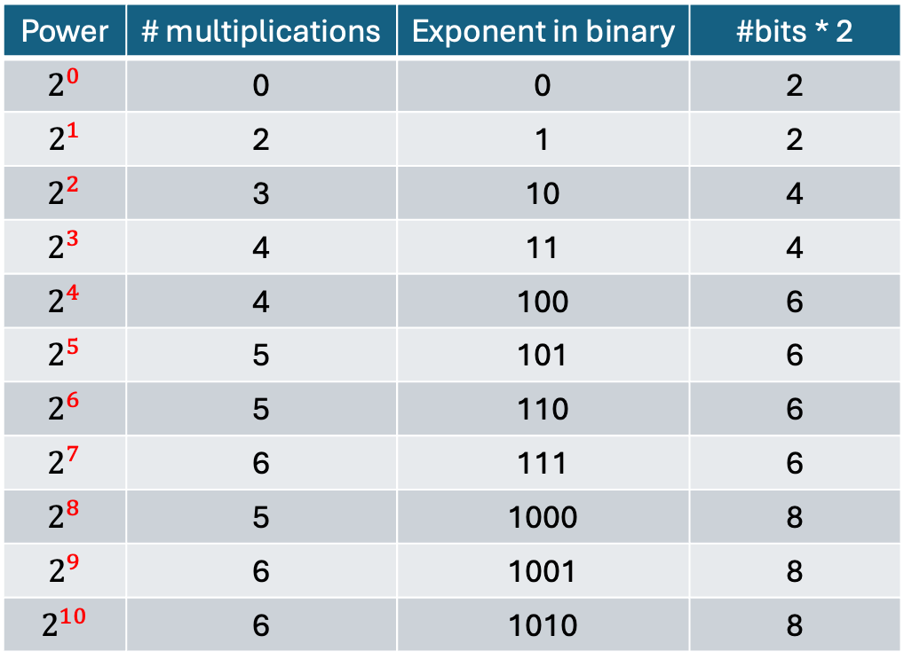
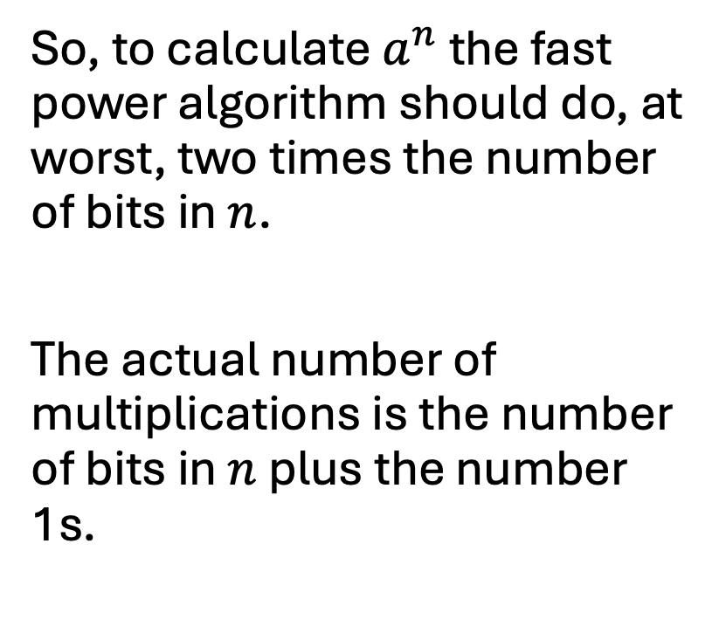
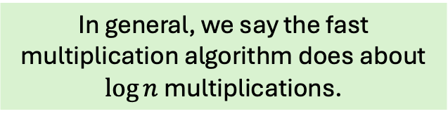
Squaring Method Performance
So, to calculate $a^{n}$ the fast power algorithm should do, at worst, two times the number of bits in $n$.
The actual number of multiplications is the number of bits in $n$ plus the number 1s.
Power | # multiplications | Exponent in binary | #bits * 2
$$2^{0}$$ | 0 | 0 | 2
$$2^{1}$$ | 2 | 1 | 2
$$2^{2}$$ | 3 | 10 | 4
$$2^{3}$$ | 4 | 11 | 4
$$2^{4}$$ | 4 | 100 | 6
$$2^{5}$$ | 5 | 101 | 6
$$2^{6}$$ | 5 | 110 | 6
$$2^{7}$$ | 6 | 111 | 6
$$2^{8}$$ | 5 | 1000 | 8
$$2^{9}$$ | 6 | 1001 | 8
$$2^{10}$$ | 6 | 1010 | 8
In general, we say the fast multiplication algorithm does about $\log{n}$ multiplications.

Slide 53
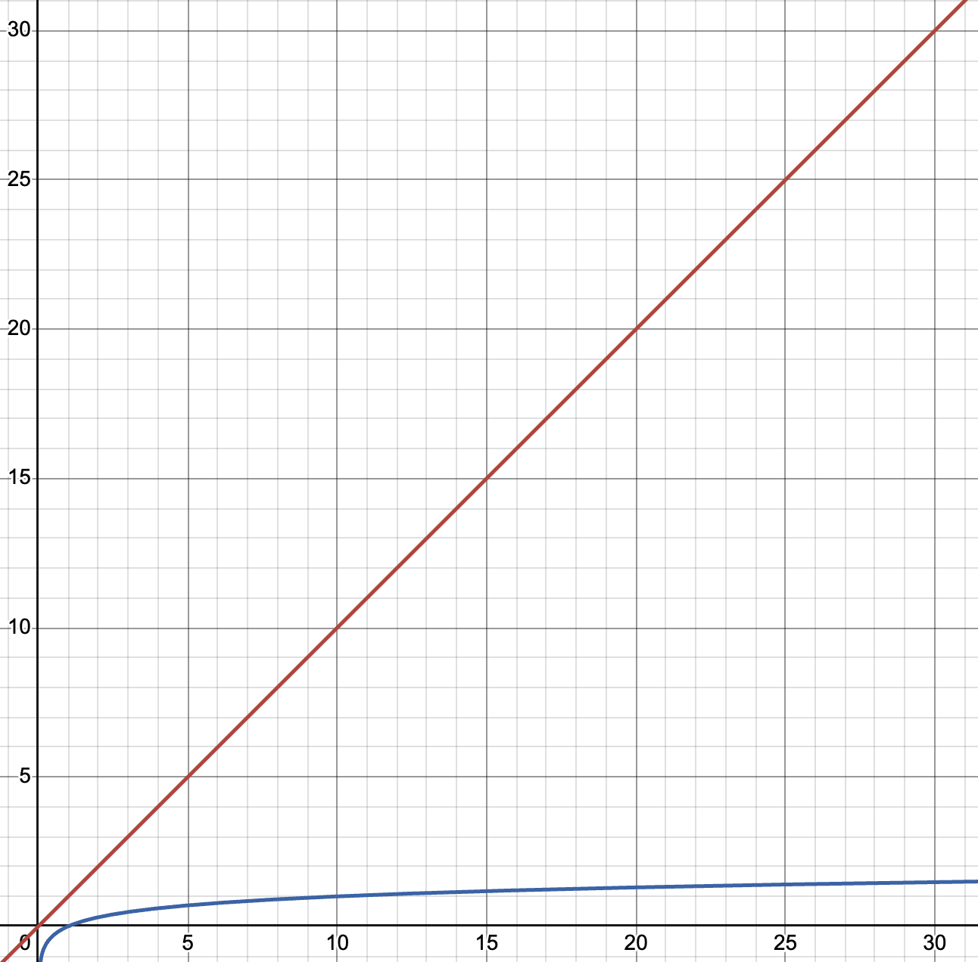

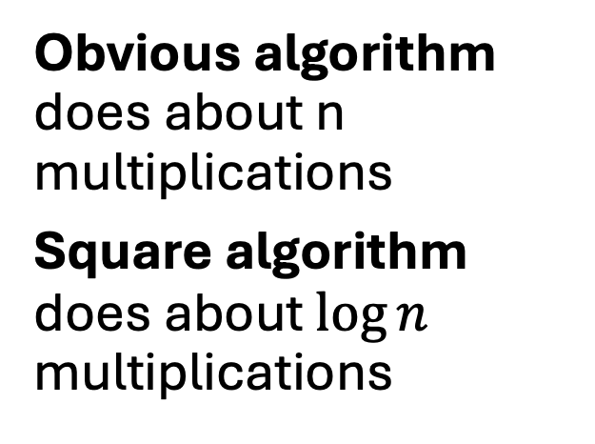
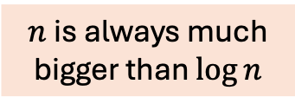
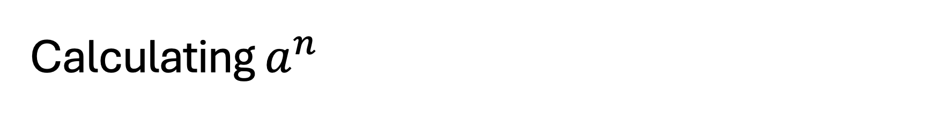
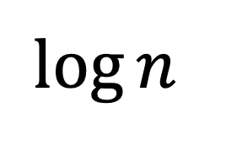
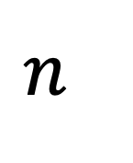
Calculating $a^{n}$
Obvious algorithm does about n multiplications
Square algorithm does about $\log{n}$ multiplications
$$n$$
# of multiplications
$n$ is always much bigger than $\log{n}$
$$\log{n}$$
Value of $n$

Slide 54

RSA Public Key Cryptography
One step of the RSA public key cryptography algorithm is to calculate this:
$$a^{65537}$$
Obvious algorithm 65536 multiplications
$a$ is an integer greater than 1.
Squaring algorithm
65537 = 10000000000000001 in binary (17 bits) Therefore, no more than 34 multiplications(!).
(exactly 17 + 2 = 19 multiplications)

Slide 55
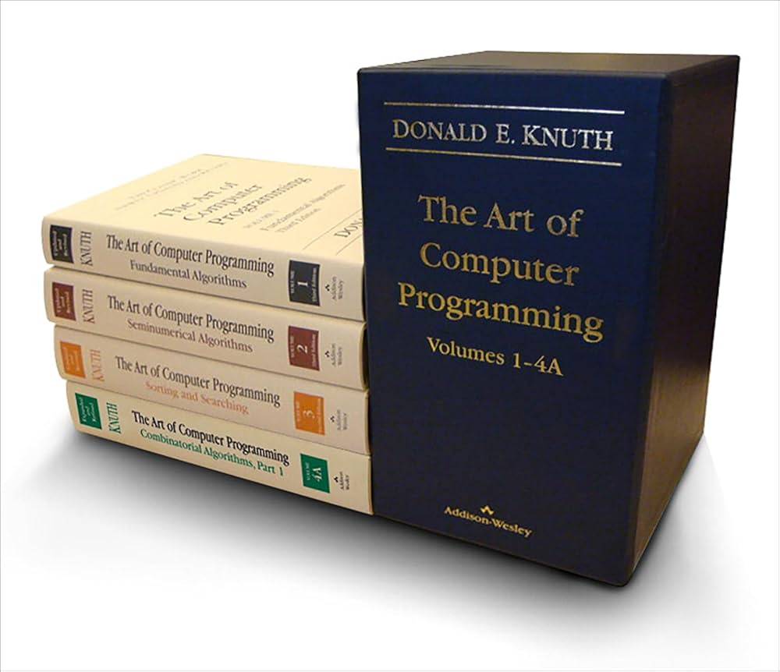
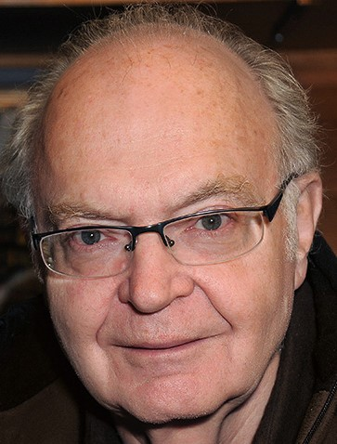
Donald Knuth and The Art of Computer Programming
In 1967 computer scientist Donald Knuth
Published the first book of a his projected
7-book series called The Art of Computer Programming.
It’s a comprehensive study of algorithms
and their analysis.
As of 2025, volume 4D on combinatorial algorithms was published.
Donald Knuth
These books help set the foundations of the mathematical analysis of algorithms.

Slide 56
Finding the max
Knuth said it was this problem helped convince him that the analysis of algorithms is a worthy topic to study.
How can you find the max value given a list of values?

Slide 57
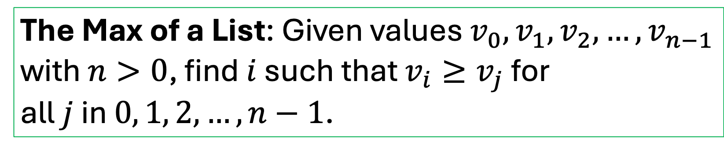
Finding the max
How can you find the max value given a list of values?
The Max of a List: Given values $v_{0},v_{1},v_{2},…, v_{n−1}$ with $n>0$, find $i$ such that $v_{i}≥v_{j}$ for all $j$ in $0, 1, 2, …, n−1$.

Slide 58
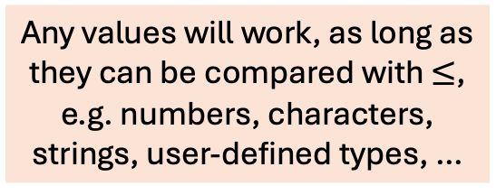
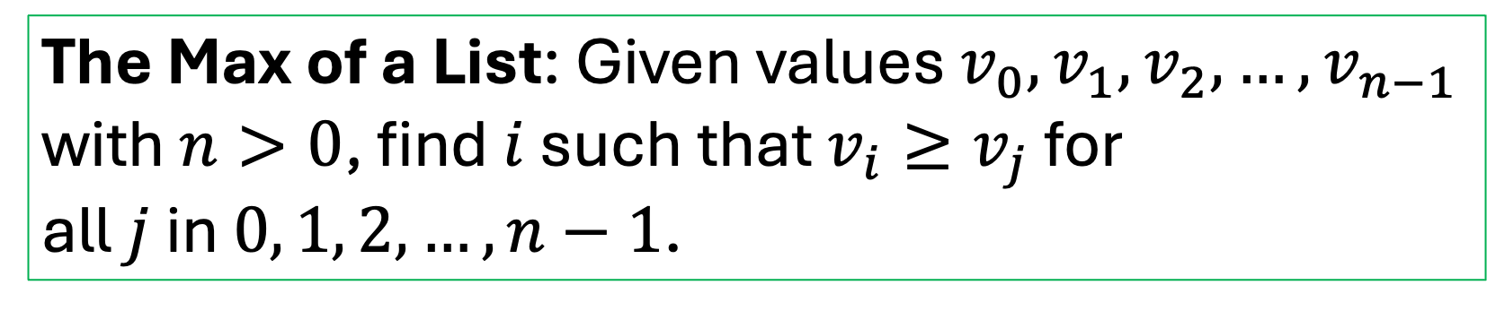
Finding the max
How can you find the max value given a list of values?
The Max of a List: Given values $v_{0},v_{1},v_{2},…, v_{n−1}$ with $n>0$, find $i$ such that $v_{i}≥v_{j}$ for all $j$ in $0, 1, 2, …, n−1$.
Any values will work, as long as they can be compared with $≤$, e.g. numbers, characters, strings, user-defined types, …

Slide 59

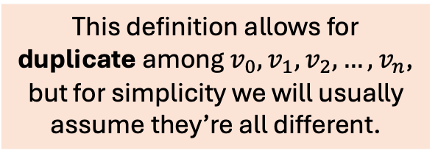
Finding the max
How can you find the max value given a list of values?
This definition allows for duplicate among $v_{0},v_{1},v_{2},…, v_{n}$, but for simplicity we will usually assume they’re all different.
The Max of a List: Given values $v_{0},v_{1},v_{2},…, v_{n−1}$ with $n>0$, find $i$ such that $v_{i}≥v_{j}$ for all $j$ in $0, 1, 2, …, n−1$.
Any values will work, as long as they can be compared with $≤$, e.g. numbers, characters, strings, user-defined types, …

Slide 60

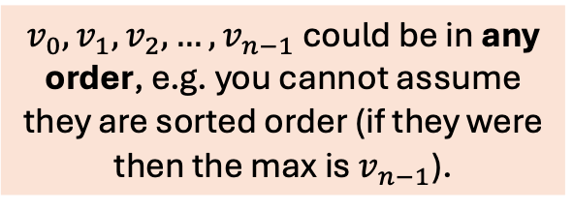
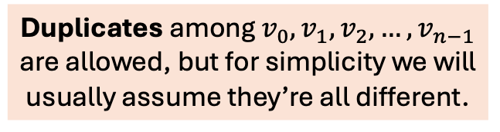
Finding the max
$v_{0},v_{1},v_{2},…, v_{n−1}$ could be in any order, e.g. you cannot assume they are sorted order (if they were then the max is $v_{n−1}$).
Duplicates among $v_{0},v_{1},v_{2},…, v_{n−1}$ are allowed, but for simplicity we will usually assume they’re all different.
The Max of a List: Given values $v_{0},v_{1},v_{2},…, v_{n−1}$ with $n>0$, find $i$ such that $v_{i}≥v_{j}$ for all $j$ in $0, 1, 2, …, n−1$.
Any values will work, as long as they can be compared with $≤$, e.g. numbers, characters, strings, user-defined types, …

Slide 61
Finding the max
The definition says nothing about the max of an empty list, so it’s up to the programmer to handle that. It’s usually treated as an error.
$v_{0},v_{1},v_{2},…, v_{n−1}$ could be in any order, e.g. you cannot assume they are sorted order (if they were then the max is $v_{n−1}$).
Duplicates among $v_{0},v_{1},v_{2},…, v_{n−1}$ are allowed, but for simplicity we will usually assume they’re all different.
The Max of a List: Given values $v_{0},v_{1},v_{2},…, v_{n−1}$ with $n>0$, find $i$ such that $v_{i}≥v_{j}$ for all $j$ in $0, 1, 2, …, n−1$.
Any values will work, as long as they can be compared with $≤$, e.g. numbers, characters, strings, user-defined types, …

Slide 62
Finding the max
From the statement of the problem, we can also make some useful units tests …

Slide 63
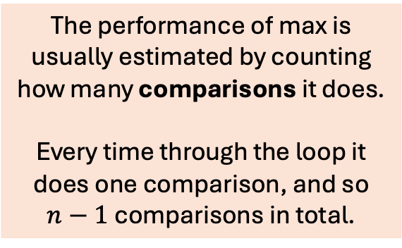
Finding the max
Basic algorithm
max = v[0]
for i = 1 to n-1 do
if v[i] > max then max = v[i]
end if end do
0
1
2
3
4
5
6
7
v
6
2
1
4
5
2
8
7
The performance of max is usually estimated by counting how many comparisons it does. Every time through the loop it does one comparison, and so $n−1$ comparisons in total.
Idea: Scan through the list looking for the max. You must check all elements.

Slide 64
Finding the max
See the implementations of max …

Slide 65
Finding the max
int max(const vector<int>& v)
{
int max_value = v[0];
int i = 1;
while (i < v.size())
{
if (v[i] > max_value)
{
max_value = v[i];
}
i++;
}
return max_value;
}
This while-loop version is good for analyzing the algorithm because each line does one thing.

Slide 66
Finding the max
Let’s count how many times each line is called for an n-element vector …
int max(const vector<int>& v)
{
int max_value = v[0];
int i = 1;
while (i < v.size())
{
if (v[i] > max_value)
{
max_value = v[i];
}
i++;
}
return max_value;
}

Slide 67
Finding the max
Let’s count how many times each line is called for an n-element vector …
1 time
int max(const vector<int>& v)
{
int max_value = v[0];
int i = 1;
while (i < v.size())
{
if (v[i] > max_value)
{
max_value = v[i];
}
i++;
}
return max_value;
}

Slide 68
Finding the max
Let’s count how many times each line is called for an n-element vector …
1 time
int max(const vector<int>& v)
{
int max_value = v[0];
int i = 1;
while (i < v.size())
{
if (v[i] > max_value)
{
max_value = v[i];
}
i++;
}
return max_value;
}

Slide 69
Finding the max
Let’s count how many times each line is called for an n-element vector …
1 time
int max(const vector<int>& v)
{
int max_value = v[0];
int i = 1;
while (i < v.size())
{
if (v[i] > max_value)
{
max_value = v[i];
}
i++;
}
return max_value;
}
1 time

Slide 70
Finding the max
Let’s count how many times each line is called for an n-element vector …
1 time
int max(const vector<int>& v)
{
int max_value = v[0];
int i = 1;
while (i < v.size())
{
if (v[i] > max_value)
{
max_value = v[i];
}
i++;
}
return max_value;
}
1 time

Slide 71

Finding the max
Let’s count how many times each line is called for an n-element vector …
1 time
int max(const vector<int>& v)
{
int max_value = v[0];
int i = 1;
while (i < v.size())
{
if (v[i] > max_value)
{
max_value = v[i];
}
i++;
}
return max_value;
}
1 time
$\sim n$ times

Slide 72
Finding the max
Let’s count how many times each line is called for an n-element vector …
1 time
int max(const vector<int>& v)
{
int max_value = v[0];
int i = 1;
while (i < v.size())
{
if (v[i] > max_value)
{
max_value = v[i];
}
i++;
}
return max_value;
}
1 time
$\sim n$ times

Slide 73

Finding the max
Let’s count how many times each line is called for an n-element vector …
1 time
int max(const vector<int>& v)
{
int max_value = v[0];
int i = 1;
while (i < v.size())
{
if (v[i] > max_value)
{
max_value = v[i];
}
i++;
}
return max_value;
}
1 time
$\sim n$ times
$\sim n$ times

Slide 74
Finding the max
Let’s count how many times each line is called for an n-element vector …
1 time
int max(const vector<int>& v)
{
int max_value = v[0];
int i = 1;
while (i < v.size())
{
if (v[i] > max_value)
{
max_value = v[i];
}
i++;
}
return max_value;
}
1 time
$\sim n$ times
$\sim n$ times

Slide 75

Finding the max
Let’s count how many times each line is called for an n-element vector …
1 time
int max(const vector<int>& v)
{
int max_value = v[0];
int i = 1;
while (i < v.size())
{
if (v[i] > max_value)
{
max_value = v[i];
}
i++;
}
return max_value;
}
1 time
$\sim n$ times
$\sim n$ times
$\sim n$ times

Slide 76
Finding the max
Let’s count how many times each line is called for an n-element vector …
1 time
int max(const vector<int>& v)
{
int max_value = v[0];
int i = 1;
while (i < v.size())
{
if (v[i] > max_value)
{
max_value = v[i];
}
i++;
}
return max_value;
}
1 time
$\sim n$ times
$\sim n$ times
$\sim n$ times

Slide 77
Finding the max
Let’s count how many times each line is called for an n-element vector …
1 time
int max(const vector<int>& v)
{
int max_value = v[0];
int i = 1;
while (i < v.size())
{
if (v[i] > max_value)
{
max_value = v[i];
}
i++;
}
return max_value;
}
1 time
$\sim n$ times
$\sim n$ times
$\sim n$ times
1 time

Slide 78
Finding the max
Let’s count how many times each line is called for an n-element vector …
1 time
int max(const vector<int>& v)
{
int max_value = v[0];
int i = 1;
while (i < v.size())
{
if (v[i] > max_value)
{
max_value = v[i];
}
i++;
}
return max_value;
}
1 time
$\sim n$ times
$\sim n$ times
??? times
$\sim n$ times
1 time

Slide 79
Finding the max
Let’s count how many times each line is called for an n-element vector …
1 time
int max(const vector<int>& v)
{
int max_value = v[0];
int i = 1;
while (i < v.size())
{
if (v[i] > max_value)
{
max_value = v[i];
}
i++;
}
return max_value;
}
1 time
$\sim n$ times
$\sim n$ times
??? times
$\sim n$ times
This line is not so obvious! How many times does it run on an n-element vector?
1 time

Slide 80
Finding the max
It’s useful to look at some sample runs to get a sense of how many times the ??? line runs …

Slide 81
Finding the max
Results for some value of n …
n = 100: 4, 6, 3, 7, 5, 2 (mean = 4.5)
n = 1000: 7, 4, 8, 5, 3, 10 (mean = 6.17)
n = 10000: 8, 7, 5, 12, 12, 10 (mean = 9.0)
n = 100000: 8, 9, 9, 13, 14, 9 (mean = 10.33)
n = 1000000: 9, 11, 19, 14, 8, 12 (mean = 12.17)
It’s surprising that these numbers are so small. Even for very large n, a new max is assigned only a few times.

Slide 82
Finding the max
Results for some value of n …
n = 100: 4, 6, 3, 7, 5, 2 (mean = 4.5)
n = 1000: 7, 4, 8, 5, 3, 10 (mean = 6.17)
n = 10000: 8, 7, 5, 12, 12, 10 (mean = 9.0)
n = 100000: 8, 9, 9, 13, 14, 9 (mean = 10.33)
n = 1000000: 9, 11, 19, 14, 8, 12 (mean = 12.17)

Slide 83
Finding the max
Results for some value of n …
n = 100: 4, 6, 3, 7, 5, 2 (mean = 4.5)
n = 1000: 7, 4, 8, 5, 3, 10 (mean = 6.17)
n = 10000: 8, 7, 5, 12, 12, 10 (mean = 9.0)
n = 100000: 8, 9, 9, 13, 14, 9 (mean = 10.33)
n = 1000000: 9, 11, 19, 14, 8, 12 (mean = 12.17)
It’s surprising that these numbers are so small. Even for very large n, a new max is assigned only a few times.

Slide 84
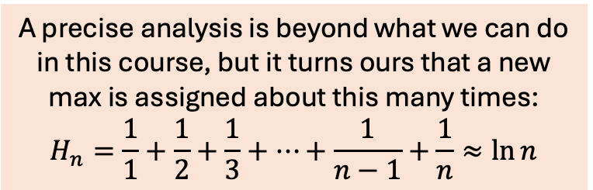
Finding the max
Results for some value of n …
n = 100: 4, 6, 3, 7, 5, 2 (mean = 4.5)
n = 1000: 7, 4, 8, 5, 3, 10 (mean = 6.17)
n = 10000: 8, 7, 5, 12, 12, 10 (mean = 9.0)
n = 100000: 8, 9, 9, 13, 14, 9 (mean = 10.33)
n = 1000000: 9, 11, 19, 14, 8, 12 (mean = 12.17)
It’s surprising that these numbers are so small. Even for very large n, a new max is assigned only a few times.
A precise analysis is beyond what we can do in this course, but it turns ours that a new max is assigned about this many times:
$$H_{n}=\frac{1}{1}+\frac{1}{2}+\frac{1}{3}+…+\frac{1}{n−1}+\frac{1}{n}≈\ln{n}$$

Slide 85


Finding the max
Results for some value of n …
n = 100: 4, 6, 3, 7, 5, 2 (mean = 4.5)
n = 1000: 7, 4, 8, 5, 3, 10 (mean = 6.17)
n = 10000: 8, 7, 5, 12, 12, 10 (mean = 9.0)
n = 100000: 8, 9, 9, 13, 14, 9 (mean = 10.33)
n = 1000000: 9, 11, 19, 14, 8, 12 (mean = 12.17)
It’s surprising that these numbers are so small. Even for very large n, a new max is assigned only a few times.
A precise analysis is beyond this course, but it turns out that a new max is assigned about this many times:
$$H_{n}=\frac{1}{1}+\frac{1}{2}+\frac{1}{3}+…+\frac{1}{n−1}+\frac{1}{n}≈\ln{n}$$
This grows very slowly … e.g. $H_{1billion}{≈}21$

Slide 86

Finding the max
Let’s count how many times each line is called for an n-element vector …
1 time
int max(const vector<int>& v)
{
int max_value = v[0];
int i = 1;
while (i < v.size())
{
if (v[i] > max_value)
{
max_value = v[i];
}
i++;
}
return max_value;
}
1 time
$\sim n$ times
$\sim n$ times
$\sim ln{n}$ times
$\sim n$ times
1 time

Slide 87

Finding the max
Let’s count how many times each line is called for an n-element vector …
1 time
int max(const vector<int>& v)
{
int max_value = v[0];
int i = 1;
while (i < v.size())
{
if (v[i] > max_value)
{
max_value = v[i];
}
i++;
}
return max_value;
}
time
$\sim n$ times
$\sim n$ times
$\sim \ln{n}$ times
$\sim n$ times
Overall, max(v) runs in time proportional to n (the size of v).
1 time

