Slide 1
Linear Search
Algorithms · Implementation · Performance Analysis
target = 7
4
3
7
1
5
9
2
6
[0]
[1]
[2]
[3]
[4]
[5]
[6]
[7]
CS Data Structures & Algorithms

Slide 2
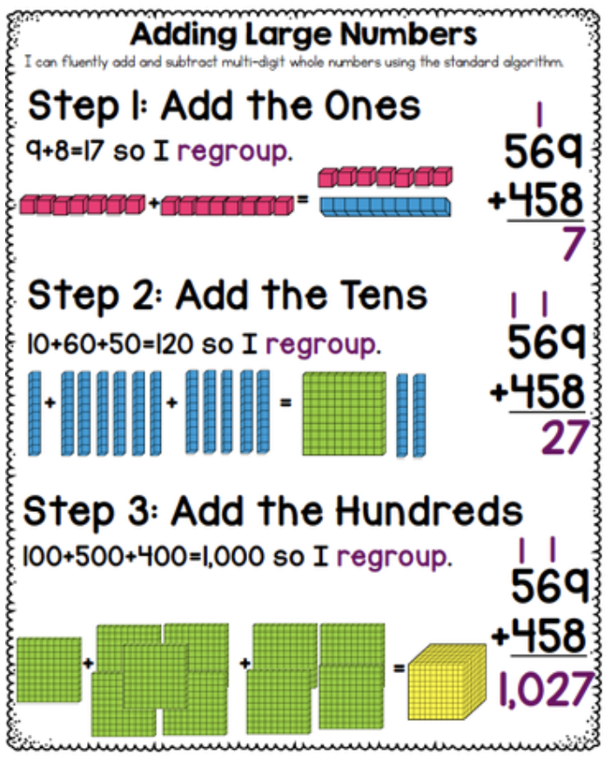
What Is an Algorithm?
Algorithm: a precise, step-by-step description of a process for solving a problem.
Long Addition
The elementary-school algorithm for adding multi-digit numbers, step by step.

Slide 3


What Is an Algorithm?
Algorithm: a precise, step-by-step description of a process for solving a problem.
Bresenham's Line
Draw a clean straight line between two pixels on a screen (no floats needed!).

Slide 4
What Is an Algorithm?
Algorithm: a precise, step-by-step description of a process for solving a problem.
Selection Sort
Repeatedly find the smallest remaining element and move it to the front.

Slide 5
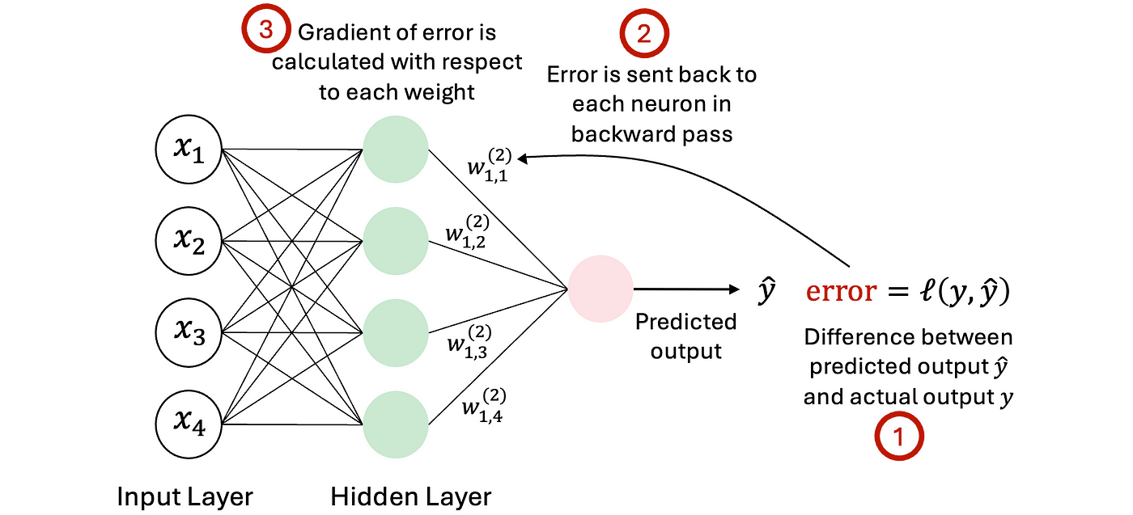
What Is an Algorithm?
Algorithm: a precise, step-by-step description of a process for solving a problem.
Backpropagation
Train a neural network by propagating error signals backwards through layers.

Slide 6
The Linear Search Problem
Given elements v₀, v₁, …, vₙ₋₁ and a target x, find index i such that v[i] == x. If no such element exists, return -1.

Slide 7

The Linear Search Problem
Given elements v₀, v₁, …, vₙ₋₁ and a target x, find index i such that v[i] == x. If no such element exists, return -1.
Example: searching for 7
4
3
7
1
5
[0]
[1]
[2]
[3]
[4]
Returns index 2 because v[2] == 7
Works with ANY type that supports ==
Elements can be in ANY order — not necessarily sorted
If x appears twice, either index may be returned
Empty vector → always returns -1

Slide 8

The Basic Algorithm
Stepping through each element one at a time
Pseudocode
Tracing: search for 2 in [5, 3, 2, 4]
5
3
2
4
i=0: v[0]=5, 5≠2 ✗
for i = 0 to n-1 do
if v[i] == x then
return i // found!
end
end
return -1 // not found
[0]
[1]
[2]
[3]
5
3
2
4
i=1: v[1]=3, 3≠2 ✗
[0]
[1]
[2]
[3]
5
3
2
4
i=2: v[2]=2, 2=2 ✓ return 2
[0]
[1]
[2]
[3]
Key insight: Stop as soon as you find x. No need to keep searching after the match!
Nothing is assumed about the order of elements — they can be in any arrangement.

Slide 9

Test Cases: Table-Based Testing
Checking correctness before writing the full implementation
struct Test_case {
string description; // what are we testing?
vector<int> input_vec; // the vector to search
int target; // the value to find
int expected_output;
};
Good practice: write your test cases BEFORE you write the function.
This forces you to think about what the function should do.
Description | Vector | Target | Expected
empty vector | {} | 2 | -1
single, found | {1} | 1 | 0
single, not found | {1} | 2 | -1
many, first found | {4,3,2,1,5} | 4 | 0
many, last found | {4,3,2,1,5} | 5 | 4
many, middle found | {4,3,2,1,5} | 2 | 2
many, not found | {4,3,2,1,5} | 0 | -1
Note: these test cases do NOT include duplicates, since our definition doesn't specify which index to return when x appears more than once.

Slide 10
Running the Tests: The Test Runner
void linear_search_test() {
int failed = 0;
for (Test_case tc : all_tests) {
int actual = linear_search(tc.target, tc.input_vec);
if (actual != tc.expected_output) {
failed++;
cout << "FAILED: " << tc.description << endl;
cout << " Expected: " << tc.expected_output << endl;
cout << " Got: " << actual << endl;
}
}
int n = all_tests.size();
cout << (n - failed) << "/" << n << " tests passed" << endl;
}
Loop through every test case automatically.
Call the function and compare to expected output.
Print a helpful message if a test fails.
Summary at the end: how many passed?

Slide 11
In-Class Practice #1
Basic Linear Search
1. Implement linear search on a vector<int> using a for-loop.
2. Implement linear search on a vector<int> using a while-loop.

Slide 12

C++ Implementation
Pre-condition: nothing is assumed (empty vector is valid)
Post-condition: returns the index of x, or -1 if not found
The function takes the target x and a reference to the vector (no copy made).
int linear_search(int x, const vector<int>& v)
{
for (int i = 0; i < v.size(); i++)
{
if (v[i] == x) return i; // found — stop immediately
}
return -1; // x was not in v
}
Returns immediately when found — no unnecessary comparisons.
Reaching here means x was never found — return -1.
const vector<int>& v means we can't modify v inside the function — a safe choice here.

Slide 13
In-Class Practice #2
Design Your Own Test Cases
1. Write a linear_search declaration for searching a vector<string>. What changes?
2. Write at least 4 test cases for searching for a char in a string (think: edge cases first!).

Slide 14
Different Search Orders
The standard algorithm goes left-to-right — but not always the best choice!
Left → Right (standard)
Simplest. Good default when order is unknown.

Slide 15
Different Search Orders
The standard algorithm goes left-to-right — but not always the best choice!
Left → Right (standard)
Right → Left
Simplest. Good default when order is unknown.
Better for file extensions: searching "." in "data.csv" starts near the end.

Slide 16
Different Search Orders
The standard algorithm goes left-to-right — but not always the best choice!
Left → Right (standard)
Right → Left
Simplest. Good default when order is unknown.
Better for file extensions: searching "." in "data.csv" starts near the end.
Wrap-around
If x tends to be at either extreme, this finds it faster on average.

Slide 17
Different Search Orders
The standard algorithm goes left-to-right — but not always the best choice!
Left → Right (standard)
Right → Left
Simplest. Good default when order is unknown.
Better for file extensions: searching "." in "data.csv" starts near the end.
Wrap-around
Near a known-likely position
If x tends to be at either extreme, this finds it faster on average.
If recent searches cluster in the same region, start there.
Since we usually know nothing about where x is, we default to simple left-to-right search.

Slide 18

location_of — When x Is Guaranteed to Be in v
// Pre-condition: x IS in v
// Post-condition: returns smallest i such that v[i] == x
int location_of(int x, const vector<int>& v)
{
int i = 0;
while (v[i] != x) i++; // only ONE comparison per iteration
return i;
}
If we happen to know x is in v
there’s a more efficient algorithm than linear search.
The pre-condition must be true before calling the function — it's the caller's responsibility!
 | linear_search | location_of
Comparisons / iteration | i < size AND v[i]==x | v[i] != x

Slide 19
Sentinel Value Search — A Slightly Faster General Search
The Trick: temporarily replace the last element with x, then use location_of
Original: searching for x = 7
4
3
2
1
5

Slide 20
Sentinel Value Search — A Slightly Faster General Search
The Trick: temporarily replace the last element with x, then use location_of
Original: searching for x = 7
4
3
2
1
5
Save original last value
5

Slide 21
Sentinel Value Search — A Slightly Faster General Search
The Trick: temporarily replace the last element with x, then use location_of
Sentinel value
Original: searching for x = 7
4
3
2
1
5
4
3
2
1
7
Set last value to 7
Save original last value
5

Slide 22
Sentinel Value Search — A Slightly Faster General Search
The Trick: temporarily replace the last element with x, then use location_of
Sentinel value
Original: searching for x = 7
4
3
2
1
5
4
3
2
1
7
Set last value to 7
location_of(7, v) returns 4 this is the sentinel value, so 7 is not in the vector
Save original last value
5

Slide 23

Sentinel Value Search — A Slightly Faster General Search
The Trick: temporarily replace the last element with x, then use location_of
Sentinel value
Original: searching for x = 7
4
3
2
1
5
4
3
2
1
7
Set last value to 7
location_of(7, v) returns 4 this is the sentinel value, so 7 is not in the vector
Save original last value
Restore the actual final value
5
4
3
2
1
5

Slide 24
Sentinel Value Search — A Slightly Faster General Search
The Trick: temporarily replace the last element with x, then use location_of
Original: searching for x = 2
4
3
2
1
5

Slide 25
Sentinel Value Search — A Slightly Faster General Search
The Trick: temporarily replace the last element with x, then use location_of
Original: searching for x = 2
4
3
2
1
5
Save original last value
5

Slide 26
Sentinel Value Search — A Slightly Faster General Search
The Trick: temporarily replace the last element with x, then use location_of
Sentinel value
Original: searching for x = 2
4
3
2
1
5
4
3
2
1
2
Set last value to 2
Save original last value
5

Slide 27
Sentinel Value Search — A Slightly Faster General Search
The Trick: temporarily replace the last element with x, then use location_of
Sentinel value
Original: searching for x = 2
4
3
2
1
5
4
3
2
1
2
Set last value to 2
location_of(2, v) returns 2 this is not the sentinel value, so 2 is in the vector
Save original last value
5

Slide 28
Sentinel Value Search — A Slightly Faster General Search
The Trick: temporarily replace the last element with x, then use location_of
Sentinel value
Original: searching for x = 2
4
3
2
1
5
4
3
2
1
2
Set last value to 2
location_of(2, v) returns 2 this is not the sentinel value, so 7 is in the vector
Save original last value
Restore the actual final value
5
4
3
2
1
5

Slide 29
Sentinel Value Search — A Slightly Faster General Search
The Trick: temporarily replace the last element with x, then use location_of
int linear_search_faster(int x, vector<int>& v) {
int n = v.size();
if (n == 0) return -1;
if (n == 1) return (v[0]==x) ? 0 : -1;
if (v[n-1] == x) return n-1; // already at end
int last = v[n-1]; v[n-1] = x; // set sentinel
int i = location_of(x, v); // guaranteed to find it
v[n-1] = last; // restore
return (i == n-1) ? -1 : i; // was it the sentinel?
}
Faster?
Yes — one comparison per iteration. But modern CPUs make the difference tiny.
Simpler?
No — the code is longer and trickier. Easy to introduce bugs.
Requirement
v cannot be const — we need to temporarily modify the last element.

Slide 30
In-Class Practice #3
Pre-conditions, Post-conditions & Edge Cases
1. What is the pre-condition of location_of? What happens if it is violated? Give a concrete example.
2. Explain in your own words the difference between linear_search and location_of. When would you use each?
3. What are two potential problems with linear_search_faster compared to the basic version?

Slide 31
Searching a Sub-Range: [begin, end)
Generalising linear search to search part of a vector
Search only the range [2, 6): elements at indices 2, 3, 4, 5
8
2
5
1
9
3
7
4
[0]
[1]
[2]
[3]
[4]
[5]
[6]
[7]
begin=2
end=6
[begin, end) is an asymmetric range. It includes begin but excludes end. Number of elements = end - begin.

Slide 32
Searching a Sub-Range: [begin, end)
Generalising linear search to search part of a vector
Search only the range [2, 6): elements at indices 2, 3, 4, 5
8
2
5
1
9
3
7
4
[0]
[1]
[2]
[3]
[4]
[5]
[6]
[7]
begin=2
end=6
[begin, end) is an asymmetric range. It includes begin but excludes end. Number of elements = end - begin.
// Search in range [begin, end)
int linear_search(const vector<int>& v, int x, int begin, int end) {
for (int i = begin; i < end; i++) {
if (v[i] == x) return i;
}
return -1;
}
int linear_search(const vector<int>& v, int x) { // full search is now just one line
return linear_search(v, x, 0, v.size());
}

Slide 33
Recursive Linear Search
Same algorithm, different thinking
Base case 1: If the vector is empty → return -1 (x not found)
Base case 2: If the first element is x → return its index (found it!)
Recursive case: Otherwise, return linear_search(x, rest(v))

Slide 34
Recursive Linear Search
Same algorithm, different thinking
Base case 1: If the vector is empty → return -1 (x not found)
Base case 2: If the first element is x → return its index (found it!)
Recursive case: Otherwise, return linear_search(x, rest(v))
int linear_search(const vector<int>& v, int x,
int begin, int end)
{
if (begin >= end) return -1; // base case 1
if (v[begin] == x) return begin; // base case 2
return linear_search(v, x, begin+1, end); // recursive
}

Slide 35
Recursive Linear Search
Same algorithm, different thinking
Base case 1: If the vector is empty → return -1 (x not found)
Base case 2: If the first element is x → return its index (found it!)
Recursive case: Otherwise, return linear_search(x, rest(v))
int linear_search(const vector<int>& v, int x,
int begin, int end)
{
if (begin >= end) return -1; // base case 1
if (v[begin] == x) return begin; // base case 2
return linear_search(v, x, begin+1, end); // recursive
}
Recursive version is elegant but slower in practice — each call saves return address, arguments, and local vars on the call stack. A compiler may optimize tail recursion away, but don't count on it.

Slide 36
In-Class Practice #4
Trace the Recursive Calls
1. Trace all recursive calls for linear_search({2,8,1,5,4}, 1, 0, 5). Show the state of begin at each call.
2. What are the two base cases in recursive linear search? Why do we need both?
3. Write the two-parameter wrapper that calls the four-parameter recursive version. Explain why these are different functions (not the same function calling itself).

Slide 37
Measuring Algorithm Performance
Counting operations instead of clock time
What’s the problem with measuring performance with a clock?
CPU speed, number of cores, cache size

Slide 38
Measuring Algorithm Performance
Counting operations instead of clock time
What’s the problem with measuring performance with a clock?
CPU speed, number of cores, cache size
Compiler optimisations (e.g. -O3)

Slide 39
Measuring Algorithm Performance
Counting operations instead of clock time
What’s the problem with measuring performance with a clock?
CPU speed, number of cores, cache size
Compiler optimisations (e.g. -O3)
Operating system overhead

Slide 40
Measuring Algorithm Performance
Counting operations instead of clock time
What’s the problem with measuring performance with a clock?
CPU speed, number of cores, cache size
Compiler optimisations (e.g. -O3)
Operating system overhead
What else is running on the computer

Slide 41
Measuring Algorithm Performance
Counting operations instead of clock time
What’s the problem with measuring performance with a clock?
CPU speed, number of cores, cache size
Compiler optimisations (e.g. -O3)
Operating system overhead
What else is running on the computer
Recursive vs iterative implementation

Slide 42
Measuring Algorithm Performance
Counting operations instead of clock time
What’s the problem with measuring performance with a clock?
CPU speed, number of cores, cache size
Compiler optimisations (e.g. -O3)
Operating system overhead
What else is running on the computer
Recursive vs iterative implementation
Might only have pseudocode

Slide 43
Measuring Algorithm Performance
Counting operations instead of clock time
What’s the problem with measuring performance with a clock?
CPU speed, number of cores, cache size
Compiler optimisations (e.g. -O3)
Operating system overhead
What else is running on the computer
Recursive vs iterative implementation
Might only have pseudocode
Solution: count key operations. For linear search the key operation is ==. This count is independent of hardware and software.

Slide 44
Measuring Algorithm Performance
Counting operations instead of clock time
What’s the problem with measuring performance with a clock?
CPU speed, number of cores, cache size
Compiler optimisations (e.g. -O3)
Operating system overhead
What else is running on the computer
Recursive vs iterative implementation
Might only have pseudocode
Solution: count key operations. For linear search the key operation is ==. This count is independent of hardware and software.
"How fast is linear search?" becomes "How many times does linear search execute == ?"
This count depends on the size of v (call it n) and whether x is in v.

Slide 45
Best Case & Worst Case Performance
On a vector of size n
BEST CASE
WORST CASE
1 comparison
n comparisons
Linear search checks v[0], finds a match, and returns immediately.
Occurs in TWO situations:
1. x is the last element
2. x is not in v at all
x=7 found here
x=7 found last
7
3
2
1
5
4
3
2
1
7
or x=7 not found
[0]
[1]
[2]
[3]
[4]
[0]
[1]
[2]
[3]
[4]
Plan for the worst case, not the best!
Probability of best case: 1/n
Don't count on it!

Slide 46
Average Case Performance
Assumptions
Comparisons for n = 10
• v has n unique elements (no duplicates)
• 50% chance x is in v
• If x is in v, equal chance of being at any index
Derivation (simplified)
When x IS in v: ~n/2 comparisons on average
When x NOT in v: n comparisons (always)
Average = (1/2)(n/2) + (1/2)(n)
= n/4 + n/2 = 3n/4
Rule of thumb: average case ≈ 3n/4. (Some textbooks say n/2 — that ignores the case where x is not found.)

Slide 47
In-Class Practice #5
Count the Comparisons
1. For linear_search(4, {3,1,4,5,7,2}): (a) How many == comparisons? (b) Best case? Worst case?
2. Suppose n=100. Estimate: best-case comparisons, worst-case comparisons, average-case comparisons.
3. A vector has 1000 elements. On average, how many comparisons does linear search do if (a) x is always in v, and (b) x is in v 50% of the time?

Slide 48
Summary: Linear Search
What it does
Key property
Variants
Finds x in v by checking each element in sequence. Returns the index, or -1 if not found.
Works on any data in any order. Only requires that == is defined for the element type.
Iterative, location_of (guaranteed found), sentinel, sub-vector range, recursive.
Performance
Key operation
When to use
Best: 1 comparison. Worst: n comparisons. Average: ~3n/4.
Count == comparisons to measure speed, independent of hardware.
When data is unsorted, or n is small.

