Slide 1
Week 3
Topics
Pointers
Memory management
CMPT 125-D100
Spring 2026
SFU Burnaby

Slide 2
Memory
Memory management is one of the major aspects of C/C++
  Joke: C turns all programming problems into memory management problems
It requires using pointers, i.e. variables that store addresses of memory locations
  They are tricky to use at first: few languages support pointers in the same way
  When you request a chunk of memory, you get a pointer to the memory
  When you are done with the memory, you use the pointer to de-allocate it
It is helpful to first understand the basic “memory model” that C++ assumes …

Slide 3
Memory
In C++, we often think of computer memory (RAM) as one big array of words.
Computer’s Main Memory
RAM = Random Access Memory
0
1076
1077
1078
1079
N-1
. . .
. . .

Slide 4
Memory
1 byte = 8 bits, e.g. 1001 0010
1 word = 64 bits
= 8 bytes
In C++, we often think of computer memory (RAM) as one big array of words.
This is for 64-bit computers. For 32-bit computers, word size would be 32 bits.
Computer’s Main Memory
RAM = Random Access Memory
0
1076
1077
1078
1079
N-1
. . .
. . .
Each memory location stores one word.

Slide 5
Memory
1 byte = 8 bits, e.g. 1001 0010
1 word = 64 bits
= 8 bytes
In C++, we often think of computer memory (RAM) as one big array of words.
This is for 64-bit computers. For 32-bit computers, word size would be 32 bits.
Each location has an address.
0
1076
1077
1078
1079
N-1
. . .
. . .

Slide 6
Memory
1 byte = 8 bits, e.g. 1001 0010
1 word = 64 bits
= 8 bytes
In C++, we often think of computer memory (RAM) as one big array of words.
This is for 64-bit computers. For 32-bit computers, word size would be 32 bits.
0
1076
1077
1078
1079
N-1
342
39
84
2
80
0
. . .
. . .
Each word is a sequence of 64 bits, but can be thought of as a non-negative integer.

Slide 7
Memory
1 byte = 8 bits, e.g. 1001 0010
1 word = 64 bits
= 8 bytes
In C++, we often think of computer memory (RAM) as one big array of words.
This is for 64-bit computers. For 32-bit computers, word size would be 32 bits.
0
1076
1077
1078
1079
N-1
342
39
84
2
80
0
. . .
. . .
Characters are represented by integer codes, e.g. T is 84 (in ASCII code).

Slide 8
Memory
1 byte = 8 bits, e.g. 1001 0010
1 word = 64 bits
= 8 bytes
In C++, we often think of computer memory (RAM) as one big array of words.
This is for 64-bit computers. For 32-bit computers, word size would be 32 bits.
0
1076
1077
1078
1079
N-1
342
39
'T'
2
80
0
. . .
. . .
We usually write the character instead of its code number.

Slide 9
Memory
The T character happens to be stored at memory address 1077.
0
1076
1077
1078
1079
N-1
342
39
'T'
2
80
0
. . .
. . .
We usually write the character instead of its code number.

Slide 10
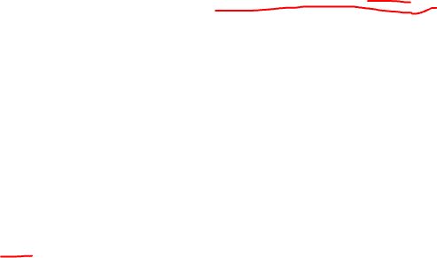
Memory
When C++ runs this statement, it’s as if a memory location is given the value of T and the label c.
char c = 'T';
C++ keeps track of the address of c.
c
0
1076
1077
1078
1079
N-1
342
39
'T'
2
80
0
. . .
. . .

Slide 11

Memory
char c = 'T';
cout << c; // T
When C++ runs this statement, it’s as if a memory location is given the value of T and the label c.
c
0
1076
1077
1078
1079
N-1
342
39
'T'
2
80
0
. . .
. . .

Slide 12
Memory
char c = 'T';
cout << c; // T
cout << int(c); // 84
c
0
1076
1077
1078
1079
N-1
342
39
'T'
2
80
0
. . .
. . .

Slide 13
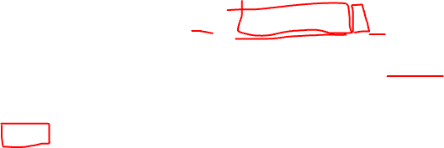
Memory
char c = 'T';
cout << c; // T
cout << int(c); // 84
cout << (void*)&c;
// 1077
& is the address-of operator in C++, i.e. it returns the memory address of the variable.
c
0
1076
1077
1078
1079
N-1
342
39
'T'
2
80
0
. . .
. . .

Slide 14
Memory
char c = 'T';
cout << c; // T
cout << int(c); // 84
cout << (void*)&c;
// 1077
This is needed to print the address.
It casts &c to the type void*.
c
0
1076
1077
1078
1079
N-1
342
39
'T'
2
80
0
. . .
. . .

Slide 15
Memory
char c = 'T';
cout << c; // T
cout << int(c); // 84
cout << (void*)&c;
// 1077
c
0
1076
1077
1078
1079
N-1
342
39
'T'
2
80
0
. . .
. . .
Important! C++ and the operating system determine a variable’s address, and that address can vary from run to run of your program.
You should not depend on the exact memory address!

Slide 16
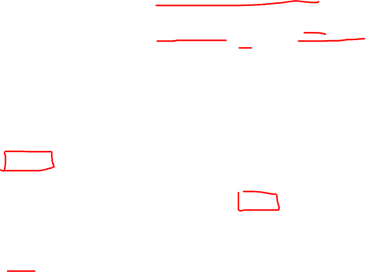
Memory
char c = 'T';
char* p = &c;
p is a pointer.
It has the type char*, so it is a pointer to a char.
p stores the address of c.
0
1076
1077
1078
1079
8821
N-1
342
39
'T'
2
80
. . .
1077
0
. . .
. . .
c
p

Slide 17

Memory
char c = 'T';
char* p = &c;
Since we don’t know the exact address, and don’t usually care about them, we usually don’t write any.
342
39
'T'
2
80
. . .
1077
0
. . .
. . .
c
p

Slide 18
Memory
char c = 'T';
char* p = &c;
Since we don’t know the exact address, and don’t usually care about them, we usually don’t write any.
Since we are not writing addresses, lets just put an arrow form p to c.
342
39
'T'
2
80
. . .
0
. . .
. . .
c
p

Slide 19
Memory
char c = 'T';
char* p = &c;
Let’s get rid of the other memory locations.
'T'
c
p

Slide 20
Memory
char c = 'T';
char* p = &c;
We often don’t bother with an entire box for pointers, and just write the p and an arrow.
'T'
p
c

Slide 21
Memory
char c = 'T';
char* p = &c;
Let’s tidy up the diagram a bit …
c
p
'T'

Slide 22
Memory
char c = 'T';
char* p = &c;
This is a typical diagram for representing he above code.
c
p
'T'

Slide 23
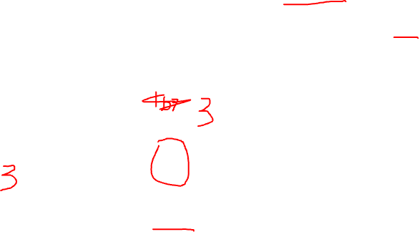
Memory
char c = 'T';
char* p = &c;
cout << *p; // T
*p refers to the value of the variable that p points to, i.e. *p is another name for c.
c
p
'T'
*p

Slide 24
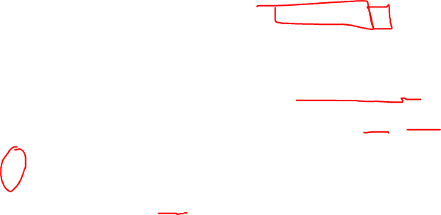
Memory
char c = 'T';
char* p = &c;
cout << *p; // T
*p = 'a';
cout << *p; // a
We can use *p anywhere we can use c.
c
p
'a'
*p

Slide 25
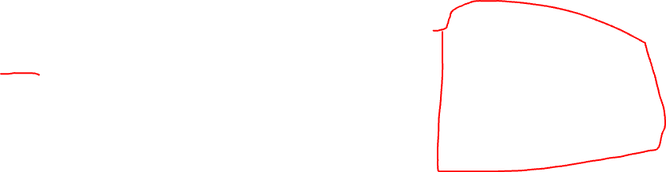
Pointers
You can have pointers to any type
  int* is the type pointer to a int
  double* is the type pointer to a double
  string* is the type pointer to a string
General Rule
If T is a C++ type, then T* points to (holds the address of) a value of type T.

Slide 26

Pointers
You can have pointers to any type
  int* is the type pointer to an int
  double* is the type pointer to a double
  string* is the type pointer to a string
You can also have pointers to pointers
  int** is the type pointer to an int*
  double** is the type pointer to a double*
  string** is the type pointer to a string*
  int*** is the type pointer to an int**
    pointer to a pointer to an int *
    pointer to a pointer to a pointer to an int
General Rule
If T is a C++ type, then T* points to (holds the address of) a value of type T.
Pointers to pointers like int** can be useful and do occur in practice! But types like int*** are very rare.

Slide 27
C++ Three Memory Regions
Every running C++ program has three main regions of memory:
  Static memory: for global variables
  Call stack memory: function call info and local variables
  Free store memory: all other memory
Static
memory
Call stack
memory
Free store
memory
Function call info
Local variables
Everything else
Global variables

Slide 28
C++ Three Memory Regions
Static memory is determined by the compiler, and it’s size never changes during the program run
Call stack memory increases and decreases as functions are called while the program runs
Static
memory
Call stack
memory
Free store
memory
Function call info
Local variables
Everything else
Global variables

Slide 29
C++ Three Memory Regions
Static memory is determined by the compiler, and it’s size never changes during the program run
Static
memory
Call stack
memory
Free store
memory
Function call info
Local variables
Everything else
Global variables

Slide 30
C++ Three Memory Regions
Static memory is determined by the compiler, and it’s size never changes during the program run
Call stack memory increases and decreases as functions are called while the program runs
Free store memory is allocated and de-allocated on demand as the program runs.
Static
memory
Call stack
memory
Free store
memory
Function call info
Local variables
Everything else
Global variables

Slide 31
C++ Three Memory Regions
Static memory is determined by the compiler, and it’s size never changes during the program run
Call stack memory increases and decreases as functions are called while the program runs
Free store memory is allocated and de-allocated on demand as the program runs.
Static
memory
Call stack
memory
Free store
memory
Function call info
Local variables
Everything else
Global variables
Automatically
managed
Automatically
managed
Manually
managed

Slide 32
C++ Three Memory Regions
Static memory is determined by the compiler, and it’s size never changes during the program run
Call stack memory increases and decreases as functions are called while the program runs
Free store memory is allocated and de-allocated on demand as the program runs.
Static
memory
Call stack
memory
Free store
memory
Function call info
Local variables
Everything else
Global variables
Automatically
managed
Automatically
managed
Free store memory is flexible and powerful, but very tricky to get right!
Manually
managed

Slide 33
C++ Three Memory Regions
Every running C++ program has three main regions of memory:
  Static memory: just declare and use globals; C++ takes care of allocating and de-allocating the memory
  Call stack memory: just call functions and use variables; C++ takes care of allocating and de-allocating the memory
  Free store memory: call new to allocate (request) memory, and delete to de-allocate (give back) memory
Static
memory
Call stack
memory
Free store
memory
Function call info
Local variables
Everything else
Global variables
Automatically
managed
Automatically
managed
Manually
managed

Slide 34
C++ Three Memory Regions
Manual management of the free store is a defining feature of C/C++
It is flexible, but very tricky to get right!
Most other languages automatically manage the free store using a a family of techniques called garbage collection
  In a running program, every so often memory in the free store is scanned and unused memory is de-allocated
  The up-shot is that the programmer requests (allocates) memory, but never needs to explicitly give it back (de-allocate), since the garbage collector will eventually de-allocate it
  Garbage-collected programs tend to be less efficient than non-garbage collected programs

Slide 35
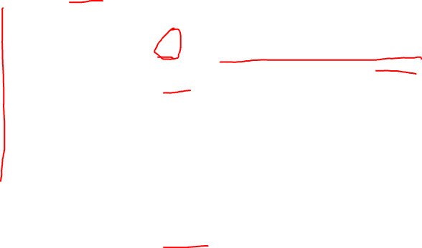
Free Store Memory
p is a local variable, and so is stored on the call stack
void f()
{
double* p = new double(6.4);
cout << *p; // 6.4
}
p
Call Stack Memory

Slide 36
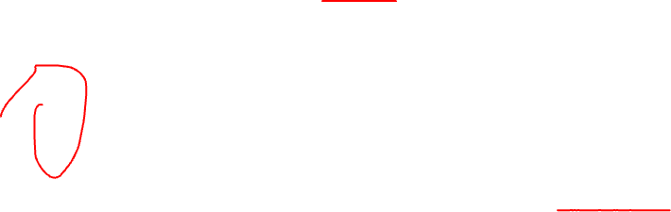
Free Store Memory
p is a local variable, and so is stored on the call stack
the address returned by new always points to memory on the free store
void f()
{
double* p = new double(6.4);
cout << *p; // 6.4
}
p
6.4
*p
Call Stack Memory
Free Store Memory

Slide 37
Free Store Memory
p is a local variable, and so is stored on the call stack
the address returned by new always points to memory on the free store
void f()
{
double* p = new double(6.4);
cout << *p; // 6.4
*p++; // 7.4
}
p
7.4
*p
Call Stack Memory
Free Store Memory

Slide 38
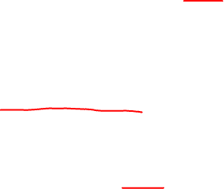
Free Store Memory
p is a local variable, and so is stored on the call stack
the address returned by new always points to memory on the free store
void f()
{
double* p = new double(6.4);
cout << *p; // 6.4
*p++; // 7.4
delete p;
}
calling delete only de-allocates the free store memory
the pointer p on the call stack is still there
p
7.4
*p
Call Stack Memory
Free Store Memory

Slide 39

Free Store Memory
p is a local variable, and so is stored on the call stack
the address returned by new always points to memory on the free store
void f()
{
double* p = new double(6.4);
cout << *p; // 6.4
*p++; // 7.4
delete p;
}
the pointer p is de-allocated when function f returns
p
7.4
*p
Call Stack Memory
Free Store Memory

Slide 40
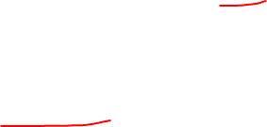
Free Store Memory
p is a local variable, and so is stored on the call stack
the address returned by new always points to memory on the free store
void f()
{
double* p = new double(6.4);
cout << *p; // 6.4
*p++; // 7.4
delete p;
}
In the region after delete and before the }, p is a dangling pointer, meaning p points to invalid memory.
p
???
*p
Call Stack Memory
Free Store Memory

Slide 41
Free Store Memory
p is a local variable, and so is stored on the call stack
the address returned by new always points to memory on the free store
void f()
{
double* p = new double(6.4);
cout << *p; // 6.4
*p++; // 7.4
// missing delete
}
Suppose as an example that you forget to call delete on p.
p
7.4
*p
Call Stack Memory
Free Store Memory

Slide 42
Free Store Memory
p is a local variable, and so is stored on the call stack
the address returned by new always points to memory on the free store
void f()
{
double* p = new double(6.4);
cout << *p; // 6.4
*p++; // 7.4
// missing delete
}
When } is reached, the local variable p is popped off the call stack.
p
7.4
*p
Call Stack Memory
Free Store Memory

Slide 43
Free Store Memory
p is a local variable, and so is stored on the call stack
the address returned by new always points to memory on the free store
void f()
{
double* p = new double(6.4);
cout << *p; // 6.4
*p++; // 7.4
// missing delete
}
Now this memory location is no longer accessible (since p is gone). This is called a memory leak.
7.4
Call Stack Memory
Free Store Memory

Slide 44
Pointer Problems
Dangling Pointer
Memory Leak
The value p points to is de-allocated before p is de-allocated.
p is de-allocated without de-allocating the value it points to
p
7.4
p
7.4
Dangling pointers often crash your program since calling *p causes undefined behaviour.
Memory leaks eventually use up memory. At first they may not cause any problem, but over time all your computer memory gets used up.

Slide 45
Pointer Problems
Dangling Pointer
Memory Leak
The value p points to is de-allocated before p is de-allocated.
p is de-allocated without de-allocating the value it points to
p
7.4
p
7.4
In C/C++, tools like valgrind are often used to check for these problems.

Slide 46

Pointer Problems
Memory Leak
Memory leaks eventually use up memory. At first they may not cause any problem, but over time all your computer memory gets used up.

Slide 47
Arrays
In C/C++, an array is a contiguous sequence of data that’s all the same type.
You manage it by keeping track of a pointer to the first value in the array.
Arrays do not know their own length! It is up to the programmer to somehow remember their length, e.g. in another variable.
C-style strings are arrays of characters that end with the special \0 character
  And they don’t know their own length: you must count characters until your hit \0

Slide 48

Arrays
Call Stack Memory
a
void f() {
int a[] = {7, -2, 4, 4, 0};
}
0
1
2
3
4
7
-2
4
4
0
The [] brackets indicate that this is an array.
a is a pointer of type int* that points to the first value of the array

Slide 49
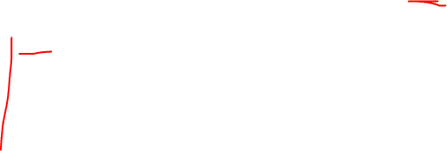
Arrays
Call Stack Memory
a
void f() {
int a[] = {7, -2, 4, 4, 0};
cout << a[0]; // 7
cout << a[1]; // -2
cout << a[2]; // 4
cout << a[3]; // 4
cout << a[4]; // 0
}
0
1
2
3
4
7
-2
4
4
0
a[0]
a[1]
a[2]
a[3]
a[4]
[]-bracket notation lets you read/write elements, e.g. a[i] is the value at index location i

Slide 50
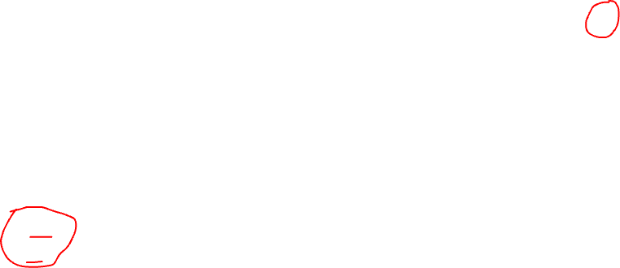
Arrays
Call Stack Memory
a
void f() {
int a[] = {7, -2, 4, 4, 0};
cout << a[0]; // 7
cout << a[1]; // -2
cout << a[2]; // 4
cout << a[3]; // 4
cout << a[4]; // 0
cout << a[-1]; // error
cout << a[5]; // error
}
-1
0
1
2
3
4
5
?
7
-2
4
4
0
?
a[-1]
a[0]
a[1]
a[2]
a[3]
a[4]
a[5]
The index value must be greater than or equal to 0, and less than 5 (the size of the array).
a[-1] or a[5] (or any out of bounds access) can cause random behavior, even crashing the program
C++ does not check if array index values are in bounds! This is a big source of errors!

Slide 51

Arrays
Call Stack Memory
a
void f() {
int a[] = {7, -2, 4, 4, 0};
cout << a[0]; // 7
cout << a[1]; // -2
cout << a[2]; // 4
cout << a[3]; // 4
cout << a[4]; // 0
for(int i = 0; i < 5; i++) {
cout << a[i];
}
}
-1
0
1
2
3
4
5
?
7
-2
4
4
0
?
a[-1]
a[0]
a[1]
a[2]
a[3]
a[4]
a[5]
These two fragments of code print the same thing.

Slide 52
Arrays
Call Stack Memory
a
void f() {
int a[] = {7, -2, 4, 4, 0};
cout << *(a + 0); // 7
cout << *(a + 1); // -2
cout << *(a + 2); // 4
cout << *(a + 3); // 4
cout << *(a + 4); // 0
}
-1
0
1
2
3
4
5
?
7
-2
4
4
0
?
a[-1]
a[0]
a[1]
a[2]
a[3]
a[4]
a[5]
a + 0
a + 1
a + 2
a + 3
a + 4
Pointer arithmetic is another way to access individual array values.
a[i] is shorthand for *(a + i)

Slide 53

Arrays
Call Stack Memory
a
void f() {
int a[] = {7, -2, 4, 4, 0};
cout << *(a + 0); // 7
cout << *(a + 1); // -2
cout << *(a + 2); // 4
cout << *(a + 3); // 4
cout << *(a + 4); // 0
for(int i = 0; i < 5; i++) {
cout << *(a + i);
}
}
-1
0
1
2
3
4
5
?
7
-2
4
4
0
?
a[-1]
a[0]
a[1]
a[2]
a[3]
a[4]
a[5]
a + 0
a + 1
a + 2
a + 3
a + 4
a[i] is shorthand for *(a + i)

Slide 54
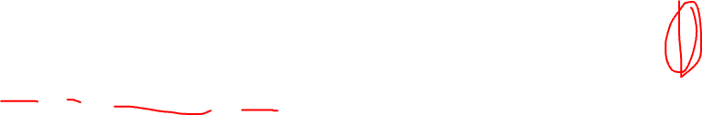
Arrays
This is another common way to use pointers to access array elements. It doesn’t need an index value.
Call Stack Memory
a
void f() {
int a[] = {7, -2, 4, 4, 0};
for(int* p = a; p < a + 5; p++) {
cout << *p;
}
}
-1
0
1
2
3
4
5
?
7
-2
4
4
0
?
a[-1]
a[0]
a[1]
a[2]
a[3]
a[4]
a[5]
a + 0
a + 1
a + 2
a + 3
a + 4

Slide 55
Arrays
This is another common way to use pointers to access array elements. It doesn’t need an index value.
Call Stack Memory
a
void f() {
int a[] = {7, -2, 4, 4, 0};
for(int* p = a; p < a + 5; p++) {
cout << *p;
}
}
-1
0
1
2
3
4
5
?
7
-2
4
4
0
?
a[-1]
a[0]
a[1]
a[2]
a[3]
a[4]
a[5]
a + 0
a + 1
a + 2
a + 3
a + 4
Need the length of the array to know when to stop.

Slide 56
Arrays
This is another common way to use pointers to access array elements. It doesn’t need an index value.
Call Stack Memory
a
void f() {
int a[] = {7, -2, 4, 4, 0};
for(int* p = a; p < a + 5; p++) {
cout << *p;
}
}
-1
0
1
2
3
4
5
?
7
-2
4
4
0
?
a[-1]
a[0]
a[1]
a[2]
a[3]
a[4]
a[5]
a + 0
a + 1
a + 2
a + 3
a + 4
Adds 1 to p so it points to the next value in the array.

Slide 57

Arrays
This is another common way to use pointers to access array elements. It doesn’t need an index value.
Call Stack Memory
a
void f() {
int a[] = {7, -2, 4, 4, 0};
for(int* p = a; p < a + 5; p++) {
cout << *p;
}
}
-1
0
1
2
3
4
5
?
7
-2
4
4
0
?
a[-1]
a[0]
a[1]
a[2]
a[3]
a[4]
a[5]
*p returns the value that p is pointing to

Slide 58
Arrays
The previous examples were done on arrays that were local variables, and so were stored on the call stack.
  Remember: anything on the call stack is automatically de-allocated when the function ends.
Now lets see how to use arrays on the free store.
The details are mainly the same, but how we allocate and de-allocate arrays on the free store is different …

Slide 59
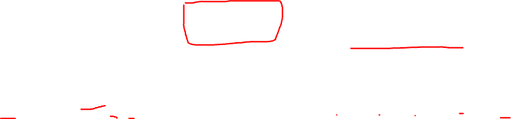
Arrays
Use new with
[]-brackets to allocate an array on the free store
Stack Memory
a
Free Store Memory
void f() {
int* a = new int[5];
delete[] a;
}
-1
0
1
2
3
4
5
?
?
?
?
?
?
?
a[-1]
a[0]
a[1]
a[2]
a[3]
a[4]
a[5]
a + 0
a + 1
a + 2
a + 3
a + 4

Slide 60
Arrays
Use new with
[]-brackets to allocate an array on the free store
Stack Memory
a
Free Store Memory
void f() {
int* a = new int[5];
delete[] a;
}
-1
0
1
2
3
4
5
?
?
?
?
?
?
?
a[-1]
a[0]
a[1]
a[2]
a[3]
a[4]
a[5]
Must use []-brackets for an array. If you use
()-brackets, you get a single int initialized to 5.
a + 0
a + 1
a + 2
a + 3
a + 4

Slide 61
Arrays
Use new with
[]-brackets to allocate an array on the free store
Stack Memory
a
Free Store Memory
void f() {
int* a = new int[5];
delete[] a;
}
-1
0
1
2
3
4
5
?
?
?
?
?
?
?
a[-1]
a[0]
a[1]
a[2]
a[3]
a[4]
a[5]
Must use []-brackets for an array. If you use
()-brackets, you get a single int initialized to 5.
a + 0
a + 1
a + 2
a + 3
a + 4
The initial values of the array are unknown: they could be anything.

Slide 62

Arrays
Use new with
[]-brackets to allocate an array on the free store
Stack Memory
a
Free Store Memory
void f() {
int* a = new int[5];
delete[] a;
}
-1
0
1
2
3
4
5
?
?
?
?
?
?
?
a[-1]
a[0]
a[1]
a[2]
a[3]
a[4]
a[5]
a + 0
a + 1
a + 2
a + 3
a + 4
Every new must have a matching delete that
de-allocates the memory when you’re done with it.

Slide 63
Arrays
Use new with
[]-brackets to allocate an array on the free store
Stack Memory
a
Free Store Memory
void f() {
int* a = new int[5];
delete[] a;
}
-1
0
1
2
3
4
5
?
?
?
?
?
?
?
a[-1]
a[0]
a[1]
a[2]
a[3]
a[4]
a[5]
Since a was allocated with []-brackets, you must de-allocate it with delete[]. If you just wrote delete, that’s an error.
a + 0
a + 1
a + 2
a + 3
a + 4
Every new must have a matching delete that
de-allocates the memory when you’re done with it.
Forgetting delete[] causes a memory leak.

Slide 64
Arrays
Stack Memory
a
Free Store Memory
void f() {
int* a = new int[5];
a[0] = 7;
a[1] = -2;
a[2] = 4;
a[3] = 4;
a[4] = 0;
delete[] a;
}
-1
0
1
2
3
4
5
?
7
-2
4
4
0
?
a[-1]
a[0]
a[1]
a[2]
a[3]
a[4]
a[5]
These statements assign the initial array values.
a + 0
a + 1
a + 2
a + 3
a + 4

Slide 65
Arrays
Stack Memory
a
Free Store Memory
void f() {
int* arr = new int[5]
{7, -2, 4, 4, 0};
delete[] a;
}
-1
0
1
2
3
4
5
?
7
-2
4
4
0
?
a[-1]
a[0]
a[1]
a[2]
a[3]
a[4]
a[5]
Or more compactly we can use this style.

Slide 66
Arrays
Stack Memory
a
Free Store Memory
void f() {
int* a = new int[5];
a[0] = 7;
a[1] = -2;
a[2] = 4;
a[3] = 4;
a[4] = 0;
for (int i = 0; i < 5; i++) {
cout << a[i] << "\n";
}
delete[] a;
}
-1
0
1
2
3
4
5
?
7
-2
4
4
0
?
a[-1]
a[0]
a[1]
a[2]
a[3]
a[4]
a[5]
a + 0
a + 1
a + 2
a + 3
a + 4
We can use array a the same way as when it was on the call stack.

Slide 67
Arrays
Stack Memory
a
Free Store Memory
void f() {
int* a = new int[5];
a[0] = 7;
a[1] = -2;
a[2] = 4;
a[3] = 4;
a[4] = 0;
for (int i = 0; i < 5; i++) {
cout << a[i] << "\n";
}
delete[] a;
}
-1
0
1
2
3
4
5
?
7
-2
4
4
0
?
a[-1]
a[0]
a[1]
a[2]
a[3]
a[4]
a[5]
These statements assign the initial array values.
a + 0
a + 1
a + 2
a + 3
a + 4
Array a is accessed using the same techniques we saw for arrays on the call stack.

Slide 68
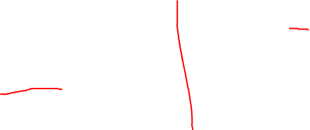
Null Pointers
This is the “ground” symbol from electronics. In computer since, it means a null pointer.
Any C++ pointer can be assigned the special value nullptr, meaning the pointer does not point to any address.
a
b
string* a = nullptr;
char* b = nullptr;
double* c = nullptr;
c

Slide 69
Null Pointers
This is the “ground” symbol from electronics. In computer since, it means a null pointer.
Any C++ pointer can be assigned the special value nullptr, meaning the pointer does not point to any address.
a
b
string* a = nullptr;
char* b = nullptr;
double* c = nullptr;
c
Note: Older versions of C++ use 0 instead of nullptr. You should use nullptr: it’s intent is clearer than writing 0.

Slide 70
Null Pointers
This is the “ground” symbol from electronics. In computer since, it means a null pointer.
Any C++ pointer can be assigned the special value nullptr, meaning the pointer does not point to any address.
a
b
string* a = nullptr;
char* b = nullptr;
double* c = nullptr;
c
Note: Older versions of C++ use 0 instead of nullptr. You should use nullptr: it’s intent is clearer than writing 0.
Important
Never de-reference a null pointer, e.g. *a is an error if
a == nullptr

Slide 71
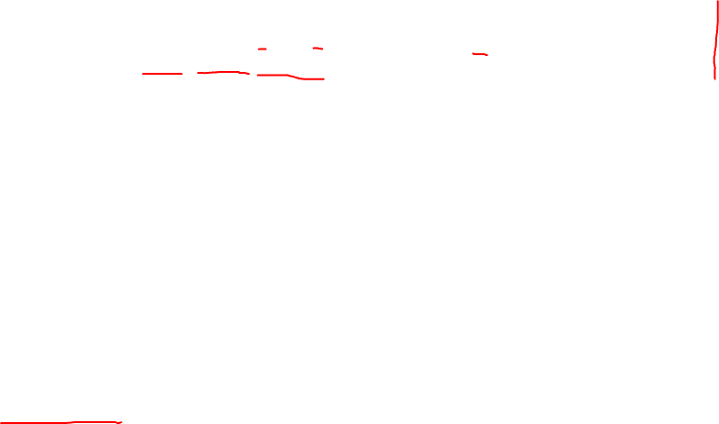
Pointers to structs (and classes)
Call Stack
Free Store
p
x: 3
y: 1
Point* p = new Point{3, 1};
delete p;
This creates a new Point object on the free store.
*p

Slide 72
Pointers to structs (and classes)
Call Stack
Free Store
p
x: 3
y: 1
Point* p = new Point{3, 1};
delete p;
*p
Every call to new should have a matching call to delete.

Slide 73
Pointers to structs (and classes)
Call Stack
Free Store
p
x: 3
y: 1
Point* p = new Point{3, 1};
cout << "x: " << (*p).x;
cout << "y: " << (*p).y;
delete p;
*p
To access values in the object, first de-reference p, i.e. write *p, and then use dot-notation.
Brackets are necessary around *p to make * apply first.

Slide 74
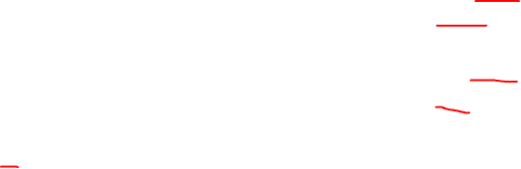
Pointers to structs (and classes)
Call Stack
Free Store
p
x: 3
p->x
y: 1
p->y
Point* p = new Point{3, 1};
cout << "x: " << (*p).x;
cout << "y: " << (*p).y;
cout << "x: " << p->x;
cout << "y: " << p->y;
delete p;
*p
Pointers to structs often use this shorthand -> notation.

Slide 75
Pointers to structs (and classes)
Call Stack
Free Store
p
x: 3
p->x
y: 1
p->y
Point* p = new Point{3, 1};
cout << "x: " << (*p).x;
cout << "y: " << (*p).y;
cout << "x: " << p->x;
cout << "y: " << p->y;
p->x = 5;
p->y = 7;
cout << "x: " << p->x;
cout << "y: " << p->y;
delete p;
*p
-> notation works like regular dot notation, but with pointers to structs.

