Slide 1

CMPT 135
Assignment 5 is due on Wednesday!
Week 14
Templates
Other C++ Features

Slide 2
Function Templates
void swap(int& a, int& b) { int temp = a; a = b; b = temp; }
void swap(string& a, string& b) { string temp = a; a = b; b = temp; }
Swapping values is very useful in sorting. But we need one swap function for each type of value.
But this function only swaps int variables. What if we want to swap strings?
Write another swap function!

Slide 3
Function Templates
void swap(int& a, int& b) { int temp = a; a = b; b = temp; }
void swap(string& a, string& b) { string temp = a; a = b; b = temp; }
Swapping values is very useful in sorting. But we need one swap function for each type of value.
Code for both functions is nearly identical. The only difference is the type name.
Idea Could we also somehow pass the type to the function?

Slide 4
Function Templates
void swap(int& a, int& b) { int temp = a; a = b; b = temp; }
void swap(string& a, string& b) { string temp = a; a = b; b = temp; }
Swapping values is very useful in sorting. But we need one swap function for each type of value.
void swap(T& a, T& b) { T temp = a; a = b; b = temp; }
If we write this then C++ will expect a and b to be of type T, which we have not defined. Somehow we have to say T can be any type.

Slide 5
Function Templates
void swap(int& a, int& b) { int temp = a; a = b; b = temp; }
void swap(string& a, string& b) { string temp = a; a = b; b = temp; }
Swapping values is very useful in sorting. But we need one swap function for each type of value.
Easy to use since C++ will usually automatically infer the type of T when you use swap.
This works! This is a template function that works with almost any type T.
template <typename T>
void swap(T& a, T& b) { T temp = a; a = b; b = temp; }
int x = 4; int y = 7; swap(x, y);
string s = "cow"; string t = "rabbit"; swap(s, t);

Slide 6
Function Templates
void swap(int& a, int& b) { int temp = a; a = b; b = temp; }
void swap(string& a, string& b) { string temp = a; a = b; b = temp; }
Swapping values is very useful in sorting. But we need one swap function for each type of value.
The type of T is inferred at compile-time by the compiler, so this is quite efficient.
Easy to use since C++ will usually automatically infer the type of T when you use swap.
This works! This is a template function that works with almost any type T.
template <typename T>
void swap(T& a, T& b) { T temp = a; a = b; b = temp; }
int x = 4; int y = 7; swap(x, y);
string s = "cow"; string t = "rabbit"; swap(s, t);

Slide 7
Function Templates
void swap(int& a, int& b) { int temp = a; a = b; b = temp; }
void swap(string& a, string& b) { string temp = a; a = b; b = temp; }
Swapping values is very useful in sorting. But we need one swap function for each type of value.
Notice that not every type T will work with swap. What are the constraints on T?
This works! This is a template function that works with almost any type T.
template <typename T>
void swap(T& a, T& b) { T temp = a; a = b; b = temp; }
int x = 4; int y = 7; swap(x, y);
string s = "cow"; string t = "rabbit"; swap(s, t);

Slide 8
Function Templates
void swap(int& a, int& b) { int temp = a; a = b; b = temp; }
void swap(string& a, string& b) { string temp = a; a = b; b = temp; }
Swapping values is very useful in sorting. But we need one swap function for each type of value.
Notice that not every type T will work with swap. What are the constraints on T?
Type T must have operator= defined for it. Otherwise you’ll get a compiler error.
This works! This is a template function that works with almost any type T.
template <typename T>
void swap(T& a, T& b) { T temp = a; a = b; b = temp; }
int x = 4; int y = 7; swap(x, y);
string s = "cow"; string t = "rabbit"; swap(s, t);

Slide 9
Function Templates
template <typename T> T min_of(const T& a, const T& b) { if (a < b) return a; return b; }
This template function returns the smaller of two values of the same type.
What are the constraints on type T?

Slide 10
Function Templates
template <typename T> T min_of(const T& a, const T& b) { if (a < b) return a; return b; }
This template function returns the smaller of two values of the same type.
We don’t know the exact type of a and b, but we do know they are the same type T.
What are the constraints on type T?
Type T must have operator< defined for it.

Slide 11
Function Templates
template <typename T> T min_of(const T& a, const T& b) { if (a < b) return a; return b; }
This template function returns the smaller of two values of the same type.
We don’t know the exact type of a and b, but we do know they are the same type T.
What are the constraints on type T?
Type T must have operator< defined for it.
Type T needs a copy constructor: the return values is a copy of the value being returned.

Slide 12
Function Templates
template <typename T> T min_of(const T& a, const T& b) { if (a < b) return a; return b; }
This template function returns the smaller of two values of the same type.
template<typename T> T min_of(const vector<T>& v) { assert(v.size() > 0); T min = v[0]; for(int i = 1; i < v.size(); i++) { min = min_of(min, v[i]); } return min;
}
You can use template functions to build other template functions.

Slide 13
Function Templates
template <typename T> T min_of(const T& a, const T& b) { if (a < b) return a; return b; }
This template function returns the smaller of two values of the same type.
template<typename T> T min_of(const vector<T>& v) { assert(v.size() > 0); T min = v[0]; for(int i = 1; i < v.size(); i++) { min = min_of(min, v[i]); } return min;
}
vector<int> nums = {2, 7, -5, 0}; cout << min_of(nums); // -5 vector<string> words = {"up", "down", "all"}; cout << min_of(nums); // "all" vector<vector<int>> m = { {4}, {1, 2, 3}, {5, 6}, {2}
}; cout << min_of(m); // {1, 2, 3}
Oops, operator<< not defined.

Slide 14
Function Templates
template <typename T> ostream &operator<<(ostream &os, const vector<T> &v) { os << "{"; for (int i = 0; i < v.size(); i++) { os << v[i]; if (i < v.size() - 1) os << ", "; } os << "}"; return os; }
This template function prints a vector<T>.
What are the constraints on type T?
Type T must have operator<< defined for it.

Slide 15
Class Templates
template <typename T> class Stack { vector<T> v;
public: Stack() : v() { } Stack(const Stack<T>& other) : v(other.v) { } bool is_empty() const { return v.size() == 0; } void push(const T& x) { v.push_back(x); } const T& peek() const { return v.back(); }
T pop() { T top = peek(); v.pop_back(); return top; }
};
C++ also uses templates to create generic contains, like vector<T>.
This is a generic stack container built on top of a vector. It works with almost any type T.
What are the constraints on type T?

Slide 16
Class Templates
template <typename T> class Stack { vector<T> v;
public: Stack() : v() { } Stack(const Stack<T>& other) : v(other.v) { } bool is_empty() const { return v.size() == 0; } void push(const T& x) { v.push_back(x); } const T& peek() const { return v.back(); }
T pop() { T top = peek(); v.pop_back(); return top; }
};
C++ also uses templates to create generic contains, like vector<T>.
This is a generic stack container built on top of a vector. It works with almost any type T.
What are the constraints on type T?
Type T must work with vector<T>, and have a copy constructor.

Slide 17
Class Templates
template <typename T> class Stack { vector<T> v;
public: Stack() : v() { } Stack(const Stack<T>& other) : v(other.v) { } bool is_empty() const { return v.size() == 0; } void push(const T& x) { v.push_back(x); } const T& peek() const { return v.back(); }
T pop() { T top = peek(); v.pop_back(); return top; }
};
template<typename T> void print(Stack<T> s) { if (s.is_empty()) { cout << "empty stack"; } else { while (!s.is_empty()) { T val = s.pop(); cout << val << " "; } } }
You can use class templates containers to make template functions.

Slide 18
Templates
Templates a popular feature of modern C++
Many language features have been added to C++ to better support templates
Template start simple, but they quickly become more complex!
Error messages of templates are notoriously long and difficult to understand
But concepts may help!
Can be used to do almost any computation at compile-time!
Often used for creating general-purpose code libraries

Slide 19
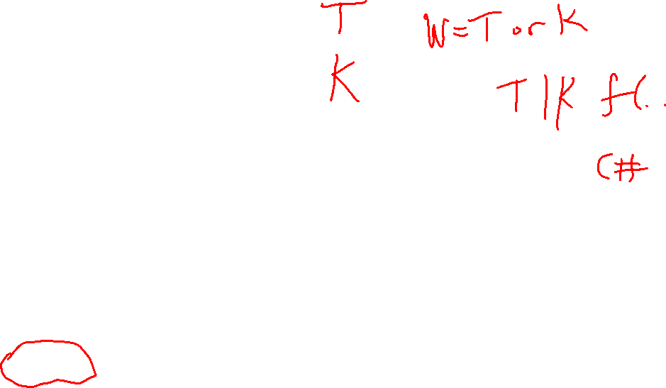
Templates
Templates have other names
Generic programming
Parameterized types
They are a feature in many statically typed languages
E.g. Java and Go initially had no support for templates due to their extra complexity, but added them later
The big win for templates is probably the ability for any programmer to create generic containers
Good example of the balance between complexity and utility: if a feature is useful enough, it might added even though it adds complexity
Languages like Python and JavaScript don’t have generics in the same way that C++ does
They are already “built in” to those languages by virtue of being able to assign different types to the same variable
But Python and JavaScript are not compiled so template errors are usually only caught at run-time
The language Typescript is a superset of JavaScript that adds much more support for types, including templates like those in C++

Slide 20
Top 10 C++ Features Not in this Course
Move semantics
Meta-programming
Smart pointers
More OOP
Type inference
Scoped enumerations
Lambda expressions
Concepts
Modules
C++ Core Guidelines

Slide 21
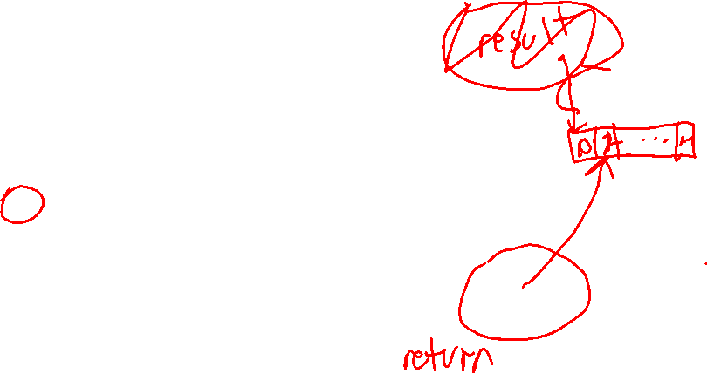
Top 10 C++ Features Not in this Course
Move semantics
Meta-programming
Smart pointers
More OOP
Type inference
Scoped enumerations
Lambda expressions
Concepts
Modules
C++ Core Guidelines
vector<int> range(int n) { vector<int> result; for(int i = 0; i < n; i++) result.push_back(i); } return result; }
Classes such as vector use a special move constructor that, when returning from a function, passes the vector’s underlying array without copying it.

Slide 22

Top 10 C++ Features Not in this Course
Move semantics
Meta-programming
Smart pointers
More OOP
Type inference
Scoped enumerations
Lambda expressions
Concepts
Modules
C++ Core Guidelines
constexpr int a = 3; constexpr int b = 5 * a + 1; // b is 16
C++ has added features, such as constexpr, that help programs do computations at compile-time instead of run-time, which can improve performance of a running program (but maybe slow down the compiler!).

Slide 23
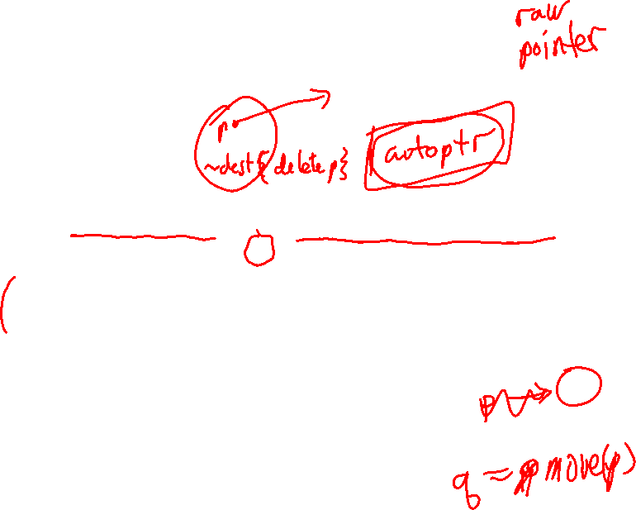
Top 10 C++ Features Not in this Course
Move semantics
Meta-programming
Smart pointers
More OOP
Type inference
Scoped enumerations
Lambda expressions
Concepts
Modules
C++ Core Guidelines
#include <memory> void demo()
{ std::unique_ptr<int> p = std::make_unique<int>(42); cout << "Value: " << *p; // value p points to is automatically deleted when // p goes out of scope }
Smart pointers do away with the need to manually call new and delete. They work similarly to regular pointers, with their own set of rules for correct usage.

Slide 24
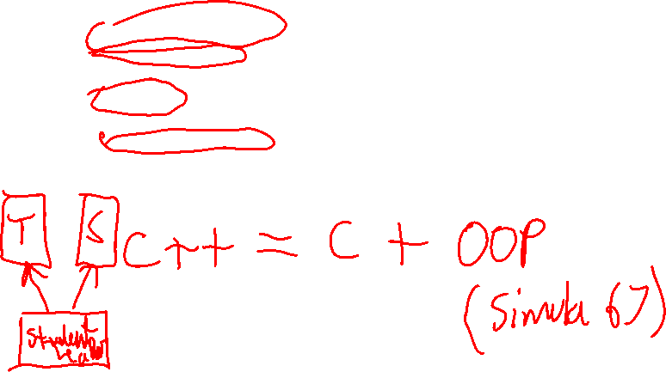
Top 10 C++ Features Not in this Course
Move semantics
Meta-programming
Smart pointers
More OOP
Type inference
Scoped enumerations
Lambda expressions
Concepts
Modules
C++ Core Guidelines
One of the original design ideas for C++ is that it was the C language plus object-oriented programming. C++ has other OOP features, e.g.:
constructor delegation, for writing more easily writing constructors.
friend functions, which are functions allowed to access private parts of an object
protected visibility, which is like private, but inheriting classes can access protected parts
multiple inheritance, where a class can inherit from more than one class, e.g. the StudentTeacher class can inherit from Student and Teacher

Slide 25
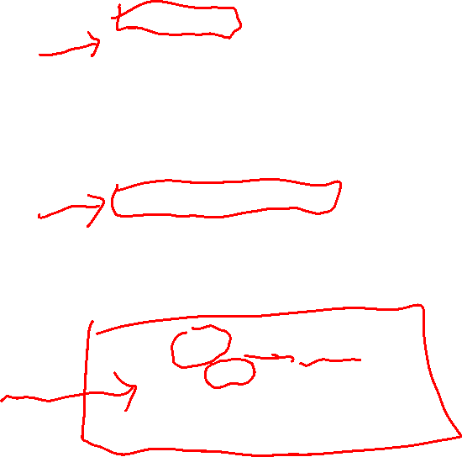
Top 10 C++ Features Not in this Course
Move semantics
Meta-programming
Smart pointers
More OOP
Type inference
Scoped enumerations
Lambda expressions
Concepts
Modules
C++ Core Guidelines
auto a = 5; // a is inferred to be of type int auto b = -3.92; // b is inferred to be of type double auto c = "cat"; // c is inferred to be of type string
In some cases, C++ can automatically infer the types of variables. This is especially useful when type names are long (which is common in C++).
vector<vector<int>> table = { {1, 2, 3}, {4, 5, 6}, {7, 8, 9} }; for (auto row : table) { for(auto val : row) { cout << val << " "; }
}
The inference is done by the compiler, so there is no run-time cost.

Slide 26
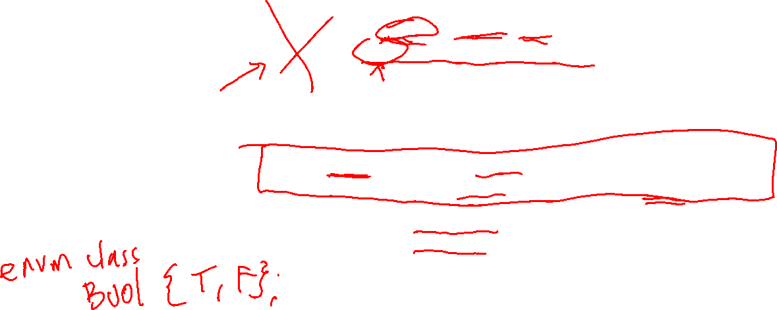
Top 10 C++ Features Not in this Course
C++ has C-style enumerations, which let you create types with a small finite set of values …
… but C-style enum values cannot be the same across different enums.
Move semantics
Meta-programming
Smart pointers
More OOP
Type inference
Scoped enumerations
Lambda expressions
Concepts
Modules
C++ Core Guidelines
enum Semester { Spring, Summer, Fall }; enum Season {Spring, Summer, Fall, Winter}; // compiler error!
So C++ has added scoped enumerations, that don’t have that problem …
enum class Semester { Spring, Summer, Fall }; enum class Season {Spring, Summer, Fall, Winter}; // ok
Semester sem = Semester::Summer; Season s = Season::Summer;

Slide 27
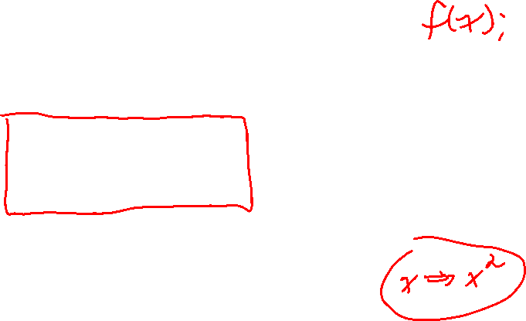
Top 10 C++ Features Not in this Course
Move semantics
Meta-programming
Smart pointers
More OOP
Type inference
Scoped enumerations
Lambda expressions
Concepts
Modules
C++ Core Guidelines
// arr is an array of n float values std::sort(arr, x + n, [](float a, float b) // lambda expression { return (b < a); }
);
A lambda expression is, essentially, a function without a name. They can be useful when you need a small one-time-use function.
Lambda expressions have been around since the 1930s, and can be used to build many programming features. Functional programming is a style of programming that emphasizes the use of functions, and so often uses lambda expressions.

Slide 28

Top 10 C++ Features Not in this Course
Move semantics
Meta-programming
Smart pointers
More OOP
Type inference
Scoped enumerations
Lambda expressions
Concepts
Modules
C++ Core Guidelines
template <typename T> requires std::integral<T> || std::floating_point<T> double average(vector<T> const &vec) { double sum = std::accumulate(vec.begin(), vec.end(), 0.0); return sum / vec.size(); }
Concepts are extension of templates that let you put constraints on the template at the point the template is declared. This makes programs more readable, and can result in much better error messages.

Slide 29

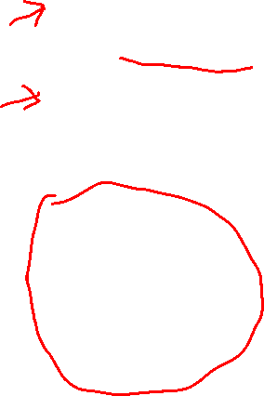
Top 10 C++ Features Not in this Course
// helloworld.cpp export module helloworld; // module declaration import <iostream>; // import the iostream module
export void hello() { // export declaration std::cout << "Hello world!\n"; }
Move semantics
Meta-programming
Smart pointers
More OOP
Type inference
Scoped enumerations
Lambda expressions
Concepts
Modules
C++ Core Guidelines
// main.cpp import helloworld; int main() { hello(); }
Modules are an alternative to #include. Modules can result in code that is easier to read, and also compiles more quickly (slow compilation is one of the unfortunate features of C++).
As of spring 2024, not all C++ compilers support modules yet. Time will tell if modules catch on and replace the use of #include.

Slide 30
Top 10 C++ Features Not in this Course
The C++ Core Guidelines are a large set of rules of thumb for “using C++ well”.
The hope is that many of the rules can be added as warning or advice in compilers, or similar tools that check for code quality.
Move semantics
Meta-programming
Smart pointers
More OOP
Type inference
Scoped enumerations
Lambda expressions
Concepts
Modules
C++ Core Guidelines
Function definition rules:
F.1: “Package” meaningful operations as carefully named functions
F.2: A function should perform a single logical operation
F.3: Keep functions short and simple
F.4: If a function might have to be evaluated at compile time, declare it constexpr
F.5: If a function is very small and time-critical, declare it inline
F.6: If your function must not throw, declare it noexcept
F.7: For general use, take T* or T& arguments rather than smart pointers
F.8: Prefer pure functions
F.9: Unused parameters should be unnamed
F.10: If an operation can be reused, give it a name
F.11: Use an unnamed lambda if you need a simple function object in one place only

Slide 31
Final Exam
Covers the whole course up to templates
See the course notes site for details
Some programming questions, some multiple-choice questions
Check the Canvas Final Exam page for details
Bring your own pencil and eraser
Bring your student card!

Slide 32
Practice Question 1
Write a non-recursive function named longestString that returns a longest string in a given vector of strings. If there is a tie, return the rightmost string. If the vector is empty throw a runtime_error exception.
For example, longestString({"four", "five", "nine", "ten"}) should return "nine".

Slide 33
Practice Question 1
string longestString(const vector<string> &v)
{
if (v.size() == 0)
{
throw runtime_error("empty vector");
}
string longest = v[0];
for (int i = 1; i < v.size(); i++)
{
if (v[i].size() >= longest.size())
{
longest = v[i];
}
}
return longest;
}
Write a non-recursive function named longestString that returns a longest string in a given vector of strings. If there is a tie, return the rightmost string. If the vector is empty throw a runtime_error exception.
For example, longestString({"four", "five", "nine", "ten"}) should return "nine".

Slide 34
Practice Question 2
Same as question 1, but this time make it recursive. You can write helper methods if necessary.

Slide 35
Practice Question 2
string longestString(const vector<string> &v, int begin)
{
if (begin == v.size() - 1) // size 1 sub-vector
{
return v[begin];
}
string longest = longestString(v, begin + 1);
if (v[begin].size() > longest.size())
{
return v[begin];
}
return longest;
}
string longestString(const vector<string> &v) {
if (v.size() == 0) throw runtime_error("empty vector");
return longestString(v, 0);
}
Same as question 1, but this time make it recursive. You can write helper methods if necessary.

Slide 36
Practice Question 3
Write a boolean function called hasDupPointer(int* arr, int n) that returns true if two or more elements in the n-element array of int pointers point to the same int (with the same address). Otherwise, return false.

Slide 37
Practice Question 3
bool hasDupPointer(int** arr, int n)
{
for (int i = 0; i < n; i++)
{
for (int j = i + 1; j < n; j++)
{
if (arr[i] == arr[j])
{
return true;
}
}
}
return false;
}
Write a boolean function called hasDupPointer(int* arr, int n) that returns true if two or more elements in the n-element array of int pointers point to the same int (with the same address). Otherwise, return false.

