Slide 1
Chapter 7: Trees
CMPT 225

Slide 2
Write down all the root-to-leaf paths for this tree.
A
B
C
D
E
F
G
H
I
J

Slide 3
Write down all the root-to-leaf paths for this tree.
A
ABE ABFH AC ADGI ADJ
There is one path for each leaf.
B
C
D
E
F
G
H
I
J

Slide 4
Definition of a Tree
A
A tree T is a set of nodes, storing values, in a parent-child relationship with the following properties:
T could be empty, i.e. it has no nodes. This is called the empty tree.
If T is non-empty, it has a special node called the root of T that has no parent.
Each node v of T different from the root has a unique parent node w. We say v is a child of w, and w is the parent of v.
B
C
D
E
F
G
w
parent
H
v
child

Slide 5
The root is the one node with no parent.
Tree terminology
Root: A
A
Nodes with 0 children.
Leaves (external nodes): C, E, F, H
B
C
D
Internal nodes: A, B, D, G
Nodes with 1 or more children.
Children of B: E, F
E
F
G
A node can have 0 or more children.
Children of C: none
H
Children of D: G

Slide 6
Tree terminology
Edges: AB, AC, AD BE, BF DG, GH
A
B
C
D
Path from A to F: ABF
G
Path from A to H: ADGH
E
F
Path from E to G: EBADG Careful: the arrows show parent-child relationships, but don’t restrict the path.
H

Slide 7
Tree terminology
Ancestors of G: G, D, A
Every node is an ancestor of itself.
A
Ancestors of C: C, A
B
C
D
Ancestors of A: A
E
F
G
Descendants of D: D, G, H
Every node is a descendant of itself.
Descendants of C: C
H
Descendants of A: A, B, C, D, E, F, G, H
If x is a node in a tree, then:
the ancestors of x are x itself, plus the ancestors of x’s parent
the descendants of x are x itself, plus all the nodes that have x as an ancestor

Slide 8
Tree terminology
A
B
C
D
Subtree rooted at B: the tree formed by all descendants of B
E
F
G
H

Slide 9
Tree terminology
Ordered tree: the children of nodes have
a well-defined order
B
A tree may, or may not, be ordered. If it is ordered, you must say so, and also say exactly how the child nodes are ordered.
C
D
E
A
F
G
This is an ordered tree: the child nodes are in alphabetical order from left to right.
H

Slide 10
Basic Tree Functions
A
Suppose p refers to a node in a tree. Then we usually assume these functions are available:
p.parent() returns the parent of p; error if p is the root
p.children() returns a list (or vector, or array, …) of p’s children
p.isRoot() returns true if p is the root, and false otherwise
p.isLeaf() or p.isExternal() returns true if p is a leaf node (i.e. external node)
p
B
C
D
E
F
G
H

Slide 11
Basic Tree Functions
A
If T is a tree, then we usually assume these functions are available:
T.root() returns the root node of the tree; error if the tree is empty
T.empty() returns true if the tree is empty, and false otherwise
T.size() returns the number of nodes in the tree
B
C
D
E
F
G
H

Slide 12
Is this a binary tree?
Binary Trees
A
A binary tree is a tree where each node has at most 2 children.
Each child of a node labeled as the left child or right child.
The left child comes before the right child in child ordering.
B
C
D
E
F
G

Slide 13
A
Binary Trees
B
C
A proper binary tree
D
E
A binary tree is proper if every node has either 0 children or 2 children.
A binary tree is improper if it is not proper.
F
G
A
An improper binary tree
B
C
D
E
F

Slide 14
Binary Trees
root
Recursive Definition
A tree T is a binary tree if:
T is empty
Or it consists of a root node whose left child is the root of a binary tree, and whose right child is the root of a binary tree
left subtree is a binary tree
right subtree is a binary tree

Slide 15
Node Depth
The depth of the root is always 0
Recursive Definition
The depth of a node p in a tree is:
0 if p is the root
1 plus the depth of its parent if p is not the root
0
1
1
1
2
2
2
3

Slide 16
Node Height
Recursive Definition
The height of a node p in a tree is:
0 if p is external (a leaf)
1 plus the max height of a child of p if p is internal (not a leaf)
3
1
0
2
0
0
1
Work from the leaves upwards. Leaves have height 0.
0

Slide 17
Tree Height
What’s the height of this tree?
The height of a tree is the height of its root.
3
1
0
2
0
0
1
0

Slide 18
Print the nodes in pre-order traversal order, starting at the root.
Tree Traversals
A
One order in which to visit all the nodes in a tree is pre-order traversal.
B
C
D
E
F
G
preorder_traversal(T, p) print p for each child c of p preorder_traversal(c)
H

Slide 19

Print the nodes in pre-order traversal order, starting at the root.
Tree Traversals
A
One order in which to visit all the nodes in a tree is pre-order traversal.
B
C
D
E
F
G
preorder_traversal(T, p) print p for each child c of p preorder_traversal(c)
H
Pre-order: A, B, E, F, C, D, G, H

Slide 20
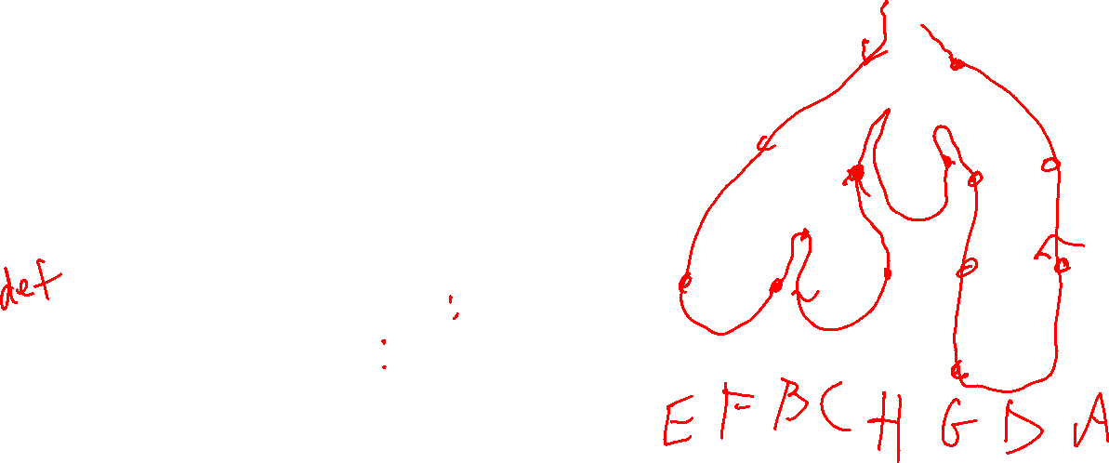
Print the nodes in post-order traversal order, starting at the root.
Tree Traversals
A
One order in which to visit all the nodes in a tree is pre-order traversal.
B
C
D
E
F
G
postorder_traversal(T, p) for each child c of p postorder_traversal(c) print p
H

Slide 21

A
Tree Traversals
B
C
D
One order in which to visit all the nodes in a tree is pre-order traversal.
G
E
F
H
postorder_traversal(T, p) for each child c of p preorder_traversal(c) print p
Post-order: E, F, B, C, H, G, D, A
Assuming print p is O(1), all n nodes are visited once, so O(n) work.

Slide 22

Binary Trees Properties
A
Suppose T is a binary tree with n nodes.
What is the max height of T?
What is the min height of T?
B
C
D
E
F
The height of a node p in a tree is:
0 if p is external (a leaf)
1 plus the max height of a child of p if p is internal (not a leaf)
G
The height of a tree is the height of its root.

Slide 23
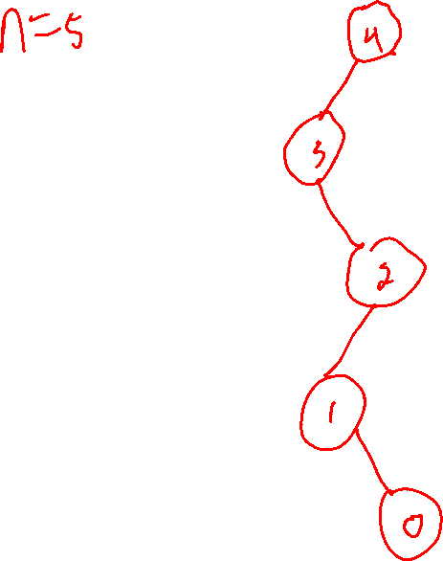
Binary Trees Properties
What is the max height of T?
How can you construct a binary tree that is as tall as possible? What does it look like?
The height of a node p in a tree is:
0 if p is external (a leaf)
1 plus the max height of a child of p if p is internal (not a leaf)
The height of a tree is the height of its root.

Slide 24
Binary Trees Properties
4
3
What is the max height of T?
How can you construct a binary tree that is as tall as possible? What does it look like?
2
1
The height of a node p in a tree is:
0 if p is external (a leaf)
1 plus the max height of a child of p if p is internal (not a leaf)
0
The height of a tree is the height of its root.

Slide 25

Binary Trees Properties
n-1
n-2
What is the max height of T?
If T has n nodes, then the height of a tree like this is n-1.
2
1
n nodes in the tree leaf starts at 0 each node is 1 higher
∴ root is height n-1 ∴ tree is height n-1
The height of a node p in a tree is:
0 if p is external (a leaf)
1 plus the max height of a child of p if p is internal (not a leaf)
0
The height of a tree is the height of its root.

Slide 26
Binary Trees Properties
A
Suppose T is a binary tree with n nodes.
What is the max height of T? n-1
What is the min height of T?
B
C
D
E
F
The height of a node p in a tree is:
0 if p is external (a leaf)
1 plus the max height of a child of p if p is internal (not a leaf)
G
The height of a tree is the height of its root.

Slide 27
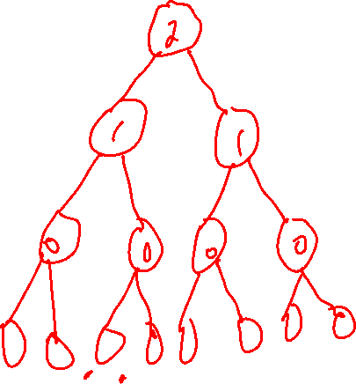
Binary Trees Properties
What is the min height of T?
How can you construct a binary tree that is as short as possible? What does it look like?
The height of a node p in a tree is:
0 if p is external (a leaf)
1 plus the max height of a child of p if p is internal (not a leaf)
The height of a tree is the height of its root.

Slide 28
Binary Trees Properties
What’s the height of this tree?
A
What is the min height of T?
How can you construct a binary tree that is as short as possible? What does it look like?
B
C
D
E
F
G
The height of a node p in a tree is:
0 if p is external (a leaf)
1 plus the max height of a child of p if p is internal (not a leaf)
The height of a tree is the height of its root.

Slide 29
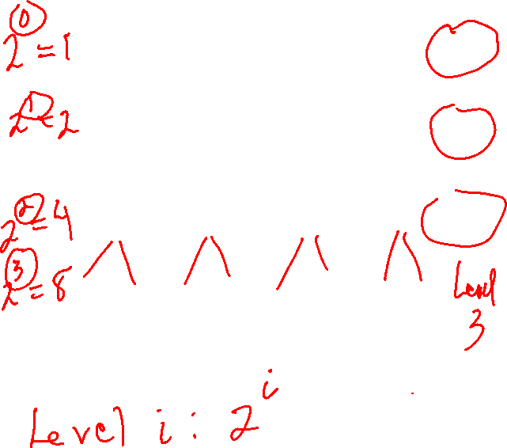
Binary Trees Properties
A
Level 0
What is the min height of T?
How can you construct a binary tree that is as short as possible? What does it look like?
B
C
Level 1
D
E
F
G
Level 2
If you continue this pattern, how many nodes are in each level?
The height of a node p in a tree is:
0 if p is external (a leaf)
1 plus the max height of a child of p if p is internal (not a leaf)
The height of a tree is the height of its root.

Slide 30
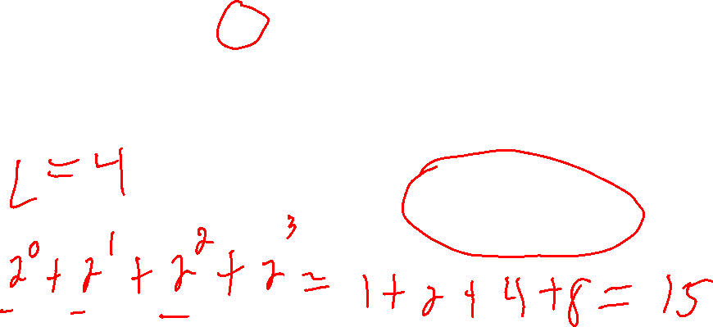


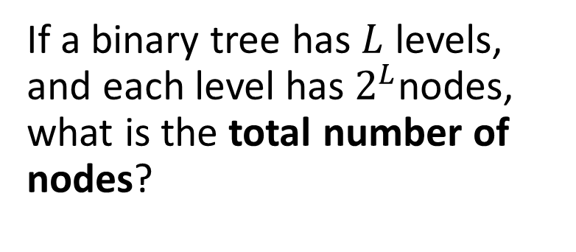


Binary Trees Properties
$$2^{0}=1$$
A
Level 0
If a binary tree has $L$ levels, and each level has${ 2}^{L}$nodes, what is the total number of nodes?
$$2^{1}=2$$
B
C
Level 1
$$2^{2}=4$$
D
E
F
G
Level 2
Level i:${ 2}^{i}$ nodes

Slide 31



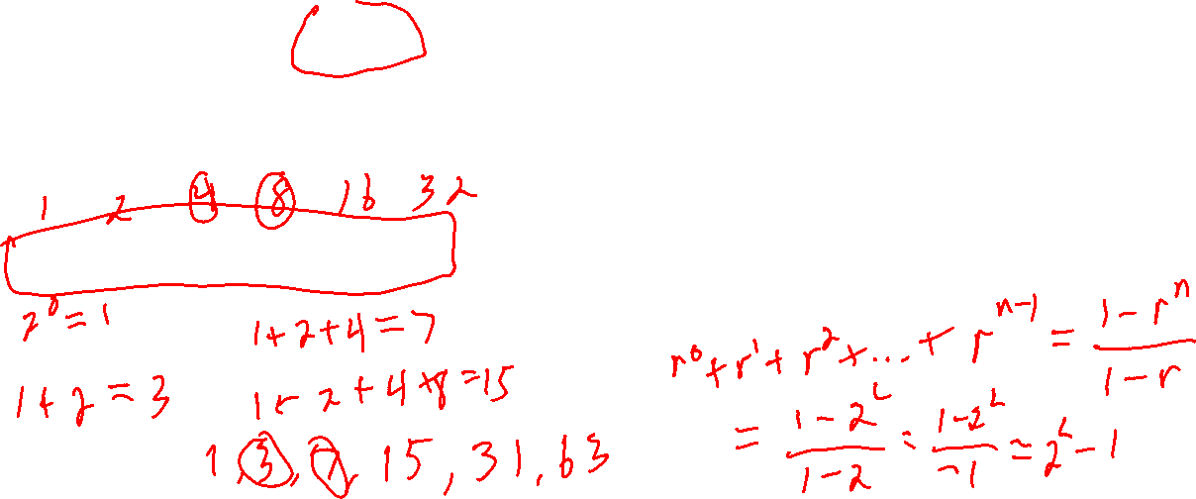
Binary Trees Properties
$$2^{0}=1$$
A
Level 0
If a binary tree has L levels, and level $i$ has${ 2}^{i}$ nodes, what is the total number of nodes?
$$2^{1}=2$$
B
C
Level 1
$$2^{2}=4$$
D
E
F
G
Level 2
$${ 2}^{0} + 2^{1}+2^{2}+ … +2^{L−1}$$
Level i: ${ 2}^{i}$ nodes

Slide 32
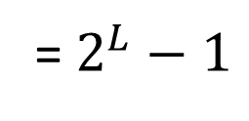

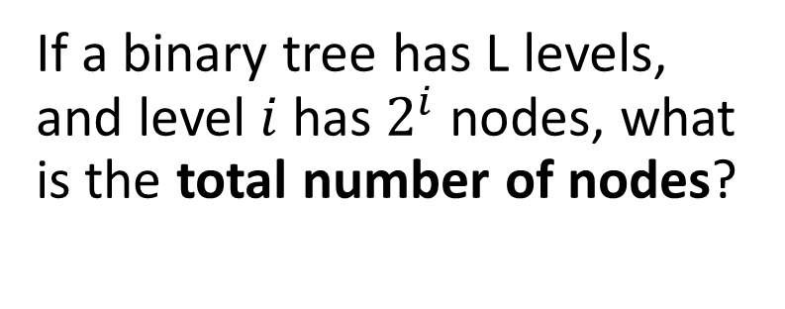
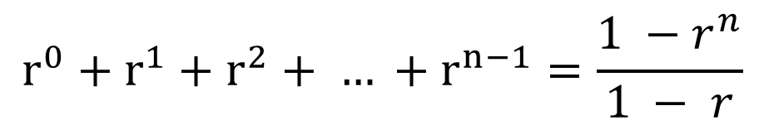

Binary Trees Properties
$$2^{0}=1$$
A
Level 0
If a binary tree has L levels, and level $i$ has${ 2}^{i}$ nodes, what is the total number of nodes?
$$2^{1}=2$$
B
C
Level 1
$$2^{2}=4$$
D
E
F
G
Level 2
$${ 2}^{0} + 2^{1}+2^{2}+ … +2^{L−1}$$
= $2^{L}−1$
You can figure this out by inspection, or use the formula for the sum of a geometric series ...
Level i: ${ 2}^{i}$ nodes
$${O(2}^{L})$$
$$r^{0}+r^{1}+r^{2}+ … +r^{n−1}=\frac{1 −{ r}^{n}}{1 − r}$$

Slide 33

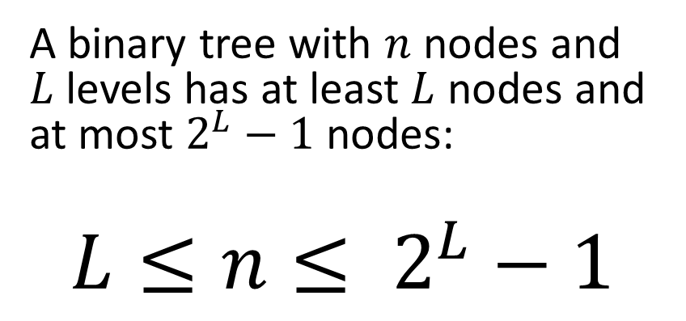
Binary Trees Properties
$$2^{0}=1$$
A
Level 0
A binary tree with $n$ nodes and $L$ levels has at least $L$ nodes and at most $2^{L}−1$ nodes:
$$L≤n≤ 2^{L}−1$$
$$2^{1}=2$$
B
C
Level 1
$$2^{2}=4$$
D
E
F
G
Level 2

Slide 34

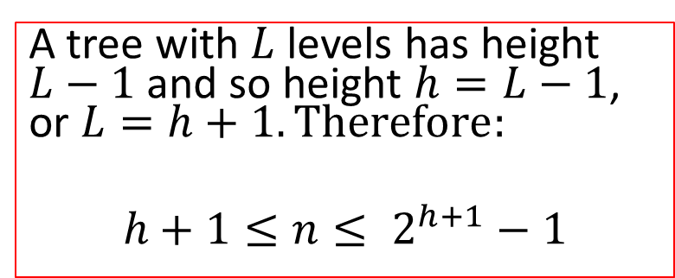
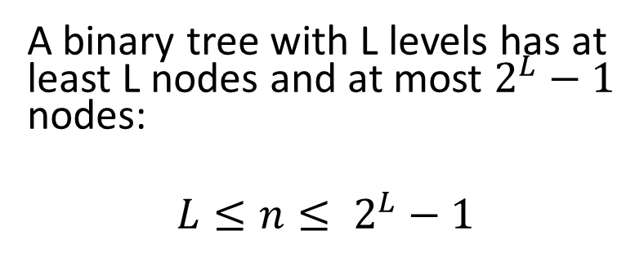
Binary Trees Properties
$$2^{0}=1$$
A
Level 0
A binary tree with $L$ levels has at least $L$ nodes and at most $2^{L}−1$ nodes:
$$L≤n≤ 2^{L}−1$$
$$2^{1}=2$$
B
C
Level 1
$$2^{2}=4$$
D
E
F
G
Level 2
A tree with $L$ levels has height $L−1$ and so height $h=L−1$, or $L=h+1. Therefore:$
$$h+1≤n≤ 2^{h+1}−1$$

Slide 35


Binary Trees Properties
$$2^{0}=1$$
A
Level 0
If a binary tree has $n$ nodes and height $h$, then:
$$2^{1}=2$$
B
C
Level 1
$$h+1≤n≤ 2^{h+1}−1$$
$$2^{2}=4$$
D
E
F
G
Level 2

Slide 36
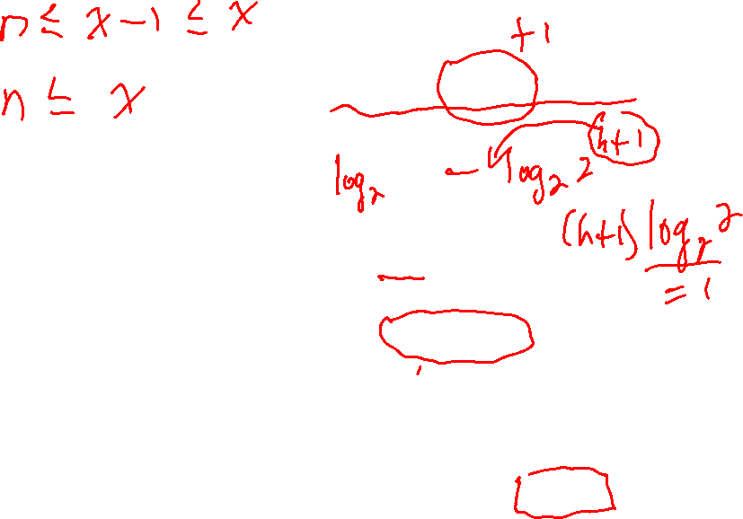
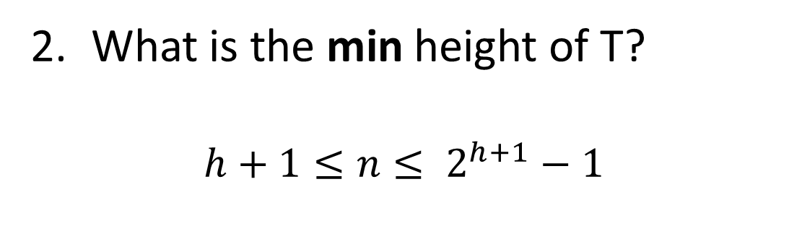


Binary Trees Properties
$$h+1≤n≤ 2^{h+1}−1≤2^{h+1}$$
$$n≤2^{h+1}$$
What is the min height of T?
$$h+1≤n≤ 2^{h+1}−1$$
$$\log{n}≤h+1$$
$$\log{n}−1≤h$$
This shows that a binary tree with n nodes must have a height of at least O(log n)
The height of a node p in a tree is:
0 if p is external (a leaf)
1 plus the max height of a child of p if p is internal (not a leaf)
The height of a tree is the height of its root.

Slide 37
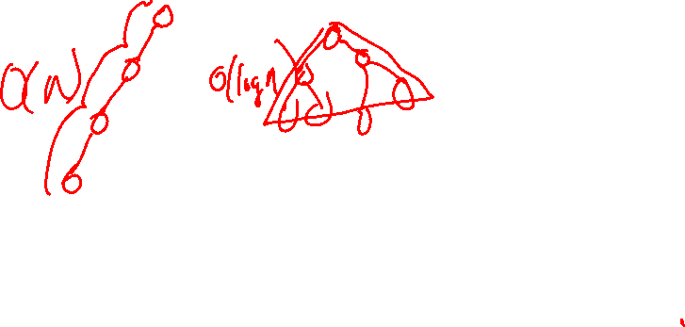
Binary Trees Properties
A
Suppose T is a binary tree with n nodes.
What is the max height of T? n-1
What is the min height of T? O(log n)
B
C
D
E
F
The height of a node p in a tree is:
0 if p is external (a leaf)
1 plus the max height of a child of p if p is internal (not a leaf)
G
The height of a tree is the height of its root.

Slide 38

Binary Trees Properties
A
Suppose T is a binary tree with n nodes.
What is the max height of T? n-1
What is the min height of T? O(log n)
See Proposition 7.10 (pages 288-289) in the textbook for some more facts like this.
B
C
D
E
F
G

