Slide 1
Data Structures and Algorithms
in CMPT 225

Slide 2
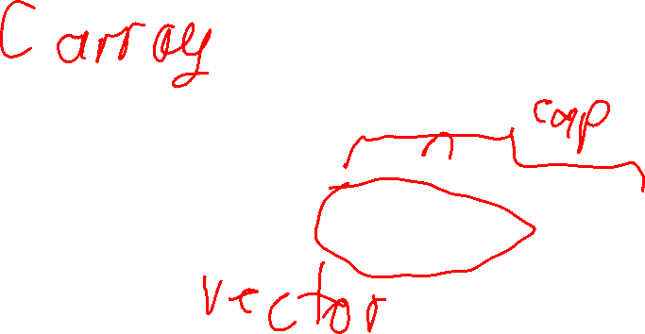
Arrays

Slide 3
Linked Lists
Start
End
Start

Slide 4
Queues

Slide 5
Stacks

Slide 6
Deques

Slide 7
Trees

Slide 8
Notation
O

Slide 9
Sorting
unsorted
denorstu

Slide 10
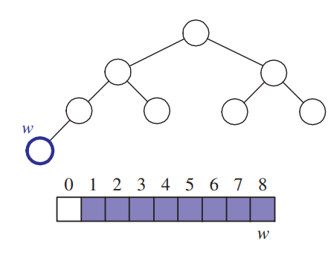
Heaps

Slide 11
Hash Tables

Slide 12
Graphs

