Slide 1
Try this Now!
Make an array of 3000 integers, and initialize it with 4, 5, 9 repeated like this:
0
1
2
3
4
5
2997
2998
2999
arr
4
5
9
4
5
9
. . .
4
5
9

Slide 2
Try this Now!
Make an array of 3000 integers, and initialize it with 4, 5, 9 repeated like this:
0
1
2
3
4
5
2997
2998
2999
arr
4
5
9
4
5
9
. . .
4
5
9
See lecture2_problem.cpp for some sample solutions.

Slide 3
CMPT 225 Week 1
SFU Surrey, Fall 2023

Slide 4
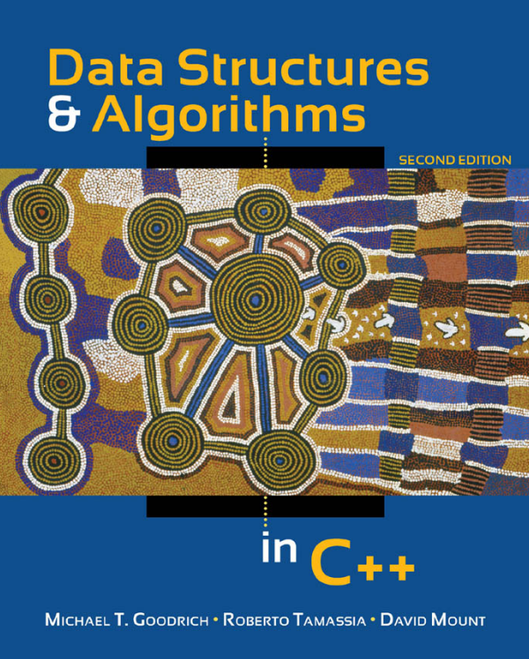
Administrative Notes
Textbook
Bookmark these sites
225 Canvas: https://canvas.sfu.ca/courses/80182
Notes and assignments: https://tjd1234.github.io/cmpt225fall2023/
Canvas is where you find
office hours for instructor and TAs
syllabus and marking scheme
your marks
weekly quizzes
announcements
discussions
…

Slide 5
What is a data structure?

Slide 6
What is a data structure?
A way of organizing data.
Arrays, strings, lists, trees, tables, and graphs are all examples of data structures.

Slide 7
What is an algorithm?

Slide 8
What is an algorithm?
A description of a sequence of actions on a data structure, usually to achieve some specific goal.
Examples: summing an array, printing all the “leaf” nodes in a tree, finding a target string in a bigger string, removing all negative numbers from an array, …

Slide 9
How many ways can you sum an array of doubles?
See sum.cpp for different ways to sum doubles in C++ …
good practice with C++ !
Assume the array contains doubles.

Slide 10
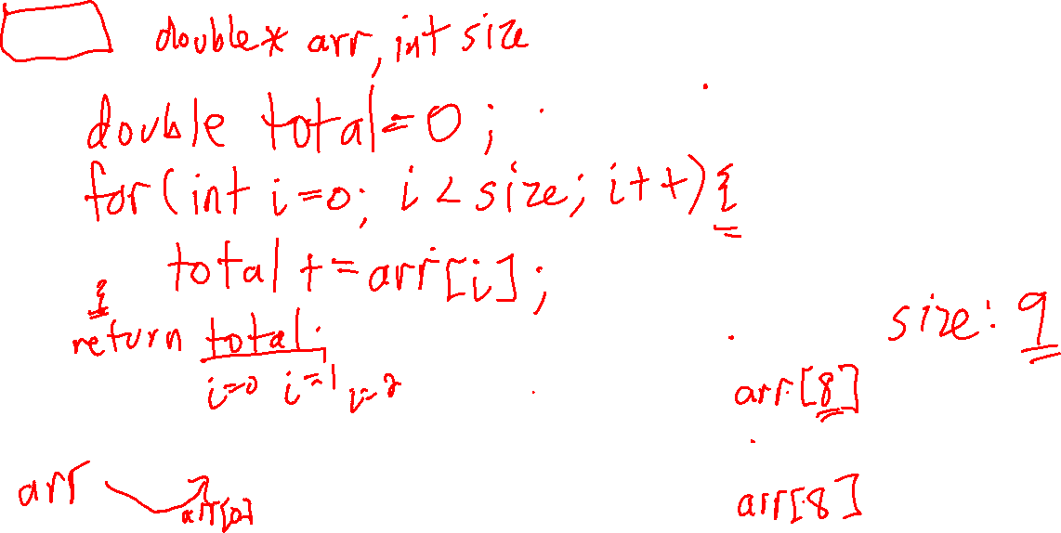
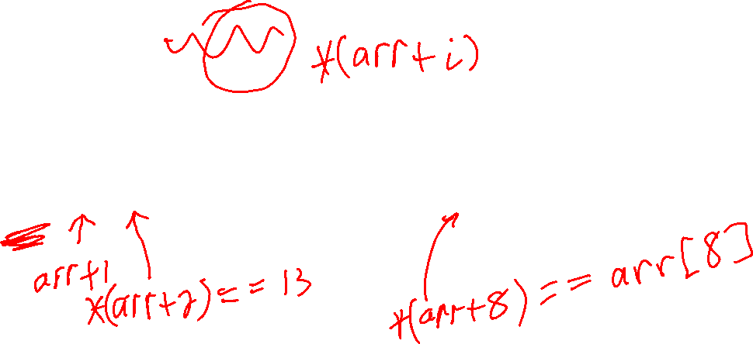
double sum( )
{
}
Arrays and pointers
0
1
2
3
4
5
6
7
8
5
6
13
11
50
12
19
14
10
Assume the array contains doubles.

Slide 11
double sum(double *arr, int size)
{
double total = 0;
for (int i = 0; i < size; i++)
{
total += arr[i];
}
return total;
}
Arrays and pointers
0
1
2
3
4
5
6
7
8
5
6
13
11
50
12
19
14
10
Assume the array contains doubles.

Slide 12
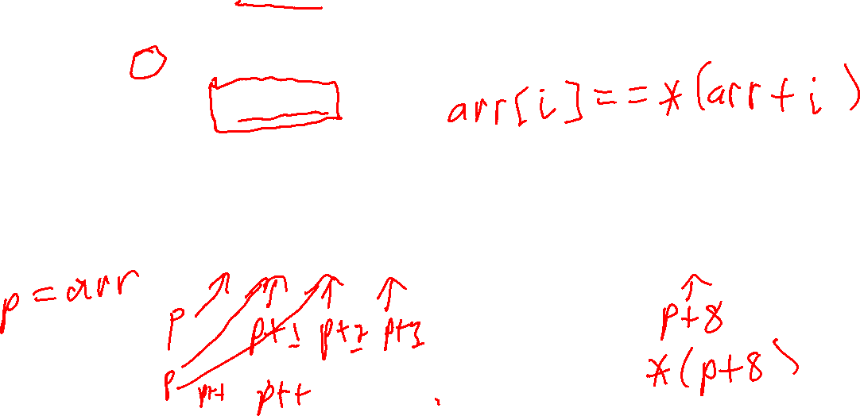
//
// Access array elements using pointer arithmetic // without []-notation.
//
double sum_array1b(double *arr, int size)
{
double total = 0;
for (int i = 0; i < size; i++)
{
total += *(arr + i);
}
return total;
}
Arrays and pointers
0
1
2
3
4
5
6
7
8
5
6
13
11
50
12
19
14
10

Slide 13
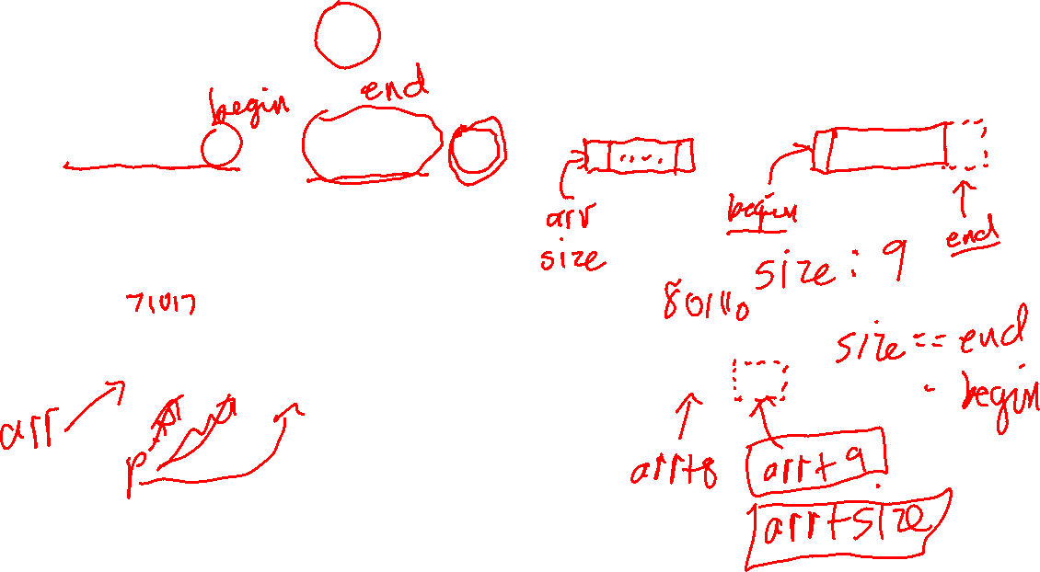
//
// You can use a pointer to iterate through an array.
//
double sum_array2(double *arr, int size)
{
double total = 0;
for (double *p = arr; p < arr + size; p++)
{
total += *p;
}
return total;
}
Arrays and pointers
0
1
2
3
4
5
6
7
8
5
6
13
11
50
12
19
14
10

Slide 14
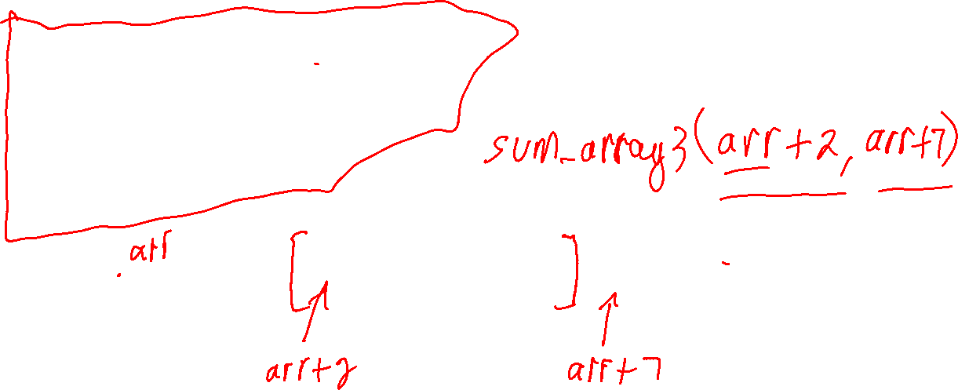
//
// - begin points to the first element in the sub-array
// - end points to the element *after* the last element // in the sub-array
//
double sum_array3(double *begin, double *end)
{
double total = 0;
for (double *p = begin; p < end; p++)
{
total += *p;
}
return total;
}
Arrays and pointers
0
1
2
3
4
5
6
7
8
5
6
13
11
50
12
19
14
10

Slide 15

//
// The C++ standard library has many helpful functions. // The accumulate function sums the elements between two // iterators (pointers). The third argument is the
// starting value of the total sum.
//
double sum_array4(double *arr, int size)
{
return accumulate(arr, arr + size, 0);
}
Arrays and pointers
0
1
2
3
4
5
6
7
8
5
6
13
11
50
12
19
14
10

Slide 16
//
// Another way to use accumulate.
//
double sum_array5(double *begin, double *end)
{
return accumulate(begin, end, 0);
}
Arrays and pointers
0
1
2
3
4
5
6
7
8
5
6
13
11
50
12
19
14
10

Slide 17
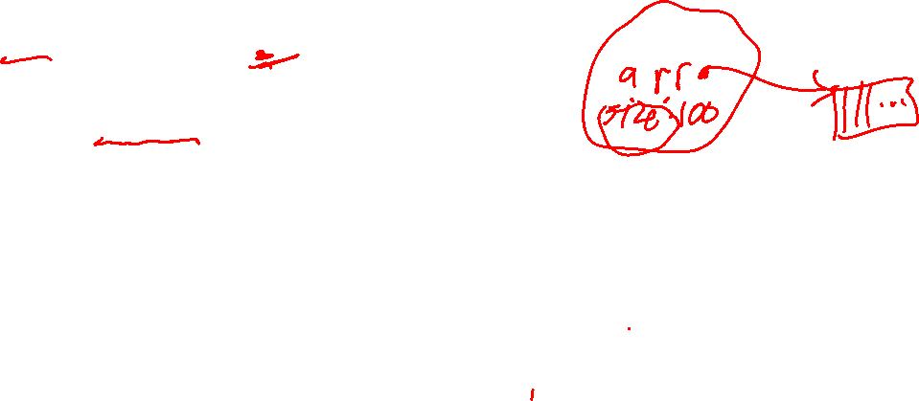
//
// In C++, vectors are generally preferred over arrays // since they are easier to work with. For example, they // store their length, can be resized, manage their
// own memory, and have many helper methods.
//
double sum_vec1(const vector<double> &v)
{
double total = 0;
for (int i = 0; i < v.size(); i++)
{
total += v[i];
}
return total;
}
vectors
0
1
2
3
4
5
6
7
8
5
6
13
11
50
12
19
14
10

Slide 18
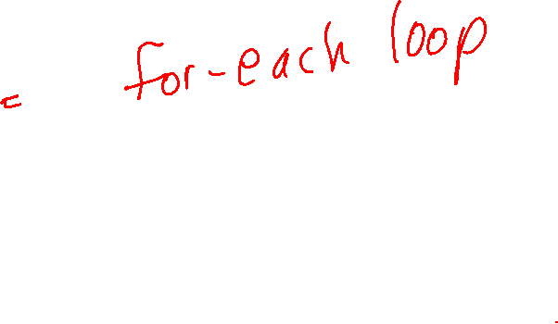
//
// Use the for-each style loop when it possible. // The code is often shorter and simpler.
//
double sum_vec2(const vector<double> &v)
{
double total = 0;
for (double x : v) {
total += x;
}
return total;
}
vectors
0
1
2
3
4
5
6
7
8
5
6
13
11
50
12
19
14
10

Slide 19
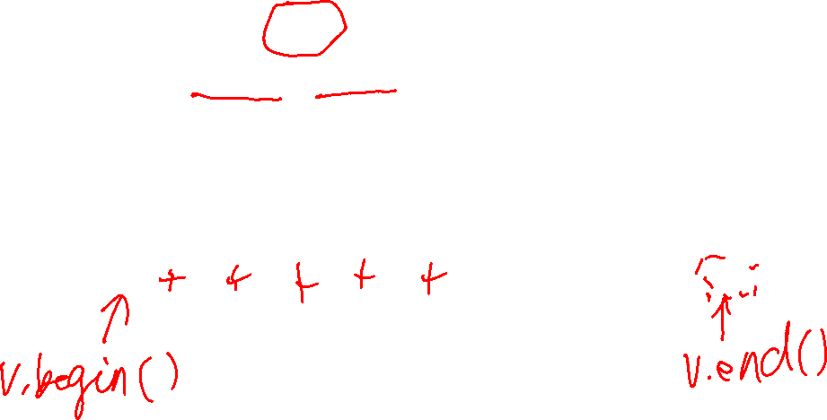
//
// The C++ standard library has many help functions. // The std::accumulate function sums the elements between // two iterators (pointers). The third argument is the
// initial value of the sum.
//
double sum_vec3(const vector<double> &v)
{
return accumulate(v.begin(), v.end(), 0);
}
vectors
0
1
2
3
4
5
6
7
8
5
6
13
11
50
12
19
14
10

Slide 20
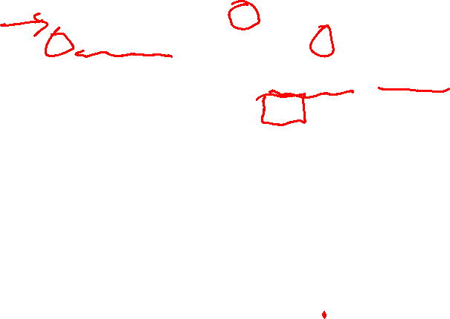
//
// Generic (templated) implementation of sum.
//
// std::accumulate works with iterators (pointers) // of any type, so sum_generic works with any type T
// that has operator+ and a constructor defined for it.
//
template <typename T>
T sum_generic(const vector<T> &v)
{
return accumulate(v.begin(), v.end(),
T() // initialize with an empty object of type T
);
}
vectors
If T is a string, returns the concatenation of all the strings in v
0
1
2
3
4
5
6
7
8
5
6
13
11
50
12
19
14
10
vector<string> w = {"cat", "dog", "mouse"};
// sum_generic(w) returns "catdogmouse"

Slide 21
In programming, what is recursion?

Slide 22
In programming, what is recursion?
Recursion is when a function calls itself, either directly or indirectly.
See recursion.cpp for some examples.

Slide 23
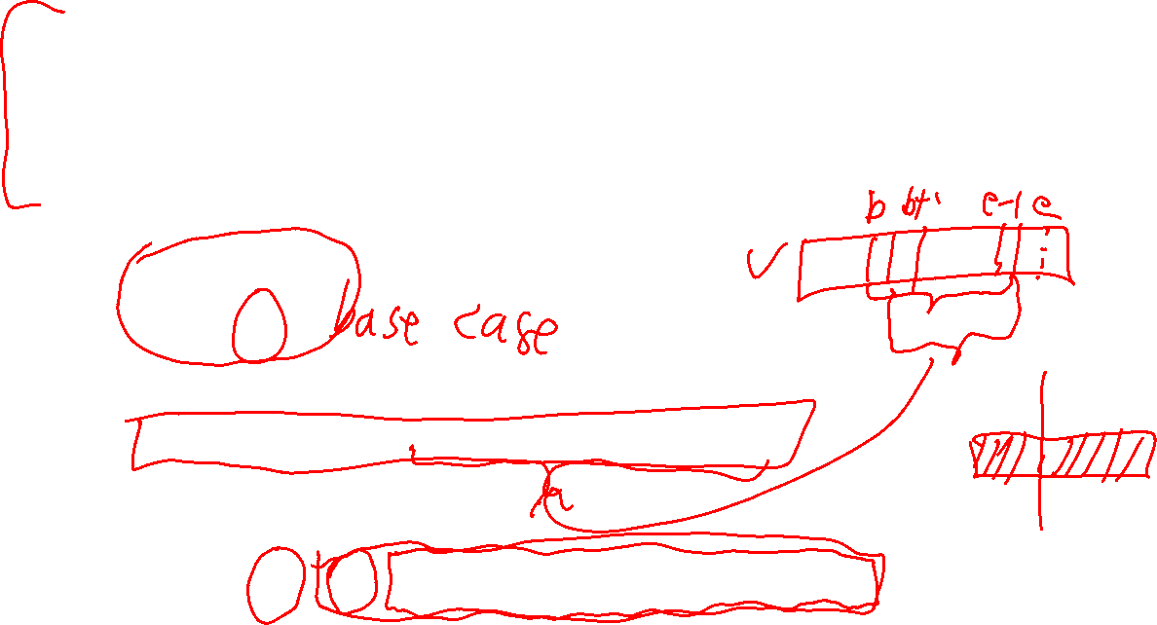
vectors
//
// Pre-condition:
// [begin, end) is a valid range of indices for vec
// Post-condition:
// returns vec[begin] + vec[begin + 1] + ... + vec[end - 1]
//
int sum_vec(const vector<int> &vec, int begin, int end)
{
if (begin == end)
{
return 0;
}
else
{
return vec[begin] + sum_vec(vec, begin + 1, end);
}
}
0
1
2
3
4
5
6
7
8
5
6
13
11
50
12
19
14
10

Slide 24
Pre-condition states what must be true before calling the function
vectors
//
// Pre-condition:
// [begin, end) is a valid range of indices for vec
// Post-condition:
// returns vec[begin] + vec[begin + 1] + ... + vec[end - 1]
//
int sum_vec(const vector<int> &vec, int begin, int end)
{
if (begin == end)
{
return 0;
}
else
{
return vec[begin] + sum_vec(vec, begin + 1, end);
}
}
Post-condition states what must be true after calling the function
0
1
2
3
4
5
6
7
8
5
6
13
11
50
12
19
14
10

Slide 25
vectors
//
// Pre-condition:
// [begin, end) is a valid range of indices for vec
// Post-condition:
// returns vec[begin] + vec[begin + 1] + ... + vec[end - 1]
//
int sum_vec(const vector<int> &vec, int begin, int end)
{
if (begin == end)
{
return 0;
}
else
{
return vec[begin] + sum_vec(vec, begin + 1, end);
}
}
int sum_vec(const vector<int> &vec)
{
return sum_vec(vec, 0, vec.size());
}
We often provide extra functions with fewer parameters to handle common cases.
0
1
2
3
4
5
6
7
8
5
6
13
11
50
12
19
14
10

Slide 26
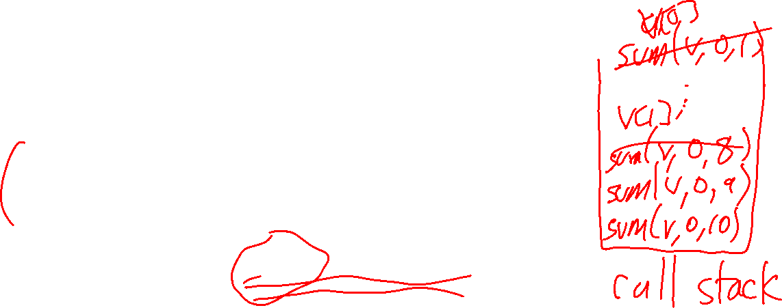
Why is this recursive sum inefficient compared to a loop-based sum?
//
// Pre-condition:
// [begin, end) is a valid range of indices for vec
// Post-condition:
// returns vec[begin] + vec[begin + 1] + ... + vec[end - 1]
//
int sum_vec(const vector<int> &vec, int begin, int end)
{
if (begin == end)
{
return 0;
}
else
{
return vec[begin] + sum_vec(vec, begin + 1, end);
}
}

Slide 27
Why is this recursive sum inefficient compared to a loop-based sum?
//
// Pre-condition:
// [begin, end) is a valid range of indices for vec
// Post-condition:
// returns vec[begin] + vec[begin + 1] + ... + vec[end - 1]
//
int sum_vec(const vector<int> &vec, int begin, int end)
{
if (begin == end)
{
return 0;
}
else
{
return vec[begin] + sum_vec(vec, begin + 1, end);
}
}
Every call to sum_vec is put onto the C++ call stack, storing copies of the parameters in the call. sum_vec is called once for each number in v, and so the stack has n calls to sum_vec, which takes up a lot of extra memory!

Slide 28
If recursion is often (very) inefficient, why do we use it?

Slide 29
If recursion is often (very) inefficient, why do we use it?
In some cases, such as recursive data structures, it results in algorithms that are much easier to understand and implement than non-recursive alternatives.
In theory, loops are never necessary and can always be replaced by recursion. This can be useful when proving mathematical facts about algorithms. Some programming languages have no loops, e.g. Haskell, Prolog.
In some cases, recursion can be automatically optimized into a more efficient loop version: tail recursive functions, where the last thing the function does is call itself, can be automatically converted to a loop by a good compiler.

