Slide 1
Data Structures and Algorithms
in CMPT225

Slide 2
Arrays

Slide 3
Sorting
unsorted
denorstu

Slide 4
Linked Lists
Start
End
Start

Slide 5
Notation
O

Slide 6
Queues

Slide 7
Stacks

Slide 8
Deques

Slide 9
Trees

Slide 10
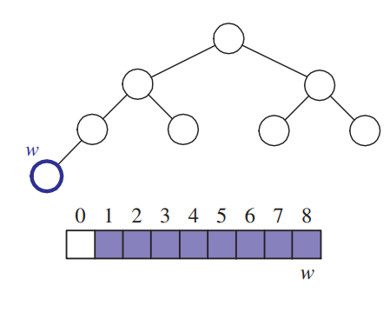
Heaps

Slide 11
Hash Tables

Slide 12
Graphs

Slide 13
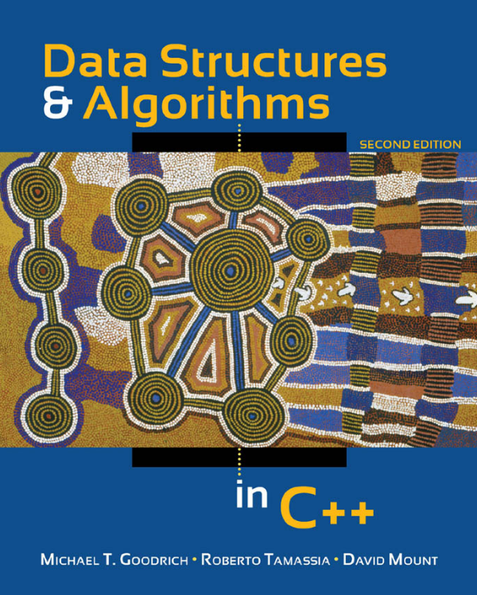
Recommended Text

