Slide 1
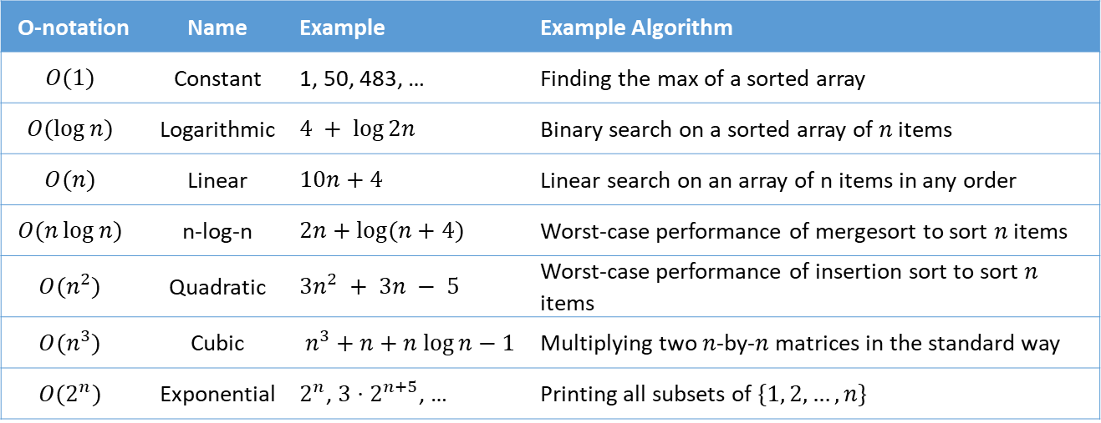
O-notation | Name | Example | Example Algorithm
$$O(1)$$ | Constant | 1, 50, 483, … | Finding the max of a sorted array
$$O(\log{n})$$ | Logarithmic | $$4 + \log{2n}$$ | Binary search on a sorted array of $n$ items
$$O(n)$$ | Linear | $$10n+4$$ | Linear search on an array of n items in any order
$$O(n\log{n})$$ | n-log-n | $$2n+\log{(n+4)}$$ | Worst-case performance of mergesort to sort $n$ items
$$O(n^{2})$$ | Quadratic | $$3n^{2} + 3n − 5$$ | Worst-case performance of insertion sort to sort $n$ items
$$O(n^{3})$$ | Cubic | $$n^{3}+n+n log⁡n−1$$ | Multiplying two $n$-by-$n$ matrices in the standard way
$$O(2^{n})$$ | Exponential | $2^{n}$, $3⋅2^{n+5}$, … | Printing all subsets of $\{1, 2, …, n\}$

