Slide 1
Week 3
CMPT 225, Fall 2023 SFU Surrey

Slide 2
Review: List2.cpp
Take a look at the code in List2.cpp …
Do you understand all the details?

Slide 3
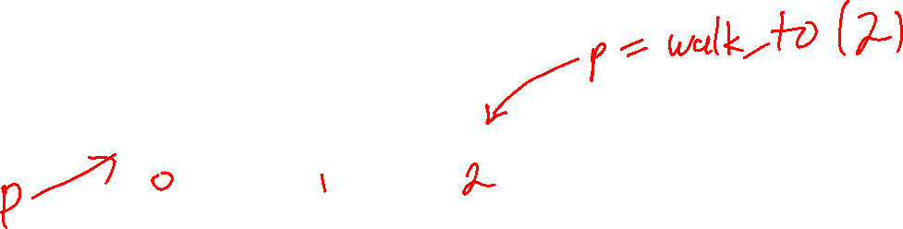
Practice Questions: walk_to
See singly_linked_list3.cpp for a sample solution.
In the List class (in List2.cpp), implement a method called walk_to(int i) that returns a pointer to the i-th node in the list.
The first node is 0, the second is 1, the third is 2, and so on.
Assume i is a valid index.
Make walk_to private: we don’t want List users getting pointers to nodes (they could mess up the node!).
H
cat
dog
bird

Slide 4
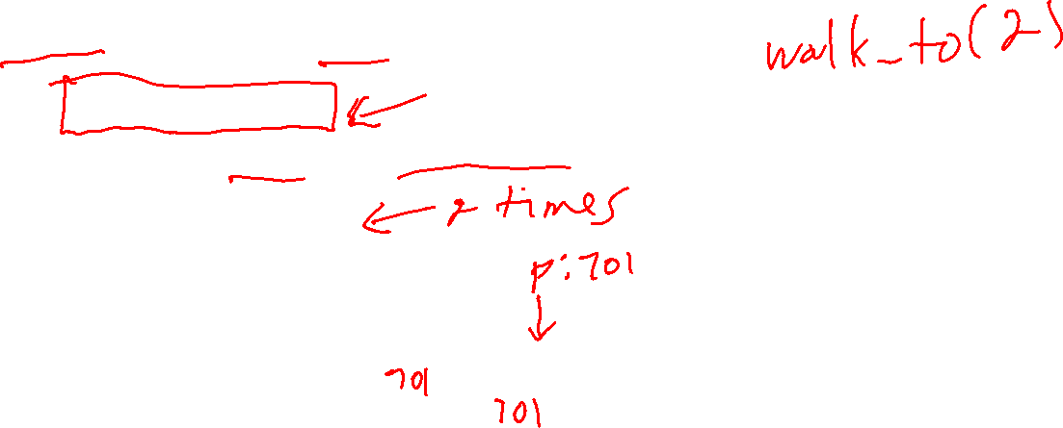
Practice Questions: walk_to
//
// Returns a pointer to the ith node in the list.
//
Node *walk_to(int index) const
{
Node *p = head;
for (int j = 0; j < index; j++)
{
p = p->next;
}
return p;
}
H
cat
dog
bird

Slide 5
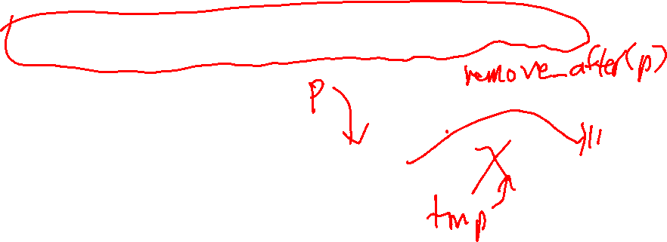
Practice Questions: remove_after
In the List class (in List2.cpp), implement the private method remove_after(Node* p), which deletes the node after the node that p points to.
Assume p points to a valid node in the list, and the list is non-empty.
Note that it can’t remove the first element of the list!
See singly_linked_list3.cpp for a sample solution.
H
cat
dog
bird

Slide 6
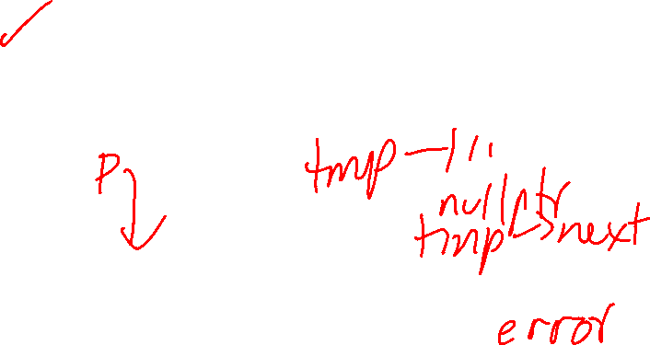
Practice Questions: remove_after
void remove_after(Node *p)
{
assert(p != nullptr);
Node *tmp = p->next;
p->next = tmp->next;
delete tmp;
}
What’s the bug in this code?
H
cat
dog
bird

Slide 7
Practice Questions: remove_after
void remove_after(Node *p)
{
assert(p != nullptr);
Node *tmp = p->next;
p->next = tmp->next;
delete tmp;
}
It doesn’t work if p points to the last node.
H
cat
dog
bird
p
tmp

Slide 8

Practice Questions: remove_after
void remove_after(Node *p)
{
assert(p != nullptr); if (p->next == nullptr) return;
Node *tmp = p->next;
p->next = tmp->next;
delete tmp;
}
We can fix it by treating it as a special case.
H
cat
dog
bird
p
tmp

Slide 9
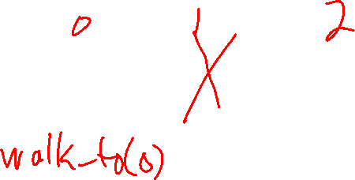
Practice Questions: remove
See singly_linked_list3.cpp for a sample solution.
In the List class (in List2.cpp), implement the public method remove(int i) that deletes the i-th node in the list.
Assume i is a valid index and the list is non-empty.
H
cat
dog
bird

Slide 10

Practice Questions: remove
H
void remove(int i)
{
assert(i >= 0 && i < size());
if (i == 0)
{
pop_front();
}
else
{
Node *p = walk_to(i - 1);
remove_after(p);
}
}
cat
dog
bird
Removing the first node is a special case.
For every other node, walk to 1 node before it and call remove_after.

Slide 11
Practice Questions: recursive size
In the List class (in List1.cpp), re-implement the size() method using recursion (and no loops). How does the recursive implementation compare to the non-recursive one?
H
cat
dog
bird

Slide 12
Practice Questions: recursive size
int size(Node *p) const
{
if (p == nullptr)
{
return 0;
}
else
{
return 1 + size(p->next);
}
}
int size() const
{
return size(head);
}
H
cat
dog
bird

Slide 13

What gets printed?
int num_called = 0;
for (int i = 0; i < 10; i++)
{
num_called++;
}
cout << num_called;

Slide 14
What gets printed?
int num_called = 0;
for (int i = 0; i < 10; i++)
{
num_called++;
}
cout << num_called;
10

Slide 15
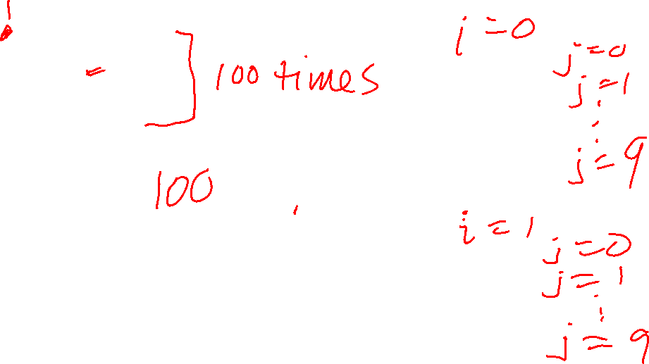
What gets printed?
int num_called = 0;
for (int i = 0; i < 10; i++)
{
for (int j = 0; j < 10; j++)
{
num_called++;
}
}
cout << num_called << "\n";

Slide 16
What gets printed?
int num_called = 0;
for (int i = 0; i < 10; i++)
{
for (int j = 0; j < 10; j++)
{
num_called++;
}
}
cout << num_called << "\n";
100

Slide 17
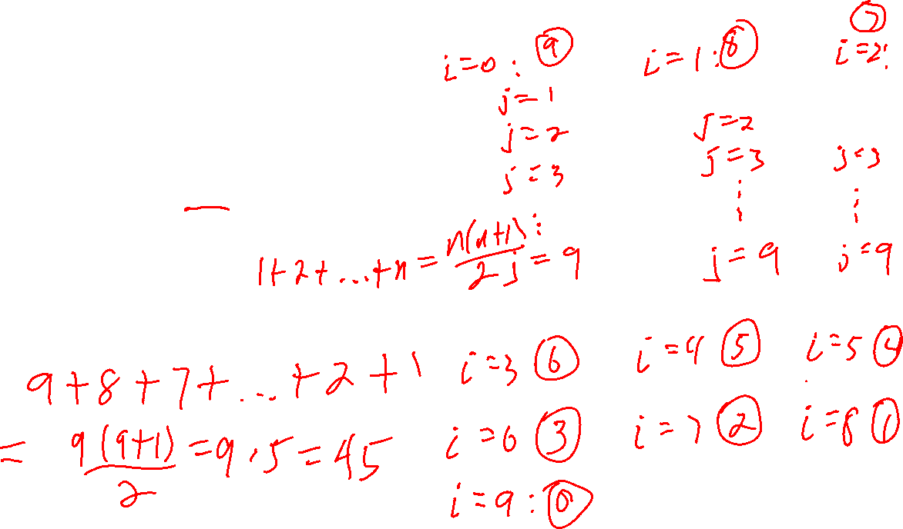
What gets printed?
int num_called = 0;
for (int i = 0; i < 10; i++)
{
for (int j = i + 1; j < 10; j++)
{
num_called++;
}
}
cout << num_called << "\n";

Slide 18
What gets printed?
int num_called = 0;
for (int i = 0; i < 10; i++)
{
for (int j = i + 1; j < 10; j++)
{
num_called++;
}
}
cout << num_called << "\n";
45

Slide 19
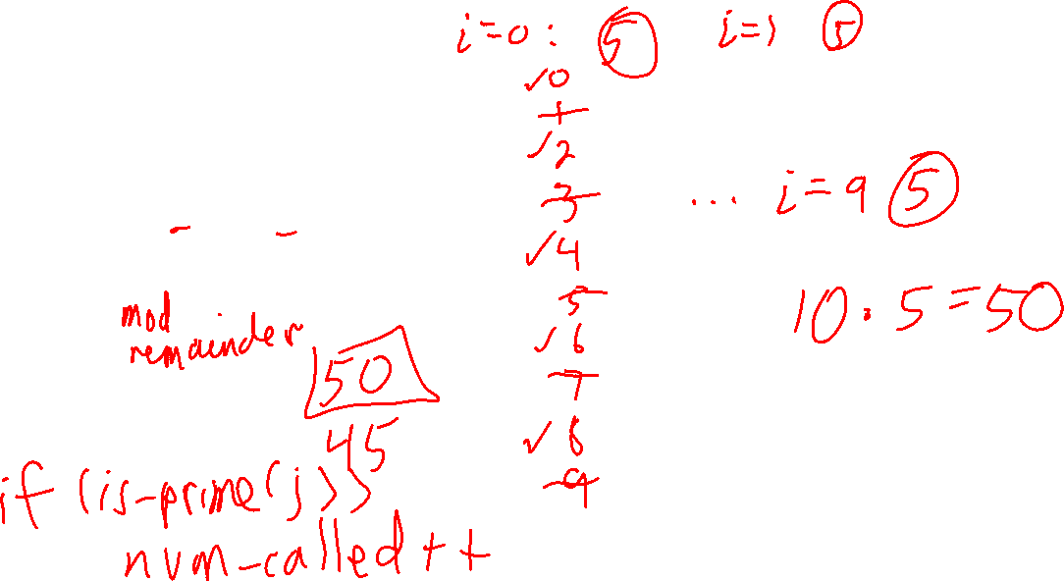
What gets printed?
int num_called = 0;
for (int i = 0; i < 10; i++)
{
for (int j = 0; j < 10; j++)
{
if (j % 2 == 0) num_called++;
}
}
cout << num_called << "\n";

Slide 20

What gets printed?
int num_called = 0;
for (int i = 0; i < 10; i++)
{
for (int j = 0; j < 10; j++)
{
if (j % 2 == 0) num_called++;
}
}
cout << num_called << "\n";
50

Slide 21
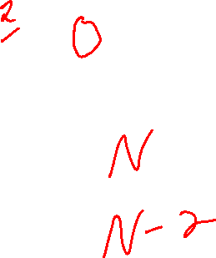
What gets printed?
int num_called = 0;
for (int i = 0; i < N; i++)
{
num_called++;
}
cout << num_called;

Slide 22
What gets printed?
int num_called = 0;
for (int i = 0; i < N; i++)
{
num_called++;
}
cout << num_called;
N

Slide 23
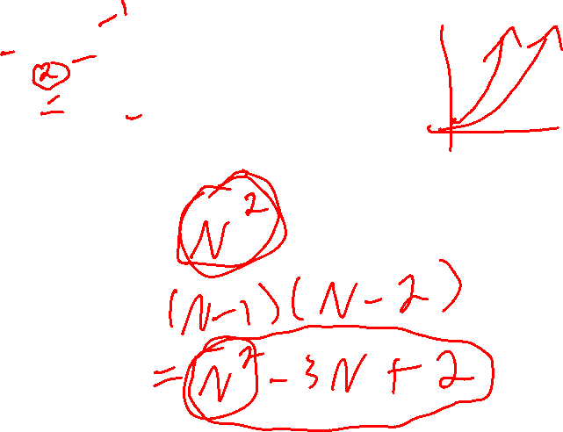
What gets printed?
int num_called = 0;
for (int i = 0; i < N; i++)
{
for (int j = 0; j < N; j++)
{
num_called++;
}
}
cout << num_called << "\n";

Slide 24

What gets printed?
int num_called = 0;
for (int i = 0; i < N; i++)
{
for (int j = 0; j < N; j++)
{
num_called++;
}
}
cout << num_called << "\n";
$$N^{2}$$

Slide 25
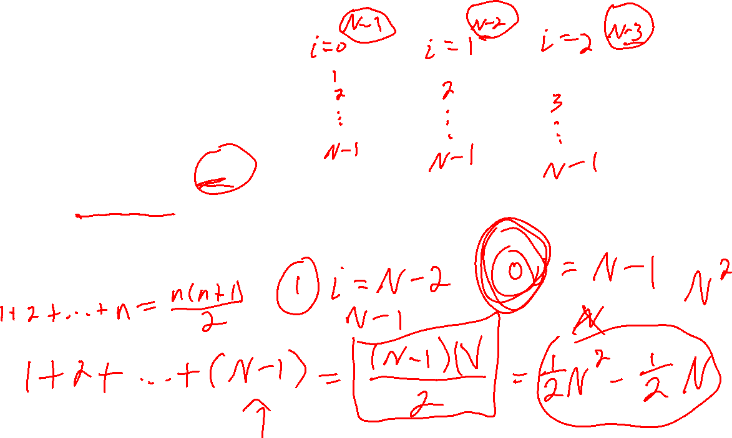
What gets printed?
int num_called = 0;
for (int i = 0; i < N; i++)
{
for (int j = i + 1; j < N; j++)
{
num_called++;
}
}
cout << num_called << "\n";

Slide 26

What gets printed?
int num_called = 0;
for (int i = 0; i < N; i++)
{
for (int j = i + 1; j < N; j++)
{
num_called++;
}
}
cout << num_called << "\n";
$$\frac{N\left(N−1\right)}{2}$$

Slide 27
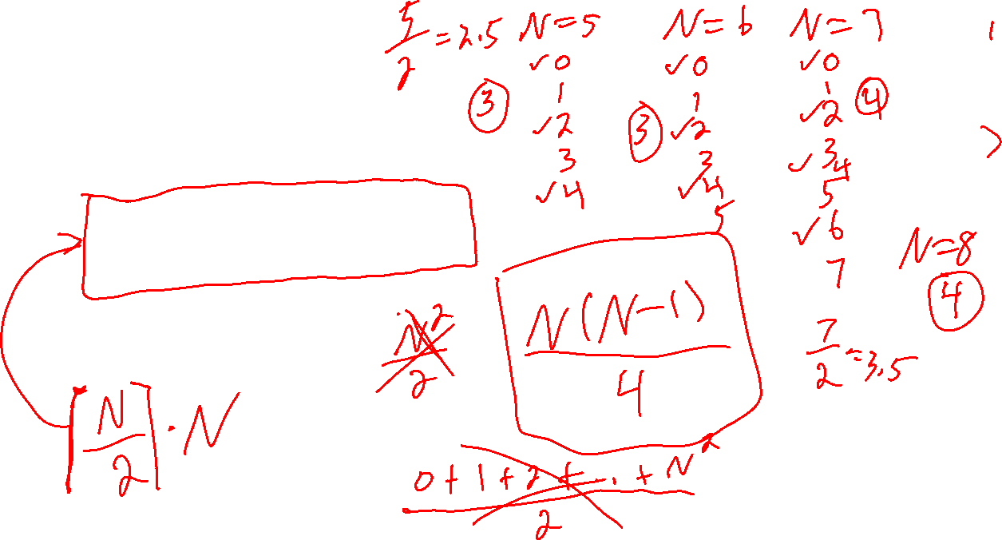
What gets printed?
int num_called = 0;
for (int i = 0; i < N; i++)
{
for (int j = 0; j < N; j++)
{
if (j % 2 == 0) num_called++;
}
}
cout << num_called << "\n";

Slide 28
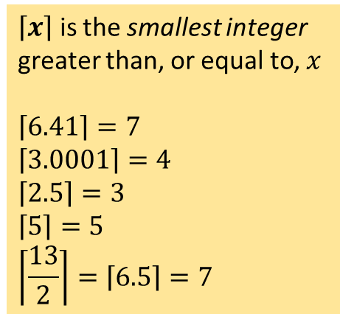

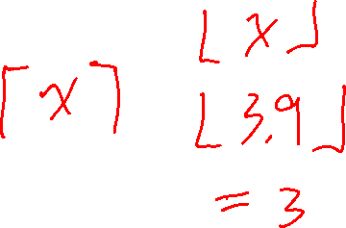
What gets printed?
int num_called = 0;
for (int i = 0; i < N; i++)
{
for (int j = 0; j < N; j++)
{
if (j % 2 == 0) num_called++;
}
}
cout << num_called << "\n";
$\left\lceil x\right\rceil$ is the smallest integer greater than, or equal to, $x$
$$\left\lceil 6.41\right\rceil =7$$
$$\left\lceil 3.0001\right\rceil =4$$
$$\left\lceil 2.5\right\rceil =3$$
$$\left\lceil 5\right\rceil =5$$
$$\left\lceil \frac{13}{2}\right\rceil =\left\lceil 6.5\right\rceil =7$$
$$N\left\lceil \frac{N}{2}\right\rceil$$

Slide 29
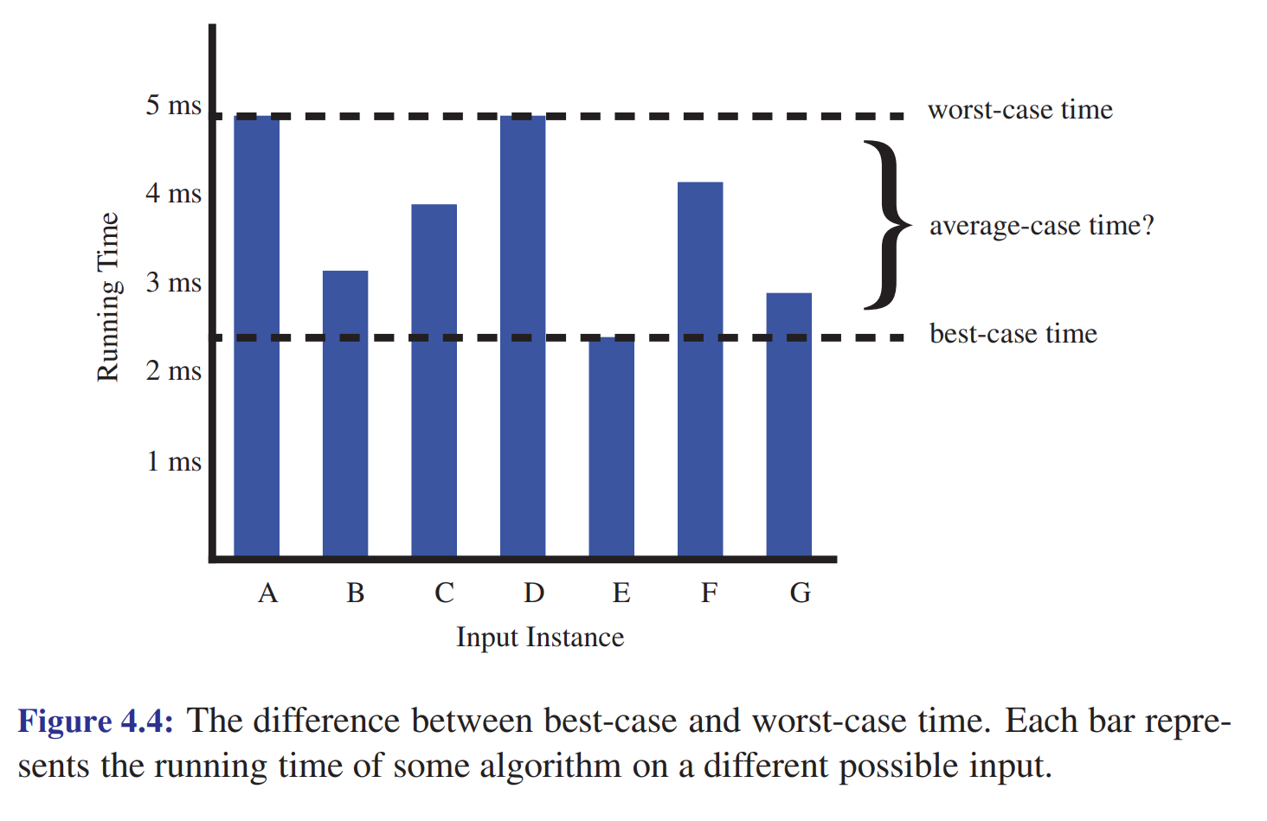
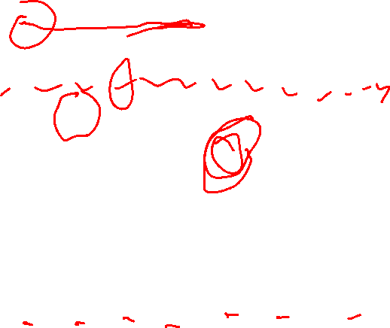

Slide 30




















$$O(\log{n})$$
$$O(n)$$
$$O(n\log{n})$$
O($n^{2}$)
O($n^{3}$)
O($2^{n}$)
$$O(1)$$
$$\log_{2}{n}$$
$n$, $3n$, $5n+10$, …
$$4n\log{2n}$$
$$n^{2}$$
$$n^{3}$$
$$2^{n}$$
1, 5, 861, 3000, …
$$\log_{10}{n}$$
$$n+log⁡n$$
$$n+n\log{n}$$
$$2n^{2}−3n$$
$$n^{3}−n^{2}+5$$
$$2^{n}+n^{100}$$
…
…
…
…
…
$${5+\log_{3}{(2n+1)}}_{}$$
…

