Slide 1
Maps and Hashing Chapter 9.1 – 9.2
CMPT 225

Slide 2
A map is an ADT that stores (key, value) pairs.
Searching/adding/removing pairs by key should be as fast as possible.
We search the map by key.
Searching by value can be very slow, or even impossible.
[(key_1, value_1), (key_2, value_2), …, (key_n, value_n)]
Each (key, value) pair is called an entry.

Slide 3
A map is an ADT that stores (key, value) pairs.
Searching/adding/removing pairs by key should be as fast as possible.
Keys are typically ints or strings.
Searching by value can be very slow, or even impossible.
[(key_1, value_1), (key_2, value_2), …, (key_n, value_n)]
The values are whatever data we want to store.

Slide 4
A map is an ADT that stores (key, value) pairs.
Keys must be unique.
[("Kal", "corn"), ("Mei","fish"), ("Ed", "corn")]
Values don’t need to be unique. There can be duplicate values.

Slide 5
Map ADT
The textbook uses C++ iterators to implement a map.
That’s a good, flexible way to do things.
But it’s relatively complex, and so we will use a simpler implementation …

Slide 6
Map ADT
size() returns # of entries in the table
put(k, v) If no entry has k as a key, (k, v) is added. If an entry does have k as a key, then it’s value is over-written to v.
contains(key) Returns true if key is in the table, false if it’s not
get(key) Returns the value associated with key. Error if key is not in the table.
remove(key) If (key, some_value) is in the table, the entry is removed. If no entry with key, then does nothing.

Slide 7
An unordered list implementation of a map.
Store the (key, value) pairs in an array, or vector, or linked list.
[("Kal", "corn"), ("Mei","fish"), ("Ed", "corn")]

Slide 8
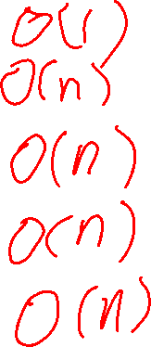
Map ADT: Unordered List Implementation
Performance:
size() returns # of entries in the table
put(k, v) If no entry with k is in the table, (k, v) is added. If an entry has k, then it’s value is over-written to v.
contains(key) Returns true if key is in the table, false if it’s not
get(key) Returns the value associated with key. Error if key is not in the table.
remove(key) If (key, some_value) is in the table, the entry is removed. If no entry with key, then does nothing
Performance:
Performance:
Performance:
Performance:

Slide 9
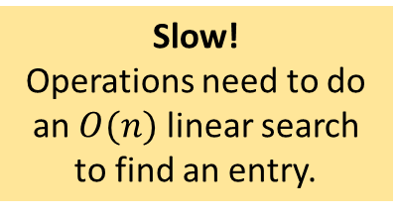
Map ADT: Unordered List Implementation
Performance:
O(1)
size() returns # of entries in the table
put(k, v) If no entry with k is in the table, (k, v) is added. If an entry has k, then it’s value is over-written to v.
contains(key) Returns true if key is in the table, false if it’s not
get(key) Returns the value associated with key. Error if key is not in the table.
remove(key) If (key, some_value) is in the table, the entry is removed. If no entry with key, then does nothing
Performance:
O(n)
Performance:
O(n)
Performance:
O(n)
Performance:
O(n)
Slow! Operations need to do an $O(n)$ linear search to find an entry.

Slide 10

An ordered list implementation of a map.
Store the (key, value) pairs in an array or vector. Sorted by key.
[("Ed", "corn"), ("Kal", "corn"), ("Mei","fish")]
Since the keys are ordered in array/vector, we can search them efficiently using binary search.
In the worst case, how many comparisons does binary search on an array of n items?

Slide 11
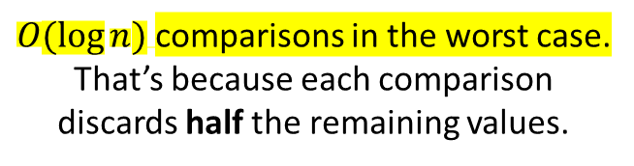
An ordered list implementation of a map.
Store the (key, value) pairs in an array or vector. Sorted by key.
[("Ed", "corn"), ("Kal", "corn"), ("Mei","fish")]
Since the keys are ordered in array/vector, we can search them efficiently using binary search.
In the worst case, how many comparisons does binary search on an array of n items?
$O(log⁡n)$comparisons in the worst case. That’s because each comparison discards half the remaining values.

Slide 12
Binary Search
0
?
n-1
What’s the index of the middle element?
Binary search finds the location of a target element x in a sorted array.

Slide 13


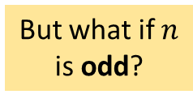
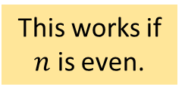
Binary Search
$$\frac{n}{2}$$
0
n-1
What’s the index of the middle element?
Binary search finds the location of a target element x in a sorted array.
half the length: $\frac{n}{2}$
n=6, middle = 3
0
1
2
3
4
5
This works if $n$ is even.
2
3
5
8
9
10
n=5, middle = 2.5
0
1
2
3
4
But what if $n$ is odd?
2
3
5
8
9

Slide 14
Binary Search
$$\frac{n}{2}$$
0
n-1
What’s the index of the middle element?
Binary search finds the location of a target element x in a sorted array.
half the length: $\frac{n}{2}$
n=6, middle = 3
0
1
2
3
4
5
This works if $n$ is even.
2
3
5
8
9
10
n=5, middle = 2.5 = 2
0
1
2
3
4
But what if $n$ is odd?
2
3
5
8
9
Truncate the .5

Slide 15

Binary Search
$$\frac{n}{2}$$
0
n-1
v
Binary search finds the location of a target element x in a sorted array.
$$\frac{n}{2}−1$$
After 1 comparison, we only need to search the left half or the right half of the array.
0
?

Slide 16

Binary Search
$$\frac{n}{2}$$
0
n-1
v
Binary search finds the location of a target element x in a sorted array.
$$\frac{n}{4}$$
$$\frac{n}{2}−1$$
After 1 comparison, we only need to search the left half or the right half of the array.
0

Slide 17
Binary Search
$$\frac{n}{2}$$
0
n-1
v
Binary search finds the location of a target element x in a sorted array.
$$\frac{n}{4}$$
$$\frac{n}{2}−1$$
After 1 comparison, we only need to search the left half or the right half of the array.
0
?
?
After 2 comparisons, we only need to search the left half or the right half of the previous array.

Slide 18


Binary Search
$$\frac{n}{2}$$
0
n-1
v
Binary search finds the location of a target element x in a sorted array.
$$\frac{n}{4}$$
$$\frac{n}{2}−1$$
After 1 comparison, we only need to search the left half or the right half of the array.
0
$$\frac{n}{4}+1$$
$$\frac{n}{2}−1$$
After 2 comparisons, we only need to search the left half or the right half of the previous array.

Slide 19
Binary Search
$$\frac{n}{2}$$
0
n-1
v
Binary search finds the location of a target element x in a sorted array.
$$\frac{n}{4}$$
$$\frac{n}{2}−1$$
After 1 comparison, we only need to search the left half or the right half of the array.
0
$$\frac{n}{4}+1$$
$$\frac{n}{2}−1$$
After 2 comparisons, we only need to search the left half or the right half of the previous array.
Each comparison cuts the array in half, and so soon all elements are gone.

Slide 20





Binary Search
How many comparisons does binary search do in the worst case, e.g. when the target element x is not in the array?
Binary search finds the location of a target element x in a sorted array.
The array initial has $n$ items.
A$fter 1 comparison it has\frac{1}{2}n=\frac{n}{2}$ items.
A$fter 2 comparisons it has\frac{1}{2}⋅\frac{n}{2}=\frac{n}{2^{2}}=\frac{n}{4}$ items.
A$fter 3 comparisons it has\frac{1}{2}⋅\frac{n}{2^{2}}=\frac{n}{2^{3}}=\frac{n}{8}$ items.
. . .
A$fter i comparisons it has\frac{1}{2}⋅\frac{n}{2^{i−1}}=\frac{n}{2^{i}}$ items.

Slide 21
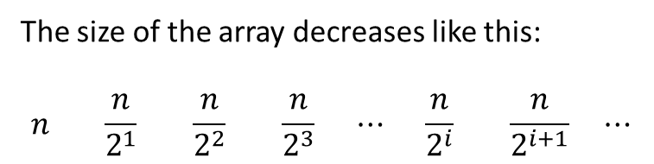
Binary Search
How many comparisons does binary search do in the worst case, e.g. when the target element x is not in the array?
Binary search finds the location of a target element x in a sorted array.
The size of the array decreases like this:
$$n \frac{n}{2^{1}} \frac{n}{2^{2}} \frac{n}{2^{3}} ⋯ \frac{n}{2^{i}} \frac{n}{2^{i+1}} ⋯$$

Slide 22
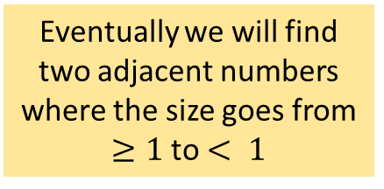
Binary Search
How many comparisons does binary search do in the worst case, e.g. when the target element x is not in the array?
Binary search finds the location of a target element x in a sorted array.
The size of the array decreases like this:
$$n \frac{n}{2^{1}} \frac{n}{2^{2}} \frac{n}{2^{3}} ⋯ \frac{n}{2^{i}} \frac{n}{2^{i+1}} ⋯$$
Eventually we will find two adjacent numbers where the size goes from $≥1$to $< 1$

Slide 23
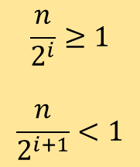
Binary Search
How many comparisons does binary search do in the worst case, e.g. when the target element x is not in the array?
Binary search finds the location of a target element x in a sorted array.
The size of the array decreases like this:
$$n \frac{n}{2^{1}} \frac{n}{2^{2}} \frac{n}{2^{3}} ⋯ \frac{n}{2^{i}} \frac{n}{2^{i+1}} ⋯$$
Eventually we will find two adjacent numbers where the size goes from $≥1$to $< 1$
$$\frac{n}{2^{i}}≥1$$
$$\frac{n}{2^{i+1}}<1$$

Slide 24


Binary Search
How many comparisons does binary search do in the worst case, e.g. when the target element x is not in the array?
Binary search finds the location of a target element x in a sorted array.
The size of the array decreases like this:
$$n \frac{n}{2^{1}} \frac{n}{2^{2}} \frac{n}{2^{3}} ⋯ \frac{n}{2^{i}} \frac{n}{2^{i+1}} ⋯$$
$$\frac{n}{2^{i}}≥1$$
$$\frac{n}{2^{i+1}}<1$$
rearrange
$$\frac{n}{2^{i+1}}<1≤\frac{n}{2^{i}}$$

Slide 25
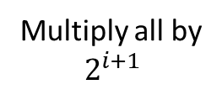

Binary Search
How many comparisons does binary search do in the worst case, e.g. when the target element x is not in the array?
Binary search finds the location of a target element x in a sorted array.
The size of the array decreases like this:
$$n \frac{n}{2^{1}} \frac{n}{2^{2}} \frac{n}{2^{3}} ⋯ \frac{n}{2^{i}} \frac{n}{2^{i+1}} ⋯$$
$$\frac{n}{2^{i}}≥1$$
$$\frac{n}{2^{i+1}}<1$$
rearrange
$$\frac{n}{2^{i+1}}<1≤\frac{n}{2^{i}}$$
Multiply all by $$2^{i+1}$$
$$n<2^{i+1}≤2n$$

Slide 26

Binary Search
How many comparisons does binary search do in the worst case, e.g. when the target element x is not in the array?
Binary search finds the location of a target element x in a sorted array.
The size of the array decreases like this:
$$n \frac{n}{2^{1}} \frac{n}{2^{2}} \frac{n}{2^{3}} ⋯ \frac{n}{2^{i}} \frac{n}{2^{i+1}} ⋯$$
$$\frac{n}{2^{i}}≥1$$
$$\frac{n}{2^{i+1}}<1$$
rearrange
$$\frac{n}{2^{i+1}}<1≤\frac{n}{2^{i}}$$
Multiply all by $$2^{i+1}$$
$$n<2^{i+1}≤2n$$
Take base 2 logs of all
$$\log_{2}{n}<\log_{2}{2^{i+1}}≤\log_{2}{2n}$$

Slide 27


Binary Search
How many comparisons does binary search do in the worst case, e.g. when the target element x is not in the array?
Binary search finds the location of a target element x in a sorted array.
The size of the array decreases like this:
$$n \frac{n}{2^{1}} \frac{n}{2^{2}} \frac{n}{2^{3}} ⋯ \frac{n}{2^{i}} \frac{n}{2^{i+1}} ⋯$$
$$\frac{n}{2^{i}}≥1$$
$$\frac{n}{2^{i+1}}<1$$
rearrange
$$\frac{n}{2^{i+1}}<1≤\frac{n}{2^{i}}$$
$$\log_{2}{n}<i+1≤{1+log}_{2}{n}$$
Multiply all by $$2^{i+1}$$
Simplify
$$n<2^{i+1}≤2n$$
$$(\log_{2}{n)}−1<i≤\log_{2}{n}$$
Take base 2 logs of all
$$\log_{2}{n}<\log_{2}{2^{i+1}}≤\log_{2}{2n}$$

Slide 28
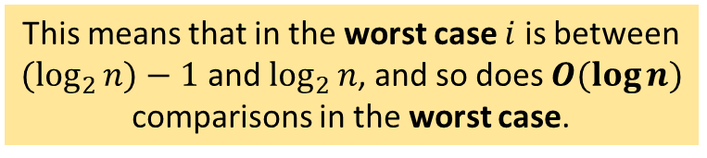

Binary Search
How many comparisons does binary search do in the worst case, e.g. when the target element x is not in the array?
Binary search finds the location of a target element x in a sorted array.
The size of the array decreases like this:
$$n \frac{n}{2^{1}} \frac{n}{2^{2}} \frac{n}{2^{3}} ⋯ \frac{n}{2^{i}} \frac{n}{2^{i+1}} ⋯$$
$$\frac{n}{2^{i}}≥1$$
$$\frac{n}{2^{i+1}}<1$$
implies
$$(\log_{2}{n)}−1<i≤\log_{2}{n}$$
This means that in the worst case $i$ is between $(\log_{2}{n)}−1$ and $\log_{2}{n}$, and so does $O(\log{n)}$ comparisons in the worst case.

Slide 29
Map ADT: Ordered List Implementation
Performance:
O(1)
size() returns # of entries in the table
put(k, v) If no entry with k is in the table, (k, v) is added. If an entry has k, then it’s value is over-written to v.
contains(key) Returns true if key is in the table, false if it’s not
get(key) Returns the value associated with key. Error if key is not in the table.
remove(key) If (key, some_value) is in the table, the entry is removed. If no entry with key, then does nothing
Performance:
O(n)
Performance:
O(log n)
Performance:
O(log n)
Performance:
O(n)

Slide 30
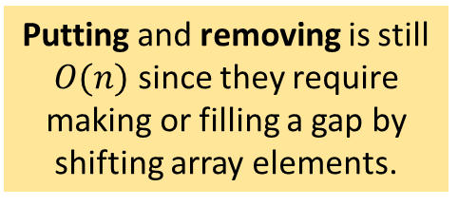
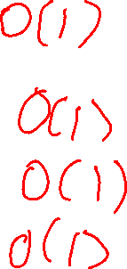
Map ADT: Ordered List Implementation
Performance:
O(1)
size() returns # of entries in the table
put(k, v) If no entry with k is in the table, (k, v) is added. If an entry has k, then it’s value is over-written to v.
contains(key) Returns true if key is in the table, false if it’s not
get(key) Returns the value associated with key. Error if key is not in the table.
remove(key) If (key, some_value) is in the table, the entry is removed. If no entry with key, then does nothing
Performance:
O(n)
Performance:
O(log n)
Performance:
O(log n)
Performance:
O(n)
Putting and removing is still $O(n)$ since they require making or filling a gap by shifting array elements.

Slide 31
Hash Tables
Hash tables are a popular data structure for implementing maps
E.g. languages such as JavaScript and Go have hash tables built-in
A well-designed hash table can give you O(1) average-case performance for key-based map operations
The basic idea is simple: use a hash function that converts a key to an index of where to store it in an array
hash(key) = hash value for key
(key, value) is stored at index location hash(key)

Slide 32
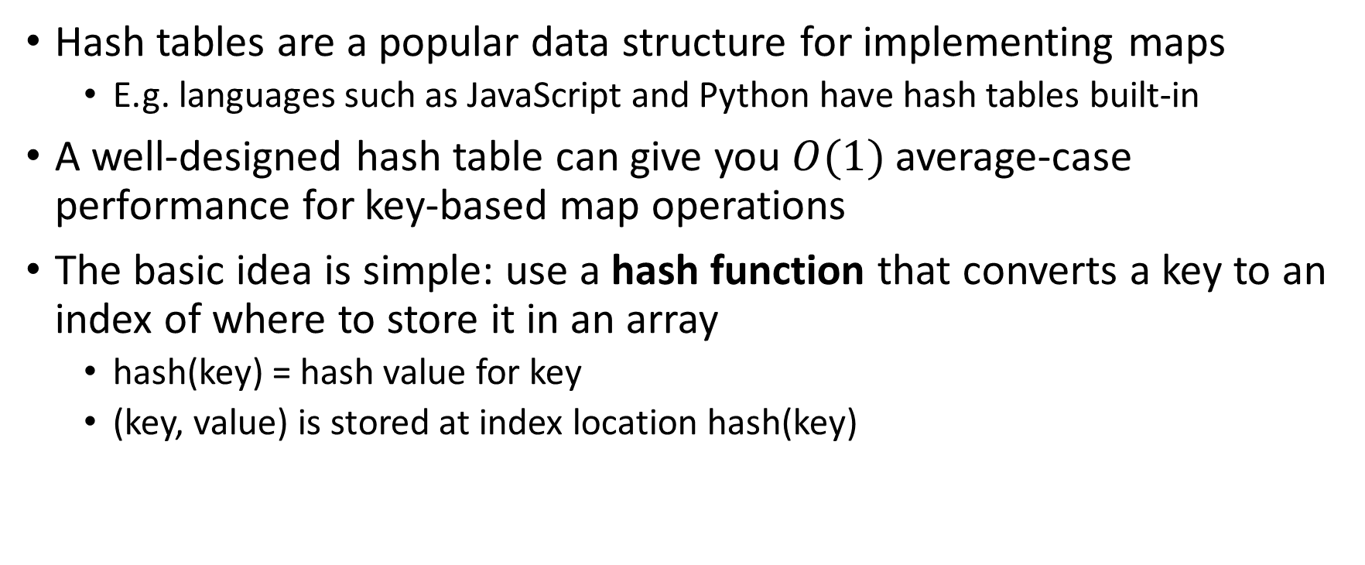
Hash Tables
Hash tables are a popular data structure for implementing maps
E.g. languages such as JavaScript and Python have hash tables built-in
A well-designed hash table can give you $O(1)$average-case performance for key-based map operations
The basic idea is simple: use a hash function that converts a key to an index of where to store it in an array
hash(key) = hash value for key
(key, value) is stored at index location hash(key)
Calculating hashes should be fast, and they should be spread out unpredictably over the array.

Slide 33
Hash Tables
Hash tables are a popular data structure for implementing maps
E.g. languages such as JavaScript and Python have hash tables built-in
A well-designed hash table can give you $O(1)$ average-case performance for key-based map operations
The basic idea is simple: use a hash function that converts a key to an index of where to store it in an array
hash(key) = hash value for key
(key, value) is stored at index location hash(key)
Problem! When two or entries are hashed to the same location, we say a collision occurs.

Slide 34
Hash Tables
Hash tables are a popular data structure for implementing maps
E.g. languages such as JavaScript and Python have hash tables built-in
A well-designed hash table can give you $O(1)$ average-case performance for key-based map operations
The basic idea is simple: use a hash function that converts a key to an index of where to store it in an array
hash(key) = hash value for key
(key, value) is stored at index location hash(key)
There are a variety of strategies for dealing with collisions.

Slide 35
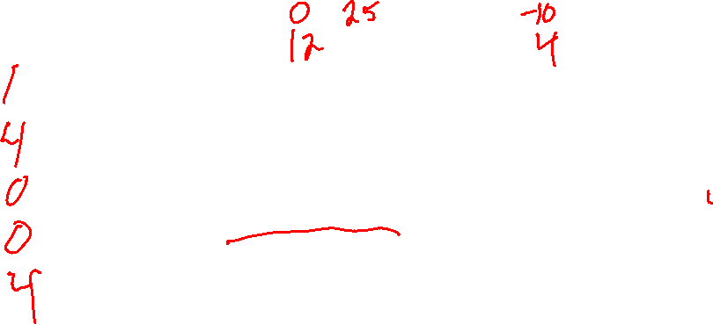
Hash Tables: Buckets
If two or more keys hash to the same location, store them in a “bucket” at that location.
Add these keys (ignore values) 25
-10 0 12
4
0
1
2
3
4
5
empty
empty
empty
empty
empty
empty
Not a great hash function, e.g. multiples of 6 all hash to 0. We use it for this example because it’s easy to calculate by hand.
hash(25) =
hash(-10) = hash(0) = hash(12) =
hash(4) =
hash(key) = abs(key) % 6
6 because that’s the size of the array
Returns an int in the range [0, 5]

Slide 36
Hash Tables: Buckets
If two or more keys hash to the same location, store them in a “bucket” at that location.
Add these keys (ignore values) 25
-10 0 12
4
0
1
2
3
4
5
empty
empty
empty
empty
empty
empty
hash(25) = 1
hash(-10) = 4 hash(0) = 0 hash(12) = 0
hash(4) = 4
hash(key) = abs(key) % 6
6 because that’s the size of the array.
Returns an int in the range [0, 5]

Slide 37
Hash Tables: Buckets
If two or more keys hash to the same location, store them in a “bucket” at that location.
Add these keys (ignore values) 25
-10 0 12
4
0
1
2
3
4
5
empty
empty
empty
0
25
-10
12
4
hash(25) = 1
hash(-10) = 4 hash(0) = 0 hash(12) = 0
hash(4) = 4
hash(key) = abs(key) % 6
6 because that’s the size of the array.
Returns an int in the range [0, 5]

Slide 38
Hash Tables: Buckets
If two or more keys hash to the same location, store them in a “bucket” at that location.
Add these keys (ignore values) 25
-10 0 12
4
0
1
2
3
4
5
You could implement the buckets as linked lists, vectors, stacks, queues, etc. Sometimes called separate chaining.
empty
empty
empty
0
25
-10
12
4
hash(25) = 1
hash(-10) = 4 hash(0) = 0 hash(12) = 0
hash(4) = 4
hash(key) = abs(key) % 6
6 because that’s the size of the array.
Returns an int in the range [0, 5]

Slide 39
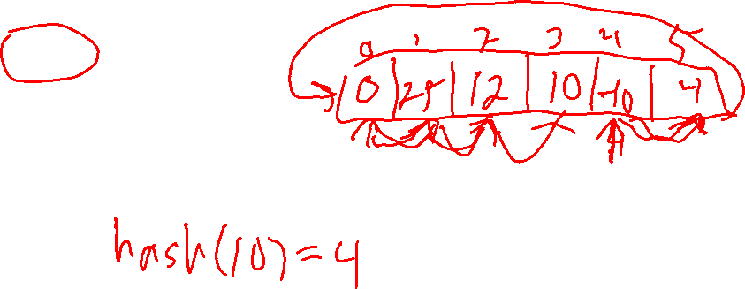
Hash Tables: Buckets
If two or more keys hash to the same location, store them in a “bucket” at that location.
Add these keys (ignore values) 25
-10 0 12
4
0
1
2
3
4
5
As long as the buckets don’t have too many items, this can be very efficient.
empty
empty
empty
0
25
-10
12
4
hash(25) = 1
hash(-10) = 4 hash(0) = 0 hash(12) = 0
hash(4) = 4
hash(key) = abs(key) % 6
6 because that’s the size of the array.
Returns an int in the range [0, 5]

Slide 40
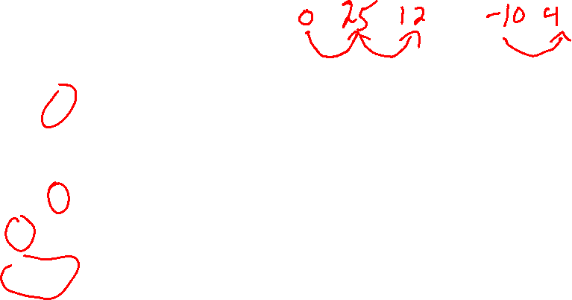
Hash Tables: Linear Probing
If two or more keys hash to the same location, then do a linear search to find the next empty location and insert it there. Wrap-around if you hit the end of the array.
Add these keys (ignore values) 25
-10 0 12
4
0
1
2
3
4
5
No extra data structure needed: all entries stored directly in the array. This kind of hash table is said to use open addressing.
hash(25) = 1
hash(-10) = 4 hash(0) = 0 hash(12) = 0
hash(4) = 4
hash(key) = abs(key) % 6

Slide 41
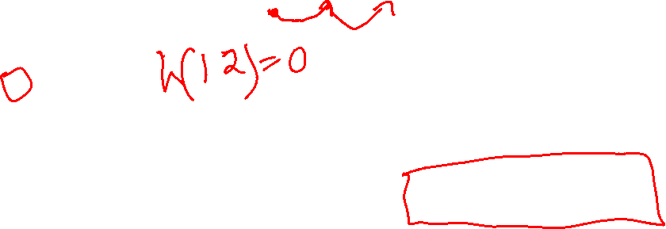
Hash Tables: Linear Probing
If two or more keys hash to the same location, then do a linear search to find the next empty location and insert it there. Wrap-around if you hit the end of the array.
Add these keys (ignore values) 25
-10 0 12
4
0
1
2
3
4
5
0
25
12
-10
4
Problem: With linear probing keys start to cluster together in long sequences, slowing down the operations.
hash(25) = 1
hash(-10) = 4 hash(0) = 0 hash(12) = 0
hash(4) = 4
hash(key) = abs(key) % 6

Slide 42
Hash Tables: Linear Probing
If two or more keys hash to the same location, then do a linear search to find the next empty location and insert it there. Wrap-around if you hit the end of the array.
Add these keys (ignore values) 25
-10 0 12
4
0
1
2
3
4
5
0
25
12
-10
4
Another problem: Removing an item is tricky. We will mark removed locations with a special “deleted” value different from empty.
hash(25) = 1
hash(-10) = 4 hash(0) = 0 hash(12) = 0
hash(4) = 4
hash(key) = abs(key) % 6

Slide 43
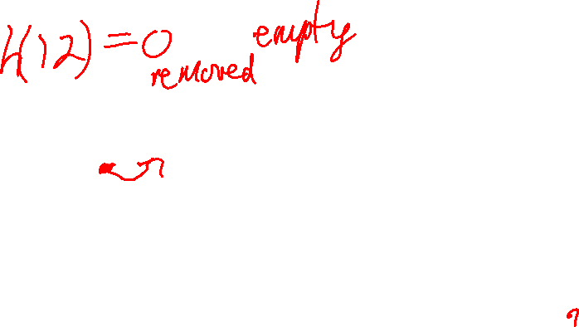
Hash Tables: Linear Probing
If two or more keys hash to the same location, then do a linear search to find the next empty location and insert it there. Wrap-around if you hit the end of the array.
Add these keys (ignore values) 25
-10 0 12
4
0
1
2
3
4
5
0
25
12
-10
4
Removal problem: Suppose we delete 25. Then how is 12 found? If we mark location 1 as “empty”, that ruins the linear probing.
hash(25) = 1
hash(-10) = 4 hash(0) = 0 hash(12) = 0
hash(4) = 4
hash(key) = abs(key) % 6

Slide 44
Hash Tables: Linear Probing
If two or more keys hash to the same location, then do a linear search to find the next empty location and insert it there. Wrap-around if you hit the end of the array.
Add these keys (ignore values) 25
-10 0 12
4
0
1
2
3
4
5
0
25
12
-10
4
Removal problem: So instead of marking it “empty”, we mark it as “deleted”. Then linear probing can work, although the code is a little more complex because now there are two non-filled cases.
hash(25) = 1
hash(-10) = 4 hash(0) = 0 hash(12) = 0
hash(4) = 4
hash(key) = abs(key) % 6

Slide 45
Hash Tables: Linear Probing
If two or more keys hash to the same location, then do a linear search to find the next empty location and insert it there. Wrap-around if you hit the end of the array.
Add these keys (ignore values) 25
-10 0 12
4
0
1
2
3
4
5
0
25
12
-10
4
Removal problem: So instead of marking it “empty”, we mark it as “deleted”. Then linear probing can work, although the code is a little more complex because now there are two non-filled cases.
hash(25) = 1
hash(-10) = 4 hash(0) = 0 hash(12) = 0
hash(4) = 4
See the sample linear probing code in hashing.cpp
hash(key) = abs(key) % 6

Slide 46
Open Addressing: Linear Probing
% N makes the sequence wrap-around when it hits the end of the array
N is the capacity of the array
Linear Probing (hash(key) + 0) % N (hash(key) + 1) % N (hash(key) + 2) % N (hash(key) + 3) % N (hash(key) + 4) % N … (hash(key) + i) % N …
Keys start to cluster, slowing it down
Removal is tricky
index positions to check on a collision

Slide 47
Open Addressing: Quadratic Hashing
Quadratic Hashing (hash(key) + 0*0) % N (hash(key) + 1*1) % N (hash(key) + 2*2) % N (hash(key) + 3*3) % N (hash(key) + 4*4) % N … (hash(key) + i*i) % N …
Avoids cluster sequences seen in linear probing
Suffers from secondary cluster patterns
Removal is tricky
Table capacity must be prime, otherwise might not find an empty location (!)
Might loop forever if the table is half or more full (need to extend table size and re-hash entries)
index positions to check on a collision

Slide 48
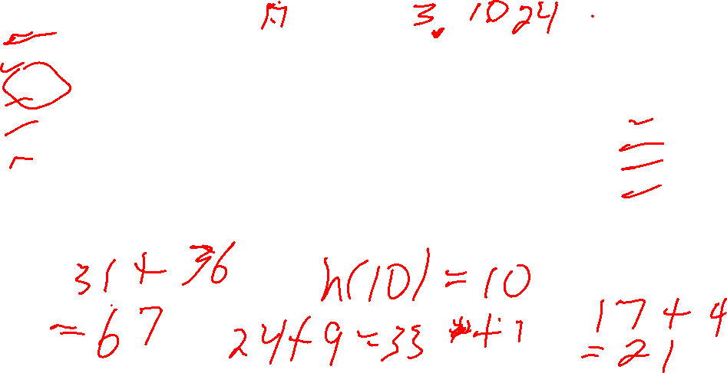
Open Addressing: Quadratic Hashing
Quadratic Hashing (hash(key) + 0*0) % N (hash(key) + 1*1) % N (hash(key) + 2*2) % N (hash(key) + 3*3) % N (hash(key) + 4*4) % N … (hash(key) + i*i) % N …
0
1
2
3
4
5
6
Add these keys:
3
10
17
24
31
Use hash(key) = key
index positions to check on a collision

Slide 49
Open Addressing: Quadratic Hashing
Quadratic Hashing (hash(key) + 0*0) % N (hash(key) + 1*1) % N (hash(key) + 2*2) % N (hash(key) + 3*3) % N (hash(key) + 4*4) % N … (hash(key) + i*i) % N …
0
1
2
3
4
5
6
17
3
10
24
31 ?
Add these keys:
3
10
17
24
31
Use hash(key) = key
index positions to check on a collision

Slide 50
Open Addressing: Double Hashing
hash'(key) = p – (key % p) is a common choice, for some prime number p < N
hash(key) is the usual hash function
Double Hashing (hash(key) + 0*hash'(key)) % N (hash(key) + 1*hash'(key)) % N (hash(key) + 2*hash'(key)) % N (hash(key) + 3*hash'(key)) % N (hash(key) + 4*hash'(key)) % N … (hash(key) + i*hash'(key)) % N …
hash'(key) is a secondary hash function
hash'(key) should never evaluate to 0
Avoids clustering seen in linear probing and quadratic hashing
Table capacity N should be prime
Removal is tricky
index positions to check on a collision

Slide 51
Buckets vs Open Addressing
Buckets can be as efficient as open addressing
However, the details matter!
The exact implementation details of the hash table, and the kind of data you give it, can make a big difference.
Hash tables are common in practice, with many variations and optimizations for special cases
See the hash table implementation of Python’s dictionaries https://github.com/python/cpython/blob/main/Objects/dictobject.c
Closed hashing, ordered keys, compact memory usage, …

Slide 52

Hash Functions
A good hash function is essential for an efficient hash table
hash: keys -> [0..n-1]
Properties of a good hash function
Deterministic, i.e. hash(key) must always return the same value
Uses all the bits of the key
If some bits in the key are ignored, then keys that differ only in the ignored bits will have the same hash value
More keys with the same hash value means collisions are more likely!
Gives a large range of unpredictable values
Narrow range could cause collisions
Patterns could cause collisions
Fast to calculate

Slide 53
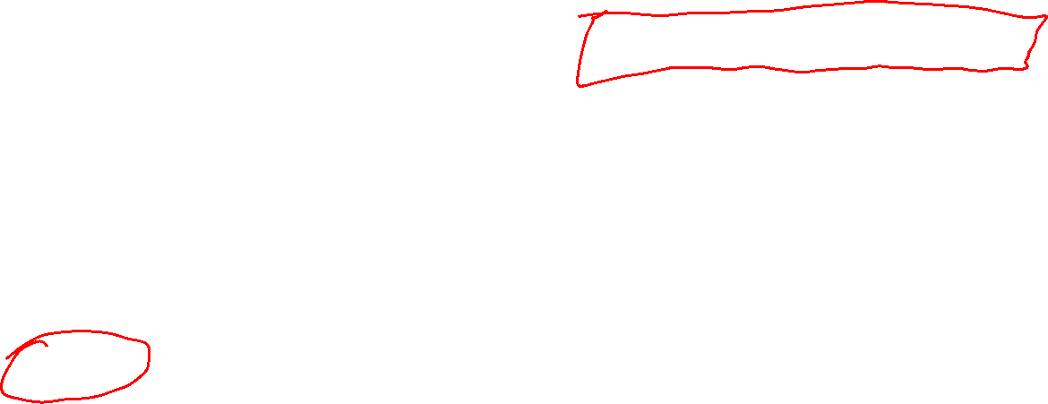
Hash Functions: Determinism
Bad hash function!
hash(key) must always return the same value when you give it the same key
Can’t depend on random numbers, time, files, network, etc.
It can only depend upon the bits in the key
hash(x) = 2*x + current_millis()
Returns a different value every time it’s called.
In programming language terminology, this says that the hash function must be a pure function.

Slide 54
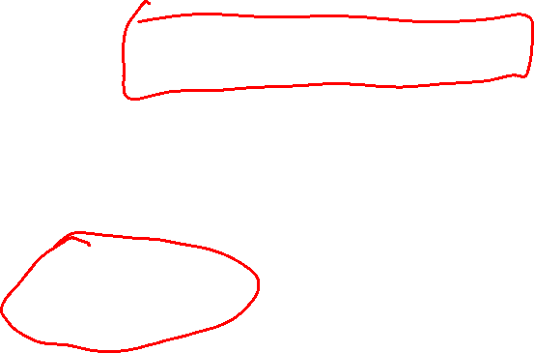
Hash Functions: Use All the Bits
Bad hash function!
hash(key) should return a value that depends on all the bits in the key
Changing any 1 bit in the key should result in a different hash value
hash(x) = x % 10
Its value depends only on the last digit of x. Only 10 hash values are possible, so lots of collisions!
Bad hash function!
hash(x) = abs(x) + 5
Assume x is an int
Ignores the sign bit: hash(a) = hash(-a)

Slide 55

Hash Functions: Wide Range of Values
Bad hash function!
hash(key) should return a wide range of values
The actual hash table could be very large
You can “compress” the values using hash(key) % N
hash(x) = x % 1000
If the hash table capacity is over 1000, this will have more collisions.
N is the capacity of the hash table
Usually designed to return non-negative values.

Slide 56

Hash Functions: Fast to Calculate
Bad hash function!
hash(key) should be fast to calculate
We want hash table operations to be as fast as possible
Determining the best balance between speed of calculation and quality of output is non-trivial!
Check out MurmurHash, a popular high-quality and efficient hash function
hash(x) = x*x + x*x*x
3 multiplications 1 addition
hash(x) = x*(x + x*x)
2 multiplications 1 addition
Better!

Slide 57
Hashing Strings Summing Characters
In C++, characters are represented as their ASCII values, so you can add them like integers.
hash("cat") = 'c' + 'a' + 't'
= 99 + 97 + 116
= 312
int hash(const string &s)
{
int result = 0;
for (int i = 0; i < s.size(); i++)
{
result += s[i];
}
return result;
}
This is an adequate, but not great, hash functions for strings.

Slide 58



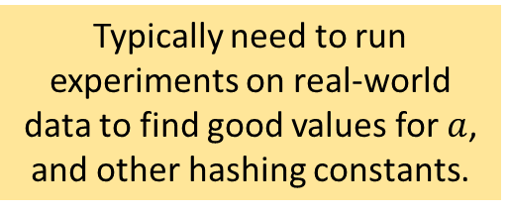
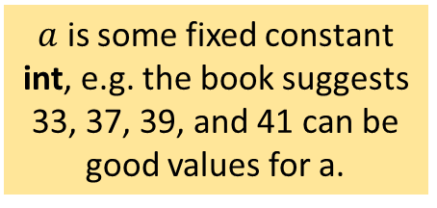

Hashing Strings Polynomial Hashing
$$x = (x_{0}, x_{1}, x_{2}, …, x_{k−1})$$
Hash functions in the form of a polynomial can be evaluated quickly using a neat trick …
$O(k^{2})$ multiplications
Polynomial’s can be more efficiently evaluated using Horner’s Rule.
$O(k)$ multiplications
$a$ is some fixed constant int, e.g. the book suggests 33, 37, 39, and 41 can be good values for a.
Typically need to run experiments on real-world data to find good values for $a$, and other hashing constants.

Slide 59

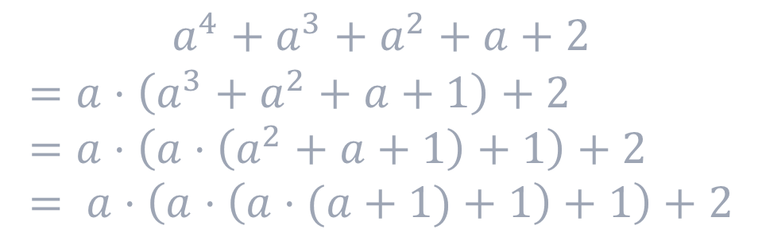

Hashing Strings Polynomial Hashing
$$x = (x_{0}, x_{1}, x_{2}, …, x_{k−1})$$
$O(k^{2})$ multiplications
Polynomial’s can be more efficiently evaluated using Horner’s Rule.
$O(k)$ multiplications
$3+2+1=6$ multiplications
$$a^{4}+a^{3}+a^{2}+a+2$$
$$=a⋅\left(a^{3}+a^{2}+a+1\right)+2 \\ =a⋅\left(a⋅\left(a^{2}+a+1\right)+1\right)+2 \\ = a⋅\left(a⋅\left(a⋅(a+1)+1\right)+1\right)+2$$
3 multiplications

Slide 60
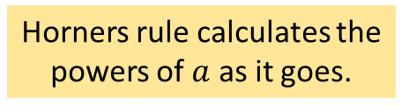
Hashing Strings Polynomial Hashing
$$x = (x_{0}, x_{1}, x_{2}, …, x_{k−1})$$
$O(k^{2})$ multiplications
Polynomial’s can be more efficiently evaluated using Horner’s Rule.
$O(k)$ multiplications
This code assumes that the zero-power term is at poly[0].
int horner(int poly[], int n, int a)
{
int result = poly[0];
for (int i = 1; i < n; i++)
result = result * a + poly[i];
return result;
}
Horners rule calculates the powers of $a$ as it goes.

Slide 61

Hashing Strings
Creating a good hash function for strings takes some work. Here is a visualization tool that can help:
https://samwho.dev/hashing-playground/

Slide 62
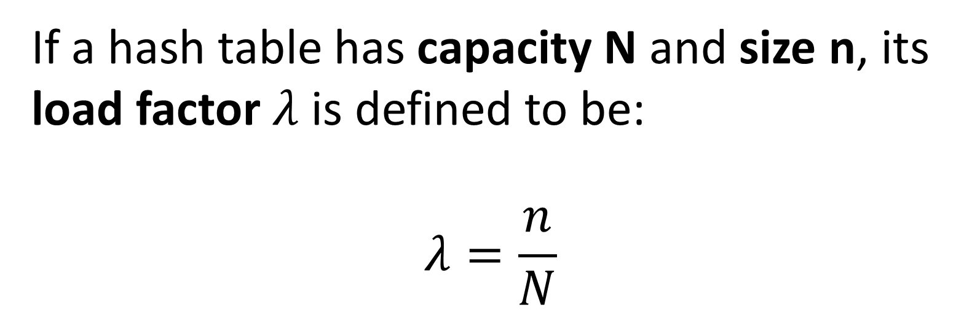
Load Factors and Re-hashing
N is underlying array size n is the number of entries in the table
If a hash table has capacity N and size n, its load factor $λ$is defined to be: $$λ=\frac{n}{N}$$
0
1
2
3
4
5
empty
empty
empty
0
25
-10
12
25
4
4
Question: Can the load factor be bigger than 1?

Slide 63
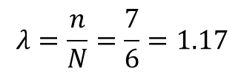
Load Factors and Re-hashing
N is underlying array size n is the number of entries in the table
If a hash table has capacity N and size n, its load factor $λ$is defined to be: $$λ=\frac{n}{N}$$
0
1
2
3
4
5
empty
empty
empty
0
25
-10
12
25
4
4
Question: Can the load factor be bigger than 1?
$$λ=\frac{n}{N}=\frac{7}{6}=1.17$$
Answer: Yes! In a hash table with buckets it can be arbitrarily large.

Slide 64
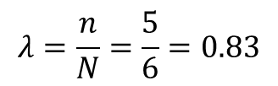
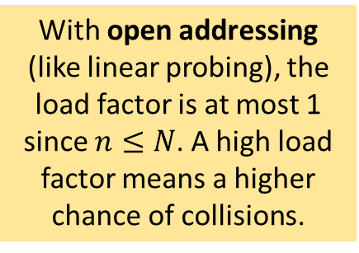
Load Factors and Re-hashing
N is underlying array size n is the number of entries in the table
If a hash table has capacity N and size n, its load factor $λ$is defined to be: $$λ=\frac{n}{N}$$
0
1
2
3
4
5
0
25
12
-10
4
$$λ=\frac{n}{N}=\frac{5}{6}=0.83$$
With open addressing (like linear probing), the load factor is at most 1 since $n≤N$. A high load factor means a higher chance of collisions.

Slide 65
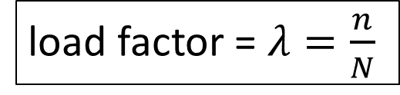
Load Factors and Re-hashing
load factor = $λ=\frac{n}{N}$
0
1
2
3
4
5
0
25
12
-10
4
Rule of Thumb: When the load factor is 0.5 or higher, extend the capacity of the hash table by making a bigger table and re-hashing all the values.
Re-hash!
0
1
2
3
4
5
6
7
8
9
10
11
Re-hashing is expensive, but hopefully it saves time overall by decreasing the number of collisions in the future.
hash(key) = abs(key) % 12

Slide 66
Load Factors and Re-hashing
load factor = $λ=\frac{n}{N}$
0
1
2
3
4
5
0
25
12
-10
4
Rule of Thumb: When the load factor is 0.5 or higher, extend the capacity of the hash table by making a bigger table and re-hashing all the values.
Re-hash!
0
1
2
3
4
5
6
7
8
9
10
11
0
25
12
4
-10
Re-hashing is expensive, but hopefully it saves time overall by decreasing the number of collisions in the future.
hash(key) = abs(key) % 12

Slide 67
Cryptographic Hash Functions
Cryptographic hash functions have properties useful in cryptography
The chance of two different keys hashing to the same value is extremely low
So practically speaking, keys with different hash values are almost certainly different
Given a particular hash value, finding a key that hashes to it is infeasible
Cryptographic hash functions are can be used for digital signatures, e.g. they can provide strong evidence that a message is from a particular sender
The Git version control system use a cryptographic hash function to name content
In Git, files and folders are associate with their hash
By using a cryptographic hash function, there is practically no concern about two different files hashing to the same value
Cryptographic hash functions are usually too slow to be used in hash tables

