Slide 1
Sorting
Chapter Sections 11.1, 11.2, 11.3

Slide 2
An n-element array/vector arr is in sorted order if it is empty, or if: arr[0] <= arr[1] <= … <= arr[n-1]
{ }
{ -5.8}
{0, 3, 7, 99, 99, 100, 200}
{"add", "bat", "bat", "batman", "cat", "cats"}

Slide 3
This function tests if arr is in sorted order.
template <typename T> bool is_sorted(const vector<T> &arr)
{
for (int i = 1; i < arr.size(); i++)
{
if (arr[i - 1] > arr[i]) return false;
}
return true;
}
Worst-case performance: ??

Slide 4
This function tests if arr is in sorted order.
template <typename T> bool is_sorted(const vector<T> &arr)
{
for (int i = 1; i < arr.size(); i++)
{
if (arr[i - 1] > arr[i]) return false;
}
return true;
}
Worst-case performance: O(n)

Slide 5
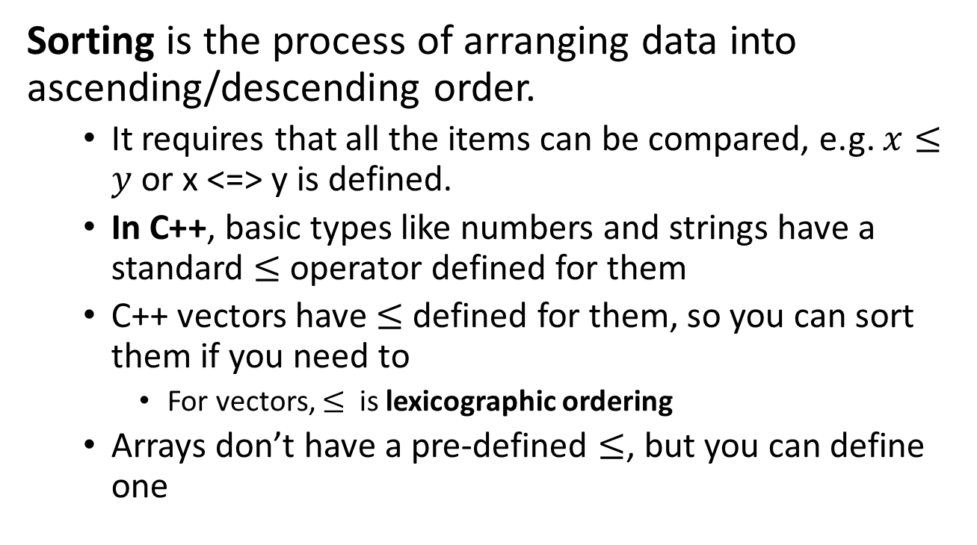
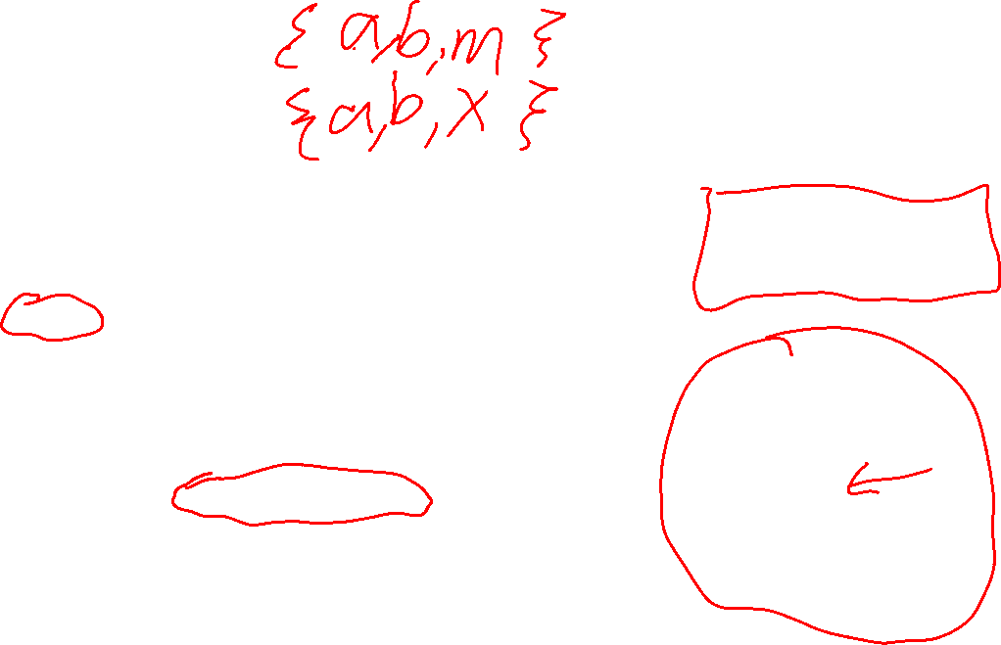
Sorting
In C++ you can overload operator<=, or some functions also let you use a comparison function defined like this: bool cmp(T x, T y) { // … }
Sorting is the process of arranging data into ascending/descending order.
It requires that all the items can be compared, e.g. $x≤y$ or x <=> y is defined.
In C++, basic types like numbers and strings have a standard $≤$ operator defined for them
C++ vectors have $≤$ defined for them, so you can sort them if you need to
For vectors, $≤$ is lexicographic ordering
Arrays don’t have a pre-defined $≤$, but you can define one
C++20 also lets you write a three-way comparison operator, i.e. the spaceship operator: x <=> y
From this one operator all the other comparisons can be defined, e.g. <, <=, >, >=, ==, !=

Slide 6
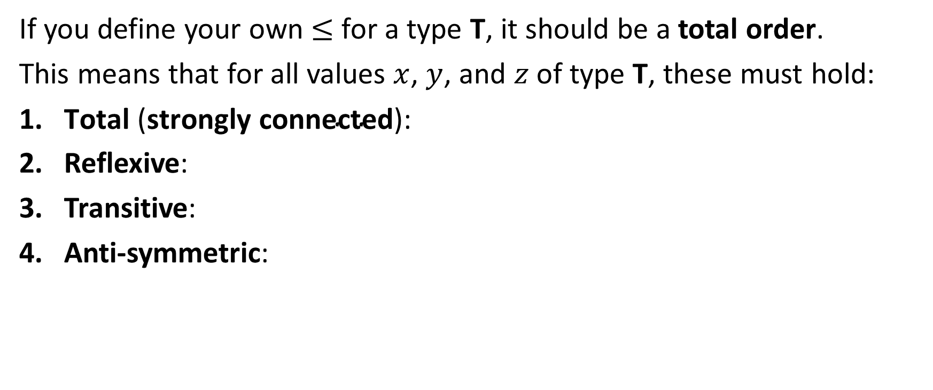
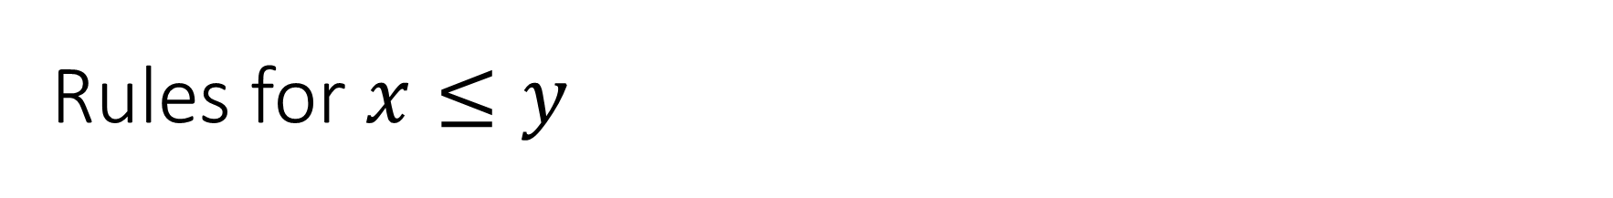
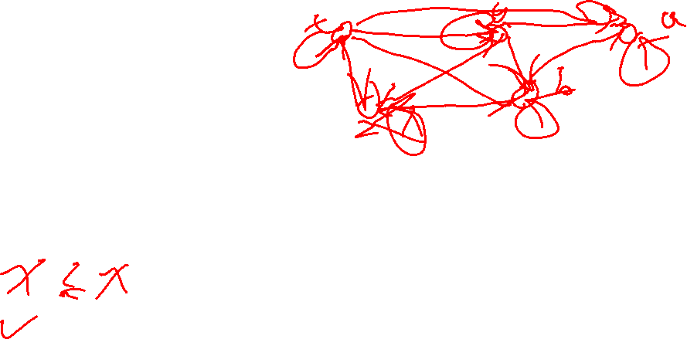
Rules for $x≤y$
If you define your own $≤$ for a type T, it should be a total order.
This means that for all values $x$, $y$, and $z$ of type T, these must hold:
$\text{T}\text{otal} \text{(}\text{strongly} \text{connected}\text{)}\text{:}$
Reflexive:
Transitive:
Anti-symmetric:

Slide 7
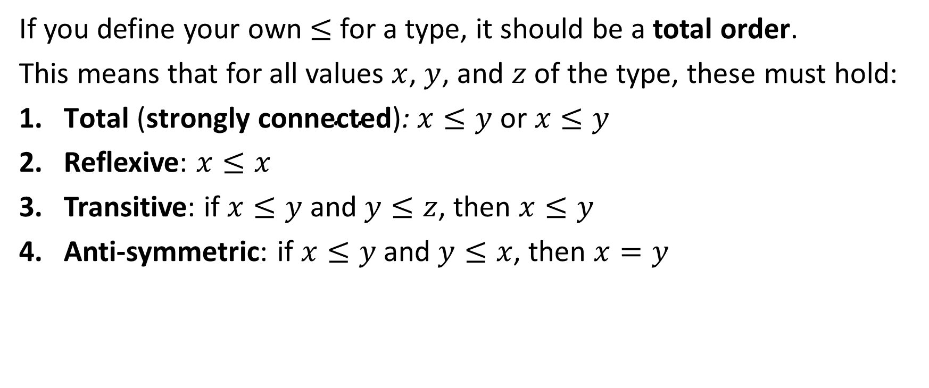
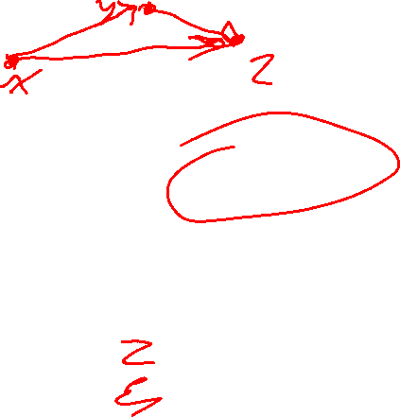
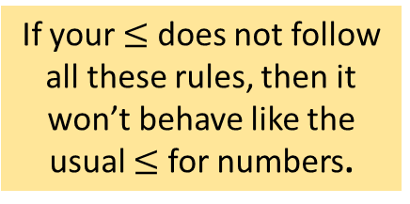
Rules for $x≤y$
If you define your own $≤$ for a type, it should be a total order.
This means that for all values $x$, $y$, and $z$ of the type, these must hold:
$\text{T}\text{otal} \text{(}\text{strongly} \text{connected}\text{)}\text{: }x≤y$ or $x≤y$
Reflexive: $x≤x$
Transitive: if $x≤y$ and $y≤z$, then $x≤y$
Anti-symmetric: if $x≤y$ and $y≤x$, then $x=y$
If your $≤$ does not follow all these rules, then it won’t behave like the usual $≤$ for numbers.

Slide 8
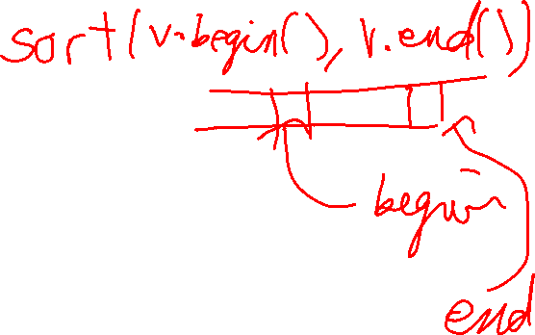
The general interface we will use for sorting functions.
// // Pre-condition: // none // Post-condition:
// ???
// template <typename T> void sort(vector<T>& arr)
T is the type of the data being sorted. We will usually take it to be int or string, but T can be any data type that can be compared with operator<= .
For convenience we will sort vector<T> objects. But you can just as easily sort regular arrays of type T[].

Slide 9
The general interface we will use for sorting functions.
// // Pre-condition: // none // Post-condition:
// ???
// template <typename T> void sort(vector<T>& arr)
What is the post-condition for the general sorting function, i.e. what is guarantee to be true after sort(arr) is called?

Slide 10
The general interface we will use for sorting functions.
// // Pre-condition: // none // Post-condition:
// arr[0] <= arr[1] <= … <= arr[n-1]
// template <typename T> void sort(vector<T>& arr)
This post-condition is wrong!
What’s the problem?
WRONG!

Slide 11
The general interface we will use for sorting functions.
// // Pre-condition: // none // Post-condition:
// arr[0] <= arr[1] <= … <= arr[n-1]
// void sort(vector<int>& arr) { v.clear(); // removes all elements }
This post-condition is wrong!
What’s the problem?
WRONG!
The post-condition allows values to be added/removed/changed.
This is not what we mean by sorting!

Slide 12
The general interface we will use for sorting functions.
// // Pre-condition: // none // Post-condition:
// ???
// template <typename T> void sort(vector<T>& arr)
What is the post-condition for the general sorting function, i.e. what is guarantee to be true after sort(arr) is called?
The same elements in arr before sort(arr) is called must be the same elements in arr after sort(arr) is called, just in a different order.
How do we guarantee this?

Slide 13
The general interface we will use for sorting functions.
The key idea is that sort permutes (re-arranges) the elements of arr into a particular ordering. No elements are removed/added/changed.
// // Pre-condition: // none // Post-condition:
// elements of arr are permuted so that // arr[0] <= arr[1] <= … <= arr[n-1]
// template <typename T> void sort(vector<T>& arr)
Correct post-condition!

Slide 14
Sometimes it will be convenient to use this more general interface.
begin
end-1
end
// // Pre-condition: // none // Post-condition:
// elements of arr are permuted so that // arr[begin] <= arr[begin+1] <= … <= arr[end-1]
// template <typename T> void sort(vector<T>& arr, int begin, int end)
arr
sort(arr, begin, end) sorts this part of the vector
arr[begin] is included
arr[end] is not included
This range is asymmetric: [begin, end)

Slide 15
Sometimes it will be convenient to use this more general interface.
begin
end-1
end
// // Pre-condition: // none // Post-condition:
// elements of arr are permuted so that // arr[0] <= arr[1] <= … <= arr[n-1]
// template <typename T> void sort(vector<T>& arr)
arr
sort(arr, begin, end) sorts this part of the vector
How can you write sort(v) using sort(b, begin, end)?

Slide 16
Sometimes it will be convenient to use this more general interface.
begin
end-1
end
// // Pre-condition: // none // Post-condition:
// elements of arr are permuted so that // arr[0] <= arr[1] <= … <= arr[n-1]
// template <typename T> void sort(vector<T>& arr) { sort(arr, 0, arr.size()); }
arr
sort(arr, begin, end) sorts this part of the vector
How can you write sort(v) using sort(b, begin, end)?

Slide 17

How many different permutations are there of an n-element vector?
For simplicity, we will assume no duplicates unless we explicitly say so.
n=6
0
1
2
3
4
5
5
2
1
4
9
3

Slide 18
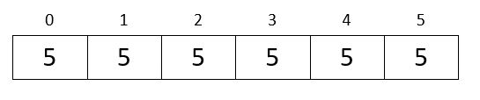


How many different permutations are there of an n-element vector?
n! is a worst-case number of permutations.
If there are duplicate values, then the number of different permutations could be as small as 1, e.g. when the values are all the same.
n=6
0
1
2
3
4
5
5
2
1
4
9
3
$$6!=1⋅2⋅3⋅4⋅5⋅6=720$$
n different items can be permuted in n factorial ways
0 factorial is defined to be 1, i.e. 0! = 1
n factorial $=n!=1⋅2⋅3⋅…⋅\left(n−1\right)⋅n$

Slide 19
0! = 1
1! = 1
2! = 2
3! = 6
4! = 24
5! = 120
6! = 720
7! = 5040
8! = 40320
9! = 362880
10! = 3628800
11! = 39916800
12! = 479001600
13! = 6227020800
14! = 87178291200
15! = 1307674368000
16! = 20922789888000
17! = 355687428096000
18! = 6402373705728000
19! = 121645100408832000
20! = 2432902008176640000
21! = 51090942171709440000
22! = 1124000727777607680000
23! = 25852016738884976640000
24! = 620448401733239439360000
25! = 15511210043330985984000000
Factorials get big fast!
Over 15 sextillion!

Slide 20
How can we sort arr by searching permutations?

Slide 21
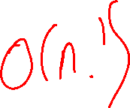
How can we sort arr by searching permutations?
template <typename T>
void permutation_sort(vector<T> &v)
{
while (!is_sorted(v))
{
next_permutation(v.begin(), v.end());
}
}
next_permutation is a standard C++ function that generates the next permutation of a vector.
One ordering of the elements of v is in sorted order, so this will, eventually, put v in sorted order.
Worst-case performance of permutation sort: ??

Slide 22
How can we sort arr by searching permutations?
template <typename T>
void permutation_sort(vector<T> &v)
{
while (!is_sorted(v))
{
next_permutation(v.begin(), v.end());
}
}
next_permutation is a standard C++ function that generates the next permutation of a vector.
One ordering of the elements of v is in sorted order, so this will, eventually, put v in sorted order.
Worst-case performance of permutation sort: O(n!)

Slide 23
How can we sort arr by searching permutations?
template <typename T>
void permutation_sort(vector<T> &v)
{
while (!is_sorted(v))
{
next_permutation(v.begin(), v.end());
}
}
next_permutation is a standard C++ function that generates the next permutation of a vector.
O(n!) is incredibly inefficient, e.g. a vector of length 25 might need to check more than 15 sextillion permutations!
Worst-case performance of permutation sort: O(n!)

Slide 24

How can we sort arr by random guessing?
template <typename T>
void randomized_permutation_sort(vector<T> &v)
{
while (!is_sorted(v))
{
random_shuffle(v.begin(), v.end());
}
}
random_shuffle is a standard C++ function that randomly permutes the elements of a vector.
O(n!) is incredibly inefficient, e.g. a vector of length 25 might need to check more than 15 sextillion permutations!
Average-case performance of randomized permutation sort: O(n!)

Slide 25
permutation_sort and randomized_permutation_sort are interesting because of how slow they are … we would never actually use them in practice!

Slide 26
Sorting by divide and conquer.
Divide and conquer is this problem-solving strategy:
Divide up a big problem into smaller problems
Solve the smaller problems
Re-combine the solutions to the smaller problems into a solution for the big problem
Divide
Solve
Question: How can we use divide and conquer to create a sorting algorithm?
Re-combine

Slide 27
Sorting by divide and conquer.
Divide and conquer is this problem-solving strategy:
Divide up a big problem into smaller problems
Solve the smaller problems
Re-combine the solutions to the smaller problems into a solution for the big problem
Divide
Sort
Sort
Question: How can we use divide and conquer to create a sorting algorithm?
Merge

Slide 28
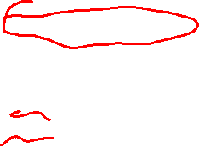
Sorting by divide and conquer.
Divide and conquer is this problem-solving strategy:
Divide up a big problem into smaller problems
Solve the smaller problems
Re-combine the solutions to the smaller problems into a solution for the big problem
Divide
Sort
Sort
sort(v)
if v.size() <=1: return
left = v[0..n/2]
right = v[n/2..n-1]
sort(left)
sort(right)
v = merge(left, right)
Merge
divide
solve
merge

Slide 29
Sorting by divide and conquer.
Divide and conquer is this problem-solving strategy:
Divide up a big problem into smaller problems
Solve the smaller problems
Re-combine the solutions to the smaller problems into a solution for the big problem
Divide
Sort
Sort
merge_sort(v)
if v.size() <=1: return
left = v[0..n/2]
right = v[n/2..n-1]
merge_sort(left)
merge_sort(right)
v = merge(left, right)
A recursive algorithm
known as merge_sort.
Merge
divide
solve
merge(left, right) efficiently combines two sorted vectors into one sorted vector
merge

Slide 30
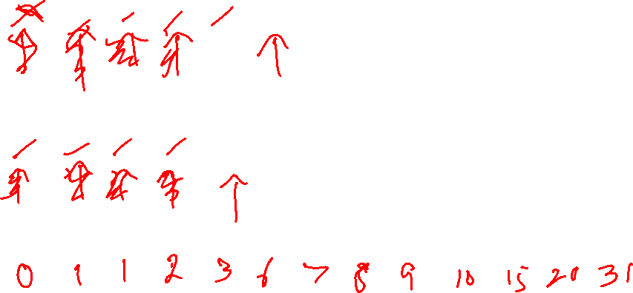
Merging two already-sorted vectors
Idea for efficiently merging
Use two pointers, a and b.
a always points to the first item in left that has not been copied to result.
b always points to the first item in right that has not been copied to result.
Put the smaller of the numbers pointed to by a and b into result, and incremented the corresponding pointer.
Repeat step 4 until all the numbers are in result.
0
1
2
3
4
5
left
1
2
6
8
9
31
Important! left and right must both already be in sorted order for merging to work
0
1
2
3
4
5
6
right
0
1
3
7
10
15
20
0
1
2
3
4
5
6
7
8
9
10
11
12
result

Slide 31
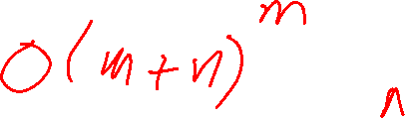
Merging two already-sorted vectors
Idea for efficiently merging
Use two pointers, a and b.
a always points to the first item in left that has not been copied to result.
b always points to the first item in right that has not been copied to result.
Put the smaller of the numbers pointed to by a and b into result, and incremented the corresponding pointer.
Repeat step 4 until all the numbers are in result.
0
1
2
3
4
5
left
1
2
6
8
9
31
Performance
Each value in left and right is moved into result using O(1) work. So O(m + n) work in total, where m and n are the array sizes.
0
1
2
3
4
5
6
right
0
1
3
7
10
15
20
If m = n, then merging does O(n) work.
0
1
2
3
4
5
6
7
8
9
10
11
12
result
0
1
1
2
3
6
7
8
9
10
15
20
31

Slide 32
Sorting by divide and conquer.
merge_sort(v)
if v.size() <=1: return
left = v[0..n/2]
right = v[n/2..n-1]
merge_sort(left)
merge_sort(right)
v = merge(left, right)
How much work does merge_sort do for an n-element vector?
this merge is O(n)
Imagine tracing how merge_sort runs on an n-element vector. We get this tree-like structure …

Slide 33
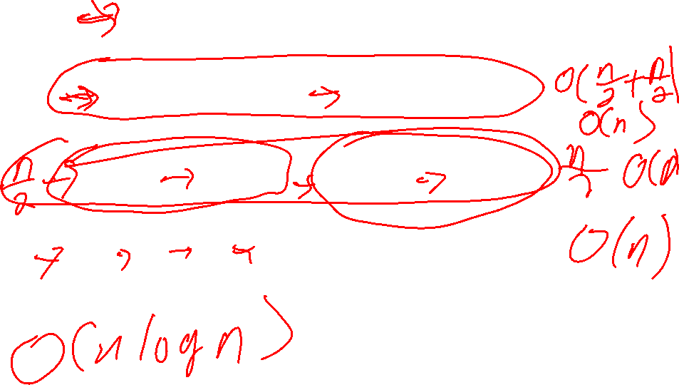
Each rectangle corresponds to a call of merge_sort.
n
n/2
n/2
Question
How tall is this tree?
n/4
n/4
n/4
n/4
n/8
n/8
n/8
n/8
n/8
n/8
n/8
n/8
Some of the array splits might not be perfectly even, but they are as close to perfect as possible.

Slide 34


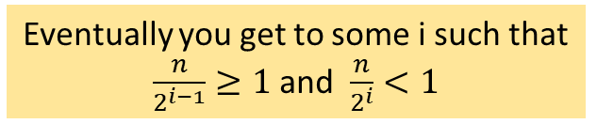



Each rectangle corresponds to a call of merge_sort.
Question
How tall is this tree?
n
level 0
$$\frac{n}{2}=\frac{n}{2^{0}}$$
n/2
level 1
$$\frac{n}{4}=\frac{n}{2^{1}}$$
n/2
Each call to merge_sort cuts the array size in half: n, n/2, n/4, n/8, …
$$\frac{n}{8}=\frac{n}{2^{2}}$$
n/4
n/4
n/4
n/4
level 2
$$\frac{n}{16}=\frac{n}{2^{3}}$$
n/8
n/8
n/8
n/8
n/8
n/8
n/8
n/8
level 3
Eventually you get to some i such that $\frac{n}{2^{i−1}}≥1$ and $\frac{n}{2^{i}}<1$
$$\frac{n}{2^{i}}$$
level i

Slide 35



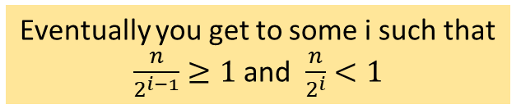


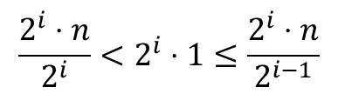
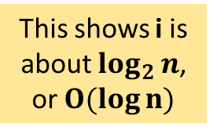
Eventually you get to some i such that $\frac{n}{2^{i−1}}≥1$ and $\frac{n}{2^{i}}<1$
Question
How tall is this tree?
$$\frac{n}{2^{i}}<1≤\frac{n}{2^{i−1}}$$
$$\frac{2^{i}⋅n}{2^{i}}<2^{i}⋅1≤\frac{2^{i}⋅n}{2^{i−1}}$$
$$n<2^{i}≤2n$$
$$\log_{2}{n}<\log_{2}{2^{i}}≤\log_{2}{2n}$$
$$\log_{2}{n}< i ≤{\log_{2}2+log}_{2}{n}$$
$$\log_{2}{n}<i≤{1+log}_{2}{n}$$
This shows i is about $\log_{2}{n}$, or $O(log⁡n)$

Slide 36






Each rectangle corresponds to a call of merge_sort.
Question
How tall is this tree?
n
level 0
$$\frac{n}{1}=\frac{n}{2^{0}}$$
n/2
level 1
$$\frac{n}{2}=\frac{n}{2^{1}}$$
n/2
Each call to merge_sort cuts the array size in half: n, n/2, n/4, n/8, …
$$\frac{n}{4}=\frac{n}{2^{2}}$$
n/4
n/4
n/4
n/4
level 2
$$\frac{n}{8}=\frac{n}{2^{3}}$$
n/8
n/8
n/8
n/8
n/8
n/8
n/8
n/8
level 3
Eventually you get to some i such that $\frac{n}{2^{i−1}}≥1$ and $\frac{n}{2^{i}}<1$
$$\frac{n}{2^{i}}$$
$$\log_{2}{n}<i≤{1+log}_{2}{n}$$
level i
i is $O(log⁡n)$

Slide 37
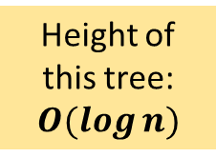
Each rectangle corresponds to a call of merge_sort.
Question
How tall is this tree?
n
level 0
$$\frac{n}{1}=\frac{n}{2^{0}}$$
n/2
level 1
$$\frac{n}{2}=\frac{n}{2^{1}}$$
n/2
Height of this tree: $O(log⁡n)$
$$\frac{n}{4}=\frac{n}{2^{2}}$$
n/4
n/4
n/4
n/4
level 2
$$\frac{n}{8}=\frac{n}{2^{3}}$$
n/8
n/8
n/8
n/8
n/8
n/8
n/8
n/8
level 3
$$\frac{n}{2^{i}}$$
$$\log_{2}{n}<i≤{1+log}_{2}{n}$$
level i
i is $O(log⁡n)$

Slide 38

Each rectangle corresponds to a call of merge_sort.
Question
How much work is done by merge_sort at each level of the tree?
n
level 0
$$\frac{n}{1}=\frac{n}{2^{0}}$$
n/2
level 1
$$\frac{n}{2}=\frac{n}{2^{1}}$$
n/2
$O(log⁡n)$
$$\frac{n}{4}=\frac{n}{2^{2}}$$
n/4
n/4
n/4
n/4
level 2
$$\frac{n}{8}=\frac{n}{2^{3}}$$
n/8
n/8
n/8
n/8
n/8
n/8
n/8
n/8
level 3
$$\frac{n}{2^{i}}$$
level i

Slide 39
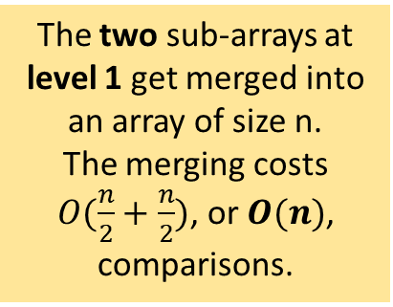
Each rectangle corresponds to a call of merge_sort.
Question
How much work is done by merge_sort at each level of the tree?
n
level 0
$$\frac{n}{1}=\frac{n}{2^{0}}$$
n/2
level 1
$$\frac{n}{2}=\frac{n}{2^{1}}$$
n/2
The two sub-arrays at level 1 get merged into an array of size n. The merging costs $O(\frac{n}{2}+\frac{n}{2})$, or $O(n)$, comparisons.
$$\frac{n}{4}=\frac{n}{2^{2}}$$
n/4
n/4
n/4
n/4
level 2
$$\frac{n}{8}=\frac{n}{2^{3}}$$
n/8
n/8
n/8
n/8
n/8
n/8
n/8
n/8
level 3
$$\frac{n}{2^{i}}$$
level i

Slide 40
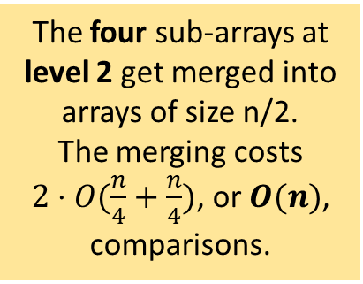
Each rectangle corresponds to a call of merge_sort.
Question
How much work is done by merge_sort at each level of the tree?
n
level 0
$$\frac{n}{1}=\frac{n}{2^{0}}$$
n/2
level 1
$$\frac{n}{2}=\frac{n}{2^{1}}$$
n/2
The four sub-arrays at level 2 get merged into arrays of size n/2. The merging costs $2⋅O(\frac{n}{4}+\frac{n}{4})$, or $O(n)$, comparisons.
$$\frac{n}{4}=\frac{n}{2^{2}}$$
n/4
n/4
n/4
n/4
level 2
$$\frac{n}{8}=\frac{n}{2^{3}}$$
n/8
n/8
n/8
n/8
n/8
n/8
n/8
n/8
level 3
$$\frac{n}{2^{i}}$$
level i

Slide 41
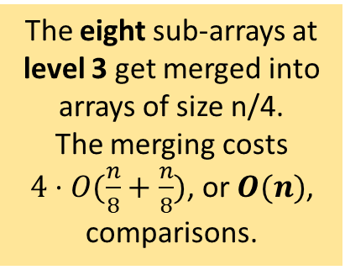
Each rectangle corresponds to a call of merge_sort.
Question
How much work is done by merge_sort at each level of the tree?
n
level 0
$$\frac{n}{1}=\frac{n}{2^{0}}$$
n/2
level 1
$$\frac{n}{2}=\frac{n}{2^{1}}$$
n/2
The eight sub-arrays at level 3 get merged into arrays of size n/4. The merging costs $4⋅O(\frac{n}{8}+\frac{n}{8})$, or $O(n)$, comparisons.
$$\frac{n}{4}=\frac{n}{2^{2}}$$
n/4
n/4
n/4
n/4
level 2
$$\frac{n}{8}=\frac{n}{2^{3}}$$
n/8
n/8
n/8
n/8
n/8
n/8
n/8
n/8
level 3
$$\frac{n}{2^{i}}$$
level i

Slide 42
Each rectangle corresponds to a call of merge_sort.
Question
How much work is done by merge_sort at each level of the tree?
n
level 0
$$\frac{n}{1}=\frac{n}{2^{0}}$$
n/2
level 1
$$\frac{n}{2}=\frac{n}{2^{1}}$$
O(n)
n/2
Every level does O(n) work!
$$\frac{n}{4}=\frac{n}{2^{2}}$$
O(n)
n/4
n/4
n/4
n/4
level 2
$$\frac{n}{8}=\frac{n}{2^{3}}$$
O(n)
n/8
n/8
n/8
n/8
n/8
n/8
n/8
n/8
level 3
Question What is the total amount of work done?
$$\frac{n}{2^{i}}$$
level i

Slide 43
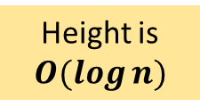
Each rectangle corresponds to a call of merge_sort.
Question
How much work does merge_sort do to sort n items?
n
level 0
$$\frac{n}{1}=\frac{n}{2^{0}}$$
n/2
level 1
$$\frac{n}{2}=\frac{n}{2^{1}}$$
O(n)
n/2
Height is $O(log⁡n)$
$$\frac{n}{4}=\frac{n}{2^{2}}$$
O(n)
n/4
n/4
n/4
n/4
level 2
$$\frac{n}{8}=\frac{n}{2^{3}}$$
O(n)
n/8
n/8
n/8
n/8
n/8
n/8
n/8
n/8
level 3
$$\frac{n}{2^{i}}$$
level i

Slide 44
Each rectangle corresponds to a call of merge_sort.
Question
How much work does merge_sort do to sort n items?
n
level 0
$$\frac{n}{1}=\frac{n}{2^{0}}$$
n/2
level 1
$$\frac{n}{2}=\frac{n}{2^{1}}$$
O(n)
n/2
Height is $O(log⁡n)$
$$\frac{n}{4}=\frac{n}{2^{2}}$$
O(n)
n/4
n/4
n/4
n/4
level 2
$$\frac{n}{8}=\frac{n}{2^{3}}$$
O(n)
n/8
n/8
n/8
n/8
n/8
n/8
n/8
n/8
level 3
$$\frac{n}{2^{i}}$$
total comparisons = (# levels in tree) x (comparisons done at each level)
level i

Slide 45
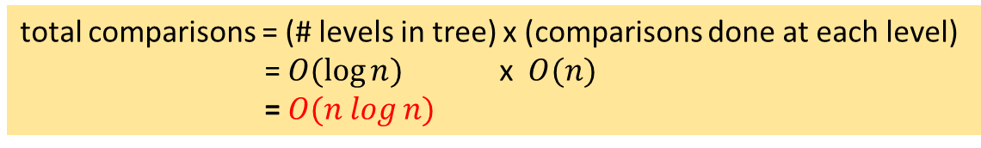
Each rectangle corresponds to a call of merge_sort.
Question
How much work does merge_sort do to sort n items?
n
level 0
$$\frac{n}{1}=\frac{n}{2^{0}}$$
n/2
level 1
$$\frac{n}{2}=\frac{n}{2^{1}}$$
O(n)
n/2
Height is $O(log⁡n)$
$$\frac{n}{4}=\frac{n}{2^{2}}$$
O(n)
n/4
n/4
n/4
n/4
level 2
$$\frac{n}{8}=\frac{n}{2^{3}}$$
O(n)
n/8
n/8
n/8
n/8
n/8
n/8
n/8
n/8
level 3
$$\frac{n}{2^{i}}$$
total comparisons = (# levels in tree) x (comparisons done at each level) = $O(log⁡n)$ x $O(n)$
= $O(n log⁡n)$
level i

Slide 46
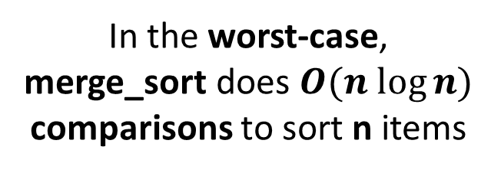

Each rectangle corresponds to a call of merge_sort.
Question
How much work does merge_sort do to sort n items?
n
level 0
$$\frac{n}{1}=\frac{n}{2^{0}}$$
n/2
level 1
$$\frac{n}{2}=\frac{n}{2^{1}}$$
n/2
O(n log n) comparisons
$$\frac{n}{4}=\frac{n}{2^{2}}$$
n/4
n/4
n/4
n/4
level 2
$$\frac{n}{8}=\frac{n}{2^{3}}$$
n/8
n/8
n/8
n/8
n/8
n/8
n/8
n/8
level 3
In the worst-case, merge_sort does $O(n log⁡n)$ comparisons to sort n items
$$\frac{n}{2^{i}}$$
level i

Slide 47
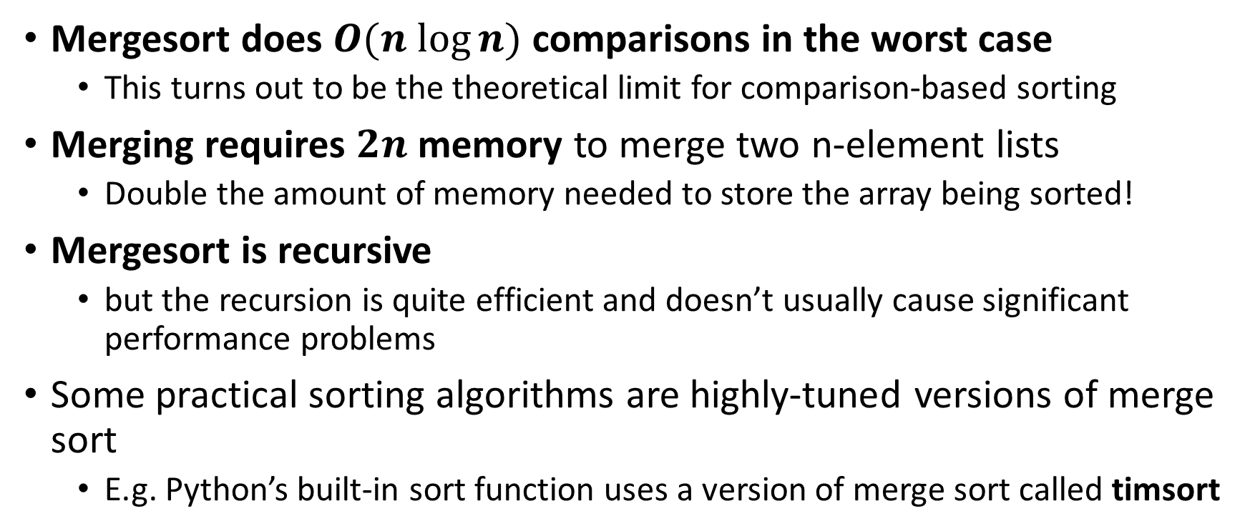
Mergesort Notes
Mergesort does $O(n log⁡n)$ comparisons in the worst case
This turns out to be the theoretical limit for comparison-based sorting
Merging requires $2n$ memory to merge two n-element lists
Double the amount of memory needed to store the array being sorted!
Mergesort is recursive
but the recursion is quite efficient and doesn’t usually cause significant performance problems
Some practical sorting algorithms are highly-tuned versions of merge sort
E.g. Python’s built-in sort function uses a version of merge sort called timsort

Slide 48


Quicksort
Quicksort is a variation on divide and conquer sorting
It uses an $O(n)$ algorithm called partitioning to split the array into two halves
The way partitioning works, there is no need for merging
Quicksort does not need $2n$ memory like mergesort does
In practice, quicksort is often the fasted general-purposes sorting algorithm
On average, quicksort is $O(n log⁡n)$, and tends to be faster than mergesort and other $O(n log⁡n)$algorithms
Problem: $O(n^{2})$in the worst case!
Can be implemented so that this worst case is very rare.
Quicksort was developed in 1959 by computer scientist Anthony Hoare.

Slide 49
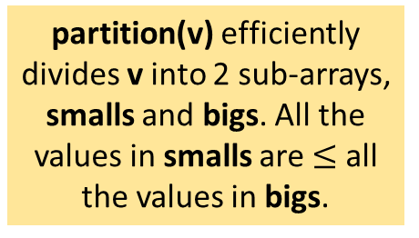
Sorting by divide and conquer.
The quicksort partition can result in sub-arrays of different sizes.
Divide and conquer is this problem-solving strategy:
Divide up a big problem into smaller problems
Solve the smaller problems
Re-combine the solutions to the smaller problems into a solution for the big problem
Partition
smalls
bigs
Sort
Sort
partition(v) efficiently divides v into 2 sub-arrays, smalls and bigs. All the values in smalls are $≤$ all the values in bigs.
quick_sort(v)
if v.size() <=1: return
smalls, bigs = partition(v)
quick_sort(smalls)
quick_sort(bigs)
Recombine
divide
solve
merge

Slide 50
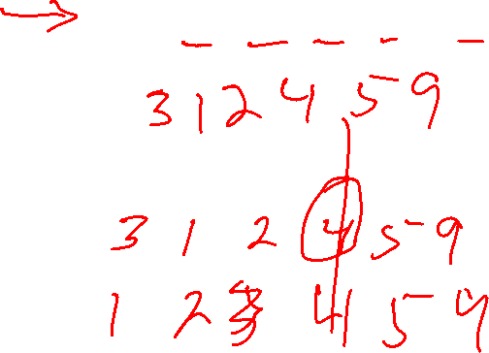
Partitioning an array
Idea for partitioning
Pick a value in the array called the pivot.
Put all the values less than the pivot to the left of the pivot.
Put all the values greater than or equal to the pivot to the right of the pivot.
The order of the elements before and after the pivot don’t matter.
0
1
2
3
4
5
4
2
1
5
9
3
pivot = 4
0
1
2
3
4
5

Slide 51
Partitioning an array
Idea for partitioning
Pick a value in the array called the pivot.
Put all the values less than the pivot to the left of the pivot.
Put all the values greater than or equal to the pivot to the right of the pivot.
The order of the elements before and after the pivot don’t matter.
0
1
2
3
4
5
4
2
1
5
9
3
pivot = 4
smalls
bigs
0
1
2
3
4
5
2
1
3
4
5
9
< pivot
>= pivot
Now when you sort the smalls and sort the bigs, the entire array is sorted (no need for merging).

Slide 52
Partitioning an array
Idea for partitioning
Pick a value in the array called the pivot.
Put all the values less than the pivot to the left of the pivot.
Put all the values greater than or equal to the pivot to the right of the pivot.
The order of the elements before and after the pivot don’t matter.
partition array
smalls
bigs
pivot
< pivot
>= pivot
Now when you sort the smalls and sort the bigs, the entire array is sorted (no need for merging).

Slide 53
Quicksort
Quicksort needs 2 main things to be efficient:
A fast partitioning algorithm
A fast way to pick a good pivot
A good pivot causes the array to be partitioned into two nearly-equal halves.
This is tough!
The median value would be the perfect pivot, but that can’t be calculated efficiently in general.
Various tricks can be used to lower the chance of bad pivots, e.g.
Median of 3: choose median of first, middle, and last element
Random pivot: choose pivot randomly
E.g. randomly shuffle the array once at the start, and then always choose the first element of sub-array to be the pivot

Slide 54

Why is quicksort sometimes slow?
In mergesort, the arrays are always divided (as close to) perfectly as possible.
n
n/2
$O(\log{n})$
n/4
n/8
comparison tree for mergesort

Slide 55
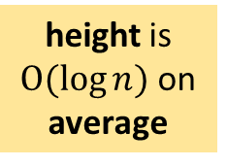
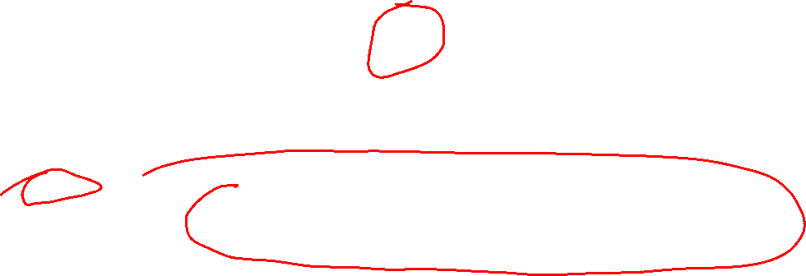
Why is quicksort sometimes slow?
The pivots for the partition might not be in the middle, resulting in unbalanced trees.
But in quicksort, the arrays could be divided unevenly.
height is $O(\log{n})$ on average
Question What’s the tallest comparison tree you can make for quicksort?
comparison tree for quicksort

Slide 56
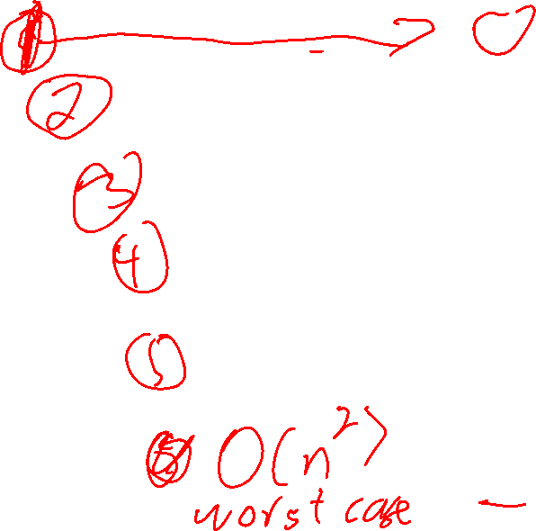
Why is quicksort sometimes slow?
Pivot always chosen to be 1st value
comparison tree for quicksort
n
Question What’s the tallest comparison tree you can make for quicksort?
n-1
height is n
n-2
n-3
One example of the worst case occurs when partition pivot values are always the min.
n-4
the size of the unsorted part decreases 1 item per level (compared to n/2 for mergesort)
1

Slide 57
Quicksort Worst Case
Pivot always chosen to be 1st value
One example: all pivots are the min
{1, 2, 5, 8, 9}
One example: all pivots are the max
{9, 8, 5, 2, 1}
One example: all pivots are either min or max
{1, 9, 8, 2, 5}
In all three cases, pivots are chosen such that all other numbers are on one side.

Slide 58
Quicksort Worst Case
Pivot always chosen to be 1st value
One example: all pivots are the min
{1, 2, 5, 8, 9}
One example: all pivots are the max
{9, 8, 5, 2, 1}
One example: all pivots are either min or max
{1, 9, 8, 2, 5}
Rule of thumb for basic quicksort It goes slower on partially ordered data

Slide 59
Quicksort vs Mergesort
 | Average Performance | Worst-case Performance | Memory Usage | Implementation
Mergsort |  |  |  | recursive; merging
Quicksort |  |  |  | recursive; partitioning

Slide 60
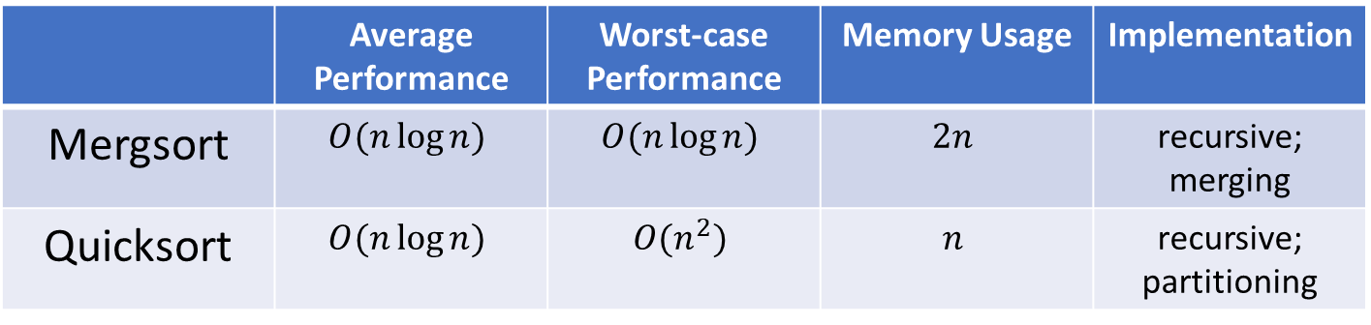
Quicksort vs Mergesort
 | Average Performance | Worst-case Performance | Memory Usage | Implementation
Mergsort | $$O(n\log{n})$$ | $$O(n\log{n})$$ | $$2n$$ | recursive; merging
Quicksort | $$O(n\log{n})$$ | $$O(n^{2})$$ | $$n$$ | recursive; partitioning

Slide 61
How Fast Can Sorting Go?
Important question! Lots of programs use sorting.
Here we will consider general-purpose sorting with a few assumptions
The sorting is deterministic, i.e. no randomness
The sorting is comparison-based, i.e. comparing 2 array values is the only operation that gets information about the array
E.g. adding numbers is not allowed
There are no duplicate values in the array being sorted

Slide 62
Comparing values in an array
arr[i] < arr[j]
1 comparison has exactly 2 possible outcomes: true or false
true
false

Slide 63
Comparing values in an array
later comparisons can depend upon the outcome of earlier comparisons
arr[i] < arr[j]
true
false
arr[s] < arr[t]
arr[u] < arr[v]
true
false
true
false

Slide 64
Comparing values in an array
the exact comparisons that are done depend upon the sorting algorithm, and the data it is sorting
arr[i] < arr[j]
true
false
arr[s] < arr[t]
arr[u] < arr[v]
true
false
true
false

Slide 65
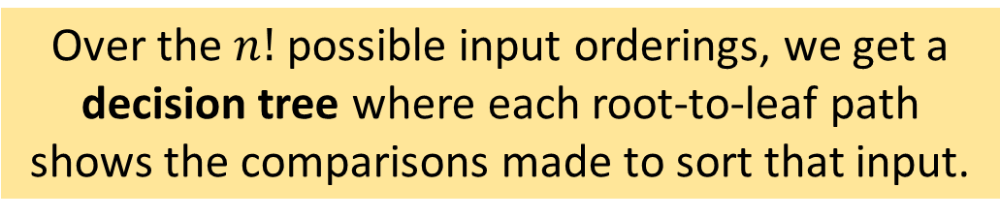
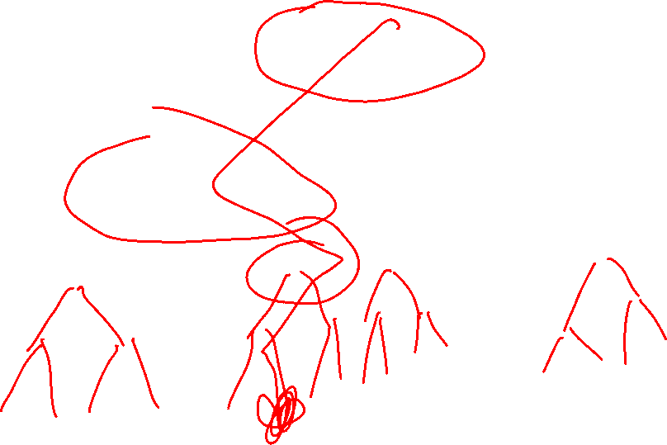
The sorting algorithm continues doing comparisons until the array is sorted.
arr[i] < arr[j]
true
false
arr[s] < arr[t]
arr[u] < arr[v]
true
false
true
false
. . .
. . .
. . .
. . .
Over the $n!$ possible input orderings, we get a decision tree where each root-to-leaf path shows the comparisons made to sort that input.

Slide 66
Decision Tree for a sorting algorithm
the green path shows the sequence of comparisons needed to sort 1 particular permutation
the red path shows the sequence of comparisons need to sort 1 particular permutation

Slide 67

Assume the array has n elements
Question How many different root-to-leaf paths are there in the decision tree?
Decision Tree for a sorting algorithm
Every possible input permutation we give the sorting algorithm results in a different path through its decision tree.
the green path shows the sequence of comparisons need to sort 1 particular permutation
the red path shows the sequence of comparisons need to sort 1 particular permutation

Slide 68
Assume the array has n elements
Question How many different root-to-leaf paths are there in the decision tree?
Decision Tree for a sorting algorithm
This is a binary tree, and so there is one root-to-leaf path for each leaf node.
the green path shows the sequence of comparisons need to sort 1 particular permutation
the red path shows the sequence of comparisons need to sort 1 particular permutation

Slide 69
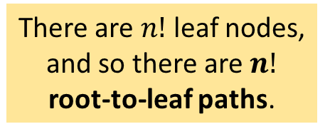
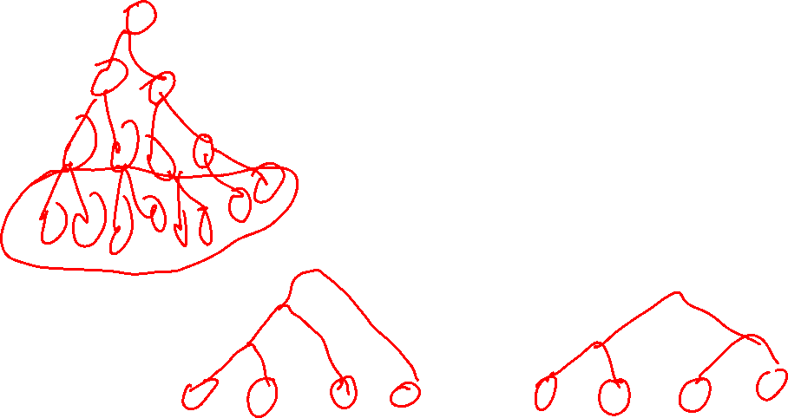
Assume the array has n elements
Question How many different root-to-leaf paths are there in the decision tree?
Decision Tree for a sorting algorithm
This is a binary tree, and so there is one root-to-leaf path for each leaf node.
There are $n!$ leaf nodes, and so there are $n!$ root-to-leaf paths.
n! leaf nodes

Slide 70

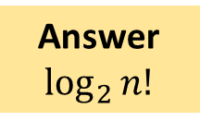
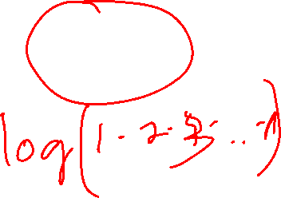
Question What’s the minimum height for a binary tree with n! leaf nodes?
Decision Tree for a sorting algorithm
Answer
$$\log_{2}{n!}$$
height = $\log_{2}{n!}$
n! leaf nodes

Slide 71
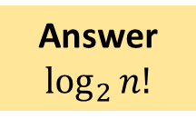
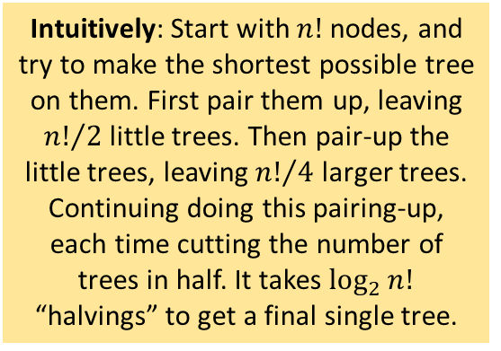
Question What’s the minimum height for a binary tree with n! leaf nodes?
Decision Tree for a sorting algorithm
Answer
$$\log_{2}{n!}$$
height = $\log_{2}{n!}$
Intuitively: Start with $n!$ nodes, and try to make the shortest possible tree on them. First pair them up, leaving ${n!}/2$little trees. Then pair-up the little trees, leaving ${n!}/4$ larger trees. Continuing doing this pairing-up, each time cutting the number of trees in half. It takes $\log_{2}{n!}$ “halvings” to get a final single tree.
Important! This is the worst-case number of comparisons that any comparison-based sorting algorithm must do. For some particular inputs it might do much better. But there’s always at least one input that needs this many comparisons.
n! leaf nodes

Slide 72
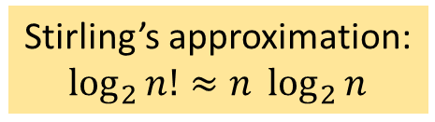
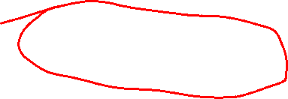
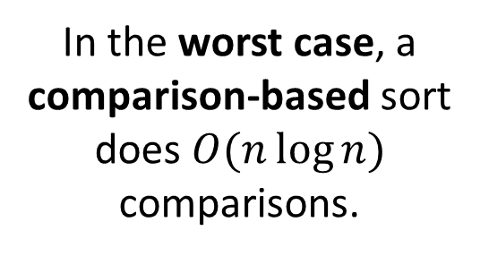
Question What’s the minimum height for a binary tree with n! leaf nodes?
Decision Tree for a sorting algorithm
Answer
$$\log_{2}{n!}$$
height = $\log_{2}{n!}$
Stirling’s approximation:
$\log_{2}{n!}≈n \log_{2}{n}$
n! leaf nodes
In the worst case, a comparison-based sort does $O(n\log{n})$ comparisons.

Slide 73
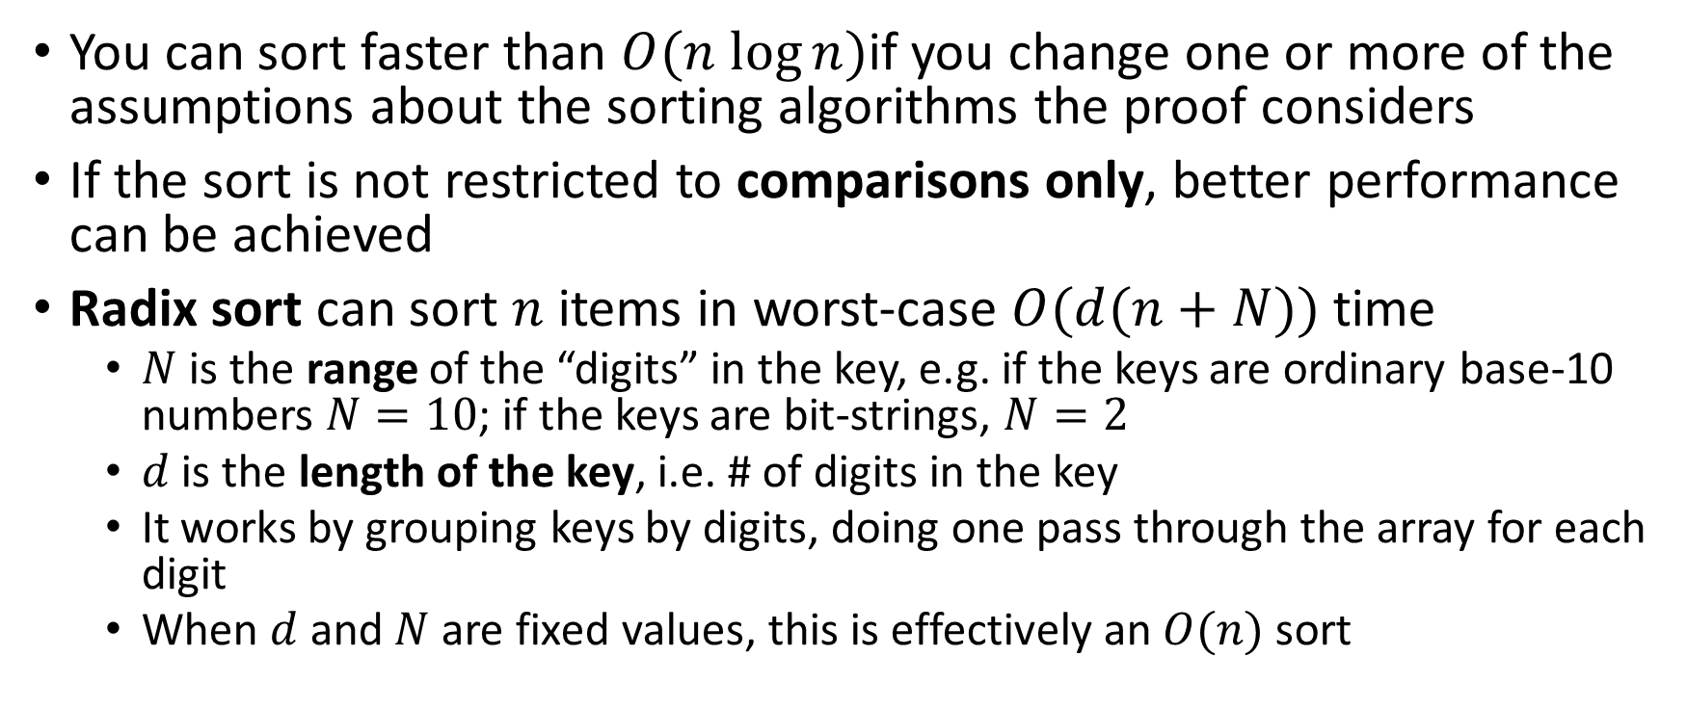
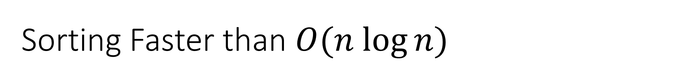
Sorting Faster than $O(n log⁡n)$
You can sort faster than $O(n log⁡n)$if you change one or more of the assumptions about the sorting algorithms the proof considers
If the sort is not restricted to comparisons only, better performance can be achieved
Radix sort can sort $n$ items in worst-case $O(d(n+N))$ time
$N$ is the range of the “digits” in the key, e.g. if the keys are ordinary base-10 numbers $N=10$; if the keys are bit-strings, $N=2$
$d$ is the length of the key, i.e. # of digits in the key
It works by grouping keys by digits, doing one pass through the array for each digit
When $d$ and $N$ are fixed values, this is effectively an $O(n)$ sort

Slide 74
Radix sort example
The numbers are 3 digits long, so radix sort will do 3 passes, one pass for each digit position.
170, 045, 075, 090, 002, 802, 002, 066

Slide 75
Radix sort example
The numbers are 3 digits long, so radix sort will do 3 passes, one pass for each digit position.
170, 045, 075, 090, 002, 802, 002, 066
170, 190, 002, 802, 002, 045, 075, 066 (sorted by right-most digit)

Slide 76
Radix sort example
The numbers are 3 digits long, so radix sort will do 3 passes, one pass for each digit position.
170, 045, 075, 090, 002, 802, 002, 066
170, 190, 002, 802, 002, 045, 075, 066 (sorted by right-most digit)
002, 802, 002, 045, 066, 170, 075, 190 (sorted by middle digit)

Slide 77
Radix sort example
The numbers are 3 digits long, so radix sort will do 3 passes, one pass for each digit position.
170, 045, 075, 090, 002, 802, 002, 066
170, 190, 002, 802, 002, 045, 075, 066 (sorted by right-most digit)
002, 802, 002, 045, 066, 170, 075, 190 (sorted by middle digit)
002, 002, 045, 066, 075, 170, 190, 920 (sorted by left-most digit)

Slide 78
Sort Visualizations
Animation of Heapsort
Many fun and interesting visualizations of sorting have been created
E.g. https://sortvisualizer.com/
Classic sorting film from the 1980s: Sorting Out Sorting
https://www.youtube.com/watch?v=HnQMDkUFzh4
Search for “sort visualizations” for many more examples!

