Slide 1
Week 3
CMPT 225, Fall 2023 SFU Surrey

Slide 2
Review: List2.cpp
Take a look at the code in List2.cpp …
Do you understand all the details?

Slide 3
Practice Questions: walk_to
In the List class (in List2.cpp), implement a method called walk_to(int i) that returns a pointer to the i-th node in the list.
The first node is 0, the second is 1, the third is 2, and so on.
Assume i is a valid index.
Make walk_to private: we don’t want List users getting pointers to nodes (they could mess up the node!).
See singly_linked_list3.cpp for a sample solution.

Slide 4
Practice Questions: remove_after
In the List class (in List2.cpp), implement the private method remove_after(Node* p), which deletes the node after the node that p points to.
Assume p points to a valid node in the list, and the list is non-empty.
Note that it can’t remove the first element of the list!
See singly_linked_list3.cpp for a sample solution.

Slide 5
Practice Questions: remove
In the List class (in List2.cpp), implement the public method remove(int i) that deletes the i-th node in the list.
Assume i is a valid index and the list is non-empty
See singly_linked_list3.cpp for a sample solution.

Slide 6
Practice Questions: recursive size
In the List class (in List1.cpp), re-implement the size() method using recursion (and no loops). How does the recursive implementation compare to the non-recursive one?
See singly_linked_list3.cpp for a sample solution.

Slide 7
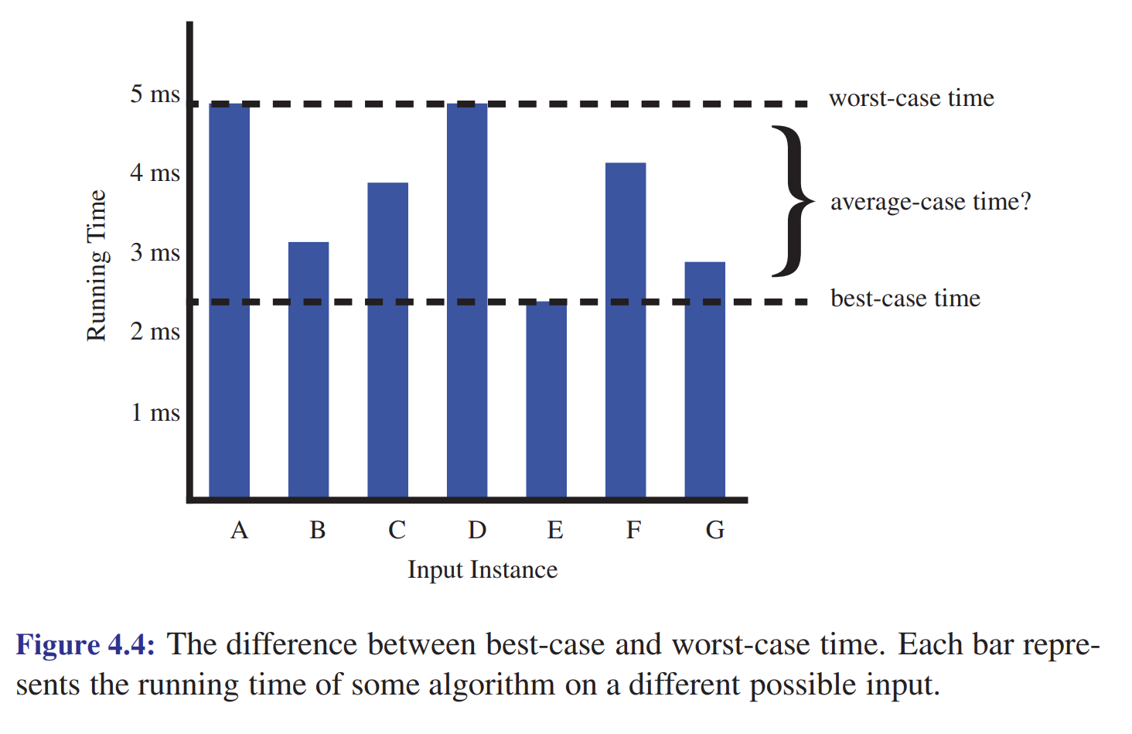

Slide 8




















$$O(\log{n})$$
$$O(n)$$
$$O(n\log{n})$$
O($n^{2}$)
O($n^{3}$)
O($2^{n}$)
$$O(1)$$
$$\log_{2}{n}$$
$n$, $3n$, $5n+10$, …
$$4n\log{2n}$$
$$n^{2}$$
$$n^{3}$$
$$2^{n}$$
1, 5, 861, 3000, …
$$\log_{10}{n}$$
$$n+log⁡n$$
$$n+n\log{n}$$
$$2n^{2}−3n$$
$$n^{3}−n^{2}+5$$
$$2^{n}+n^{100}$$
…
…
…
…
…
$${5+\log_{3}{(2n+1)}}_{}$$
…

