Slide 1
Week 4
CMPT 225, Fall 2023 SFU Surrey

Slide 2
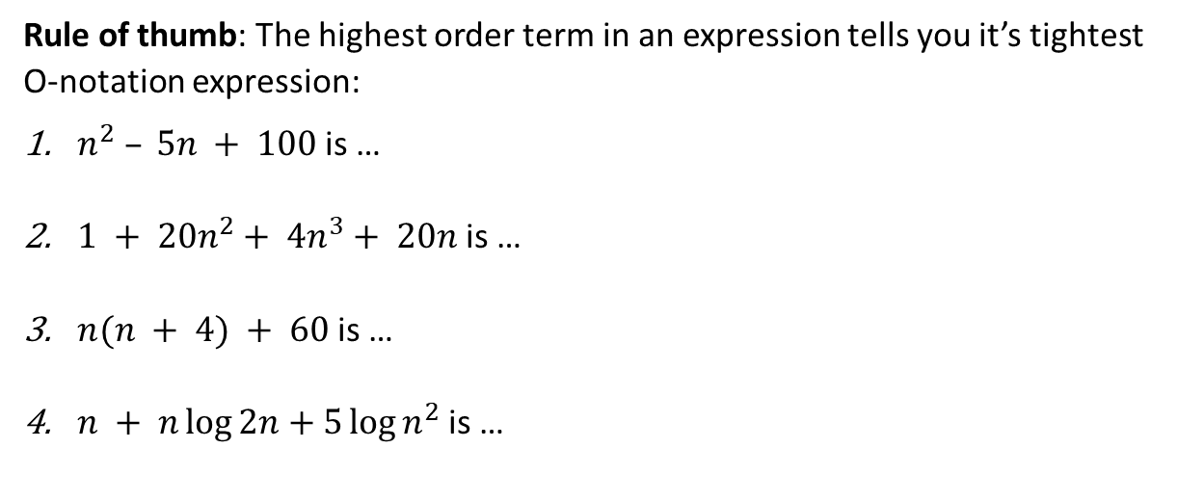
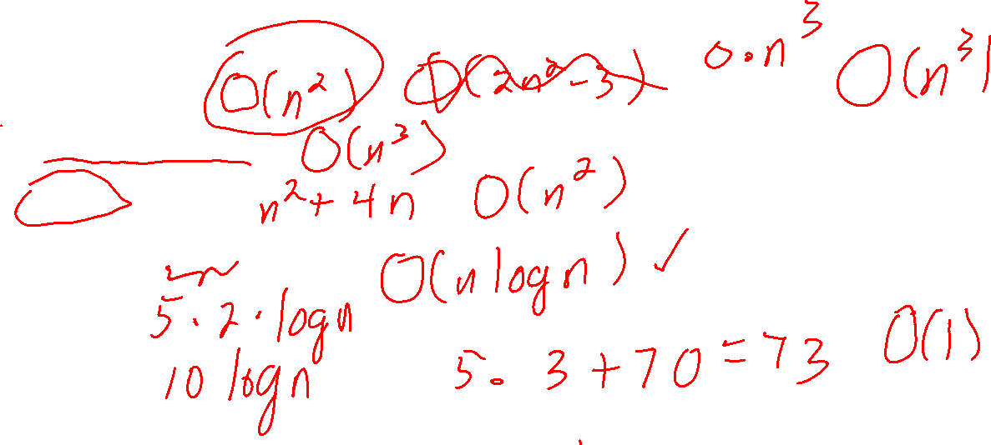
O-notation Examples
Rule of thumb: The highest order term in an expression tells you it’s tightest O-notation expression:
$n^{2} – 5n + 100$is …
$1 + 20n^{2}+ 4n^{3}+ 20n$is …
$n(n + 4) + 60$is …
$n + n\log{2n}+5\log{n^{2}}$is …

Slide 3
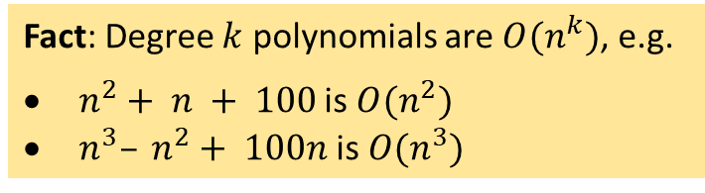
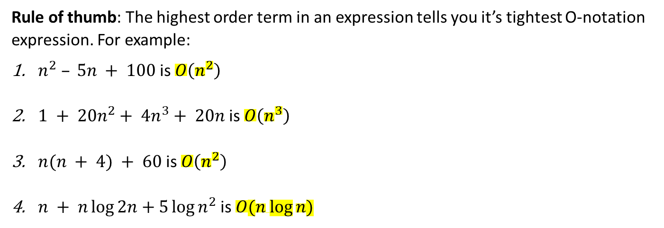
O-notation Examples
Rule of thumb: The highest order term in an expression tells you it’s tightest O-notation expression. For example:
$n^{2} – 5n + 100$is $O\left(n^{2}\right)$
$1 + 20n^{2}+ 4n^{3}+ 20n$is $O\left(n^{3}\right)$
$n(n + 4) + 60$is $O\left(n^{2}\right)$
$n + n\log{2n}+5\log{n^{2}}$is $O(n log⁡n)$
Fact: Degree $k$ polynomials are $O(n^{k})$, e.g.
$n^{2}+ n + 100$is $O(n^{2})$
$n^{3}– n^{2}+ 100n$is $O(n^{3})$

Slide 4
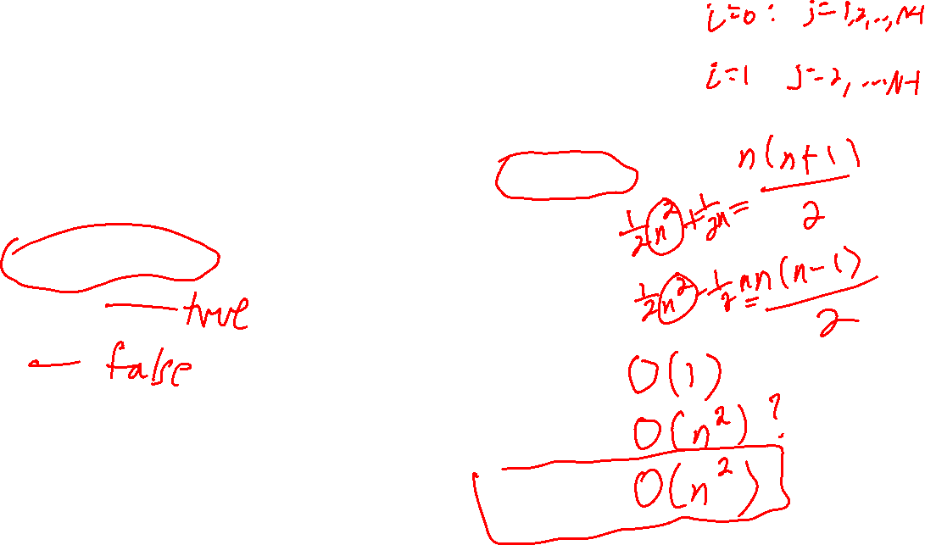
Checking for Duplicates
bool has_duplicate(int[] arr) // arr has N elements
for i = 0 to N-1: for j =i + 1 to N-1: if arr[i] == arr[j]: return false
return true
What’s a good key instruction?
For an N-element array, how many times is the key instruction executed? Answer using O-notation...
Best case:
0 | 1 | 2 | 3 | 4
4 | 5 | 3 | 1 | 3
Average case:
Worst case:

Slide 5


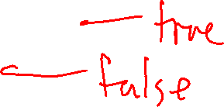
Checking for Duplicates
bool has_duplicate(int[] arr) // arr has N elements
for i = 0 to N-1: for j =i + 1 to N-1: if arr[i] == arr[j]: return false
return true
What’s a good key instruction? == (comparisons)
For an N-element array, how many times is the key instruction executed? Answer using O-notation...
Best case: O(1)
0 | 1 | 2 | 3 | 4
4 | 5 | 3 | 1 | 3
Average case: O($n^{2}$)
Worst case: O($n^{2}$)

Slide 6
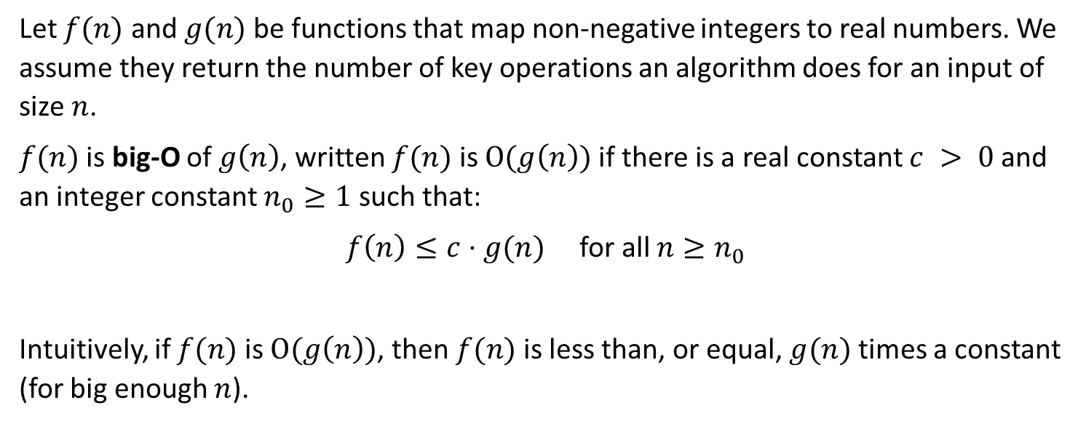
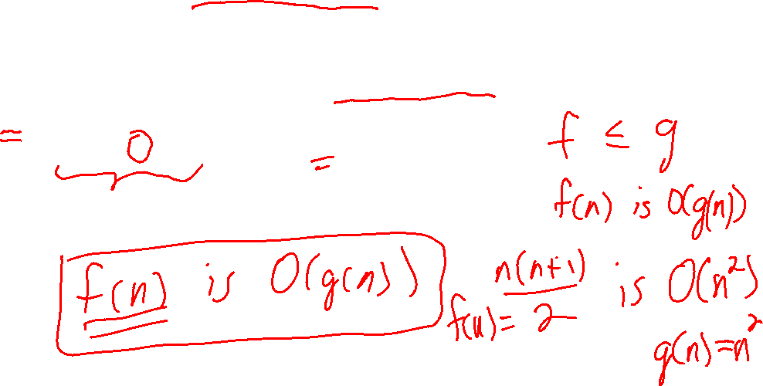
Definition of O-notation
Memorize this definition!
Let $f(n)$ and $g(n)$ be functions that map non-negative integers to real numbers. We assume they return the number of key operations an algorithm does for an input of size $n$.
$f(n)$ is big-O of $g\left(n\right)$, written $f(n)$ is $O(g\left(n\right))$if there is a real constant $c > 0$ and an integer constant $n_{0}≥1$ such that:
$f\left(n\right)≤c⋅g(n)$ for all $n≥n_{0}$
Intuitively, if $f(n)$ is $O(g\left(n\right))$, then $f(n)$ is less than, or equal, $g(n)$ times a constant (for big enough $n$).

Slide 7
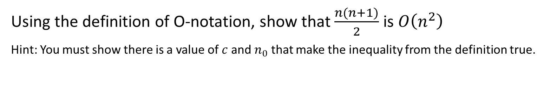
O-notation Examples
Using the definition of O-notation, show that $\frac{n(n+1)}{2}$ is $O\left(n^{2}\right)$
Hint: You must show there is a value of $c$ and $n_{0}$ that make the inequality from the definition true.

Slide 8
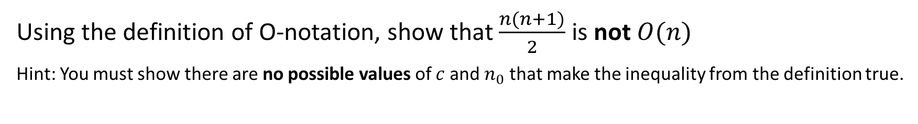
O-notation Examples
Using the definition of O-notation, show that $\frac{n(n+1)}{2}$ is not $O(n)$
Hint: You must show there are no possible values of $c$ and $n_{0}$ that make the inequality from the definition true.

Slide 9
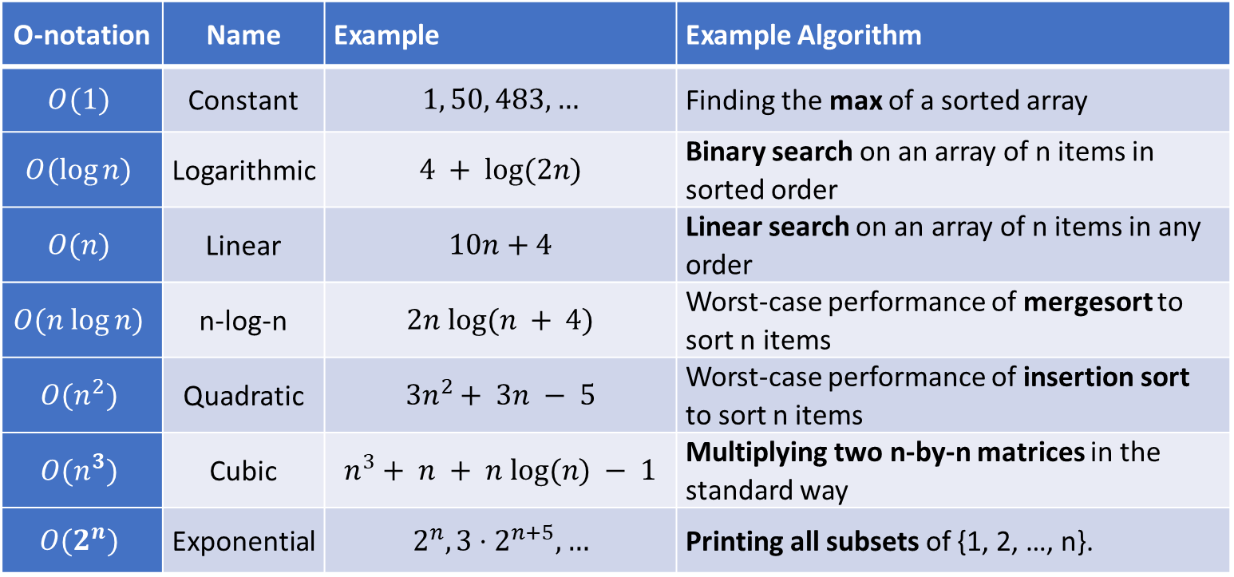
O-notation Examples
O-notation | Name | Example | Example Algorithm
$$O(1)$$ | Constant | $$1, 50, 483, …$$ | Finding the max of a sorted array
$$O(log⁡n)$$ | Logarithmic | $$4 + log⁡(2n)$$ | Binary search on an array of n items in sorted order
$$O(n)$$ | Linear | $$10n+4$$ | Linear search on an array of n items in any order
$$O(n log⁡n)$$ | n-log-n | $$2n log⁡(n + 4)$$ | Worst-case performance of mergesort to sort n items
$$O(n^{2})$$ | Quadratic | $$3n^{2}+ 3n − 5$$ | Worst-case performance of insertion sort to sort n items
$$O(n^{3})$$ | Cubic | $$n^{3}+ n + n log⁡(n) − 1$$ | Multiplying two n-by-n matrices in the standard way
$$O(2^{n})$$ | Exponential | $$2^{n}, 3⋅2^{n+5}, …$$ | Printing all subsets of {1, 2, …, n}.

Slide 10




















O-notation
$$O(\log{n})$$
$$O(n)$$
$$O(n\log{n})$$
O($n^{2}$)
O($n^{3}$)
O($2^{n}$)
$$O(1)$$
$$\log_{2}{n}$$
$n$, $3n$, $5n+10$, …
$$4n\log{2n}$$
$$n^{2}$$
$$n^{3}$$
$$2^{n}$$
1, 5, 861, 3000, …
$$\log_{10}{n}$$
$$n+log⁡n$$
$$n+n\log{n}$$
$$2n^{2}−3n$$
$$n^{3}−n^{2}+5$$
$$2^{n}+n^{100}$$
…
…
…
…
…
$${5+\log_{3}{(2n+1)}}_{}$$
…
O-notation, also called asymptotic notation, is a popular way of talking about algorithm performance. Given an expression, O-notation “throws away” all the low-order terms and constants, leaving a simpler expression that is essentially true when n is large.

Slide 11
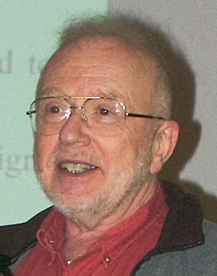

ADTs: Abstract Data Types
What is an abstract data type (ADT)?
Why do we use them?
How can we implement them?
Barbara Liskov 2008 Turing Award Winner
David Parnas Canadian Computer Scientist
In the 1970s, they helped explain how programs can be written using abstract data types. Parnas wrote a famous paper on modular programming, and Liskov created and developed the CLU language to show how ADTs could be used efficiently.

Slide 12
ADTs: Abstract Data Types
What is an abstract data type (ADT)?
Why do we use them?
How can we implement them?

Slide 13
ADTs: Abstract Data Types
What is an abstract data type (ADT)?
An ADT is a mathematical model of a data structure that specifies the type of the data stored, the operations supported on the data, and the types of the parameters of the operations.
An ADT specifies what each operation does, but not how it does it.

Slide 14

ADTs: Abstract Data Types
E.g. g++ developers could update the implementation of std::string to be faster, and you wouldn’t need to make any changes to your existing code (it would just run faster).
Why do we use them?
Modularity: An ADT specifies the interface between it and the rest of the program. We can change the implementation of a well-designed ADT without changing the code that calls it.
Encapsulation: ADTs hide and manage implementation details of objects, preventing the programmer using it from accidentally messing up these details.
E.g. Assuming std::string is implemented using a char* C-style string, this pointer is hidden from the user of std::string so they cannot change it.

Slide 15
ADTs: Abstract Data Types
What is an abstract data type (ADT)?
An ADT is a mathematical model of a data structure that specifies the type of the data stored, the operations supported on the data, and the types of the parameters of the operations.
An ADT specifies what each operation does, but not how it does it.
Why do we use them?
An ADT specifies the interface between it and the rest of the program. We can change the implementation of a well-designed ADT without changing the code that calls it.
How can we implement them?
In C++, ADTs are usually implemented as base classes where the methods are all public, abstract, and virtual.
E.g. g++ developers could update the implementation of std::string to be faster, and you wouldn’t need to make any changes to your existing code (it would just run faster).

Slide 16
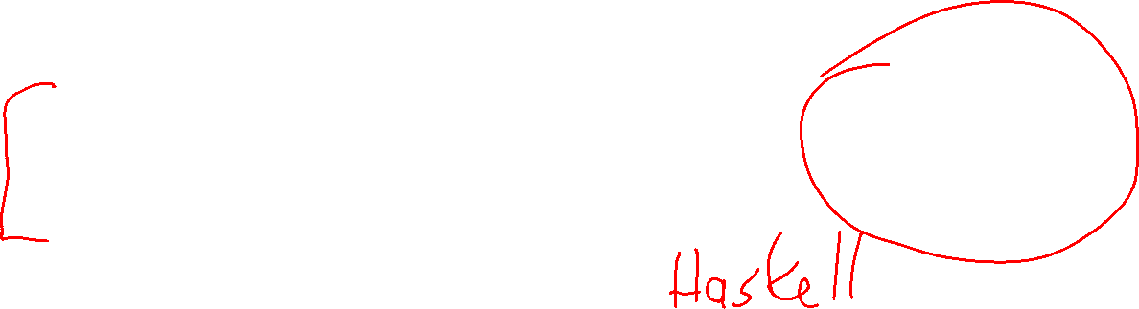
ADTs: Abstract Data Types
Wordlist_base from assignment 1 is an example of an ADT. It specifies methods and what they should do, but no implementation is given.
std::string is an ADT in the sense that we know how strings ought to behave, but we don’t really know anything about their implementation.
In math, integers can be treated as an ADT. Numbers, and the operations on them like + and *, are specified to work exactly. But math doesn’t tell you how you implement * or +. That’s up to you, and you can do it any way that makes sense and gives the correct answer.
E.g. The algorithms humans and computers use for multiplication are quite different, but they end up giving the same answers.

Slide 17
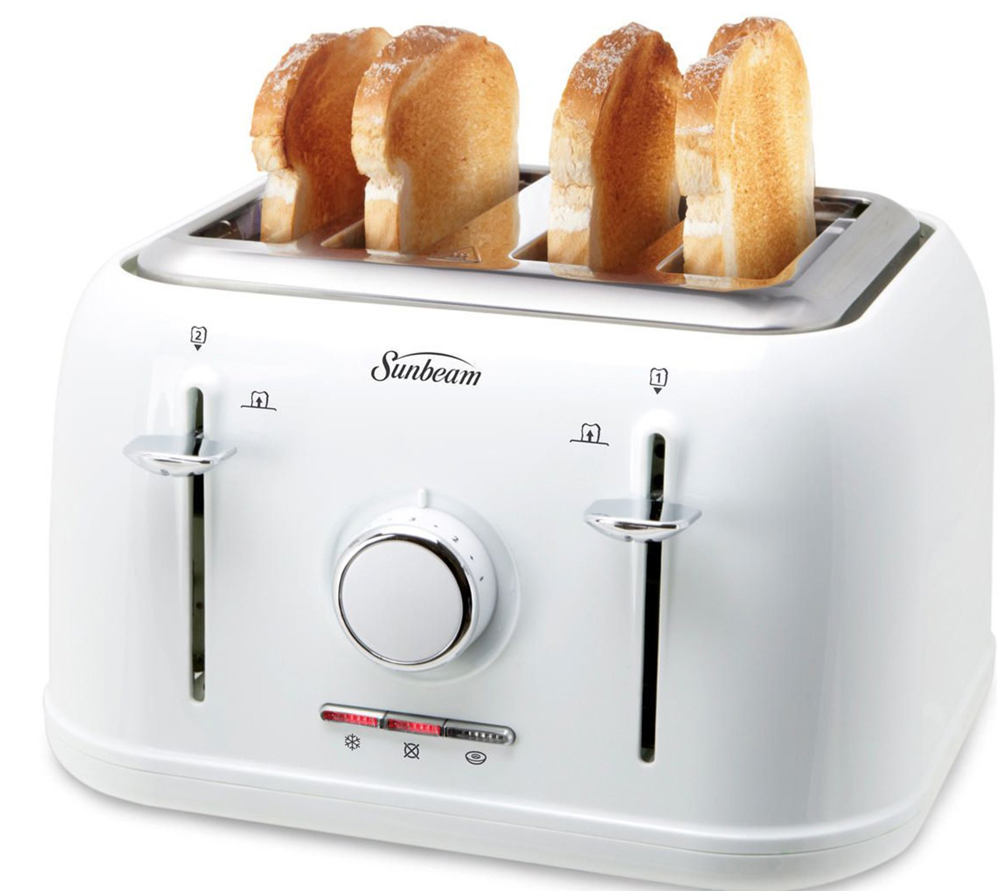



ADTs: Abstract Data Types
An electrical outlet is a good example of the essential idea of an ADT.
Any electrical device can be plugged into any outlet.
The device doesn’t know how the electricity is generated, and the outlet has no idea what the device does.
Plus, the outlet is encapsulated: you can’t mess around with its internals unless you make a special effort to do so.

Slide 18
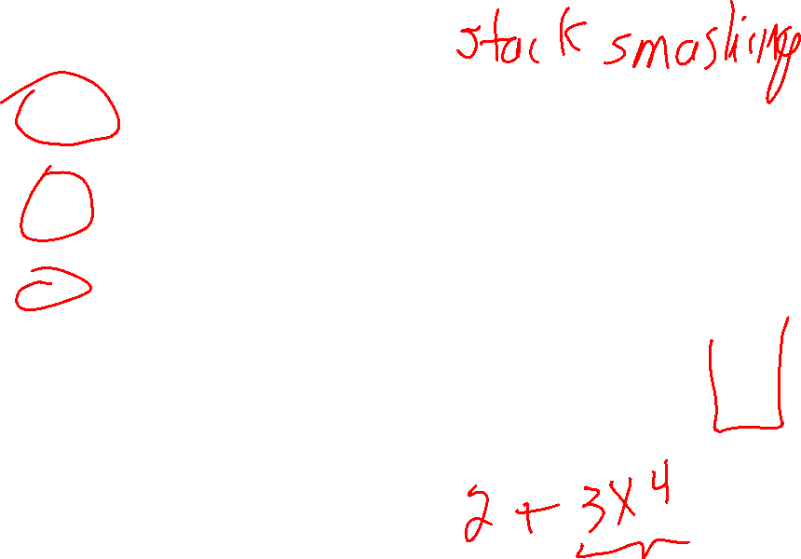
The Stack ADT
In practice, all these operations usually have worst-case O(1) running time, i.e. they are all very fast and don’t depend on the size of the stack.
push(x): puts x on top of the stack; error if the stack is full (stack overflow); O(1)
pop(): removes the item on top of the stack; error if the stack is empty (stack underflow); O(1)
top(): returns a copy of the top of the stack without removing it; error if the stack is empty; O(1)
size(): returns the number of items in the stack; O(1)
empty(): returns true if the stack is empty, and false otherwise; O(1)
push
pop
C
top
D
A
bottom

Slide 19
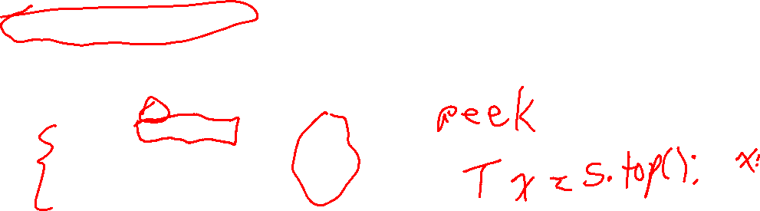
The Stack ADT
A “constant reference” is returned here, which returns a reference to the top stack item without making a copy or allowing it to be changed.
//
// T is the type of the elements in the stack. // T must have a copy constructor.
//
template <typename T>
struct Stack_base
{
virtual void push(const T &x) = 0;
virtual T pop() = 0;
virtual const T &top() const = 0;
virtual bool empty() const = 0;
virtual int size() const = 0;
virtual ~Stack_base() {}
};
push
pop
C
top
D
A
bottom

Slide 20
The Stack ADT
A “constant reference” is returned here, which returns a reference to the top stack item without making a copy or allowing it to be changed.
//
// T is the type of the elements in the stack. // T must have a copy constructor.
//
template <typename T>
struct Stack_base
{
virtual void push(const T &x) = 0;
virtual T pop() = 0;
virtual const T &top() const = 0;
virtual bool empty() const = 0;
virtual int size() const = 0;
virtual ~Stack_base() {}
};
push
pop
C
top
A stack can be efficiently implemented with an array, vector (comes with push_back and pop_back), and linked lists.
D
A
bottom

Slide 21
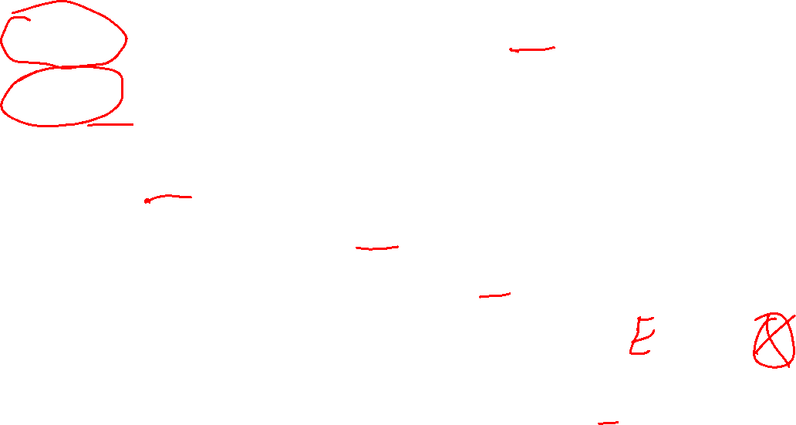
The Queue ADT
In practice, all these operations usually have worst-case O(1) running time, i.e. they are all very fast and don’t depend on the size of the queue.
enqueue(x): add x to the end of the queue; error if queue is full; O(1)
dequeue(): remove the item at the front of the queue; error if queue is empty; O(1)
front(): return a copy of the front queue item without removing it; error if queue is empty; O(1)
size(): return number of items in the queue; O(1)
empty(): return true if queue is empty, and false otherwise; O(1)
enqueue
C
D
A
dequeue
back
front

Slide 22
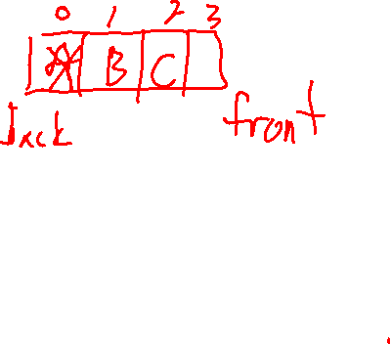
The Queue ADT
In practice, all these operations usually have worst-case O(1) running time, i.e. they are all very fast and don’t depend on the size of the queue.
enqueue(x): add x to the end of the queue; error if queue is full; O(1)
dequeue(): remove the item at the front of the queue; error if queue is empty; O(1)
front(): return a copy of the front queue item without removing it; error if queue is empty; O(1)
size(): return number of items in the queue; O(1)
empty(): return true if queue is empty, and false otherwise; O(1)
A queue can be efficiently implemented with a linked list. It’s a bit trickier with arrays/vectors: usually you use a circular array to make both enqueueing and dequeing O(1)
enqueue
C
D
A
dequeue
back
front

Slide 23
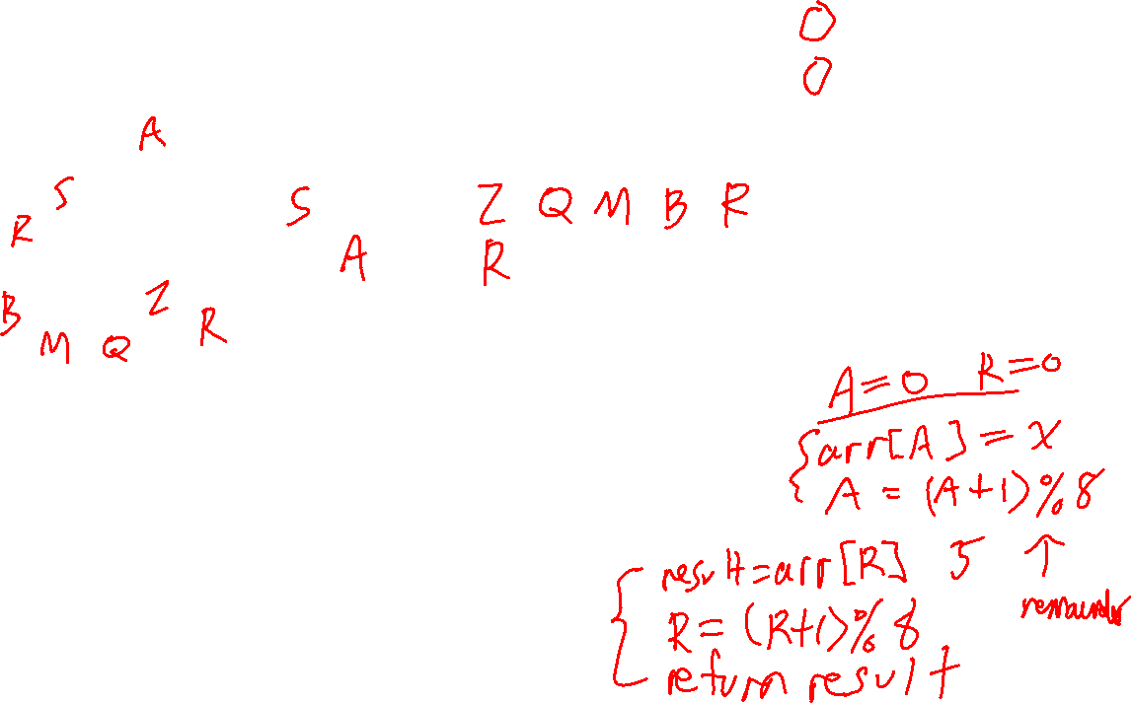
R: index of next item to remove (front item of queue) A: index of next location where an item will be added (back of queue)
Circular Arrays
0 | 1 | 2 | 3 | 4 | 5 | 6 | 7
0
1
7
2
6
3
5
4
Make new empty queue:
enqueue(x):
dequeue(x):
A queue can be efficiently implemented with a linked list. It’s a bit trickier with arrays/vectors: usually you use a circular array to make both enqueueing and dequeing O(1)

Slide 24
R: index of next item to remove (front item of queue) A: index of next location where an item will be added (back of queue)
Circular Arrays
0 | 1 | 2 | 3 | 4 | 5 | 6 | 7
0
1
7
2
6
3
5
4
Make new empty queue: R=0, A=0
enqueue(x): arr[A] = x A = (A + 1) % max_size
dequeue(): result = arr[R] R = (R + 1) % max_size return result
A queue can be efficiently implemented with a linked list. It’s a bit trickier with arrays/vectors: usually you use a circular array to make both enqueueing and dequeing O(1)

Slide 25
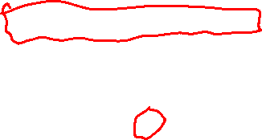
The Queue ADT
A “constant reference” is returned here, which is a reference to the front item without making a copy or allowing it to be changed.
//
// T is the type of the elements in the queue.
// T must have a copy constructor.
//
template <typename T>
struct Queue_base
{
virtual void enqueue(const T &x) = 0;
virtual T dequeue() = 0;
virtual const T &front() const = 0;
virtual bool empty() const = 0;
virtual int size() const = 0;
virtual ~Queue_base() {}
}; // class Queue_base
enqueue
C
D
A
dequeue
back
front

Slide 26
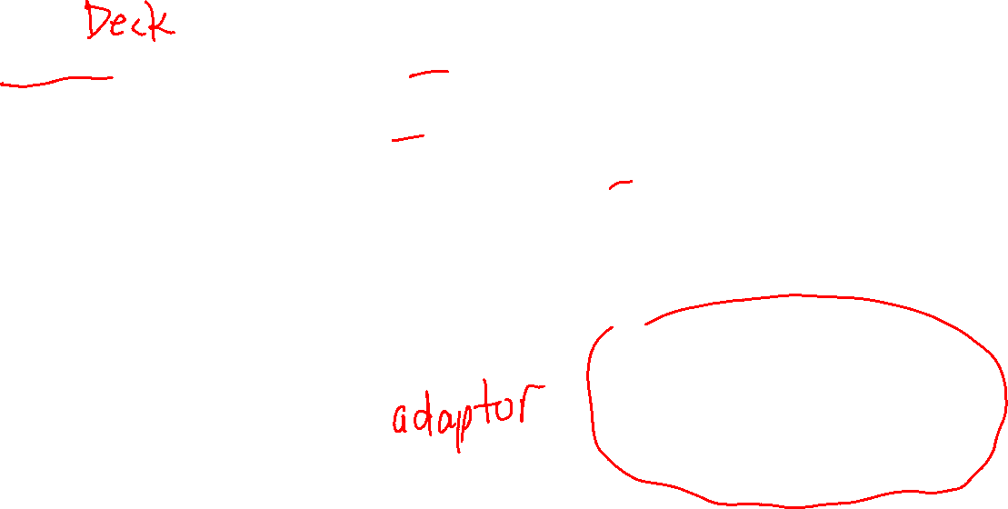
The Deque ADT
Deque means “double-ended queue”.
In practice, all these operations usually have worst-case O(1) running time, i.e. they are all very fast and don’t depend on the size of the queue.
insertFront(x): add x to the front of the deque; O(1)
insertBack(x): add x to the end of the deque; O(1)
eraseFront(): remove the front item of the deque; error if it’s empty; O(1)
eraseBack(): remove the back item of the deque; error if it’s empty ; O(1)
size(): returns number of items in the deque; O(1)
empty(): returns true if empty, false otherwise; O(1)
Note that by removing operations from a dequeue, we can use it to simulate a stack or queue.
C
D
A
front
back

Slide 27
Stack, Queue, and Deques
Stacks, queues, and deques are often implemented as arrays/vectors or linked lists.
To implement queues and deques efficiently with arrays, you can use circular arrays, i.e. treat the array as if it were a circle.
Some uses of stacks: function calls in programming languages; undo in programs; storage for tree/graph search algorithms; …
Some uses of queues: simulating “line ups”; processing events in a program in the order they occur ; storage for tree/graph search algorithms; …
Rule of thumb: Stacks, queues, and deques are efficient and simple, and so you should always try to use them in place of an array/vector if you can.

