Slide 1
Priority Queues and Heaps Chapter 8.1-8.3
CMPT 225

Slide 2
What is an abstract data type (ADT)?

Slide 3
What is an abstract data type (ADT)?
mathematics is precise!
An ADT is a mathematical model of a data structure that specifies the:
type of the data stored
operations supported on them
types of the parameters of the operations
An ADT specifies what each operation does, but not how it does it.

Slide 4
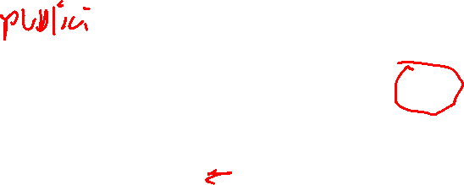
In C++, ADTs are often represented as abstract base classes.
template <typename T> class Queue_base { virtual int size() const = 0;
virtual void enqueue(T x) = 0;
virtual T front() = 0;
virtual void dequeue() = 0; };
An ADT is a mathematical model of a data structure that specifies the:
type of the data stored
operations supported on them
types of the parameters of the operations
An ADT specifies what each operation does, but not how it does it.

Slide 5
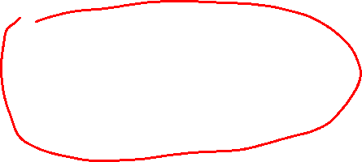
template <typename T> class Queue_base { // returns # of items in queue virtual int size() const = 0;
// adds a copy of x to the end // of the queue virtual void enqueue(T x) = 0; // returns a copy of the item at // the front of the queue; error // if empty virtual T front() = 0;
// removes the item at the front // of the queue; error if empty virtual void dequeue() = 0; };
In C++, ADTs are often represented as abstract base classes.
back
front
add
remove

Slide 6

template <typename T> class Queue_base { // returns # of items in queue virtual int size() const = 0;
// adds a copy of x to the end // of the queue virtual void enqueue(T x) = 0; // returns a copy of the item at // the front of the queue; error // if empty virtual T front() = 0;
// removes the item at the front // of the queue; error if empty virtual void dequeue() = 0; };
In C++, ADTs are often represented as abstract base classes.
back
front
add
remove
dequeue() always removes the front element of the queue. The front item also has the property that it is the ____________ item in the queue.

Slide 7
template <typename T> class Queue_base { // returns # of items in queue virtual int size() const = 0;
// adds a copy of x to the end // of the queue virtual void enqueue(T x) = 0; // returns a copy of the item at // the front of the queue; error // if empty virtual T front() = 0;
// removes the item at the front // of the queue; error if empty virtual void dequeue() = 0; };
In C++, ADTs are often represented as abstract base classes.
back
front
add
remove
dequeue() always removes the front element of the queue. The front item also has the property that it is the oldest item in the queue.

Slide 8
template <typename T> class Queue_base { // returns # of items in queue virtual int size() const = 0;
// adds a copy of x to the end // of the queue virtual void enqueue(T x) = 0; // returns a copy of the item at // the front of the queue; error // if empty virtual T front() = 0;
// removes the item at the front // of the queue; error if empty virtual void dequeue() = 0; };
In C++, ADTs are often represented as abstract base classes.
back
front
add
remove
dequeue() always removes the oldest item from the queue.
What other kinds of rules might you have for dequeue() ?

Slide 9
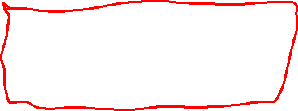
template <typename T> class Queue_base { // returns # of items in queue virtual int size() const = 0;
// adds a copy of x to the end // of the queue virtual void enqueue(T x) = 0; // returns a copy of the item at // the front of the queue; error // if empty virtual T front() = 0;
// removes the item at the front // of the queue; error if empty virtual void dequeue() = 0; };
What other kinds of rules might you have for dequeue() ?
Other possible rules for dequeue():
Remove the most recently added item: this makes it behave like a stack!
Remove a random item
Remove the “biggest” item, where “biggest” is defined specifically for the item
Remove the item that minimizes some function priority(x). This can approach works for most useful dequeue() rules.

Slide 10

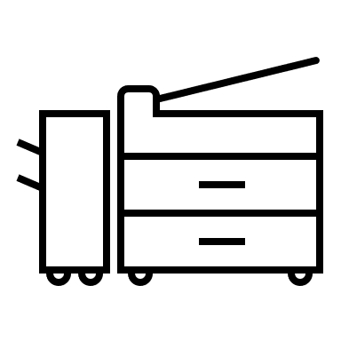

always prints job with lowest key
back
Printer Queue
may, 3,
ye, 2,
bob, 3,
dan, 6,
Printer
user, pri,
Print job
What other kinds of rules might you have for dequeue() ?

Slide 11
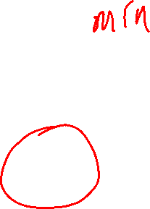
A priority queue
always prints job with lowest priority value
back
Printer Queue
may, 3,
ye, 2,
bob, 3,
dan, 6,
Printer
user, pri,
Print job
What other kinds of rules might you have for dequeue() ?

Slide 12
Priority Queue Abstract Data Type (ADT)
Important This assumes there is a function priority(x) that returns the priority value of x. The priority function is defined by the programmer depending upon the application.
size() returns number of items in the priority queue
insert(x) adds a copy of item x to the priority queue
min() returns a copy of the item with the smallest key value; error if empty
removeMin() removes the item min() refers to; error if empty

Slide 13
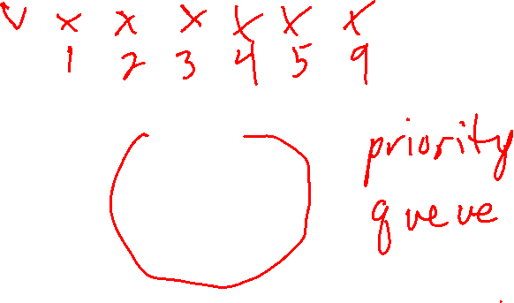
How can you use a priority queue to sort a vector of numbers?
0
1
2
3
4
5
5
2
1
4
9
3

Slide 14
How can you use a priority queue to sort a vector of numbers?
0
1
2
3
4
5
5
2
1
4
9
3
v passed by reference
priority_queue_sort(v) pq = empty priority queue while v.size() > 0: pq.insert(v.back()) v.pop_back() while pq.size() > 0: v.push_back(pq.min()) pq.removeMin() end
Move all values from v into the priority queue
Move all values from the priority queue back into v

Slide 15
template <typename T>
void pq_sort(vector<T> &v)
{
priority_queue<T> pq;
for (int i = 0; i < v.size(); i++)
{
pq.insert(v[i]);
}
for (int i = 0; i < v.size(); i++)
{
v[i] = pq.min();
pq.remove_min();
}
}
No need to remove the value from v since it will be over-written in the next loop.

Slide 16
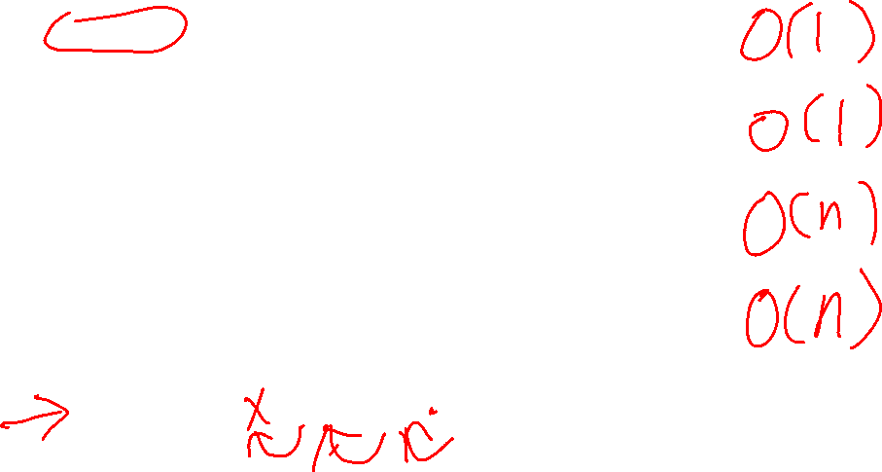
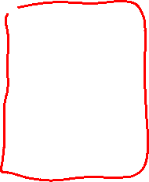
Priority Queue Implementation 1: Fast Insertion (unordered list)
size() v.size() Performance:
insert(x) v.push_back() Performance:
min() using a loop, find min key Performance:
removeMin() using a loop, remove min key Performance:
0
1
2
3
4
5
5
2
1
4
9
3

Slide 17
Priority Queue Implementation 1: Fast Insertion (unordered list)
size() v.size() Performance: O(1)
insert(x) v.push_back() Performance : O(1) (no re-sizing)
min() using a loop, find min key Performance : O(n)
removeMin() using a loop, remove min key Performance: O(n)
0
1
2
3
4
5
5
2
1
4
9
3

Slide 18
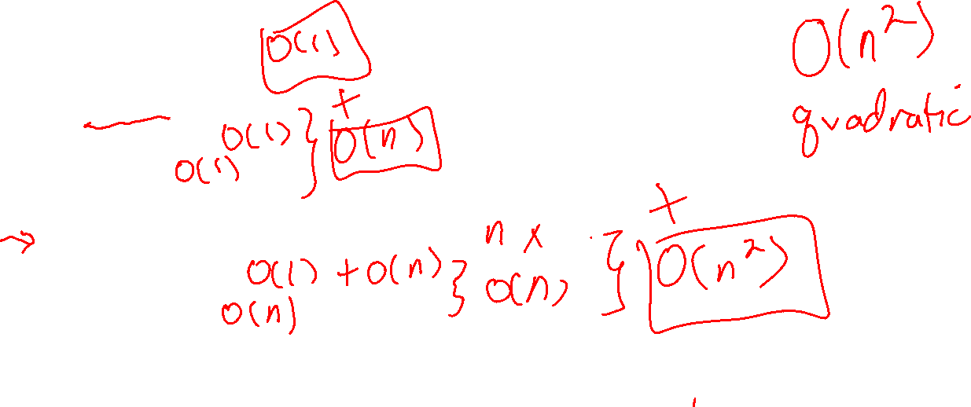
Using the fast insertion implementation, what is the performance of each line of this algorithm?
0
1
2
3
4
5
5
2
1
4
9
3
priority_queue_sort(v) pq = empty priority queue while v.size() > 0: pq.insert(v.back()) v.pop_back() while pq.size() > 0: v.push_back(pq.min()) pq.removeMin() end

Slide 19
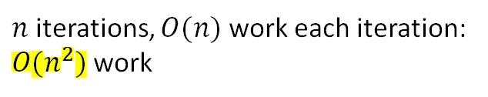
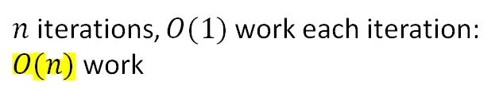
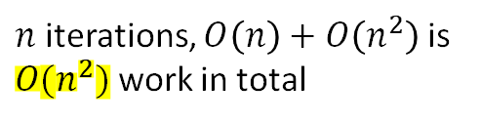
Using the fast insertion implementation, what is the performance of each line of this algorithm?
0
1
2
3
4
5
5
2
1
4
9
3
priority_queue_sort(v) pq = empty priority queue while v.size() > 0: pq.insert(v.back()) v.pop_back() while pq.size() > 0: v.push_back(pq.min()) pq.removeMin()
O(1)
O(1) + O(1) is O(1)
$n$ iterations, $O(1)$ work each iteration: $O(n)$ work
O(1)
O(1)
$n$ iterations, $O\left(n\right)+O\left(n^{2}\right)$ is $O(n^{2})$ work in total
O(n) + O(1) is O(n)
$n$ iterations, $O(n)$ work each iteration: $O(n^{2})$ work
O(n)

Slide 20
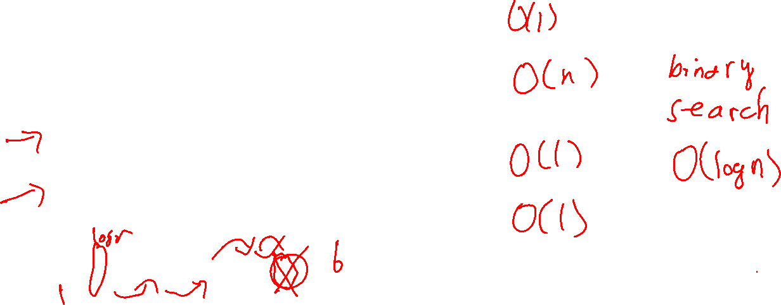
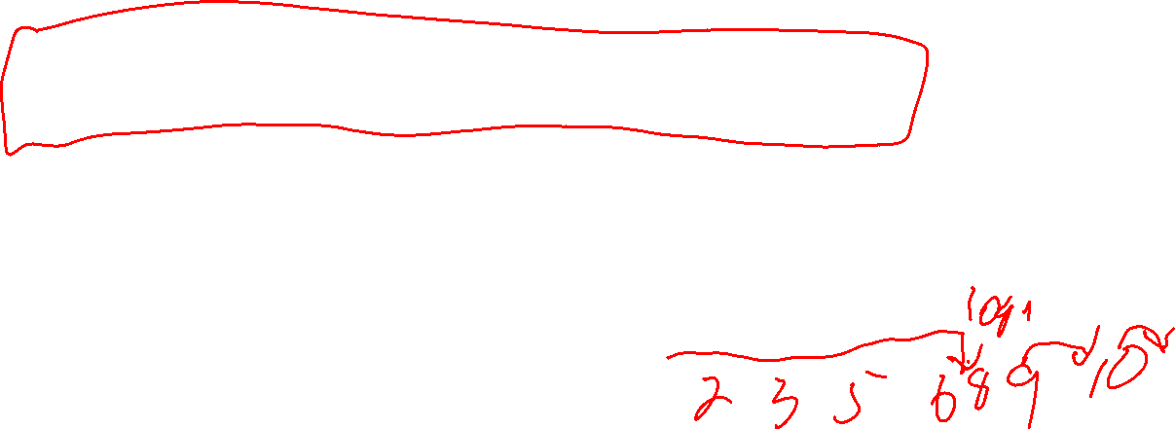
Priority Queue Implementation 2: Fast Removal (ordered list)
Idea: keep the vector in sorted order, always inserting new values at the correct place to keep it sorted.
size() v.size() Performance:
insert(x) insert at sorted position Performance: using a loop to shift values
min() v.back() Performance:
removeMin() v.pop_back() Performance:
0
1
2
3
4
5
9
5
4
3
2
1

Slide 21
Priority Queue Implementation 2: Fast Removal (ordered list)
Keep the vector in sorted order, always inserting new values at the correct place to keep it sorted.
size() v.size() Performance: O(1)
insert(x) insert at sorted position Performance: O(n) using a loop to shift values
min() v.back() Performance: O(1)
removeMin() v.pop_back() Performance: O(1)
0
1
2
3
4
5
9
5
4
3
2
1

Slide 22
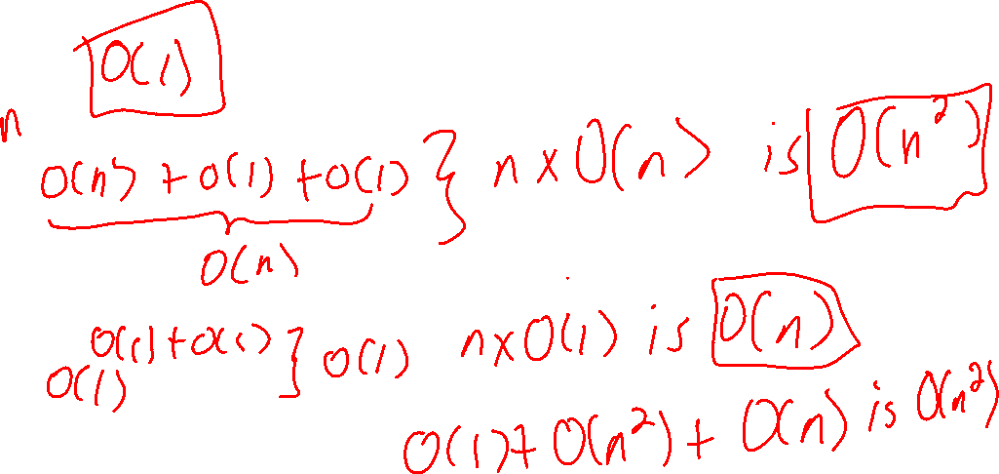
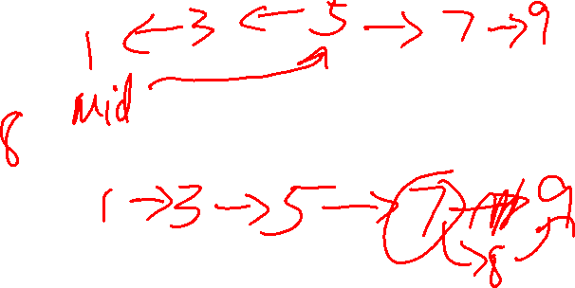
Using the fast removal implementation, what is the performance of each line of this algorithm?
0
1
2
3
4
5
v
5
2
1
4
9
3
priority_queue_sort(v) pq = empty priority queue while v.size() > 0: pq.insert(v.back()) v.pop_back() while pq.size() > 0: v.push_back(pq.min()) pq.removeMin()

Slide 23
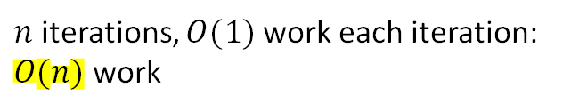
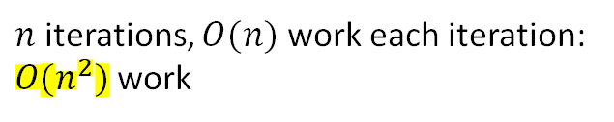
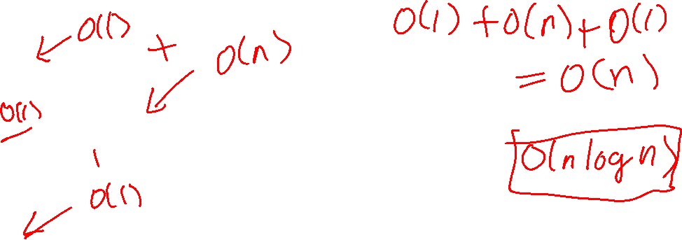

Using the fast removal implementation, what is the performance of each line of this algorithm?
0
1
2
3
4
5
v
5
2
1
4
9
3
priority_queue_sort(v) pq = empty priority queue while v.size() > 0 do pq.insert(v.back()) v.pop_back() end while pq.size() > 0 do v.push_back(pq.min()) pq.removeMin() end
O(1)
O(n) + O(1) is O(n)
$n$ iterations, $O(n)$ work each iteration: $O(n^{2})$ work
O(1)
O(1)
$n$ iterations, $O\left(n^{2}\right)+O(n)$ is $O(n^{2})$ work in total
O(1) + O(1) is O(1)
$n$ iterations, $O(1)$ work each iteration: $O(n)$ work
O(1)

Slide 24

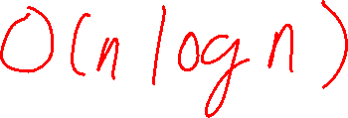
Implementing Priority Queues
The obvious vector implementations of priority queue sort are both $O(n^{2})$
At least one of insertion or removal is $O(n)$
Is there a way to make both insertion and removal fast in a priority queue?

Slide 25
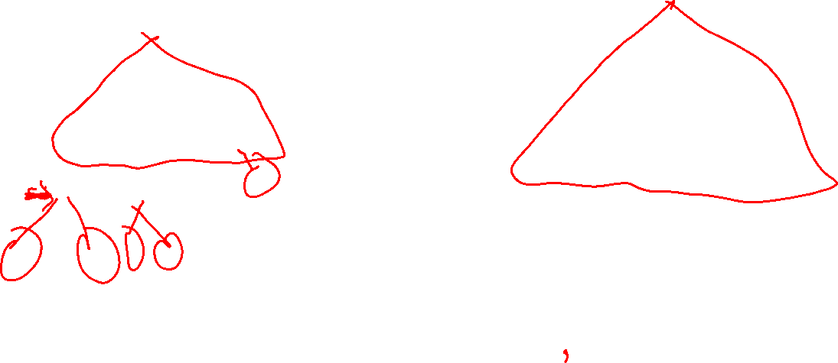
What do these trees have in common?

Slide 26
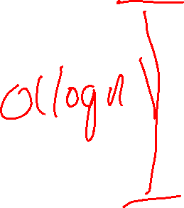
What do these trees have in common?
This makes the trees as short as possible, i.e. height O(log n).
Binary trees
Complete trees
all levels of the tree have the max # of nodes
leaf nodes are filled in from the left

Slide 27
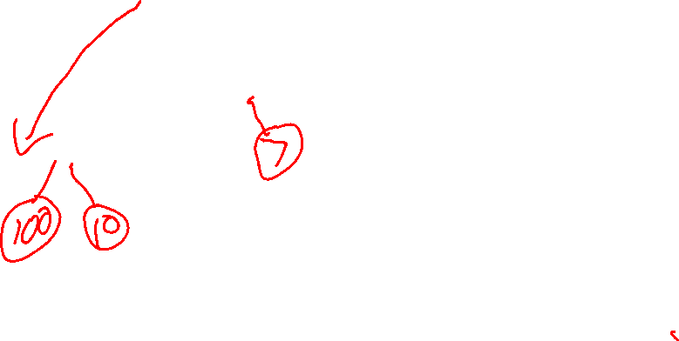
What rule do the numbers in the nodes follow?
What’s special about the root numbers?
3
2
5
10
4
6
6
8
15
11
9
8
10
9
7

Slide 28
What rule do the keys in the nodes follow?
What’s special about the root key?
root is min value
root is min value
3
2
5
10
4
6
6
8
15
11
9
8
10
P
9
7
C1
C2
For all nodes: child keys are >= parent key Except for the root (has no parent)
The Heap-Order Property

Slide 29
Write down the definition of a heap.

Slide 30
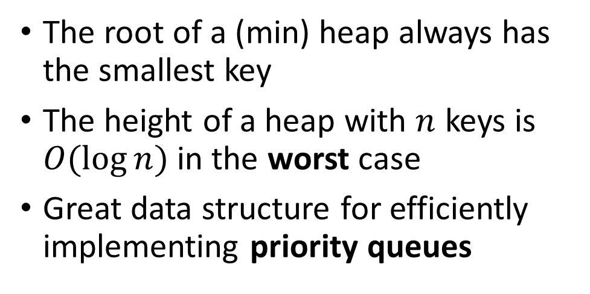
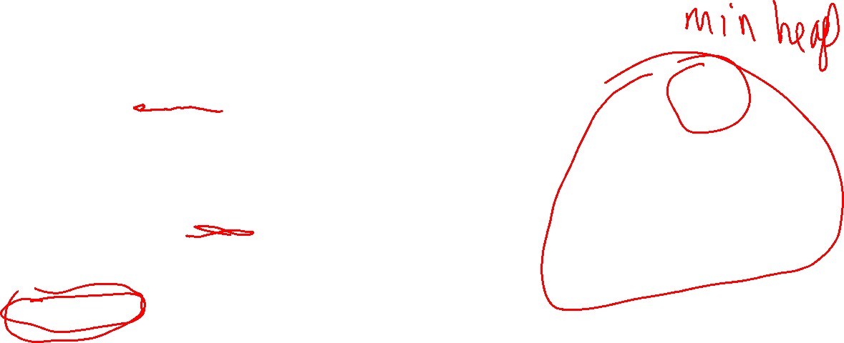
Min Heaps
A heap is a complete binary tree where every node has the Heap-Order property.
3
5
10
The root of a (min) heap always has the smallest key
The height of a heap with $n$ keys is $O(log⁡n)$in the worst case
Great data structure for efficiently implementing priority queues
6
8
15
11
9
7
You could choose to order heaps so that max is at the top instead of the min. That would be a max heap. We’re using min heaps in this course.

Slide 31
Priority Queue Abstract Data Type (ADT)
size(): returns number of items in the priority queue
insert(x): adds item x to the priority queue
min(): returns a copy of the item with the smallest key value; error if empty
removeMin(): removes the item min() refers to; error if empty
A min heap can efficiently implement both these operations at the same time.

Slide 32

insert(x): adds item x to the priority queue
How can you efficiently insert 4 into this min heap so that it remains a heap?
3
5
10
6
8
15
11
9
7
Heap-Order Property
For all non-root nodes, child keys are >= their parent key.

Slide 33
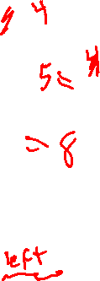
insert(x): adds item x to the priority queue
How can you efficiently insert 4 into this min heap so that it remains a heap?
3
5
10
6
8
15
11
9
7
4
Heap-Order Property
For all non-root nodes, child keys are >= their parent key.
Start by adding it as a new right-most leaf on the bottom level.

Slide 34
insert(x): adds item x to the priority queue
How can you efficiently insert 4 into this min heap so that it remains a heap?
3
5
10
6
8
15
11
9
7
4
Heap-Order Property
For all non-root nodes, child keys are >= their parent key.
If it is smaller than its parent, then swap it with its parent.

Slide 35
insert(x): adds item x to the priority queue
How can you efficiently insert 4 into this min heap so that it remains a heap?
3
5
10
6
4
15
11
9
7
8
A heap is a complete binary tree where every node that has the Heap-Order property.

Slide 36
insert(x): adds item x to the priority queue
How can you efficiently insert 4 into this min heap so that it remains a heap?
3
4
10
6
5
15
11
9
7
8
Heap-Order Property
For all non-root nodes, child keys are >= their parent key.

Slide 37
insert(x): adds item x to the priority queue
How can you efficiently insert 4 into this min heap so that it remains a heap?
3
4
10
6
5
15
11
9
7
8
Heap-Order Property
For all non-root nodes, child keys are >= their parent key.

Slide 38
insert(x): adds item x to the priority queue
How can you efficiently insert 4 into this min heap so that it remains a heap?
3
4
10
6
5
15
11
9
7
8
Heap-Order Property
For all non-root nodes, child keys are >= their parent key.

Slide 39
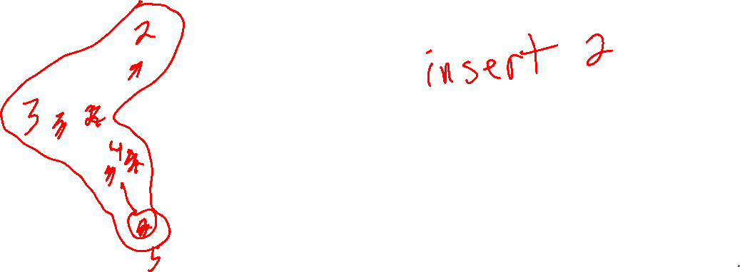
How can you insert 2 into this min heap so that it remains a heap?
3
4
10
6
5
15
11
9
7
8
Heap-Order Property
For all non-root nodes, child keys are >= their parent key.

Slide 40
How you insert 2 into this min heap so that it remains a heap?
2
3
10
6
4
15
11
9
7
8
5
Heap-Order Property
For all non-root nodes, child keys are >= their parent key.

Slide 41
How much work does inserting into a min heap do?
2
3
10
6
4
15
11
9
7
8
5
Heap-Order Property
For all non-root nodes, child keys are >= their parent key.

Slide 42
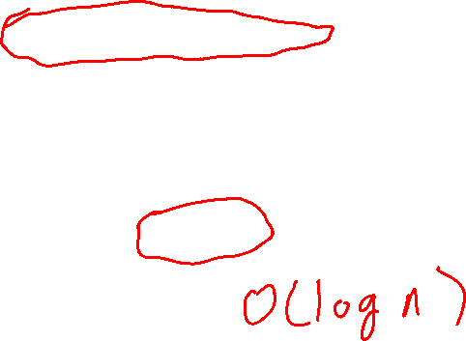
How much work does inserting into a min heap do?
In the worst case, added key goes from bottom of the tree to the root, doing O(1) work at each level.
2
3
10
6
4
15
11
Since a heap is a complete binary tree, the height of a heap with n nodes is at most O(log n).
9
7
8
5
Worst-case performance of insert(x):

Slide 43
How much work does inserting into a min heap do?
In the worst case, added key goes from bottom of the tree to the root, doing O(1) work at each level.
2
3
10
6
4
15
11
Since a heap is a complete binary tree, the height of a heap with n nodes is at most O(log n).
9
7
8
5
Worst-case performance of insert(x):
O(log n)

Slide 44

How much work does inserting into a min heap do?
In the worst case, added key goes from bottom of the tree to the root, doing O(1) work at each level.
Path of x to its stopping node is at most O(log n) steps.
O(log n) height
Since a heap is a complete binary tree, the height of a heap with n nodes is at most O(log n).
x
Worst-case performance of insert(x):
O(log n)

Slide 45
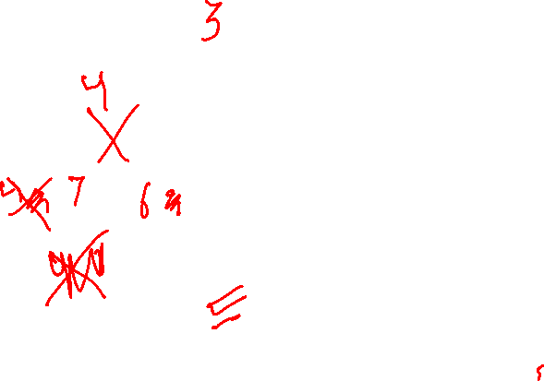
removeMin(): removes the min key (the root) of the heap
After removing the root key, how can you make the tree a heap?
2
3
10
6
4
15
11
9
7
8
5
Heap-Order Property
For all non-root nodes, child keys are >= their parent key.

Slide 46
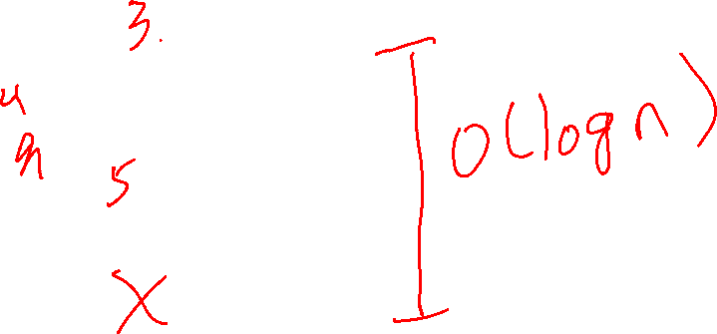
removeMin(): removes the min key (the root) of the heap
2
3
10
6
4
15
11
9
7
8
5
Copy the last element of the heap into the root.
Heap-Order Property
For all non-root nodes, child keys are >= their parent key.

Slide 47
removeMin(): removes the min key (the root) of the heap
Fix the heap by swapping the new root down to its correct node.
5
3
10
6
4
15
11
9
7
8
Heap-Order Property
For all non-root nodes, child keys are >= their parent key.

Slide 48
removeMin(): removes the min key (the root) of the heap
Fix the heap by swapping the new root down to its correct node.
3
5
10
6
4
15
11
9
7
8
Heap-Order Property
For all non-root nodes, child keys are >= their parent key.

Slide 49
removeMin(): removes the min key (the root) of the heap
3
4
10
6
5
15
11
9
7
8
Fix the heap by swapping the new root down to its correct node.
Heap-Order Property
For all non-root nodes, child keys are >= their parent key.

Slide 50
removeMin(): removes the min key (the root) of the heap
3
4
10
6
5
15
11
9
7
8
this node has been removed
Heap-Order Property
For all non-root nodes, child keys are >= their parent key.

Slide 51
How much works does removing the min do?
Copying the last element of the heap into the root is: O(1)
2
3
10
6
4
15
11
9
7
8
5

Slide 52
How much works does removing the min do?
Copying the last element of the heap into the root is: O(1)
5
3
10
height O(log n)
In the worst case, the new root is swapped-down to the bottom level of the tree, O(1) work per swap.
6
4
15
11
9
7
8
Worst-case performance of removeMin():

Slide 53
How much works does removing the min do?
Copying the last element of the heap into the root is: O(1)
5
3
10
height O(log n)
In the worst case, the new root is swapped-down to the bottom level of the tree, O(1) work per swap.
6
4
15
11
9
7
8
Worst-case performance of removeMin():
O(log n)

Slide 54
How much work does removing min from a min heap do?
In the worst case, added key goes from bottom of the tree to the root, doing O(1) work at each level.
Path of root to its stopping node is at most O(log n) steps.
O(log n) height
Since a heap is a complete binary tree, the height of a heap with n nodes is at most O(log n).
Worst-case performance of removeMin():
O(log n)

Slide 55
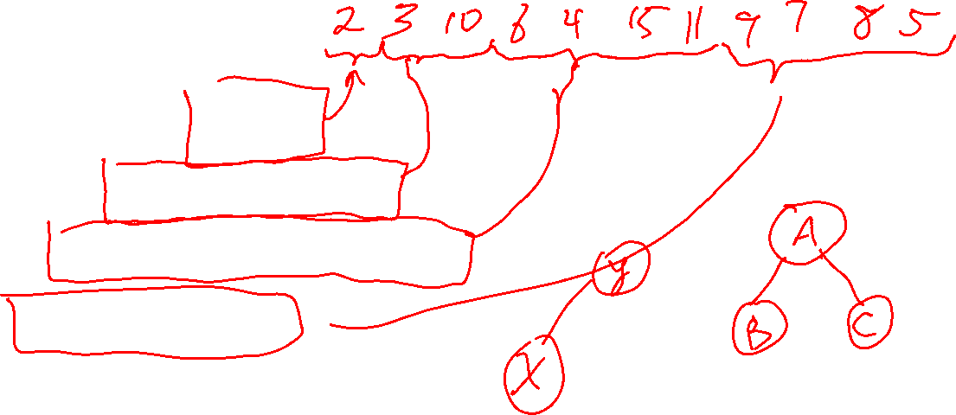
How can you represent a heap efficiently in an array/vector?
0
1
2
3
4
5
6
7
8
9
10
2
3
10
6
4
15
11
9
7
8
5

Slide 56
How can you represent a heap efficiently in an array/vector?
0
1
2
3
4
5
6
7
8
9
10
Level 0
2
Level 1
3
10
Level 2
6
4
15
11
Level 3
9
7
8
5

Slide 57
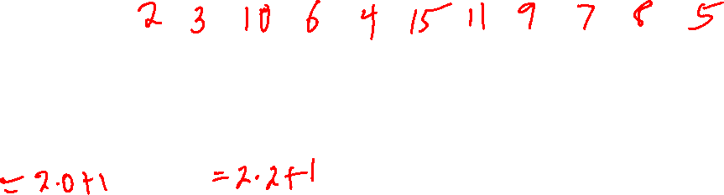
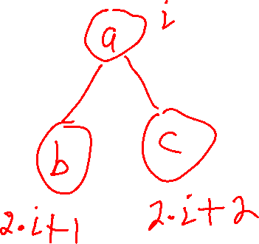
How can you represent a heap efficiently in an array/vector?
0
1
2
3
4
5
6
7
8
9
10
Level 0
2
0
Level 1
3
1
10
2
Level 2
6
3
4
4
15
5
11
6
Level 3
9
7
7
8
8
9
5
10

Slide 58
How can you represent a heap efficiently in an array/vector?
0
1
2
3
4
5
6
7
8
9
10
2
3
10
6
4
15
11
9
7
8
5
Level 0
2
0
What’s the rule for where heap values are stored in a corresponding vector?
Level 1
3
1
10
2
a
i
Level 2
6
3
4
4
15
5
11
6
b
?
c
?
Level 3
9
7
7
8
8
9
5
10

Slide 59
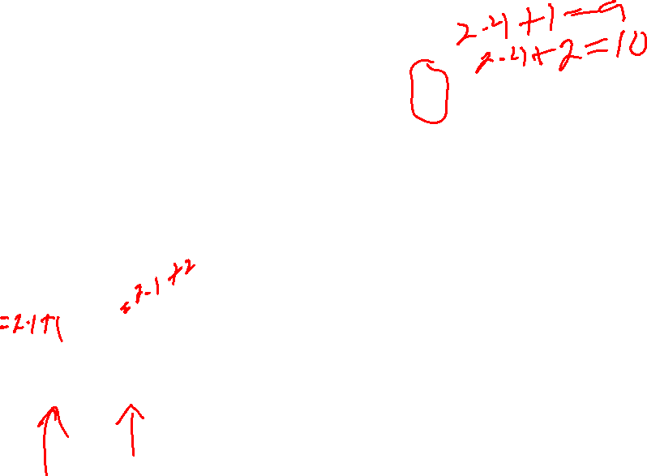
How can you represent a heap efficiently in an array/vector?
0
1
2
3
4
5
6
7
8
9
10
2
3
10
6
4
15
11
9
7
8
5
Level 0
2
0
What’s the rule for where heap values are stored in a corresponding vector?
Level 1
3
1
10
2
a
i
Level 2
6
3
4
4
15
5
11
6
b
2i+1
c
2i+2
Level 3
9
7
7
8
8
9
5
10
Note The textbook treats index 0 as a dummy location and starts at index 1.
The root is always at index 0

Slide 60

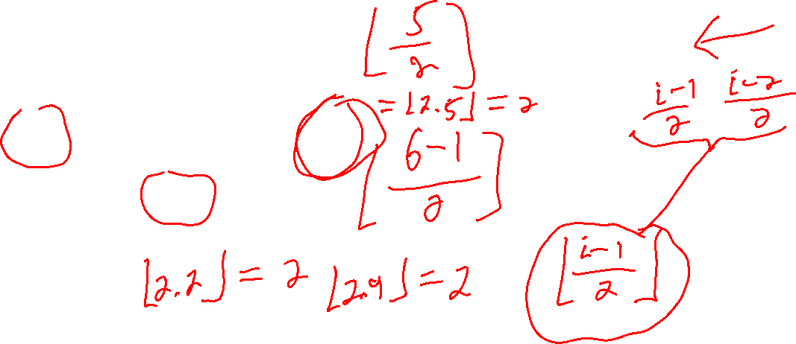
How can you represent a heap efficiently in an array/vector?
0
1
2
3
4
5
6
7
8
9
10
2
3
10
6
4
15
11
9
7
8
5
Level 0
2
0
What’s the index of a node’s parent?
Level 1
3
1
10
2
a
?
Level 2
6
3
4
4
15
5
11
6
Careful! This could be the left or right child of the parent.
7
8
8
9
10
b
$$i$$
Level 3
9
7
5

Slide 61
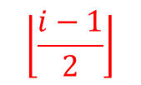
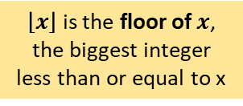
How can you represent a heap efficiently in an array/vector?
0
1
2
3
4
5
6
7
8
9
10
2
3
10
6
4
15
11
9
7
8
5
Level 0
2
0
What’s the index of a node’s parent?
Level 1
3
1
10
2
$$\left\lfloor \frac{i−1}{2}\right\rfloor$$
a
Level 2
6
3
4
4
15
5
11
6
9
10
b
$$i$$
$\left\lfloor x\right\rfloor$ is the floor of $x$, the biggest integer less than or equal to x
Level 3
9
7
7
8
8
5

Slide 62


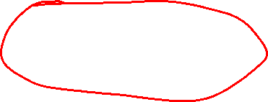
How can you represent a heap efficiently in an array/vector?
0
1
2
3
4
5
6
7
8
9
10
2
3
10
6
4
15
11
9
7
8
5
Level 0
2
0
Level 1
3
1
10
2
a
i
$$\left\lfloor \frac{i−1}{2}\right\rfloor$$
a
Level 2
6
3
4
4
15
5
11
6
b
2i+1
c
2i+2
The root is always at index 0
b
$$i$$
Level 3
9
7
7
8
8
9
5
10
left_child(i) = 2*i + 1 right_child(i) = 2*i + 2 parent(i) = floor((i-1)/2)

Slide 63
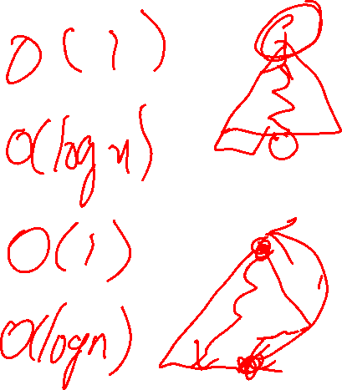
Priority Queue Implementation 3: Heap
size() v.size() Performance:
insert(x) add as leaf, Performance: bubble-up
min() return root Performance:
removeMin() overwrite with Performance: right-most leaf, bubble-down

Slide 64




Priority Queue Implementation 3: Heap
size() v.size() Performance:
insert(x) add as leaf, Performance: bubble-up
min() return root Performance:
removeMin() overwrite with Performance: right-most leaf, bubble-down
$$O(1)$$
$$O(\log{n})$$
$$O(1)$$
$$O(\log{n})$$

Slide 65
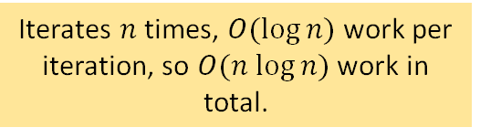

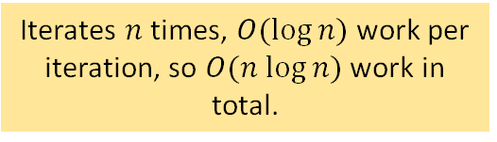


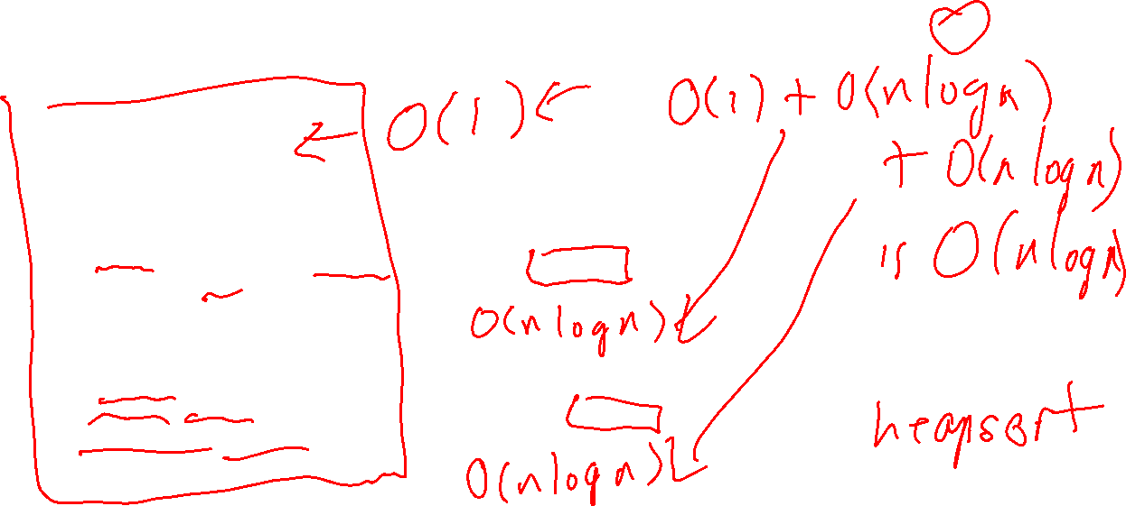


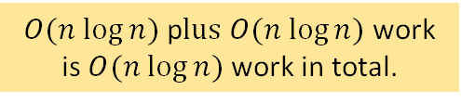
Using a heap implementation, what is the performance of each line of this algorithm?
0
1
2
3
4
5
5
2
1
4
9
3
priority_queue_sort(v) pq = empty priority queue while v.size() > 0: pq.insert(v.back()) v.pop_back() while pq.size() > 0: v.push_back(pq.min()) pq.removeMin()
$$O(1)$$
$$O(1)+O(log⁡n)$$
Iterates $n$ times, $O(log⁡n)$ work per iteration, so $O(n log⁡n)$ work in total.
$$O(1)$$
$O(n log⁡n)$ p$lus O(n log⁡n)$ work is $O(n log⁡n)$ work in total.
$$O(1)$$
Iterates $n$ times, $O(log⁡n)$ work per iteration, so $O(n log⁡n)$ work in total.
$$O\left(1\right)+O(1)$$
$$O\left(\log{n}\right)$$

Slide 66
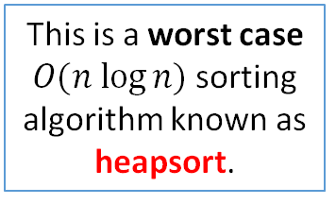
Using a heap implementation, what is the performance of each line of this algorithm?
0
1
2
3
4
5
5
2
1
4
9
3
This is a worst case $O(n log⁡n)$sorting algorithm known as heapsort.
priority_queue_sort(v) pq = empty priority queue while v.size() > 0: pq.insert(v.back()) v.pop_back() while pq.size() > 0: v.push_back(pq.min()) pq.removeMin()
$$O(1)$$
$$O(1)+O(log⁡n)$$
Iterates $n$ times, $O(log⁡n)$ work per iteration, so $O(n log⁡n)$ work in total.
$$O(1)$$
$O(n log⁡n)$ p$lus O(n log⁡n)$ work is $O(n log⁡n)$ work in total.
$$O(1)$$
Iterates $n$ times, $O(log⁡n)$ work per iteration, so $O(n log⁡n)$ work in total.
$$O\left(1\right)+O(1)$$
$$O\left(\log{n}\right)$$

Slide 67
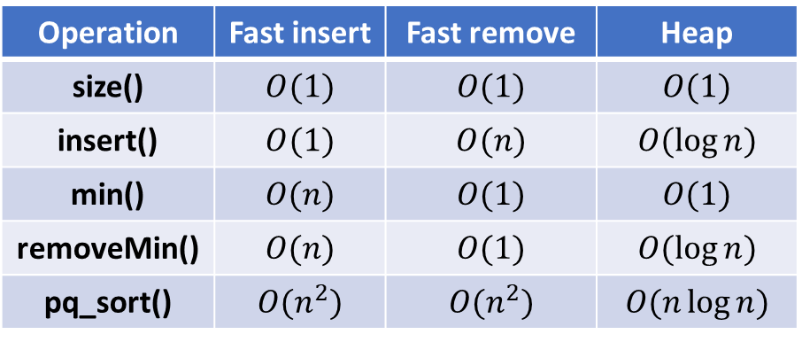
Priority Queue Sorting
all implemented as a vector
Operation | Fast insert | Fast remove | Heap
size() | $$O(1)$$ | $$O(1)$$ | $$O(1)$$
insert() | $$O(1)$$ | $$O(n)$$ | $$O(\log{n})$$
min() | $$O(n)$$ | $$O(1)$$ | $$O(1)$$
removeMin() | $$O(n)$$ | $$O(1)$$ | $$O(\log{n})$$
pq_sort() | $$O(n^{2})$$ | $$O(n^{2})$$ | $$O(n\log{n})$$
Priority queue operations

Slide 68
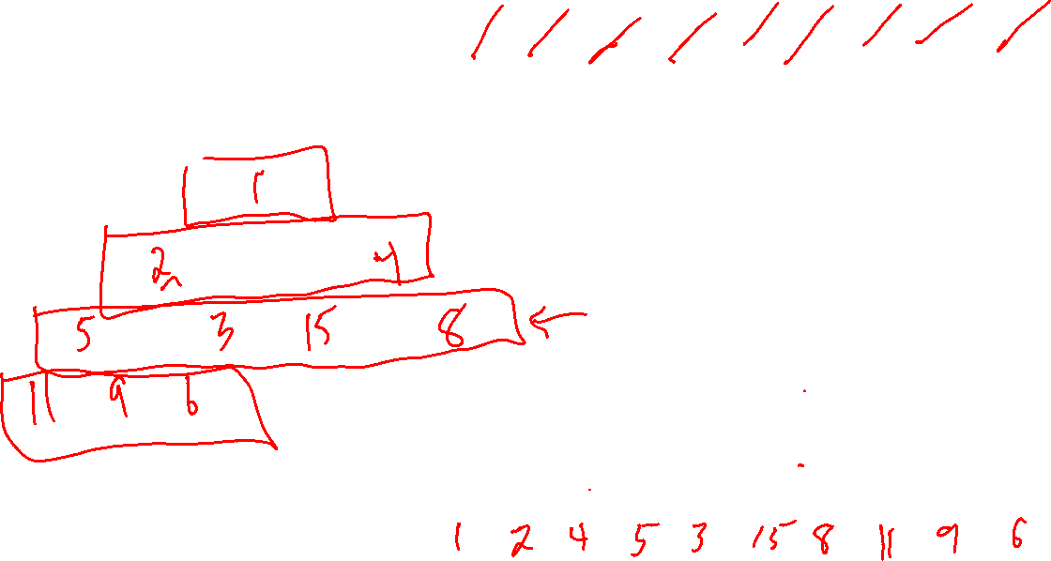
Insert the following keys into an empty min heap in the order given. Show the final heap tree and array (put the root at index 0 of the array).
5, 9, 15, 6, 4, 8, 2, 11, 1, 3
0
1
2
3
4
5
6
7
8
9

Slide 69
Insert the following keys into an empty min heap in the order given. Show the final heap tree and array (put the root at index 0 of the array).
5, 9, 15, 6, 4, 8, 2, 11, 1, 3
1
2
4
5
3
15
8
11
9
6
0
1
2
3
4
5
6
7
8
9

Slide 70
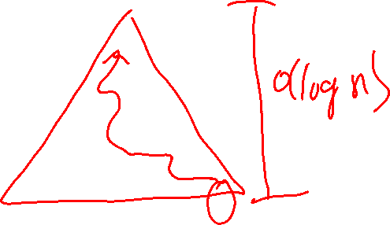
Insert the following keys into an empty min heap in the order given. Show the final heap tree and array (put the root at index 0 of the array).
5, 9, 15, 6, 4, 8, 2, 11, 1, 3
1
2
4
5
3
15
8
11
9
6
0
1
2
3
4
5
6
7
8
9
1
2
4
5
3
15
8
11
9
6

Slide 71
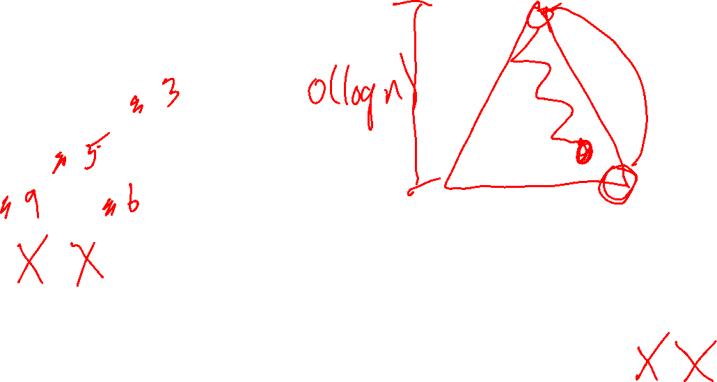
What does this min heap look like after calling removeMin()? Draw the heap tree and heap array (put the root at index 0)
1
2
4
5
3
15
8
11
9
6
0
1
2
3
4
5
6
7
8
9
1
2
4
5
3
15
8
11
9
6

Slide 72
What does this min heap look like after calling removeMin()? Draw the heap tree and heap array (put the root at index 0)
2
3
4
5
6
15
8
11
9
0
1
2
3
4
5
6
7
8
9
2
3
4
5
6
15
8
11
9

Slide 73
Call removeMin() again.
2
3
4
5
6
15
8
11
9
0
1
2
3
4
5
6
7
8
2
3
4
5
6
15
8
11
9

Slide 74
Call removeMin() again.
3
5
4
9
6
15
8
11
0
1
2
3
4
5
6
7
8
3
5
4
9
6
15
8
11
9

