Slide 1
Week 2
CMPT 225, Fall 2023 SFU Surrey

Slide 2
Do this now! Write C++ code that creates and prints this data structure:
H
cat
dog
bird
This symbol means the null pointer.

Slide 3
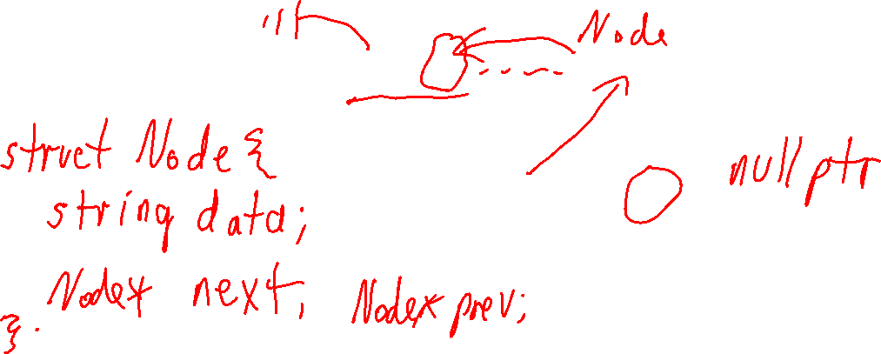
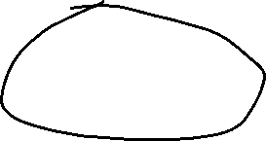
Do this now! Write C++ code that creates and prints this data structure:
See singly_linked_list0.cpp for a step-by-step solution.
H
cat
dog
bird
This symbol means the null pointer.

Slide 4
Add the following functions to singly_linked_list0.cpp …
empty() returns true if the list is empty, and false otherwise
size() returns the number of nodes in the list
print() prints the values in the list to cout
push_front(x) adds a new node, with value x at the front of the list
pop_front() removes the front element of the list, and returns a copy of it
clear() removes all elements from the list
Test each function a little bit to make sure it is correct.
See singly_linked_list1.cpp for a sample solution.

Slide 5
Update singly_linked_list1.cpp like this…
Make a class called List.
Put the Node class in the private part of List.
Put the head pointer in the private part of List.
Put all the previous functions into List as methods. For methods that don’t modify the list, make them const.
Add the destructor ~List() that de-allocates all node in the list.
Test each function a little bit to make sure it is correct.
See singly_linked_list2.cpp for a sample solution.

Slide 6
Which do you prefer? Why?
The list with the global head pointer?
The list that is encapsulated inside a class?

Slide 7
Which do you prefer? Why?
Why I prefer the class list:
It hides the details of the Node and pointers from the user.
It makes it hard to accidentally mess-up the list, e.g. by setting head == nullptr
The destructor automatically cleans up memory when the list is no longer used.
It’s easy to make multiple lists.
The list with the global head pointer?
The list that is encapsulated inside a class?

Slide 8
Abstract Data Types (ADTs)
Imagine a class List has these methods:
empty() returns true if the list is empty, and false otherwise
size() returns the number of nodes in the list
print() prints the values in the list to cout
push_front(x) adds a new node, with value x at the front of the list
pop_front() removes the front element of the list, and returns a copy of it
clear() removes all elements from the list
Notice that nothing is said about how List is implemented. It might be a singly-linked
list, or it might not.
It could be implemented with a vector instead of a linked list.

Slide 9
Abstract Data Types (ADTs)
ADTs are very useful!
An ADT tells you what an object does, but does not say how the type is implemented.
Imagine a class List has these methods:
empty() returns true if the list is empty, and false otherwise
size() returns the number of nodes in the list
print() prints the values in the list to cout
push_front(x) adds a new node, with value x at the front of the list
pop_front() removes the front element of the list, and returns a copy of it
clear() removes all elements from the list
Notice that nothing is said about how List is implemented. It might be a singly-linked
list, or it might not.
It could be implemented with a vector instead of a linked list.

Slide 10
Abstract Data Types (ADTs)
ADTs are very useful!
An ADT tells you what an object does, but does not say how the type is implemented.
Imagine a class List has these methods:
empty() returns true if the list is empty, and false otherwise
size() returns the number of nodes in the list
print() prints the values in the list to cout
push_front(x) adds a new node, with value x at the front of the list
pop_front() removes the front element of the list, and returns a copy of it
clear() removes all elements from the list
Notice that nothing is said about how List is implemented. It might be a singly-linked
list, or it might not.
An ADT specifies the interface of an object without saying how that objects is implemented.
It could be implemented with a vector instead of a linked list.

Slide 11
Abstract Data Types (ADTs)
ADTs are very useful!
An ADT tells you what an object does, but does not say how the type is implemented.
Imagine a class List has these methods:
empty() returns true if the list is empty, and false otherwise
size() returns the number of nodes in the list
print() prints the values in the list to cout
push_front(x) adds a new node, with value x at the front of the list
pop_front() removes the front element of the list, and returns a copy of it
clear() removes all elements from the list
Notice that nothing is said about how List is implemented. It might be a singly-linked
list, or it might not.
An ADT specifies the interface of an object without saying how that objects is implemented.
In C++, we usually represent an ADT as an abstract base class …
It could be implemented with a vector instead of a linked list.

Slide 12
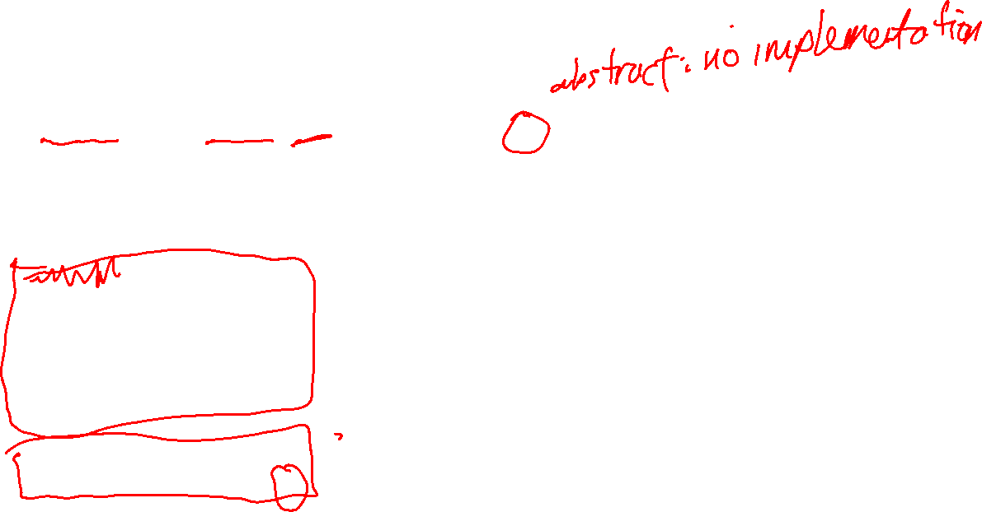
Abstract Data Types (ADTs)
class List_base {
public:
virtual bool empty() const = 0;
virtual int size() const = 0;
virtual void print() const = 0;
virtual void push_front(const string &s) = 0;
virtual string pop_front() = 0;
virtual string peek_front() const = 0;
virtual void clear()
{
while (!empty())
{
pop_front();
}
}
// virtual destructor
virtual ~List_base() { }
};

Slide 13
Abstract Data Types (ADTs)
class List_base {
public:
virtual bool empty() const = 0;
// ...
};
A C++ class is private by default. An abstract base class should have all public methods.
virtual means inheriting classes provide their own implementation of this method
= 0 means the method is abstract, i.e. it has no implementation in this class (and so an inheriting class must provide an implementation)

Slide 14
Abstract Data Types (ADTs)
class List_base {
public:
// ...
virtual void clear()
{
while (!empty())
{
pop_front();
}
}
// ...
};
virtual means inheriting classes can, if they like, over-ride this default implementation of clear and provide their own
In some cases, it might be possible to have a default implementation of base class method using other methods in the class.

Slide 15
Abstract Data Types (ADTs)
class List_base {
public:
// ...
// virtual destructor
virtual ~List_base() { }
};
C++ base classes should always declare a public virtual destructor. This allows inheriting classes to provide their own destructors.

Slide 16
Abstract Data Types (ADTs)
class List_base {
public:
virtual bool empty() const = 0;
// ...
};
List inherits from List_base. This means every object of type List is (also) an object of type List_base.
class List : public List_base { // ...
public:
bool empty() const { return head == nullptr; }
// ...
};

Slide 17
Abstract Data Types (ADTs)
class List_base {
public:
virtual bool empty() const = 0;
// ...
};
This public means all the methods inherited from List_base have the same visibility. E.g. public methods in List_base are public in List.
class List : public List_base { // ...
public:
bool empty() const { return head == nullptr; }
// ...
};

Slide 18

Abstract Data Types (ADTs)
class List_base {
public:
virtual bool empty() const = 0;
// ...
};
List_base
List
We can represent inheritance relationships use a class diagram, like above. The arrow always points to the class being inherited from.
class List : public List_base { // ...
public:
bool empty() const { return head == nullptr; }
// ...
};

Slide 19
Class Hierarchies
List_base
Any number of classes can inherit from List_base. They can implement the abstract (= 0) methods in List_base in any way that makes sense.
List
List_vec
List_vec

Slide 20
Class Hierarchies
List_base
List
List_vec
List_vec
Better_List
You can also have classes inherit from other classes …
Each inheriting class can add new methods, or over-ride methods in one of its parent classes.
Even_Better_List

Slide 21
Class Hierarchies
List_base
List
List_vec
List_vec
It’s possible to design big inheritance hierarchies with many classes. But we will not create big class hierarchies in this course.
Better_List
Even_Better_List
Instead, we will focus on ADTs using abstract base classes with a single level of inheritance.

Slide 22
Add these methods to singly_linked_list2.cpp …
operator== to test if two lists have the same elements in the same order.
operator!= to test if two lists don’t have the same elements in the same order.
contains(x) that returns true if x is in the list, and false otherwise.
push_front_new(x) adds x as the front element of x if x is not already contained in the list; does nothing if x is already in the list
Test each function a little bit to make sure it is correct.
See singly_linked_list3.cpp for a sample solution.

Slide 23
Add these methods to singly_linked_list2.cpp … but use only recursion and no loops
operator== to test if two lists have the same elements in the same order.
operator!= to test if two lists don’t have the same elements in the same order.
contains(x) that returns true if x is in the list, and false otherwise.
push_front_new(x) adds x as the front element of x if x is not already contained in the list; does nothing if x is already in the list
Test each function a little bit to make sure it is correct.
See singly_linked_list3_recursive.cpp for a sample solution.

