Slide 1
Chapter 7: Trees
CMPT 225

Slide 2
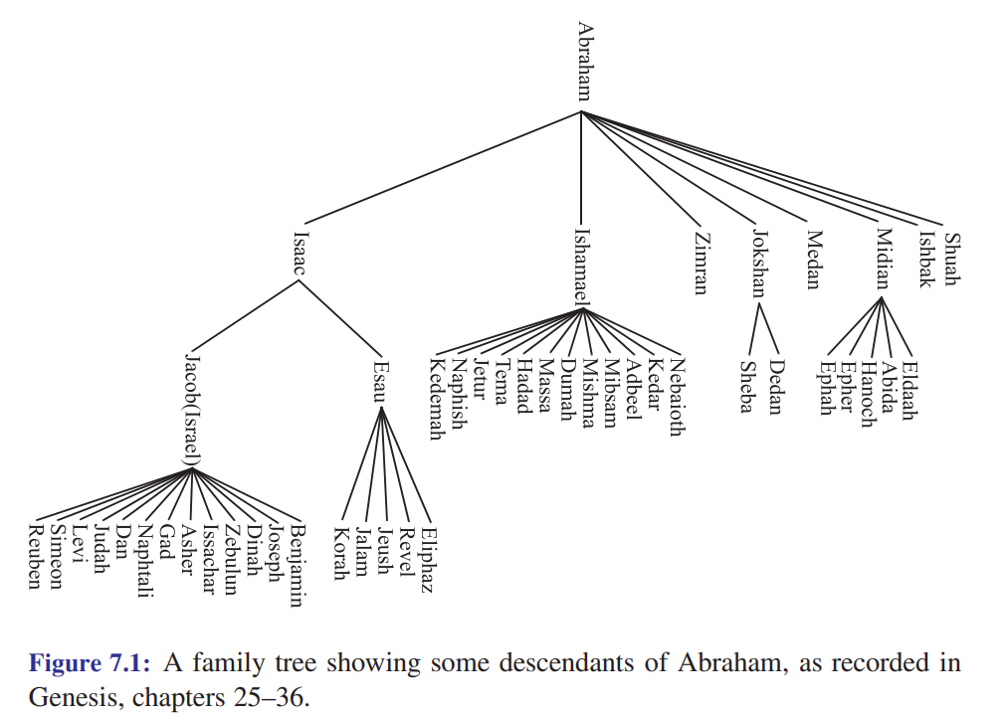

Family Tree

Slide 3
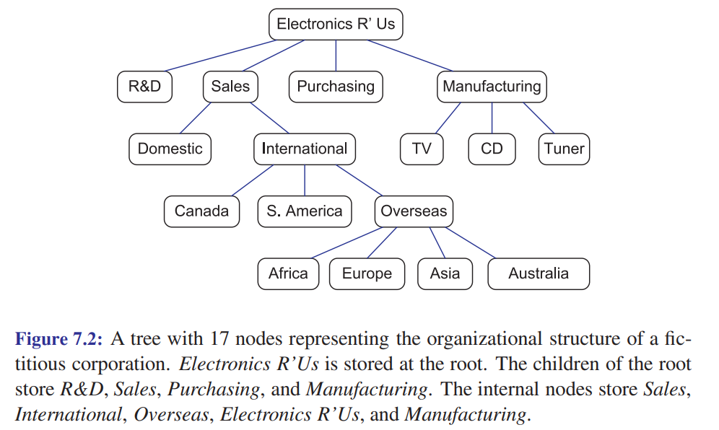
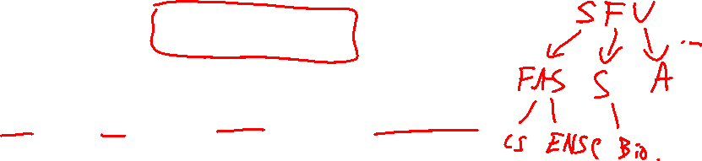
Organization Tree

Slide 4
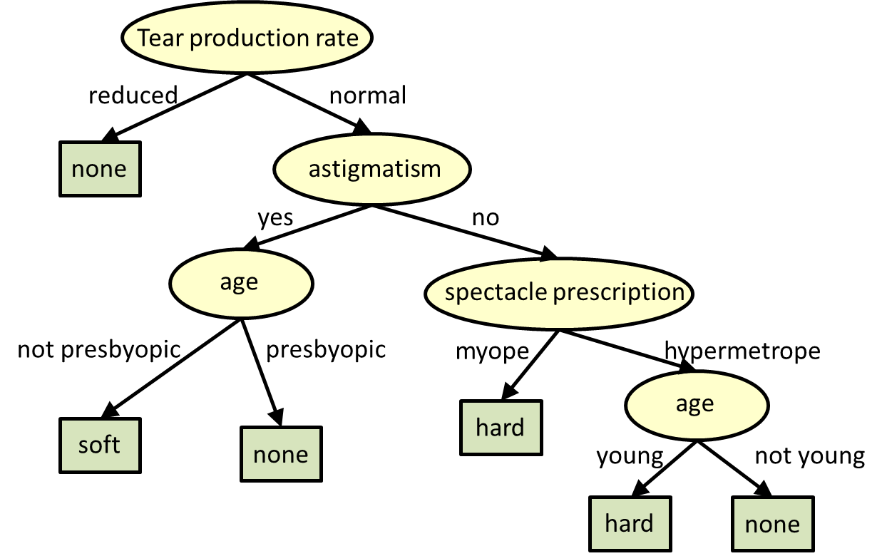

Decision Tree for deciding what type of contact lenses to wear: soft, hard, or none
Hypermetrope means farsighted, i.e. can see far-away objects clearly, but not near-by objects.
Presbyopia is the gradual loss of the eyes ability to focus on near-by objects.
Myopic means nearsighted, i.e. can see near-by objects clearly, but not far-away objects.

Slide 5
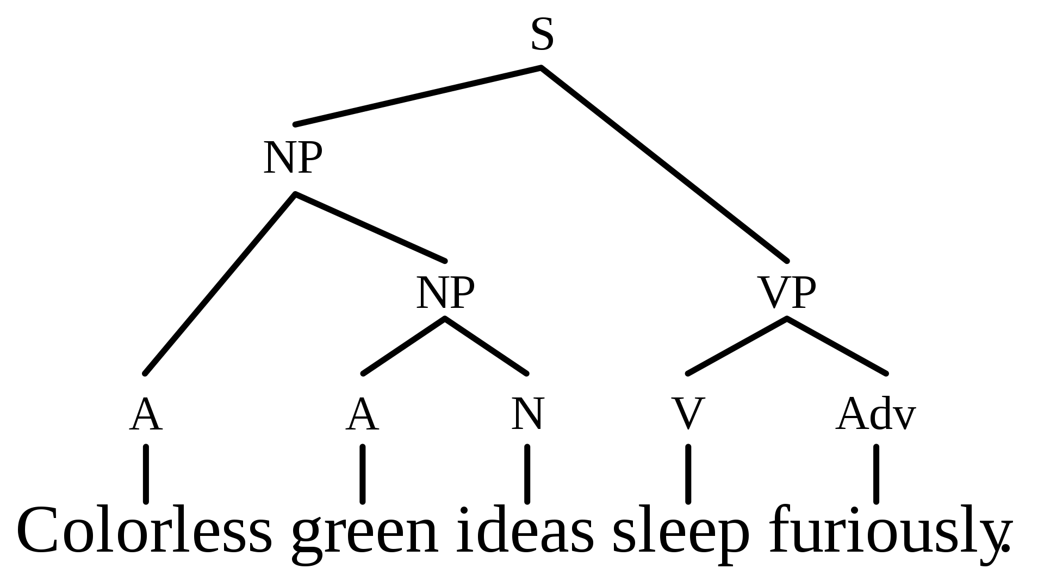
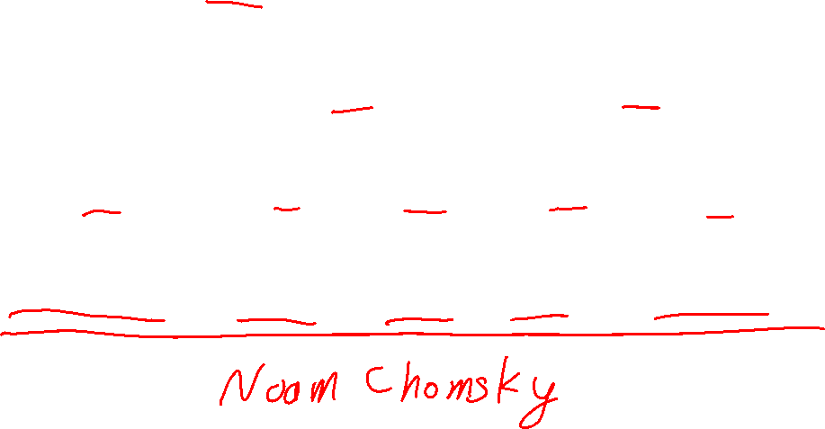
A: adjective N: noun V: verb
Adv: adverb NP: noun phrase
VP: verb phrase
S: sentence
Syntax Tree

Slide 6
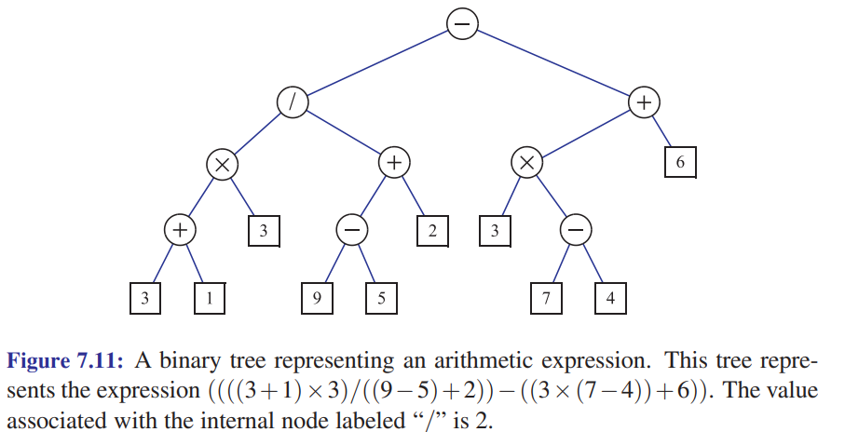
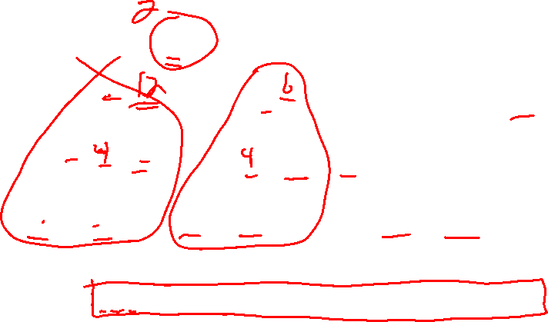
Syntax Tree for an Arithmetic Expression

Slide 7
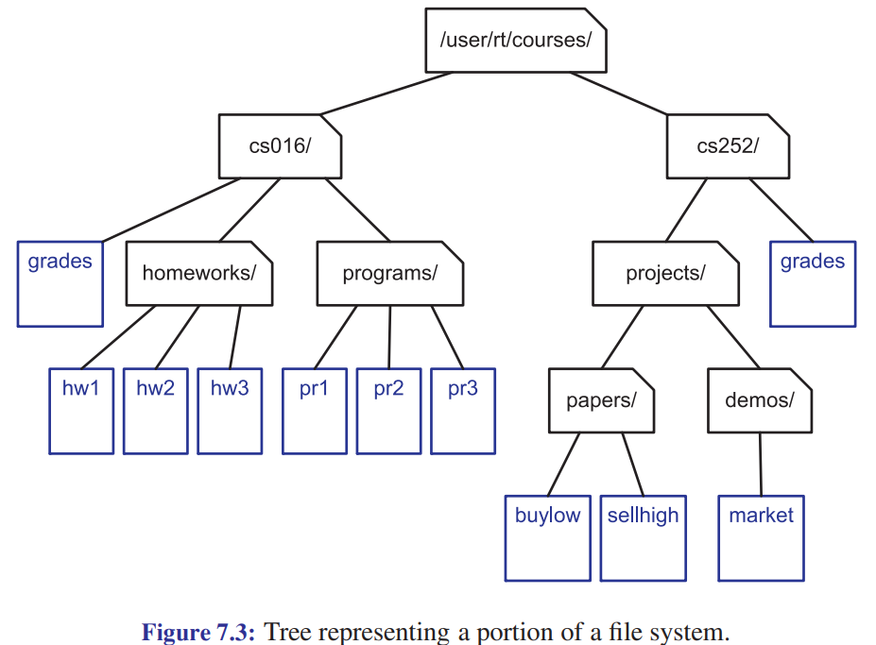
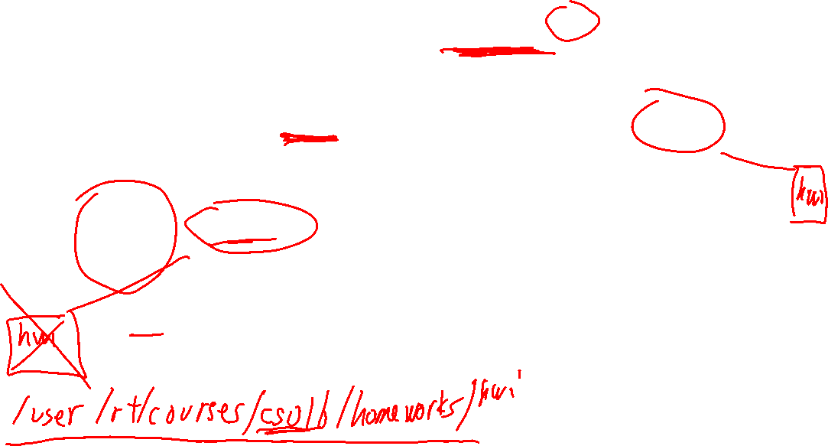
File System Tree

Slide 8
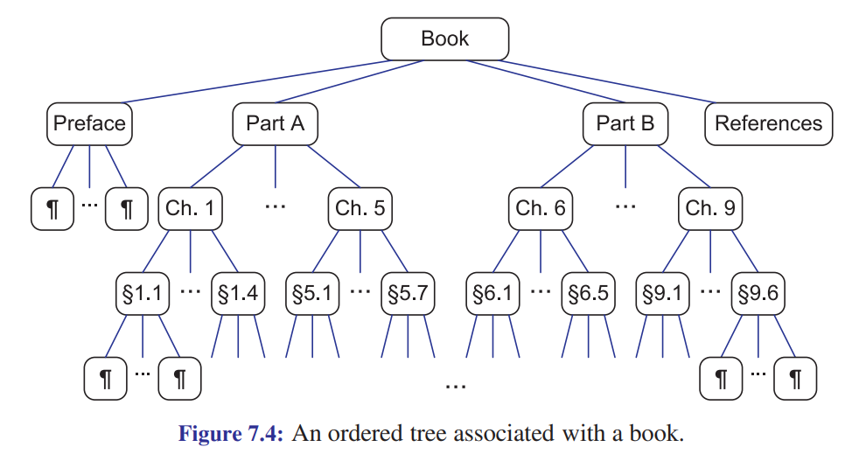

Chapter and Section Structure of a Book

Slide 9
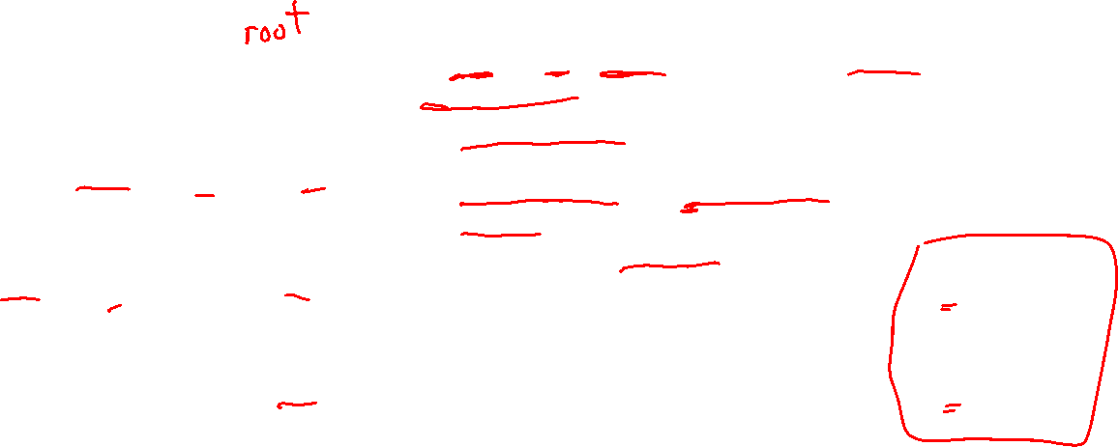
Definition of a Tree
A
A tree T is a set of nodes, storing values, in a parent-child relationship with the following properties:
T could be empty, i.e. it has no nodes. This is called the empty tree.
If T is non-empty, it has a special node called the root of T that has no parent.
Each node v of T different from the root has a unique parent node w. We say v is a child of w, and w is the parent of v.
B
C
D
E
F
G
w
parent
H
v
child

Slide 10

Is it a tree?
A tree T is a set of nodes, storing values, in a parent-child relationship with the following properties:
T could be empty, i.e. it has no nodes. This is called the empty tree.
If T is non-empty, it has a special node called the root of T that has no parent.
Each node v of T different from the root has a unique parent node w. We say v is a child of w, and w is the parent of v.
A
B
C
D
E
F
G
w
parent
H
v
child

Slide 11

Is it a tree?
A tree T is a set of nodes, storing values, in a parent-child relationship with the following properties:
T could be empty, i.e. it has no nodes. This is called the empty tree.
If T is non-empty, it has a special node called the root of T that has no parent.
Each node v of T different from the root has a unique parent node w. We say v is a child of w, and w is the parent of v.
A
B
C
D
w
parent
E
F
G
v
child

Slide 12
A
C
B
C
D
A
B
F
D
E
F
G
same trees
drawn differently
E
G
G
B
E
A
F
D
C

Slide 13
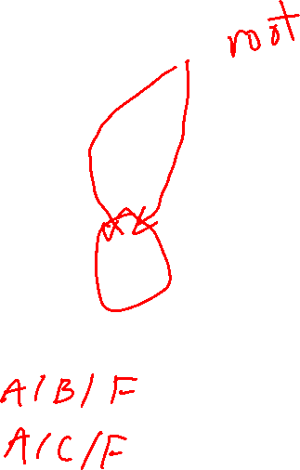
Is it a tree?
A tree T is a set of nodes, storing values, in a parent-child relationship with the following properties:
T could be empty, i.e. it has no nodes. This is called the empty tree.
If T is non-empty, it has a special node called the root of T that has no parent.
Each node v of T different from the root has a unique parent node w. We say v is a child of w, and w is the parent of v.
A
B
C
D
E
F
G
w
parent
H
v
child

Slide 14

Is it a tree?
A tree T is a set of nodes, storing values, in a parent-child relationship with the following properties:
T could be empty, i.e. it has no nodes. This is called the empty tree.
If T is non-empty, it has a special node called the root of T that has no parent.
Each node v of T different from the root has a unique parent node w. We say v is a child of w, and w is the parent of v.
B
C
D
E
F
G
w
parent
H
v
child

Slide 15

Is it a tree?
A tree T is a set of nodes, storing values, in a parent-child relationship with the following properties:
T could be empty, i.e. it has no nodes. This is called the empty tree.
If T is non-empty, it has a special node called the root of T that has no parent.
Each node v of T different from the root has a unique parent node w. We say v is a child of w, and w is the parent of v.
A
B
C
D
E
F
G
w
parent
H
v
child

Slide 16
Is it a tree?
A tree T is a set of nodes, storing values, in a parent-child relationship with the following properties:
T could be empty, i.e. it has no nodes. This is called the empty tree.
If T is non-empty, it has a special node called the root of T that has no parent.
Each node v of T different from the root has a unique parent node w. We say v is a child of w, and w is the parent of v.
A
B
C
D
E
F
G
w
parent
H
v
child

Slide 17

Is it a tree?
A tree T is a set of nodes, storing values, in a parent-child relationship with the following properties:
T could be empty, i.e. it has no nodes. This is called the empty tree.
If T is non-empty, it has a special node called the root of T that has no parent.
Each node v of T different from the root has a unique parent node w. We say v is a child of w, and w is the parent of v.
A
B
C
D
E
F
G
w
parent
H
v
child

Slide 18

Is it a tree?
A tree T is a set of nodes, storing values, in a parent-child relationship with the following properties:
T could be empty, i.e. it has no nodes. This is called the empty tree.
If T is non-empty, it has a special node called the root of T that has no parent.
Each node v of T different from the root has a unique parent node w. We say v is a child of w, and w is the parent of v.
A
B
C
D
E
F
G
w
parent
H
v
child

Slide 19
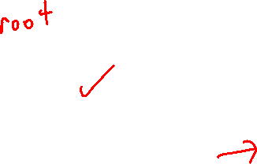
Is it a tree?
A tree T is a set of nodes, storing values, in a parent-child relationship with the following properties:
T could be empty, i.e. it has no nodes. This is called the empty tree.
If T is non-empty, it has a special node called the root of T that has no parent.
Each node v of T different from the root has a unique parent node w. We say v is a child of w, and w is the parent of v.
A
w
parent
v
child

Slide 20
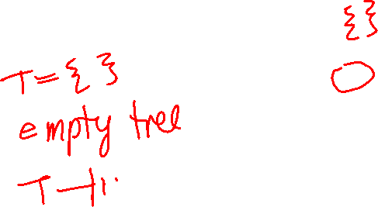
Is it a tree?
A tree T is a set of nodes, storing values, in a parent-child relationship with the following properties:
T could be empty, i.e. it has no nodes. This is called the empty tree.
If T is non-empty, it has a special node called the root of T that has no parent.
Each node v of T different from the root has a unique parent node w. We say v is a child of w, and w is the parent of v.
w
parent
v
child

Slide 21
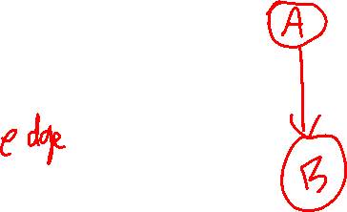
Is it a tree?
A tree T is a set of nodes, storing values, in a parent-child relationship with the following properties:
T could be empty, i.e. it has no nodes. This is called the empty tree.
If T is non-empty, it has a special node called the root of T that has no parent.
Each node v of T different from the root has a unique parent node w. We say v is a child of w, and w is the parent of v.
w
parent
v
child

Slide 22
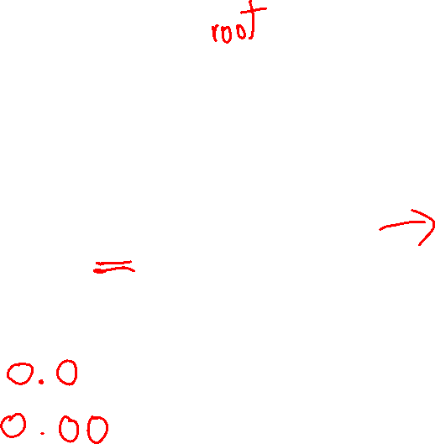
Is it a tree?
A tree T is a set of nodes, storing values, in a parent-child relationship with the following properties:
T could be empty, i.e. it has no nodes. This is called the empty tree.
If T is non-empty, it has a special node called the root of T that has no parent.
Each node v of T different from the root has a unique parent node w. We say v is a child of w, and w is the parent of v.
A
B
C
D
E
F
G
w
parent
H
v
child

Slide 23

Is it a tree?
A tree T is a set of nodes, storing values, in a parent-child relationship with the following properties:
T could be empty, i.e. it has no nodes. This is called the empty tree.
If T is non-empty, it has a special node called the root of T that has no parent.
Each node v of T different from the root has a unique parent node w. We say v is a child of w, and w is the parent of v.
A
B
C
D
E
F
G
w
parent
H
v
child

Slide 24


Is it a tree?
A tree T is a set of nodes, storing values, in a parent-child relationship with the following properties:
T could be empty, i.e. it has no nodes. This is called the empty tree.
If T is non-empty, it has a special node called the root of T that has no parent.
Each node v of T different from the root has a unique parent node w. We say v is a child of w, and w is the parent of v.
A
B
w
parent
v
child

Slide 25

Is it a tree?
A tree T is a set of nodes, storing values, in a parent-child relationship with the following properties:
T could be empty, i.e. it has no nodes. This is called the empty tree.
If T is non-empty, it has a special node called the root of T that has no parent.
Each node v of T different from the root has a unique parent node w. We say v is a child of w, and w is the parent of v.
A
B
C
D
E
F
G
w
parent
H
v
child
Continues infinitely …

Slide 26
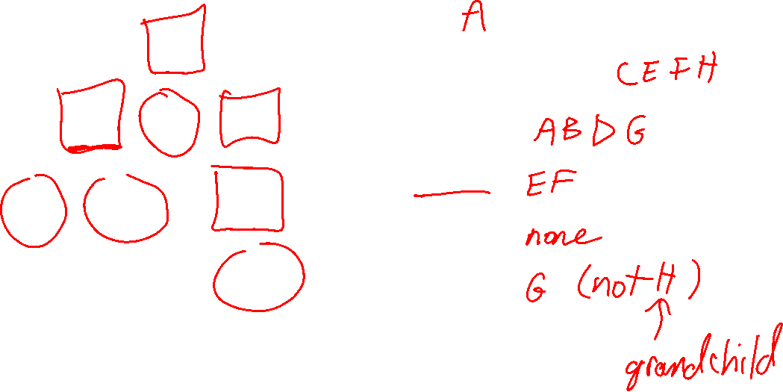

Tree terminology
Root:
A
Leaves (external nodes):
B
C
D
Internal nodes:
Children of B:
E
F
G
Children of C:
H
Children of D:

Slide 27
The root is the one node with no parent.
Tree terminology
Root: A
A
Nodes with 0 children.
Leaves (external nodes): C, E, F, H
B
C
D
Internal nodes: A, B, D, G
Nodes with 1 or more children.
Children of B: E, F
E
F
G
A node can have 0 or more children.
Children of C: none
H
Children of D: G

Slide 28
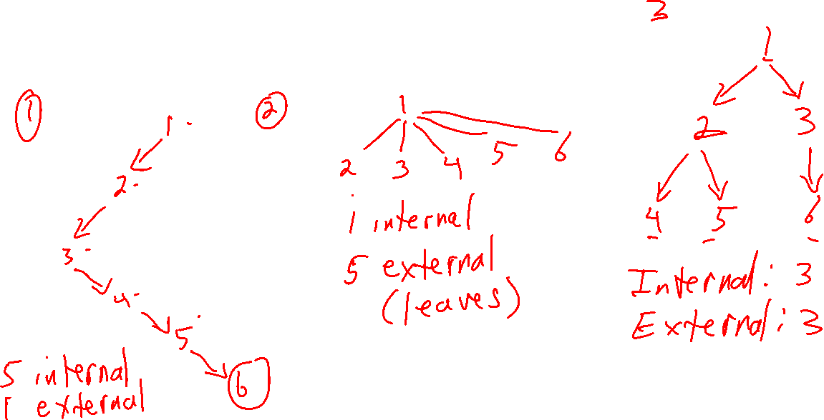
Tree terminology
Draw a tree with 6 nodes with:
More internal nodes than external node
More external nodes than internal nodes
The same number of internal and external nodes

Slide 29
Tree terminology
Draw a tree with 6 nodes with:
More internal nodes than external node
More external nodes than internal nodes
The same number of internal and external nodes
1
1
1
2
2
3
2
3
4
5
6
3
Internal: 1 External: 5
4
5
6
4
Internal: 3 External: 3
Internal: 5 External: 1
5
6

Slide 30
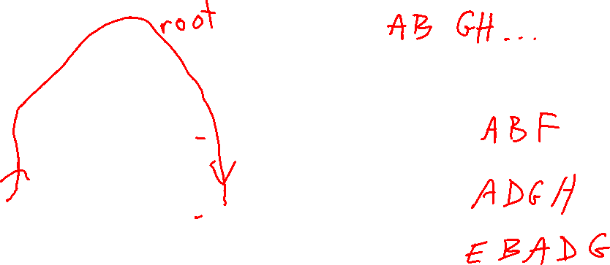
Tree terminology
Edges:
A
B
C
D
Path from A to F:
G
Path from A to H:
E
F
Path from E to G: Careful: the arrows show parent-child relationships, but don’t restrict the path.
H

Slide 31
Tree terminology
Edges: AB, AC, AD BE, BF DG, GH
A
B
C
D
Path from A to F: ABF
G
Path from A to H: ADGH
E
F
Path from E to G: EBADG Careful: the arrows show parent-child relationships, but don’t restrict the path.
H

Slide 32
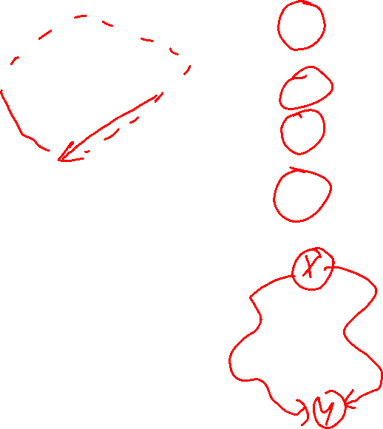

Tree Facts
A
Fact There is exactly one path between any two nodes in a tree. Fact There are no “cycles” in a tree.
Fact If you remove any edge of a tree, you get two trees.
Fact If you add an edge (without adding a node),
the result is not a tree.
B
C
D
E
F
G
H

Slide 33

Tree terminology
A
Ancestors of G:
Ancestors of C:
B
C
D
Ancestors of A:
E
F
G
Descendants of D:
Descendants of C:
H
Descendants of A:
If x is a node in a tree, then:
the ancestors of x are x itself, plus the ancestors of x’s parent
the descendants of x are x itself, plus all the nodes that have x as an ancestor

Slide 34
Tree terminology
Ancestors of G: G, D, A
Every node is an ancestor of itself.
A
Ancestors of C: C, A
B
C
D
Ancestors of A: A
E
F
G
Descendants of D: D, G, H
Every node is a descendant of itself.
Descendants of C: none
H
Descendants of A: A, B, C, D, E, F, G, H
If x is a node in a tree, then:
the ancestors of x are x itself, plus the ancestors of x’s parent
the descendants of x are x itself, plus all the nodes that have x as an ancestor

Slide 35
Tree terminology
Ancestors of G: G, D, A
Every node is an ancestor of itself.
A
Ancestors of C: C, A
B
C
D
Ancestors of A: A
E
F
G
Descendants of D: D, G, H
Every node is a descendant of itself.
Descendants of C: none
H
Descendants of A: A, B, C, D, E, F, G, H
Fact The root is an ancestor of all nodes, including itself.
Fact All nodes, including the root, are descendants of the root.
If x is a node in a tree, then:
the ancestors of x are x itself, plus the ancestors of x’s parent
the descendants of x are x itself, plus all the nodes that have x as an ancestor

Slide 36

Tree terminology
A
B
C
D
Subtree rooted at B: the tree formed by all descendants of B
E
F
G
H

Slide 37

Tree terminology
Ordered tree: the children of nodes have
a well-defined order
A
A tree may, or may not, be ordered. If it is ordered, you must say so, and also say exactly how the child nodes are ordered.
B
C
D
E
F
G
This is an ordered tree: the child nodes are in alphabetical order from left to right.
H

Slide 38
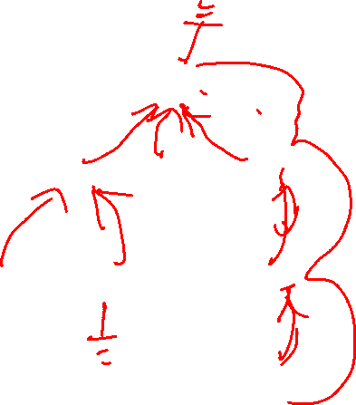
Basic Tree Functions
A
Suppose p refers to a node in a tree. Then we usually assume these functions are available:
p.parent() returns the parent of p; error if p is the root
p.children() returns a list (or vector, or array, …) of p’s children
p.isRoot() returns true if p is the root, and false otherwise
p.isLeaf() or p.isExternal() returns true if p is a leaf node (i.e. external node) and false otherwise
p
B
C
D
E
F
G
H
We usually assume these functions all run in worst-case O(1) time.

Slide 39

Basic Tree Functions
A
If T refers is a tree, then we usually assume these functions are available:
T.root() returns the root node of the tree; error if the tree is empty
T.empty() returns true if the tree is empty, and false otherwise
T.size() returns the number of nodes in the tree
B
C
D
E
F
G
H
We usually assume these functions all run in worst-case O(1) time.

Slide 40
Definition of a Tree
A
A tree T is a set of nodes, storing values, in a parent-child relationship with the following properties:
T could be empty, i.e. it has no nodes. This is called the empty tree.
If T is non-empty, it has a special node called the root of T that has no parent.
Each node v of T different from the root has a unique parent node w. We say v is a child of w, and w is the parent of v.
B
C
D
E
F
G
w
parent
H
v
child

Slide 41
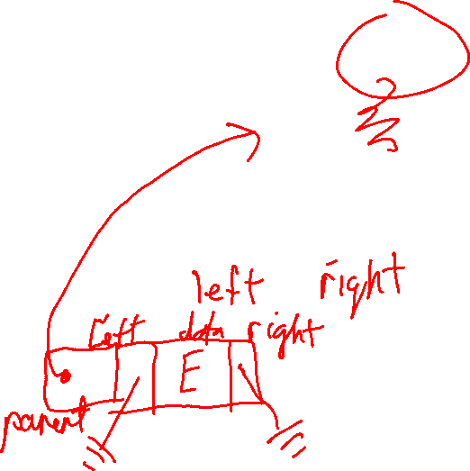
Is this a binary tree?
Binary Trees
A
A binary tree is a tree where each node has at most 2 children.
Each child of a node is labeled as the left child or right child.
The left child comes before the right child in child ordering.
B
C
D
E
F
G
H

Slide 42
Is this a binary tree?
Binary Trees
A
A binary tree is a tree where each node has at most 2 children.
Each child of a node is labeled as the left child or right child.
The left child comes before the right child in child ordering.
B
C
D
E
F
G

Slide 43
Is this a binary tree?
Binary Trees
A binary tree is a tree where each node has at most 2 children.
Each child of a node is labeled as the left child or right child.
The left child comes before the right child in child ordering.

Slide 44

Is this a proper or improper binary tree?
Binary Trees
A
A binary tree is proper if every node has either 0 children or 2 children.
A binary tree is improper if it is not proper.
B
C
D
E
F
G

Slide 45
Is this a proper or improper binary tree?
Binary Trees
A
A binary tree is proper if every node has either 0 children or 2 children.
A binary tree is improper if it is not proper.
B
C
D
E

Slide 46

Is this a proper or improper binary tree?
Binary Trees
A
A binary tree is proper if every node has either 0 children or 2 children.
A binary tree is improper if it is not proper.
B
C
D
E
F
G

Slide 47

Is this a binary tree? Is it proper or improper?
Binary Trees
A binary tree is a tree where each node has at most 2 children.
Each child of a node is labeled as the left child or right child.
The left child comes before the right child in child ordering.

Slide 48
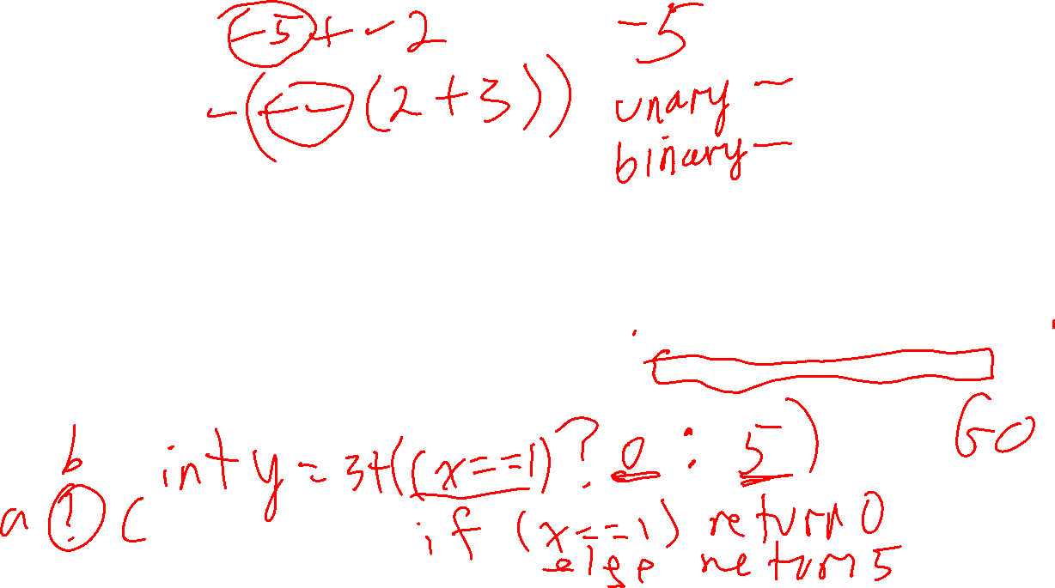
Is this a binary tree? Is it proper or improper?
Binary Trees
A binary tree is a tree where each node has at most 2 children.
Each child of a node is labeled as the left child or right child.
The left child comes before the right child in child ordering.

Slide 49

Binary Trees
root
Recursive Definition
A tree T is a binary tree if:
T is empty
Or it consists of a root node whose left child is the root of binary tree, and whose right child is the root of a binary tree
left subtree is a binary tree
right subtree is a binary tree

Slide 50
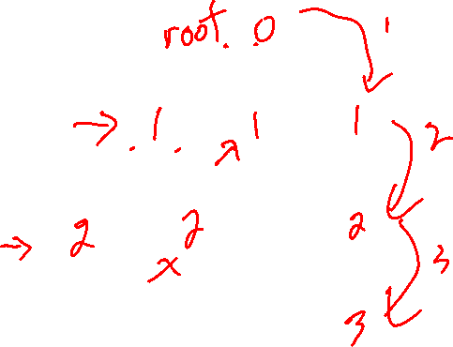
Node Depth
Write the depth of each node.
The depth of a node p in a tree is the number of ancestors of p, excluding p itself.
If p is a node in a tree, then:
the ancestors of p are p itself, plus the ancestors of p’s parent
the descendants of p are p itself, plus all the nodes that have p as an ancestor

Slide 51
Node Depth
Write the depth of each node.
0
The depth of a node p in a tree is the number of ancestors of p, excluding p itself.
1
1
1
2
2
2
If p is a node in a tree, then:
the ancestors of p are p itself, plus the ancestors of p’s parent
the descendants of p are p itself, plus all the nodes that have p as an ancestor
3

Slide 52

Node Depth
Recursive Definition
The depth of a node p in a tree is:
0 if p is the root
1 plus the depth of its parent if p is not the root
0
1
1
1
2
2
2
3

Slide 53
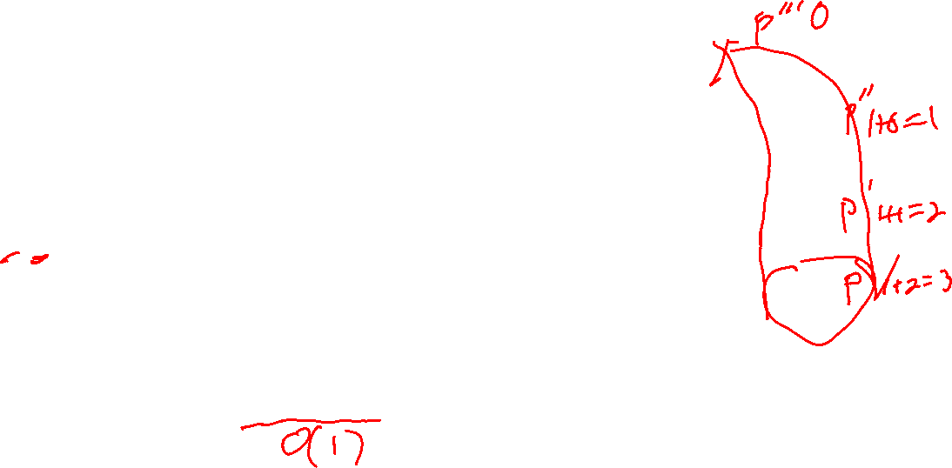
Node Depth
Recursive Definition
The depth of a node p in a tree is:
0 if p is the root
1 plus the depth of its parent if p is not the root
0
1
1
1
2
2
2
depth(T, p) if p.isRoot(): return 0 else: return 1 + depth(T, p.parent())
pseudocode for depth of a node; T is a tree p is a node in T
3
In the worst case, how much work does this do?

Slide 54
0
Node Depth
Recursive Definition
The depth of a node p in a tree is:
0 if p is the root
1 plus the depth of its parent if p is not the root
1
1
1
2
2
2
3
depth(T, p) if p.isRoot(): return 0 else: return 1 + depth(T, p.parent())
pseudocode for depth of a node; T is a tree p is a node in T
It runs in O(depth of node p).
What’s the deepest a node could be in a tree with n nodes?

Slide 55
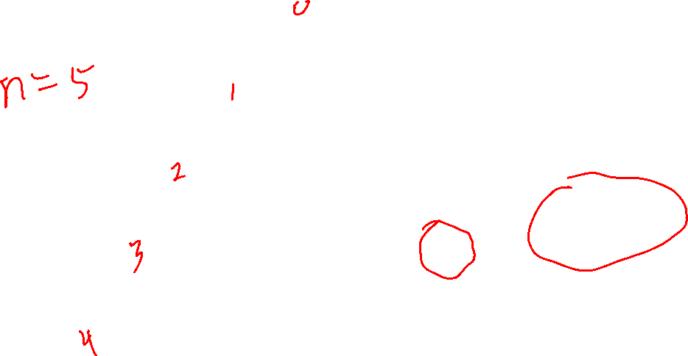
A tree with n nodes could have a node of depth n-1.
That means the depth(T, p) algorithm does O(n) recursive calls in the worst case.

Slide 56

0
Node Depth
Recursive Definition
The depth of a node p in a tree is:
0 if p is the root
1 plus the depth of its parent if p is not the root
1
1
1
2
2
2
3
depth(T, p) if p.isRoot(): return 0 else: return 1 + depth(T, p.parent())
pseudocode for depth of a node; T is a tree p is a node in T
Does O(n) recursive calls in the worst case. Depends on how tall the tree is.

Slide 57
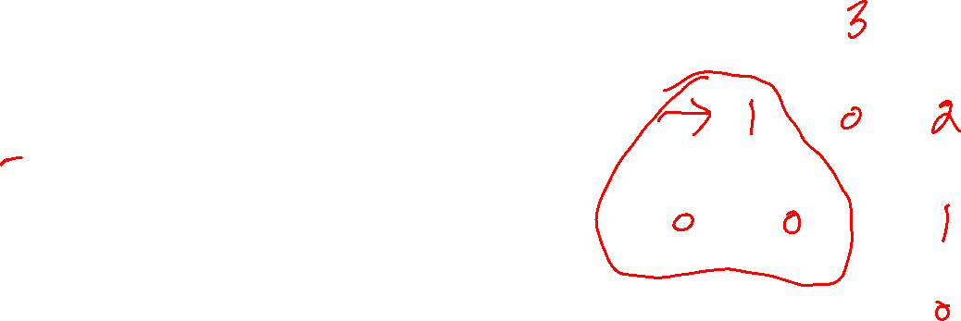
Node Height
Write the height of each node.
Recursive Definition
The height of a node p in a tree is:
0 if p is external (a leaf)
1 plus the max height of a child of p if p is internal (not a leaf)

Slide 58
Node Height
Write the height of each node.
Recursive Definition
The height of a node p in a tree is:
0 if p is external (a leaf)
1 plus the max height of a child of p if p is internal (not a leaf)
3
1
0
2
0
0
1
0

Slide 59

Node Height
3
Recursive Definition
The height of a node p in a tree is:
0 if p is external (a leaf)
1 plus the max height of a child of p if p is internal (not a leaf)
1
0
2
0
0
1
0
node_height(T, p) if p.isLeaf() then return 0 else return max {node_height(c) : c is a child of p}
pseudocode for height of a node T is a tree p is a node in T
If there are n nodes in the tree, now many times is node_height called?

Slide 60
Node Height
3
Recursive Definition
The height of a node p in a tree is:
0 if p is external (a leaf)
1 plus the max height of a child of p if p is internal (not a leaf)
1
0
2
0
0
1
0
node_height(T, p) if p.isLeaf() then return 0 else return max {node_height(c) : c is a child of p}
pseudocode for height of a node T is a tree p is a node in T
node_height is called on almost all nodes.
So O(n) calls to node_height

Slide 61
Tree Height
What’s the height of this tree?
The height of a tree is the height of its root.
3
1
0
2
0
0
1
0

Slide 62
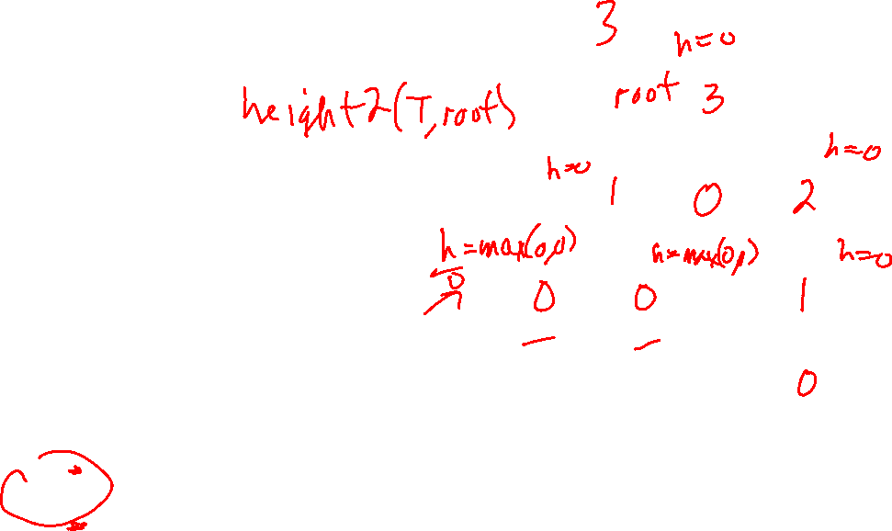
Tree Height
Tree height =
The height of a tree is the height of its root.
height2(T, p) if p.isLeaf(): return 0 else: h = 0 for each child c of p: h = max(h, height2(T, c))
return 1 + h
pseudocode for height of a tree T is a tree p is a node in T

Slide 63
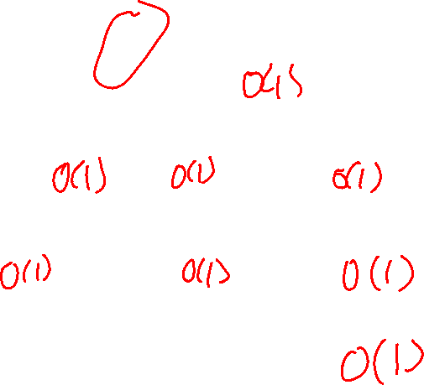
Tree Height
Tree height = 3
The height of a tree is the height of its root.
3
1
0
2
height2(T, p) if p.isLeaf(): return 0 else: h = 0 for each child c of p: h = max(h, height2(T, c))
return 1 + h
pseudocode for height of a tree T is a tree p is a node in T
0
0
1
0
If tree has n nodes and p is the root, how much work does this do?

Slide 64

Tree Height
height2(T, T.root) is called on each node of the tree
Not counting the recursive call, each call to height2 does O(1) work, i.e. isLeaf() and max are both O(1)
The total work for the entire tree is the sum of the work done at each node
height2 is called once for each node in the tree: height2 is called n times
Each of those n calls does O(1) work at the node (isLeaf and max)
So the total work is a constant times O(n), which is O(n)
The height of a tree is the height of its root.
height2(T, p) if p.isLeaf(): return 0 else: h = 0 for each child c of p: h = max(h, height2(T, c))
return 1 + h
pseudocode for height of a tree T is a tree p is a node in T

Slide 65
Tree Height
h = 3
The height of a tree is the height of its root.
3
1
0
2
height2(T, p) if p.isLeaf(): return 0 else: h = 0 for each child c of p: h = max(h, height2(T, c))
return 1 + h
pseudocode for height of a tree T is a tree p is a node in T
0
0
1
0
O(n) work in the worst case.

Slide 66
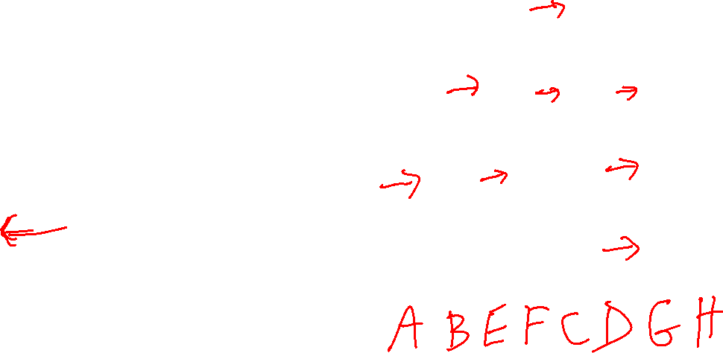
Print the nodes in pre-order traversal order, starting at the root.
Tree Traversals
A
One order in which to visit all the nodes in a tree is pre-order traversal.
B
C
D
E
F
G
preorder_traversal(T, p) print p for each child c of p: preorder_traversal(T, c)
H

Slide 67
Print the nodes in pre-order traversal order, starting at the root.
Tree Traversals
A
One order in which to visit all the nodes in a tree is pre-order traversal.
B
C
D
E
F
G
preorder_traversal(T, p) print p for each child c of p: preorder_traversal(T, c)
H
Pre-order: A, B, E, F, C, D, G, H

Slide 68
A
Tree Traversals
B
C
D
One order in which to visit all the nodes in a tree is pre-order traversal.
E
F
G
H
preorder_traversal(T, p) print p for each child c of p preorder_traversal(T, c)
Pre-order: A, B, E, F, C, D, G, H
If there are n nodes in the tree, how much work does preorder_traversal(T, root) do?

Slide 69
A
Tree Traversals
B
C
D
One order in which to visit all the nodes in a tree is pre-order traversal.
E
F
G
H
preorder_traversal(T, p) print p for each child c of p preorder_traversal(T, c)
Pre-order: A, B, E, F, C, D, G, H
Assuming print p is O(1), all n nodes are visited once, so O(n) work.

Slide 70
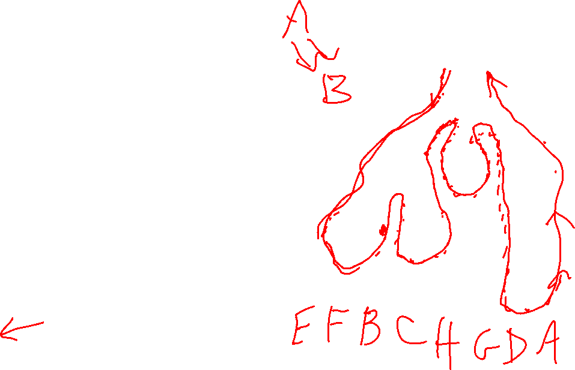
Print the nodes in post-order traversal order, starting at the root.
Tree Traversals
A
One order in which to visit all the nodes in a tree is pre-order traversal.
B
C
D
E
F
G
postorder_traversal(T, p) for each child c of p postorder_traversal(T, c) print p
H

Slide 71
A
Tree Traversals
B
C
D
One order in which to visit all the nodes in a tree is pre-order traversal.
G
E
F
H
postorder_traversal(T, p) for each child c of p preorder_traversal(c) print p
Post-order: E, F, B, C, H, G, D, A
Assuming print p is O(1), all n nodes are visited once, so O(n) work.

