Slide 1
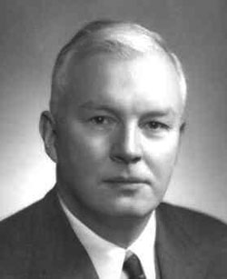
Haskell
A Functional Programming Language with Static Typing and Type Inference
Haskell Curry (1900 – 1982)
Computer Scientist

Slide 2
Haskell
The Haskell programming language first appeared in 1990 …
... Hubble Space Telescope put into orbit
… Germany reunified
… first McDonald’s in Moscow

Slide 3
1990 Top Grossing Movies

Slide 4
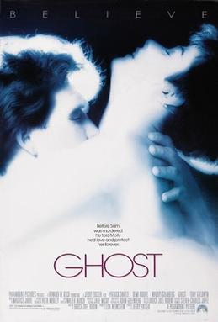
1990 Top Grossing Movies
1. Ghost
2. Home Alone
3. Pretty Woman
4. Dances With Wolves
5. Total Recall
6. Back to the Future Part III
7. Die Hard 2
8. Presumed Innocent
9. Teenage Mutant Ninja Turtles
10. Kindergarten Cop

Slide 5
#1 Song of 1990

Slide 6
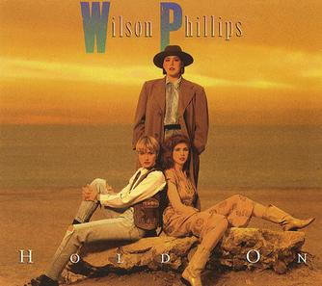
Top Songs of 1990
1. "Hold On" Wilson Phillips
2. "It Must Have Been Love" Roxette
3. "Nothing Compares 2 U" Sinéad O'Connor
4. "Poison" Bell Biv DeVoe
5. "Vogue" Madonna
6. "Vision of Love" Mariah Carey
7. "Another Day in Paradise" Phil Collins
8. "Hold On" En Vogue
9. "Cradle of Love" Billy Idol
10. "Blaze of Glory" Jon Bon Jovi

Slide 7
1990 Best Selling U.S.A. Home Video Game

Slide 8

1990 Best Selling U.S.A. Home Video Game

Slide 9
Top TV Series of 1990

Slide 10
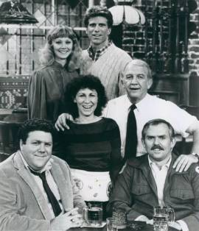

Top TV Series of 1990
1. Cheers
2. 60 Minutes
3. Roseanne
4. A Different World
5. The Cosby Show
6. Murphy Brown
7. Empty Nest
America's Funniest Home Videos
9. Monday Night Football
10. The Golden Girls
Designing Women

Slide 11
Haskell Major Features
Statically typed-checked (at compile-time)
Like C++, Go, Rust
Unlike Racket, Python, JavaScript (dynamically type-checked at run-time)
Nice notation for types
Lazy evaluation
Expressions are not evaluated until they are needed
Immutable by default
Values cannot be changed (!)
All functions are pure (no side-effects)
Of course, to be useful, there are ways to work around this, e.g. monads and the IO type

Slide 12
Haskell Major Features
Algebraic data types (aka sum types)
Like enums on steroids
Pattern matching
Like if-statements on steroids
Composition and currying are built-in
Racket lets us define such things, but in Haskell they are built-in and used all the time
Can result in very concise programs (sometimes too concise --- can by cryptic!)
Equational style
Functions are often written as a series of equations
Allows for “equational reasoning”, similar to math

