Slide 1

Scheme (LISP) A functional and dynamically typed language with good support for lists and higher order functions.
1975
CMPT 383
Summer 2026
SFU Surrey
LISP: 1958

Slide 2
What was going on in 1975?

Slide 3
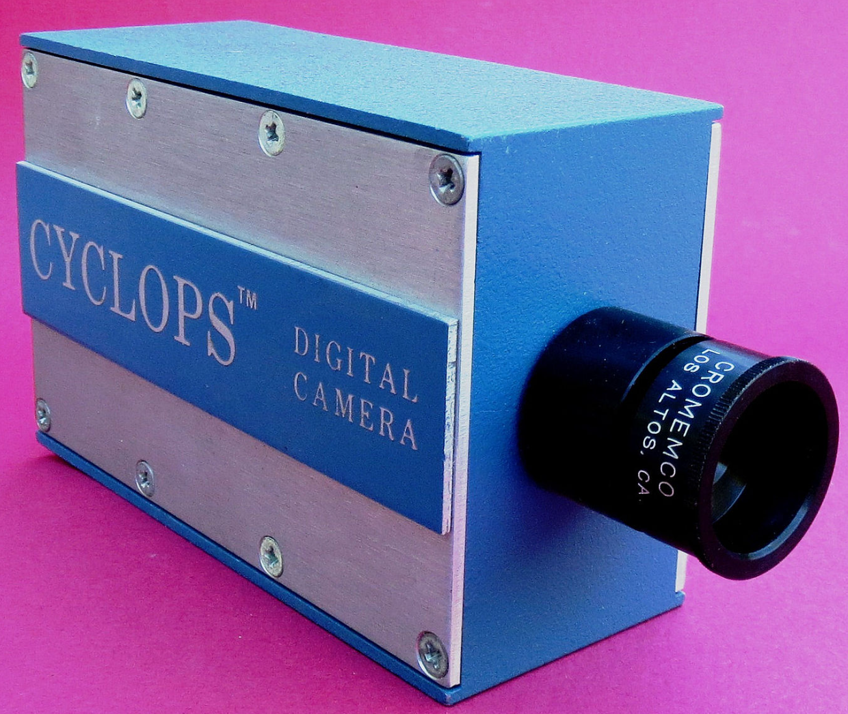
1975: First Appearances
Cromemco Cyclops
First all-digital camera
32x32 pixel resolution

Slide 4

1975: First Appearances
Cromemco Cyclops
First all-digital camera
32x32 pixel resolution

Slide 5
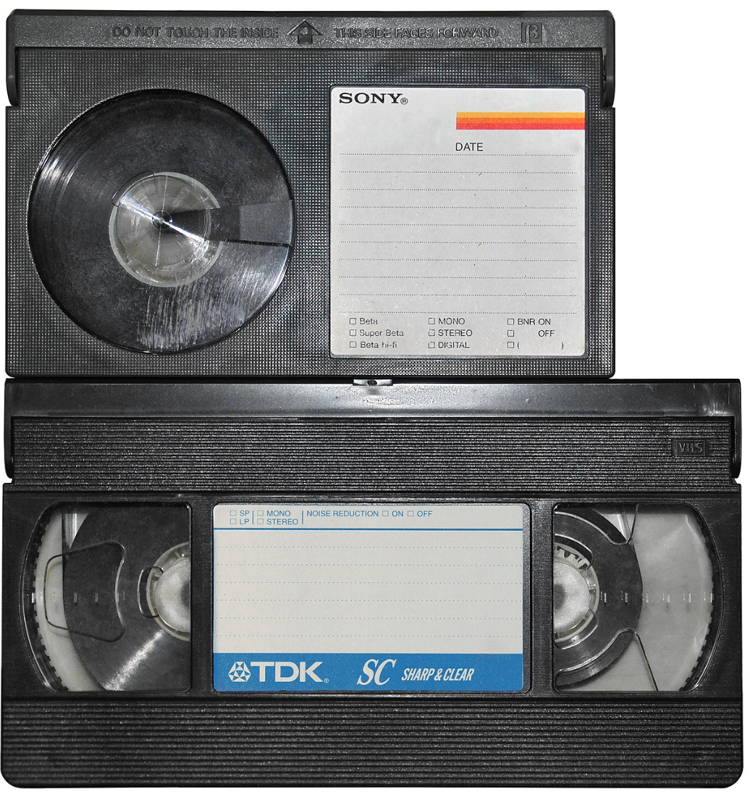
1975: First Appearances
Cromemco Cyclops
First all-digital camera
32x32 pixel resolution
Betamax and VHS Consumer video recorder formats

Slide 6
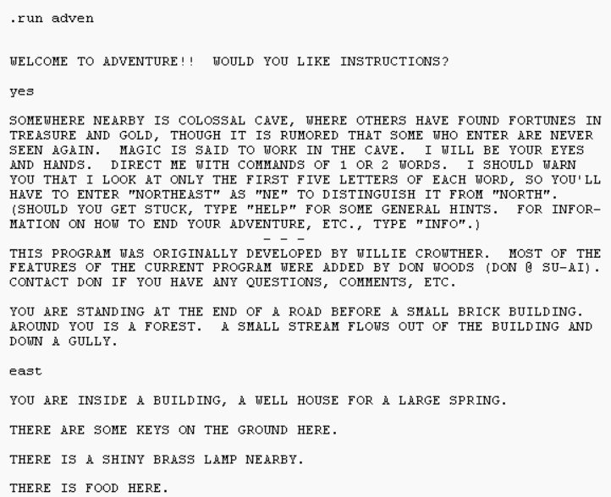
1975: First Appearances
Cromemco Cyclops
First all-digital camera
32x32 pixel resolution
Colossal Cave Adventure
First text-based role-playing game
Betamax and VHS Consumer video recorder formats

Slide 7
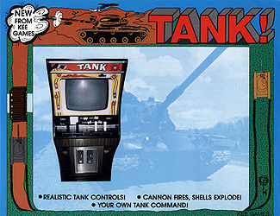
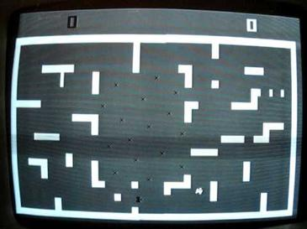
1975: Highest-grossing Arcade Game
Tank / Tank II Kee Games (Atari)

Slide 8

1975: Highest-Grossing Movie

Slide 9
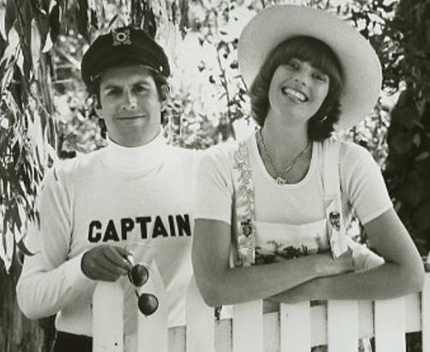
1975: Most Popular Song
Love will Keep us Together
Captain and Tennille

Slide 10
1975: Facts
Canadian PM: Pierre Trudeau
American President: Gerald Ford
Vietnam war ended
Saturday Night Live comedy show started
Average US income: $14,100.00

Slide 11
LISP 1958
Scheme 1975
Racket ~1995

Slide 12
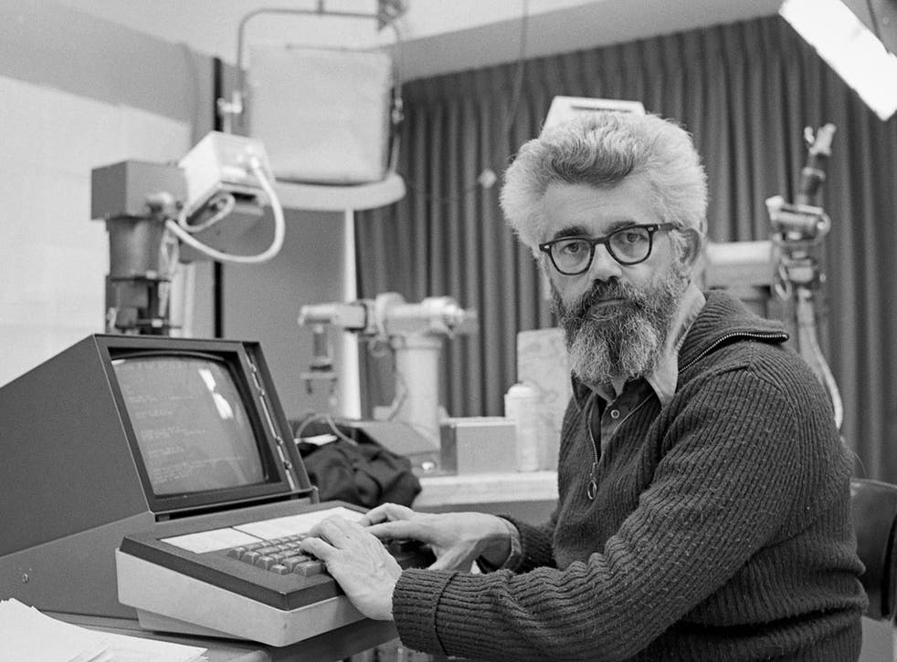
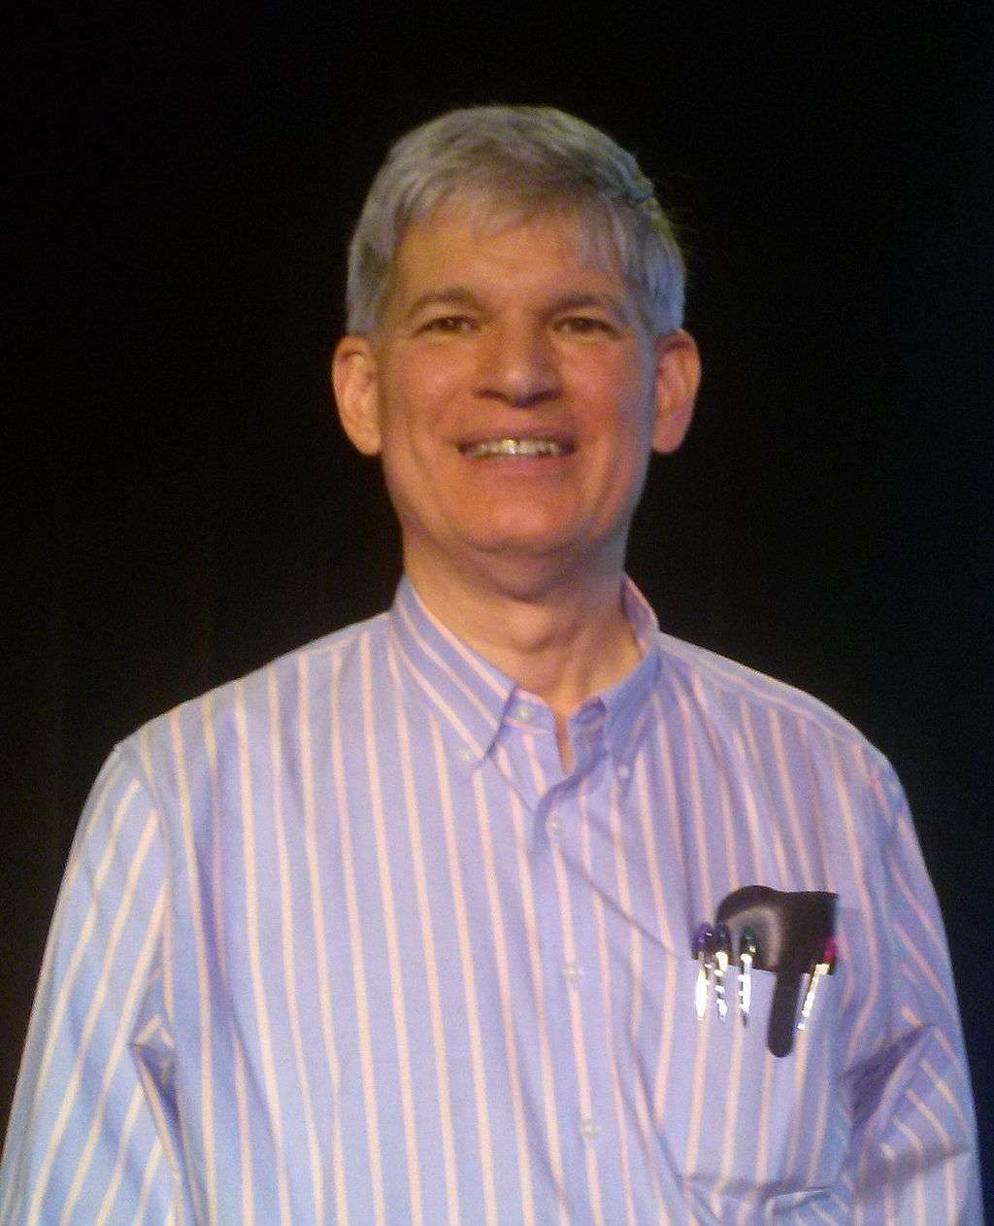
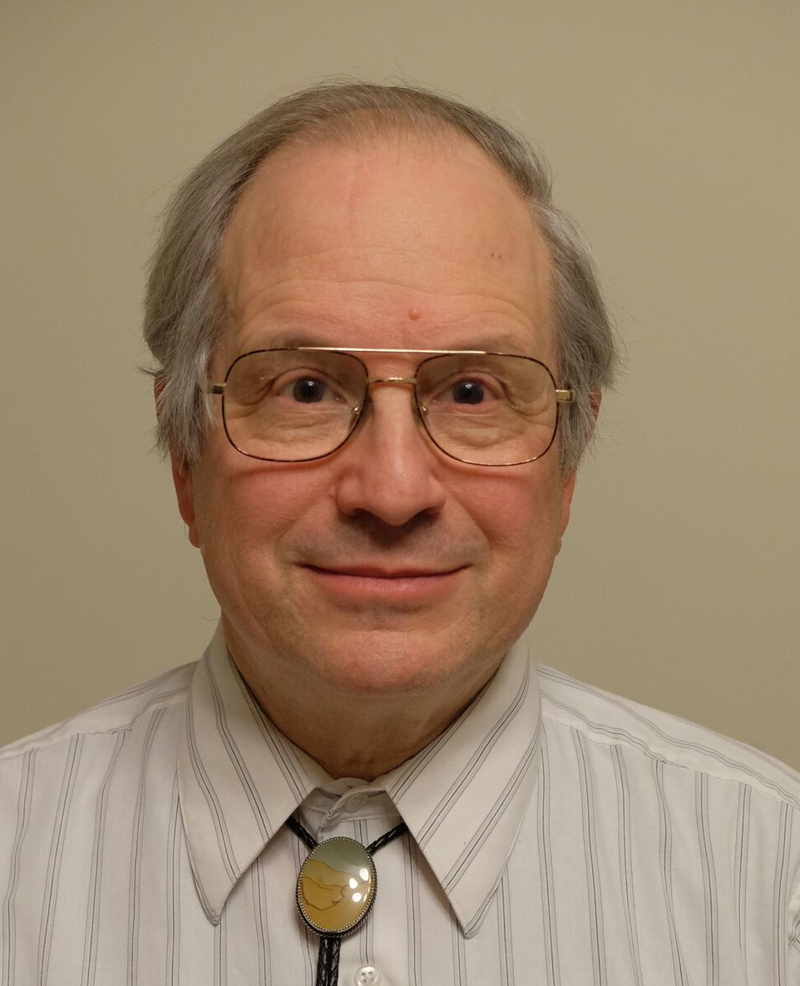
LISP and Scheme’s Original Designers
John McCarthy (1927-2011)
Original designer of LISP (1958)
Guy Steele and Gerald Sussman
Original designers of Scheme (1975)
Also coined the term “Artificial Intelligence”, and for many years was a leading AI researcher.
Racket is a modern dialect of Scheme, with many new ideas.

Slide 13

Scheme Probably Can’t Get You a Job!
The original version of JavaScript was implemented as a Scheme-style language, before being modified to look more C-like.
It’s mostly a research language used by a subset of academic programming language researchers.
A variation of LISP called Clojure has more recently gained some popularity for practical programming (but still pretty niche compared to other languages)
Clojure

Slide 14
What is Scheme/LISP Good for?
Popular in traditional “symbolic” AI research.
Packed with all kinds of interesting ideas, many of which have inspired more mainstream languages.
A good language for writing other programming languages and programming language tools.

Slide 15
What is Scheme Not so Good For?
Scheme is generally not as efficient as other languages.
Scheme is not used much in practice, so it can be hard to find support for it.
Scheme’s notation is simple, but maybe too simple. ()-style notation results in lots and lots of parentheses, which many programmers dislike.

Slide 16
Major Features of Scheme
Functions are first-class objects
Functions can be passed and returned (including closures)
Interpreted
Easy to evaluate individual expressions
Memory-safe and garbage-collected
No dangling pointers, no manual memory deletion
Homoiconic
Scheme programs are written as Scheme lists
Flexible
Powerful macro system allows for major changes to the language

Slide 17
Major Features of Scheme
Types
Dynamically typed, i.e. types checked at run-time (like Python)
Symbols Lists are the key data structure
Lexical Scoping
One of the first languages to fully implement the name-scoping rules we now take for granted in programming (scope can be determined from source code)
Tail Recursion
Tail-recursive functions are automatically optimized into loops

Slide 18
Major Features Not in Scheme
Features not part of Scheme
No type declarations
No pointers
No built-in notion of object-oriented programming

Slide 19
Hello, World!
;; hello_world.rkt
(print "Hello, world!")
Download and run this in the DrRacket IDE. We’ll use both the interpreter and file editor in DrRacket.

