Slide 1
CMPT 383 Comparative Programming Languages
Surrey
Fall 2026

Slide 2
Introduction
This course compares these programming languages:
Python
Advanced features of one of the most popular programming languages ever.
Racket
A version of LISP, an influential language first created in the 1950s. The programs are lists!
Haskell
An elegant language that is similar spirit to LISP, but adds static type checking. Packed with all kind of interesting ideas.

Slide 3
Marking
Throughout the semester there are 3 in-class 30-minute closed-book quizzes about the most recent course topics.
You must do these in-person.
If you miss one for any reason, your %-score on the final exam will replace the %-score of the missed quiz.
Similarly, if your %-score on the final is higher than a %-score on a quiz, we’ll replace that quiz with the final %-score.
The final exam is 3 hours and covers the entire course.

Slide 4
Marking
There are no assignments or projects worth any marks
But we will publish problem sets
If you don’t do the problem sets, you may fail the quizzes

Slide 5
Installing the Languages
Linux is probably the easiest way to get install and use all the languages in this course.
VS Code (or similar programming editors) have helpful plug-ins for most languages.
You may find that AI is less helpful for Racket and Haskell : they are not that common in practice!
Use AI as a tool to help your learn, but not to do your learning for you

Slide 6
Python
We’ll use regular Python … make sure you use a recent version (e.g. from this year or last year).
We assume you know basic Python already.
We will investigate a variety of more advanced features

Slide 7
1991: Top 10 Movies

Slide 8

1991: Top 10 Movies
1 | Terminator 2: Judgment Day
2 | Robin Hood: Prince of Thieves
3 | Beauty and the Beast
4 | Hook
5 | The Silence of the Lambs
6 | JFK
7 | The Naked Gun 2½: The Smell of Fear
8 | The Addams Family
9 | Cape Fear
10 | Hot Shots!

Slide 9
1991: Top 10 Songs

Slide 10
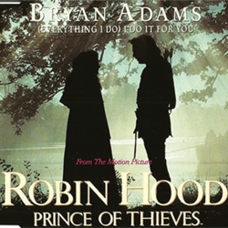
1991: Top 10 Songs
1 | (Everything I Do) I Do It for You | Bryan Adams
2 | I Wanna Sex You Up | Color Me Badd
3 | Gonna Make You Sweat (Everybody Dance Now) | C+C Music Factory
4 | Rush Rush | Paula Abdul
5 | One More Try | Timmy T
6 | Unbelievable | EMF
7 | More Than Words | Extreme
8 | I Like the Way (The Kissing Game) | Hi-Five
9 | The First Time | Surface
10 | Baby Baby | Amy Grant

Slide 11
1991: Top Home Video Games (US)

Slide 12

1991: Top Home Video Games (US)
1 | Sonic the Hedgehog | Sega Genesis
2 | Super Mario World | Super Nintendo Entertainment System
3 | F-Zero

Slide 13
1991: Top 10 TV Shows

Slide 14

1991: Top 10 TV Shows
1 | 60 Minutes
2 | Roseanne
3 | Murphy Brown
4 | Cheers
 | Home Improvement
6 | Designing Women
7 | Full House
8 | Murder, She Wrote
9 | Major Dad
10 | Coach
 | Room for Two

Slide 15
1991: Major Stories
April: The Persian Gulf War Ends (invasion of Kuwait by Iraq)
September: student Linus Torvalds releases the Linux operating system kernel
December: The USSR dissolved as a country
US National Science Foundation lifts commercial restrictions on use of the Internet

Slide 16


Python
First released: 1991
Original Designer: Guido Van Rossum
Python emphasizes code readability, simplicity, and ease-of-programming.
Python is dynamically typed, and has optional static typing.

Slide 17
Dynamic Typing vs Static Typing
Dynamic Typing e.g. Python, JavaScript, Racket, …
Static Typing e.g. C++, Java, Haskell, Rust, …
Types are checked at run time
Can be faster to write: no need to explicitly declare types
Type errors can occur in “production systems”
Typically needs more testing to find bugs
Types are checked at compile time
Often no need to check types at run-time
Types in source code can harm readability
Many programmers have strong opinions on static vs dynamic type. Dynamic typing can be better for prototyping or short scripts, while static typing is generally better for big programs.

Slide 18
Dynamic Typing vs Static Typing
Some languages are moving to a middle ground of typing …
Some dynamic languages have optional static types, e.g. Python and TypeScript both allow --- but don’t require --- programmers to specify types for variables, functions, etc.
Some statically type languages provide inference rules to automatically infer types without the user explicitly typing them
e.g. Haskell, Rust, even C++ (e.g. auto keyword)

Slide 19
The Zen of Python
If you type import this into the Python interpreter, you get a list of aphorisms …
>>> import this
The Zen of Python, by Tim Peters
Beautiful is better than ugly. Explicit is better than implicit. Simple is better than complex. Complex is better than complicated. Flat is better than nested. Sparse is better than dense. Readability counts. Special cases aren't special enough to break the rules. Although practicality beats purity. Errors should never pass silently. Unless explicitly silenced. In the face of ambiguity, refuse the temptation to guess. There should be one-- and preferably only one --obvious way to do it. Although that way may not be obvious at first unless you're Dutch. Now is better than never. Although never is often better than *right* now. If the implementation is hard to explain, it's a bad idea. If the implementation is easy to explain, it may be a good idea. Namespaces are one honking great idea -- let's do more of those!

Slide 20
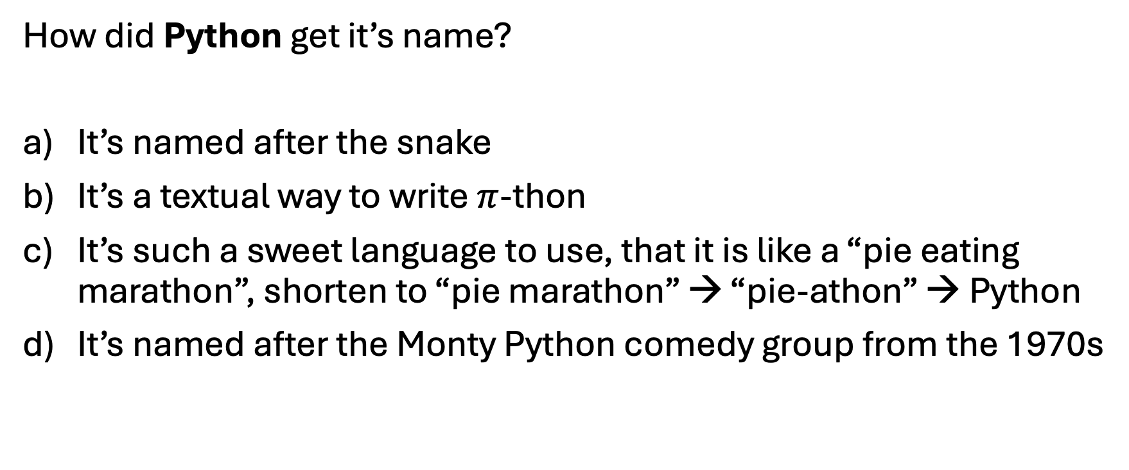
Python’s Name
How did Python get it’s name?
It’s named after the snake
It’s a textual way to write $π$-thon
It’s such a sweet language to use, that it is like a “pie eating marathon”, shorten to “pie marathon” → “pie-athon” → Python
It’s named after the Monty Python comedy group from the 1970s

