Slide 1

Scheme (LISP)
A functional and dynamically typed language with good support for lists and higher order functions.
LISP: 1960
Scheme: 1975
Racket: 1995
CMPT 383
Fall 2026
SFU Surrey

Slide 2
What was going on in 1960?

Slide 3
1960: First Appearances

Slide 4
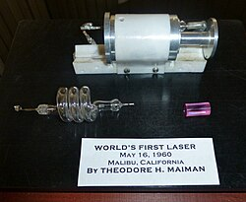
1960: First Appearances
The Laser

Slide 5
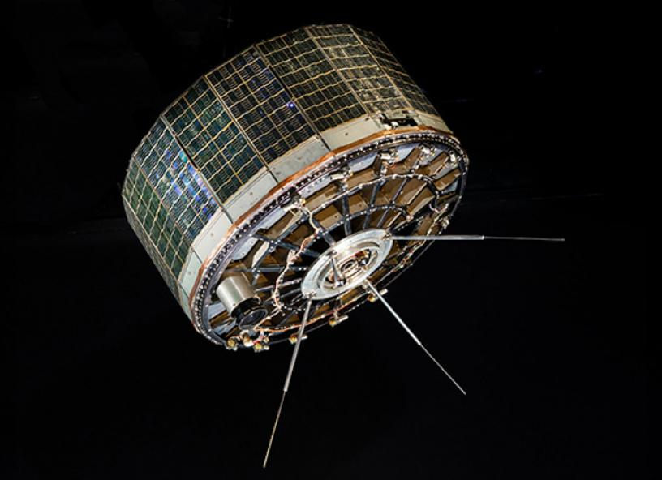
1960: First Appearances
1st Weather Satellite: TIROS1
The Laser

Slide 6
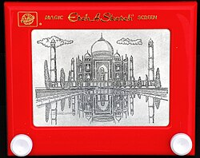
1960: First Appearances
1st Weather Satellite: TIROS1
Etch A Sketch
The Laser

Slide 7
1960: Highest Grossing Video Game
??

Slide 8
1960: Highest Grossing Video Game
No video games yet!

Slide 9
1960: Top Grossing Movie
??

Slide 10
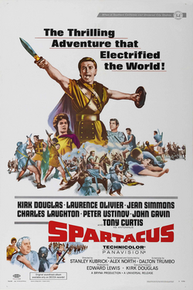
1960: Top Grossing Movie
Spartacus
An epic historical drama that tells the story of an enslaved Roman gladiator who leads a rebellion against the Roman Republic. Celebrated for its iconic "I'm Spartacus!" scene and grand battle sequences, the film remains a timeless cinematic symbol of resistance against tyranny.

Slide 11
1960: Most Popular Song
??

Slide 12
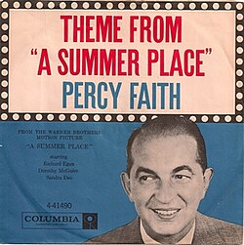
1960: Most Popular Song
??
A lush, orchestral instrumental standard that captures a timeless, nostalgic feeling of youthful romance and easygoing vintage summer calm.

Slide 13
What was going on in 1975?

Slide 14
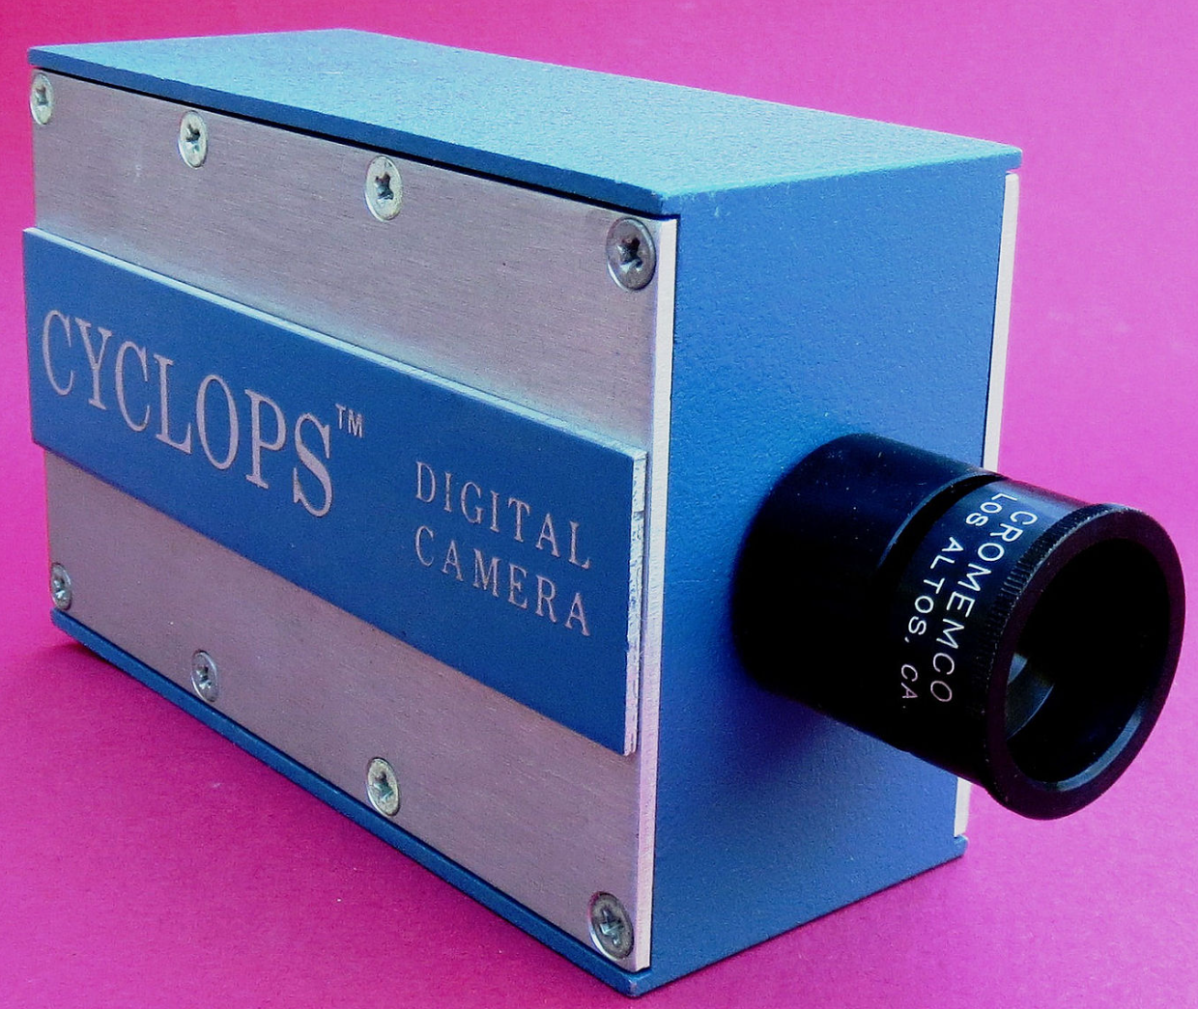
1975: First Appearances
Cromemco Cyclops
First all-digital camera
32x32 pixel resolution

Slide 15

1975: First Appearances
Cromemco Cyclops
First all-digital camera
32x32 pixel resolution

Slide 16
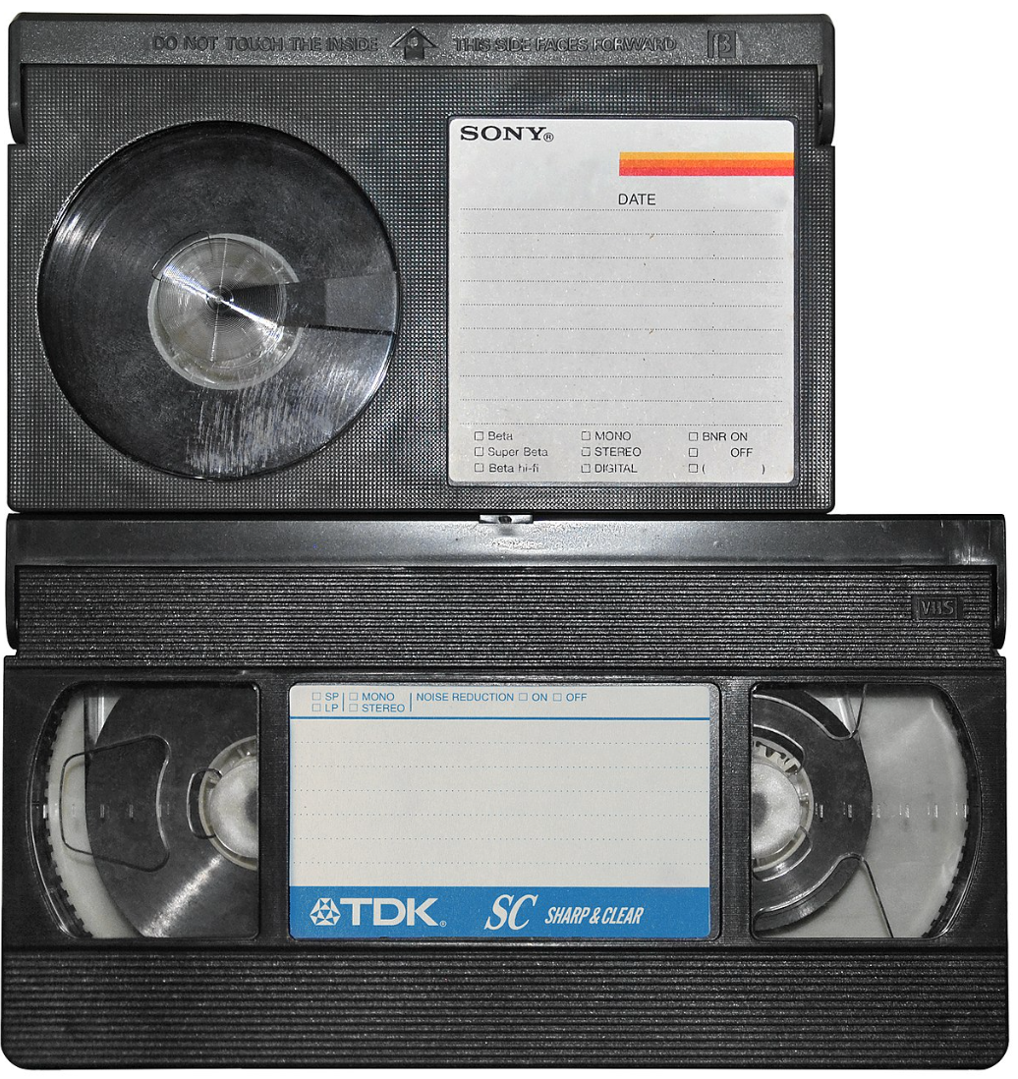
1975: First Appearances
Cromemco Cyclops
First all-digital camera
32x32 pixel resolution
Betamax and VHS
Consumer video recorder formats

Slide 17
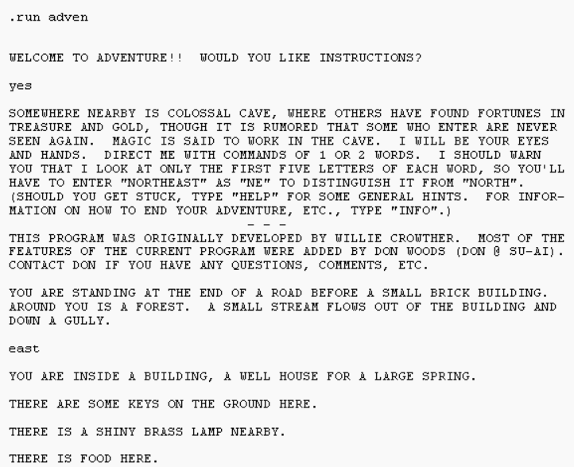
1975: First Appearances
Cromemco Cyclops
First all-digital camera
32x32 pixel resolution
Colossal Cave Adventure
First text-based role-playing game
Betamax and VHS
Consumer video recorder formats

Slide 18
1975: Highest-grossing Arcade Game
??

Slide 19
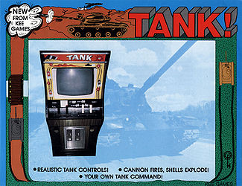
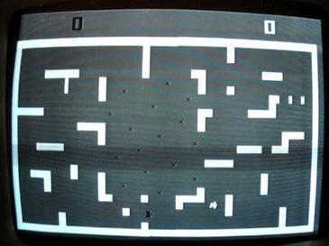
1975: Highest-grossing Arcade Game
Tank / Tank II
Kee Games (Atari)

Slide 20
1975: Highest-Grossing Movie
??

Slide 21
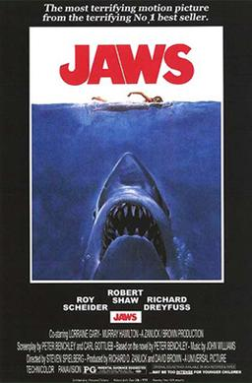
1975: Highest-Grossing Movie

Slide 22
1975: Most Popular Song
??

Slide 23
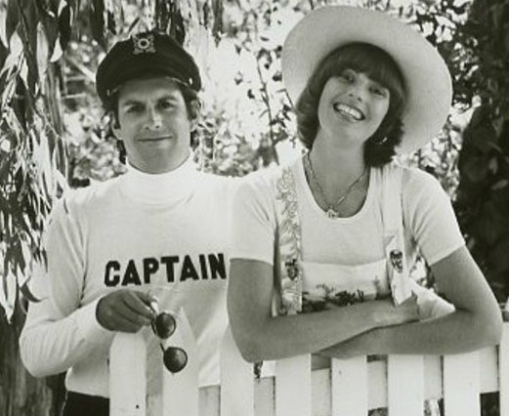
1975: Most Popular Song
Love will Keep us Together
Captain and Tennille

Slide 24
LISP 1960
Scheme 1975
Racket 1995

Slide 25
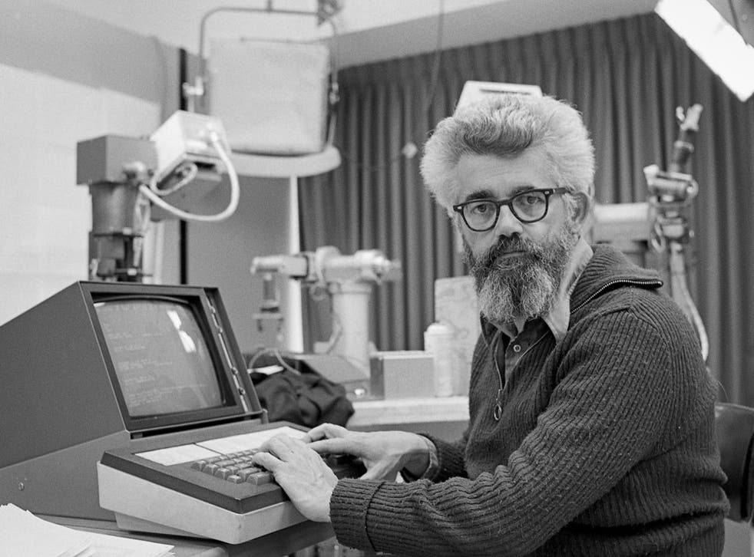
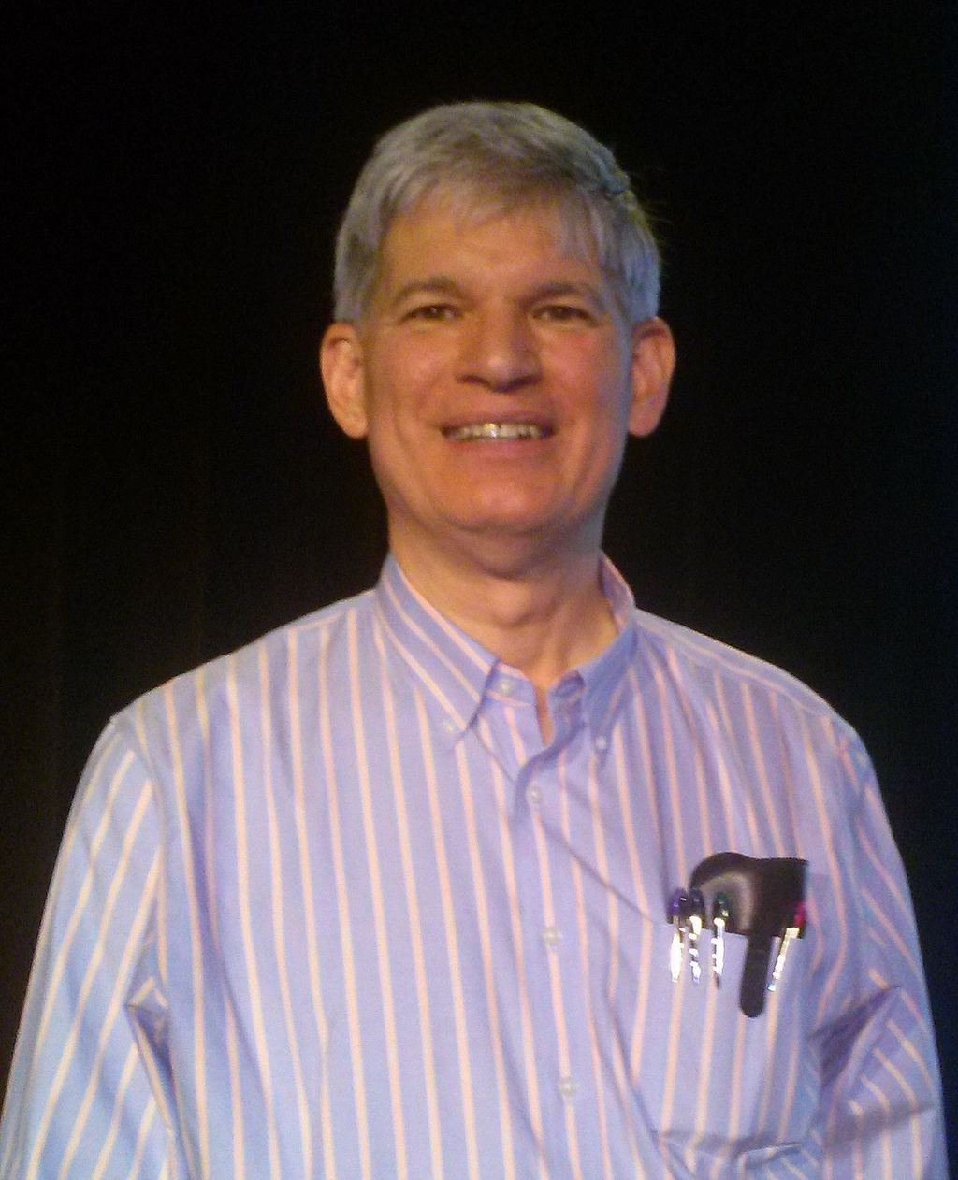
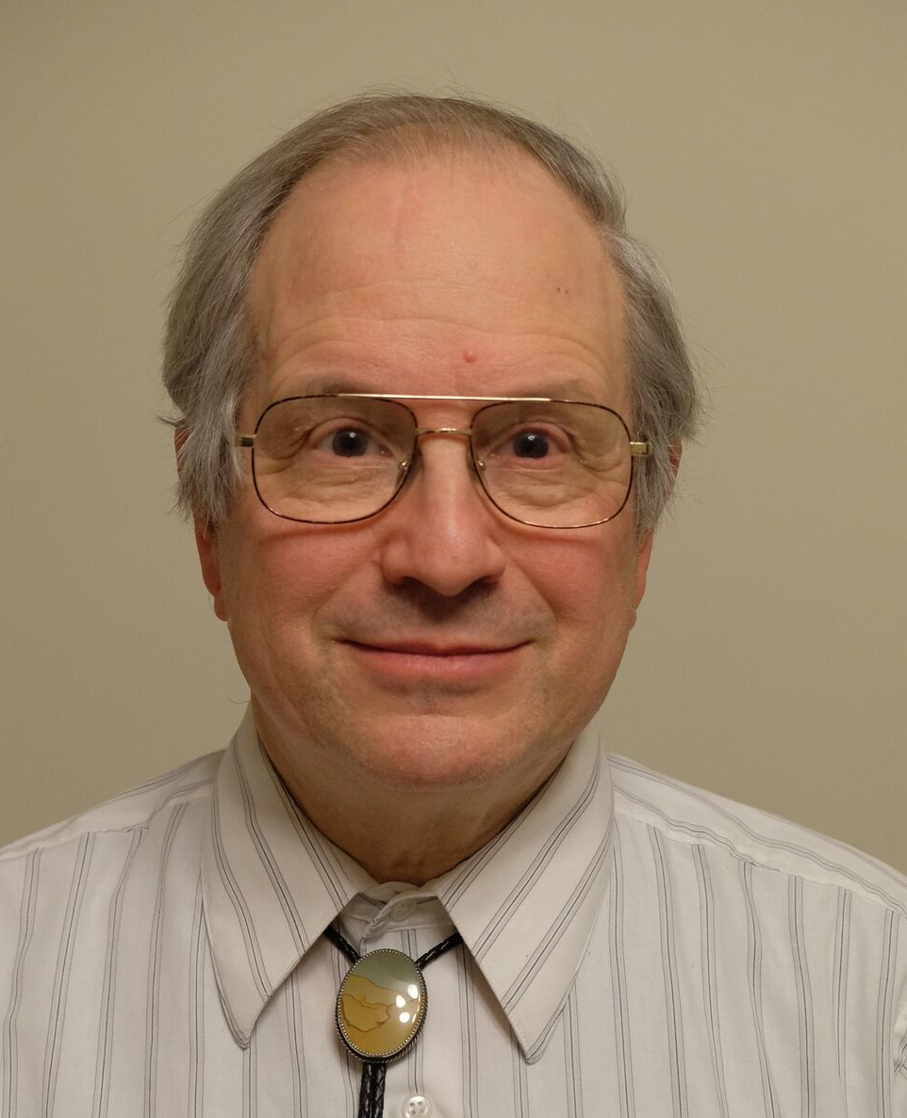
LISP and Scheme’s Original Designers
John McCarthy (1927-2011)
Original designer of LISP (1960)
Guy Steele and Gerald Sussman
Original designers of Scheme (1975)
Also coined the term “Artificial Intelligence”, and for many years was a leading AI researcher.
Racket is a modern dialect of Scheme, with many new ideas.

Slide 26

Scheme Probably Can’t Get You a Job!
The original version of JavaScript was implemented as a Scheme-style language, before being modified to look more C-like.
It’s mostly a research language used by a subset of academic programming language researchers.
A variation of LISP called Clojure has gained some popularity as a practical programming (but still pretty niche compared to other languages)
Clojure

Slide 27
What is Scheme/LISP Good for?
Popular in traditional “symbolic” AI research.
Packed with all kinds of interesting ideas, many of which have inspired more mainstream languages.
A good language for writing other programming languages and programming language tools.

Slide 28
What is Scheme Not so Good For?
Scheme is generally not as efficient as other languages.
Scheme is not used much in practice, so it can be hard to find support for it.
Scheme’s notation is simple, but maybe too simple.
()-style notation results in lots and lots of parentheses, which many programmers dislike.

Slide 29
Major Features of Scheme
Functions are first-class objects
  Functions can be passed and returned (including closures)
Interpreted
  Easy to evaluate individual expressions
Memory-safe and garbage-collected
  No dangling pointers, no manual memory deletion
Homoiconic
  Scheme programs are written as Scheme lists
Flexible
  Powerful macro system allows for major changes to the language

Slide 30
Major Features of Scheme
Types
  Dynamically typed, i.e. types checked at run-time (like Python)
  Symbols are a data type
  Lists are the key data structure
Lexical Scoping
  One of the first languages to fully implement the name-scoping rules we now take for granted in programming (scope can be determined from source code)
Tail Recursion
  Tail-recursive functions are automatically optimized into loops

Slide 31
Major Features Not in Scheme
Features not part of Scheme
  No static type declarations
  No pointers
  No built-in notion of object-oriented programming

Slide 32
Hello, World!
;; hello_world.rkt
(print "Hello, world!")
Download and run this in the DrRacket IDE. We’ll use both the interpreter and file editor in DrRacket.

