Slide 1
Shaders
An Introduction

Slide 2
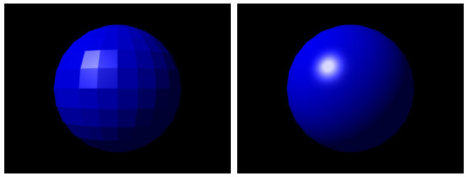

Slide 3


Slide 4
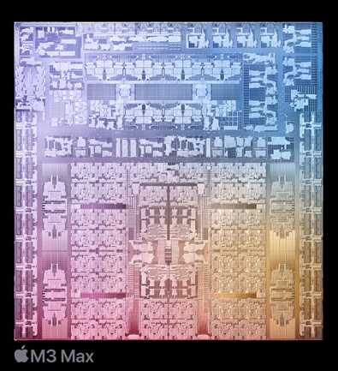
CPUs Compared to GPUs
Main CPU
Can do everything
Expensive
~10 cores that can run in parallel
Can do graphics, but too slow for real time (e.g. for games)

Slide 5
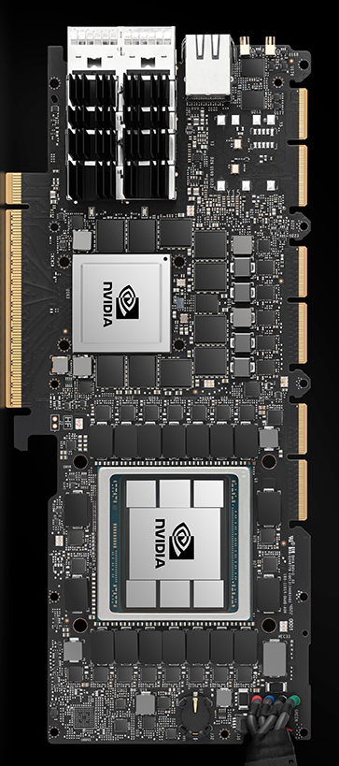
CPUs Compared to GPUs
Graphics CPU
Can only do operations specific to graphics, e.g. basic math
Programmed using special languages limited to their operations
1000s of “little” CPUs that run in parallel
RTX 4090 has over 16,000 cores
Fast enough to do real time graphics: 1 core per pixel

Slide 6
