Slide 1
Introduction to Shaders

Slide 2
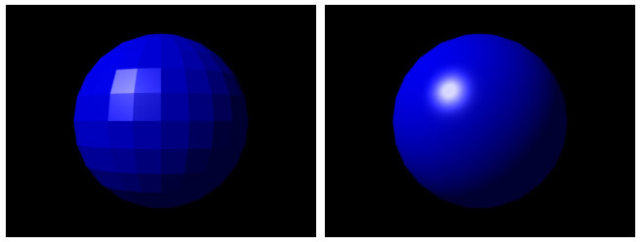

Many kinds of graphical effects are done by applying a complex mathematical function to each pixel.
A 1024 x 1024 screen has over a million pixels, and in animation running at 60 frames per second (fps) that’s over 60 million function calls per second.

Slide 3
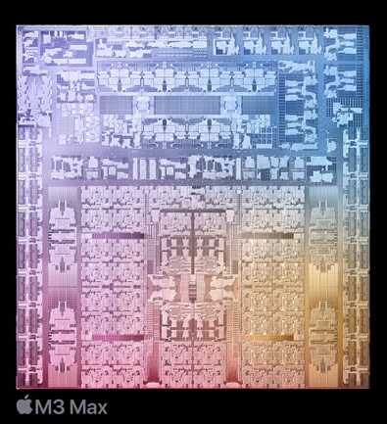
CPUs Compared to GPUs
Main CPU
General-purpose: can do everything
~10 cores that can run in parallel
Can do graphics, but too slow for many real time full-screen special effects (e.g. for games)

Slide 4
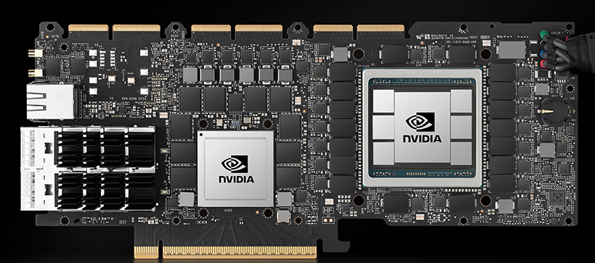
CPUs Compared to GPUs
Main CPU
Graphics CPU
General-purpose: can do everything
~10 cores that can run in parallel
Can do graphics, but too slow for many real time full-screen special effects (e.g. for games)
Special-purpose: only does computations useful for graphics
1000s of “little” cores that run in parallel
e.g. RTX 4090 has over 16,000 cores
Programmed using shader languages
Fast enough to do real time full-screen graphics special effects
1 core per pixel

Slide 5
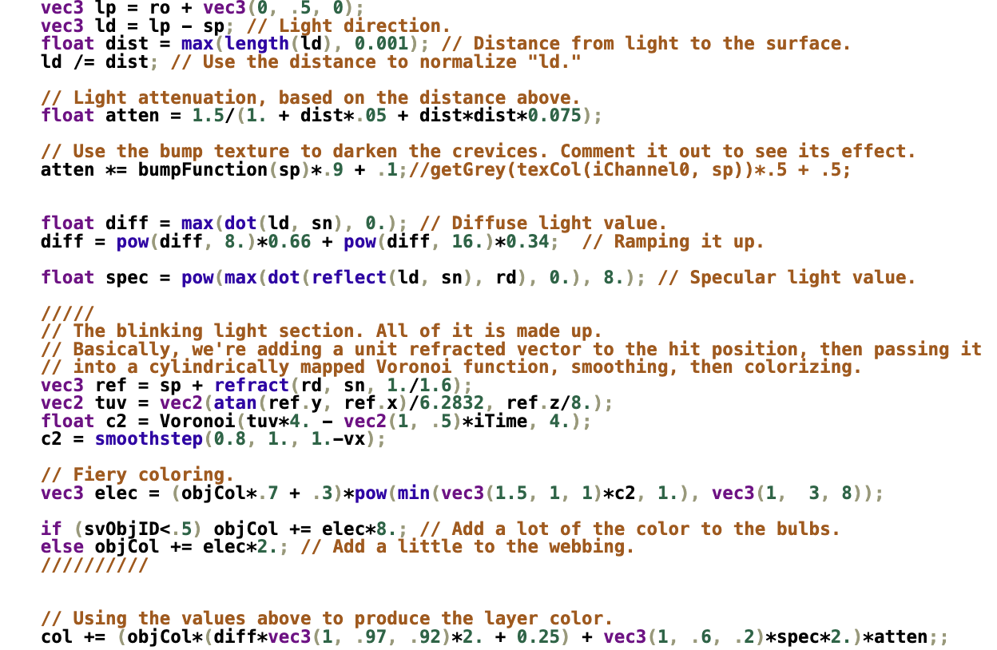
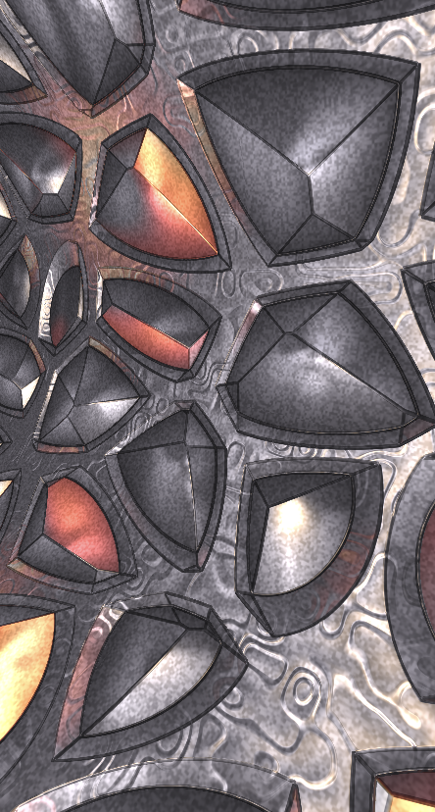
Sample shader code written in GLSL
The code is applied to every pixel to make the image on the right.

