Slide 1
Nifty Assignment: Decaboard
WCCCE 2025
Toby Donaldson, Simon Fraser University

Slide 2
Introduction
I wanted a fun and visual assignment for beginners with a “low floor, high ceiling”.

Slide 3
Introduction
I wanted a fun and visual assignment for beginners with a “low floor, high ceiling”.
I happened across the game Replicube, which uses Lua to color voxels (3D pixels) using code in the style of shaders.
shaders apply one function to thousands of pixels in parallel

Slide 4
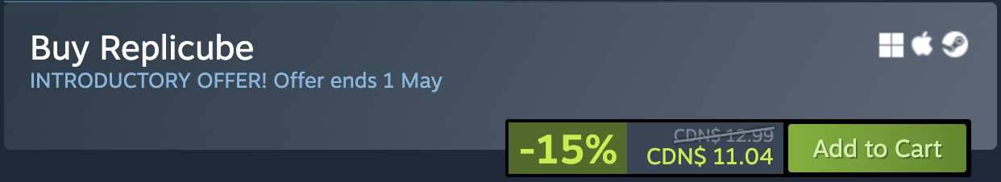
Introduction
I wanted a fun and visual assignment for beginners with a “low floor, high ceiling”.
I happened across the game Replicube, which uses Lua to color voxels (3D pixels) using code in the style of shaders.
shaders apply one function to thousands of pixels in parallel

Slide 5
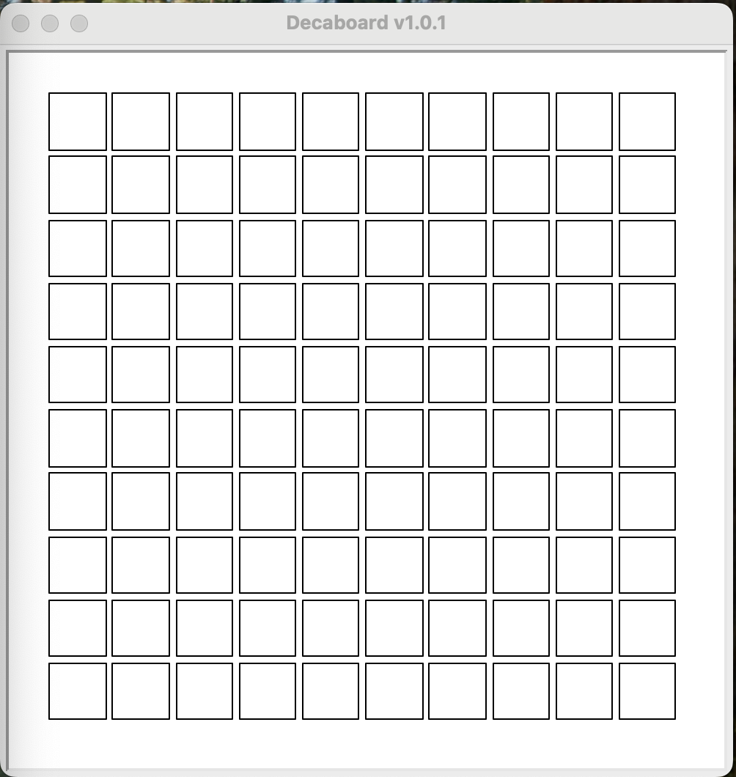
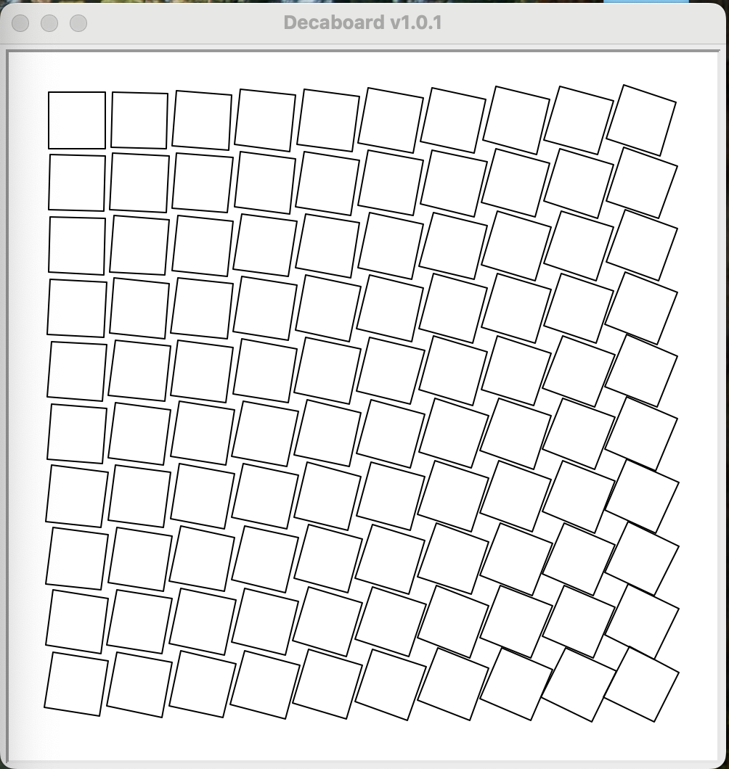
Decaboard
So in the spirit of Replicube, Decaboard is a Python-based 2D grid of squares that you set to be at any angle using a single function applied to all cells (shader-style programming).
It is a 10-by-10 grid of squares that you can rotate.
Actual shaders are not used, they are simulated using Python turtle graphics.

Slide 6
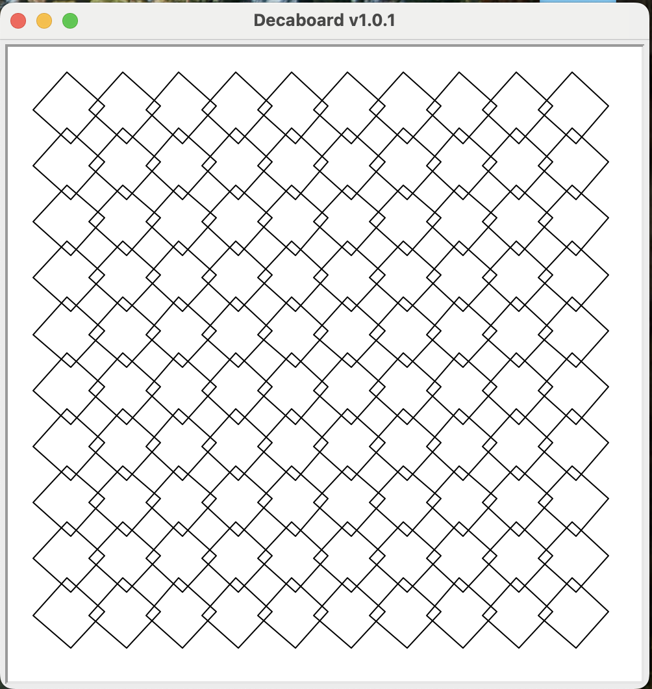
Decaboard
In the picture all the squares are rotated the same amount.
What code in angleIt will do that?
import decaboard
def angleIt(row, col, elapsed_seconds):
your code goes here
decaboard.run_board(angleIt, 1400, 200)

Slide 7
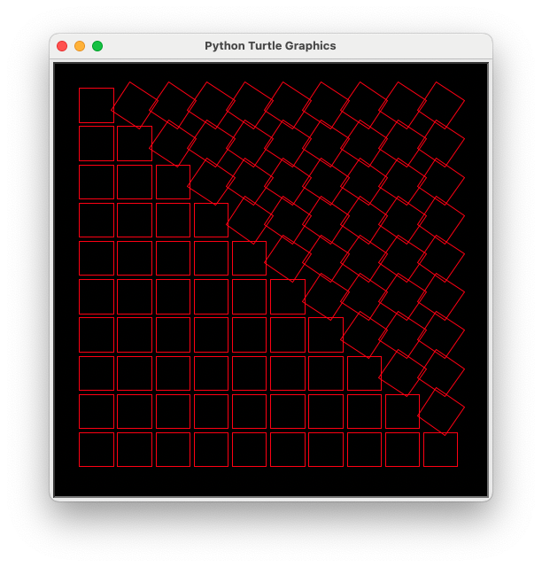
Good Features of Decaboard
Introduces shader coding, i.e. writing one pure function that is applied to all cells
2D simplifies coordinates
Angles are used instead of colors, and so can still give interesting results for “out of bound” errors
Using familiar functions in a novel way, e.g. sin to squish, abs for symmetry
Low floor, high ceiling
Decaboard+: allow changing more than just the angle of the square, but more complex
Move to real shaders using, say, ShaderToy

Slide 8
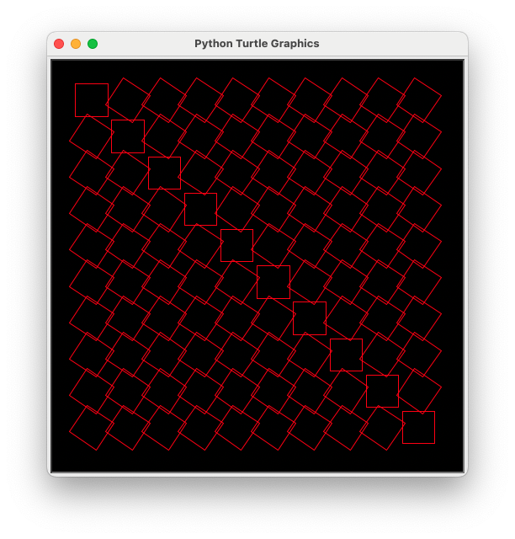
Some Student Feedback
Used with 2 classes of high school students
Lots of interest in the idea of shaders (many students know it from games)
Very easy to make fun things happen
The initial problems are intriguing and not hard
For some students, quickly became too easy, they wanted to do more

Slide 9
Suggestions
This could be used as a fun and easy assignment in week 1 or 2 of an intro Python course
Not suggesting that the whole course should be based on this! It’s just one fun assignment.
Decaboard+ is a more advanced version that uses dictionaries to set angle, size, color, position; and also takes mouse coordinates as input …
So could re-visit the original Decaboard later in the course as an example of dictionaries

