Slide 1
Shaders
An Introduction

Slide 2
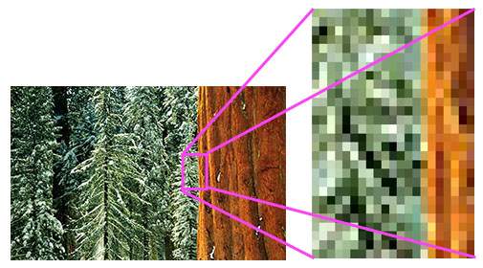
Images are Mades of Pixels
Notes:
Images are made of pixels. A picture is the smallest piece of a digital image, and has a color. If an image in 1200 x 500, then it has 500 * 500 = 250,000 (one quarter of a million pixels)

Slide 3

Notes:
In this example, a special effect has been applied to the left image, giving the image on the right. This is done by doing a calculation at each pixel of the picture to determine its new color. For a 500 x 500 image that’s 250,000 calculations. As long as the calculations are relatively short and simple most modern CPUs can do this. But more sophisticated operations can require so many calculations that regular CPUs can’t do them in real time.

Slide 4
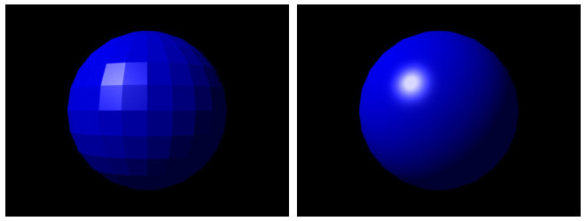
Notes:
As an example of a more sophisticated calculation, In computer graphics a common task is to take a picture, like on the left, and ”smooth” it to look like the one on the right. For a 3D sphere, these calculations would typically involve calculating the color based on the angle that light hits a pixel. If a picture is 500 x 500 pixels, then that’s 250,000 operations that must be done. If the image is animated in real time, you might do these operations, say, 60 times a second, requiring 15 million operations a second just to make the ball look smooth. In games, pictures are typically much bigger, 1440 x 900 on this computer, which is just under 1.3 million pixels. That amounts to about 78 million calculations per second 60 fps. This is just for graphics --- there computer still needs to do lots of other things at the same time.

Slide 5
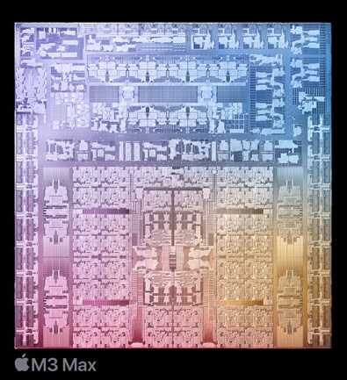
CPUs Compared to GPUs
Main CPU
Can do everything
Expensive
~10 – 30 “cores” that can run in parallel
Can do graphics, but too slow for real time (e.g. for real-time effects in 3D games)

Slide 6
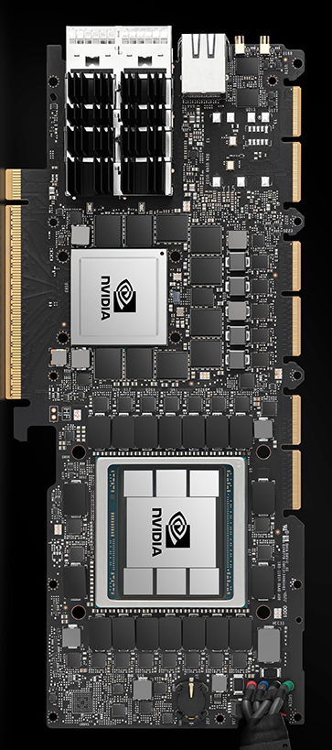
CPUs Compared to GPUs
Graphics CPU
Can only do operations specific to graphics, e.g. basic math
Programmed using special languages limited to these operations
1000s of “little” CPUs, or “cores”, that run in parallel
RTX 4090 has over 16,000 cores
Fast enough to do real time graphics: 1 core per pixel
Also used in AI

Slide 7
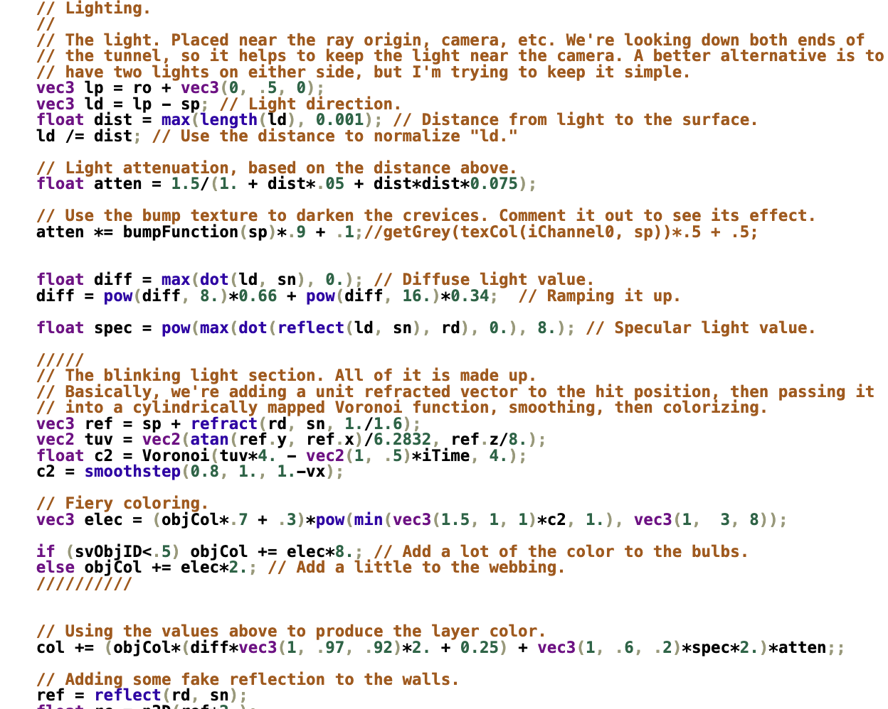
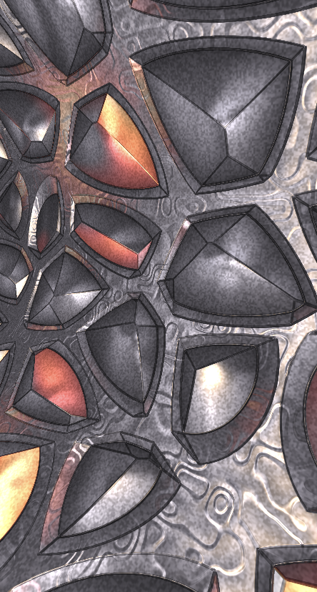
Notes:
This is an example of a program written in a shader language. This program is run at the same time one very pixel of an image, and results in the image shown. Despite being limited as compared to a regular CPU, there are tricks to make all kinds of images and animations.

