Slide 1
Shaders
An Introduction

Slide 2
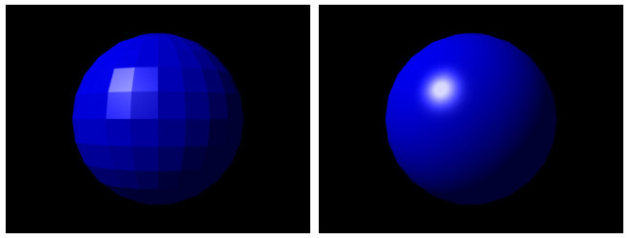
Notes:
In computer graphics a common task is to take a picture, like on the left, and ”smooth” it to look like the thing on the right. For a 3D sphere, these calculations would typically involve calculating the color based on the angle that light hits a pixel.

Slide 3

Notes:
In this example, a special effect has been applied to the left image, giving the image on the right. Again, this is done by doing calculations at each pixel of the picture. For a 500 x 500 image that’s 250,000 sets of calculations! A regular computer CPU can have trouble doing this quickly.

Slide 4
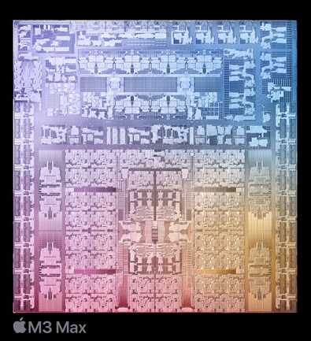
CPUs Compared to GPUs
Main CPU
Can do everything
Expensive
~10 cores that can run in parallel
Can do graphics, but too slow for real time (e.g. for games)

Slide 5
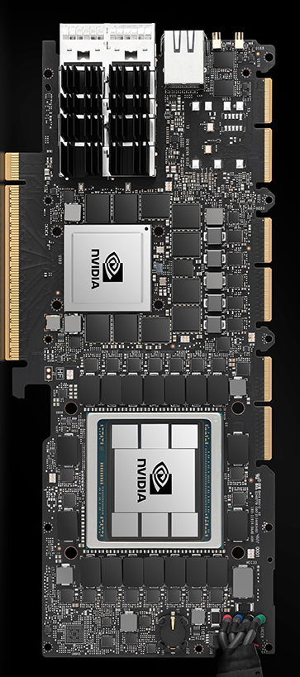
CPUs Compared to GPUs
Graphics CPU
Can only do operations specific to graphics, e.g. basic math
Programmed using special languages limited to their operations
1000s of “little” CPUs, or “cores”, that run in parallel (at the same time)
RTX 4090 has over 16,000 cores
Fast enough to do real time graphics: 1 core per pixel

Slide 6
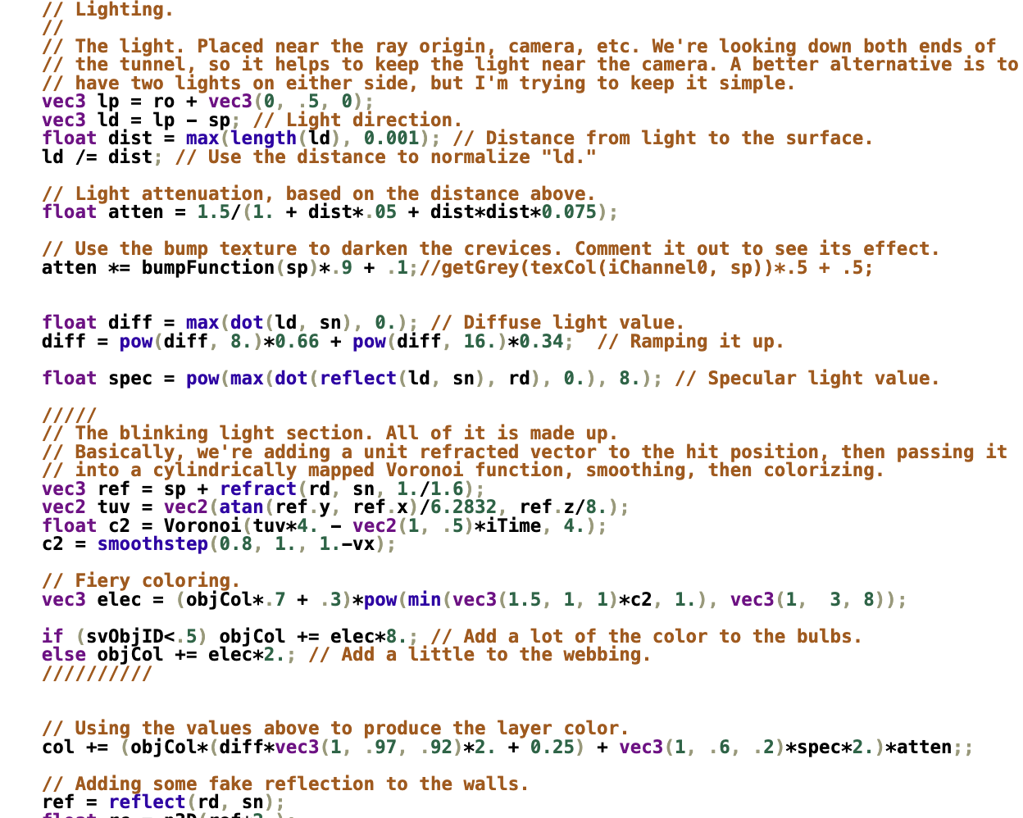
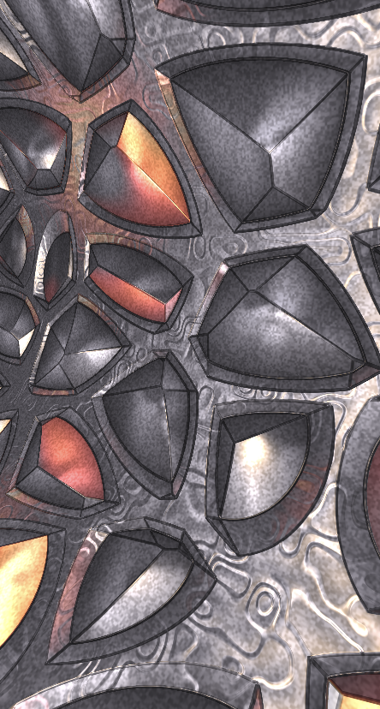
Notes:
This is an example of a program written in a shader language. This program is run at the same time one very pixel of an image, and results in the image shown. Despite being limited as compared to a regular CPU, there are tricks to make all kinds of images and animations.

