Slide 1
CSS & JS Animations in React
A short guide on animations inside the web and React
Mario Jimenez - 02/19/25

Slide 2
What the presentation is about:
Brief history of animations on websites
Brief intro to CSS + JS
Why animations can improve page metrics
How to integrate some CSS animation libraries to your websites and React apps
Some great and impressive examples of animations used inside websites.
This is not an all inclusive and comprehensive guide. More of an intro.

Slide 3
About me
Former Software Engineer at Socially Elite Pro
Currently pursuing a Master’s Degree of Science in Computer Science
Volunteer Software Engineer for Austin Public Library. Formally volunteered for Open Austin
Sometimes build SaaS and online businesses - DevOpsJobs.app | APIplaza.co | PetWarez Inc.
Tech blogger: https://medium.com/@7adam7e
Sometimes create music. Sometimes do photography

Slide 4





Brief history of animations in websites
Earliest example: Graphics Interchange Format (GIF) in the 1980s (Pronounced either “jif” or “gif”)
Started gaining more tracking in the 1990s. When more internet users where going online
Early 2000s: Main animation tool was Adobe Flash. Was used in almost every website and app on the web at one point until being discontinued. For many reasons (unsecure, bad on mobile
JS + HTML5 + CSS3 nowadays. With JavaScript becoming the most popular software for web animations

Slide 5
Brief intro to CSS + JS
CSS was developed by Håkon Wium Lie, to separate styles from code on site-> Good for animations
JavaScript was developed by Brendan Eich during NetScape Era. - > Also good
HTML5 -> Latest animation tool
You can use HTML5 + CSS + JS all at the same time. Or 1-2 at the same time

Slide 6
You can do pretty much anything you can think of using animations
Interactive menus
Video Games
Data science project
Help guide
Short films
Art and photography galleries
Product mockup
Architectural dioramas
Planetary system show
Marketing campaings
Movie promos
Music artist features

Slide 7
Why animations can help you:
Make your React app more interactive and more fun for non-technical users
Users tend to remember cool looking animations and sometimes come back to see it again. Sometimes even telling their friends and family (Word of mouth funnel)
Direct your clients to the specific section or feature of a web app or web page you want them to see
Increase Click through rate (CTR) / app / conversion rate for visitors.
More sales for specific product being sold on your product

Slide 8
How to integrate animations to website
Custom code snippets
External libraries
Inline code
Animation frameworks. From npm’s website for easy installation

Slide 9
Possible pitfalls and Cons
Too many animations turn users off.
Too much content being loaded at the same time can make it sluggish
Bad animations / animations done badly can also turn users away
Some animations don’t work on some specific browsers (Chrome with WebGL animations or CSS3 animations Safari)

Slide 10
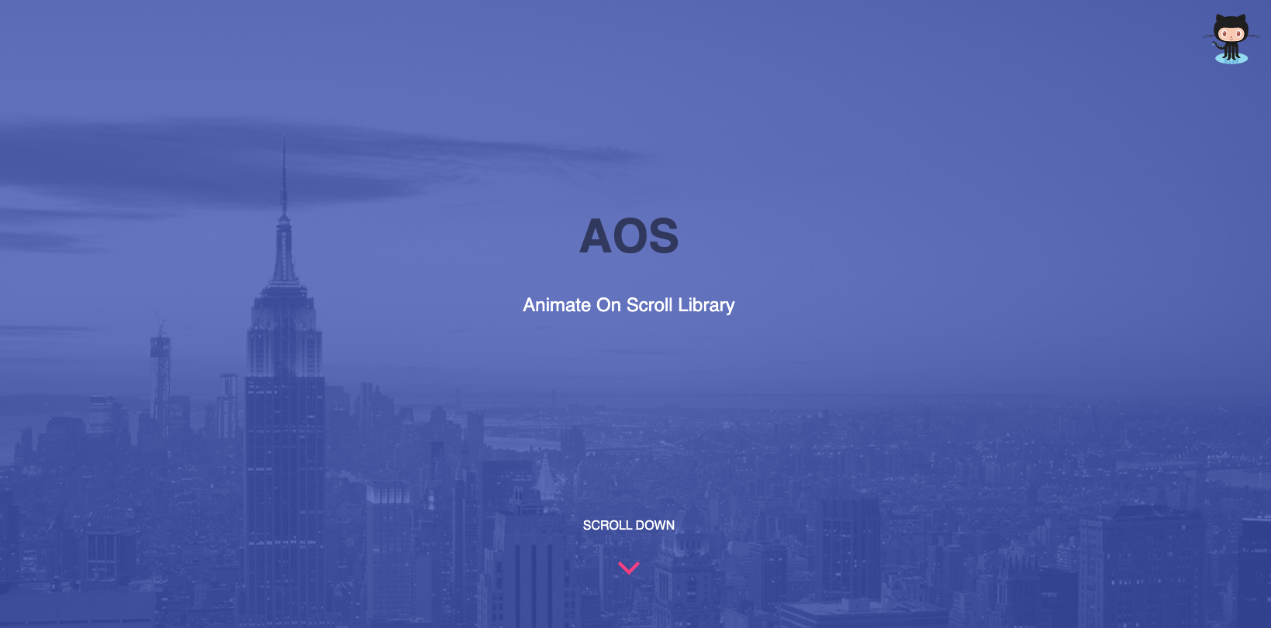
Example JavaScript/React animations library
Animate on Scroll
https://michalsnik.github.io/aos/

Slide 11
Some animation library examples
animate.css - https://animate.style/
anime.js https://animejs.com/
granim.js https://sarcadass.github.io/granim.js/examples.html
D3.js - https://observablehq.com/@d3/gallery?utm_source=d3js-org&utm_medium=hero&utm_campaign=try-observable
Fullpage: https://alvarotrigo.com/fullPage/#page1

Slide 12
Good examples of functional animations
Codepen(great inspiration site) - https://codepen.io/search/pens?q=
https://warhol-arts.webflow.io/
https://www.apple.com/imac/
https://www.apple.com/macbook-pro/
https://threejs.org/
http://robinmastromarino.com/
http://vr.ff.com/us/
https://demos.littleworkshop.fr/infinitown
https://hajimewatanabe.jp/biography/
https://hsmkrt1996.com/
https://poki.com/en/g/crossy-road
https://neal.fun/design-the-next-iphone/
https://neal.fun/absurd-trolley-problems/
https://virtual.bbcmic.ro/?disc1=bs-badappl.dsd&autoboot
https://iss-sim.spacex.com/
https://history-of-animation.webflow.io
https://giphy.com/search/lunar-new-year

Slide 13
Conclusion
Adding animations to your website or app can make everything look much better. But can turn people away from your project if not handled well
Use in moderation.
And test before shipping your code
Don’t be intimidated when making any complex animation projects online.
You can do any of the web projects I showed you today. And even make them better.

Slide 14
Reach out to me if you have any questions :
Github: https://github.com/tjdev7/
Website: https://tjdev7.co/
Twitter/X: https://twitter.com/Tjdev7
LinkedIn: https://www.linkedin.com/in/mariojimenez1/
Medium: https://medium.com/@7adam7e

Slide 15
Resources:
https://github.com/tjdev7/reactatx-css-js-react-animations
https://kinsta.com/blog/javascript-libraries/
https://www.microverse.org/blog/javascript-library-vs-javascript-frameworks-the-differences
https://www.awwwards.com/websites/animation/
https://medium.com/@milberferreira/the-history-of-web-animation-63b106c97fdf

