Slide 1

CSS Frameworks and You:
A guide to integrating responsive frameworks
into your React projects
Mario Jimenez

Slide 2
About me
Been attending meetup groups for years. Decide to contribute
Former Software Engineer at Socially Elite Pro
Volunteer Software Engineer for Austin Public Library. Formally volunteered for Open Austin
Sometimes build SaaS and online businesses - DevOpsJobs.app | APIplaza.co | PetWarez Inc.
Tech blogger: https://medium.com/@7adam7e
Sometimes create music. Sometimes do photography

Slide 3
What the presentation is about:
CSS frameworks. What are they all about?
How you can use them in most of your projects?
Multiple CSS frameworks at use by different websites and companies
Getting you into using a framework via a step by step sample project

Slide 4
What I hope that you get from this presentation
Improve your Front-End / Web Development and Web Designing
Enhance your communication with your UI/UX Designer, Product Managers, etc, about webpage elements
Attract more users, traffic, or sales to your service using some of the frameworks
Improve the UI/UX design and visual interactivity of your website, app, project, SaaS, etc
Stop spending a lot of time center aligning website elements

Slide 5
What are CSS frameworks?
Ready to use code rules and parameters used for Front-End Dev Work
Comes with its own styling, layouts, and font styling for each text element
Lets you easily create responsive grids, forms, buttons, and other elements for a website
Provides consistent styling for your Front-End Dev work
Great for adding responsive design, grids and mobile friendly CSS parameters to your project

Slide 6
Where you can implement new frameworks:
Small web applications
Legacy apps
Progressive Web Applications
SaaS
Sales pages / landing pages
Personal websites
Codebases with separate CSS libraries referenced

Slide 7
Pros of using frameworks
Extremely small libraries. Some take only 2 kilobytes of data to install (milligram.io)
Cut down Dev time
Ease up testing and user experiences on multiple platforms (smartphones, desktops, tablets, etc)
Easy to update and change each framework
They work on any type of JS/React/JS framework project. Dev stack agnostic
Free to use, try and install the majority of frameworks (FOSS)
Framework documentation and guides are always available

Slide 8
Cons of CSS Frameworks
CSS that’s already installed in projects loses priority
Sometimes rigid for Front-End Development. The CSS rules that the framework become the main rules
It can turn into a mess of code if you don’t take good care of your codebase and organize everything

Slide 9





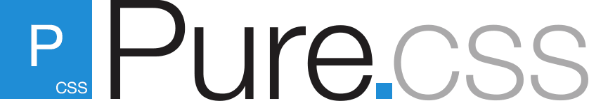






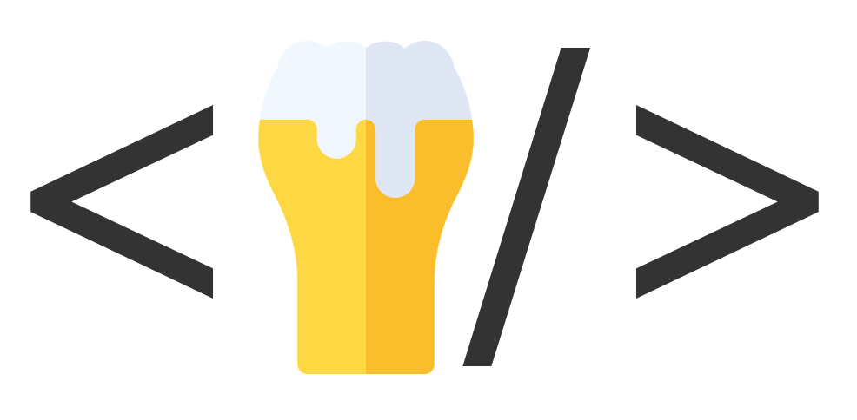
Some example frameworks
There’s many options to choose from:

Slide 10
A few companies and startups
that use CSS frameworks:
Bootstrap: Mastercard, Spotify, LinkedIn, Twitter, Duolingo, Udemy, Robinhood
Tailwind: Shopify, Medium
Bulma: Fujitsu, Infosys, University of California in Berkley
Skeleton: The Range, WikiTree
Foundation: Barclays Bank, Pixar, Mini Cooper
Milligram: Node.js foundation, Airform

Slide 11
Frameworks are all available on npm.js
Free and easy to install on any React project

Slide 12
Some example websites and components from
some of the frameworks
https://bulma.io/expo/
https://icons.getbootstrap.com/
http://getskeleton.com/examples/landing/
https://mui.com/material-ui/getting-started/templates/
https://tailwindui.com/components?utm_medium=navigation&utm_source=tailwindcss

Slide 13
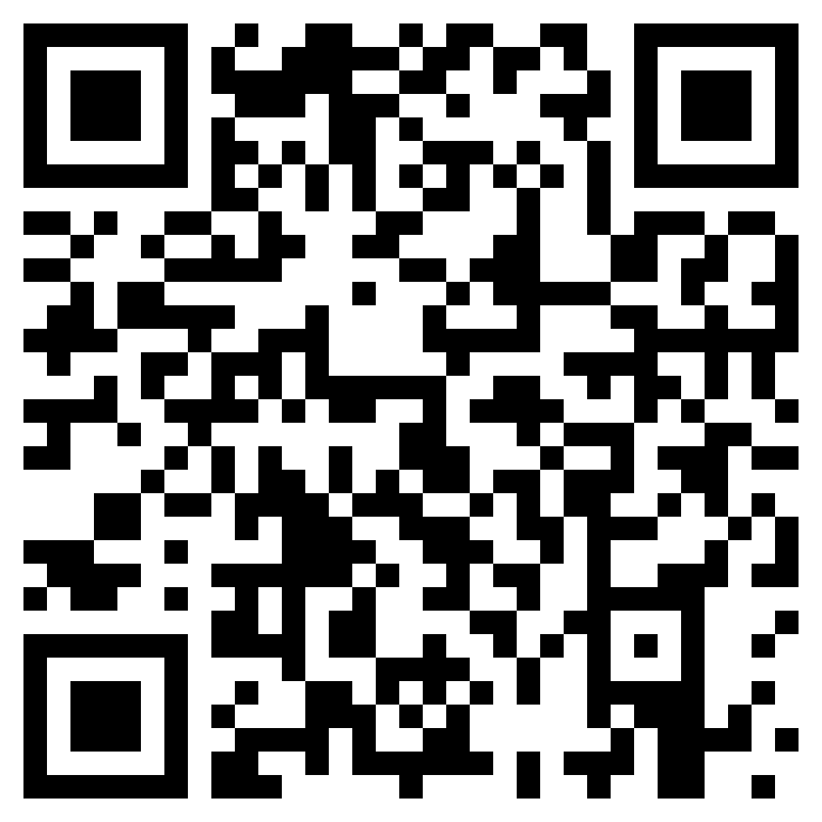
Demo project
URL: https://github.com/tjdev7/reactatx-css-frameworks-samples
GitHub Commands:
https://github.com/tjdev7/reactatx-css-frameworks-samples.git
Git clone git@github.com:tjdev7/reactatx-css-frameworks-samples.git
gh repo clone tjdev7/reactatx-css-frameworks-samples
Shortened URL: https://bit.ly/40Li9rz

Slide 14
My small advice
Read the documentation. Follow the walkthrough guides before doing anything
Don’t rush development. You will get a messed up codebase if you do
Use a separate Git branch / container / directory to test things out
Experiment, then test everything on all test mediums before pushing to main/master. Take a few minutes off before making the push with fresh eyes
If a mistake ever happens, just revert the recent push

Slide 15
Conclusion
I created this presentation with the hope that it helps you, the attendee improve your Dev cycle. And to help people in your company, group, stealth company, etc.
I really do hope my presentation helped you out in any way
Reach out to me if you need help. I can answer whenever I’m available via email or LinkedIn page.

Slide 16
Hope you liked it
Hope it helped you out personally
Hope that you make some great work with it

Slide 17
Reach out to me:
Github: https://github.com/tjdev7/
Website: https://tjdev7.co/
Twitter/X: https://twitter.com/Tjdev7
LinkedIn: https://www.linkedin.com/in/mariojimenez1/
Medium: https://medium.com/@7adam7e

Slide 18
Additional resources
https://mui.com/
https://getbootstrap.com/
https://tailwindcss.com/
https://get.foundation/
https://bulma.io/
http://getskeleton.com/
https://getuikit.com/
https://stackshare.io/tailwind-css
https://milligram.io/typography.html
https://www.beercss.com/
https://jenil.github.io/chota/
https://stackoverflow.design/
https://semantic-ui.com/
https://pure-css.github.io/

Slide 19
Npm links
https://www.npmjs.com/package/bootstrap
https://www.npmjs.com/package/tailwindcss
https://www.npmjs.com/package/uikit
https://www.npmjs.com/package/bulma
https://www.npmjs.com/package/@mui/material

