Slide 1

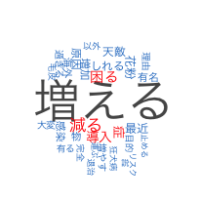



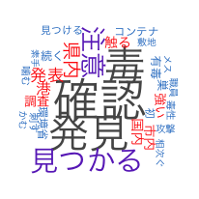




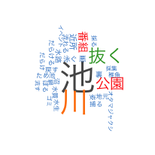


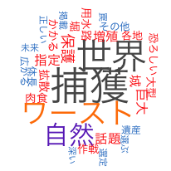

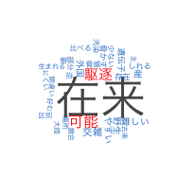

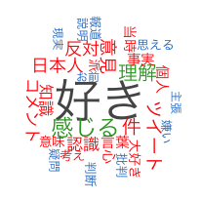

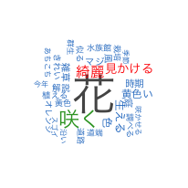

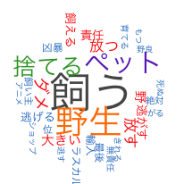
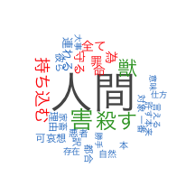
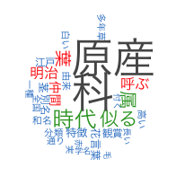


Slide 2
Topic 01
Topic 02
Topic 03
Topic 04
Topic 05
Topic 06
Topic 07
Topic 08
Topic 09
Topic 10
Topic 11
Topic 12
Topic 13
Topic 14
Topic 15
Topic 16
Topic 17
Topic 18
Topic 19
Topic 20
Topic 21
Topic 22
Topic 23
Topic 24
Topic 25

