Slide 1
Online
<<Service>>
WEB UI
Nearline
MVC
<<Analysys>>
<<Service DBMS>>
Python
Was
Data
import
Oracle
<<JDBC>>
Offline
<<M/L>>
<<BigData platform>>
Python
SQL
<<JDBC>>
SQLonHadoop
M/L
HDFS
hdfs dfs -put

Slide 2
<<Service>>
WEB UI
MVC
<<Analysys>>
<<Service DBMS>>
Python
Was
Data
import
Oracle
<<JDBC>>
<<M/L>>
<<BigData platform>>
Python
SQL
<<JDBC>>
SQLonHadoop
M/L
HDFS
hdfs dfs -put

Slide 3
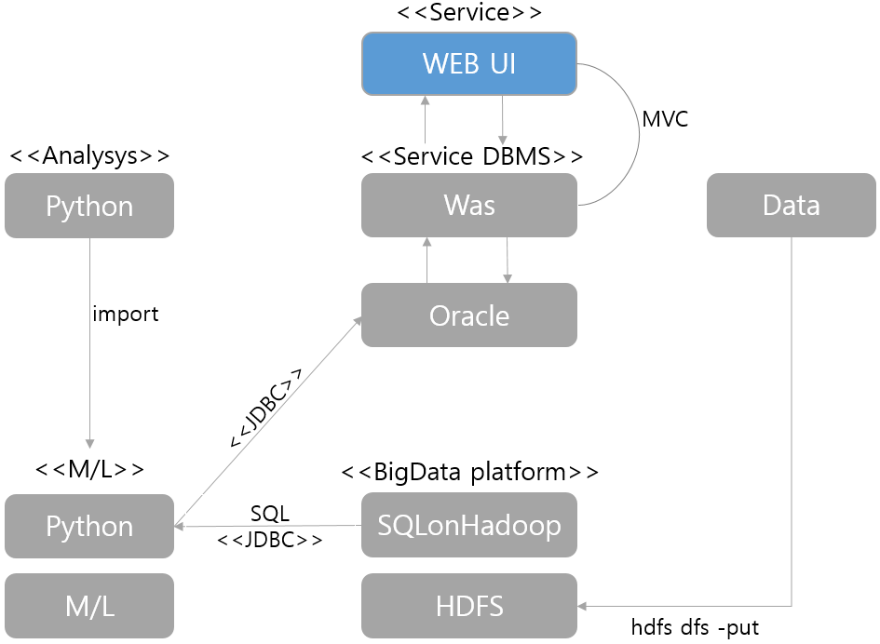
WEB UI

