Slide 1
Three points at the corners of your triangle
P1, P2, P3
Where Pi = [xi yi zi]

Slide 2

The normal is then given by:

Slide 3
Which is the cross product:
N = (P2 – P1) * (P3 – P1)

Slide 4

=

Slide 5
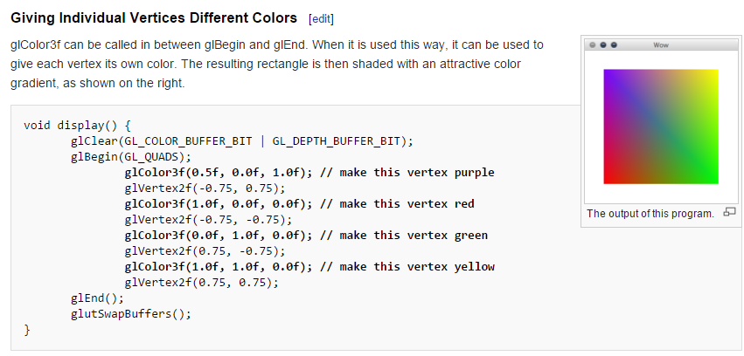
Use glColor3f() in the vertext delivery loop
(i.e. between glBegin and glEnd) to set each
vertex color
- http://en.wikibooks.org/wiki/OpenGL_Programming/Basics/Color

Slide 6
Display test.ply (it’s ASCII)
Draw the triangle only if the normal points toward the viewer
Set the color of each as a function of the
angle between the viewer and the
surface normal.
You choose the base color and interpolation function.

