Slide 1
A Web Application to interactively visualize assay screening data
Janice Tjeng
Notes:
Presentation
Project
Background: chemistry team aims to incorporate computational techniques to accelerate drug discovery, one application is to automate the analysis of assay screening to enable lead identification
Most proud of:
Data viz
Lasting impact: currently being in used for lead identification
Establish a data-driven culture for which more advanced analysis are based upon, analysis can be applied to visualize any type of multi-dimensional data sets

Slide 2
agenda
Defining the Problem
Discovering the Data
Developing Solution
Deploying Solution
Future Work
Q & A
Conclusion
improvements

Slide 3
Defining the problem
Previous method
Current solution
Manual and non-standardized analysis
Time consuming
Automated and standardized analysis
Time efficient
Enable lead identification
Notes:
Before tool is developed, scientists were manually visualizing data using Spotfire
Drag & drop to create heatmap dendrogram
Not standardized: produces different output depending on how the clusters are computed
Not reproducible
Time consuming & does not produce meaningful insights (based on the viz, not able to intuitively identify leads)
Tool automates & standardize process
Upload data in UI
Analysis runs in the backend to produce standardized visualization that tunes the clustering algorithm to produce the best possible viz
Reproducible
Generate meaningful insights: able to identify leads intuitively

Slide 4
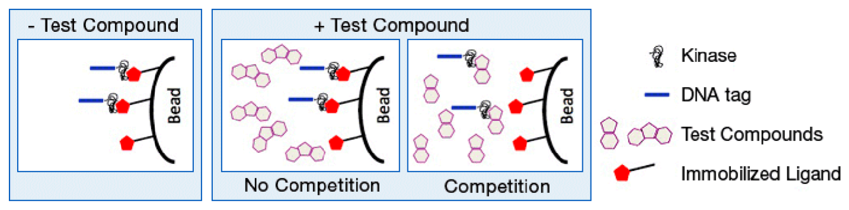
Discovering the Data
KINOMEscan assay panel of 489 kinases
500 compounds
Measure amount of kinase bound to ligand with and without the compound
% control (PoC)
<35% PoC
Source: DiscoverX
Notes:
Kinases of a wide variety (lipid, tyrosine, mutants, pathogen, atypical)
Using single concentration screens across full assay panel
Explain meaning of PoC: amount of kinase bound to ligand with the introduction of compound
Lower PoC, less kinase bound to ligand with introduction of compound, the stronger the compound inhibits kinase function.
As we see in the figure on the right…
Lower PoC, compounds more active
Why choose low PoC: goal is to develop drugs that inhibit activating kinase mutations

Slide 5
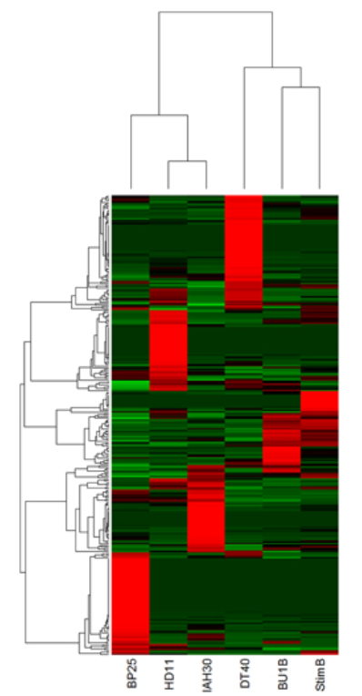
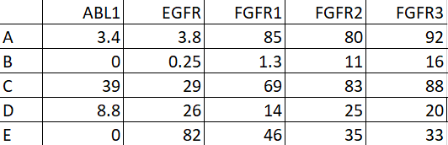
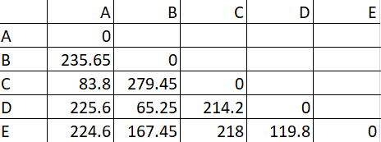
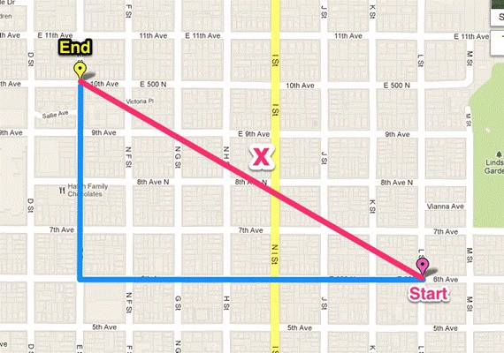

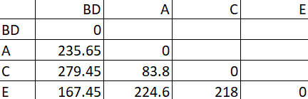
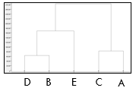

Developing solution
Measuring similarity
Manhattan distance
Distance formula selected by tuning
Measured by Dunn index (DI)
$DI=\frac{Σinter−cluster distance}{Σintra−cluster distance}$
Repeat
Notes:
Clustering method to group data points based on similarity
Distance correspond to height of dendrogram
Repeat above steps to generate dendrogram and measure DI
Ratio between inter-cluster and intra-cluster
Tried kmeans but doesn’t work as well because of the lack of dendrogram (not able to see how compounds are related)

Slide 6
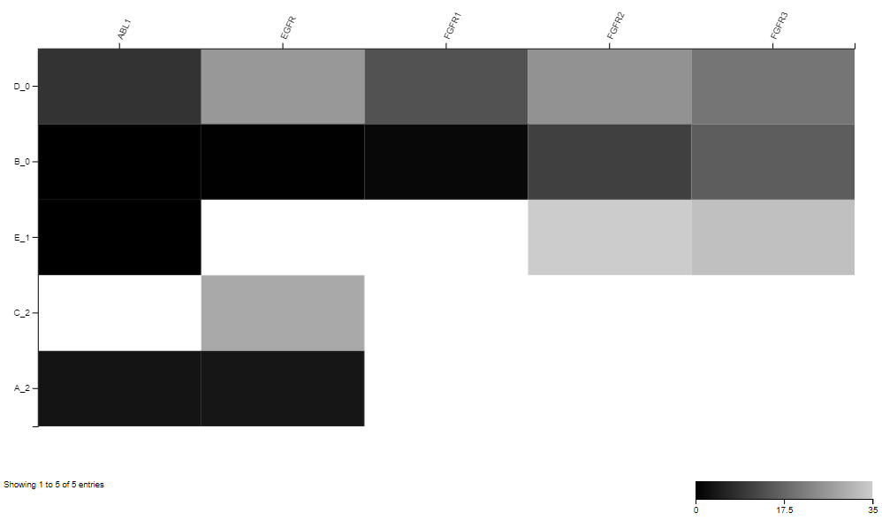
Developing solution (cont.)
Assigning clusters
Arbitrary value
Tuning to select number of clusters
Minimize intra cluster variation
Creating heatmap

Slide 7
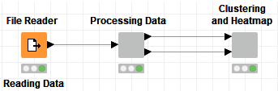
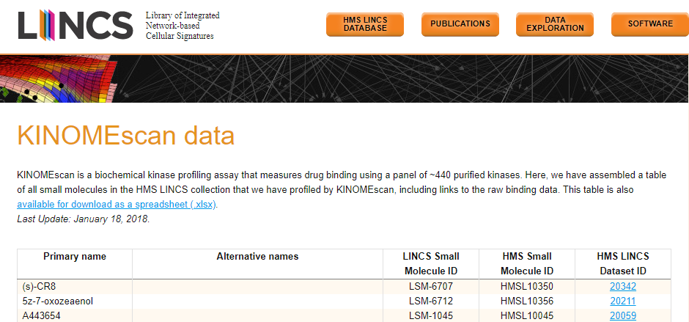
Deploying solution
KNIME workflow demo
Sample data set
HMS LINCS Project
Notes:
Dataset obtained from HMS: Library of Integrated Network-based Cellular Signatures
Screen kinase against these compounds at 10microMolar, picked these kinases for demonstration
Actual data has more compounds but limited data set from source. Not many compounds with same experimental conditions
Talk about interactivity

Slide 8
improvements
Re-tune clustering algorithm on larger data sets
Speed up run-time on larger data sets
Additional interfaces
Additional visualizations
Notes:
Solution is deployed for 500 kinases & compounds, want to extend on larger data sets such as that from HTS

Slide 9
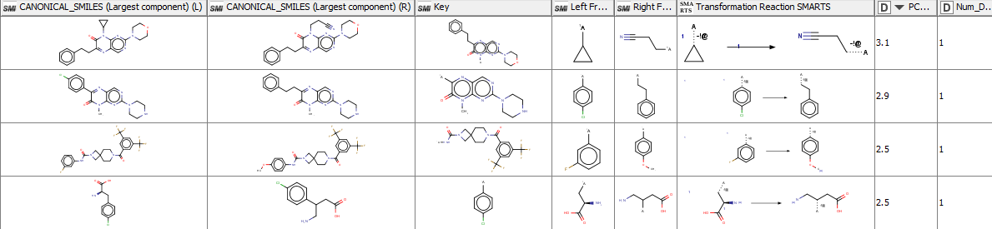
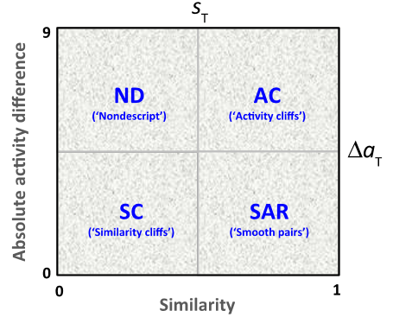
Future work
Matched Molecular Pairs (MMP)
Vogt et al., 2014
Notes:
MMP:
Generate molecular pairs & compute changes in activity
Look for activity cliffs
Pchembl value (-log of various concentrations), positive means R fragment has higher Kd/Ic50
Have a better idea of structures we are looking for, use information to build predictive models

Slide 10
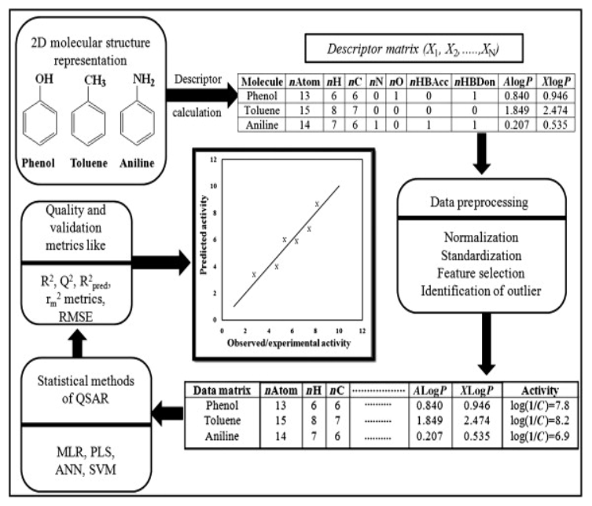
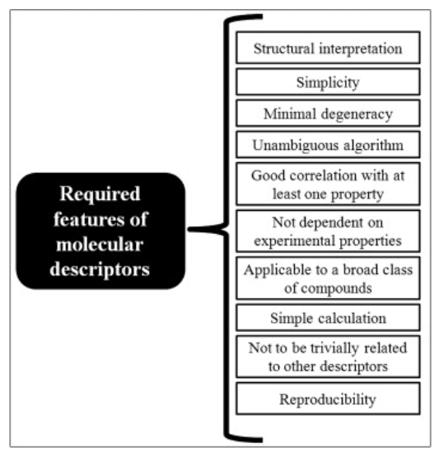
Future work (cont.)
Predictive models
Calculate molecular descriptors
Using software programs
Select relevant descriptors
Remove outliers
Feature selection
Train models
Evaluate models
Linear
Error terms
Deploy model
Non-linear
Predict activity of new compounds
Update model with new data
Incorporate into workflow
Roy et al., 2015
Notes:
such that we make certain structural modifications & predict activity & synthesize drugs if they show desired activity → save time and cost in drug synthesis while a better understanding of the structures and activity we are looking for, optimizing leads in a data driven way
Understand molecular descriptors: numerical representation of molecule
Remove outliers:
Z-score: Number of std away from mean. Standardize value by taking difference btw data point and mean/std
Values with scores above and below a threshold are removed
Feature selection:
Backward elimination
PCA (explain more)
Linear models:
MLR
Non-linear models:
RF
Neural network
Genetic Function Approximation
Deploy:
Select model with lowest error
Predict on unseen data
Update and re-evaluate model with new data on the cloud
Output table with molecules, selected descriptors, and activities

Slide 11
Lead optimization workflow - example
Exploratory
Visualization tool
Descriptive
MMP
Predictive
Predictive models
Reduce time in identifying and optimizing leads
Reduce time and cost in drug development
Notes:
Tie it to bigger picture of reducing time and cost associated with drug discovery, design, & development
Exploratory: visualize and select compounds that selectively inhibit kinase function
Descriptive: Better understand how the structure of compounds relate to the activity
Predictive: Once we better understand structures, we can use that information to predict the activity of new compounds and specifically develop drugs that have the targeted activity to reduce cost and time associated with drug development
If we develop drug quicker, shorter time to market, competitive advantage, more revenue, and more patient lives saved.

Slide 12
conclusion
User-friendly, intuitive visualization tool to identify potential leads
Low-cost, scalable, and quick deployment
Inspire data-driven drug discovery and development
Notes:
Visualization tool developed for the project
Low-cost: open source
Scalable: works for any data set, even extensible to other types of multidimensional data sets
Quick deployment: push the workflow to the server that runs on AWS
Inspire data-driven drug discovery & development for which more advanced analysis is developed (MMP is actually a continuation of the work), & ultimately predictively analytics to optimize leads and reduce time & cost in drug discovery

Slide 13


Slide 14

THANK YOU!

Slide 15
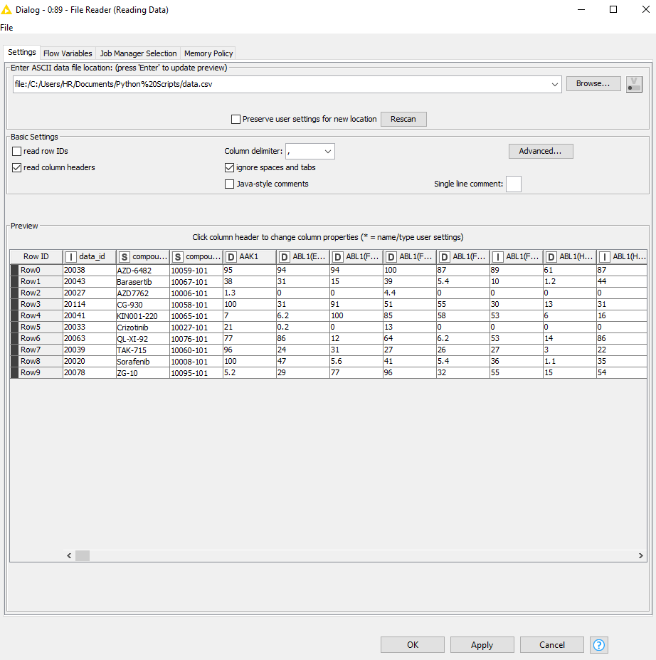
APPENDIX – FILE UPLOAD

Slide 16
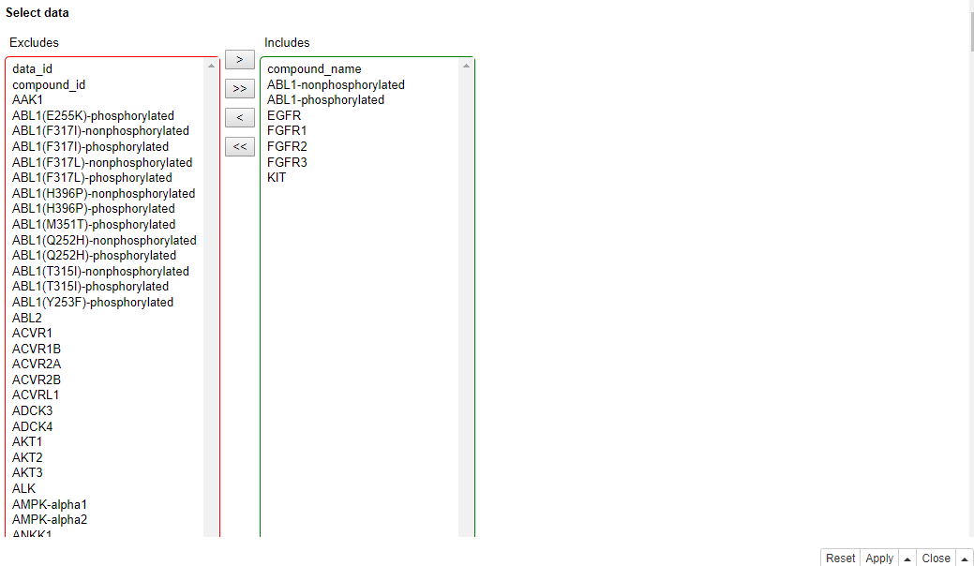
APPENDIX – KINASE SELECTION

Slide 17
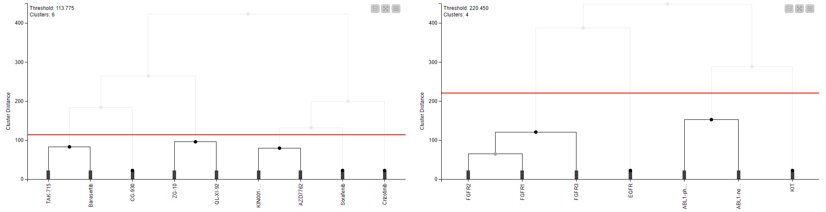
Appendix – Sample output

Slide 18
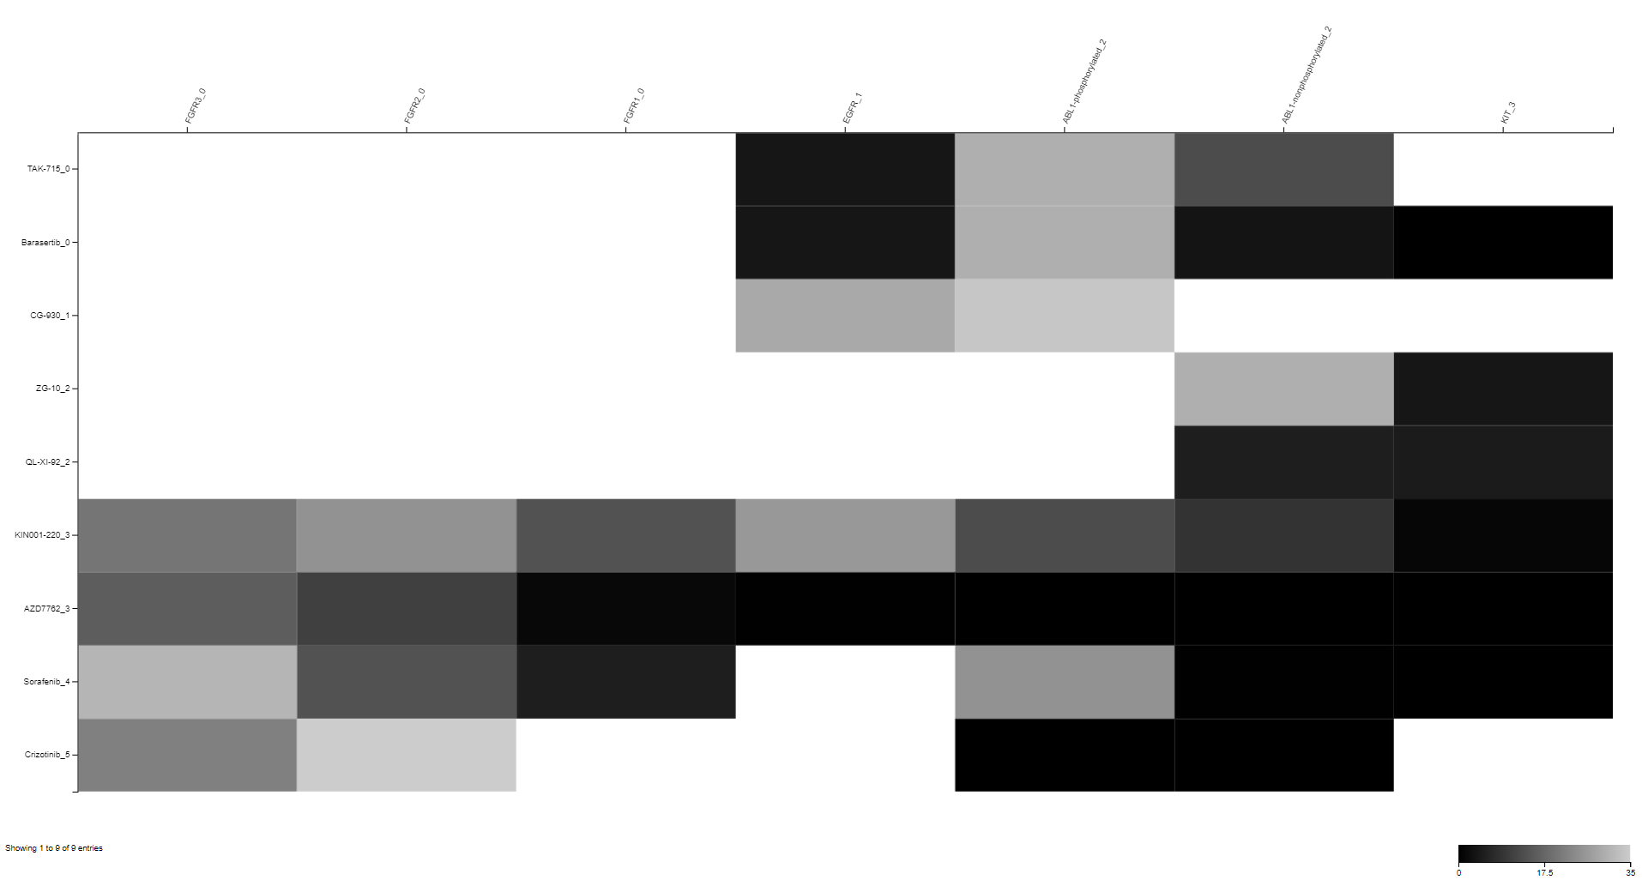
Appendix – sample output

Slide 19
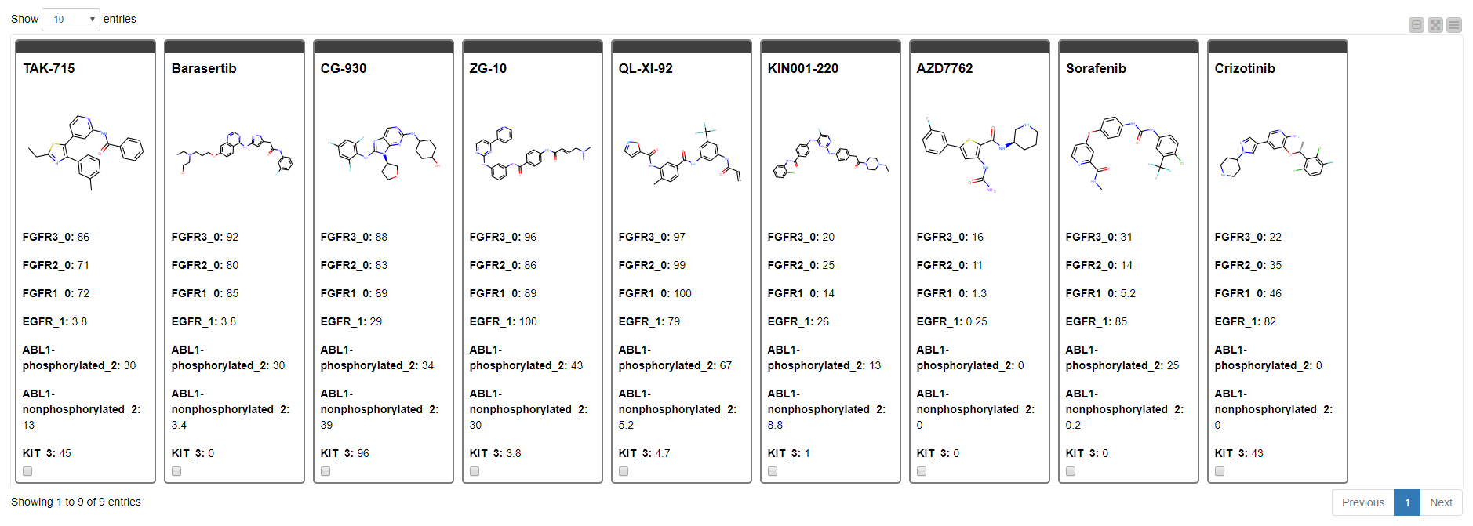
Appendix – sample output

Slide 20
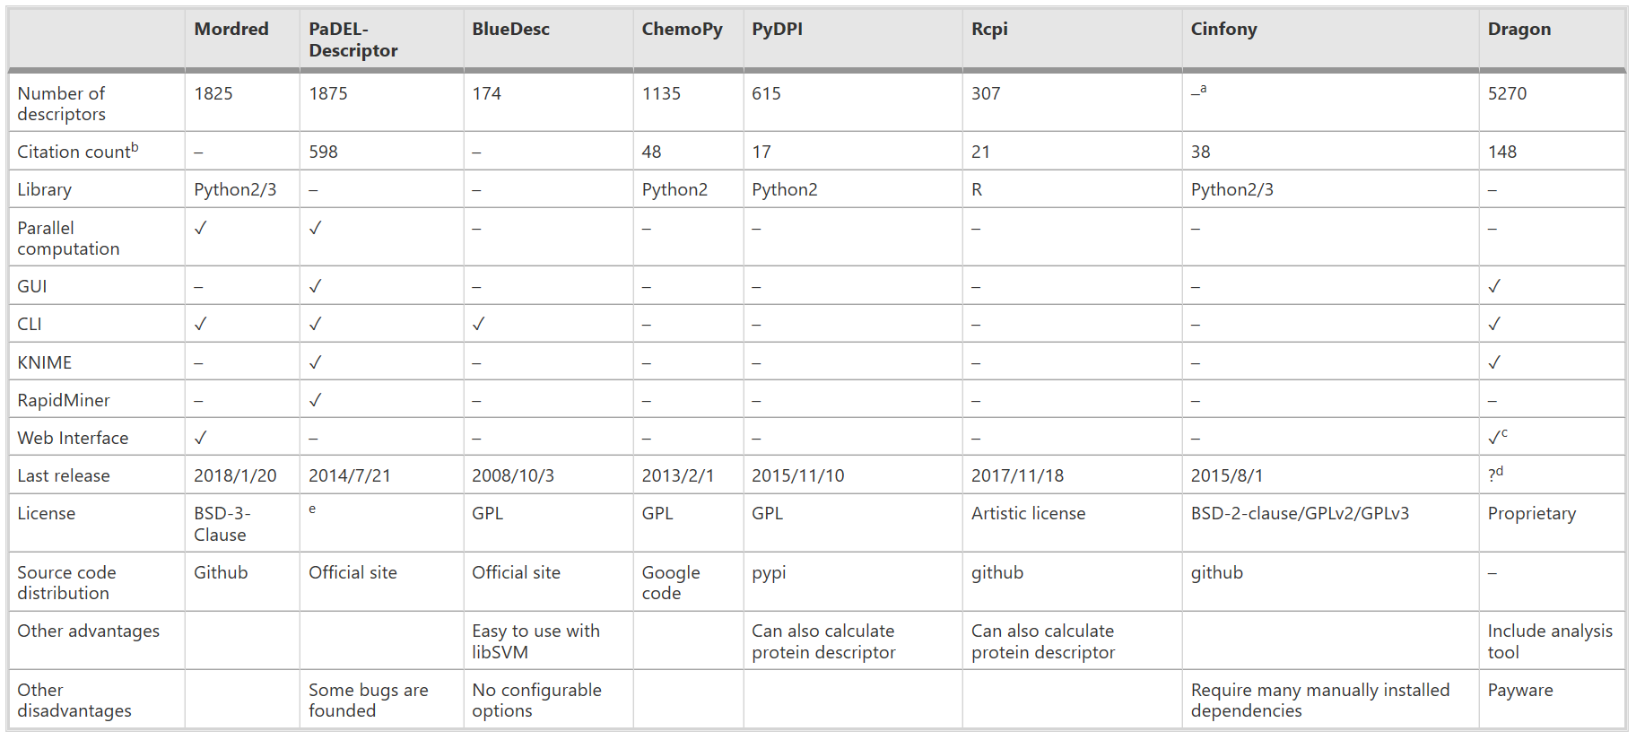
Appendix – example software
Moriwaki et al., 2018

Slide 21
Sources
DiscoverX. www.discoverx.com/services/drug-discovery-development-services/kinase-profiling/kinomescan
HMS LINCS Project. www.lincs.hms.harvard.edu/db
Moriwaki, H., Tian, Y., Kawashita, N., Takagi, T. “Mordred: A Molecular Descriptor Calculator.” Journal of Cheminformatics 10, 4 (2018).
Roy, K., Kar, S., Das, R. “Understanding the Basics of QSAR for Applications in Pharmaceutical Sciences and Risk Assessment.” Academic Press (2015). 47-80.
Vogt, M., Iyer, P., Maggiora, G., Bajorath, J. “Conditional Structure-Activity Similarity Maps.” 248th Fall National American Chemical Society Meeting. (2014). www.bulletin.acscinf.org/PDFs/247nm133.pdf

