Slide 1
A Web App to interactively visualize results from assay screening
Janice Tjeng
Notes:
Highlight currently being in use

Slide 2
agenda
Defining the Problem
Discovering the Data
Developing Solution
Deploying Solution
Future Work
Q & A
Conclusion
improvements
Notes:
Potential leads: compounds that are selective against assays. Divide compounds according to their activities and visualize different groups of activities.
SAR: determine chemical group responsible for evoking a target effect

Slide 3
Defining the Problem
How do we identify leads based on data from assay screening?
How can we analyze structure-activity relationships to optimize leads?
Notes:
Potential leads: compounds that are selective against assays. Divide compounds according to their activities and visualize different groups of activities.
SAR: determine chemical group responsible for evoking a target effect

Slide 4
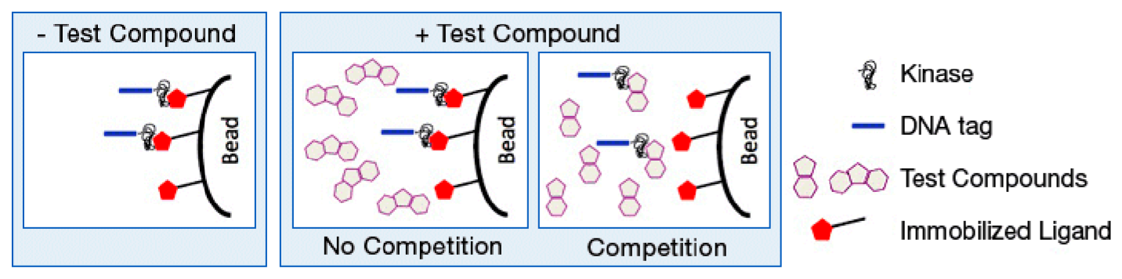
Discovering the Data
KINOMEscan assay panel of 489 kinases
500 compounds
Measure amount of kinase bound to ligand with and without the compound
% control (PoC)
<35% PoC
Source: DiscoverX
Notes:
Kinases of a wide variety (lipid, tyrosine, mutants, pathogen, atypical)
Using single concentration screens across full assay panel
Explain meaning of PoC: Degree to which a compound inhibits kinase function

Slide 5
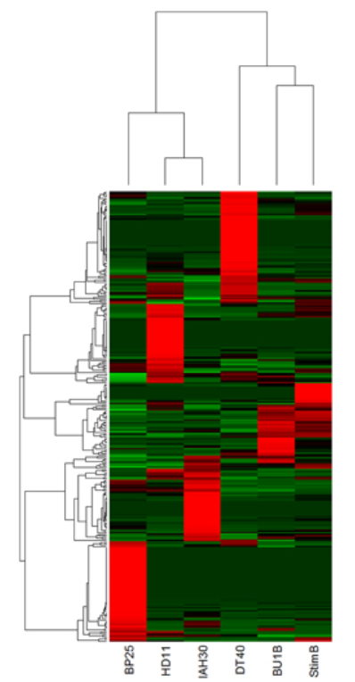
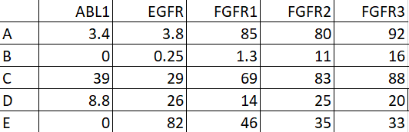
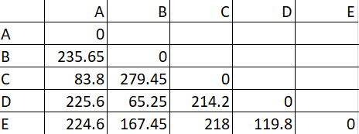
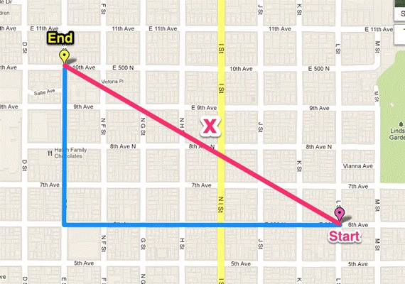

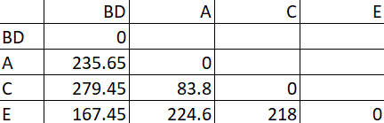
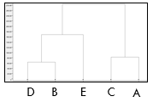

Developing solution
Measuring similarity
Manhattan distance
Distance formula selected by tuning
Measured by Dunn index (DI)
$DI=\frac{inter−cluster distance}{intra−cluster distance}$
Repeat
Notes:
Clustering method to group data points based on similarity
Distance correspond to height of dendrogram
Ratio between inter-cluster and intra-cluster
Tried kmeans but doesn’t work as well (because we have to define number of clusters beforehand)

Slide 6
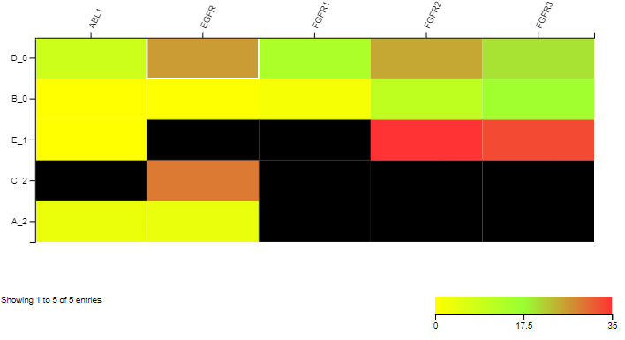
Developing solution (cont.)
Assigning clusters
Arbitrary value
Tuning to select number of clusters
Minimize intra cluster variation
Creating heatmap

Slide 7
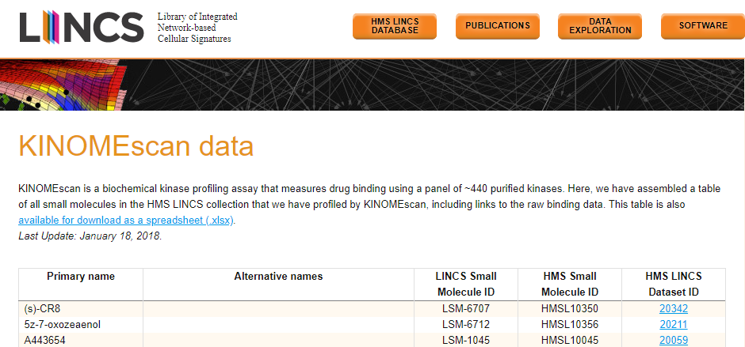
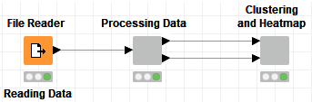
Deploying solution
Sample data set
KNIME workflow demo
HMS LINCS Project
Notes:
Dataset obtained from HMS: Library of Integrated Network-based Cellular Signatures
Screen kinase against these compounds at 10microMolar, picked these kinases for demonstration
Actual data has more compounds but limited data set from source. Not many compounds with same experimental conditions
Talk about interactivity

Slide 8
improvements
Re-tune clustering algorithm on larger data sets
Speed up run-time on larger data sets
Additional interfaces
Additional visualizations

Slide 9
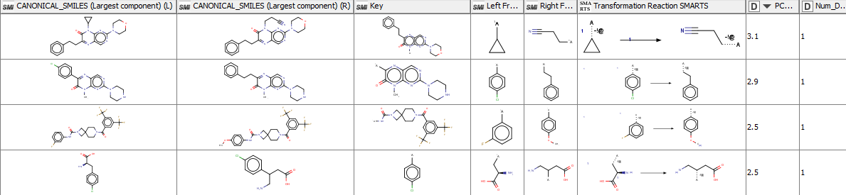
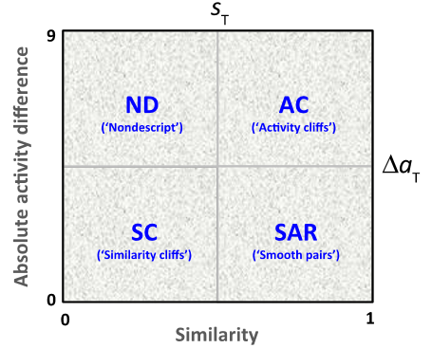
Future work
Matched Molecular Pairs (MMP)
Vogt et al., 2014
Notes:
MMP:
Generate molecular pairs & compute changes in activity
Look for activity cliffs
Pchembl value (-log of various concentrations), positive means R fragment has higher Kd/Ic50

Slide 10
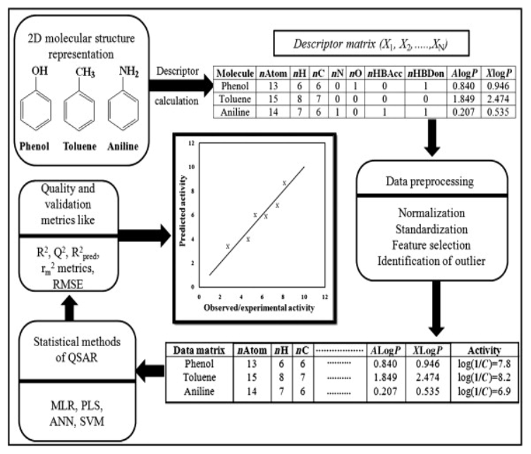
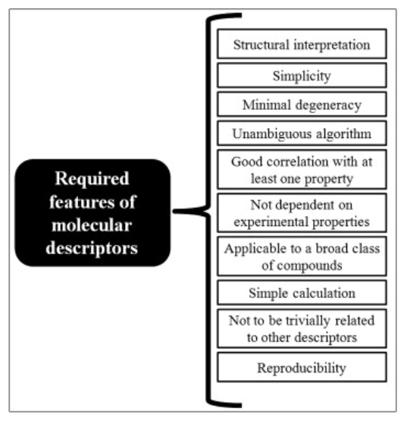
Future work
Predictive models
Calculate molecular descriptors
Using software programs
Select relevant descriptors
Remove outliers
Feature selection
Train models
Evaluate models
Linear
Error terms
Deploy model
Non-linear
Predict activity of new compounds
Update model with new data
Incorporate into workflow
Roy et al., 2015
Notes:
Predict activity of compounds that are not yet synthesized before we design the drugs. Better understand important descriptors that we can optimize during drug development.
Understand molecular descriptors: numerical representation of molecule
Remove outliers:
Z-score: Number of std away from mean. Standardize value by taking difference btw data point and mean/std
Values with scores above and below a threshold are removed
Feature selection:
Backward elimination
PCA (explain more)
Linear models:
MLR
Non-linear models:
RF
Neural network
Genetic Function Approximation
Deploy:
Select model with lowest error
Predict on unseen data
Update and re-evaluate model with new data on the cloud
Output table with molecules, selected descriptors, and activities

Slide 11
Lead optimization workflow - example
Exploratory
Visualization tool
Descriptive
MMP
Predictive
Predictive models

Slide 12
conclusion
User-friendly, intuitive visualization tool to identify potential leads
Low-cost, scalable, and quick deployment
Inspire data-driven drug discovery and development
Notes:
Potential leads: compounds that are selective against assays. Divide compounds according to their activities and visualize different groups of activities.
SAR: determine chemical group responsible for evoking a target effect

Slide 13


Slide 14

THANK YOU!

Slide 15
Appendix – number of clusters

Slide 16
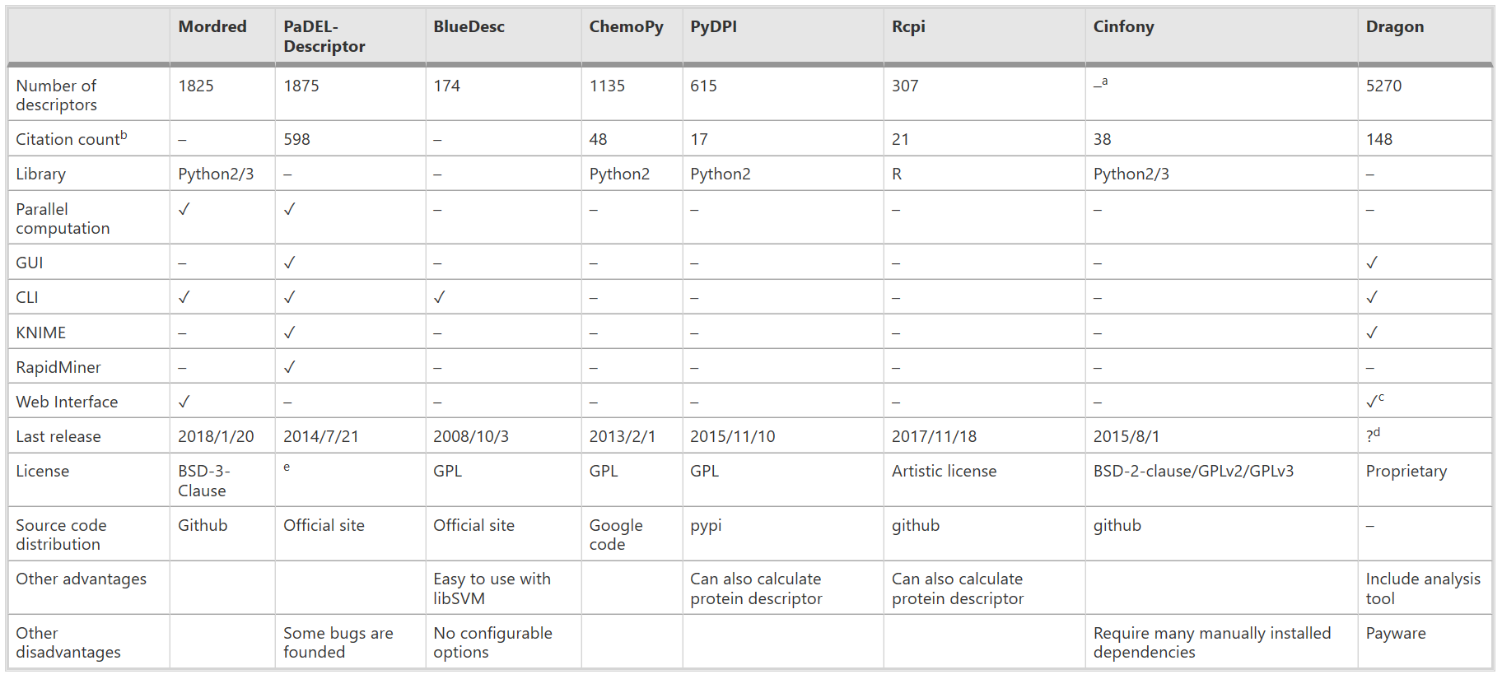
Appendix – example software
Moriwaki et al., 2018

Slide 17
Sources
DiscoverX. www.discoverx.com/services/drug-discovery-development-services/kinase-profiling/kinomescan
HMS LINCS Project. www.lincs.hms.harvard.edu/db
Moriwaki, H., Tian, Y., Kawashita, N., Takagi, T. “Mordred: A Molecular Descriptor Calculator.” Journal of Cheminformatics 10, 4 (2018).
Roy, K., Kar, S., Das, R. “Understanding the Basics of QSAR for Applications in Pharmaceutical Sciences and Risk Assessment.” Academic Press (2015). 47-80.
Vogt, M., Iyer, P., Maggiora, G., Bajorath, J. “Conditional Structure-Activity Similarity Maps.” 248th Fall National American Chemical Society Meeting. (2014). www.bulletin.acscinf.org/PDFs/247nm133.pdf

