Slide 1



Accountable Multi-Signatures with Constant Size Public Keys
Dan Boneh, Aditi Partap, Brent Waters
https://eprint.iacr.org/2023/1793
Notes:
Hi everyone, im aditi, and today i’ll be presenting our work on accountable Multi-Signatures with Constant Size Public Keys. This is joint work with dan boneh at Stanford, and brent waters at NTT and UT Austin

Slide 2

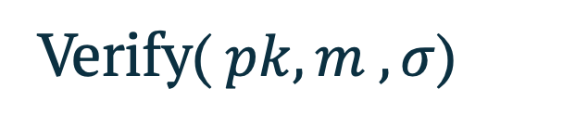
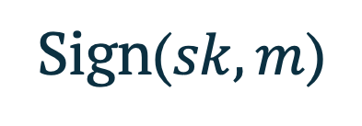
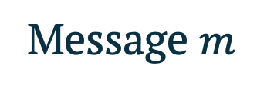
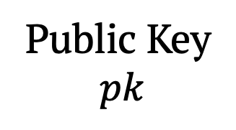
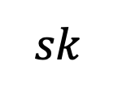
Signatures
Message $m$
Public Key
$$pk$$
KeyGen()
$$sk$$
Sign($sk,m$)
Verify($pk,m ,σ$)
𝝈
Valid!
Existential Unforgeability under Chosen Message Attack
Notes:
The way signatures work, is we would run KeyGen generate a public key pk, and a corresponding secret key sk.
Then, we can use this secret key to sign any message m, and get the signature sigma.
Anyone can verify this signature by using the public key and m.
The key property of signatures is existential unforgeability, under the chosen message attack.

Slide 3



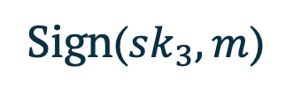


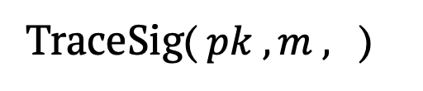

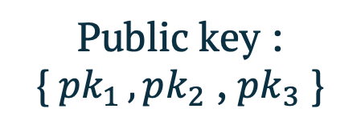
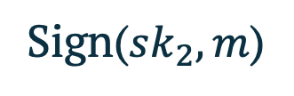

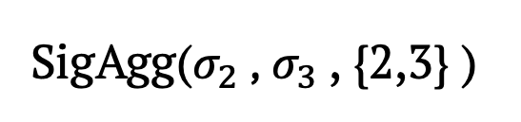




Accountable Multi-Signatures
$$n=3$$
Msg $m$
LocalKeyGen()
LocalKeyGen()
LocalKeyGen()
Public key :
{$pk_{1 },pk_{2}$ , $pk_{3}$ }
$$pk_{1} ,sk_{1}$$
$$pk_{2} ,sk_{2}$$
$$pk_{3} ,sk_{3}$$
Sign($sk_{2},m$)
Sign($sk_{3},m$)
$$σ_{2}$$
$$σ_{3}$$
SigAgg($σ_{2}$ , $σ_{3}$, {2,3} )
$$σ$$
$$\{2,3\}$$
TraceSig($pk , m ,$ )
Accountability: One malicious coalition cannot frame another
Notes:
The focus of today’s talk is multisignatures: where we have n parties, in our example: n=3, alice bob and Charlie.
each party runs a LocalKEYGen algo to generate their own public key – secret key pair. Overall pk of the multisig is the list of all these public keys. Then, we can get a signature from any subset of parties e.g. here, we can send the msg to bob and Charlie, they can run the Sign algo with their sk’s to get sigs sigm2 and sigma3
These can then be aggregated to get a full multisignature sigma. One key property of multisigs is accountability: specirically, there is a TraceSig algo, which takes as input the pk, m, sigmature, and outputs the set of all parties who contributed to this sig. e.g. here, we’ll get 2,3 as the output. And accountability says that a malicious set of parties cannot blame an honest party.

Slide 4


Applications of Accountable Multi-Signatures
Rogue Signature identifies corrupt parties
Notes:
Multisihs are widely used in financial applications, like banking and also proof of stake consensus, because accountability is crucial there, e.g. if there’s a rogue transaction with a valid signature, then the sig can be used to identify the corrupt parties.

Slide 5

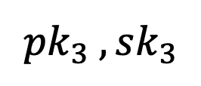
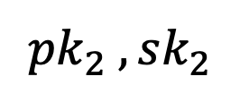
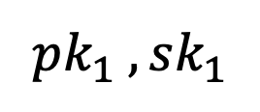

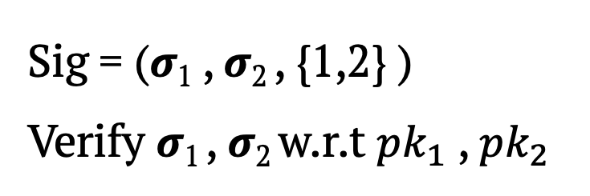
The Trivial Accountable Multi-Signature
Keys of all parties are sampled independently for some signature scheme.
Combined Sig : Concatenation of all individual sigs.
Public key : {$pk_{1 },pk_{2}$ , $pk_{3}$ }
$$pk_{1} ,sk_{1}$$
$$pk_{2} ,sk_{2}$$
$$pk_{3} ,sk_{3}$$
𝝈₁
𝝈₂
Sig = (𝝈₁ , 𝝈₂ , {1,2} )
Verify 𝝈₁ , 𝝈₂ w.r.t $pk_{1}$ , $pk_{2}$
Notes:
Now, Lets see a trivial Accountable Multisig scheme to get more intuition.
Here, keys for all parties are sampled independently for some sign scheme.
In our example here, A,B,C each have an independent pk,sk pair. The overall pk of the scheme is the list of all these pub keys, pk1 to pk3.
Then, the sign on a msg is just a list of signs from all the parties involved.
E.g. lets say Alice,Bob wanna sign something. They’ll use their own secret keys to generate signatures sig1 and sig2, and the overall sign is just concat of sig1 and sig2. To verify, we separately verify sig1 wrt pk1 and sig2 wrt pk2.

Slide 6
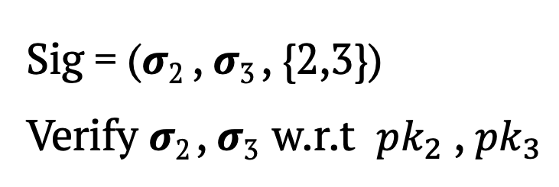
The Trivial Accountable Multi-Signature
Keys of all parties are sampled independently for some signature scheme.
Combined Sig : Concatenation of all individual sigs.
Public key : {$pk_{1 },pk_{2}$ , $pk_{3}$ }
Even though we have better Accountable Multi-Sig schemes !
$$pk_{1} ,sk_{1}$$
$$pk_{2} ,sk_{2}$$
$$pk_{3} ,sk_{3}$$
𝝈₂
𝝈₃
Sig = (𝝈₂ , 𝝈₃ , {2,3})
Verify 𝝈₂ , 𝝈₃ w.r.t $pk_{2}$ , $pk_{3}$
Large Sigs
Slow Verify
Many real-world deployments (e.g. Bitcoin) use this trivial Accountable Multi-Sig!
Notes:
Similarly, sign from bob, charlie is just a concat of sig2 and sig3. this scheme is quite inefficient since it has large signatures, it’s a list of t individual signatures, also slow to verify: need to verify each individual signature separately.
Note there do exist more efficient accountable MultiSig schemes, where the signature is short and verification is efficient.
but, most real world deployments still use this trivial accountable multiSig construction!
In this talk, we give another reason why not to use the trivial construction:

Slide 7


Problem: Large Verification key!
Verifier needs to store the public key of all $n$ parties to verify any sig!
Verification key : {$pk_{1 },pk_{2}$ , $pk_{3}$ }
$$pk_{1} ,sk_{1}$$
$$pk_{2} ,sk_{2}$$
$$pk_{3} ,sk_{3}$$
More problems…
No Proactive Refresh – Cannot refresh secret key shares without changing the public key
Notes:
Specifically, the verification key in the trivial MultiSig is very large: the verifier needs to store the pk of all n parties involved.
This is true not only for the trivial multisig, but also for most other known constructions.
This can be quite cumbersome especially as we scale to larger n in real world deployments.
There’s actually many other problems as well, one that I’d like to highlight is that ti does NOT support proactive refresh… specifically, there’s no way to refresh the secret key shares without changing the public key!

Slide 8
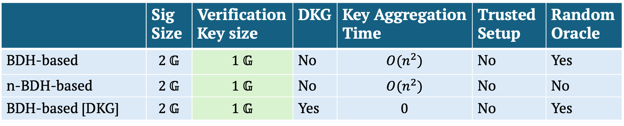
This work: Accountable Multi-signatures with Constant-size verification keys
Three pairings-based constructions:
One lattice-based construction [based on Damgård, Orlandi, Takahashi, Tibouchi’21]
 | Sig Size | Verification Key size | DKG | Key Aggregation Time | Trusted Setup | Random Oracle
BDH-based | $$\text{2 }\text{𝔾}$$ | $$\text{1 }\text{𝔾}$$ | No | $$O(n^{2})$$ | No | Yes
n-BDH-based | $$\text{2 }\text{𝔾}$$ | $$\text{1 }\text{𝔾}$$ | No | $$O(n^{2})$$ | No | No
BDH-based [DKG] | $$\text{2 }\text{𝔾}$$ | $$\text{1 }\text{𝔾}$$ | Yes | $$0$$ | No | Yes
Notes:
Based on this issue, in our work, we give 4 constructions of multisigs with constant size verification key. We have 3 pairings based construction: the first one is based on the BDH assumption, its vk has just one group element, the sig size is two group elements. There’s no trusted setup, but we do use the RO model. Our second construction has the same parameters, but without the random oracle model! Both these require public key aggregation which requires O(n^2) time. Our third construction gets rid of this key aggregation issue, but at the cost of a DKG for setup.
Our fourth construction is lattice-based, and it uses a prior const by damgard et al as its basis.

Slide 9
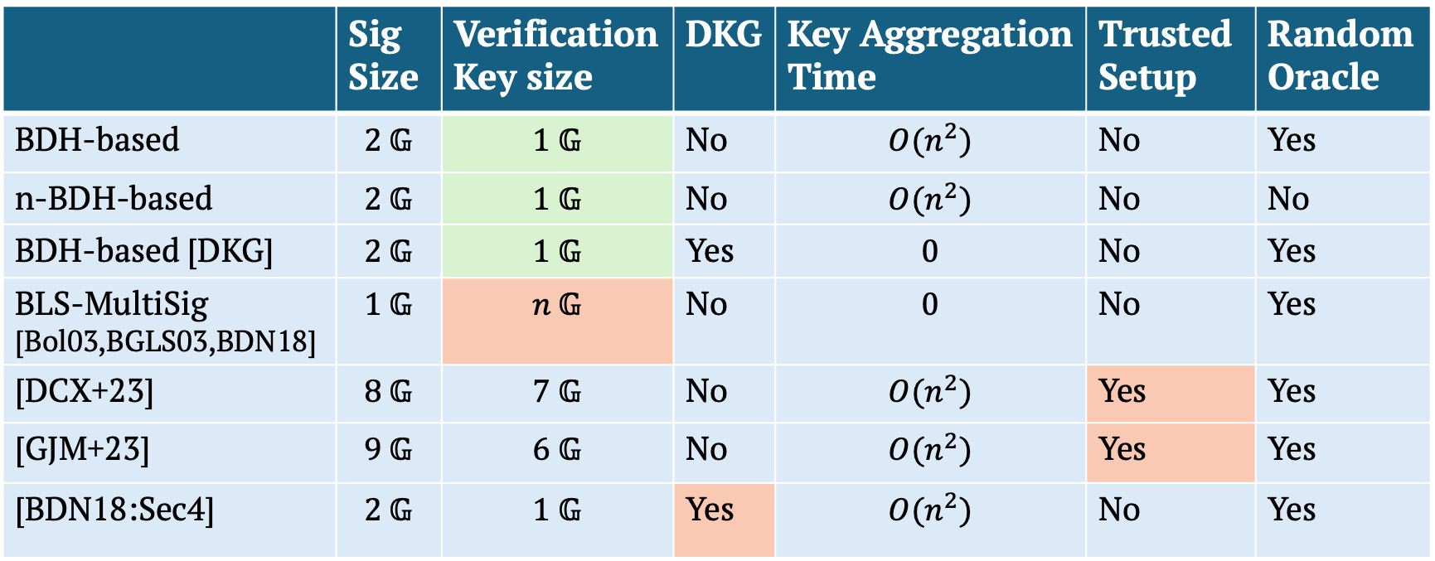
This work: Accountable Multi-signatures with Constant-size verification keys
Three pairings-based constructions:
One lattice-based construction [based on Damgård, Orlandi, Takahashi, Tibouchi’21]
 | Sig Size | Verification Key size | DKG | Key Aggregation Time | Trusted Setup | Random Oracle
BDH-based | $$\text{2 }\text{𝔾}$$ | $$\text{1 }\text{𝔾}$$ | No | $$O(n^{2})$$ | No | Yes
n-BDH-based | $$\text{2 }\text{𝔾}$$ | $$\text{1 }\text{𝔾}$$ | No | $$O(n^{2})$$ | No | No
BDH-based [DKG] | $$\text{2 }\text{𝔾}$$ | $$\text{1 }\text{𝔾}$$ | Yes | $$0$$ | No | Yes
BLS-MultiSig [Bol03,BGLS03,BDN18] | $$\text{1 }\text{𝔾}$$ | $$n \text{𝔾}$$ | No | $$0$$ | No | Yes
[DCX+23] | $$\text{8 }\text{𝔾}$$ | $$\text{7 }\text{𝔾}$$ | No | $$O(n^{2})$$ | Yes | Yes
[GJM+23] | $$\text{9 }\text{𝔾}$$ | $$\text{6 }\text{𝔾}$$ | No | $$O(n^{2})$$ | Yes | Yes
[BDN18:Sec4] | $$\text{2 }\text{𝔾}$$ | $$\text{1 }\text{𝔾}$$ | Yes | $$O(n^{2})$$ | No | Yes
Can combine with [BPR23] to support
proactive refresh with small verification keys!
Notes:
IN TERMS of related works: the most commonly used multisig is based on BLS sigs (there’s been many works on improving it): the best one has sig of size one group element, but the vk is linear in n.
There’s been a few works which achieve const size vk: the work by das et al has 7 gp elems in the vk : slightly larger, but more importantly, it requires a trusted setup! Simialrly garg et al from 2023 also requires a trusted setup. Lastly, a work by boneh et al in 2018 also had a scheme with const size vk and short sig, they also have O(n^2) key agg time, but the main 2 issues with that scheme were 1. it has a 1round DKG, 2. their proof actually have quadratic loss in security because they use the rewinding lemma. In contrast, we have a much tighter security analysis. Additionally, all of these works are in the RO model, whereas we also adapt our scheme to be secure in the standard model.
One more thing I wanna mention: is that we can actually use our schemes in combination with a prior work, to support proactive refresh for the multisig, while still keeping verification key short!

Slide 10




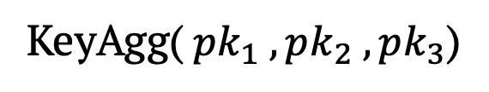
Definitions: Syntax
$$n=3$$
LocalKeyGen()
LocalKeyGen()
LocalKeyGen()
$$pk_{1} ,sk_{1}$$
$$pk_{2} ,sk_{2}$$
$$pk_{3} ,sk_{3}$$
KeyAgg($pk_{1} , pk_{2} , pk_{3}$)
Combining Key
$$pkc , vk$$
Verification Key
Notes:
Similar to what we saw before, we have a LocalKGen algo, which each party runs to get its public and secret key. then, we have a new algorithm which we call KeyAgg, which takes as input all the public keys, and aggregates them into a combiners key pkc and a verification key vk. After keyAgg, the verifier only needs to store vk!

Slide 11
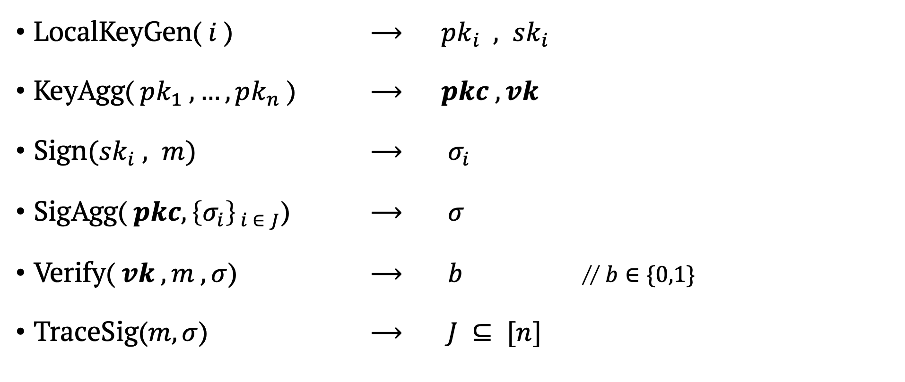
Definitions: Syntax
LocalKeyGen($i$) ⟶ $pk_{i} , sk_{i}$
KeyAgg($pk_{1} , …, pk_{n}$) ⟶ $pkc , vk$
Sign$(sk_{i} , m)$ ⟶ $σ_{i}$
SigAgg(${ pkc, \left\{σ_{i}\right\}}_{ i ∈ J}$) ⟶ $σ$
Verify($vk , m , σ$) ⟶ $b$ // $b∈\{0,1\}$
TraceSig($m,σ$) ⟶ $J ⊆ [n]$
Notes:
here i've listed all the algorithms: so LocalKeyGen, KeyAgg
then we have Sign algo: Pi can gen a sig on msg m using its key ski,
then SigAgg takes as input the combiner key pkc, and a list of sigs from a set J, and outputs the agg sig.
then Verify:takes as input the vk, the msg m and the sig, and outputs whether the sig is valid.
lastly, sicne we're talking about accountable multisigs, we also have a TraceSig alg which

Slide 12
Security properties
Unforgeability & Accountability:
Hard to produce a valid signature on a new message
that traces to a set containing an honest party,
even if the adversary generates all other public keys.
Notes:
in terms of security, we deifne a single property that captures both unforgeability and accountability
at a high level, it should be hard for an adv to generate a valid sig on a new msg that traces to a set with an honest party, even if it can generate all other public keys, and can see sigs of the honest party on arbit msgs of its choice.
Note that this captures rogue key attacks since adv can sample its own keys.

Slide 13
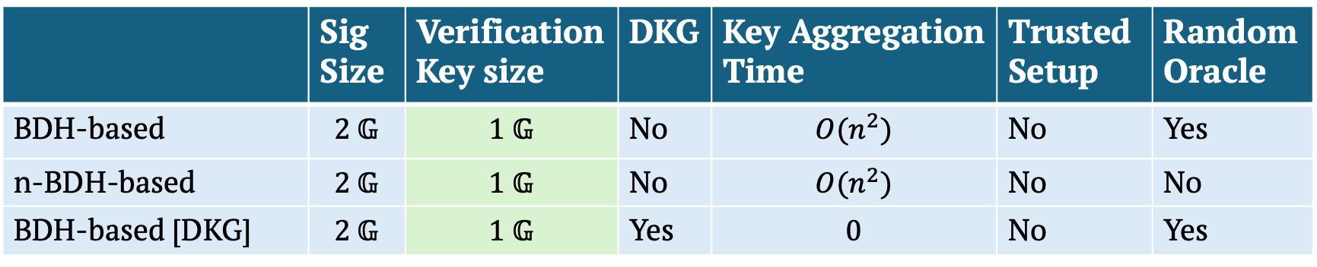
Our Constructions
Three pairings-based constructions:
One lattice-based construction [based on Damgård, Orlandi, Takahashi, Tibouchi’21]
 | Sig Size | Verification Key size | DKG | Key Aggregation Time | Trusted Setup | Random Oracle
BDH-based | $$\text{2 }\text{𝔾}$$ | $$\text{1 }\text{𝔾}$$ | No | $$O(n^{2})$$ | No | Yes
n-BDH-based | $$\text{2 }\text{𝔾}$$ | $$\text{1 }\text{𝔾}$$ | No | $$O(n^{2})$$ | No | No
BDH-based [DKG] | $$\text{2 }\text{𝔾}$$ | $$\text{1 }\text{𝔾}$$ | Yes | $$0$$ | No | Yes

Slide 14
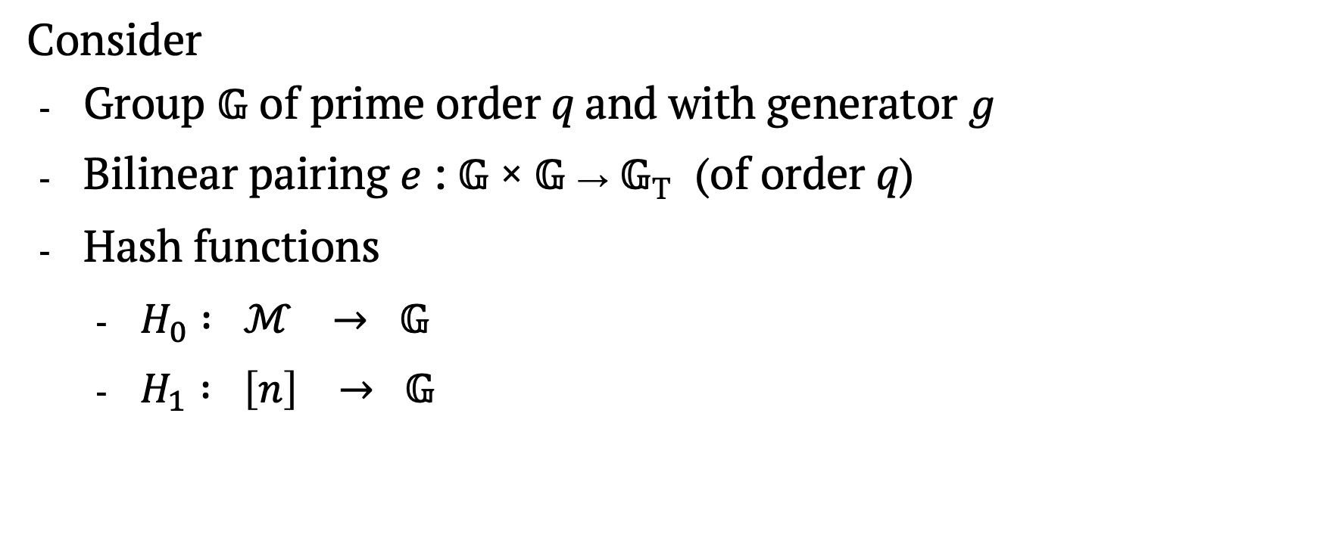
BDH-based Accountable Multi-Signature
Consider
Group 𝔾 of prime order q and with generator 𝑔
Bilinear pairing 𝑒 : 𝔾 × 𝔾 → 𝔾_{T} (of order q)
Hash functions
$H_{0} : ℳ → 𝔾$
$H_{1} : \left[n\right] → 𝔾$
Notes:
Lets start with a quick recap on pairings:
I’m considering symmetric pairings for simplicity, but our scheme does work with assymetric pairings as well.

Slide 15



BDH-based Accountable Multi-Signature
LocalKeyGen($i=1$):
$α_{1}←$$ $ℤ_{q}$ and set $sk_{1}←α_{1}$
Output $pk_{1}= g^{α_{1}} , \{pk_{1,2} , …, pk_{1,n}\}$
$$H_{1}{\left(1\right)}^{α_{1}}$$ | $$H_{1}{\left(2\right)}^{α_{1}}$$ | $$…$$ | $$H_{1}{\left(n\right)}^{α_{1}}$$
Secret
$$pk_{1,2}$$
$$pk_{1,n}$$
Notes:
Ok, lets start with localKeyGen, for party i=1. this party first samples alpha_1 randomly from Zq, and sets sk1 to be alpha1.
Then, it computes a bunch of group elements: specifically, H(1)^a1 : this will remain secret, but it also produces H(2)^a1, H(3)^a1 and so on till H(n)^a1. all these elements, except for the first one, are part of its public key. So we denote H(2)^a1 as pk12 and so on. So P1 publishes pk1 containing g^a1 and all these other terms, pk12 to pk1n.

Slide 16


BDH-based Accountable Multi-Signature
$$pk_{1} →$$
$$H_{1}{\left(1\right)}^{α_{1}}$$ | $$H_{1}{\left(2\right)}^{α_{1}}$$ | $$…$$ | $$H_{1}{\left(n\right)}^{α_{1}}$$
$$g^{α_{1}}$$
Notes:
I’ve summarized the previous slide here: we have pk1 containing H(2)^a1 to H(n)^a1, along with g^a1. Again note that the grayed out part is secret.

Slide 17
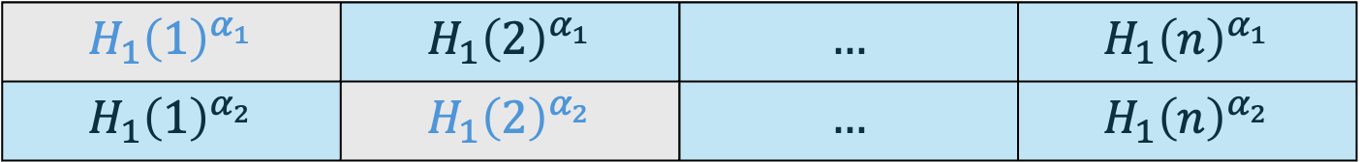


BDH-based Accountable Multi-Signature
$$pk_{1} →$$
$$H_{1}{\left(1\right)}^{α_{1}}$$ | $$H_{1}{\left(2\right)}^{α_{1}}$$ | $$…$$ | $$H_{1}{\left(n\right)}^{α_{1}}$$
$$H_{1}{\left(1\right)}^{α_{2}}$$ | $$H_{1}{\left(2\right)}^{α_{2}}$$ | $$…$$ | $$H_{1}{\left(n\right)}^{α_{2}}$$
$$g^{α_{1}}$$
$$pk_{2} →$$
$$g^{α_{2}}$$
Notes:
Then, similarly, party2 runs its localKeyGen, and publishes H(1)^a2, H(3)^a2 and so on till H(n)^a2, again note that the gray element H(2)^a2 is secret. And it also published g^a2.

Slide 18

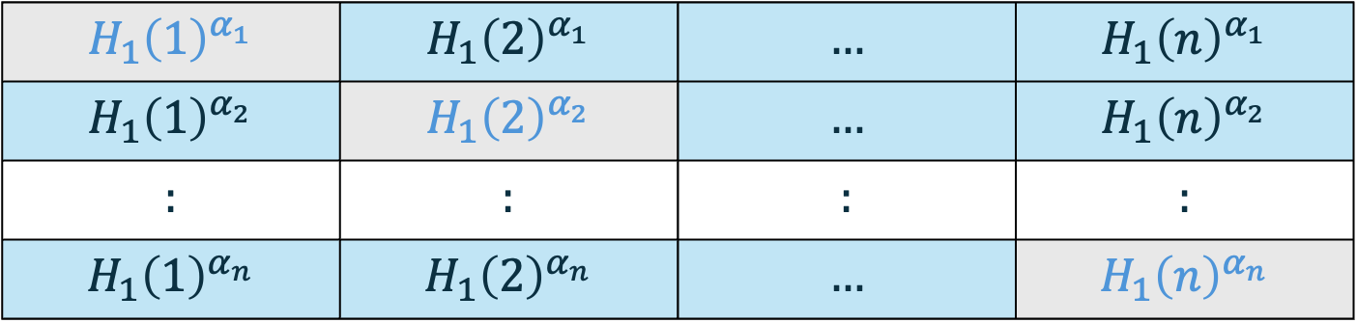

BDH-based Accountable Multi-Signature
$$pk_{1} →$$
$$H_{1}{\left(1\right)}^{α_{1}}$$ | $$H_{1}{\left(2\right)}^{α_{1}}$$ | $$…$$ | $$H_{1}{\left(n\right)}^{α_{1}}$$
$$H_{1}{\left(1\right)}^{α_{2}}$$ | $$H_{1}{\left(2\right)}^{α_{2}}$$ | $$…$$ | $$H_{1}{\left(n\right)}^{α_{2}}$$
$$:$$ | $$:$$ | $$:$$ | $$:$$
$$H_{1}{\left(1\right)}^{α_{n}}$$ | $$H_{1}{\left(2\right)}^{α_{n}}$$ | $$…$$ | $$H_{1}{\left(n\right)}^{α_{n}}$$
$$g^{α_{1}}$$
$$pk_{2} →$$
$$g^{α_{2}}$$
$$pk_{n} →$$
$$g^{α_{n}}$$
Notes:
Similarly, Pn publishes all elements in this last row, as it spublic key except for H(n)^an.

Slide 19

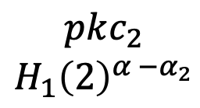

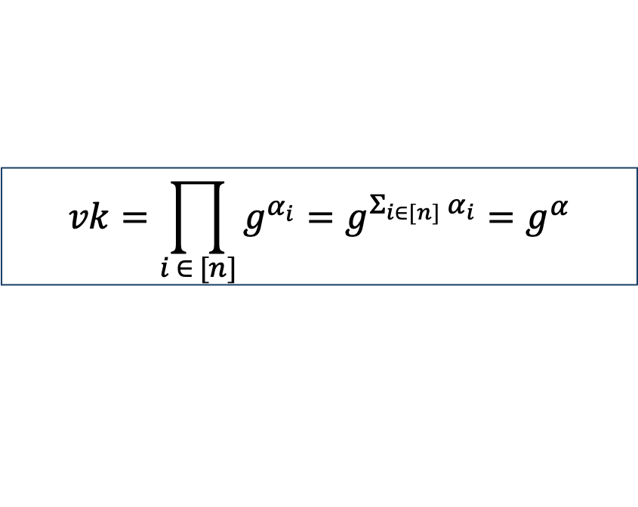
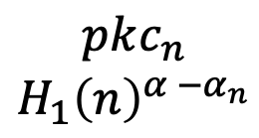

BDH-based Accountable Multi-Signature: KeyAgg
KeyAgg():
$$pk_{1} →$$
$$H_{1}{\left(1\right)}^{α_{1}}$$ | $$H_{1}{\left(2\right)}^{α_{1}}$$ | $$…$$ | $$H_{1}{\left(n\right)}^{α_{1}}$$
$$H_{1}{\left(1\right)}^{α_{2}}$$ | $$H_{1}{\left(2\right)}^{α_{2}}$$ | $$…$$ | $$H_{1}{\left(n\right)}^{α_{2}}$$
$$:$$ | $$:$$ | $$:$$ | $$:$$
$$H_{1}{\left(1\right)}^{α_{n}}$$ | $$H_{1}{\left(2\right)}^{α_{n}}$$ | $$…$$ | $$H_{1}{\left(n\right)}^{α_{n}}$$
$$g^{α_{1}}$$
$$pk_{2} →$$
$$g^{α_{2}}$$
Sig Verification key is just one group element!
$$pk_{n} →$$
$$g^{α_{n}}$$
$$pkc_{1}$$
$$pkc_{2}$$
$$H_{1}{\left(2\right)}^{α −α_{2}}$$
$$pkc_{n}$$
$$H_{1}{\left(n\right)}^{α −α_{n}}$$
$$H_{1}{\left(1\right)}^{Σ_{j≠1}α_{j}}= H_{1}{\left(1\right)}^{α −α_{1}}$$
$$vk=\prod_{i ∈ [n]}{g^{α_{i}}}=g^{Σ_{i∈[n]} α_{i}}=g^{α}$$
Notes:
Next, lets see how we aggregate these keys. First, we multiply al the g^ai terms, to get the vk, which is equal to g^sum ai. For simplicity, I will now refer to the sum of ai’s as alpha.
Next, for the combining key, we multiply all elements in thismatrix column-wise. Specifically, pkc1 would be h(1)^a2 *h(1)^a3 …and so on till h(1)^an. We can simplify this to get h(1)^a – a1, cuz it contains all ai terms except a1. Similarly, pkc2 would be the prod of all elems in the 2nd col, which gives h(2)^a-a2, and so on.
So combining key has n elems, pkc1 to pkcn.
And As promised before: the vk is indeed just one group element. This is all that the vf needs to store, to vf any sig.

Slide 20

BDH-based Accountable Multi-Signature: Sign
Sign($sk_{i}= α_{i} , m$):
Sample $r_{i}←$$ $ℤ_{q}$
Output $( σ_{i,0}← g^{r_{i}} , σ_{i,1} ←H_{0}{\left(m\right)}^{r_{i}}⋅H_{1}{\left(i\right)}^{α_{i}} )$
Secret
Notes:
next, lets see how party i signs a msg m.
first, it samples a rand elem ri in Zq.
then, the sig has 2 parts: sig_i,0 this is just g^ri, and sig_i1 is h(m)^ri * h(i)^ai.
recall here that h(i)^ai was the secret element, and this is essentially the secret signing key for Pi.

Slide 21

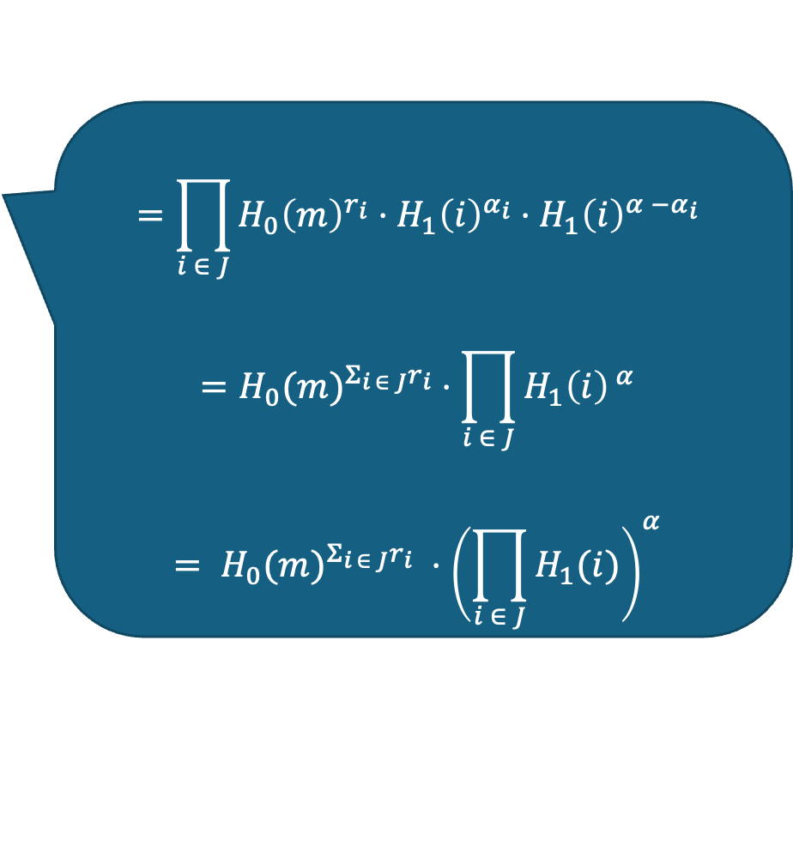
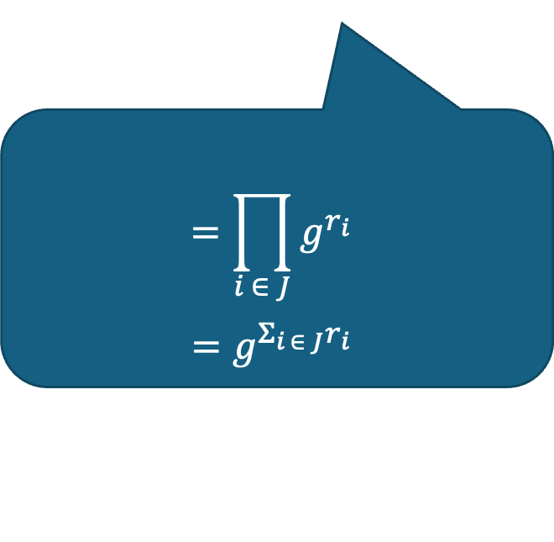
Aggregating several signatures into one
SigAgg$\left(pkc=\{pkc_{1} , …, pkc_{n}\} , {\left\{σ_{i}\right\}}_{i ∈ J}\right):$
Parse $σ_{i}$ as ${(σ}_{i,0} , { σ}_{i,1})$
Compute
$σ_{0}←\prod_{i ∈ J}{σ_{i,0}}$ and $σ_{1}←\prod_{i ∈ J}{σ_{i,1}⋅pkc_{i}}$
Aggregated sig $= (σ_{0} , σ_{1} , J)$
$$=\prod_{i ∈ J}{H_{0}{\left(m\right)}^{r_{i}}⋅H_{1}{\left(i\right)}^{α_{i}}⋅H_{1}{\left(i\right)}^{α −α_{i}}}$$
$$={H_{0}(m)}^{Σ_{i ∈ J}r_{i}}⋅\prod_{i ∈ J}{H_{1}{\left(i\right)}^{ α}}$$
$$= {H_{0}(m)}^{Σ_{i ∈ J}r_{i}} ⋅{\left(\prod_{i ∈ J}{H_{1}(i)}\right)}^{α}$$
$$=\prod_{i ∈ J}{g^{r_{i}}}$$
$$=g^{Σ_{i ∈ J}r_{i}}$$
Notes:
Next, to aggregate sigs from parties in a set J, we first parse each sign sig_i as sig_i,0 and sig_i,1
then, we essentially combine the sigs element-wise.
specifically, sig0 becomes the prod of sig_i,0 for all i. this means that sig0 is equal to the prod of g^ri, simplifying this, we get g^sum of ri for all i in J.
then, sig1 is the prod of all sig_i,1 terms, along with the pkc_i terms from the combining key. lets see what this gives us.
expanding the terms, we get sig1 is equal to the prod of H(m)^ri for all i in J, mult with h(i)^ai for all i, times h(i)^a-ai
simplifying this, we get h(m)^sum of all ri, times prod of H(i)^a for all i in J.
the aggregated sig is just sig_0, sig1, and the signing set J.

Slide 22

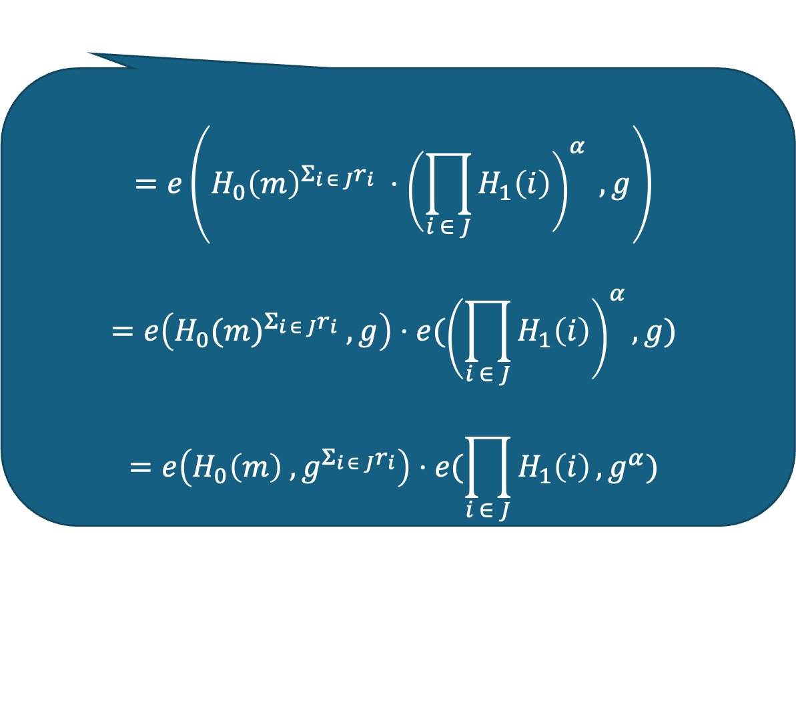
Aggregated Signature Verification
Verify$\left(vk=g^{α} , m , σ=\left(σ_{0} , σ_{1} , J\right)\right):$
Return $e\left(σ_{1} , g\right)==e\left(H_{0}\left(m\right) , σ_{0}\right)⋅e( \prod_{i∈J}{H_{1}(i)} , vk)$
$$=e\left({H_{0}\left(m\right)}^{Σ_{i ∈ J}r_{i}} ⋅{\left(\prod_{i ∈ J}{H_{1}\left(i\right)}\right)}^{α} , g\right)$$
$$=e\left({H_{0}(m)}^{Σ_{i ∈ J}r_{i}} , g\right)⋅e({\left(\prod_{i ∈ J}{H_{1}\left(i\right)}\right)}^{α}, g)$$
$$=e\left(H_{0}\left(m\right) , g^{Σ_{i ∈ J}r_{i}}\right)⋅e(\prod_{i ∈ J}{H_{1}\left(i\right)}, g^{α})$$
Notes:
to verify an aggregated sig, we can essentially use pairings.
specifically, we need to check if the pairing of sig1 with g equals pairing of h(m) with sig0 times pairing of prod of h(i) for all i in J with the vk.
to see why this is correct, lets expand the left side:
we have pairing of h(m)^sum ri times (prod of h(i)) to the power a, with g.
Splitting the terms, we get this is equal to pairing of h(m)^sum ri with g, and pairing of prod of H(i)^a with g.
because of bilinearity, this is indeed equal to the right side.

Slide 23

BDH-based Accountable Multi-Signature: TraceSig
T$raceSig\left( m , σ=\left(σ_{0} , σ_{1} , J\right)\right):$
Output $J ⊆ [n]$
Notes:
lastly, to trace a sig in our scheme, we simply output the set J which is already part of the sig itself.

Slide 24

Security Analysis
Based on Bilinear Diffie-Hellman assumption:
Thm. For every adversary $𝒜$, there exists adversary $ℬ$such that
${ Adv}_{BDH−Sig}^{uf}\left(𝒜\right)≤$ $e⋅(q_{s}+1) {·Adv}_{BDH}^{}$($ℬ$)
Where $q_{s}$ is an upper bound on the number of queries to the signing oracle.
Notes:
so thats how our BDH based scheme works. in our paper, we prove unforgeability of this scheme based on the Bilinear DH assumption. specifically, for every adv A that breaks unf, there exists an adv B that breaks BDH, s.t. adv of A is bounded by e*qs+1 times adv of B, where qs is a bound on the #sign queries done by A.

Slide 25
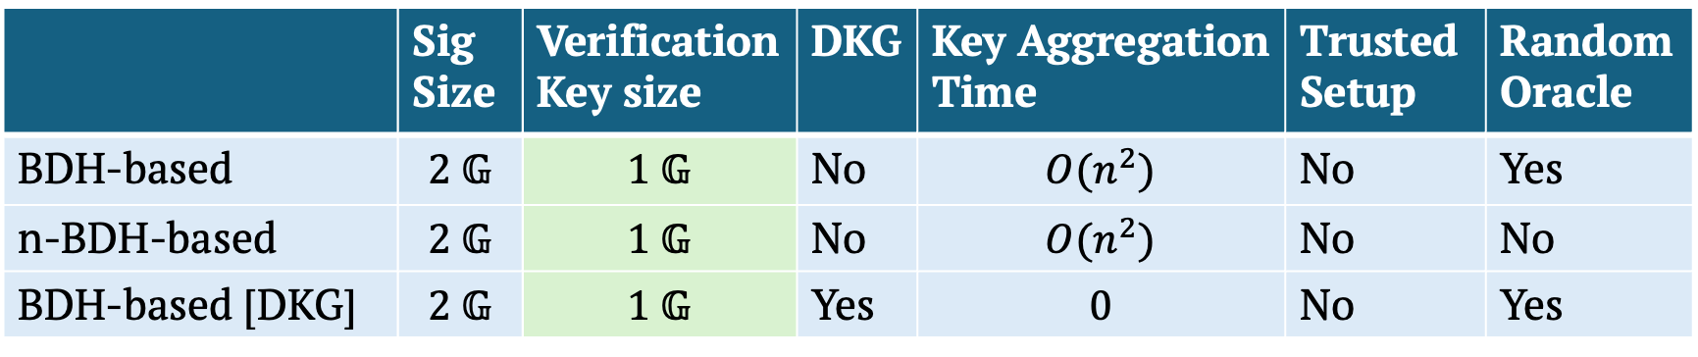
Summary
Most Accountable Multi-Signatures have large verification key
This paper gives 4 constructions with constant-size verification key:
 | Sig Size | Verification Key size | DKG | Key Aggregation Time | Trusted Setup | Random Oracle
BDH-based | $$\text{2 }\text{𝔾}$$ | $$\text{1 }\text{𝔾}$$ | No | $$O(n^{2})$$ | No | Yes
n-BDH-based | $$\text{2 }\text{𝔾}$$ | $$\text{1 }\text{𝔾}$$ | No | $$O(n^{2})$$ | No | No
BDH-based [DKG] | $$\text{2 }\text{𝔾}$$ | $$\text{1 }\text{𝔾}$$ | Yes | $$0$$ | No | Yes
[And one lattice-based construction based on Damgård, Orlandi, Takahashi, Tibouchi’21]
Notes:
to summarise, most acc MultiSigs, including the trivial multisig have large vk.
In our work, we present 4 const with const size vk, three of which are pairings based, and the last one is lattice-based.
We also present lots of optimizations for our schemes -- plz check out the paper for more details.

Slide 26
Thank you!
Questions?
https://eprint.iacr.org/2023/1793
Notes:
thankyou!

Slide 27
Comparison to BDN18
Tighter security proof (no rewinding)
Variant of our construction proven secure in the standard model
Non-interactive local key generation
Notes:
Also lattice based construction…

Slide 28
Comparison to [DCX+23] , [GJM+23]
Don’t require a trusted setup
Don’t require AGM for security proof
Shorter Verification key and Sig

